Slide 1
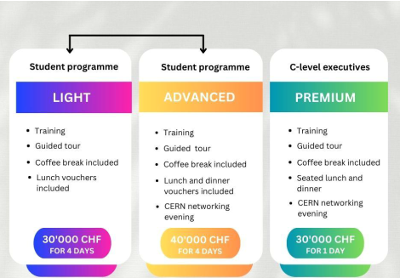
ID2 financials
Financial tracking through CET downloads.
Monthly analysis through Power BI: detailed overviews.
Running costs of ID2 are approx. 400K CHF.
Reserves: 640K CHF (for ID2 extension) + 51K CHF (‘parked’ by IPT). 2024 budget request cycle starts in Feb/March.
Most salaries running through ATTRACT.
ATTRACT will finish next year; important to have ATTRACT 1B, but we can manage without
New initiatives
Sustained funding through new HEU applications.
Executive programmes (Business Schools): offer to Lausanne is on the table.
  Potential profit (independent of selection): 20K CHF.
  Approx. 4-5 programmes p/y.
  Pilot expected in Q4 2024.
Green Village update by Faezeh
 | Acronym | Topic | CERN allocation (if approved)
 | TRACS | Researcher training | 720K EUR
GV | i-Bridge | Sewage system monitoring | 350K EUR
GV | CURATE | Tunnel monitoring | 500K EUR
GV | SOLES | Energy efficient building renovation | 800K-1M EUR
GV | REBALANCE | Nature based solutions for open spaces (CERN: Holodeck + socio-acceptance) | unknown
GV | SEEN | Energy district | Unknown

Slide 2
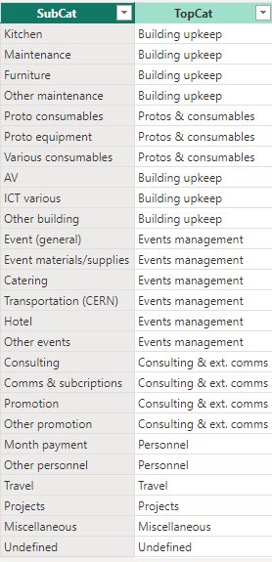
EDH entries
Let’s use a simple system to identify costs (subcat).
Makes allocation more consistent, makes monitoring simpler.
It does not add to your work, but makes my life easier.
Final list of sub-cats to be determined (Laetitia, Laura, Catarina, Dina)

Slide 3
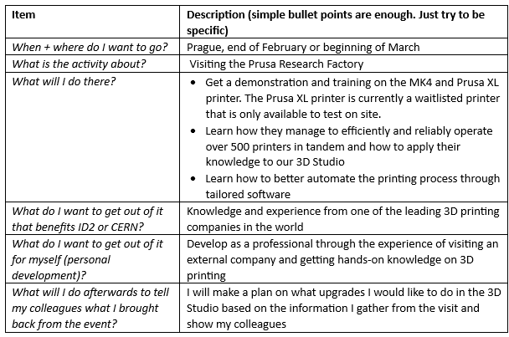
Travel requests
Not to add bureaucracy.
To have clarity, so I can make a decision based on concrete info (costs will show through EDH).
To be consistent, so that nobody feels unfairly treated.
To have travels on file. Needed in case we need to justify future budget requests from CERN. We have to be able to show what and why we have these expenses and what we have gained from them.

