Slide 1
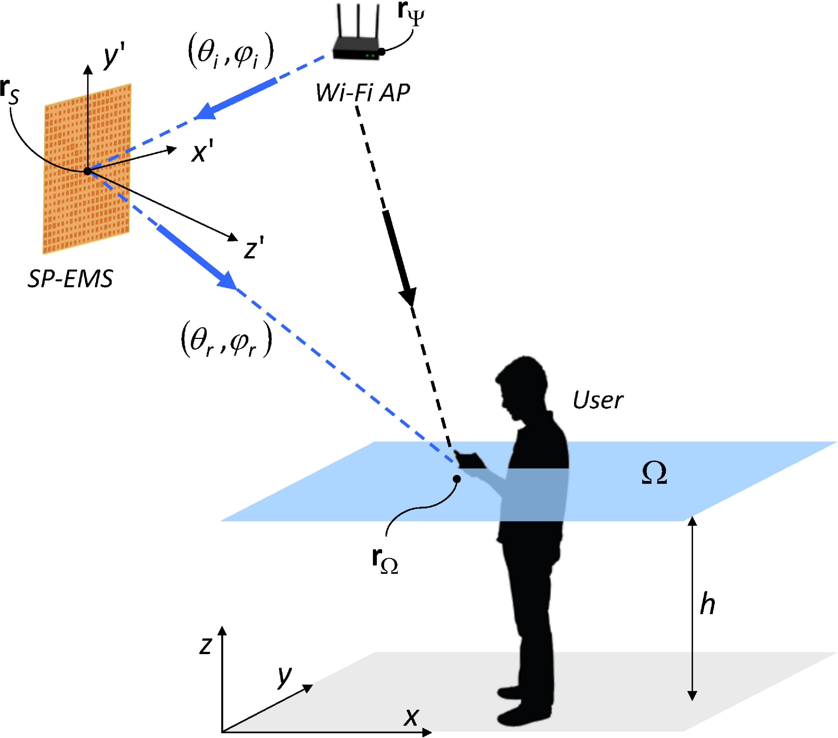
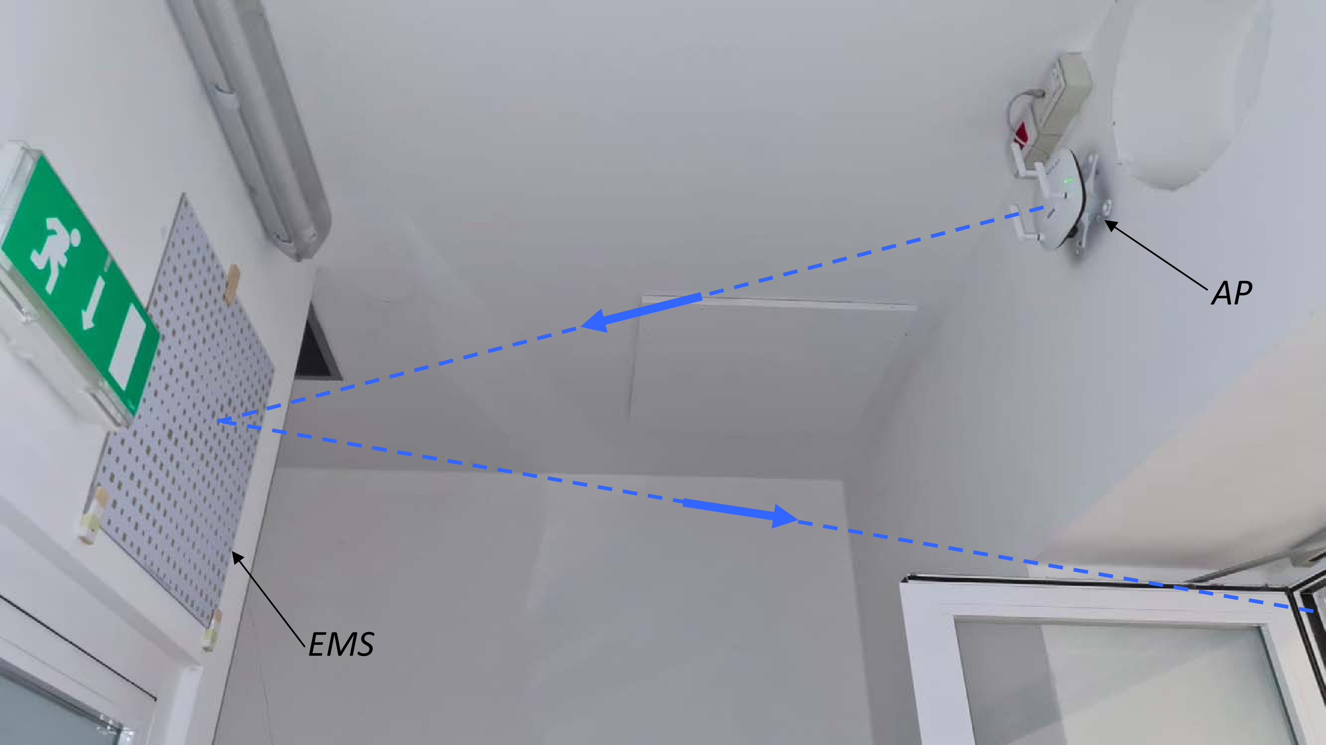
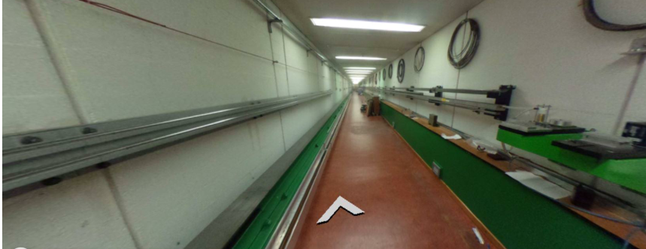
New Collaboration Agreement
The ELEDIA@UniTN research group at the Department of Civil, Environmental and Mechanical Engineering (DICAM) of the University of Trento has come up with a smart solution to make 6G work better without needing so much equipment. They've created a special kind of 'magic wallpaper' that can direct internet signals exactly where they're needed, making 6G faster and cheaper to set up. They're testing this technology in one of CERN tunnel.

Slide 2
Collaboration between RCN Norway and CERN through the SFI-CGV Application
The SFI offer by the Research Council of Norway (RCN):
The Centres for Research-based Innovation are to develop expertise in fields of importance for innovation and value creation. Through long-term research conducted in close collaboration between research-performing companies and prominent research groups, the SFI centres are to enhance technology transfer, internationalisation and researcher training.
The SFI centres may receive support for a total of eight years (an initial five-year period with the possibility of a three-year extension).

Slide 3
Main objective
• Educate new experts (PhDs and MSc’s) within the innovative areas of the center for recruitment to partners (Share of external funding represents share of PhDs within the center)
• Utilize the Green Village infrastructure and research spirit & expertise at CERN for demonstration and value creation of innovations
• Create an international research & cooperation hub with companies and end-users to achieve most

Slide 4
Content of the Innovation Areas:
• Interaction between the industrial partners, IA leader and team CERN
• Description of PhD tasks
  Annual work plans (MSc topics)
• Executive Education events [@ CERN with partners]
• Roadmap for CERN
  Specification of innovative technology
  Demonstration of technology (Tenders from CERN & Spin-off)

Slide 5
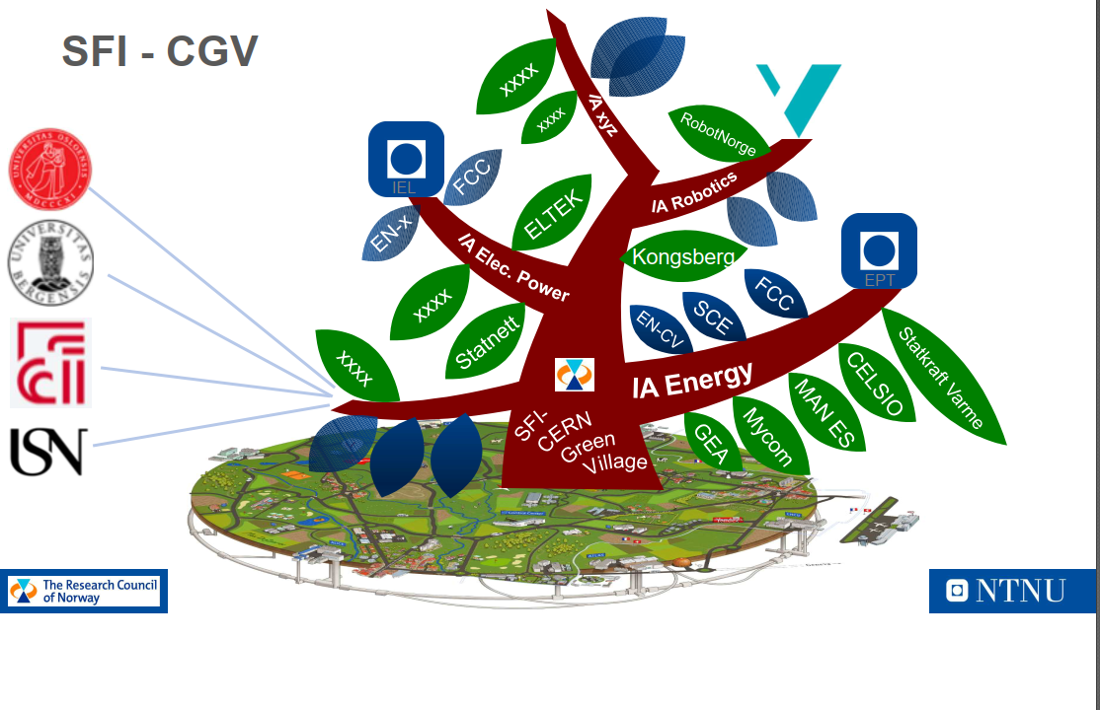

Slide 6
Next Steps?
Integrating Green Village in the Student Program:
  Develop a curriculum that includes hands-on projects at Green Village, where students can apply sustainable concepts in a real-world setting.
Strategy for Net-Zero:
  Create a roadmap for CERN to achieve net-zero emissions.
Sustainable Action for XX Operation:
  Implement sustainable practices in day-to-day operations, such as waste reduction, sustainable sourcing, and eco-friendly facilities management.
Increasing Visibility of Green Village:
  Enhance marketing efforts, host open days, and utilize social media to raise awareness about Green Village's sustainability initiatives.
Integrating Successful Sustainability Stories:
  Share case studies and success stories of sustainability projects at Green Village to inspire and educate the community and stakeholders.

