Slide 1
Future of IdeaSquare student programmes
Team Day 9th Feb 2024
Ole Werner, Catarina Batista, Tuuli Utriainen

Slide 2
What’s ongoing/ status
- 2 visits already happened (OPER.CBI + PdP ATTRACT)
- Reporting of i2planet development workshop
- Temporary re-structuring of i2Planet related responsilbilities
- operating at full demand with lessened capacity
- what needs to be picked up and by who?

Slide 3
How 2024 will look like
- 90% of calendar space is booked in Feb – 46/52 weeks are booked (all events, not only edu)
- i2P pilots (heavier planning and designing)
- outline process of desiging a pilot
- “Last round” CBI + ATTRACT programs
- Executive education?
- Quo Vadis 2.0
- New collaborations arising (St. Johns, St. Gallen, …)
- Development efforts aimed at helping with demand (Future Days, innosuisse, OIS…) – why and what is the expected benefit
- Practicioner’s guide

Slide 4
How 2025 might look like
- Empty calendar, baby – why we are doing promo so we have new projects/entities
- i2Planet pilots mature and are run again in a more established manner
- Trying out longer i2Planet formats, more touchpoints with i2/continuity
- CBI transition to be expected – similar timelines to CBI FP and CBI A3 to be kept

Slide 5
Things to learn from/improve
- Prioritising what to accept, making space in our calendar (and minds) to plan and design new stuff.
- deciding on “standby” deadlines and free weeks.
- Time planning and allocation for i2P development and pilot design.
- Are tours/public facing events done only by Edu team?
- Fee for space usage to cover logistics work around visits (?) – food for thought?
- Consider internal positioning at CERN – what are our contact points, what is our rationale for providing these educational services? What is the conversion rate of our alumni?

Slide 6
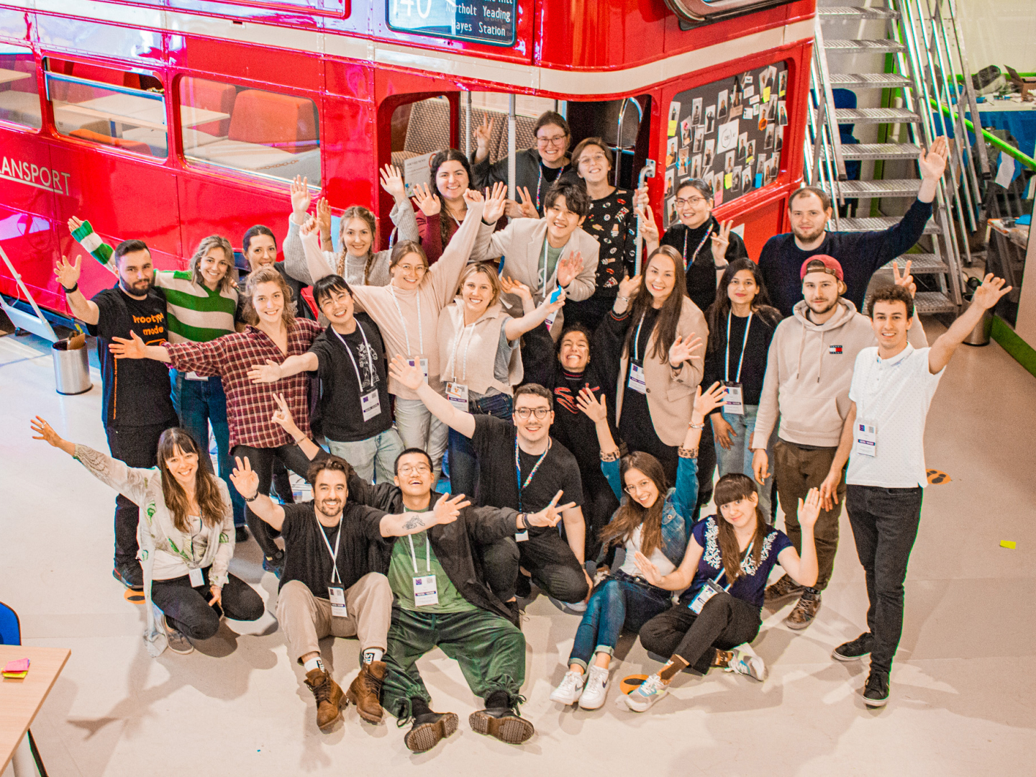
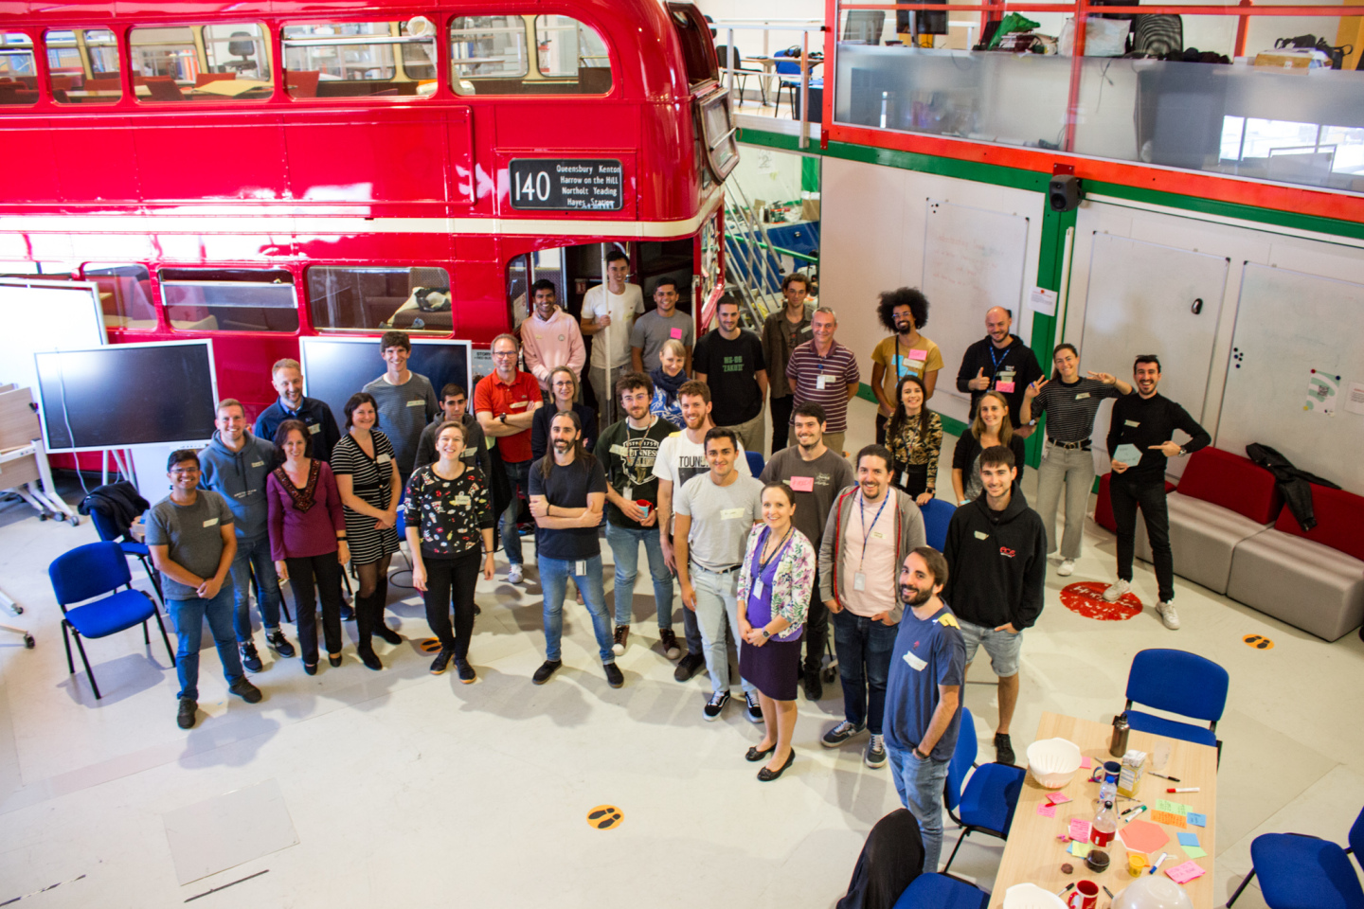
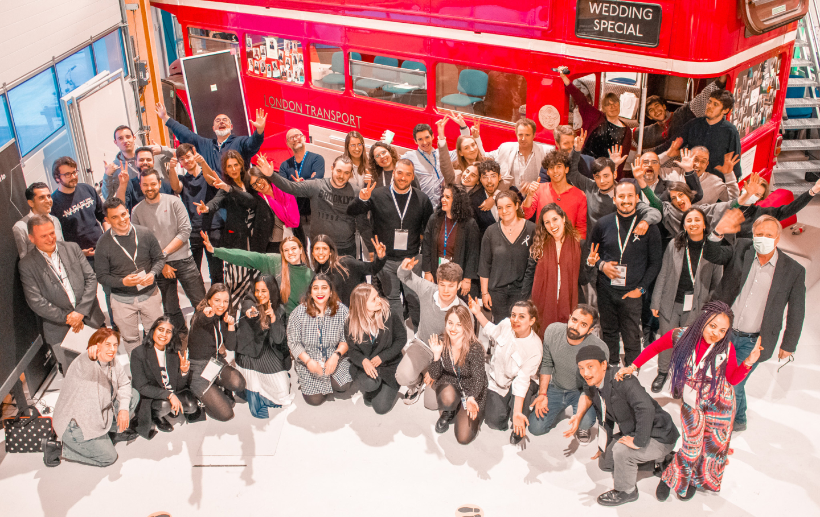
Thank you!

