Slide 1
Prototyping activities at IdeaSquare
Team Meeting 09.02.2024
Dina Zimmermann

Slide 2

What’s ongoing/status

Slide 3
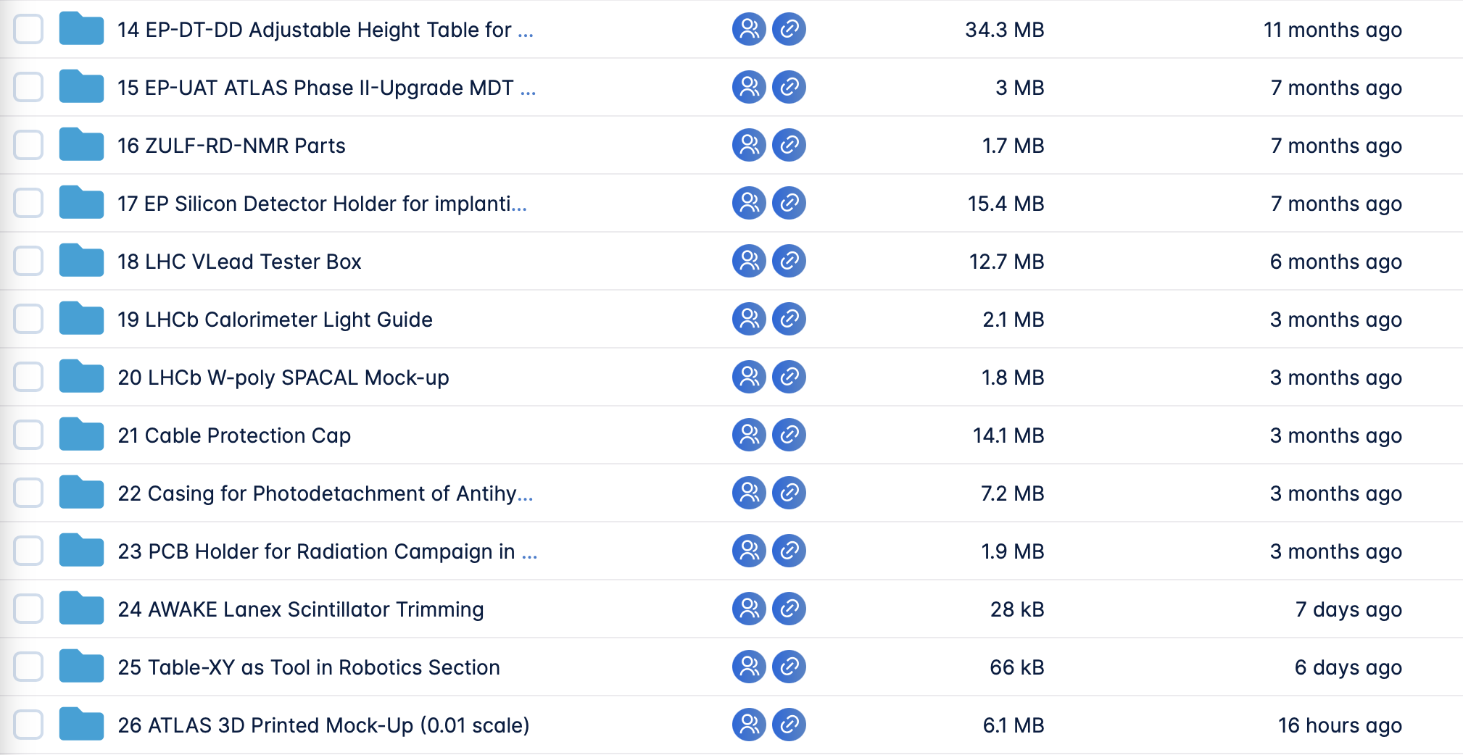
CERN Collaboration Projects
More than 13 Collaboration Projects within CERN
With groups such as:
ATLAS
LHCb
Bond Lab
AWAKE
CLEAR
ZULF-RD-NMR

Slide 4
Workshops and events
Arduino workshop
Held by Alberto Perro
2h workshop for CERN Personnel
6 workshops the last year
60+ attendees
Prototyping at CERN event
June and November
CERN Personell brings their prototypes and shares insights
30+ attendees
FPGA Programming using LabVIEW
Held by Adriaan Rijllart
2 x 2h for CERN personnel
5 workshops the last year
50+ attendees

Slide 5
Training for machine usage
3D printing training
How to use the FDM 3D printers at IdeaSquare
1h training
Every month
47 trained since last year
Laser Cutter training
How to use the Laser Cutter at IdeaSquare
1h training
Every month
45 trained since last year

Slide 6
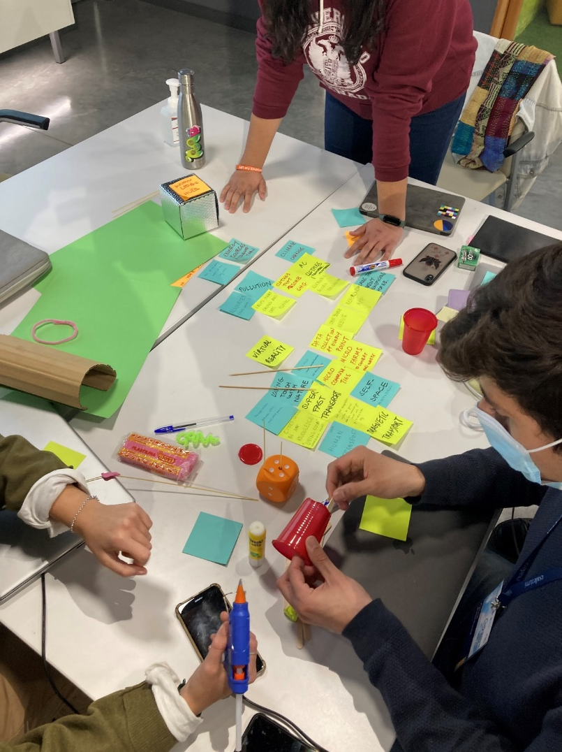
Prototyping during student programs
Prototyping under 10 out of 18 student programs last year
Variations of low and high fidelity prototypes

Slide 7
How 2024 will look like

Slide 8
Future of CERN Collaboration Projects
Continue as before
Has not been too time demanding - but could be a problem in the future if too many wants to use IdeaSquare

Slide 9
Future workshops and events
Informal talks with Robert Cailliau
Do a test run by the next two weeks – starting with the LiveCode talk
Minipix Detector workshop
Held by Pinelopi Christodoulou
Something Markus started before he left
We got a proposal of a workshop from Pinelopi
Notes:
pinelopi.christodoulou@cern.ch

Slide 10
Future of training for machine usage
Thoughts
Training on the Water Jet
Training on the Resin printers (rare)
Possibility: CAD course for beginners

Slide 11
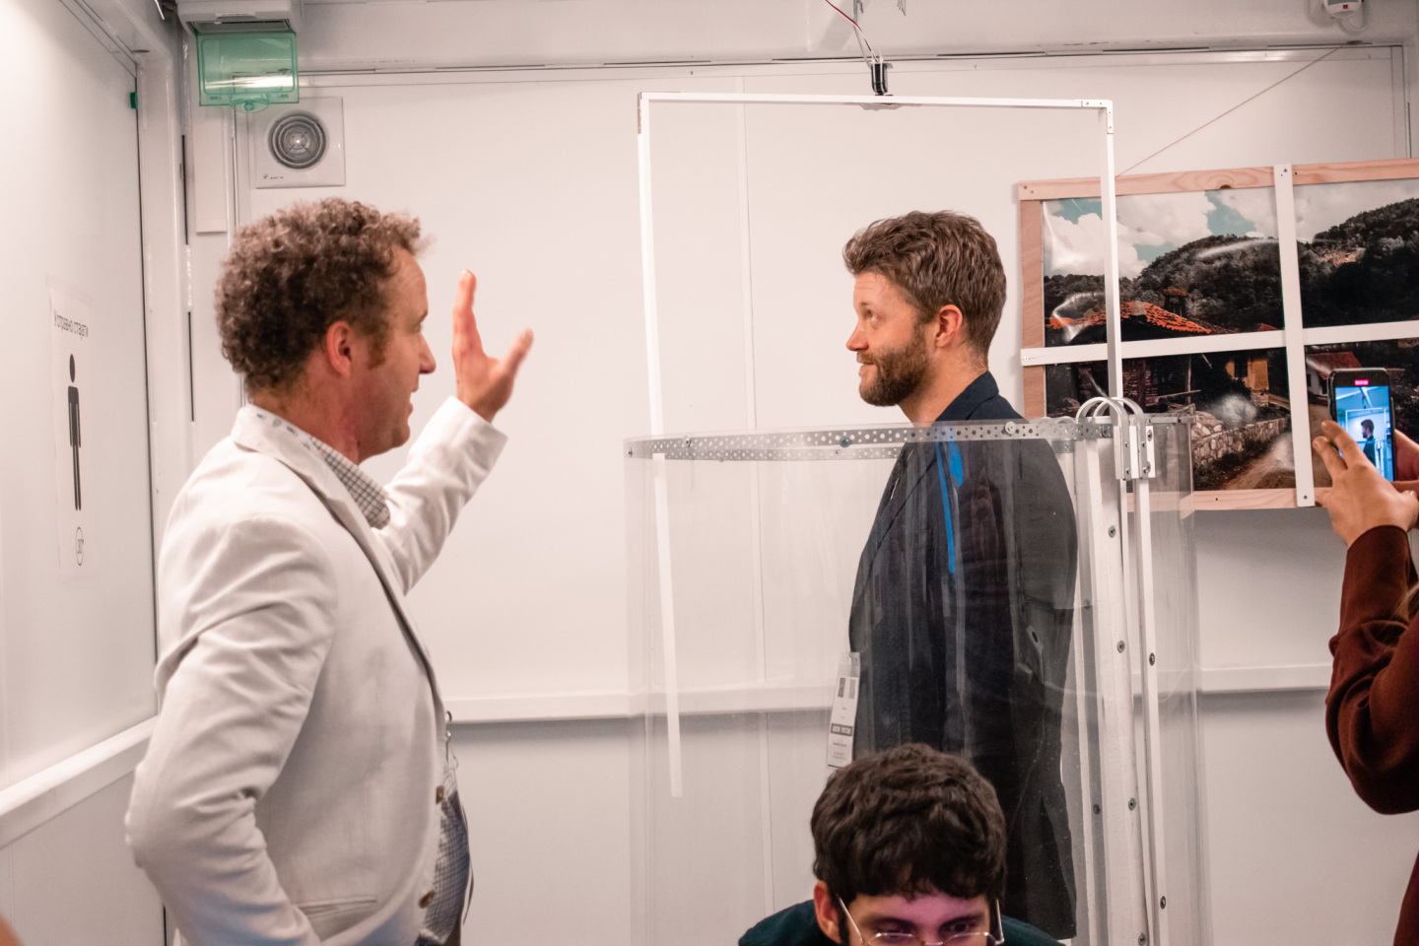
Prototyping during student programs
Would like to move into higher fidelity - test with TeSi program in April
Teaching students for to use the machines and make them explore the workshops more
Develop I2P Prototyping

Slide 12

How 2025 will look like

Slide 13
Future of CERN Collaboration Projects
Still continue in 2025 (could discuss this)

Slide 14
Future workshops and events
Informal talks with Robert Cailliau
Do a test run by the next two weeks – starting with the LiveCode talk
Minipix Detector workshop
Held by Pinelopi Christodoulou
Something Markus started before he left
We got a proposal of a workshop from Pinelopi
FPGA Programming using LabVIEW
Held by Adriaan Rijllart
2 x 2h for CERN personnel
5 workshops the last year
50+ attendees
Arduino workshop
Held by Alberto Perro
2h workshop for CERN Personnel
6 workshops the last year
60+ attendees
Prototyping at CERN event
June and November
CERN Personell brings their prototypes and shares insights
30+ attendees
Notes:
pinelopi.christodoulou@cern.ch

Slide 15
Future of training for machine usage
3D printing training
How to use the FDM 3D printers at IdeaSquare
1h training
Every month
47 trained since last year
Laser Cutter training
How to use the Laser Cutter at IdeaSquare
1h training
Every month
45 trained since last year
Water Jet Training
How to use the WAZER
1h training
Every second month
Resin printer training
How to use the FormLabs Form 3
1h training
Every third month
CAD course
Basic introduction to CAD modelling for CERN Personell
Could be extended to students

Slide 16
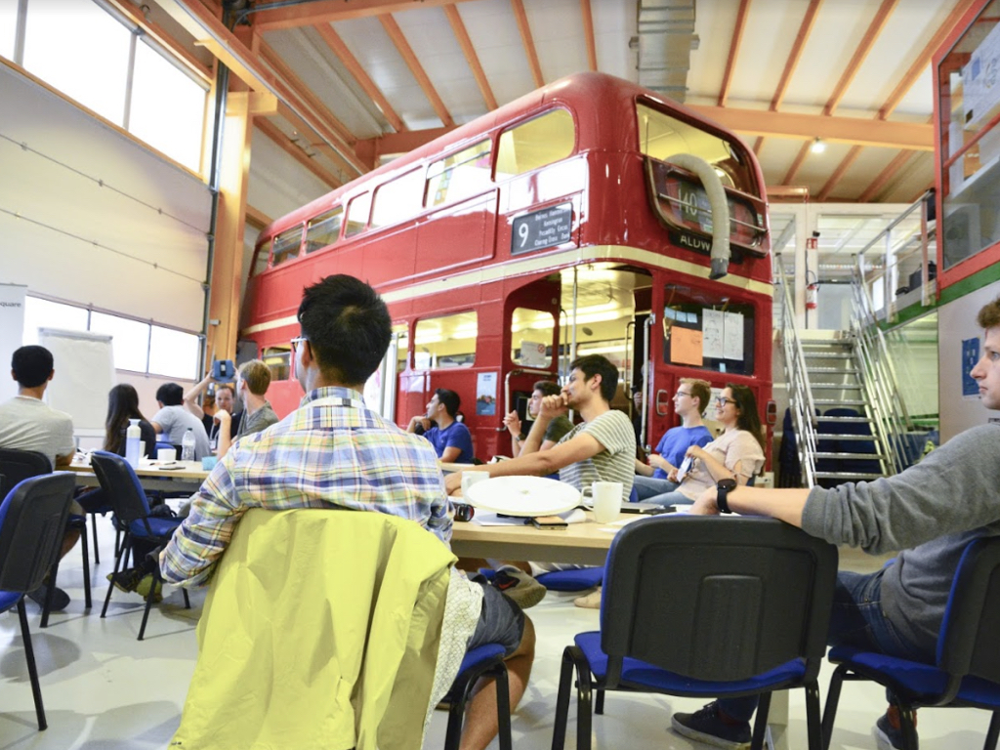
Prototyping during student programs
Fully developed I2P Prototyping
Training of machine usage for students

Slide 17

Things to learn from/improve

Slide 18
Improvements
More time on student prototyping sessions and be more present in student projects
Improve physical workshops more (inventory, VR headset etc.)
Maintenance of 3D printers
Update print farm by buying:
  PRUSA XL
  Prusa MK3s
  Get rid of Creality Printer
  Possibly dismantle the German RepRap
  Connect the printers to the WiFi

Slide 19
Improvements
Stronger connection with prototypers and student programs!
Update Electro Shop by:
  Getting rid of Umuts ols computers
  Making a new system for inventory
  Cleaning out cupboards
Update the Machine Shop by:
  Doing an inventory
  Updating missing parts and replace old equipment (ex. old saws)

Slide 20

Suggestions

Slide 21
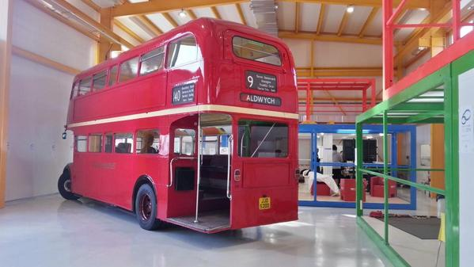
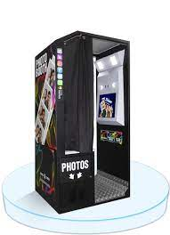
Homemade photobooth in the bus
Possible questions:
What is your opinion on IdeaSquare?
What will you bring with you back from IdeaSquare to your hometown?

Slide 22
Homemade photobooth in the bus
Using
Rasberry Pie
Screen
Button
Camera
SD-card
Purpose:
Gather real-time impressions from students on video
Can be used in comms and for the 10 year anniversary/ATTRACT event
A way to increase personal, technical knowledge for me

Slide 23
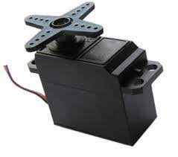
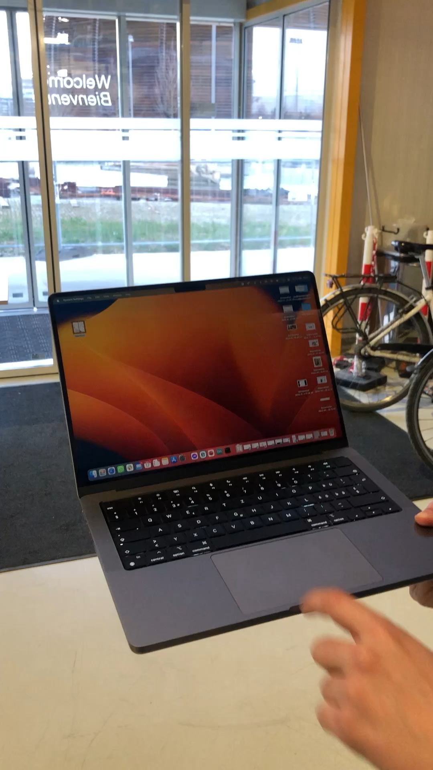
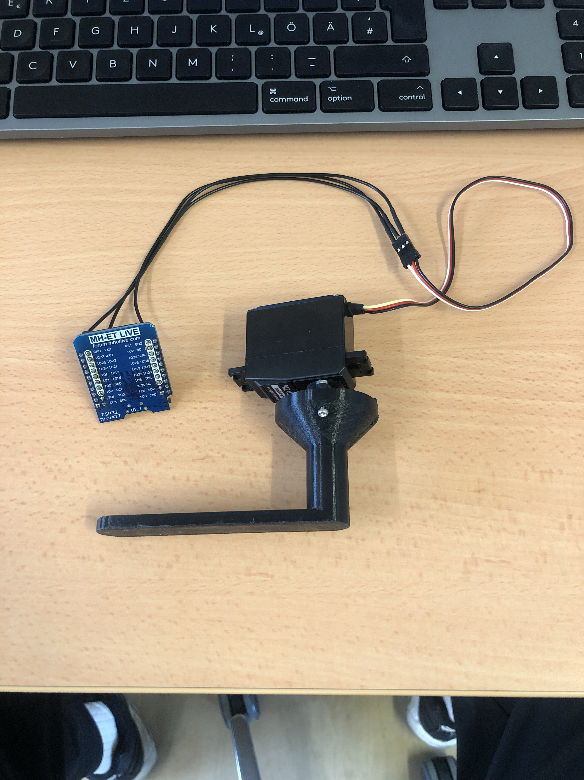
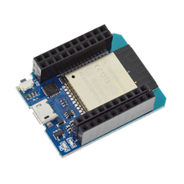
Side-project
ESP 32 MH-ET LIVE

