Slide 1
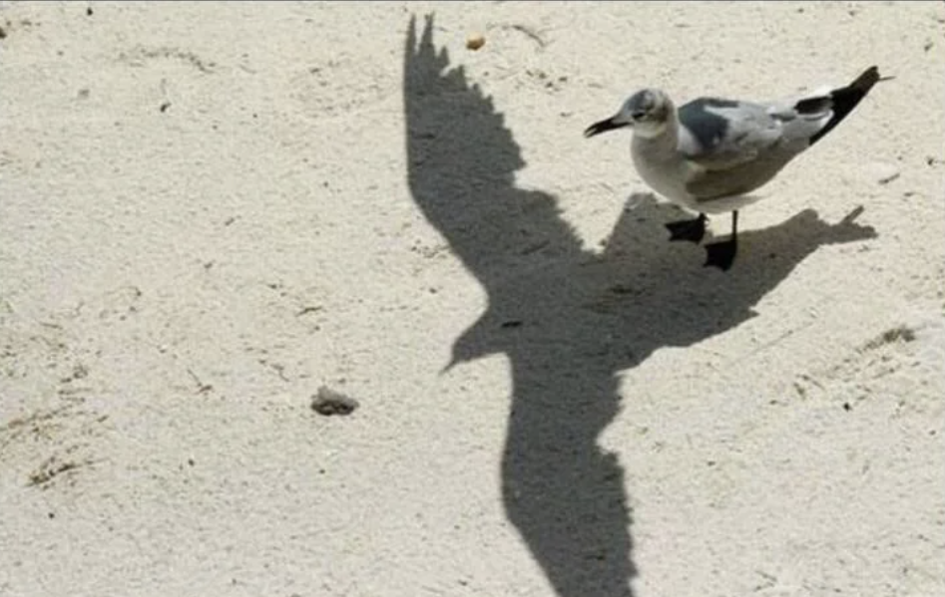
Personal Slide Ole
How do I see IdeaSquare in 2024 and 2025: A personal view.
  A place for Students, executives, and CERNies to explore thinking big,
How do I see myself growing at IdeaSquare (wishes, dreams, goals, etc).
  PhD + managing visits/groups = becoming an (internationally connected) professional
How do I plan to achieve it (key actions, milestones…what am I gonna do about it).
  Reading (more) papers, doing research & writing about it; taking responsibility for planning& organising things (taking the lead when proposing something)
What concrete support would I need.
  Research coffe motivation, more clear image of division of tasks/ possibility to spend time on it

