Slide 1

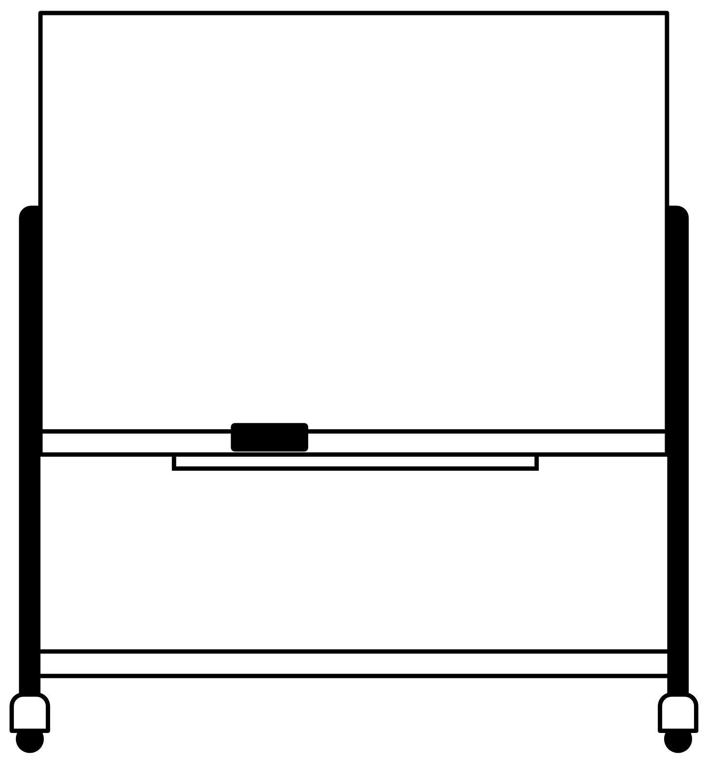







IdeaSquare in 2024 / 2025
Braver than ever before
Paving the innovation way forward with I2P
Turning heropreneurs into agents of real change
Sharing this know-how to others in collaboration.
Myself at IdeaSquare
CIJ and I2 finally figured out.
Stay to see & support the plans come to fruition.
Organizing, applying for funding & also doing more research…
Action plan and Support
Step 1: Set the table to support continued research activities of I2 people
Step 2: Search and apply for funding opportunities
Support: Pls keep me in mind if there are opportunities
Notes:
How do I see IdeaSquare in 2024 and 2025: A personal view.
IdeaSquare 2024 and 2025! Braver than ever before and paving the way forward for innovation with I2P and turning heropreneurs into agents of real change through thinking different. Sharing this knowledge and thinking to others in collaboration.
How do I see myself growing at IdeaSquare (wishes, dreams, goals, etc).
After getting the hang of CIJ, editorial work, and business about I2 in general, I would like to stay longer and see and support the plans for research our people have come to fruition. Organizing research, applying for funding, but also doing more research…
How do I plan to achieve it (key actions, milestones…what am I gonna do about it).
Step 1: Plan well and set the table to support the research activities of the people, whatever the future may bring
Step 2: Search and apply for funding opportunities
What concrete support would I need.
Just people keeping this info in mind and making use of it as they see best.

