Slide 1
CERN Solvay Camp – 2024
Introduction to Superconducting Magnets
Susana Izquierdo Bermúdez
susana.izquierdo.bermudez@cern.ch

Slide 2
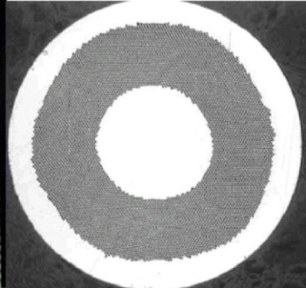

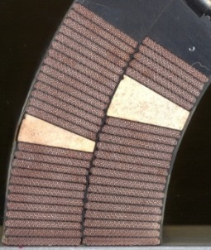
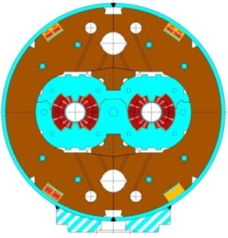
Goal of the course
Overview of superconducting magnets for particle accelerators (dipoles and quadrupoles)
Exciting, fancy and dirty mixture of physics, engineering, and chemistry
  Chemistry and material science: superconducting materials
  Quantum physics: the key mechanisms of superconductivity
  Classical electrodynamics: magnet design
  Mechanical engineering: support structures
  Electrical engineering: powering of the magnets and their protection
  Cryogenics: keep them cool …
  Cost optimization also plays a relevant role
Superconducting strand
Superconducting cable
Superconducting coil
Superconducting magnet

Slide 3
References
Superconducting magnets for particle accelerators are a vast domain. This lecture will be especially focused on magnets for colliders, with a special eye on the CERN high energy infrastructures (LHC and HL-LHC). They are based on:
  P. Ferracin, E. Todesco, S. Prestemon, “Superconducting accelerator magnets”, US Particle Accelerator School, www.uspas.fnal.gov.
  E. Todesco, “Masterclass -Design of superconducting magnets for particle accelerators”, https://indico.cern.ch/category/12408/
Many thanks to Paolo F., Ezio T. and Luca B., for all the material I took from them for this course, and for everything I learnt from them on superconducting magnets!

Slide 4
Outline
  Particle accelerators, magnets and the need of superconductors
  Superconducting magnets
    Conductor
    Magnetic design and coil fabrication
    Mechanical design and assembly
    Quench, training and protection
  Future outlook

Slide 5
Outline
  Particle accelerators, magnets and the need of superconductors
  Superconducting magnets
    Conductor
    Magnetic design and coil fabrication
    Mechanical design and assembly
    Quench, training and protection
  Future outlook

Slide 6
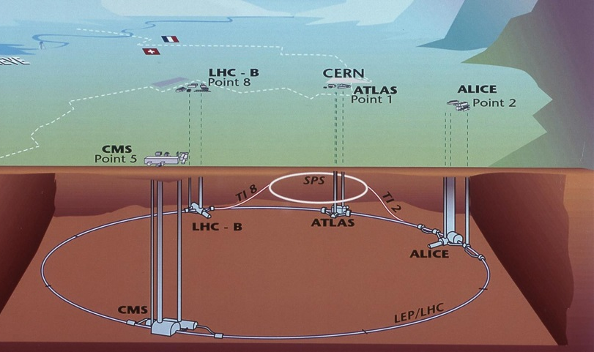
The LHC
“The Arc”
Dipoles: magnetic field steers (bends) the particles in a ∼circular orbit
Quadrupoles: magnetic field provides the force necessary to stabilize linear motion.
    They act as a spring: focus the beam
    Prevent protons from falling to the bottom of the aperture due to the gravitational force (it would happen in less than 60 ms!)
Correctors
“Long straight sections (LSS)”
Interaction regions (IR) where the experiments are housed
  Quadrupoles for strong focusing in interaction point
  Dipoles for beam crossing in two-ring machines
Regions for other services
  Beam injection (dipole kickers)
  Accelerating structure (RF cavities)
  Beam dump (dipole kickers)
  Beam cleaning (collimators)

Slide 7

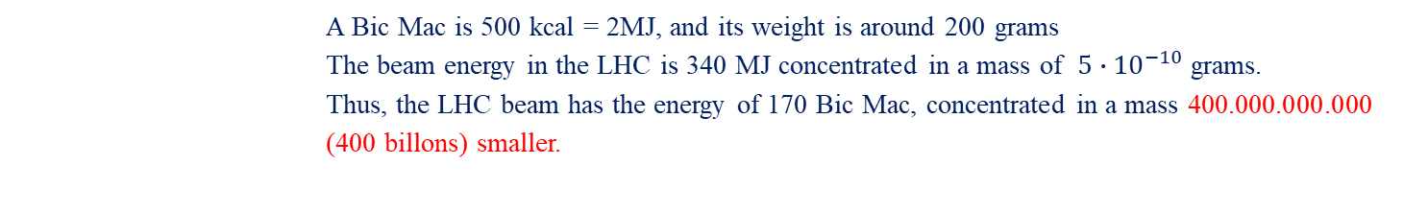
Energy level in the LHC
Energy: Ability of making a work. Typically, we measure it in Joules or Calories. In the LHC, in Tera-Electron-Volts (13 TeV). How much is that?
A Tera is One Million of Millions
An Electron-Volt is the energy acquired by one electron (or proton) accelerated by a potential of 1 volt.
The energy of each proton is: :
7TeV=7∙10¹²eV=7∙10¹²∙1.6∙10⁻¹⁹C∙1V=1.1∙10⁻⁶J
In the beam, we have about 310.000 billons of protons (which can seem a lot, but they are 5∙10⁻¹⁰g), so the energy of the beam is:
310∙10¹²∙1.1∙10⁻⁶J = 340 MJ (340.000 kJ)
If we compare it with a Bic Mac:
 | A Bic Mac is 500 kcal = 2MJ, and its weight is around 200 grams The beam energy in the LHC is 340 MJ concentrated in a mass of ${5∙10}^{−10}$ grams. Thus, the LHC beam has the energy of 170 Bic Mac, concentrated in a mass 400.000.000.000 (400 billons) smaller.

Slide 8
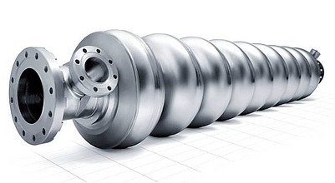
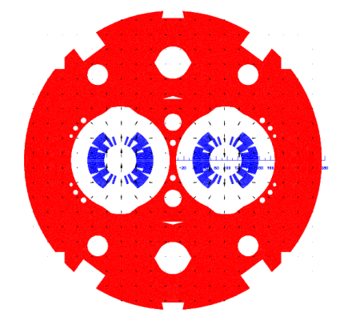
Do we need superconductors?
Principle of synchrotrons:
  Driving particles in the same accelerating structure several times.
Electro-magnetic field accelerates particles
Magnetic field steers the particles in a ∼ circular orbit
Particle accelerated → energy increased → magnetic field increased (“synchro”) to keep the particles on the same orbit of curvature ρ
B
Constant
Lesson 1: If we want more energetic particles, either we make stronger magnets or we increase the size of our accelerator.

Slide 9
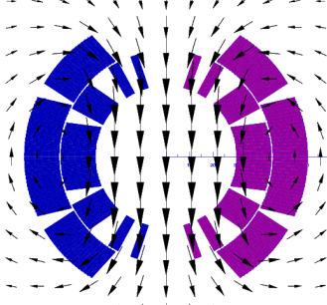
Do we need superconductors?
The magnetic field produced by an electromagnets is proportional to the current density and the size of the coil .
J_{o} = current density
w = coil width
w
  In normal conducting magnets, J ~ 5 A/mm²
  In superconducting magnets, J_{e} ~ 600-700 A/mm²
Lesson 2: If we want magnets with B>2T and a reasonable size (and energy consumptions), superconductors are needed
So the answer to the question if we need superconductors is:
¡YES!

Slide 10
Do we need superconductors?
Lesson 1: If we want more energetic particles, either we make stronger magnets or we increase the size of our accelerator.
Lesson 2: If we want magnets with B>2T and a reasonable size (and energy consumptions), superconductors are needed
So the answer to the question if we need superconductors is:
¡YES!

Slide 11
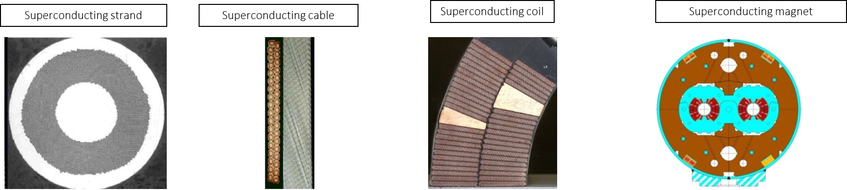
Outline
  Particle accelerators, magnets and the need of superconductors
  Superconducting magnets
    Conductor
    Magnetic design and coil fabrication
    Mechanical design and assembly
    Quench, training and protection
  Future outlook

Slide 12
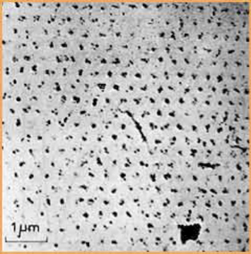
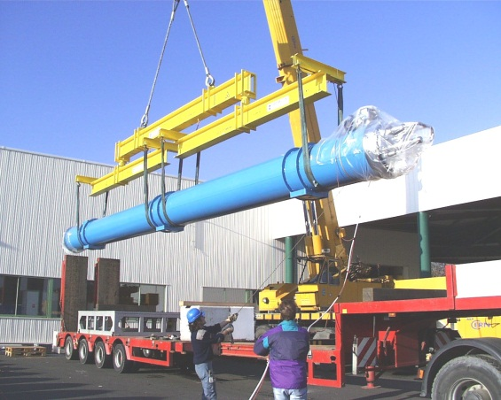
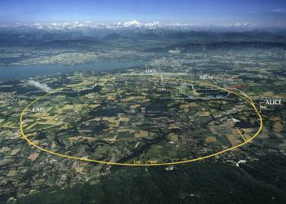
Superconducting magnets
The science of superconducting magnets is an exciting, fancy and dirty mixture of physics, engineering, and chemistry
  Chemistry and material science: superconducting materials
  Quantum physics: the key mechanisms of superconductivity
  Classical electrodynamics: magnet design
  Mechanical engineering: support structures
  Electrical engineering: powering of the magnets and their protection
  Cryogenics: keep them cool …
Very different order of magnitudes
The cost optimization also plays a relevant role
Quantized fluxoids penetrating a superconductor used in accelerator magnets
A 15m truck unloading a 27 tons LHC dipole
Large Hardon Collider
27 km, 8.33 T,14 TeV
1300 tons NbTi

Slide 13
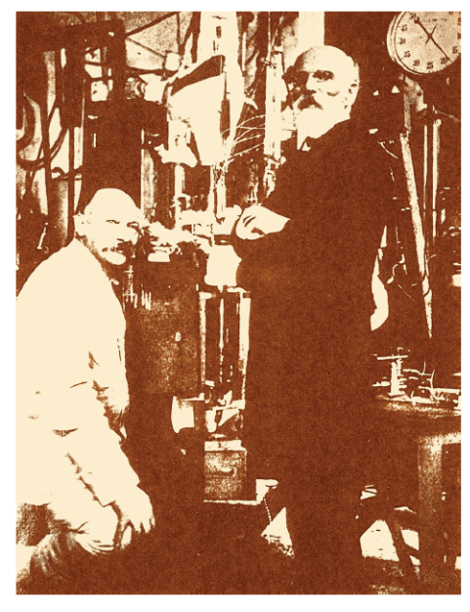
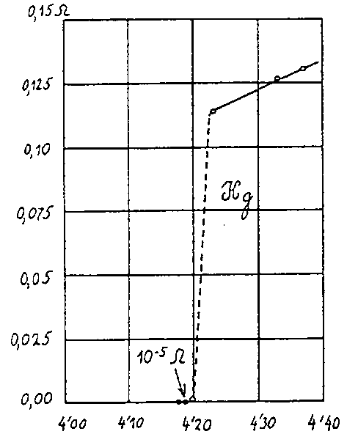
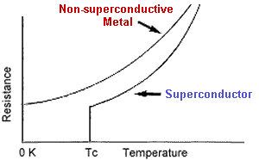
Superconductivity
In 1911, Kammerling-Onnes, discovered superconductivity (ZERO resistance of mercury wire at 4.2 K)
The temperature at which the transition takes place is called critical temperature T_{c}
Observed in may materials
  but not in the typical best conductors (Cu, Ag, Au)
At T > T_{c} , superconductor very poor conductor

Slide 14
Practical superconductors
50 years later …
Nb and Ti → ductile alloy
Extrusion + drawing
T_{c} is ~9.2 K at 0 T
B_{C2} is ~14.5 T at 0 K
Firstly in Tevatron (80s), then all the other
~50-200 US$ per kg of wire
(1 euro per m)
Nb and Sn → intermetallic compound
Brittle, strain sensitive, formed at ~650-700°C
T_{C} is ~18 K at 0 T
B_{C2} is ~28 T at 0 K
Used in NMR, ITER
~700-1500 US$ per kg of wire
(5 euro per m)
Critical surface for Nb-Ti and Nb₃Sn

Slide 15
Practical superconductors
Typical operation parameters
(for a 0.85 mm diameter strand)
Cu
Nb-Ti
Nb₃Sn
J_{e} ~ 5 A/mm²
I ~ 3 A
B = 2 T
J_{e} ~ 600-700 A/mm²
I ~ 300-400 A
B = 8-9 T
J_{e} ~ 600-700 A/mm²
I ~ 300-400 A
B = 12-13 T

Slide 16
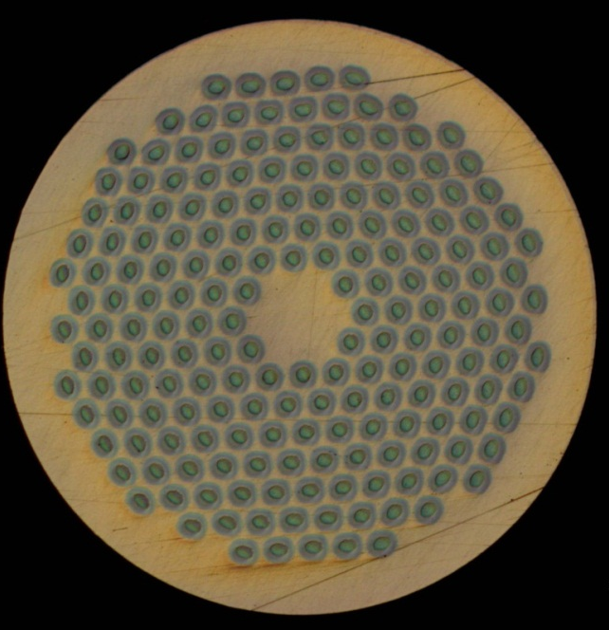
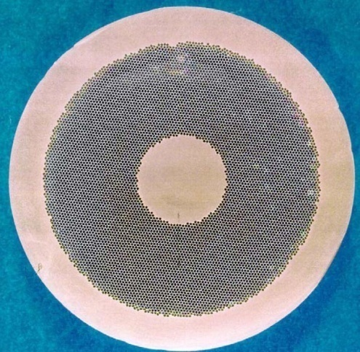
Practical superconductors
Typical operation parameters
(for a 0.85 mm diameter strand)
Cu
Nb-Ti
Nb₃Sn
J_{e} ~ 5 A/mm²
I ~ 3 A
B = 2 T
J_{e} ~ 600-700 A/mm²
I ~ 300-400 A
B = 8-9 T
J_{e} ~ 600-700 A/mm²
I ~ 300-400 A
B = 12-13 T

Slide 17

Strand: a multifilament wire
Superconducting materials are produced in small filaments and surrounded by a stabilizer (typically copper) to form a “multi-filament wire” o “strand”
Why small filaments are needed?
  Stability (flux jumps)
  Magnetic field quality
    Persistent currents
    Inter-filament coupling currents
Why are they embedded in a copper matrix?
  Protection, to redistribute the current in case of quench

Slide 18
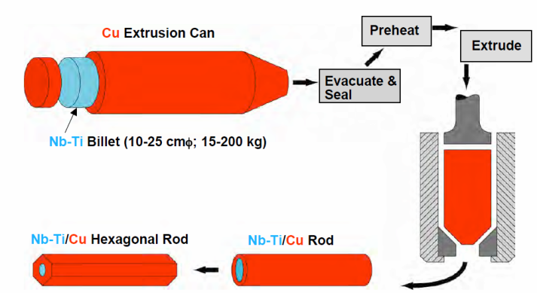
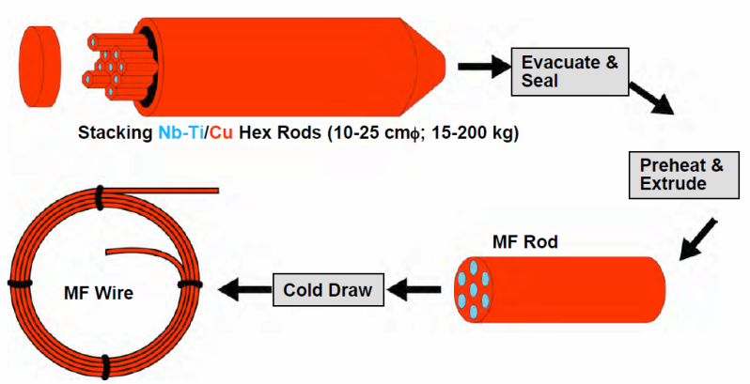
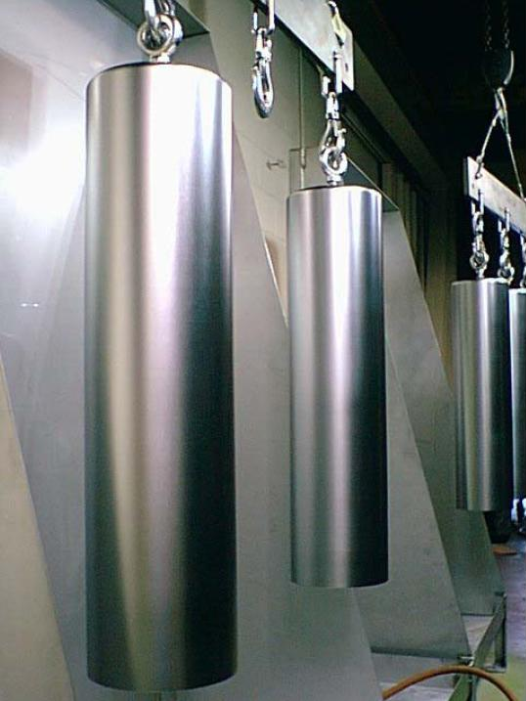
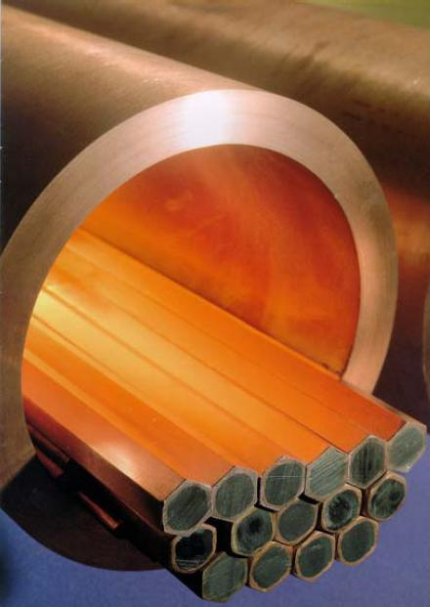
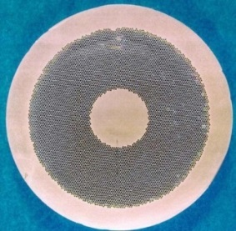
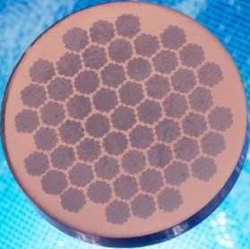
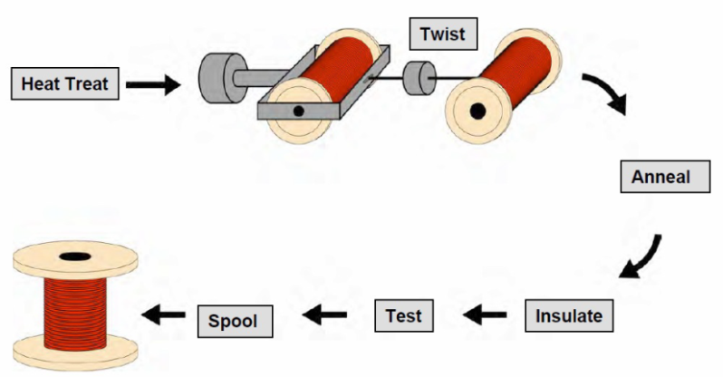
Strand: Manufacturing process (NbTi)
Nb-Ti ingots
  200 mm ∅, 750 mm long
Monofilament rods are stacked to form a multifilament billet
  then extruded and drawn down
  can be re-stacked: double-stacking process

Slide 19
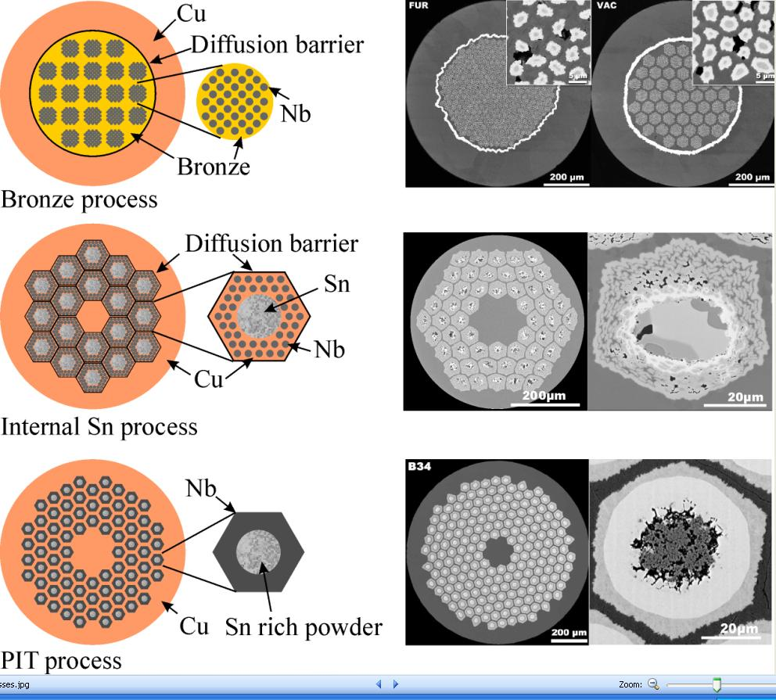
Strand: Manufacturing process (Nb₃Sn)
See lecture Michael Eisterer
Bronze process
by A. Godeke
Since Nb₃Sn is brittle
  It cannot be extruded and drawn like Nb-Ti. It must be formed at the end of the fabrication of the cable (or the coil).
Process in several steps
  Fabrication of the wire, assembling multifilament billets from with Nb and Sn separated. Different processes tried in industrial scale (bronze process, internal tin process, powder in tube process)
  Fabrication of the cable
  Fabrication of the coil. Two different techniques:
      Wind & react” (more common). First coil winding and then formation of Nb₃Sn
      “React & wind”. First formation of Nb₃Sn and then coil winding
  Reaction. Heating to about 600-700 C in vacuum or inert gas (argon) atmosphere, and the Sn diffuses in Nb and reacts to form Nb₃Sn.
Internal tin process
Powder in tube process

Slide 20
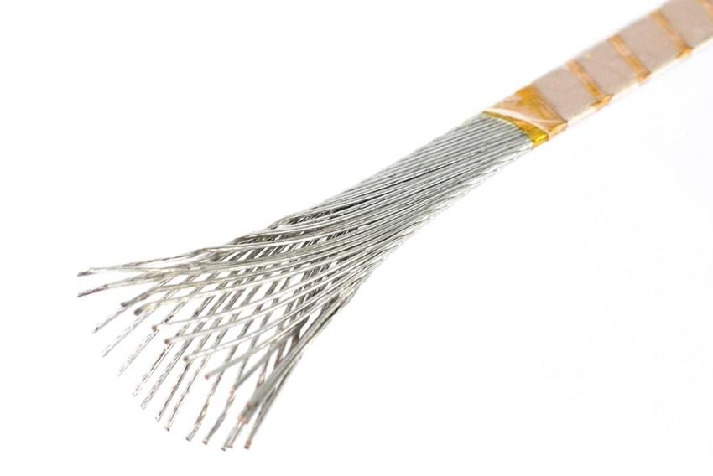
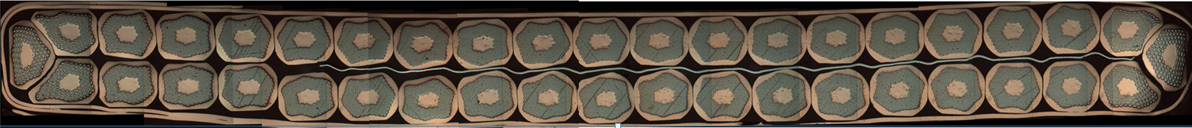
The cable
Most of the superconducting coils for particle accelerators wound from a multi-strand cable (Rutherford cable). The strands are twisted to
  Reduce inter-strand coupling currents
    Losses and field distortions.
  Provide more mechanical stability
  Current redistribution (in case a defect in one strand)
  Reduction the number of turns (easier winding, lower inductance)
  Reduction strand piece length
Picture by Charlie Sanabria
Picture by Jerome Fleiter

Slide 21
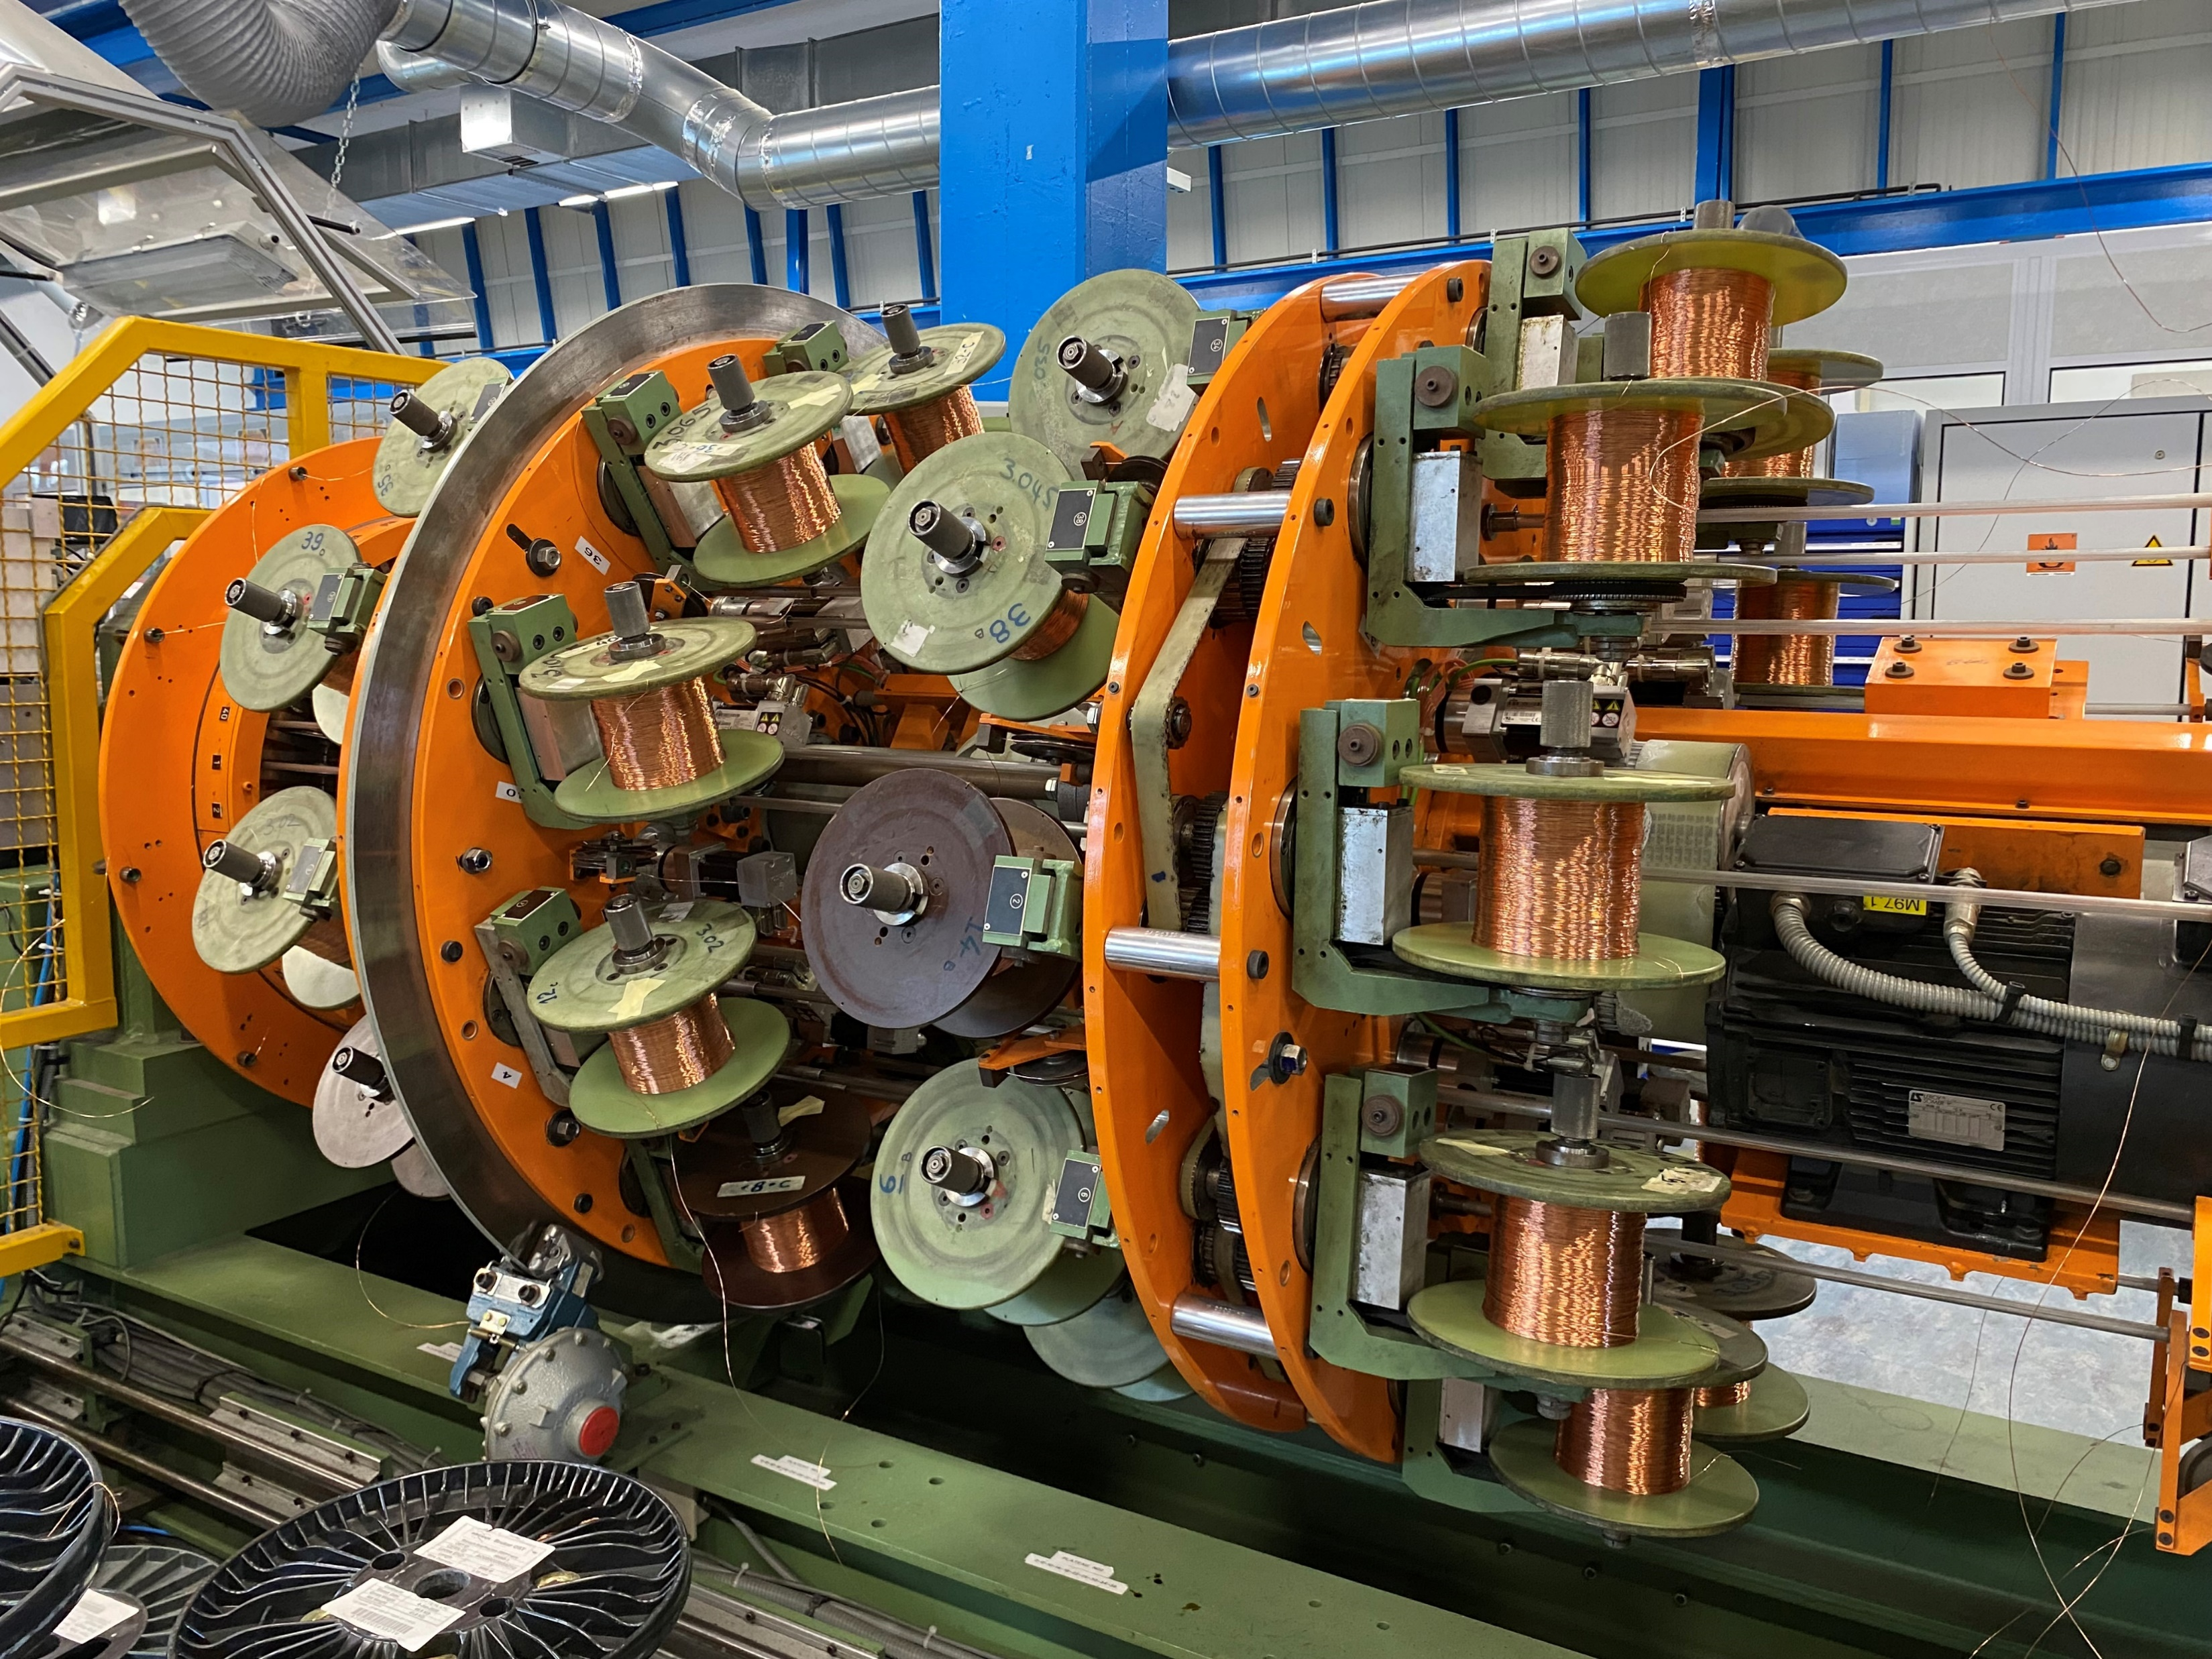
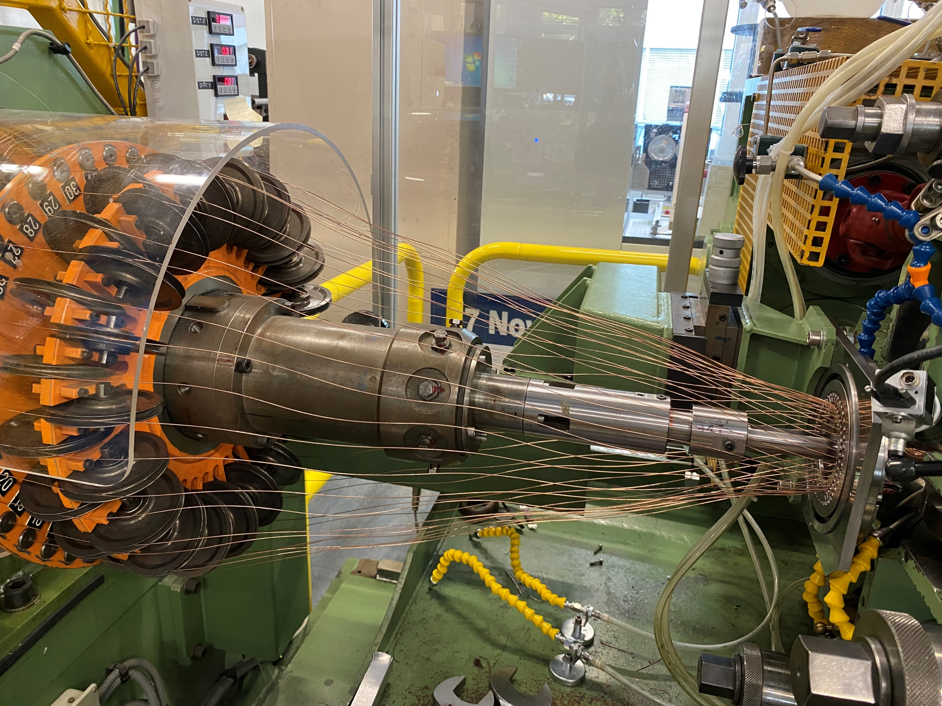
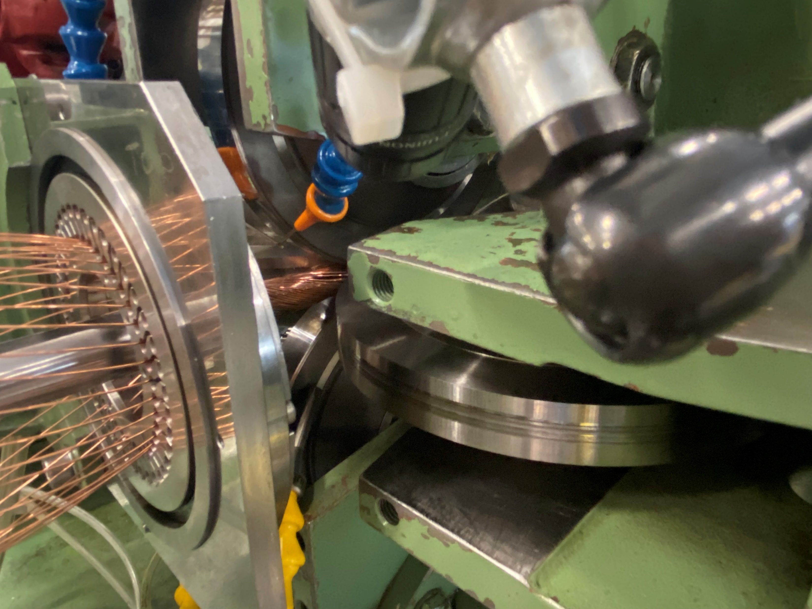
Fabrication of the Rutherford cable
Fabrication of the Rutherford cable:
  Strands wound on spools mounted on a rotating drum
  Strands twisted around a conical mandrel into rolls
  The rolls compact the cable and provide the final shape
CERN cabling machine

Slide 22
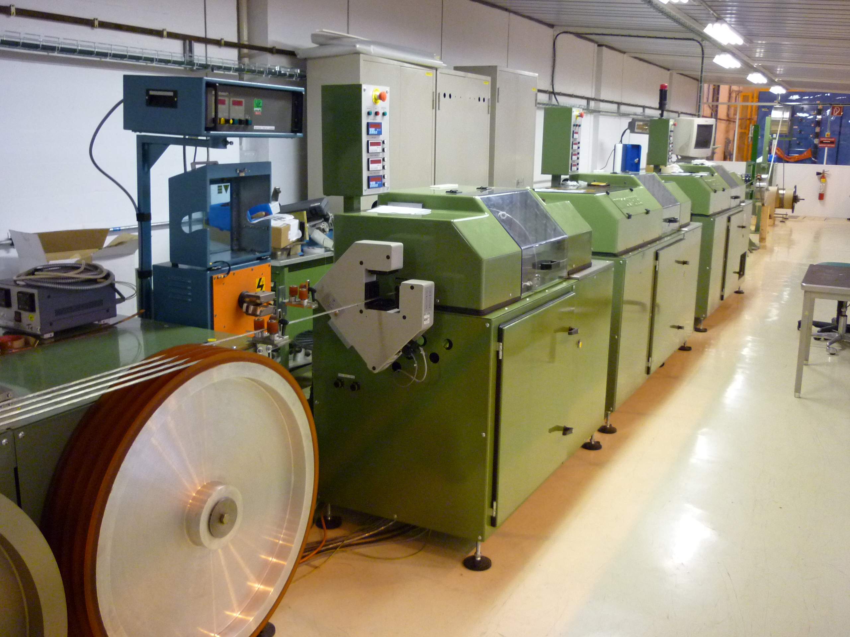
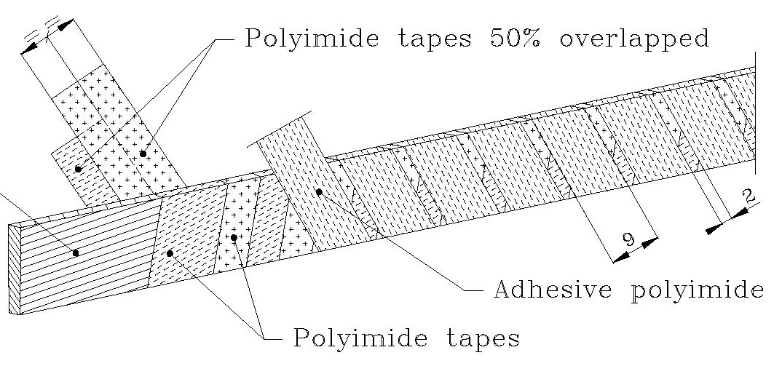
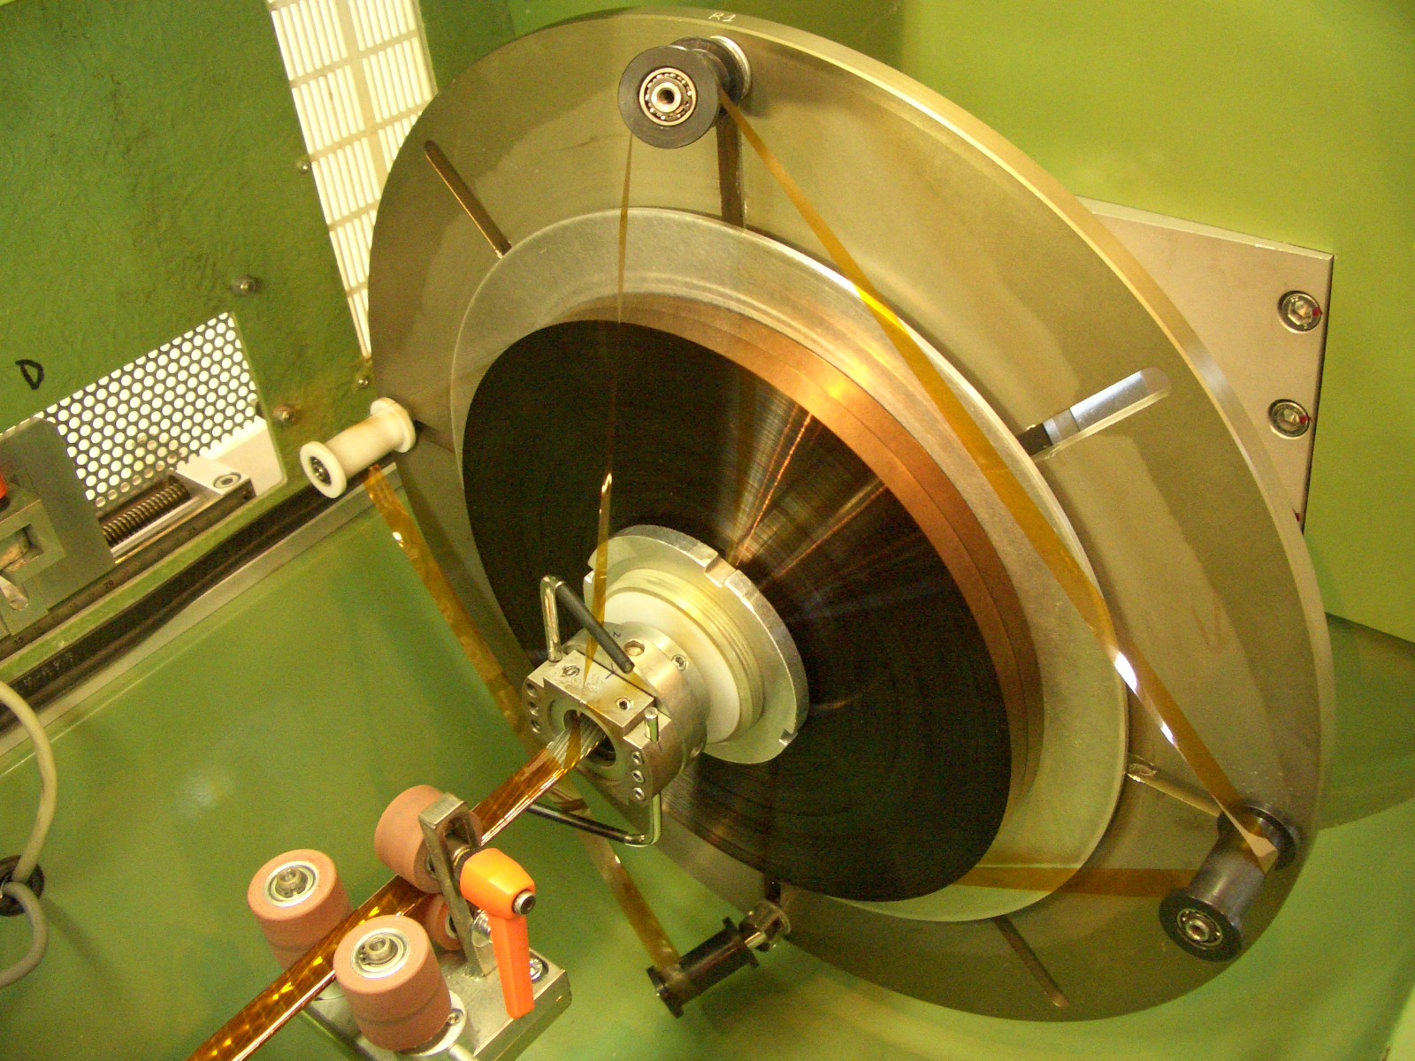
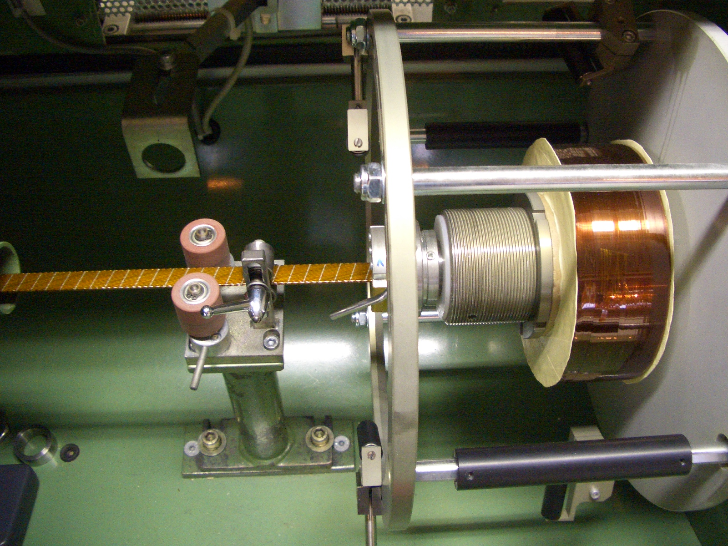
Cable insulation
The cable insulation must feature
  Good electrical properties to withstand turn-to-turn V after a quench
  Good mechanical properties to withstand high pressure conditions
  Porosity to allow penetration of helium (for non-impregnated coils)
  Radiation hardness (depending on the location in the machine)
In Nb-Ti magnets the most common insulation is a series of overlapped layers of polyimide (Kapton®).
In the LHC case: two polyimide layers 50.8 µm thick wrapped around the cable with a 50% overlap, with another adhesive polyimide tape 68.6 µm thick wrapped with a spacing of 2 mm.
Polyimide insulation for Nb-Ti

Slide 23
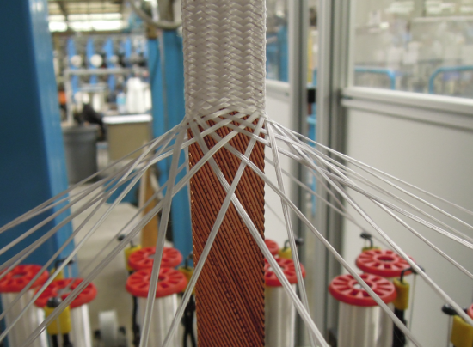
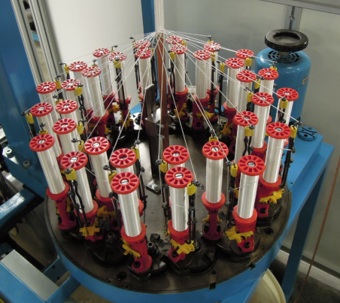
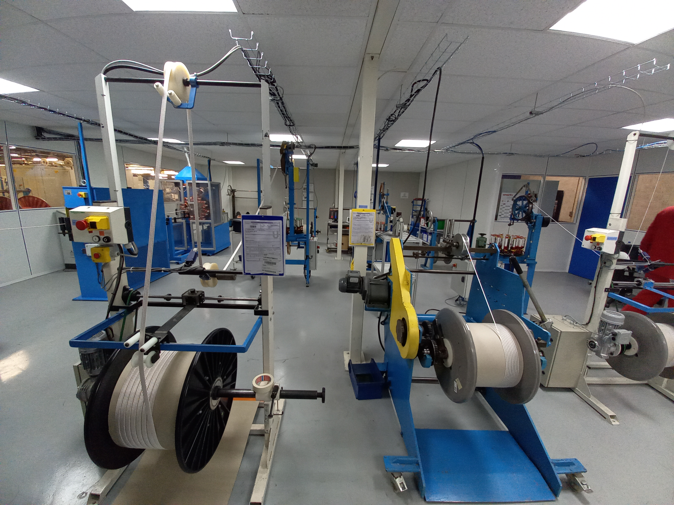
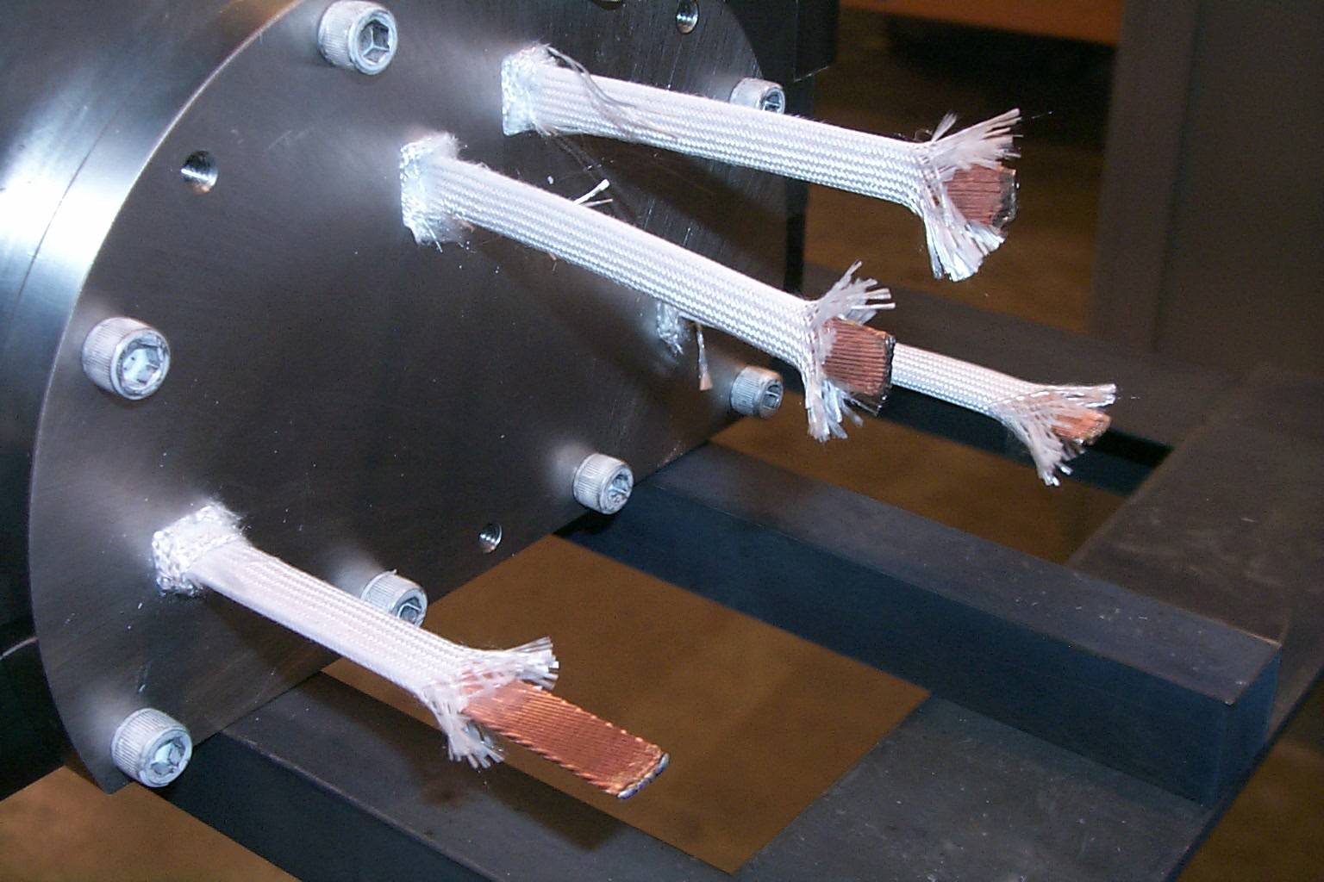
Cable insulation
In Nb₃Sn magnets, where cable are reacted at 600-700 °C, the most common insulation is fiberglass: tape or sleeve or braided.
  Braided insulation is done in industry for HL-LHC cables
Typically, the insulation thickness varies between 100 and 200 µm.
Fiber glass insulation for Nb₃Sn

Slide 24
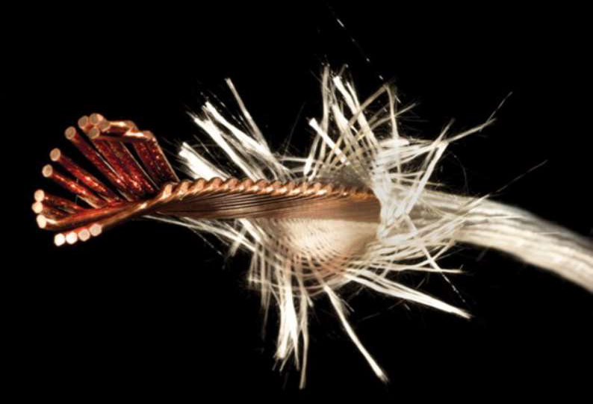
Summary
Strand made from twisted filaments in a stabilizing matrix (stability, protection, field quality)
Cable is insulated (dielectric strength, mechanical robustness)
Cable made from twisted wires (stability, protection, field quality)

Slide 25
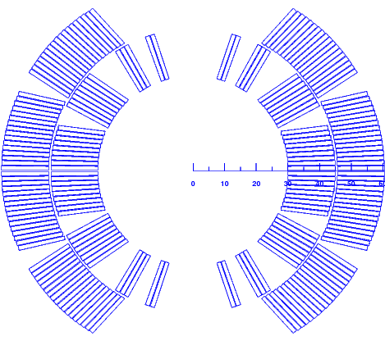
How to create a dipole field?
Perfect dipole
Within a cylinder carrying j₀, the field is perpendicular to the radial direction and proportional to the distance to the centre r:
  Combining the effect of two intersecting cylinders
But…
The aperture is not circular
Not easy to simulate with a flat cable
-J₀
+J₀
-J₀
+J₀
From ideal to practice configuration
The idea: reproduce a cosθ current distribution with a cable (Rectangular cross-section and constant J)
It will not be a perfect field…but it can be pretty close!
25

Slide 26
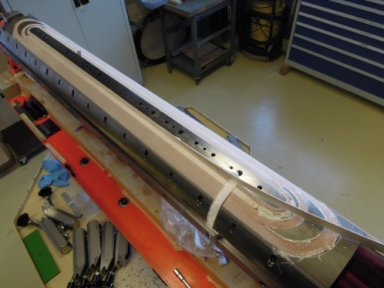
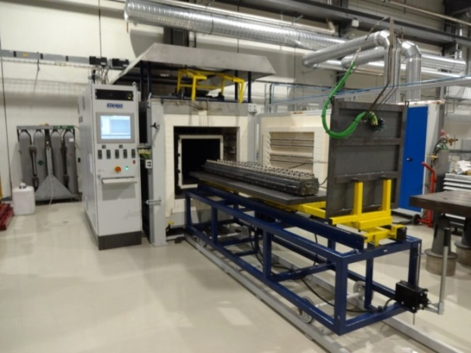
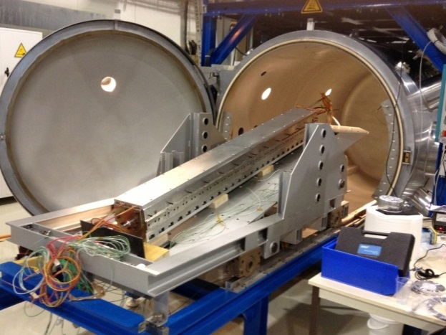
Coil fabrication (Nb₃Sn)
Winding & Curing
Reaction
Impregnation
The cable is wound around a pole on a mandrel.
A ceramic binder is applied and cured (T~ 150 C) to have a rigid body easy to manipulate.
Sn and Nb are heated to 650-700 C in vacuum or inert gas (argon) →Nb₃Sn
The cable becomes brittle
In order to have a solid block, the coil placed in a impregnation fixture
The fixture is inserted in a vacuum tank, evacuated → epoxy injected

Slide 27
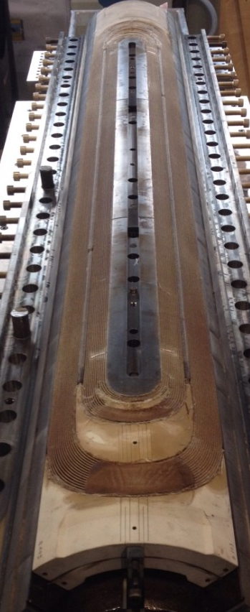
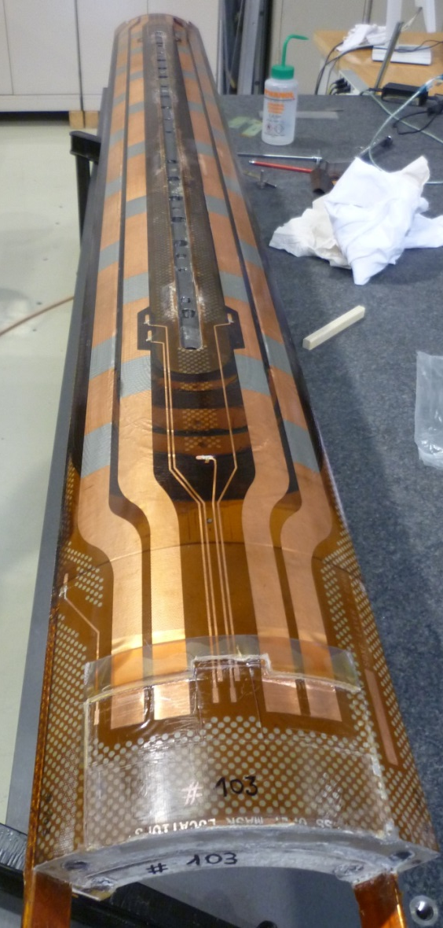
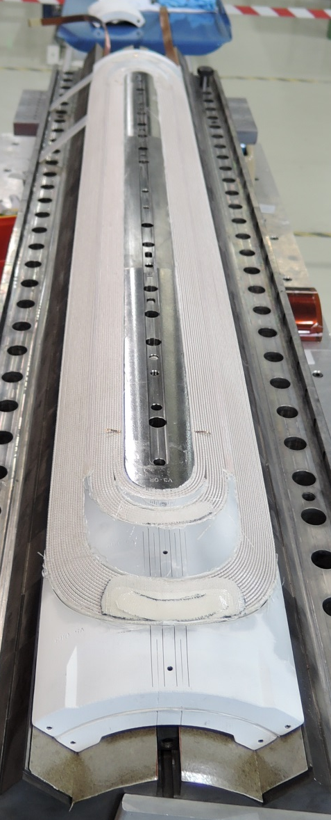
Coil at different manufacturing steps
After curing
After reaction
After impregnation

Slide 28
Mechanical design
In the presence of a magnetic field B, an electric charged particle q in motion with a velocity v is acted on by a force F_{L} called electro-magnetic (Lorentz) force [N]:
A conductor element carrying current density J (A/mm²) is subjected to a force density f_{L} [N/m³]
Some examples (values per aperture):
Nb-Ti LHC MB (8.3 T)
  F_{x} = 340 t per meter
    ~300 compact cars
  F_{z} = 27 t
Nb₃Sn DS dipole (11T)
  F_{x} = 620 t per meter
  F_{z} = 47 t

Slide 29
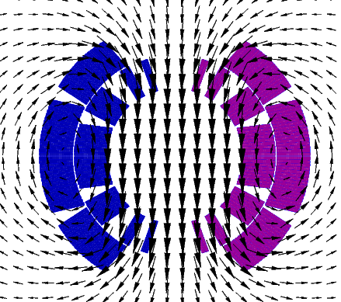
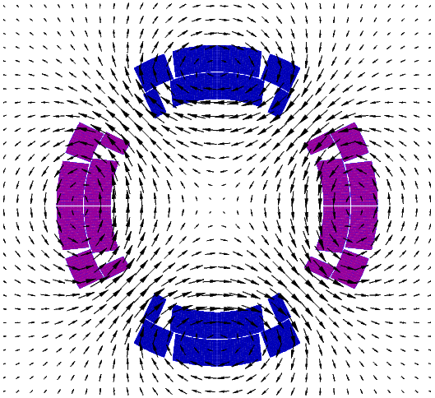
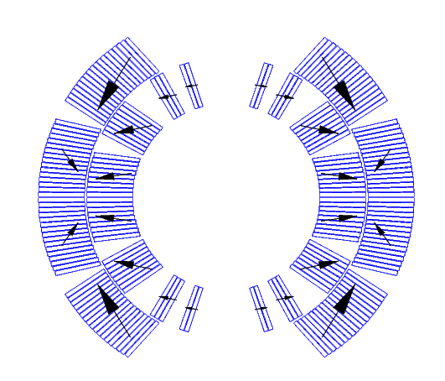
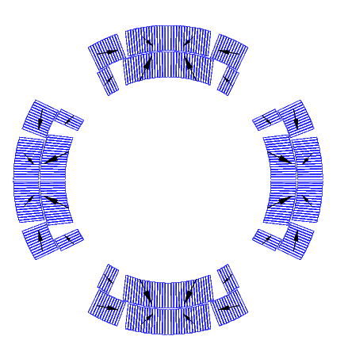
Electro-magnetic force
The e.m forces in a dipole/quadrupole magnet tend to push the coil
  Towards the mid-plane in the azimuthal direction
  Outwards on the radial direction.

Slide 30


Electro-magnetic force
In the coil ends, the electromagnetic forces tend to push the coil outwards in the longitudinal direction (F_{z} > 0)
Fz
Fz
Fz
Fz
11 T dipole for HL-LHC
MQXF quadrupole for HL-LHC

Slide 31


Deformation and stress
Effect of e.m forces
  change in coil shape → effect on field quality
  a displacement of the conductor → potential release of frictional energy
  Nb-Ti magnets: possible damage of kapton insulation at~150-200 MPa.
  Nb₃Sn magnets: possible conductor degradation at about 150-200 MPa.
All the components must be below stress limits.
LHC dipole at 0 T
LHC dipole at 9 T
By P. Ferracin
Displacement scaling = 50

Slide 32


Overview of the coil stress
Collaring: By clamping the coils, the collars provide
  coil pre-stressing;
  rigid support against e.m. forces
  precise cavity

Slide 33

Overview of the coil stress
Collaring: By clamping the coils, the collars provide
  coil pre-stressing;
  rigid support against e.m. forces
  precise cavity
Yoking: Ferromagnetic yoke around the collared coil provide
  Magnetic function
  Mechanical function (increase the rigidity of the coil support structure and limit radial displacement)
  Alignment, assembly features…

Slide 34


Overview of the coil stress
Collaring: By clamping the coils, the collars provide
  coil pre-stressing;
  rigid support against e.m. forces
  precise cavity
Yoking: Ferromagnetic yoke around the collared coil provide
  Magnetic function
  Mechanical function (increase the rigidity of the coil support structure and limit radial displacement)
  Alignment, assembly features…
Shell welding: two half shells welded around the coil to provide
  Helium container
  Additional rigidity
  If necessary, the welding press can impose the desired curvature on the cold mass

Slide 35
Overview of coil stress
4. Cool-down
  Components shrink differently
    Again, coil positioning within 20-50 μm
  Significant variations of coil stress
5. Excitation
  The pole region of the coil unloads
    Depending on the pre-stress, at nominal field the coil may unload completely
All these contributions taken into account in the mechanical design:
  Minimize coil motion (pre-stress)
  Minimize cost and dimension of the structure
  Maintain the maximum stress of the component below the plasticity limits
  …and for (especially) Nb₃Sn coils, limit coil stress (150-200 MPa).

Slide 36


Quench definition
Quench = irreversible transition to normal state
  Heat generation > cooling
Why do magnets quench?
Thermal energy released by
  Mechanical events
    Frictional motion
    Epoxy cracking
  Electromagnetic events
    Flux-jumps ,AC loss
  Thermal events
    Degraded cooling
  Nuclear events
    Particle showers
What do we do when a magnet quenches?
  Conversion magnetic energy
  thermal energy (redistribute the energy in the whole coil volume, joule heating)
$$J^{2}η$$

Slide 37



Why is it a problem ?
Quench is the result of the resistive transition, leading to appearance of voltage, temperature increase, thermal and electro-magnetic forces, and cryogen expulsion
If the process does not happen uniformly: as little as 1 % of the magnet mass may absorb the total energy – large damage potential !
Result of the chain of events triggered by a quench in an LHC bus-bar
Result of degradation due to local heating in a NbTi coil
Result of electrical short circuit quench heater to coil in a Nb₃Sn coil

Slide 38


The quench event: summary
Quench starts
Thermal energy released by a precursor
Heaters effective
Distributed quench in the coil
Quench front propagates
Validation delay
Heater delay
Current decay due to the resistance growth in the coil
Quench detected
Quench validated
(power supply off, protection system fired)
Typical time scale:
From quench start to quench detected ~ 5 ms
Validation delay ~ 10 ms
Heater delay ~ 20 ms
Current decay ~ 100-200 ms
Maximum acceptable temperature: 350K
Temperature rise in the conductor

Slide 39
Training
Training is characherized by two phenomena:
  The occurrence of premature quenches (below short sample limit)
  The progressive increase of quench current, ramp after ramp
The magnet «improves» ramp after ramp to reach the nominal performance = operating point with margin
Training of LHC sectors to 6.5 TeV
Main identified causes :
  Frictional motion
    E.m. forces → motion → quench
    Coil progressively locked by friction in a secure state
  Epoxy failure
    E.m. forces → epoxy cracking → quench
    Once epoxy locally fractured, further cracking appears only when the e.m. stress is increased.

Slide 40
Outline
  Particle accelerators, magnets and the need of superconductors
  Superconducting magnets
    Conductor
    Magnetic design and coil fabrication
    Mechanical design and assembly
    Quench, training and protection
  Future outlook

Slide 41


Hi-Lumi LHC
Construct.
Physics
Upgr.
Design, R&D
Proto
Construct.
Physics
Design, R&D
Construct.
Physics
From LHC to HiLumi LHC
  Integrated L: ~300 → 3000fb^{–1}
Reduce beam size in Interaction regions (IR) by factor 2
Triplet quadrupole aperture doubled (70 mm → 150 mm)
by E. Todesco

Slide 42

We are in the middle of the series construction of the magnets needed for HL-LHC

Slide 43

Post LHC: The FCC playground
Key technology: High field superconducting magnets
1300 tons NbTi
3000 tons LTS
700 tons HTS
9000 tons LTS
2000 tons HTS
6000 tons Nb3Sn
3000 tons NbTi

Slide 44







The High Field Magnet program
https://hfm.web.cern.ch/
CERN Feather-M2 HTS 5 T insert magnet
Courtesy of G. Kirby, J. Van Nugteren
Courtesy of C. Senatore
Courtesy of E. Rochepault

Slide 45
Thank you
For questions, don’t hesitate!
susana.izquierdo.bermudez@cern.ch

