Slide 1
Introduction to Particle Accelerators for the CERN-Solvay Student Camp
Rende Steerenberg – BE/OP
28 May 2024

Slide 2

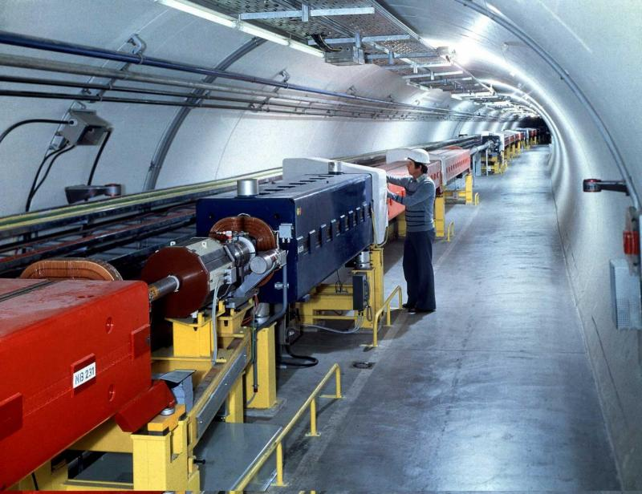
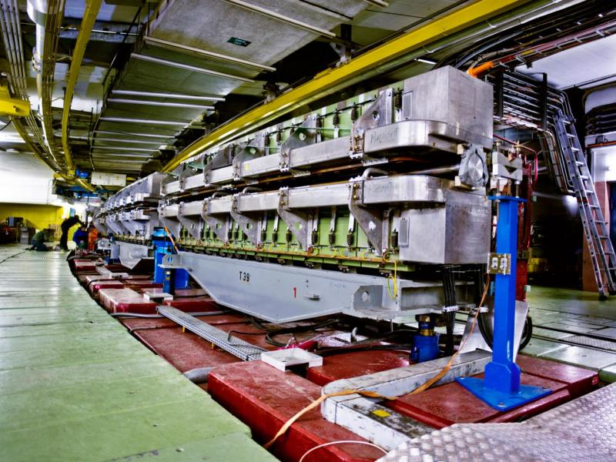
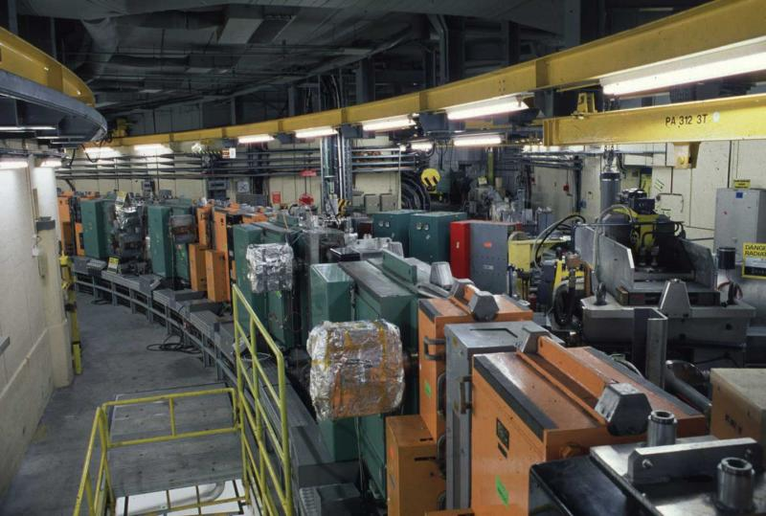
Content
Why Accelerators & Colliders?
The CERN Accelerator Complex
An Accelerator’s Main Ingredients
A Brief Word on the Future

Slide 3
Content
Why Accelerators & Colliders?
The CERN Accelerator Complex
An Accelerator’s Main Ingredients
A Brief Word on the Future

Slide 4
What is the first physics formula that jumps in your mind?

Slide 5
E = M c²
This is the most famous equation of twentieth-century physics.
It is a statement that mass and energy are two forms of the same thing, and that one can be converted into the other.
In our accelerator we add Energy to the particle through our RF systems and observe the Mass created in the experiments.

Slide 6
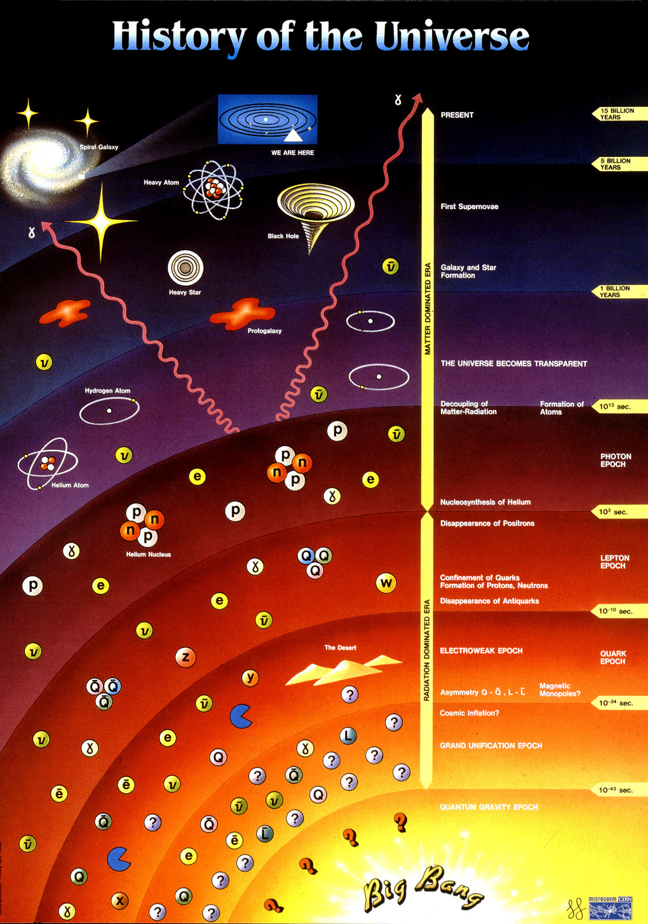
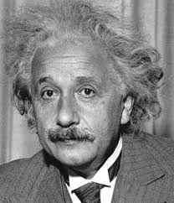
Creating Matter from Energy
During the Big Bang Energy was transformed in matter
E = m・c²
In our accelerators we provide energy to the particles we accelerate.
In the detectors we observe the matter created

Slide 7
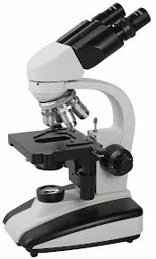
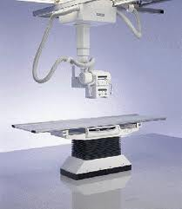
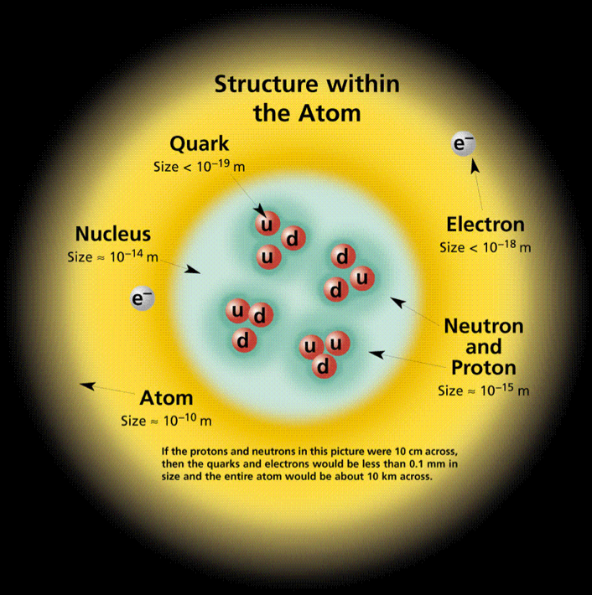
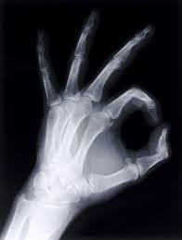
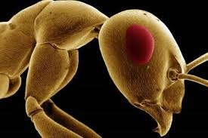
Looking to smaller dimensions
Visible light
λ = 400 ➔ 700 nm
X-ray
λ = 0.01 ➔ 10 nm
Particle accelerators
λ < 0.01 nm
λ =
h c
Increasing the energy will reduce the wavelength
E

Slide 8
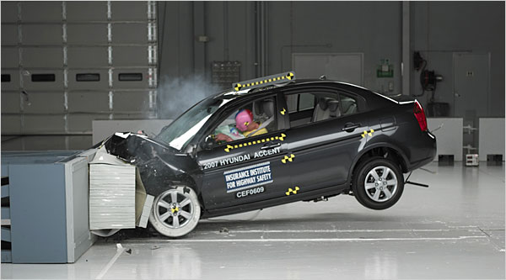

Fixed Target vs. Colliders
Fixed Target
Collider
Much of the energy is lost in the target and only part is used to produce secondary particles
All energy will be available for particle production

Slide 9

The Aim:
Specific assemblies of quarks
form hadrons.
Protons, Neutrons, pions,..
Gravitational force
Electromagnetic force
Strong interacting force
Weak interacting force
For every particle there is a corresponding anti-particle
Verify the Standard Model
Search for physics beyond the Standard Model

Slide 10
Content
Why Accelerators & Colliders?
The CERN Accelerator Complex
An Accelerator’s Main Ingredients
A Brief Word on the Future

Slide 11
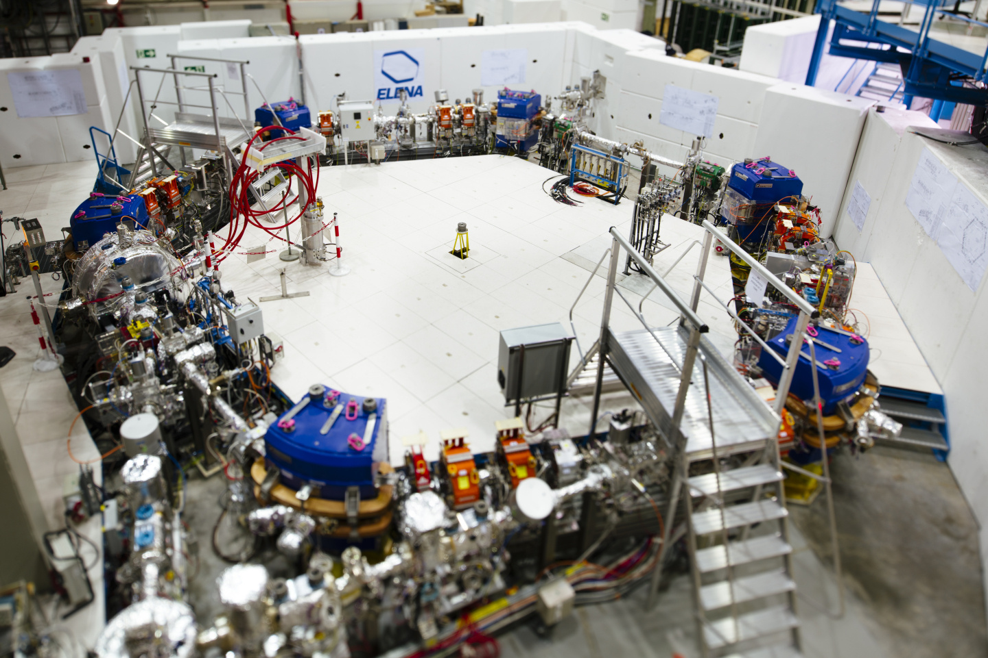
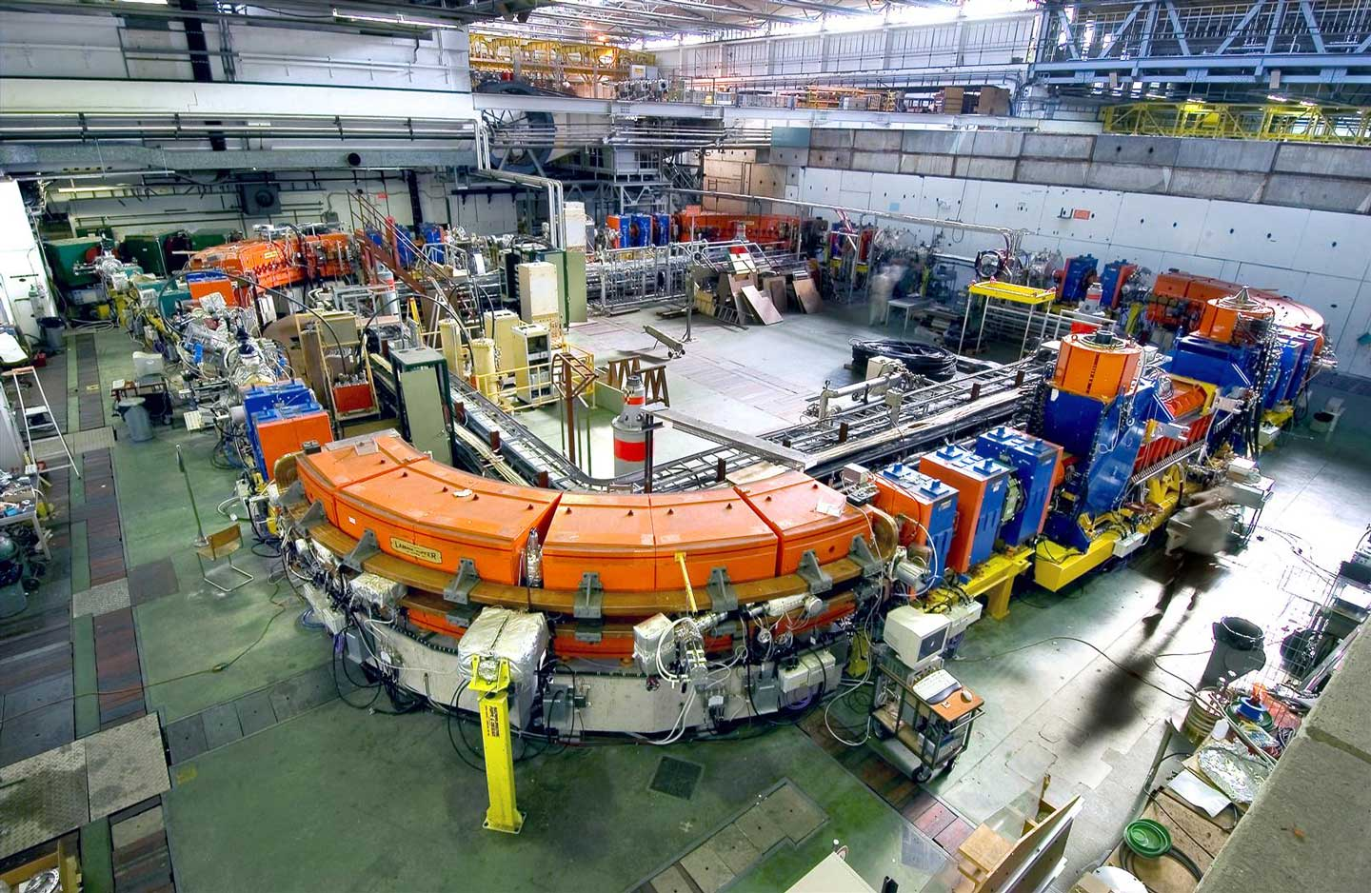
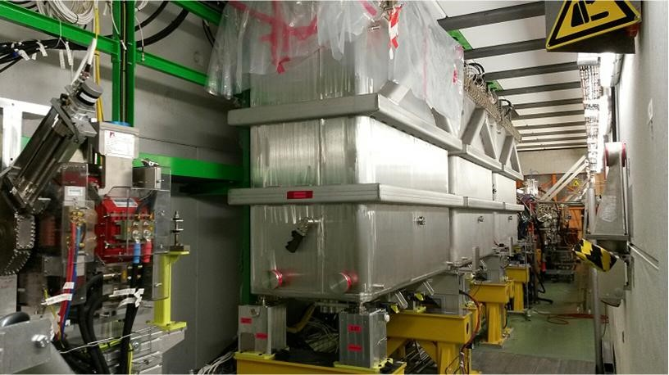
The CERN Accelerator Complex

Slide 12
The LHC Cycle
= Field in main magnets
= Beam 1 intensity (current)
= Beam 2 intensity (current)
Time
6.8 TeV
450 GeV
Injection
Ramp
Squeeze
&
Adjust
Stable beams for physics
Dump
&
Ramp down

Slide 13
Filling the LHC & Satisfying Fixed Target users
To LHC clock-wise or counter clock-wise
= Field in main magnets
= Proton beam intensity (current)
450 GeV
= Beam transfer
SPS
26 GeV
PS
1.4 GeV
PSB
1.2 seconds
Time

Slide 14
Content
Why Accelerators & Colliders?
The CERN Accelerator Complex
An Accelerator’s Main Ingredients
A Brief Word on the Future

Slide 15
What does “Relativity” in an accelerator mean for you?

Slide 16
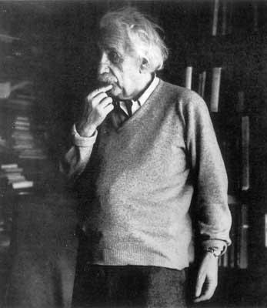
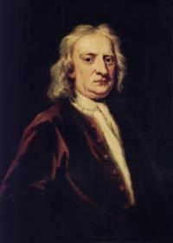
Towards Relativity…
Einstein:
Energy and mass increase not much velocity
velocity
PS
c
Newton:
SPS / LHC
energy
PSB

Slide 17
What units for energy do you know?

Slide 18
The Units we use for Energy in Accelerators
The energy acquired by an electron in a potential of 1 Volts is defined as being 1 eV
Thus 1 eV = 1.6 x 10⁻¹⁹ Joules
The unit eV is too small to be used today, we use:
  1 KeV = 10³, MeV = 10⁶, GeV = 10⁹, TeV = 10¹²

Slide 19
The Energy in the LHC beam
The energy in one LHC beam at high energy is about 320 Million Joules
This corresponds to the energy of a TGV train going at 150 km/h
...... but then concentrated in the size of a needle

Slide 20

The LEIR Accelerator as Example
Building 150

Slide 21
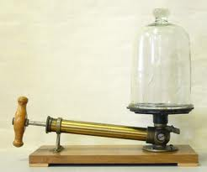
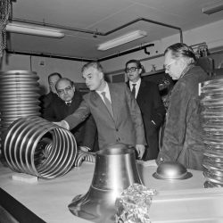
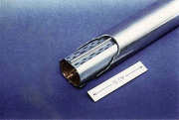
Travelling through nothingness
Vacuum in a mostly stainless steel vacuum chamber is required to avoid the particles to interact with the gas molecules
Especially important for low energy particles and anti-matter particles, but also for colliders ….
In the LHC vacuum is also used as thermal insulator

Slide 22
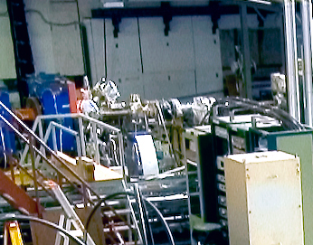
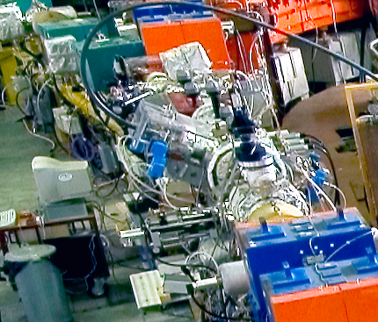
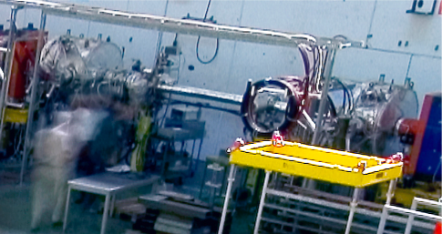
Injecting & Extracting Particles
Extraction
Injection
Injection

Slide 23
Injecting & Extracting Particles
Incoming beam
Magnetic field
No magnetic field
Circulating beam
Injected beam
Septum Magnet
Kicker Magnet

Slide 24
Septum Magnet

Slide 25
Injecting & Extracting Particles
Extracted beam
Magnetic field
No magnetic field
Circulating beam
Circulating beam
Septum Magnet
Kicker Magnet

Slide 26
Make Particles Circulate
Main Dipoles
Main Dipoles
Main Dipoles
Main Dipoles

Slide 27
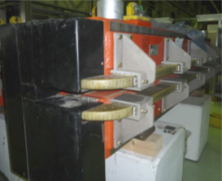
Deviating Charged Particles
Moving charged particles are deviated
in a magnetic field
Magnetic Lorentz Force:

Slide 28
Any ideas about how strong magnet fields in dipole magnets can be?

Slide 29
Motion in the Horizontal Plane
Two charged Particles in a homogeneous magnetic field
Horizontal motion
Particle B
Particle A
Horizontal
displacement
0
Machine circumference
2π
Particle B
Particle A
Different particles with different initial conditions in a homogeneous magnetic field will cause oscillatory motion in the horizontal plane → Betatron Oscillations

Slide 30
Motion in the Vertical Plane
The horizontal motion seems to be “stable”…. What about the vertical plane ?
Many particles many initial conditions
Any ideas on how to solve this issue?
Vertical
displacement
→ s
Many different angles

Slide 31
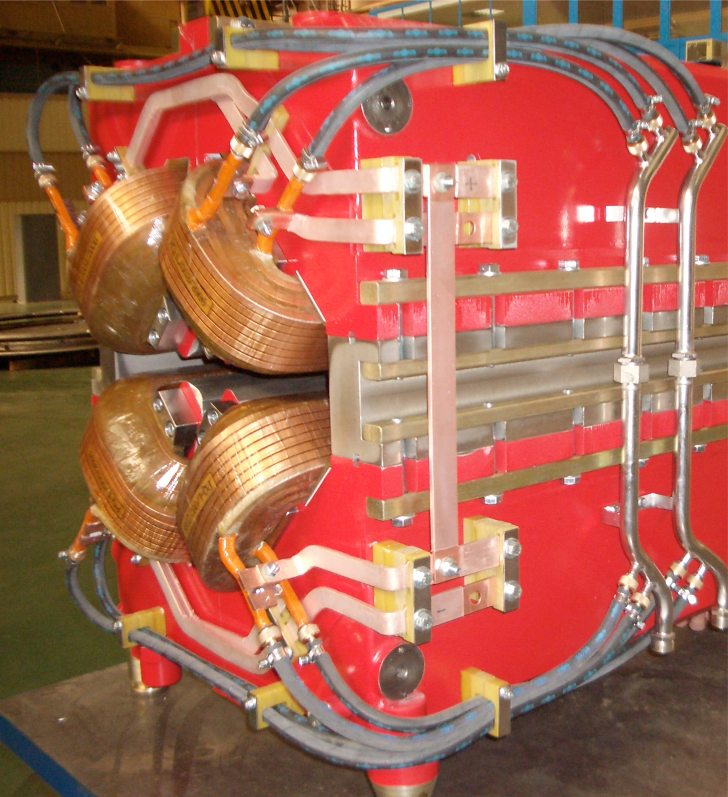
Focusing Particle Beams, a bit like a lens
Force on particles
Focusing Quadrupole
Rotated by 90º
De-focusing Quadrupole
QF
QD
QF

Slide 32
Focusing Particle Beams in LEIR
Main Dipoles
Main Dipoles
Main Dipoles
Quadrupoles

Slide 33
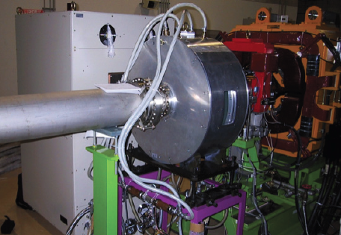
Accelerating Particles, Using Electrical Fields
Accelerating
Cavity

Slide 34
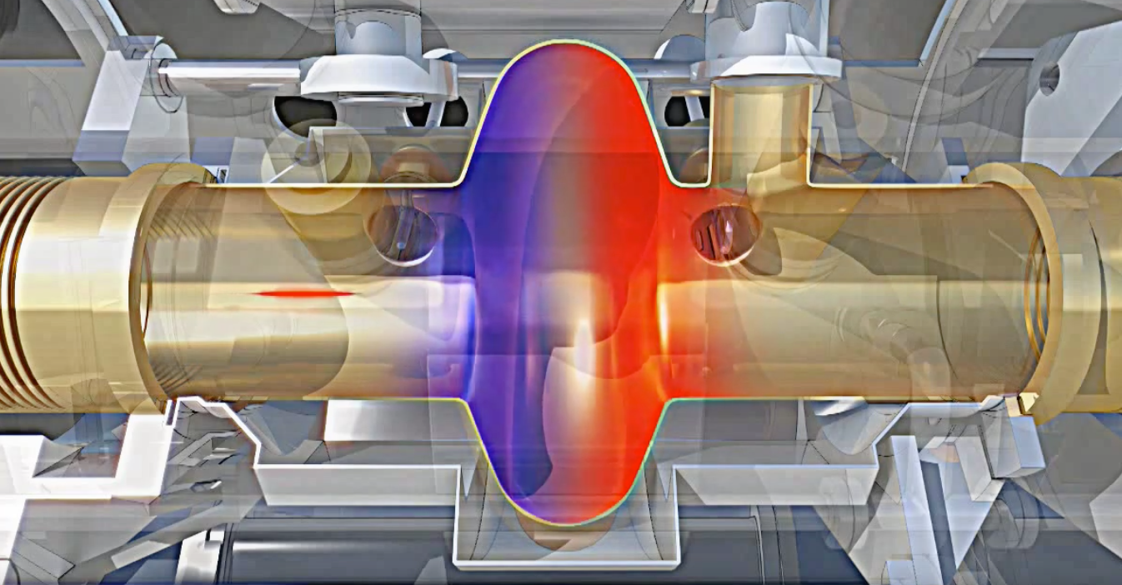
Radio Frequency Cavity
Charged particles are accelerated by a longitudinal electric field
The electric field needs to alternate with a harmonic of the revolution frequency

Slide 35
RF Cavities
Super conducting fixed frequency cavities (LHC)
Variable frequency cavity (PS)
Fixed frequency cavities (SPS)

Slide 36
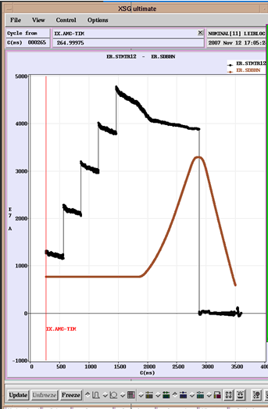
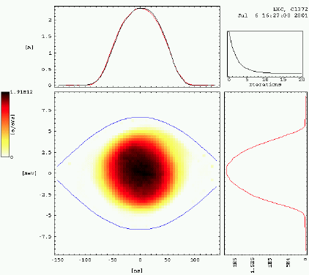
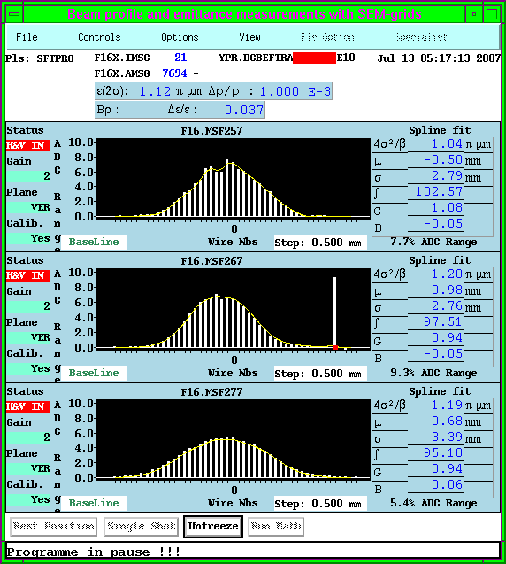
The Eyes of Operations
Beam intensity or current measurement
Longitudinal beam profile measurements
Transverse beam profile measurement
Measure the LHC luminosity, number of events per surface and time unit.
Any many more beam properties…..

Slide 37
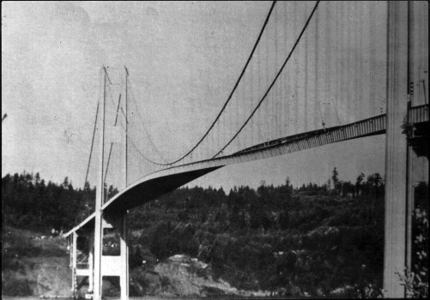
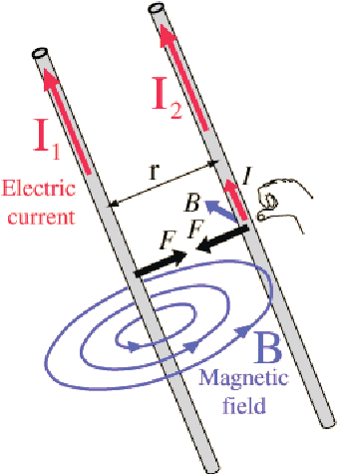
Possible Limitations
Machines and elements cannot be built with infinite perfection
Same phase and frequency for driving force and the system can cause resonances and be destructive
+
+
Neighbouring charges with the same polarity experience repelling forces
Moving particles create currents, These currents result in attracting or repelling magnetic fields

Slide 38
Content
Why Accelerators & Colliders?
The CERN Accelerator Complex
An Accelerator’s Main Ingredients
A Brief Word on the Future

Slide 39
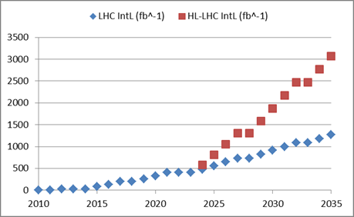
Luminosity, the Figure of Merit
Number of bunches
Intensity per bunch
Geometrical
Correction
factors
Beam dimensions
Maximise Luminosity:
Bunch intensity
Transverse beam size
Beam size at collision points
Crossing angle
Machine availability
High-Luminosity LHC
X 2

Slide 40
H- injection, a Key LIU Ingredient
Before stripping foil
x’
Charge exchange injection with H⁻
+
-
+
+
-
-
-
+
-
+
+
-
+
-
+
-
+
x
+
-
+
-
+
+
-
+
Behind stripping foil
x’
+
+
+
+
+
+
+
+
+
+
+
+
+
+
+
+
+
x
+
+
+
+
+
+
+
+
Phase Space Painting is possible (various particle distributions)

Slide 41
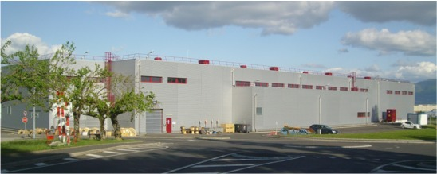
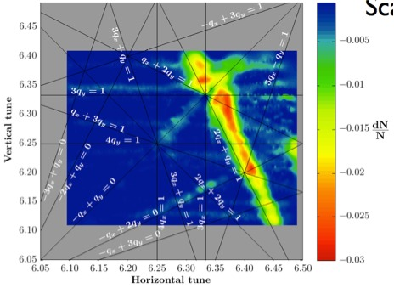
The LHC Injector Upgrade Project is Completed
LINAC4 – PS Booster:
  New LINAC 4 with H⁻ injection
  Higher injection energy
  New Finemet® RF cavity system
  Increase of extraction energy
PS:
  Injection energy increase from 1.4 GeV to 2 GeV
  New Finemet® RF Longitudinal feedback system
  New RF beam manipulation scheme to increase beam brightness
SPS
  Machine Impedance reduction (instabilities)
  New 200 MHz RF system
  Vacuum chamber coating against e-cloud
These are only the main modifications and this list is not exhaustive

Slide 42
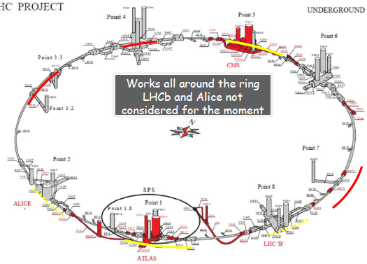
The High Luminosity LHC Project
New IR-quads (inner triplets)
  New 11T short dipoles
  Collimation upgrade
  Cryogenics upgrade
  Crab Cavities
  Cold powering
  Machine protection
  …

Slide 43
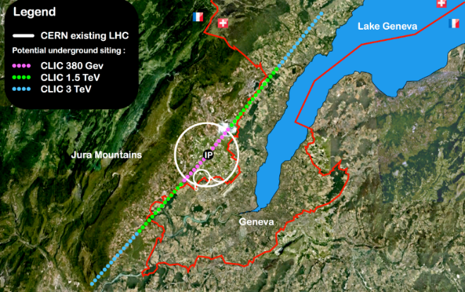
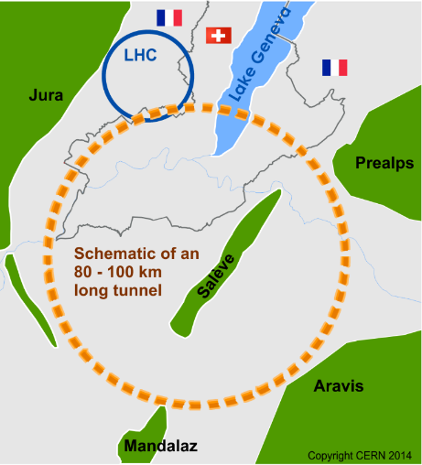
Possible Future Accelerators
Compact Linear Collider (CLIC)
Linear e⁺e⁻ collider up to 3 TeV
Future Circular Collider (FCC)
100 TeV pp collisions in 100km ring
Requires new magnet technology
e⁺e⁻ collider (FCC-ee) as 1st step
High Energy LHC in the present LHC tunnel
~ 30 TeV with FCC magnet technology
European Strategy for Particle Physics

Slide 44
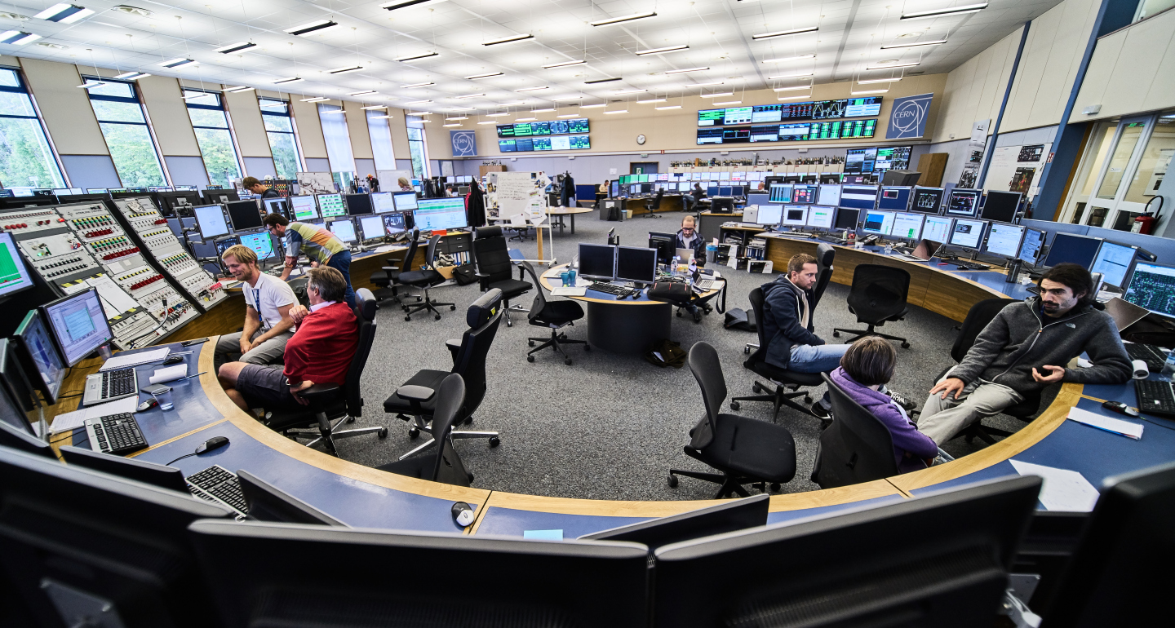
Follow us…
https://op-webtools.web.cern.ch/Vistar/vistars.php

