Slide 1


Welcome!
CERN-Solvay student camp

Slide 2
Welcome to…

Slide 3
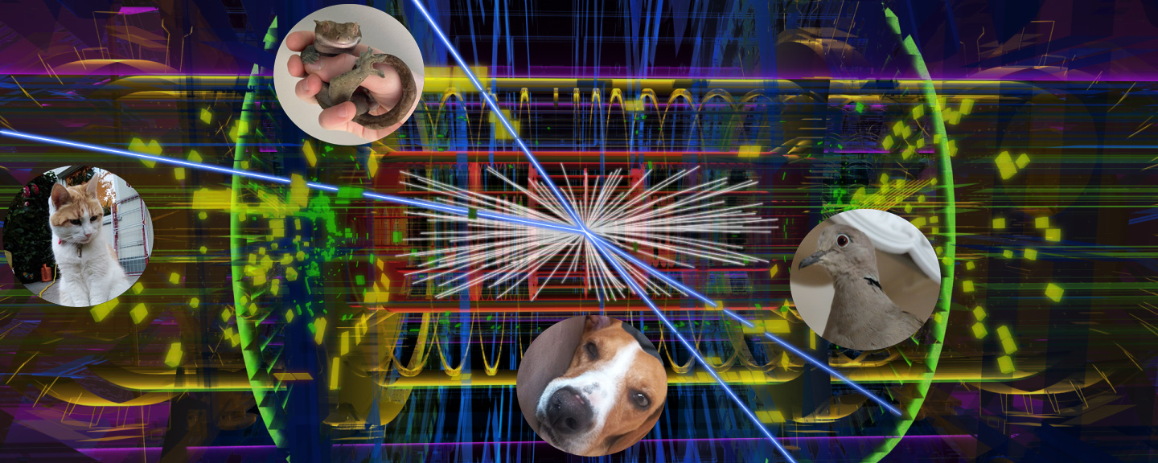
The physics menagerie
Welcome to…

Slide 4
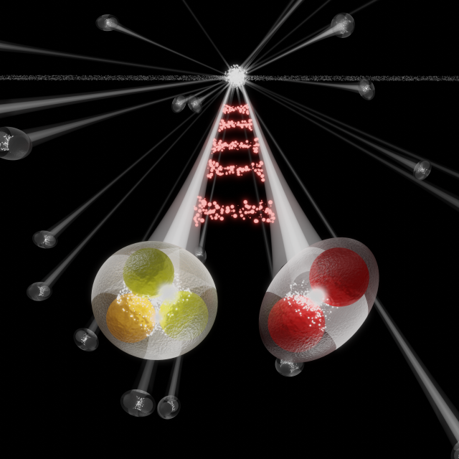
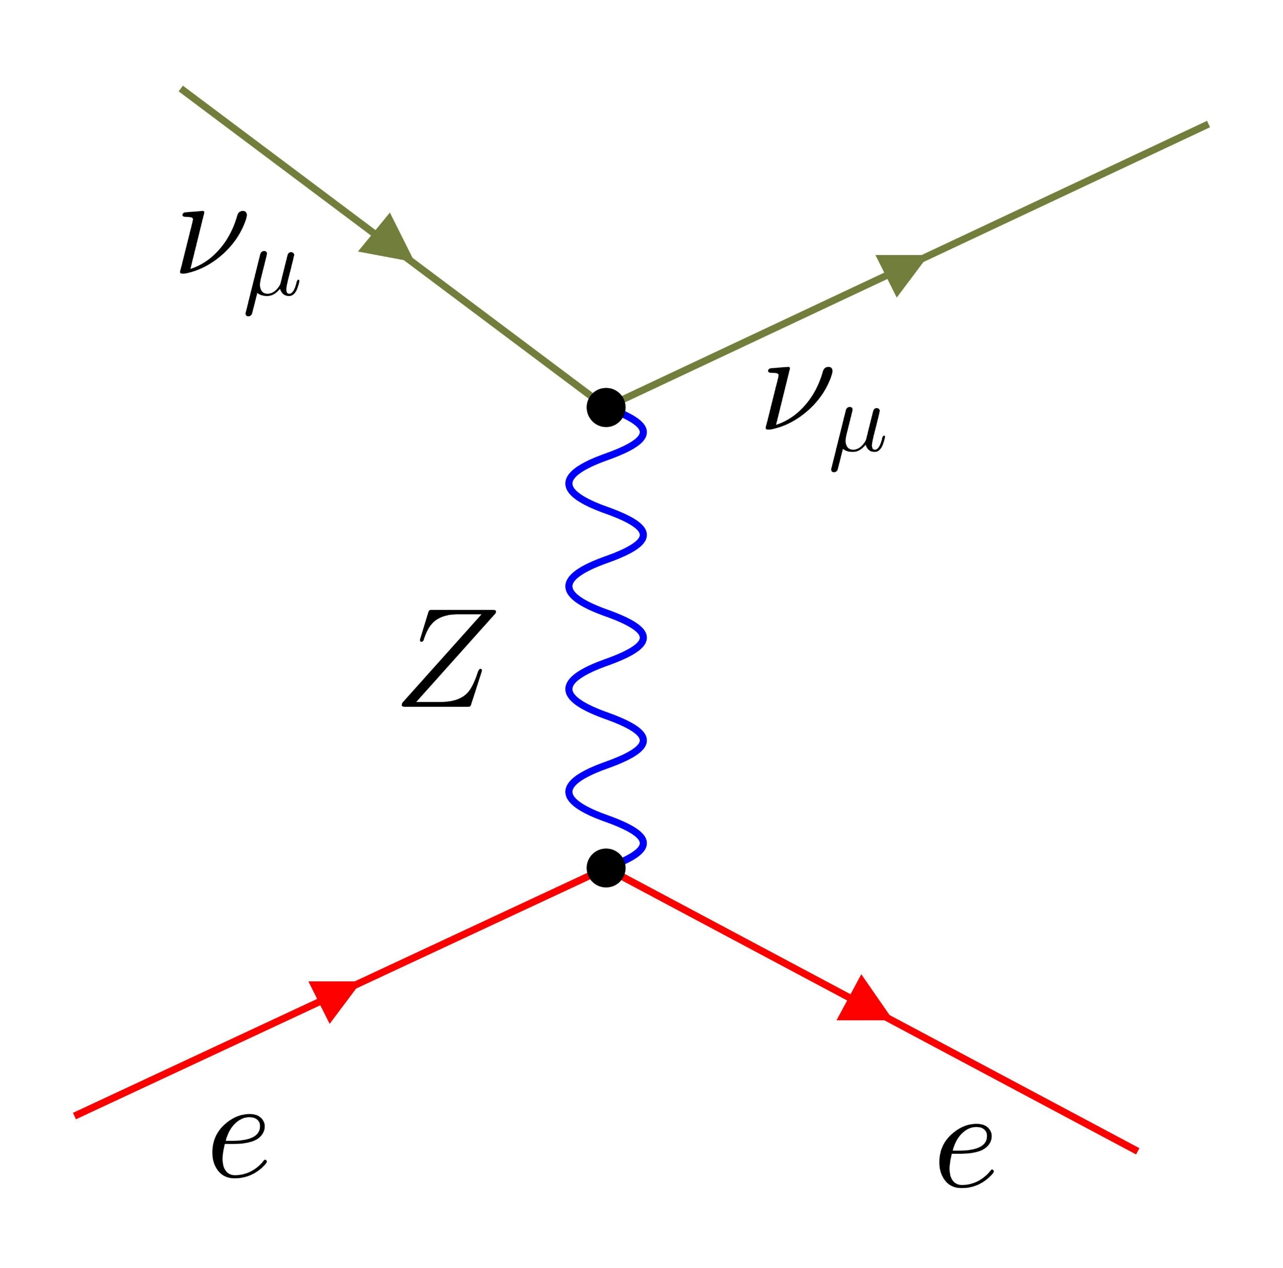
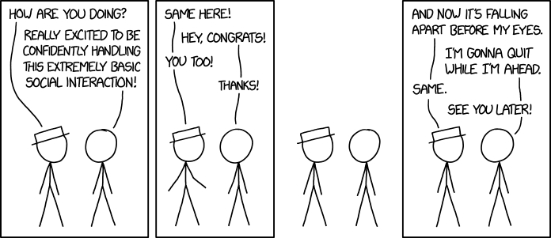
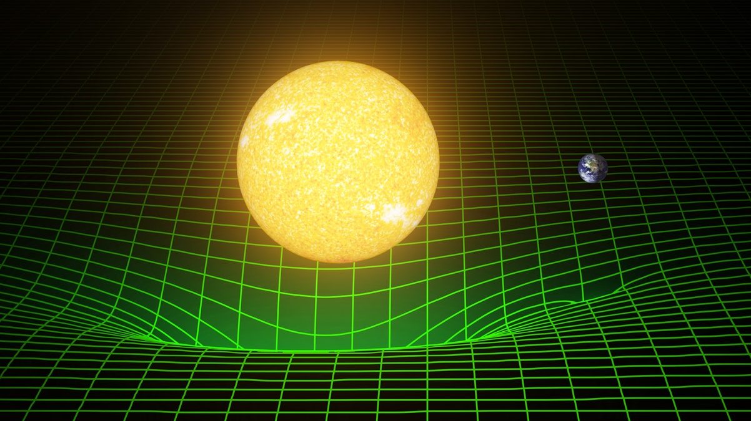
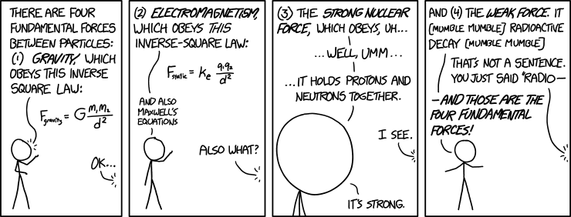
Interactions!

Slide 5
1. General information
2. Project day selection
3. Questionnaire

Slide 6
1. General information
2. Project day selection
3. Questionnaire

Slide 7

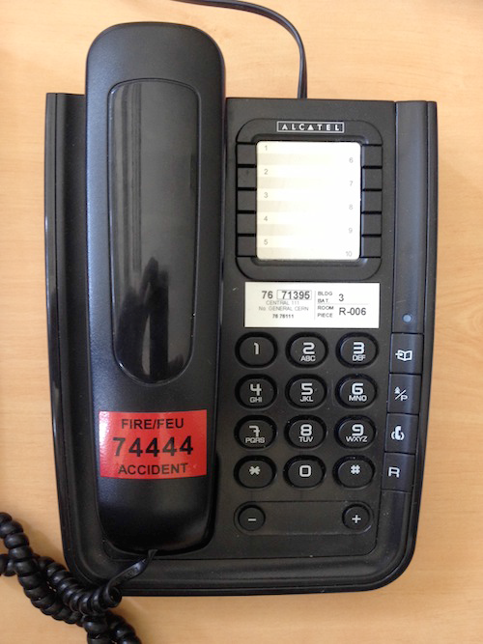
Important Numbers
EMERGENCY: Fire brigade
+41 22 76 74444 (internal: 74444)
NON-EMERGENCY: CERN medical service
+41 22 76 73802
FIRST POINT OF CONTACT: Accompanying teachers
+41 75411 2063 Anna Wallner
+41 75411 2048 Jean-Pierre Grootaerd
CAMP MANAGER:
+41 75411 0675 Guillaume Durey

Slide 8
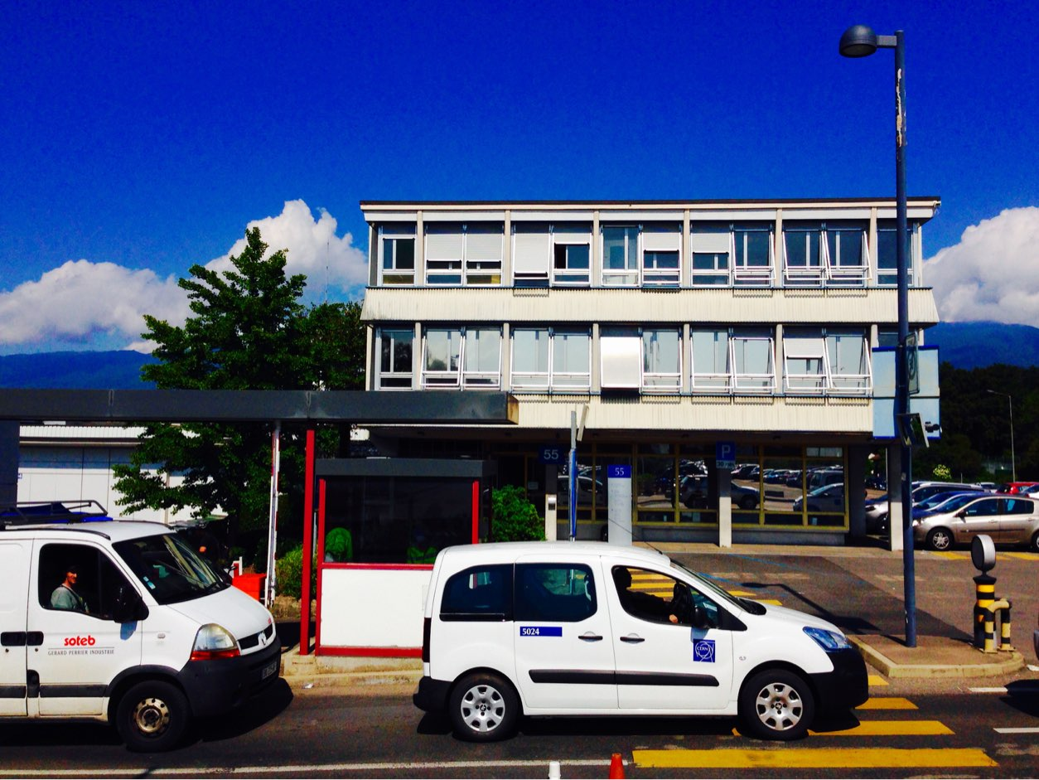
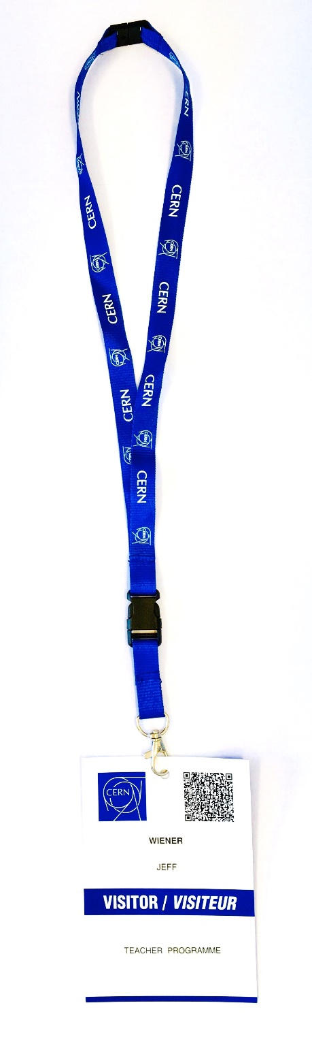
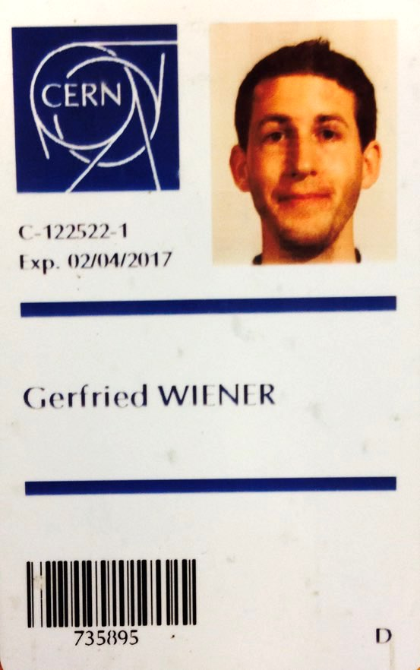

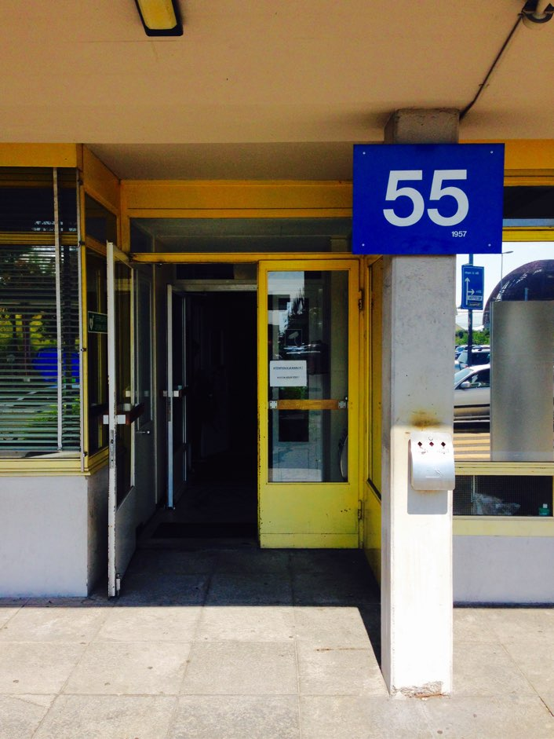
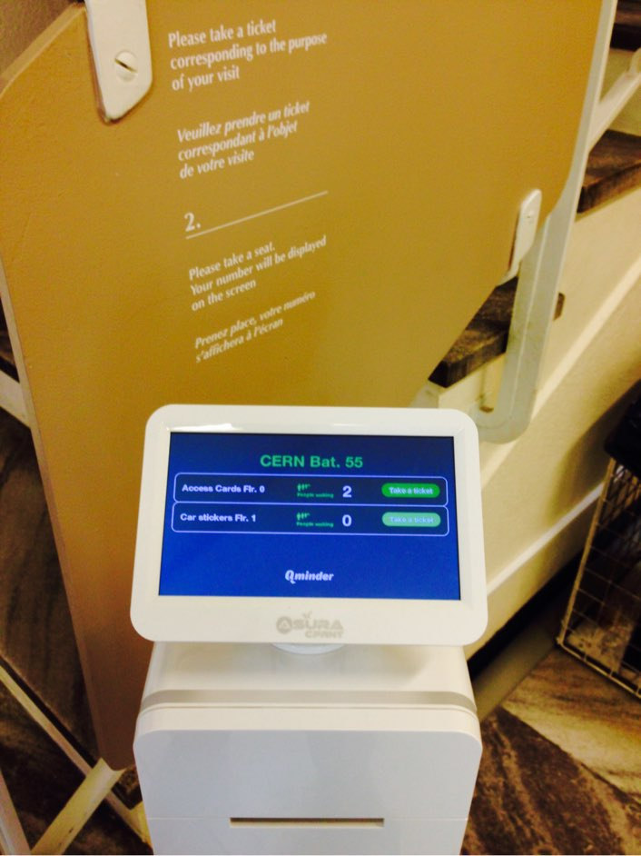
Access card & registration
Group A
8:00 tomorrow
Group B
8:30 tomorrow
Bring your passport
Building 55

Slide 9
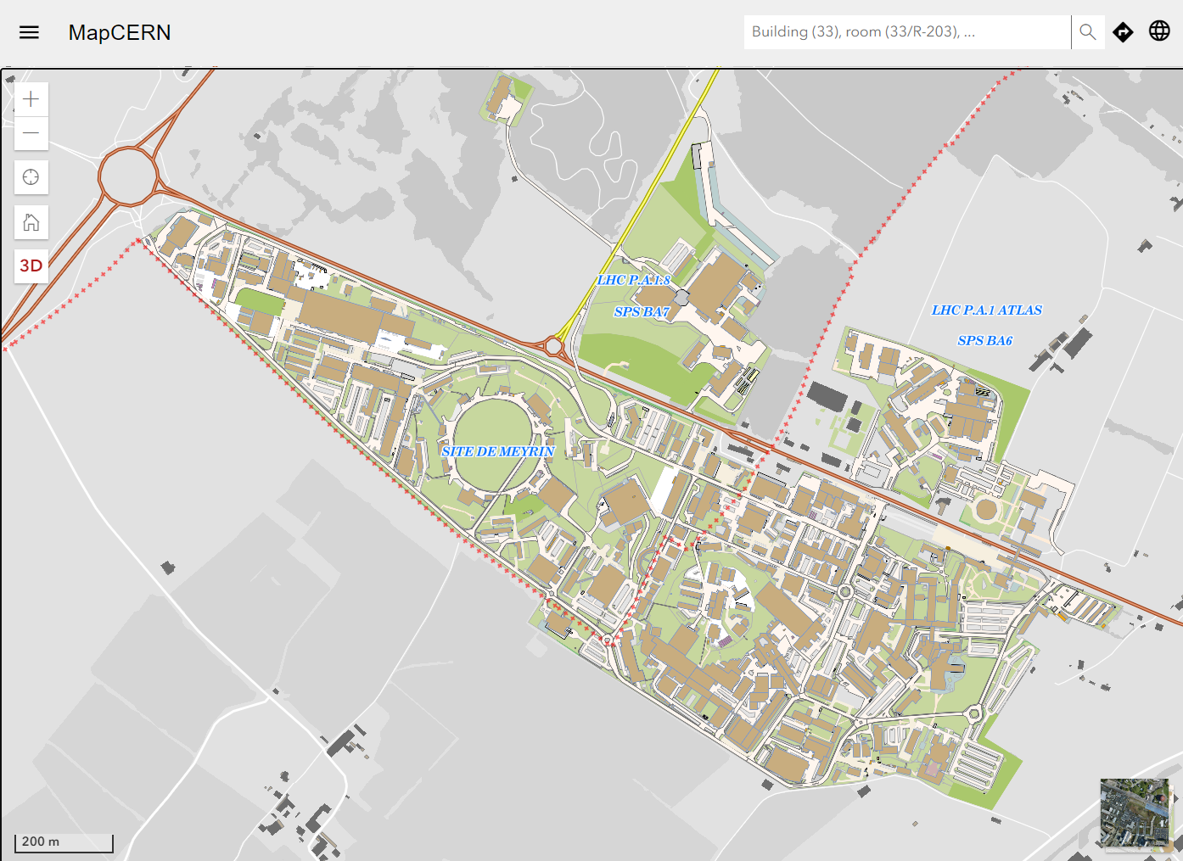
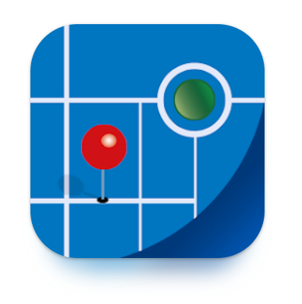
Getting around
MapCERN

Slide 10
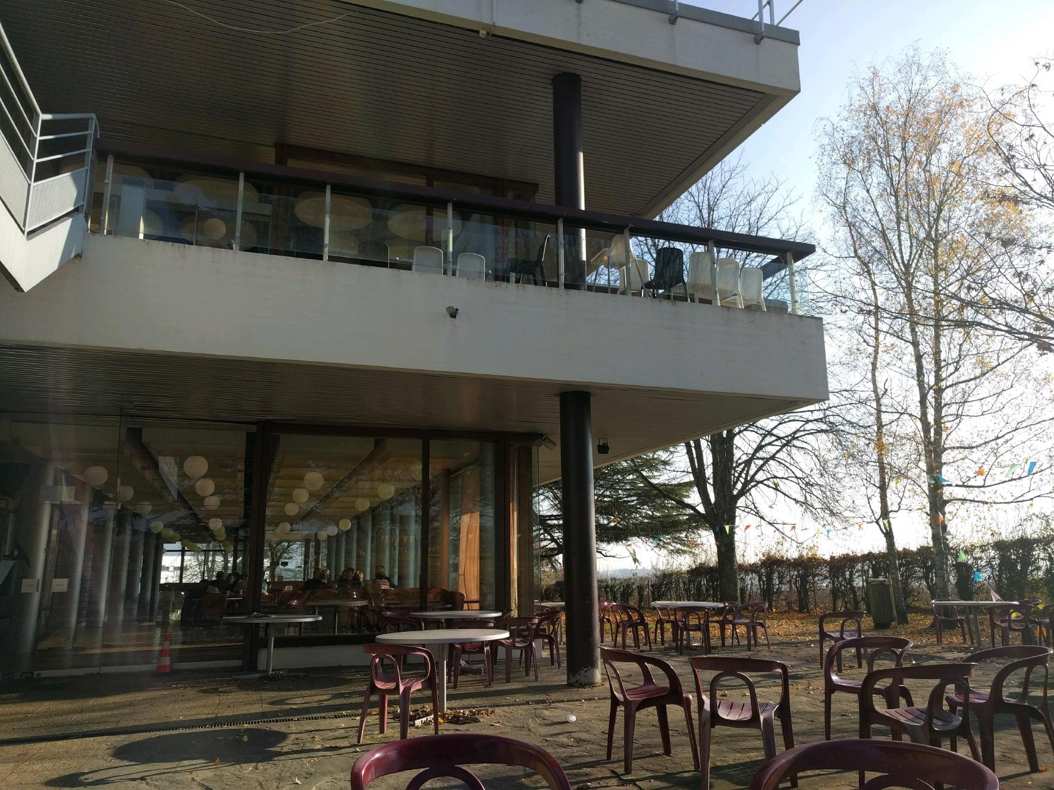
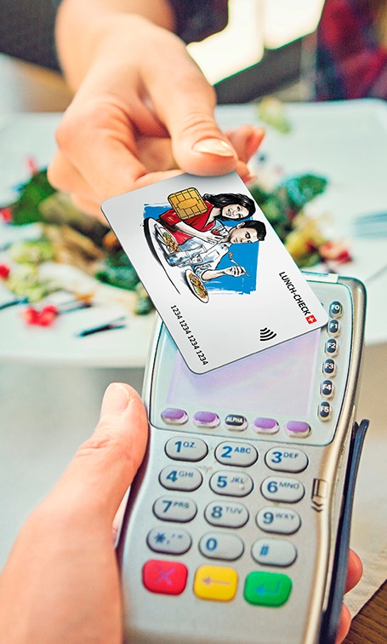
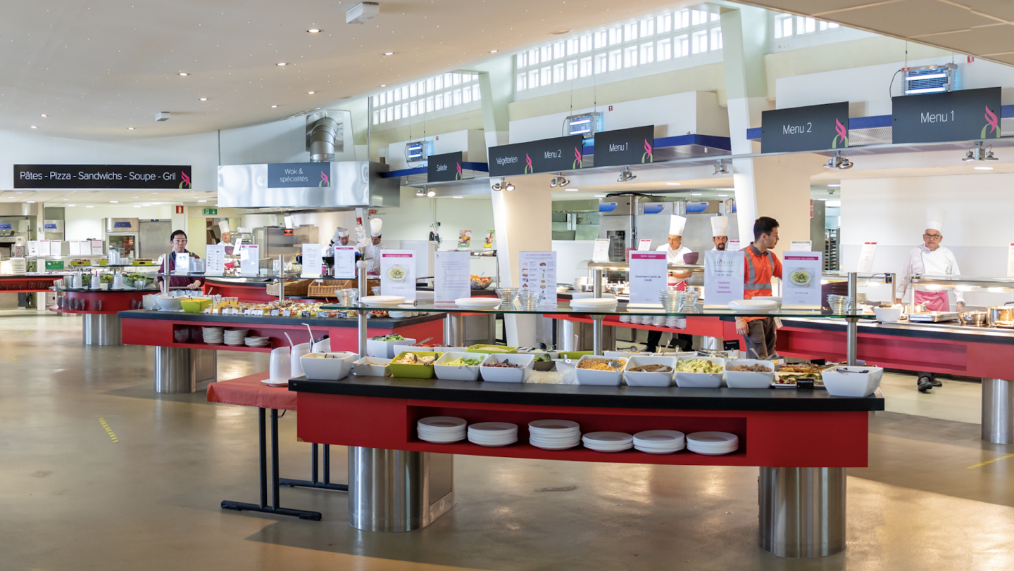
Restaurants
Restaurant 2,
building 504,
open 7-17
Restaurant 1, bldg 501, open 6-22
Breakfast | Lunch | Dinner
6:30-10:30 | 11:30-14:15 | 18:00-20:30
Ask for allergens
Stay away from tomatoes
Return the salad bowl
You have 40 CHF per day
Scan your QR code

Slide 11


With great powers…
… comes great responsibility

Slide 12
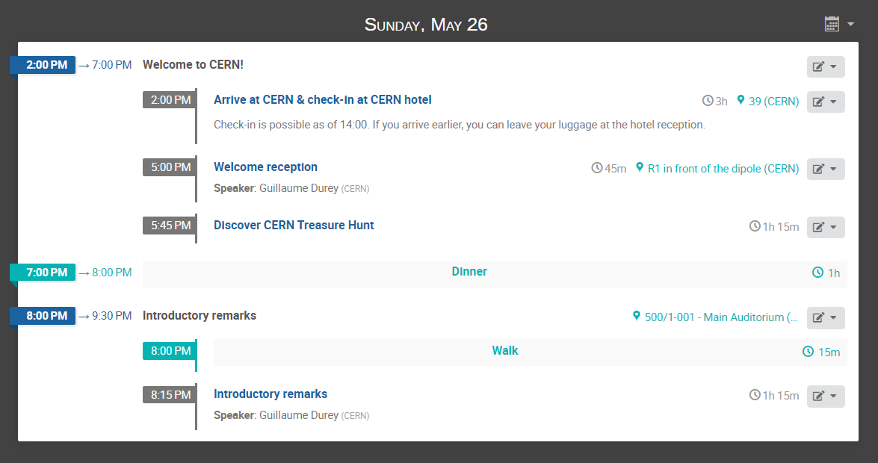

Timetable
cern.ch/solvay-camp-timetable

Slide 13

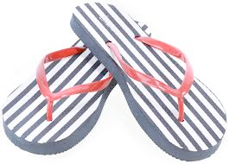
CERN Visits

Slide 14




Photos, videos & social media
To share your photos
to be archived
and used by CERN and Solvay,
upload them here →
To share your adventures
on your own social media accounts,
please tag @CERN and @SolvayGroup
and use #CERNSolvayEducation
Official group photo tomorrow afternoon
We will be your paparazzi during the week ;-)
cern.ch/solvay-camp-photos
pwd: Charm_Quark
#CERNSolvayEducation

Slide 15
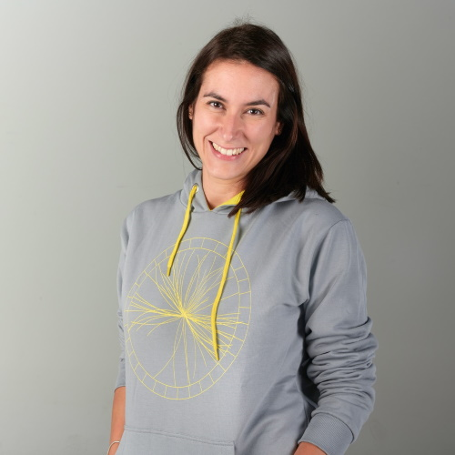
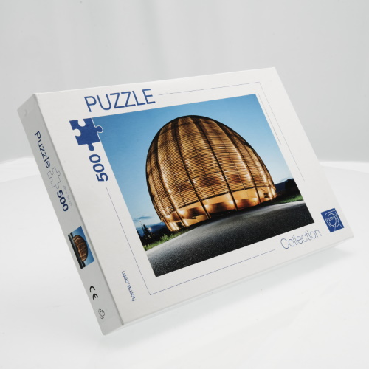

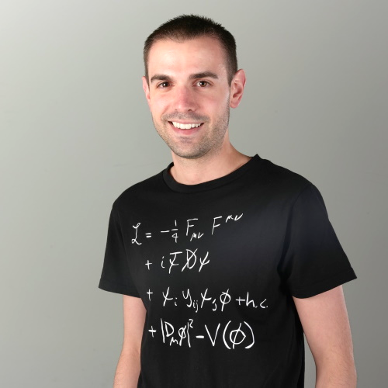
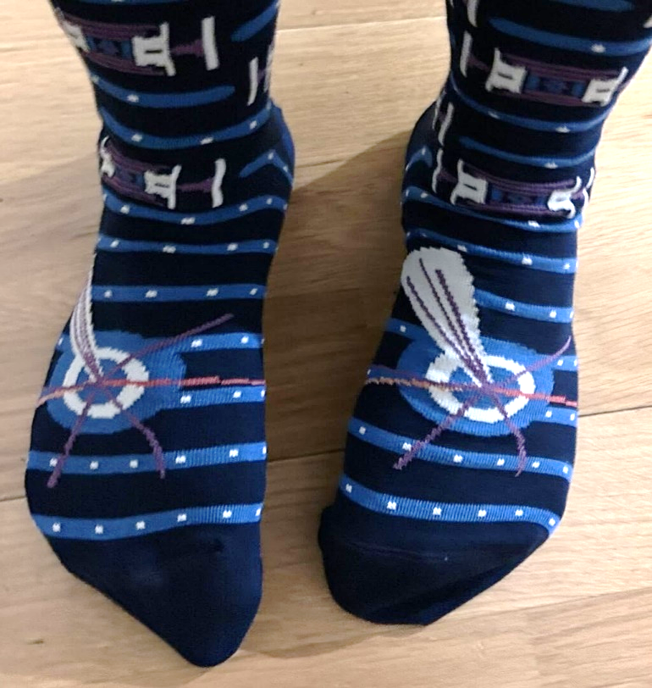
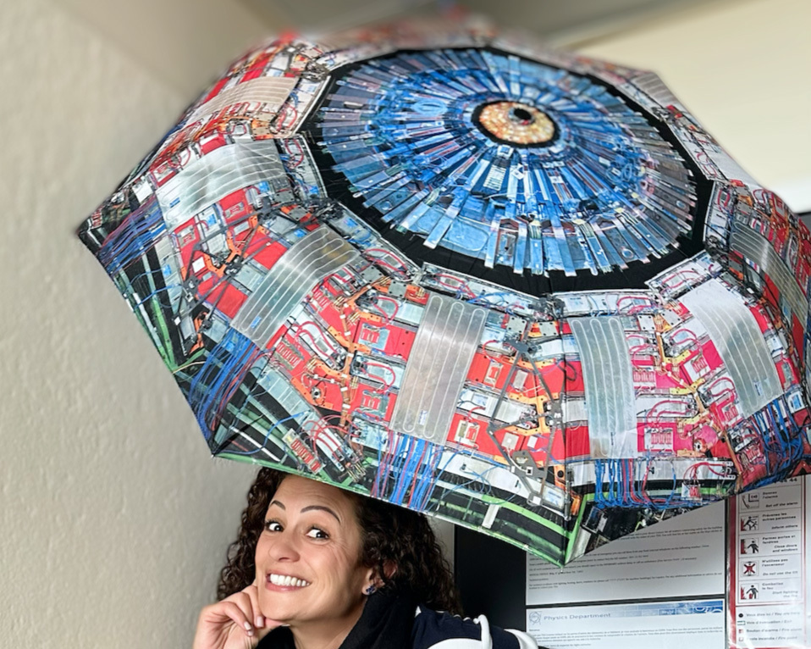
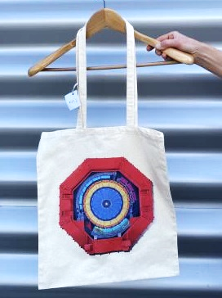

Shops!
SG Gift Shop | SG Reception | Tue-Sun 8:00-18:00
CERN Kiosk | Main Building | M-F 7:30-11:00 11:30-16:00
ATLAS Shop | 40/5-B01 | M-F 8:30-12:30 13:30-17:30
CMS Shop | 40/4-D01 | M-F 9:00-12:00 14:00-17:00
LHCb Shop | 2/1-024 | M-F 8:30-12:30 13:30-17:30
ALICE Shop | 301/R-029 | M-F 8:30-12:30 13:30-17:30
CERN Library | 52/1-054 | M-F 9:00-18:00
Special
package

Slide 16
1. General information
2. Project day selection
3. Questionnaire

Slide 17
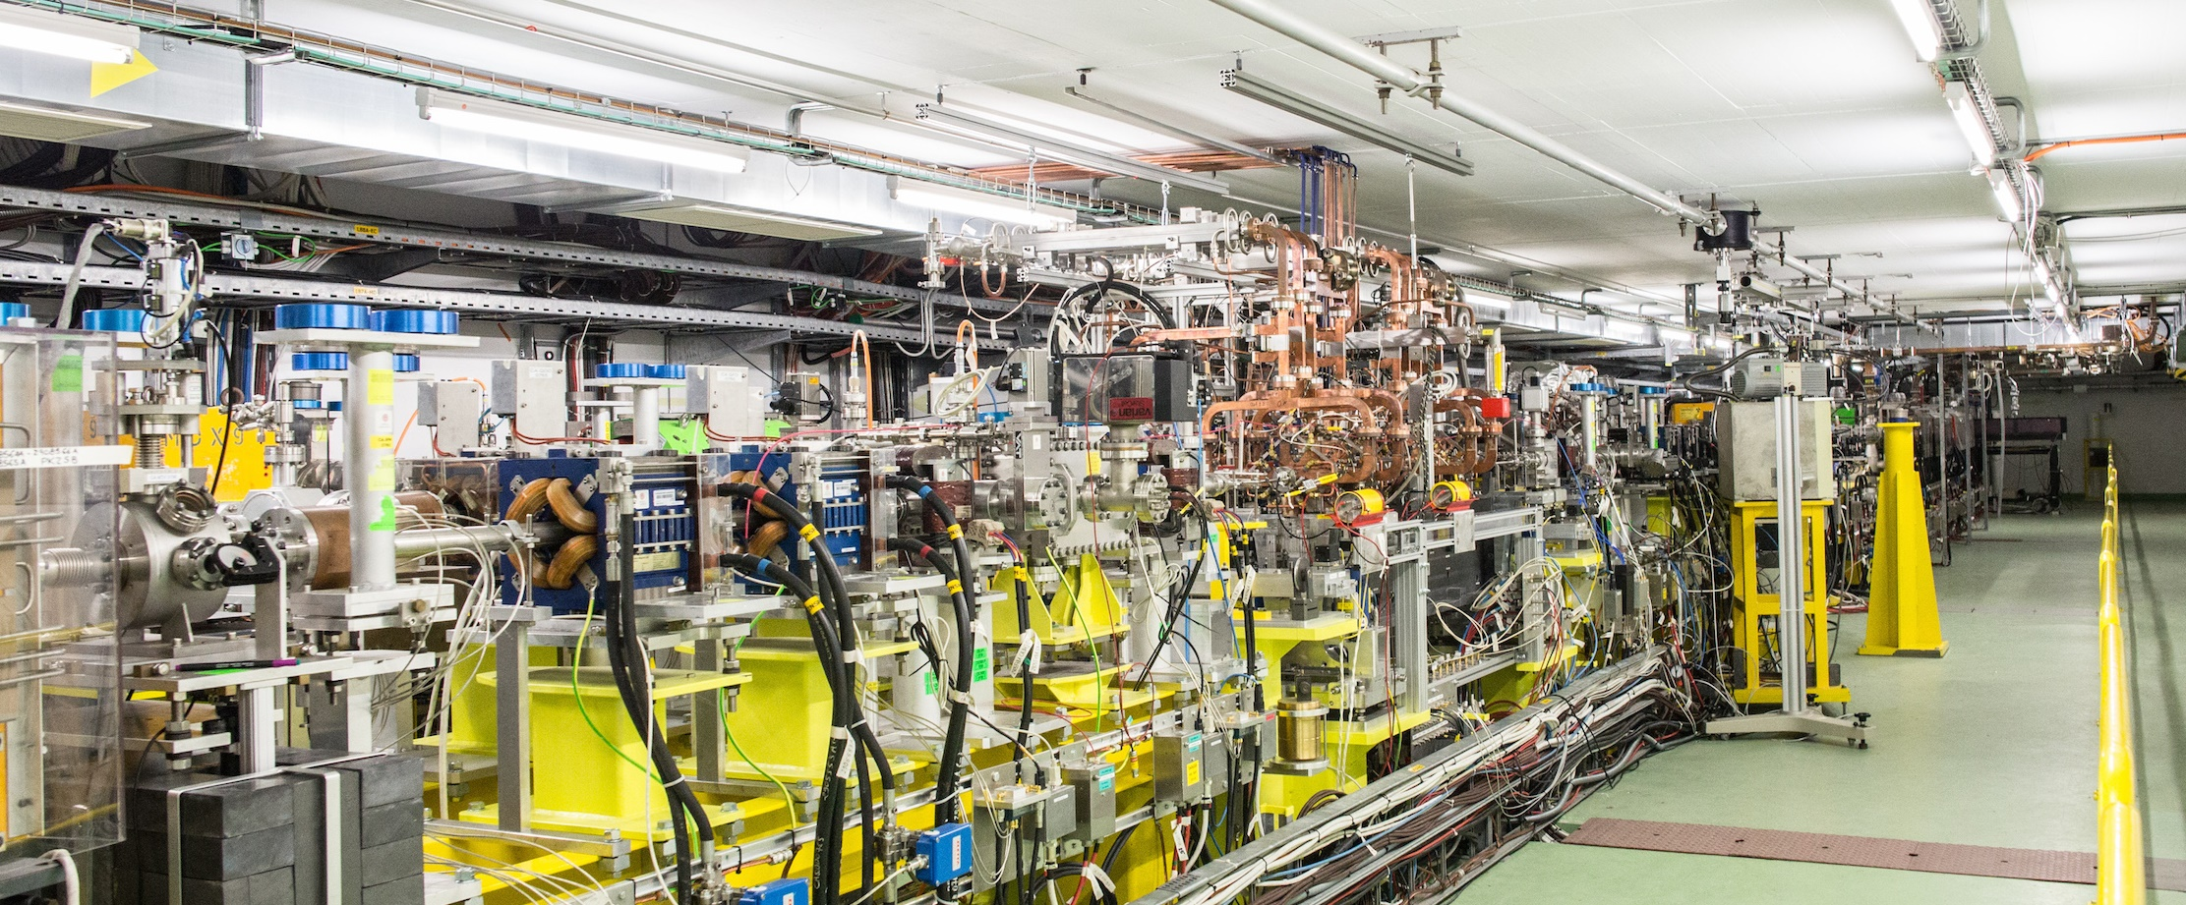
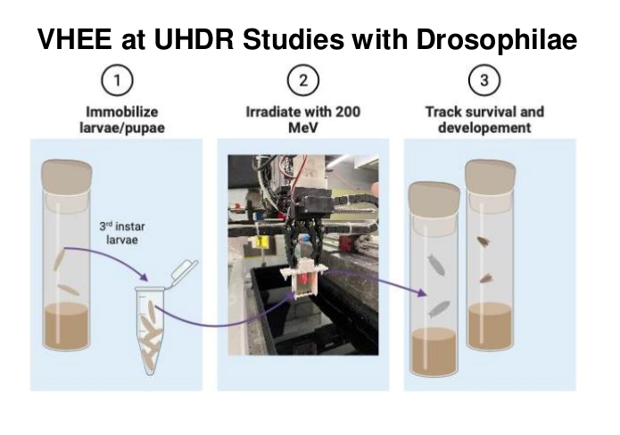
CLEAR – CERN Linear Electron Accelerator for Research
Supervisor: Pierre Korysko
CLEAR is an electron LINAC and an experimental beamline, operated at CERN as a multi-purpose test facility. Scientists book time with CLEAR to perform R&D on accelerator components or novel accelerating techniques, or to study the effects of electron irradiation on electronic components in space or medical contexts. This week, scientists are using CLEAR to investigate e-beam cancer treatment techniques, in particular to study the FLASH effect on fruit fly larvae. You will prepare the samples and work from the control room to power up the beam and irradiate the samples.

Slide 18
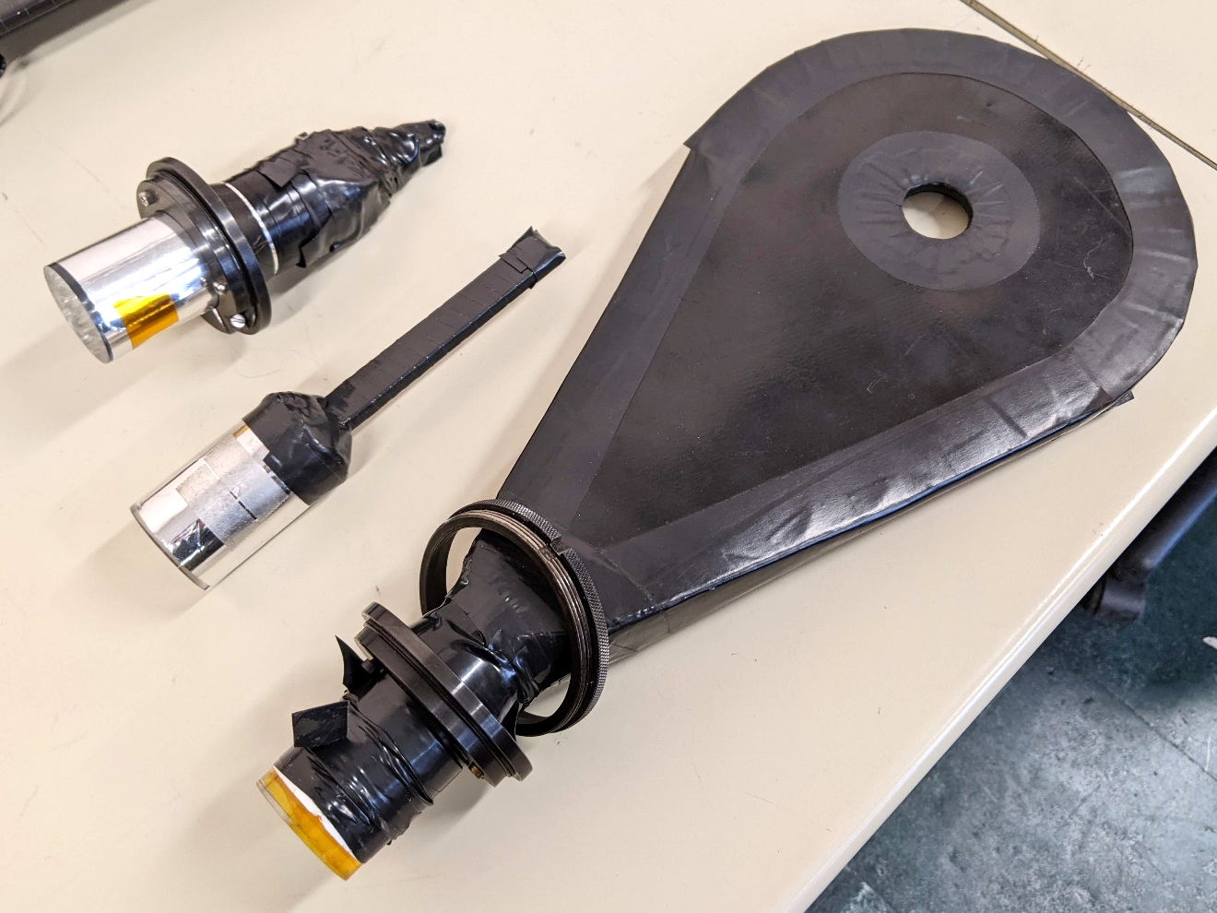
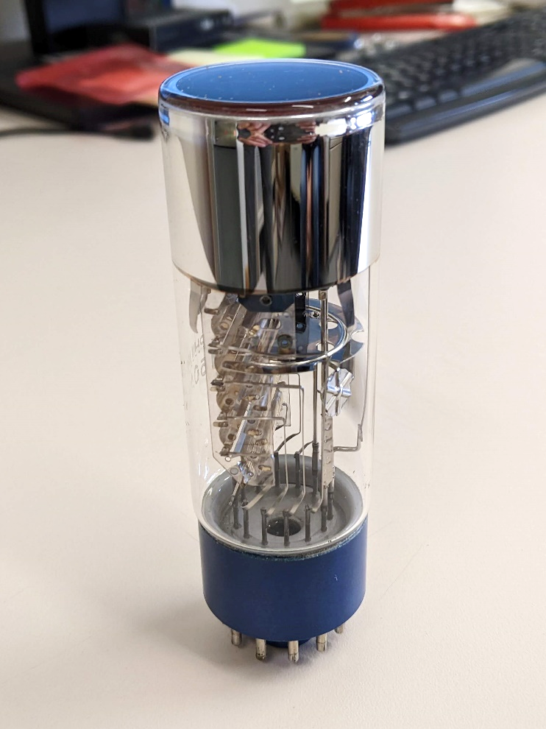
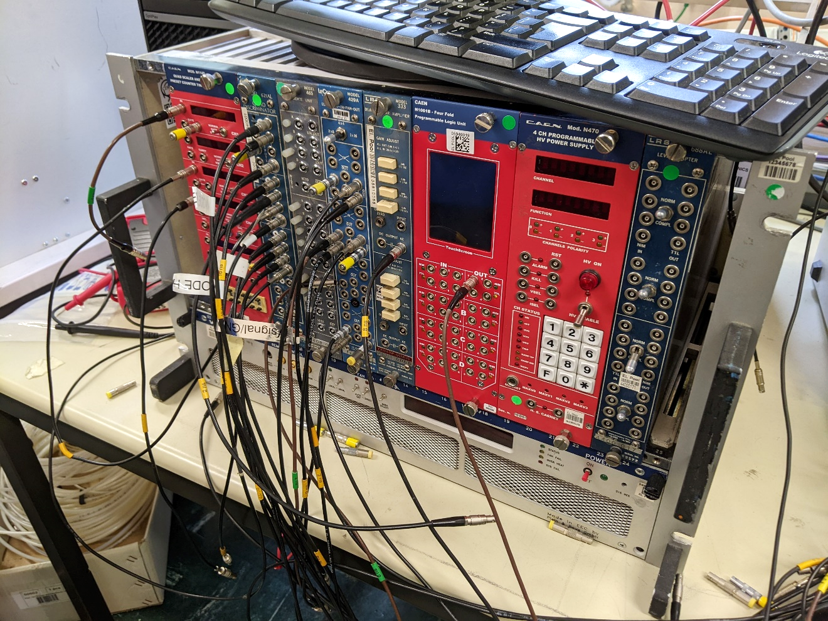
Data acquisition workshop
Supervisors: Markus Joos & Martin Schwinzerl
You probably know cloud chambers – the first particle detectors, which are analogue. You also probably know ATLAS or CMS, our giant state-of-the-art particle detectors, which are digital. While the former are a bit outdated, the latter are a bit too complex. This workshop is your chance to spend one day with the perfect particle detector: a pair of scintillators and photomultiplier tubes coupled to a standard electronic system. You will get to understand the core concepts behind trigger logic and data acquisition. You will detect cosmic ray muons and convert physical interactions into logical electronic signals. You will measure the muon flux and investigate how to sort out real detection events from fake signals due to random noise.

Slide 19
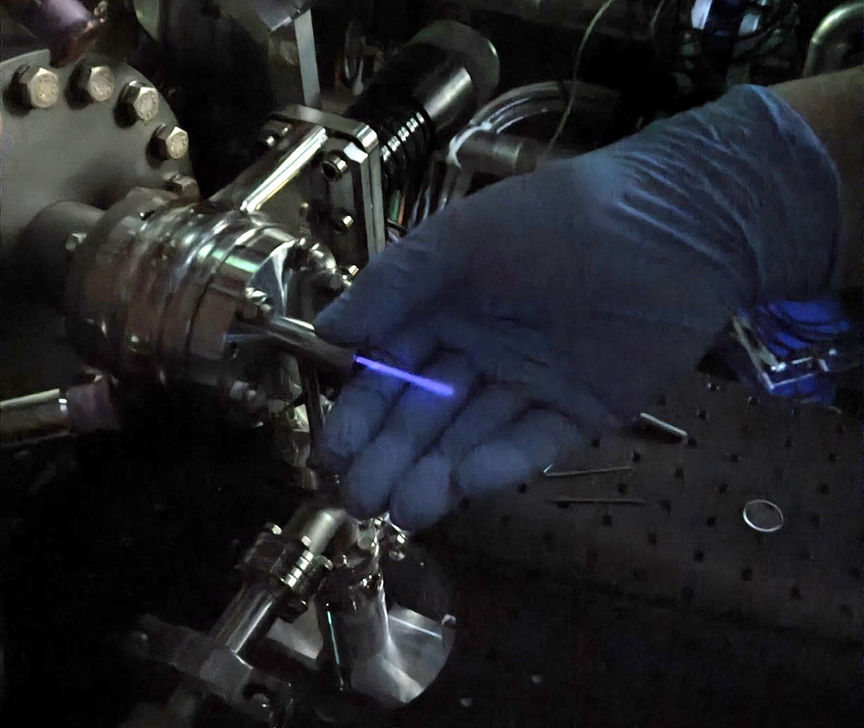
ELISA – Experimental Linac for Surface Analysis
Supervisor: Serge Mathot
ELISA is a proton LINAC located in the Science Gateway exhibitions – the first proton accelerator to be installed in a science centre! When ELISA becomes fully functional, visitors will be able to attend physics demonstrations with the proton beam – seeing how it can be bent or attenuated, how its color or range can be changed, etc. Scientists will be able to book time with ELISA to perform PIXE (Particle-Induced X-ray Emission) or RBS (Rutherford backscattering spectrometry) measurements, which reveal the elemental composition of a sample. These non-destructive techniques are very useful in the field of art preservation and art authentication. You will be the first students to perform a workshop with ELISA.

Slide 20
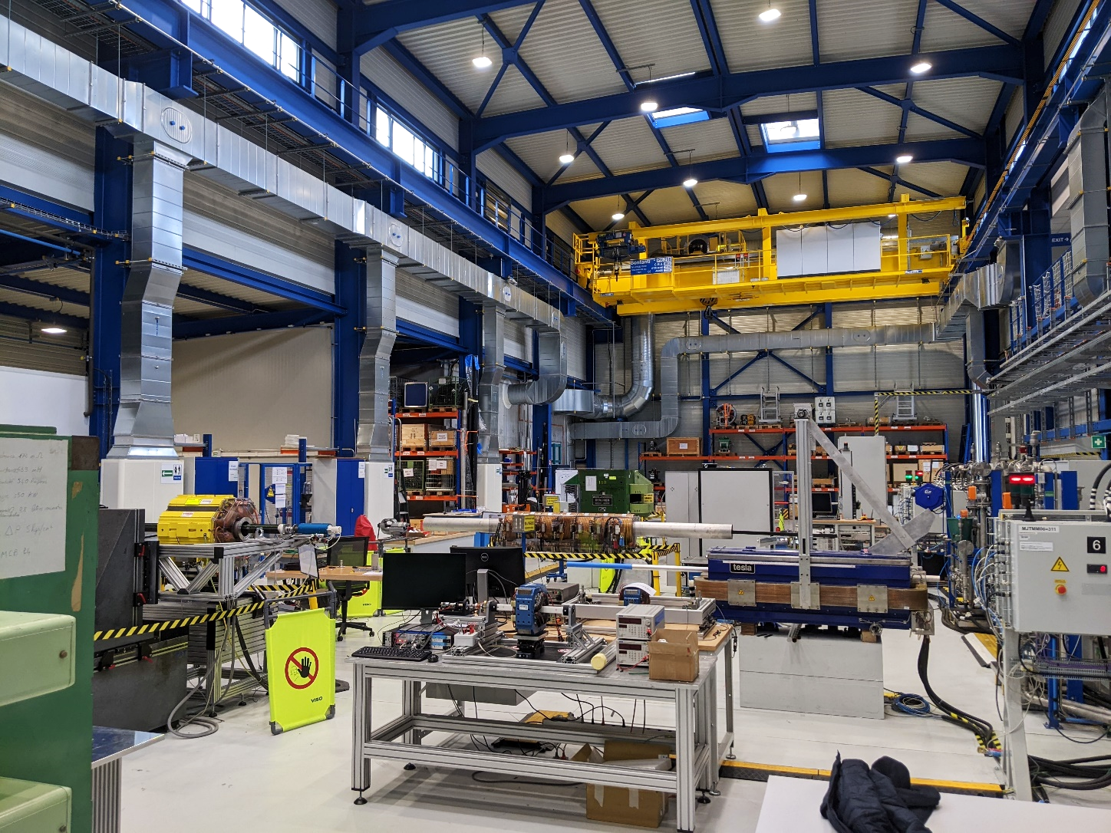
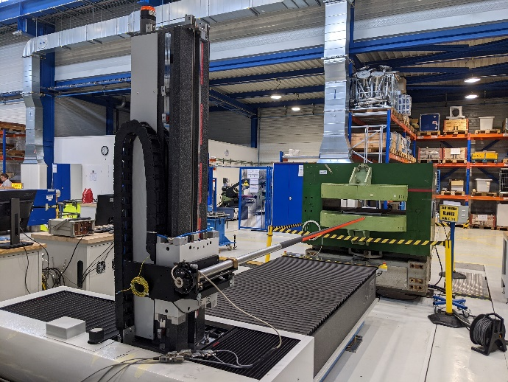
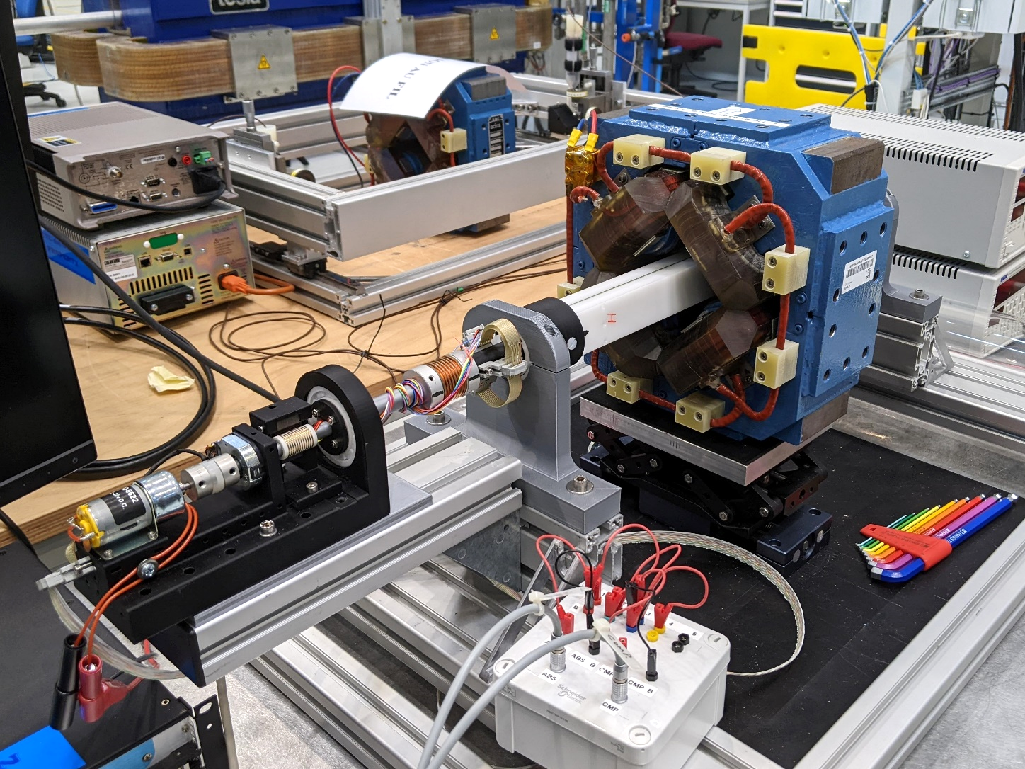
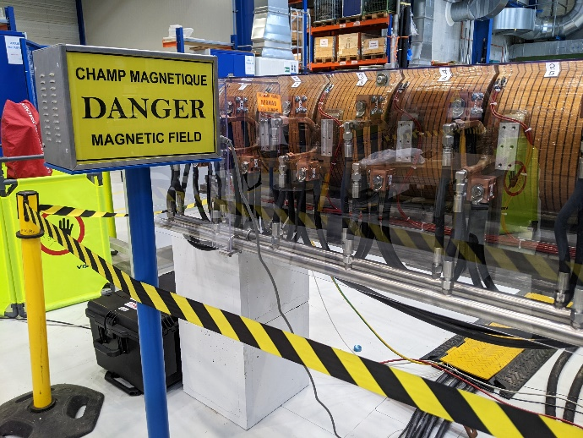
Magnetic Measurements Lab
Supervisors: Lucio Fiscarelli, Vincenzo Di Capua, Melvin Liebsch, Mariano Pentella, Piotr Rogacki
At CERN, we constantly need to design, build, test and repair electromagnets for our circular accelerators. There is a huge diversity of magnet types – dipoles, quadrupoles, sextupoles, solenoids, kickers, etc. – which all perform a different task. There are two main electromagnet technologies: superconducting magnets, which require cryogenic cooling and are only found in the LHC, and “normal conducting” (resistive) magnets, which are everywhere else. In this brand-new lab, engineers measure the magnetic field of various resistive magnets to make sure that they meet their design specifications. You will work on mapping the magnetic field of quadrupole magnets, using two different techniques (rotating coil and stretched wire).

Slide 21
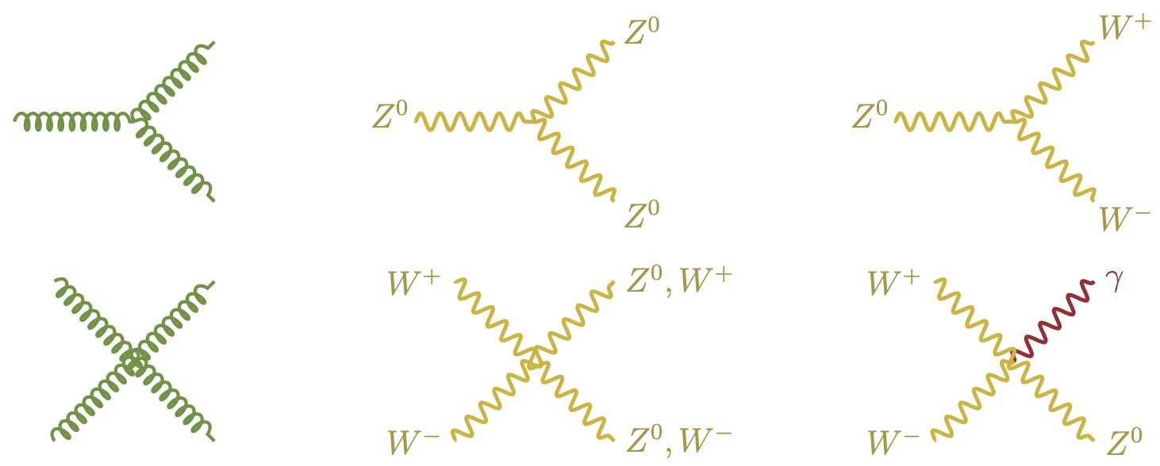
Theory workshop
Supervisor: Silke van der Schueren
You might have heard of Feynman diagrams before: it's those funny drawings of straight and wavy or curly lines, that are used as a representation of elementary particle interactions (such as those that are created at the LHC at CERN). In this project, we will look at the theory behind them, unravel their mysteries, and learn how to read these types of diagrams.
This will help us to better understand what might be happening during particle collisions, which types of interactions can occur, and which are unlikely, and how new particles are found.

Slide 22
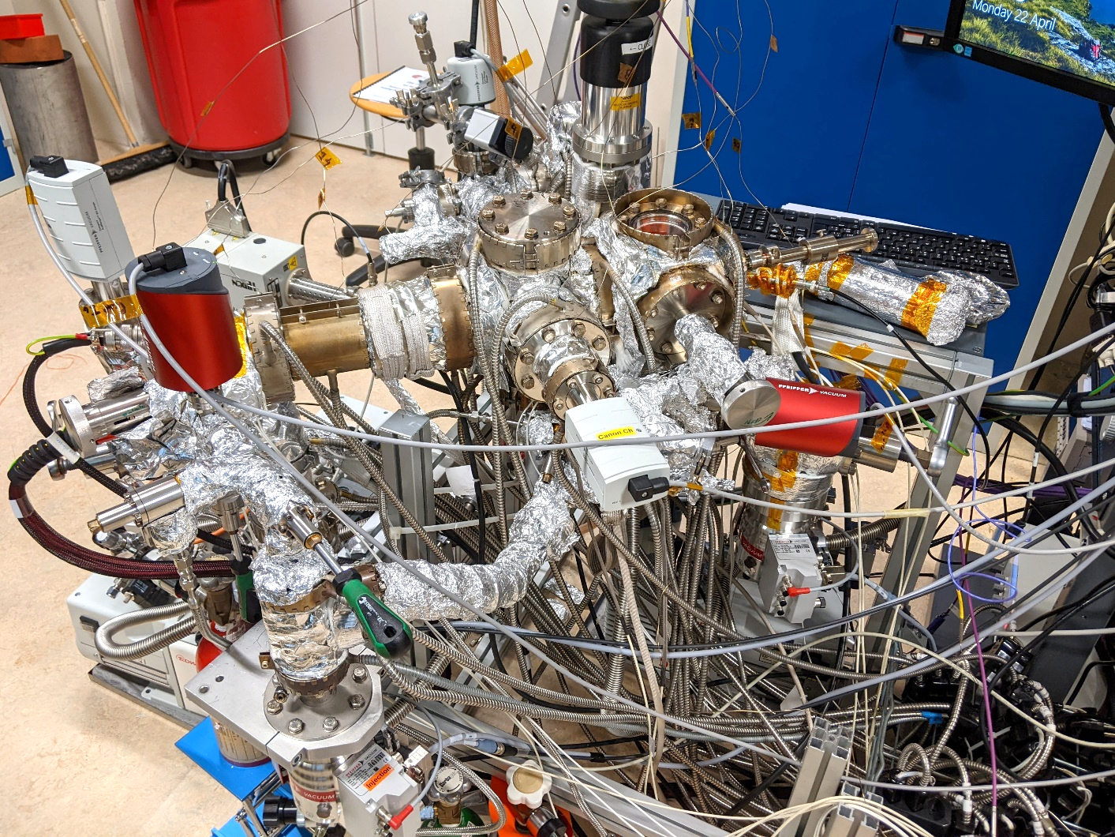
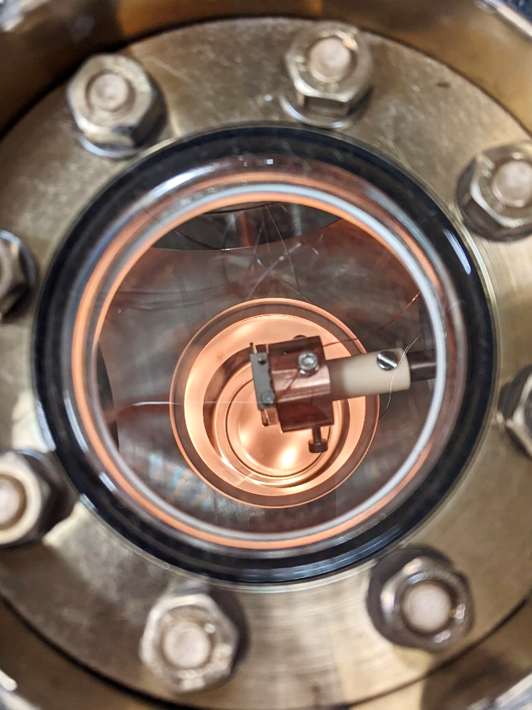
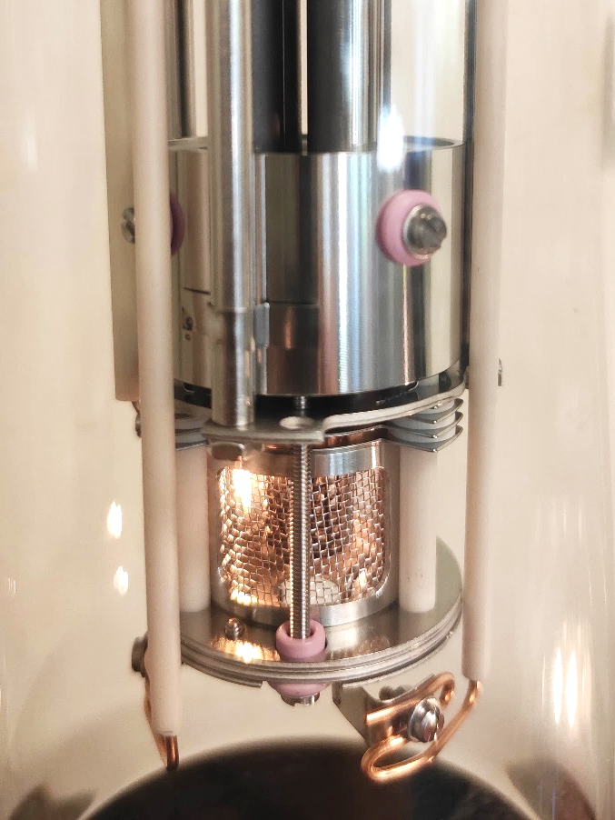
Vacuum Lab
Supervisors: Vincent Baglin, Sophie Meunier, Thomas Daures
Particles in circular accelerators must travel in vacuum pipes, as collisions with gas molecules could lead to beam losses. In the LHC, the protons must travel in a vacuum as empty as interstellar space (10⁻¹³ atmospheres) to ensure a proper beam lifetime. This is incredibly low, but why can’t we go even lower? The walls of the beam pipe keep releasing molecules into the pipe, which become very low-pressure, residual gases. To ensure beams in the LHC are as stable as possible, CERN engineers must know at all times which molecules are released, and what pressure they generate. You will operate an ion gun hitting a metal target and analyse the gasses resulting from the collision, using mass spectrometers and vacuum gauges.

Slide 23
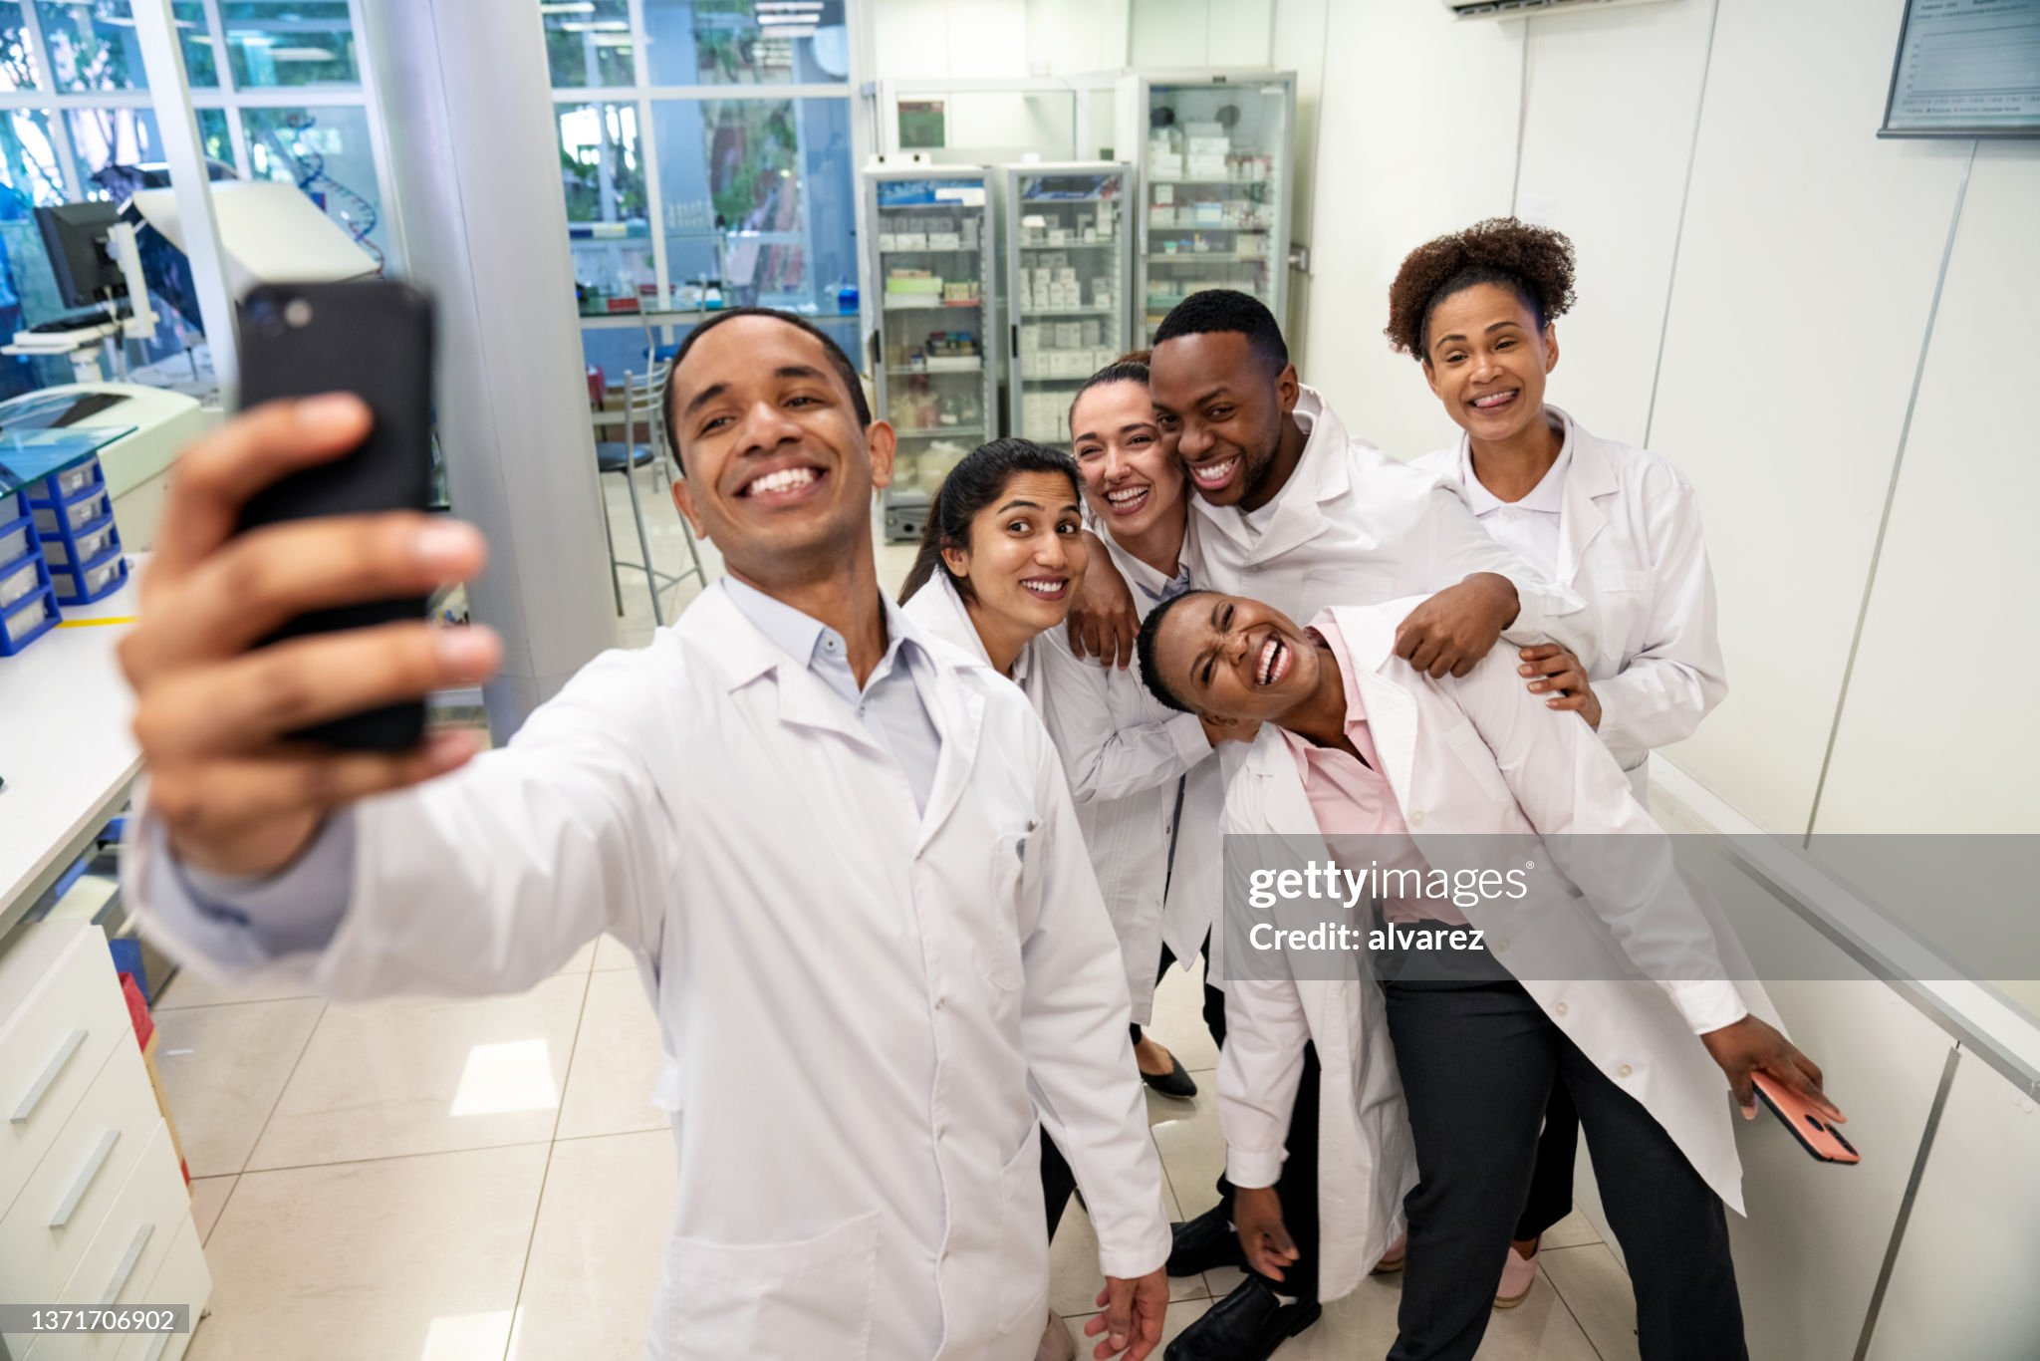
Project day review
5:45 pm on Friday
We want a project day review
in the form of a social media «story».
That’s one video per group,
a minute or two in length,
shot and edited on your phone,
vertical video orientation,
everyone gives updates about the day.
You do not need to post it online,
but you can if you want ☺

Slide 24

Time to choose!
cern.ch/solvay-camp-project

Slide 25
1. General information
2. Project day selection
3. Questionnaire

Slide 26

And now… questionnaire time!
cern.ch/solvay-camp-q1

