Slide 1
SAC Feedback (condensed version)
iFAST Meeting, Paris, France
M Minty, A Yamamoto and C P Welsch

Slide 2
Overview
Executive Summary
Highlights from Plenary Sessions
SAC Comments and Suggestions for the Future

Slide 3
Executive Summary

Slide 4
Executive Summary
The iFAST Project continues to very impactfully enable the
translation of accelerator technology across scientific fields and to society, and
in the development of technologies for next generation particle accelerators.
Compared to one year ago, the objectives of the technical WPs are transitioning (or have already transitioned) from planning, conceptual designs, and prototypes to first articles.

Slide 5
Executive Summary, continued
Many tasks have achieved, or are close to achieving, their deliverables with outstanding results - to mention a few highlights: thin film coatings for superconducting (SC) cavities, high temperature superconducting magnets including novel material and manufacturing methods, high-power/high-efficiency klystrons and power amplifiers, advanced materials for high-power beams, high gradient guns, and much more.
i.FAST technology developments already having impact on; for example, on
future accelerators (e.g. colliders: HL-LHC, FCC-ee, ILC,... light sources, high power linacs,...)
other scientific fields and society.
as promoted by i.FAST co-sponsorship of many workshops and conferences.
Since the inception of i.FAST and especially within the last year, collaborations between laboratories, universities, and industry appear to be strengthening.
Many examples of early and close interactions with industry were presented evidencing more manufacturable and cost-effective designs and foreseen accelerated “science-to-market”.

Slide 6
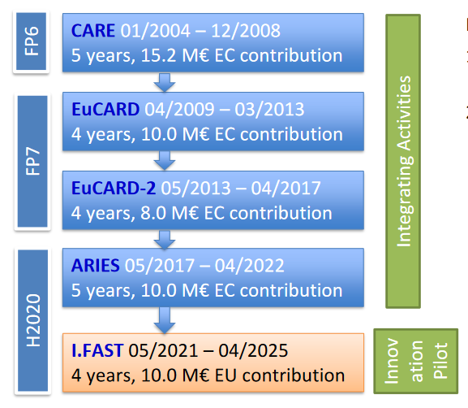
Executive Summary, continued
The i.FAST SAC very much appreciates the detailed and thorough responses to last year’s recommendations.
The SAC strongly encourages continued planning for support beyond i.FAST for future accelerator-based science and technology developments in coordination with supporting collaborations and co-innovation with Research Institutes and industry (technology clusters?).

Slide 7
Highlights from Plenary Sessions (condensed)

Slide 8
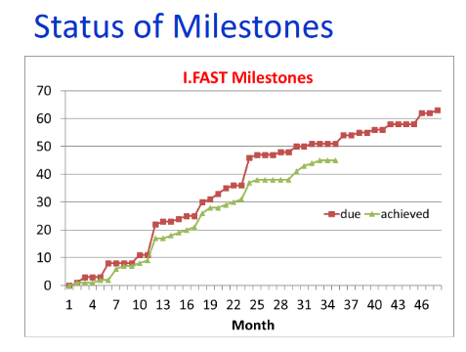
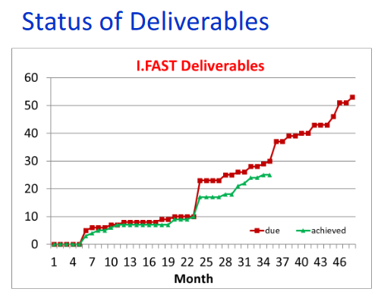
Session 1 - Introduction, Communication, Training, Applications
The i.FAST Project is entering the fourth and final year of the project.
The schedules for achieving cumulative iFAST milestones and deliverables are not tracking the goals as closely compared to one year ago. Various reasons were cited, including for example vendor insolvency, availability of beam time, or availability of skilled personnel.
Affected task leaders are proactively reigning in their schedules and it appears that all milestones and all but maybe one or two deliverables will be achieved within the iFAST Project lifetime.

Slide 9
Communication
Training
The SAC commends iFAST for maintaining clear communication targets and identified target groups. It is noted that these are on track after 3 years. There is a good link with established communication outlets including Accelerating News and the iFAST website, however we renew our recommendation for more showcasing of project outcomes and other project-wide news. The SAC also recommends engaging the public relations channels at partner organizations more fully.
The SAC considers Challenge Based Innovation (CBI) an excellent initiative for attracting the next generation of scientists and engineers into accelerator R&D and its synergy with the aims and mission of the ESI. The SAC appreciated the detailed information about the diversity of applicants, and the good balance amongst the final (selected) participants.
The iFAST Academia-Industry Exchange Program has successfully stimulated cross-sector collaboration and triggered several promising interdisciplinary R&D projects.

Slide 10
Session 2 - Industry
The SAC thanks the organizers for including this dedicated session and the speakers for the excellent overviews of industry-driven innovation opportunities.
The SAC acknowledges the innovation survey and detailed analysis of the impact of industry–related activities in response to last year’s SAC suggestions.
The good potential to de-risk developments through co-innovation and how iFAST support has been critical for this, was made clear.

Slide 11
Session 3 - New Concepts
Technology breakthroughs required in several areas incl. plasma, high power lasers and novel magnets; impressive progress was reported.
iFAST helps develop a landscape for future accelerators; the events have informed strategic technology roadmaps.
The SAC would like to commend the speakers for consolidating research and innovation in Europe through highly successful workshop series and by attracting additional funding.
The SAC considers the continuation of collaborative workshops related to specific areas essential, and recommends that these be funded through the respective projects and consortia.

Slide 12
Session 4 - Accelerator Technologies
The SAC recognizes and acknowledges that iFAST activities are pioneering and demonstrate innovative cutting-edge accelerator technology, focusing on: HTS magnet, thin-film SRF, and Additive Manufacturing technologies, as well as advanced manufacturing and high efficiency klystron technologies, all well highlighted in the presentations.
The SAC strongly encourages iFAST accelerator technology development to adopt good sustainability practices.

Slide 13
Session 5 - Light Sources / iFAST Highlights
The SAC acknowledges the important successes in light source development. We are pleased to see that iFAST-supported events have helped drive innovation and leverage significant funding.
Several promising new technologies were presented, including:
  permanent and superconducting magnets with opportunities for more energy efficient accelerators,
  advanced electron guns were successfully tested at high power,
  machine learning models for which clear performance metrics should be developed as a next step.
The SAC looks forward to future reports on operational experience with the innovations presented in this session.

Slide 14
Session 6 - Sustainability
The SAC recognizes that “sustainability” is increasingly important and should be integrated into each and every i.FAST activity.
EC guidance and recommendations including the Life Cycle Assessment (LCA) with the scope for environmental footprint were much appreciated. LCA analyses were presented for the RUEDI Project and Linear Collider efforts. Developments within the iFAST program were also presented.
The SAC recommends that iFAST promotes integration of sustainability within the existing project, and to convey the message more widely.

Slide 15
SAC Comments and Suggestions

Slide 16
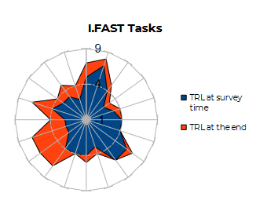
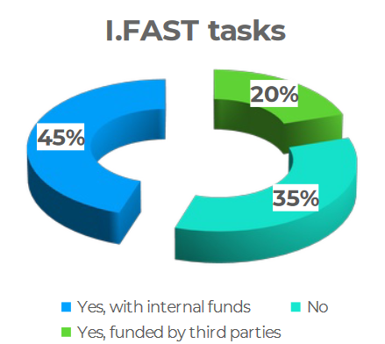
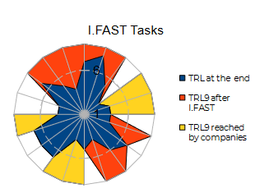
SAC Comments to the Response to Previous Recommendations
Past recommendations:
For each technology, state TRL.
These technologies should be critically assessed re realistic pathway to identified markets and the time scales required.
It was not always made clear enough which developments are happening because of iFAST.
SAC comments:
The SAC really appreciates the analyses and presentation, which provided:
  a clearer understanding of the achieved and estimated TRLs;
  insights into funding contributions toward iFAST activities, and common interests resulting from iFAST-funded R&D.

Slide 17
SAC Suggestions
If a task is foreseen to run late, the SAC advises to consider a grant agreement amendment to better reflect expectations.
The SAC strongly encourages iFAST and its partnerships integrate the methodologies and tools highlighted in the sustainability session into all activities.
The SAC endorses the industry-academia exchange program and encourages more iFAST partners to engage with it.

Slide 18
SAC Suggestions
At the next and final iFAST annual meeting, the SAC would appreciated for each presentation
  a slide with impact statements achieved to date and projections for the anticipated impact of their work (i.e. foreseen application)
  a slide elaborating on achieved Technical Readiness Levels (TRL).
The SAC strongly supports a 2025 Challenge Based Innovation (CBI) and recommends that i.FAST explore opportunities to continue CBI beyond the lifetime of the i.FAST project e.g. through institutional and industry support.
The SAC suggest for consideration a post-iFAST survey, to better understand the time needed to reach TRL9 (highest level) across the innovation portfolio, where relevant and future market potential.

Slide 19
Acknowledgement and Thanks
Maud Baylac
Valérie Brunner
Walid Kaabi
Antoine Le Gall
Sylvie Leray
Anne-Laure Pelé
Lazar Nikitovic
Maurizio Vretenar
The team of the Fondation Biermans Lapôtre
iFAST participants for the collaborative and congenial discussions.

Slide 21
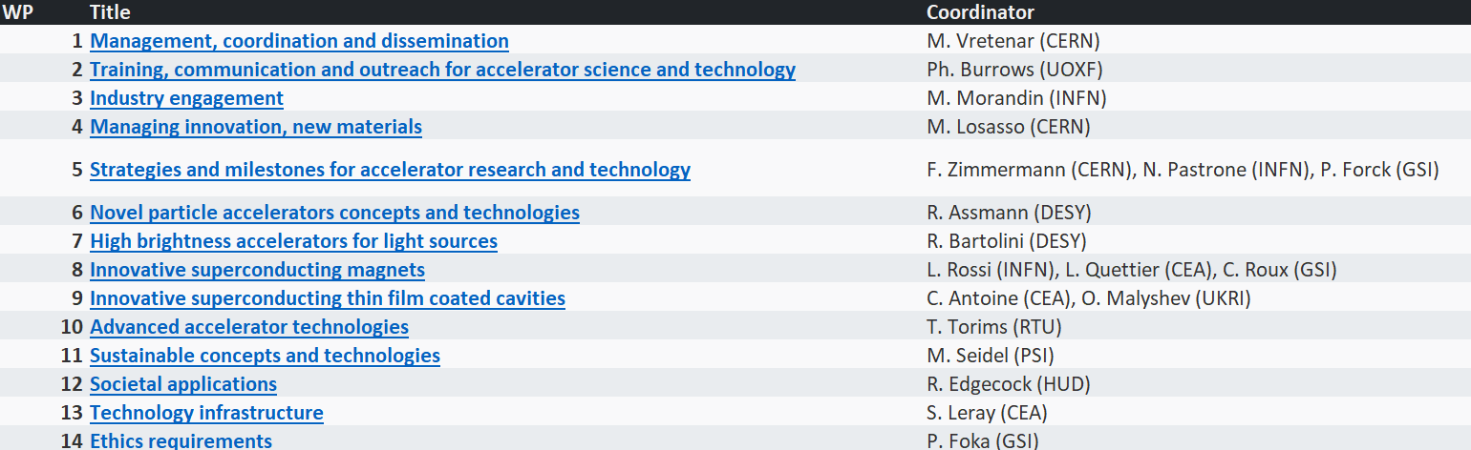
Reminder: I.FAST Work Packages

