Slide 1
Report from the Coordinator
M. Vretenar, 2024 I.FAST Governing Board Meeting
Paris, 19 April 2023

Slide 2
Status of the project
Nearly completed the 3rd Year of activity (April 2024) – only one more year to go.
Initial delays and organisational problems due to the material and energy crisis solved.
Several additional delays are appearing in the technical Work Packages, related to manufacturing issues, late delivery of components, movements of personnel. In addition, some Deliverables were originally declared following a wrong schedule. The consequence is a request for changing delivery dates of 8 Deliverables that has to be submitted to the Project Officer.
This happens at the critical moment of preparation of the 2nd Periodic Report (covering 18 months, from October 2022 to April 2024) to be submitted by end of June, combining technical information from WP and Task Leaders with financial information from the beneficiaries.
The Review for Period 2 will take place online on July 15th, with the Project Officer Sotirios Kakarantzas and the external reviewer Mehmet Zeyrek (Ankara University), who has already reviewed the 1st periodic Report. Task Leader and WP Coordinators should attend.
2024 Annual Meeting most successful ever: 147 registered

Slide 3
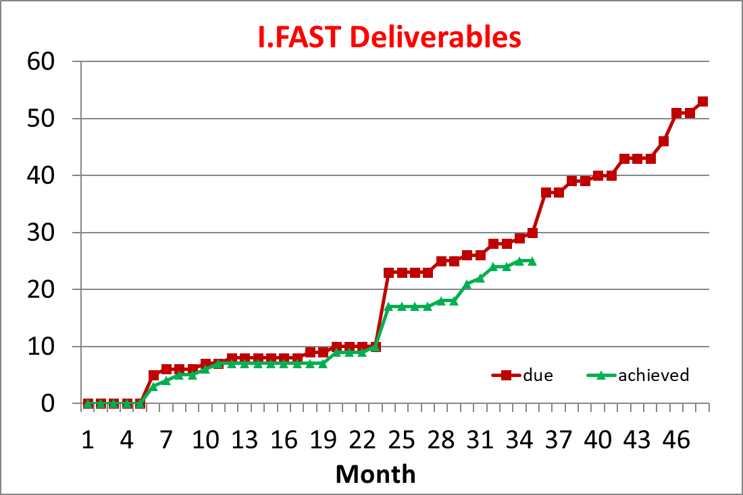
Status of Deliverables
STATUS OF DELIVERABLES DUE IN PERIOD 2 (up to M36)
1 Deliverables is very late
D7.5 Construction of XLS pre-prototype M32 (G. Dauria)
6 Deliverables are due at M36 (end April) and should have been received at end March – only 2 will (hopefully) come
D2.3 Industrial training scheme (L. Garolfi) – delay to M48?
D11.3 Prototype adjustable PM quadrupole (B. Shepherd) – delay M44
D3.2 Business development case (S. Djamschid) – in prep.
D6.4 Improvement of laser intensity stability (F. Mathieu) ok
D10.4 First PSD data from NEG Coating (O. Malyshev) request delay to M44
D11.2 Klystron prototype completed and validated (N. Catalan)
1 Deliverable was delayed with PO agreement
D4.3 Beam windows prototype (to M38)
4 Deliverables announced as late, still to be agreed by PO
D10.5 Machine learning at ESS (M46)
D9.1 Thin-Film SRF roadmap (M45)
D7.6 Construction of XLS full prototype (M48)
D9.3 First 6 GHz cavity coated (M46)

Slide 4
Main delays identified
Problems with the CompactLight accelerating modules: loss of a critical collaborator, then brazing issues on the couplers. A solution is being implemented (repair + new parts), but there is no guarantee of success.
Problems with longitudinally variable dipole for synchrotron light: design not yet finished, striving to complete prototype before end of I.FAST.
Problems with the high-efficiency klystron: low quality of outsourced components, need to repair in-house. Should be completed in 2024.
Concerns about the SC magnet demonstrators that will be completed only at end 2024 and be tested (UU and INFN) in 2025, just before I.FAST end.
Deliverables and Milestones for WP9 were declared starting from a wrong M1 – should be only an administrative issue. But WP9 will have 6 Deliverable Reports in 4 months during 2025: a concern!

Slide 5
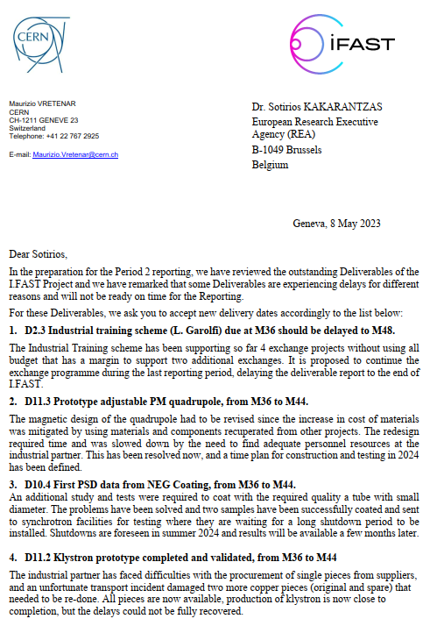
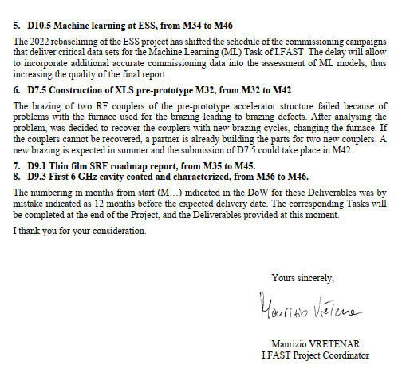
Letter to the Project Officer
8 Deliverables to be delayed (in addition to 1 already delayed):

Slide 6
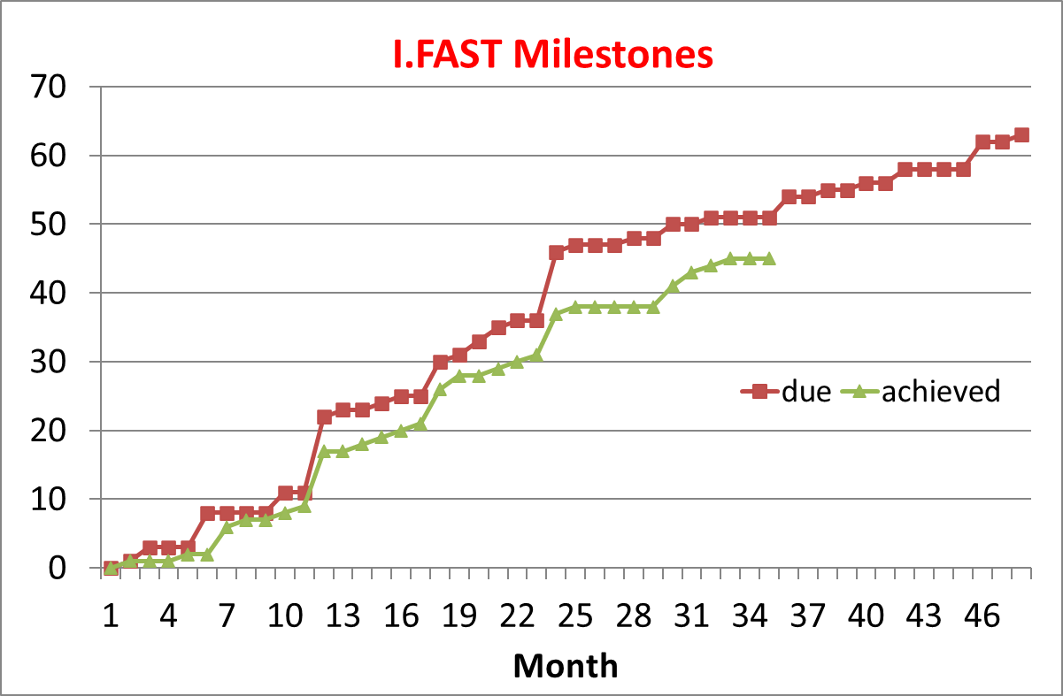
Status of Milestones
7 Milestones late
MS5 (ACO Workshop), for March.
MS30 (CompactLight) delayed to M48.
MS52 (Workshop efficient magnets): delayed to M34.
MS26 (optics for ELETTRA): coming since months…
MS56 delayed to M38
MS37 (thin film Workshop), delayed to M42.
MS34 (curved CCT formers): no news.
+ 1 Milestone in advance (MS54)
A good justification for the late Milestones must be given in the Periodic report

Slide 7
Positive highlights
Remarkable progress with all the large-scale prototypes of I.FAST. Some are late, but all have advanced considerably in the last year.
The 3rd CBI event on Accelerators for Health is being organised thanks to an important contribution from institutional sponsors (I.FAST can cover only part of budget).
Testing of the Additive Manufactured RFQ is progressing, and additional prototypes are being fabricated thanks to industrial support.
The AMICI WP13 has completed its activities with two detailed reports.
GaN amplifier modules have worked at kW level.
New applications are being explored, with a strong support from industry. Additive Manufacturing.
Industrial participation remains outstanding: report on R&D contributions and dedicated session at Paris, successful industry workshop on cryogenics, creation of permanent Accelerator-Industry Forum.

Slide 8
Periodic Report 2 – technical part
Covers the second 18-month period (October 2022 – April 2024)
Must be submitted 2 months after end of period (30 June 2024)
Task Leaders have received a template to be filled in with a description of activities (October 2022 - April 2024): summary, objectives, description of work, meetings, milestones, deliverables, publications, justifications for delays or late Deliverables and Milestones. 2/3 pages per Task.
End of April 2024: deadline for sending the contributions to Valérie, who assembles the WP Sections and sends them to WP Coordinators for validation.
15 May 2024: deadline for WP Coordinators to send WP chapters to Valérie.
End of May: complete document sent to WP Coordinators for approval.
15 June: Report ready for submission.

Slide 9

Thank you for your attention
This project has received funding from the European Union’s Horizon 2020 Research and Innovation programme under GA No 101004730.

