Slide 1
Move Enterprise AI Use Cases From Development to Production With Full-Stack AI Inferencing

Slide 2






Inferencing in the end-to-end AI workstream
The shift from AI training to AI inferencing
AI Training
AI Inference
DATA PROCESSING
TRAIN
OPTIMIZE
DEPLOY
RUN
Collect, cleanse and transform training data set
Select model and fine tune for desired accuracy
Optimize model for target H/W accelerator
Deploy on-premise, in the cloud or edge
Serve model for optimal user experience & TCO
Notes:
An end-to-end AI workstream or process would consist of two distant but interconnected phases: The AI Training phase of the left and the AI Inferencing phase on the right
the Training phase has been getting a lot media attention because of the very fast advancements in AI networks and transformers that have produced large language models now pushing the boundaries of a Trillion parameters.
However, what we are seeing today from an enterprise perspective is massive shit in attention and focus from the Training Phase to the Inference Phase. That is primarily driven by the explosion in number of available cleansed data sets, AI models and even trained models that are available today on open-source marketplace.
For example, today , there are over 300,000 AI models on Hugging Face and …. Which is taking a lot of burden off enterprises that are now shifting to focus of how can we take advantage of these existing of that data sets and model models and put them into production for inference with in our enterprise
It is also where a lot of the recurring cost of AI reside today and this where we will be focusing our discussion today.

Slide 3







AI inferencing requires a full stack approach
NVIDIA AI Inference Platform optimizes every layer of the stack
Production Runtimes
Security & reliability
Technical support
Ongoing delivery
Integration with cloud, AI tools, and K8
Marketplace accessibility
Retire cloud contractual spend commitments
MLOPS Ecosystem
Application Frameworks
AI use cases & workflows
Workload & infra management
Data curation tools & pretrained models
Batching of incoming requests
Multi-instance model deployment
Concurrent model execution
AI Inference Platform
Model
Serving
Compilers,
Runtime-
Libraries
Model optimizations (quantization)
Multi GPU/Node Communication
Run time optimizations (memory mgmt.)
Hardware Accelerators
Massive parallel processing
AI specific H/W accelerators (transformer engines)
Power efficiency and TCO
Notes:
As I alluded to earlier, the NVIDIA inference platform takes a full stack approach to solving enterprise AI inferencing requirements. We will dive into each of these 6 layers in detail in the next slides but I wanted to provide you with a quick run down first so if you joined this webinar because you have some specific challenge in mind you can get a preview of where it sits in the stack on what pieces of the platform will address it.
At the very bottom of the stack you have of course the Inferencing Hardware Accelerators. These should offer massive parallel processing capabilities. Along with dedicated engines built specifically for AI -like Transformer engines- and also have offer high power efficiency.
Sitting immediately on top of H/W Accelerators are compilers and runtime libraries that introduce very specific optimization and memory management capabilities that ensure that the AI model that you are running can really take advantage of all the underlying capabilities of the GPU
Next come the Model Servers that are purpose built for AI inferencing and must be intelligent enough to understand the latency, throughout of your use case and be able to serve multiple different models concurrently.
On top of Model Server servers comes the use case itself like NLP, ASR. Here you want ensure that you have access to a large library of reusable components so you are not reinventing the wheel every time you start a new AI project.
Of course everything we talked has to be compatible and have pre-built integrations into your existing cloud and IT environment. That is the MLOPs Ecosystem layer.
Finally comes the enterprise Production Run time. Deploying one or two models for experimentation purposes is one thing, maintaining dozens of models –especially if these models are customer facing- for long periods of time requires having access to security and support services offered from the vendor that engineered and built the stack and knows it intimately.
The NVIDIA Inference platform covers all of these pieces and brings them together effortlessly for our customers.
Let's dive into each of these layers.

Slide 4
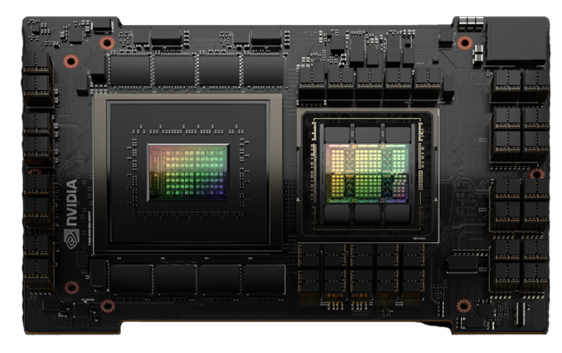
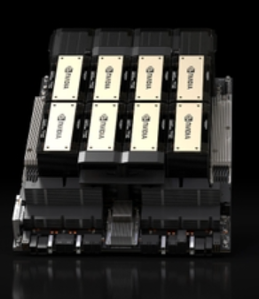
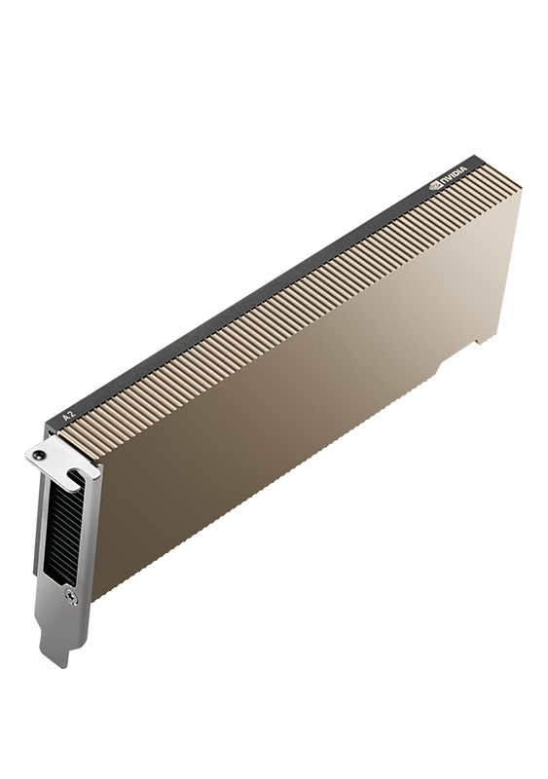
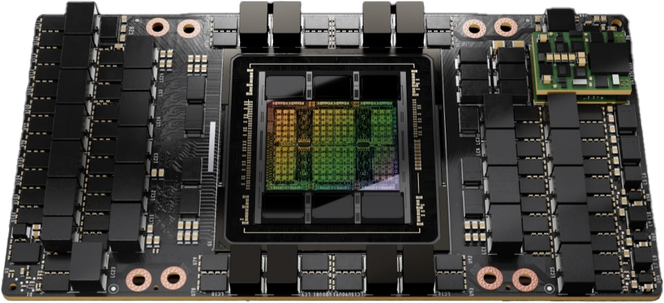
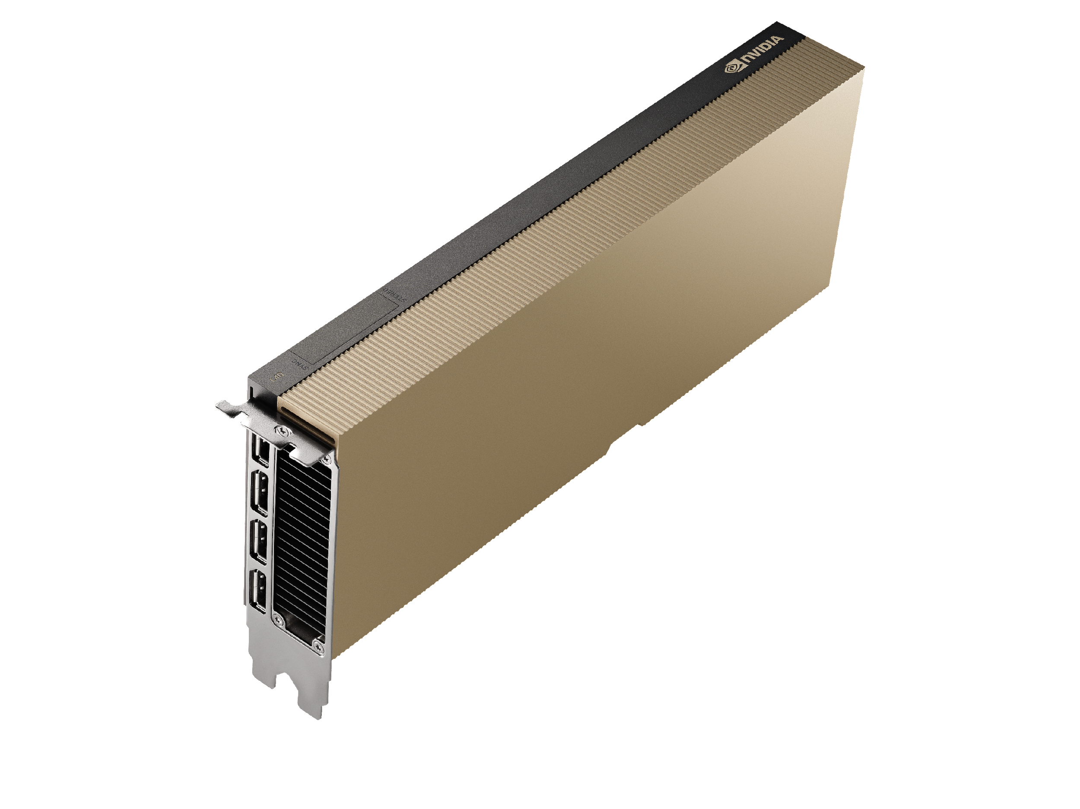
The broadest and deepest selection of GPUs for AI inference
Production Runtimes
MLOPS Ecosystem
Application Frameworks
Model
Serving
284x Faster Inference
than x86
1.9x Faster Inference
than H100
30x Faster Inference
than A100
1.7x Faster Inference
than HGX A100
120x Faster AI Video than CPUs
NVIDIA Grace Hopper
NVIDIA HGX H200
NVIDIA H100
NVIDIA L40S
NVIDIA L4
Compilers,
Runtime-
Libraries
GH200: 65B LLM, Simulation x86, DGX H100 and Grace Hopper systems
H200: Inference on Llama2 70B: ISL 2K, OSL 128 | Throughput | H100 1x GPU BS 8 | H200 1x GPU BS 3
H100: Inference on Megatron 530B parameter model chatbot for input sequence length=128, output sequence length=20 | A100 cluster: HDR IB network | H100 cluster: NDR IB network for 32 A100 vs 16 H100 for 1 sec latency
L40S: ResNet-50 V1.5, INT8, BS=32, 1x A100 SXM, 1x L40S
L4: End-to-end Computer Vision pipeline using CV-CUDA with pre-processing, decode, inference (SegFormer, ResNet-101), encode, post-processing using 8x L4 server, TRT 8.6.0 vs 2S Xeon 8362 Server with OpenCV 4.7
Hardware Accelerators
Notes:
Starting from the bottom. We have the NVIDIA GPUs that offer a complete portfolio of H/W accelerators depending on your use case and requirements.
L4:Starting from the right hand side of the slide with our entry level Universal AI inferencing GPU – the L4 GPU with 24GB of memory - that is optimized for a wide variety of workloads starting of course from AI inferencing but extending into other workloads like Video, Graphics and Virtual Workstations **** 2/ The L4 GPUs delivers 120x better performance on CPU based servers and virtual machines. They are also tremendously cost effective and energy efficient with a TDP (Thermal Design Power) of only 72W. The L4s are ideal for Computer Vision AI Models (Microsoft Resent-50 image classification model, for Dall-E image generation models and LLMs under 5Billion like the GTP3 ada(350M) and Babbage(3B) models.
L40S:Next, we have the L40S Ada Love Lace GPU – which is NVIDIA’s most powerful Universal GPU for the Data Center with 48GB of memory, 18+ cores, and a dedicated transformer engine for Matrix Multiply Operations that are common in Transformer Networks. The L40S can be used for both Inferencing as well as Training along with a diverse set of accelerated compute workloads like 3D graphics, rendering and video applications. The L40s can be used for inferencing for LLMs up to 175B parameters like the GPT 3 Davinci.
H100. We also offer the NVIDIA H100 Hopper GPU and its success the H100 GPU. These GPUs are based on the Hopper Architecture and come with Transformer Engine and our 4th generation of Tensor Cores delivering unprecedented performance, scalability, and security for literally every and all workloads from Training of very large language models to inference delivering up to 30x performance gains on LLMBs with 175B like the ChatGPT 3 Davinci. The H200 that we just announced a few weeks ago raises the bar even further delivering 2x performance gains on inferencing for LLAMA 70B compared to H100.
Lastly, we offer the NVIDIA GH200 Grace Hopper Superchip: which combines an CPU processor based on the ARM Neoverse Architecture with the Hopper GPU. This super chip delivers 284x more performance vs. CPUs to address LLMs, recommenders, vector databases and more.

Slide 5
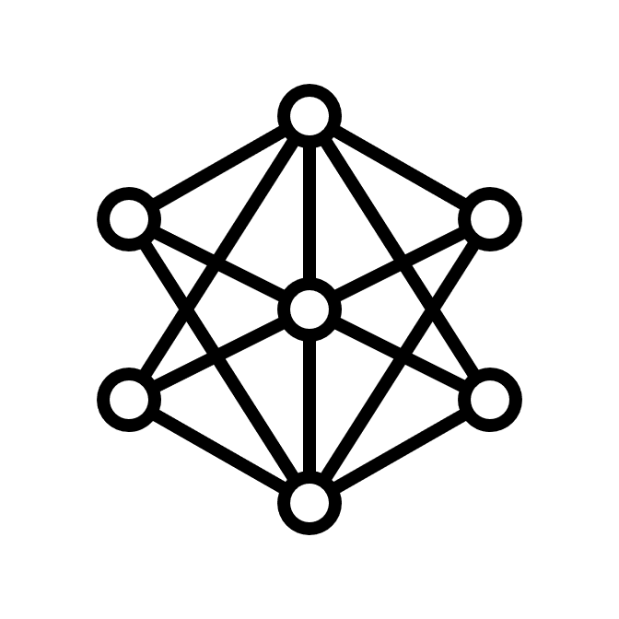

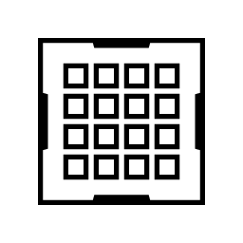
NVIDIA TensorRT
Accelerate and optimize every network, including CNNs, RNNs, and Transformers
Production Runtimes
Trained
DNN
TensorRT
TensorRT Runtime
NVIDIA
GPUs
MLOPS Ecosystem
Reduced mixed precision: FP32, TF32, FP16, and INT8.
Layer and tensor fusion: Optimizes use of GPU memory bandwidth.
Kernel auto-tuning: Select best algorithm on target GPU.
Dynamic tensor memory: Deploy memory-efficient apps.
Multi-stream execution: Scalable design to process multiple streams.
Time fusion: Optimizes RNN over time steps.
Application Frameworks
Model
Serving
Compilers,
Runtime-
Libraries
Hardware Accelerators
Notes:
The next layer up in the NVIDIA Inference Platform is our NVIDIA TensorRT which is a Software Development Kit SDK designed specifically to accelerate inference of trained AI models on NVIDIA’s GPU. As you can see in the visual at the top, TesnorRT takes a trained network, consisting of the network definition and trained parameters, and then applies memory optimization techniques –like Layer and Tensor Fusion, Kernel auto tuning to bo select the best algorithm based on the target GPU and Time fusion in the case Recurrent Neural Networks – and then produces a highly optimized runtime engine that performs inference on NVIDIA GPUs with higher performance and lower latency.

Slide 6
NVIDIA TensorRT-LLM
Accelerate and optimize inference performance for the latest LLMs
Production Runtimes
State of the Art LLM optimization
Built for NVIDIA GPUs
Supports latest LLMs
MLOPS Ecosystem
Application Frameworks
Multi GPU multi node inference
Memory bandwidth optimizations
In-flight batching
Paged attention
Windows beta release
Hopper
Ada-Lovelace
Ampere
Volta
Turning
LLaMA-v2
BLOOM
Falcon
GPT-J
GPT-Nemo
Mistral
MPI
and more…
Model
Serving
Compilers,
Runtime-
Libraries
Hardware Accelerators
Notes:
We also just recently announced the General Availability of TensorRT-LLM which builds on top of TensorRT adding specific optimizations for Large Language Models.
Most notably it supports Multi GPU and Multi Note Inference, allowing you to deploy large LLM that might not fit on a single GPU by spreading them across multiple GPUs or multiple Nodes
It also introduces In-flight batching, Paged Attention and Memory Bandwidth optimization all with the goal of helping you increase the utilization of your GPU and lower latency.****And, on the GitHub repository we have also made available fully optimized and ready to run compiled versions of some of the most popular LLMs that are in production today which you can implement with a simple Python API call- including models like Meta’s LLAMA2, Falcon, Mosaic MPT, Bloom and dozens of other models.
As I said, we have a diverse audience today so for folks that are new to ML or don’t have deep ML software development backgrounds, A relatable analogy and way to think of TensorRT is to think of a car that just got off the factory floor. At that point, the car is not really optimized for a particular use case. If you want to take that car out on the track and race it for speed you would need to install a new set of performance tires, you might want to take off pieces of the car that are unnecessarily heavy like the hood and the trunk and replace them with lighter weight carbon fiber pieces. You would also want to change the suspension of the car to make sure that the car can make sharp turns at high speeds.

Slide 7

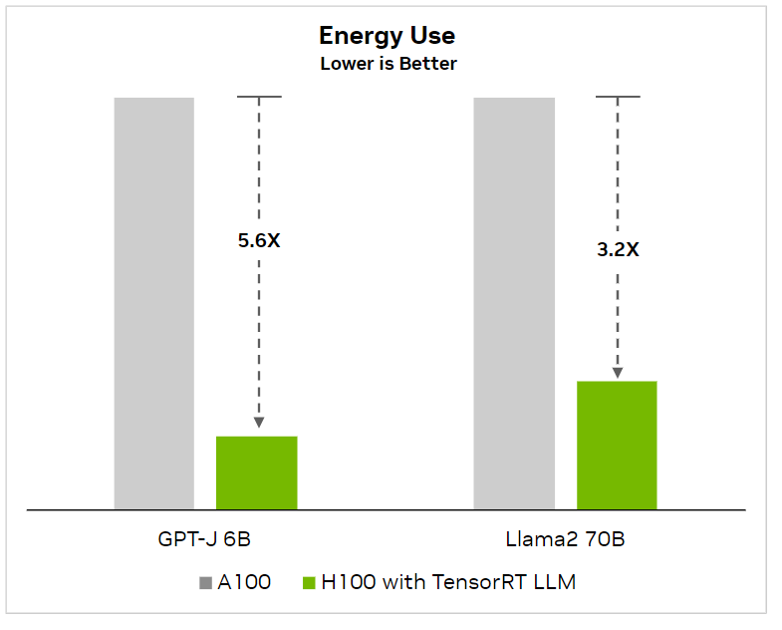
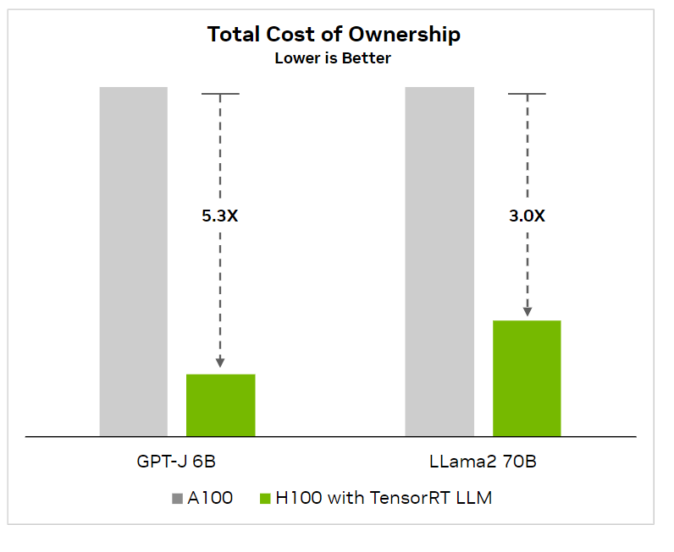
NVIDIA TensorRT-LLM supercharges performance and lowers TCO
Accelerate Inference and Reduce Energy Usage
Enterprise Support
MLOPS Ecosystem
Application Frameworks
Model
Serving
Compilers,
Runtime-
Libraries
Hardware Accelerators
H100 TensorRT-LLM results for September 2023
Text summarization, variable input/output length, CNN / DailyMail dataset |
A100 FP16 PyTorch eager mode | H100 FP8 | H100 FP8, TensorRT-LLM, in-flight batching
Notes:
You can see on these bar charts an example of the latency, performance and TCO gains that you can achieve by compiling your model using TRT or TRT-LLM.
On a 6B GPT model you can achieve a 2x increase in performance running on the same NVIDIA H100 by just compiling your model with TRT-LLM which are depicted in the top bars running on GPT 6b and LLAMA2 models.
Compiling your model using TRT can also help you lower your energy use and reduce TCO by between 3-5x because you can use your GPU more efficiently with techniques like inflight batching and more efficient memory management that eliminates bottlenecks where the GPU is sitting idle waiting for incoming requests or other operations.

Slide 8
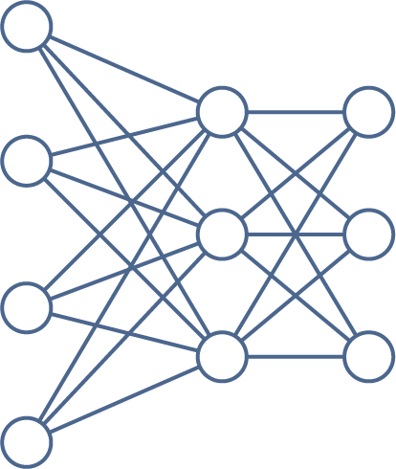
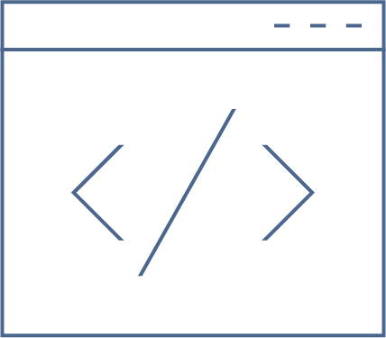

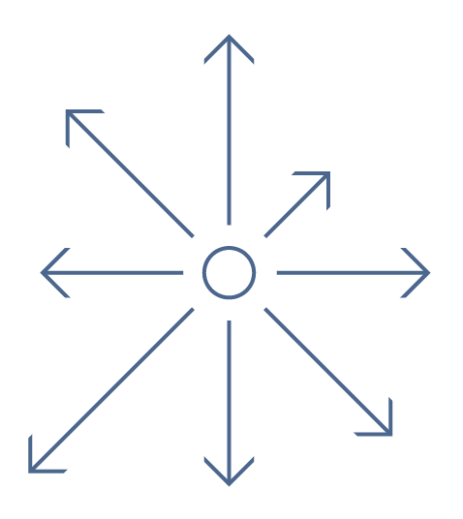
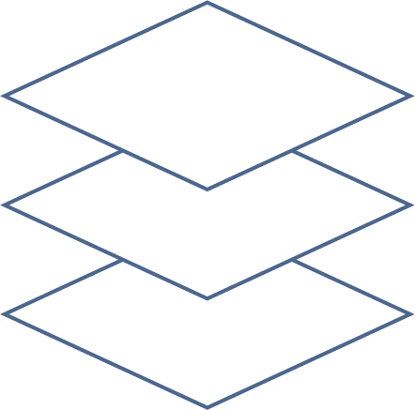

NVIDIA Triton Inference Server
The most versatile cross-platform and fully-featured inferencing server
Enterprise Support
MLOPS Ecosystem
Any Framework
Any Model
Any Query Type
TensorFlow, PyTorch, ONNX, XGBoost, OpenVINO, Python, Custom
Deep learning, tree-based (XGBoost, scikit-learn etc.), model ensembles
Real time, Batched, Audio and Video streaming
Application Frameworks
Model
Serving
Any HW or Location
Any Platform
High Performance
Compilers,
Runtime-
Libraries
CPU or GPU on Cloud, on-prem, edge and embedded
ML platform, Kubernetes, Virtualized |
CPU metrics
Concurrent model execution, Model analyzer, ++
Hardware Accelerators
Notes:
Once you have optimized your model the real fun begins which is how do you deploy your model.
This is where the NVIDIA Triton Open-Source Inference Server comes into play. Triton docker container is super popular and has been downloaded hundreds of thousands of times since its release in 2018.
Its an open source application built from the ground up to serve AI models in highly complex production environments that could be running dozens of models concurrently and serving millions of predictions. *
While speaking with our customers they tell us that Triton helped them reduce the time it takes to deploy models in production with Triton from 3 months to 15 minutes..
Triton supports multiple frameworks like TF, PYTORCH, XGBoost, OpenVion and many other. It also supports different AI models including DL, Tree-based models, Model Ensembles, and it supports different query types like RealTime, Batched or Streaming for Audio and Video applications. It runs CPU and GPUs, on premise or in the cloud.

Slide 9
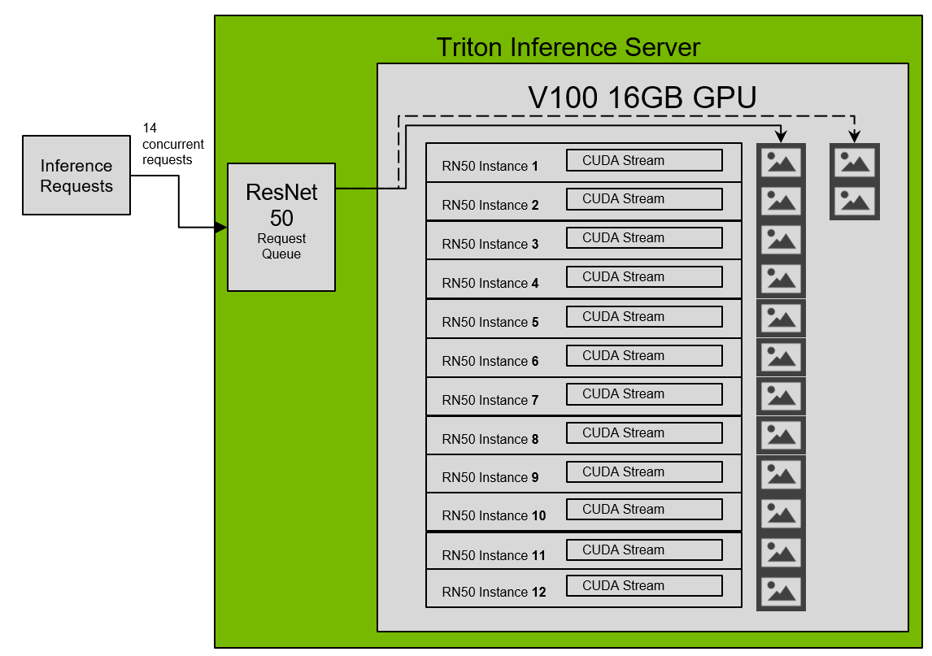
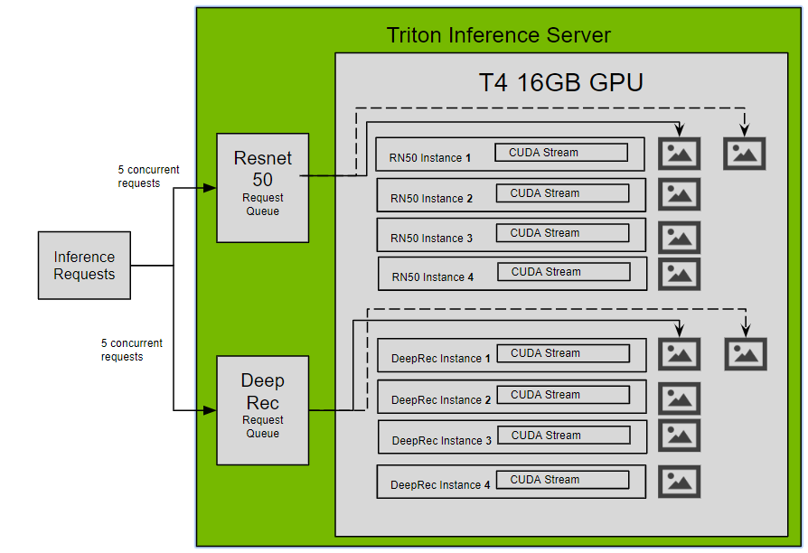
NVIDIA Triton Inference Server
The most versatile cross-platform and fully-featured inferencing server
Concurrent Model Execution
Enterprise Support
Example 1
Concurrently run max number of instances of a single model on one GPU
Example 2
Concurrently run max number of instances of multiple models on one GPU
MLOPS Ecosystem
Application Frameworks
Model
Serving
Compilers,
Runtime-
Libraries
Hardware Accelerators
Notes:
I just want to take a few minutes and double click into three unique features of Triton. The first is Concurrent Model Execution.
Triton’s unique architecture allows multiple different models or multiple instances of the same model to execute in parallel on same GPU. When deploying Triton you can specify how many parallel executions of a model you should allow. If an incoming inference request arrives and the GPU is busy serving a different request it will pass that request to the second instance of the model thus reducing latency and increasing throughout of the GPU.
The goal of this feature is to really allow you to extract the most utilization from your GPU. This is particularly helpful for small models like Resenet 50 where you can fit up to 12 instances of the model on an entry level 16GB GPU.

Slide 10
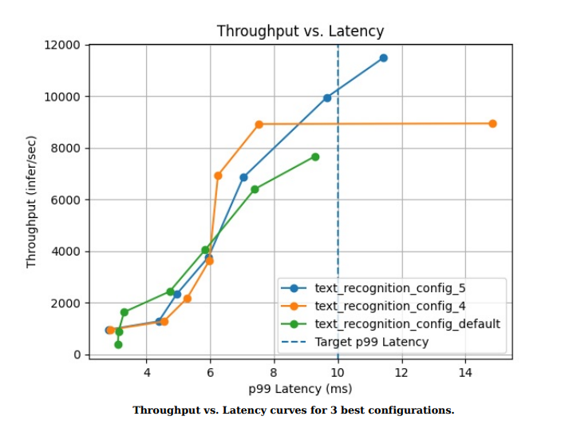
NVIDIA Triton Inference Server
The most versatile cross-platform and fully-featured inferencing server
Enterprise Support
MLOPS Ecosystem
Model Analyzer
Run customizable configuration sweeps to meet SLAs
Identify best configuration for optimal performance under constraints
Analyze results through reports and charts
Application Frameworks
Model
Serving
Compilers,
Runtime-
Libraries
Hardware Accelerators
Notes:
Another very notable feature of Triton is the Model Analyzer.
In a production environment, AI applications can have very specific latency and thruput requirements. There are two levers that IT can adjust that impact how long an incoming request would sit in the inference server queue before it is processes by the GPU: 1/increase or decrease the batch size of the inference requests and load additional instances of the same model on the target GPU or virtual machine.
Playing around with these two variables requires trial and error and can be laborious given the large number of different possible combinations.
Model Analyzer solves this challenge. You can provide it with your constraints such 10ms latency limit for every incoming inference request and it will automatically rung tests or sweeps against the various common combinations of batch sizes and instance numbers providing you with a graph like the one you see on the slide.

Slide 11
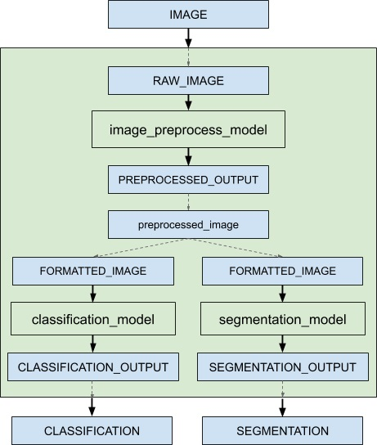
NVIDIA Triton Inference Server
The most versatile cross-platform and fully-featured inferencing server
Enterprise Support
MLOPS Ecosystem
Model Ensembles
Serve pipelines of one or more models
Shares GPU memory to optimize performance​
Each model in pipeline can run on different framework and H/W
Application Frameworks
Model
Serving
Compilers,
Runtime-
Libraries
Hardware Accelerators
Notes:
Last feature I want to double click on for Triton is the Model Ensembles.
Many production AI use cases require a pipeline of ML models to be executed to deliver on the final output. A popular example is conversational AI pipeline that consists of a pipeline of 3 different models: an automatic speech recognition (ASR) module to convert the input audio waveform to text, a large language model (LLM) module to understand the input and provide a relevant response, and a text-to-speech (TTS) module to produce speech from the output of the LLM.
Another example is computer vision AI applications which typically require some preprocessing steps on the input data before feeding it to the ML models, like resizing or cropping, before being feeding it into the models.
Triton’s Model Ensembles feature automates that process for you allowing you to focus on your use case and not all the backend plumbing that is needed to coordinate and synchronize these workflows accelerating the time to production for your models.

Slide 12
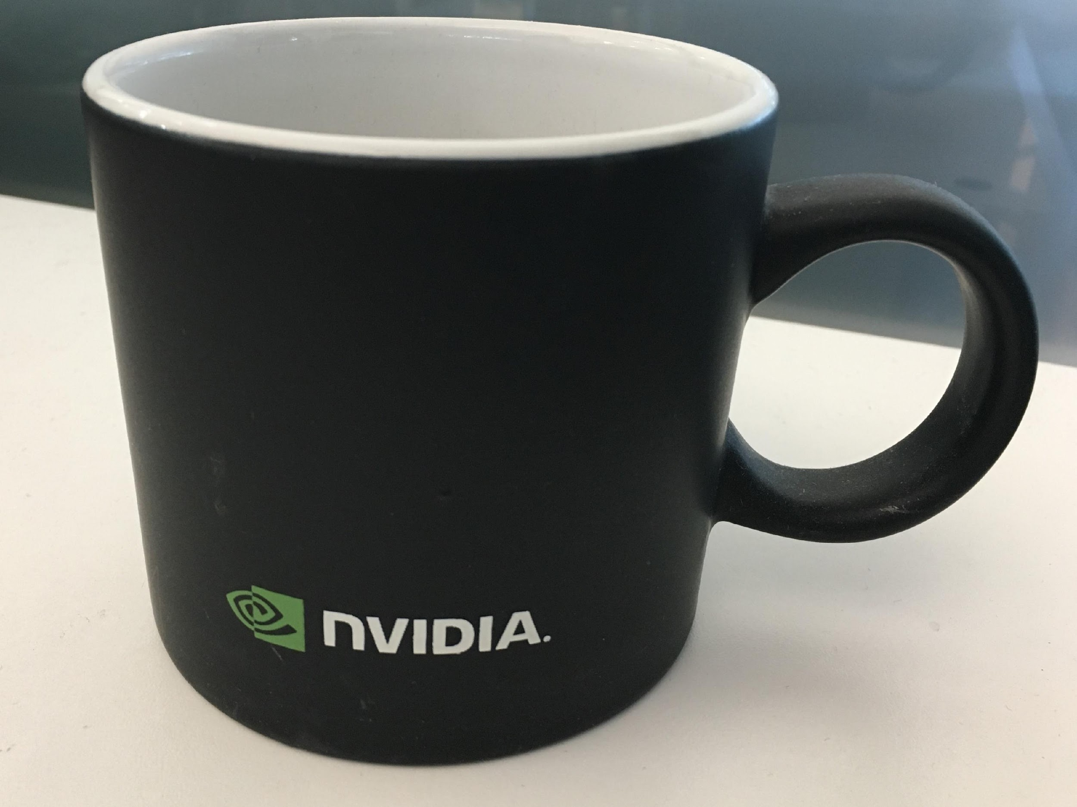
NVIDIA Triton Inference Server
The most versatile cross-platform and fully-featured inferencing server
Deploy Triton and serve models in 3 easy steps
Enterprise Support
# Step 1: Create the example model repository
git clone -b r23.10 https://github.com/triton-inference-server/server.git
cd server/docs/examples
./fetch_models.sh
# Step 2: Launch triton from the NGC Triton container
docker run --gpus=1 --rm --net=host -v ${PWD}/model_repository:/models nvcr.io/nvidia/tritonserver:23.10-py3 tritonserver --model-repository=/models
# Step 3: Sending an Inference Request
docker run -it --rm --net=host nvcr.io/nvidia/tritonserver:23.10-py3-sdk
/workspace/install/bin/image_client -m densenet_onnx -c 3 -s INCEPTION /workspace/images/mug.jpg
# Inference should return the following
Image '/workspace/images/mug.jpg':
15.346230 (504) = COFFEE MUG
13.224326 (968) = CUP
10.422965 (505) = COFFEEPOT
Image classification example with Densenet
MLOPS Ecosystem
Application Frameworks
Model
Serving
Compilers,
Runtime-
Libraries
COFFEE MUG
Hardware Accelerators
Notes:
My personal favorite feature of Triton is that it is super easy install and deploy. You can literally install it right now on your computer right now. If you have a docker engine installed your workstation then you can literally with 3 lines of code install Triton on your computer.
And if you don’t have a GPU on your laptop or workstation. That’s fine as well. Triton works on CPUs too. All you would need to do is remove the GPU flag that you see in the second code line and you should be good to go. It is really that simple.

Slide 13



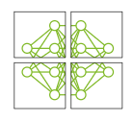





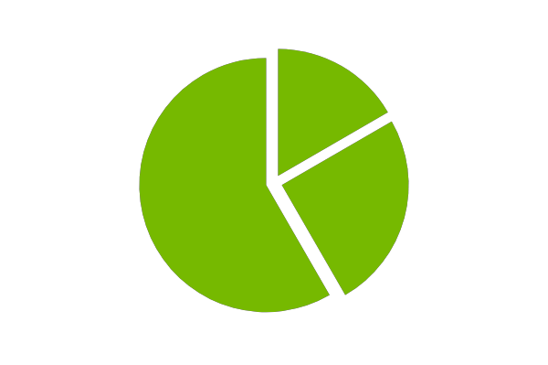

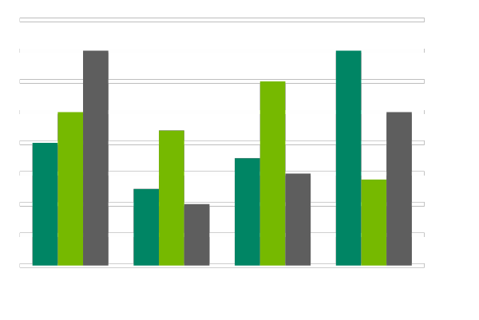
NVIDIA NeMo for building generative AI applications
Build, customize and deploy generative AI models
Production Runtimes
NVIDIA NeMo
MLOPS Ecosystem
Data
Curation
Distributed
Training
Model
Customization
Accelerated
Inference
Retrieval Augmented
Generation
Guardrails
In-domain, secure, cited responses
…
Application Frameworks
In-domain queries
Model
Serving
RAPIDS
Megatron Core
NeMo
Triton & TensorRT-LLM
NeMo Inform
NeMo Guardrails
Model Development
Enterprise Application Deployment
Compilers,
Runtime-
Libraries
Hardware Accelerators
Notes:
NVIDIA NeMo™ is an end-to-end, cloud-native framework to build, customize, and deploy generative AI models anywhere. It includes training and inferencing frameworks, guard railing toolkits, data curation tools, and pretrained models, offering enterprises an easy, cost-effective, and fast way to adopt generative AI.

Slide 14
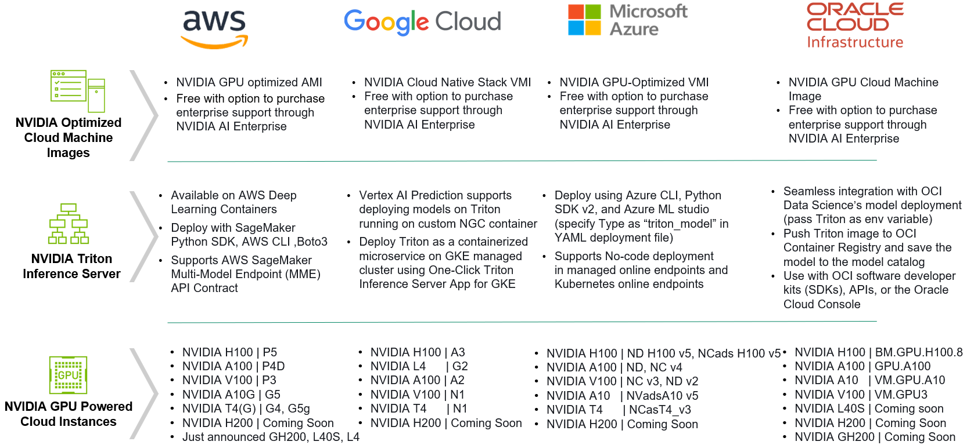
NVIDIA AI Inference Platform in the cloud
Broad and deep support of the NVIDIA Inference Platform in the cloud
Production Runtimes
MLOPS Ecosystem
Application Frameworks
Model
Serving
Compilers,
Runtime-
Libraries
Hardware Accelerators
Cloud service providers listed in alphabetical order. Please visit CSP’s respective website for latest NVIDIA GPU powered compute Instances at www.aws.com , www.cloud.google.com, www.azure.Microsoft.com, and www.oracle.com
Notes:
Triton:
1/When it comes to the software layer of the inference stack, once again you will notice that NVIDIA’s open source Triton Inference Server is deeply integrated across all the different CSPs. So, whether you are using AWS SageMaker, Google Vertex AI, Azure ML or OCI’s Data Science cloud tools you will find low code and no code deployment options to launch the Triton Inference Server directly from the AI tools that your IT teams are certified and trained on using saving you time, money and IT human resources.
2/*** For example, if you are using OCI Data Science Platform then you can simply pass the word “Triton” as an environment variable in your command line arguments during model deployment and automatically launch a triton inference endpoint.
3/**** Similarly of you are using the Azure ML CLI tool then you can simply enter the words “Triton_model” in your YAML deployment configuration file. GCP also offers a one click deployment option with their GKE managed clusters and AWS offers Triton on their AWS Deep learning Containers.
4/**** The point is, if you have standardized your IT department on any of these tools and prefer to deploy Triton directly via these tools in a no code low code approach then you can do that today. 5/*** Of course, all of NVIDIA’s software is made available as part of our Nemo framework packaged up in a Docker container that is fully compatible with all cloud Kubernetes engines like Amazon AKS, and Google EKS so you can always pull that container and deploy it directly to your instance which is what we will show you today during the hands on demo portion of the meeting.

Slide 15
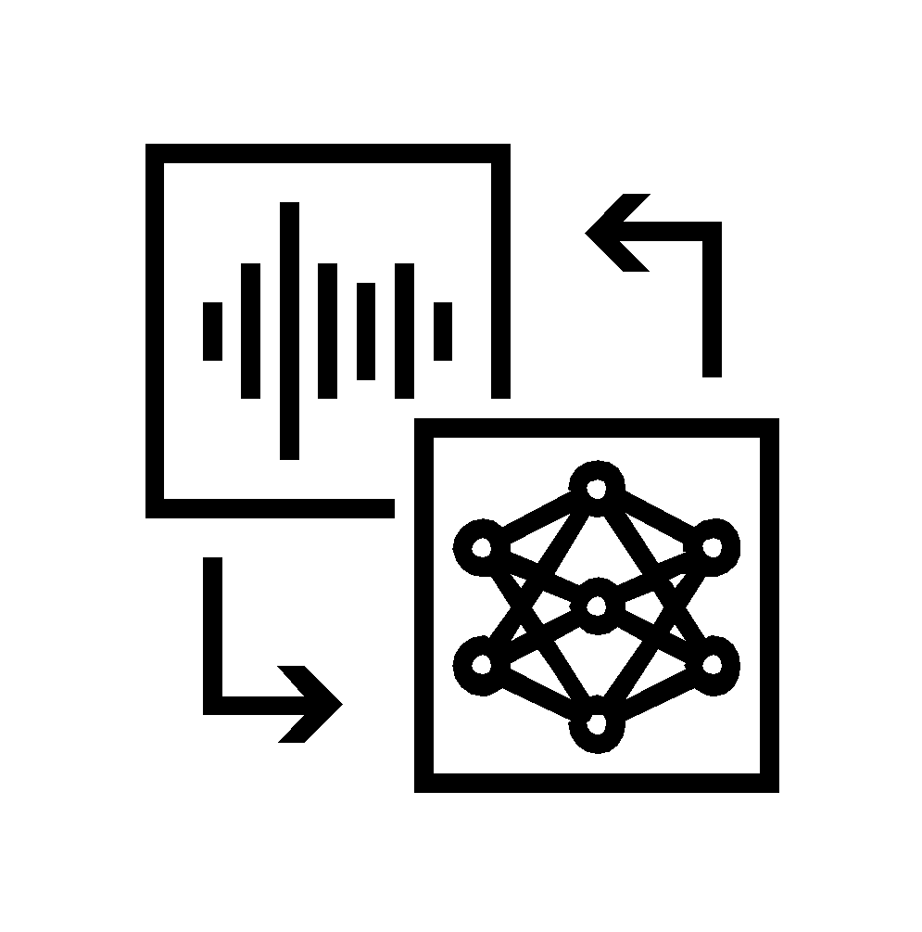


NVIDIA AI Enterprise
Enterprise-grade software platform for uninterrupted AI runtimes
Production Runtimes
MLOps
AI Applications
NVIDIA AI Enterprise for Inference
MLOPS Ecosystem
Infrastructure Management
Application Frameworks
Cloud Native Management
and Orchestration
GPU Operator, Network Operator
Application Frameworks
LLM
NeMo
Speech AI
Riva
Cybersecurity
Morpheus
Medical Imaging
Clara
More
Cluster Management
Base Command Manager Essentials
AI Development
Model
Serving
Data Science / Prep
RAPIDS, RAPIDS Accelerator
for Apache Spark
Model Training and Customization
NeMo, TAO, PyTorch, TensorFlow
Compilers,
Runtime-
Libraries
Infra Acceleration Libraries
Magnum IO, vGPU, CUDA
Deploy at Scale
Triton Inference Server
Optimize for Inference
TensorRT, TensorRT-LLM
Hardware Accelerators
Cloud | Data Center | Workstations | Edge

Slide 16
THANK YOU

