Slide 1
X-Box Summary
28.02.2024

Slide 2
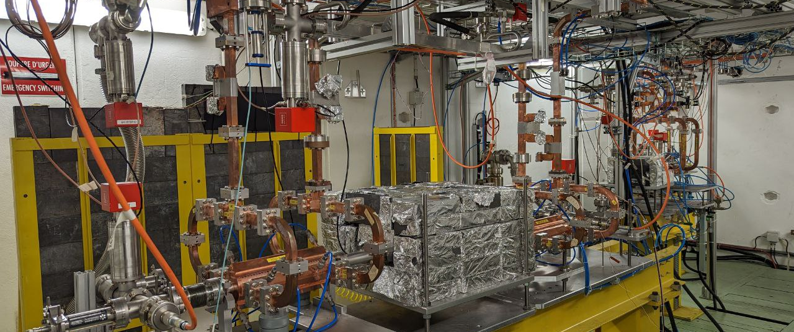
X-Box 2: TD31 N3 N4

Slide 3
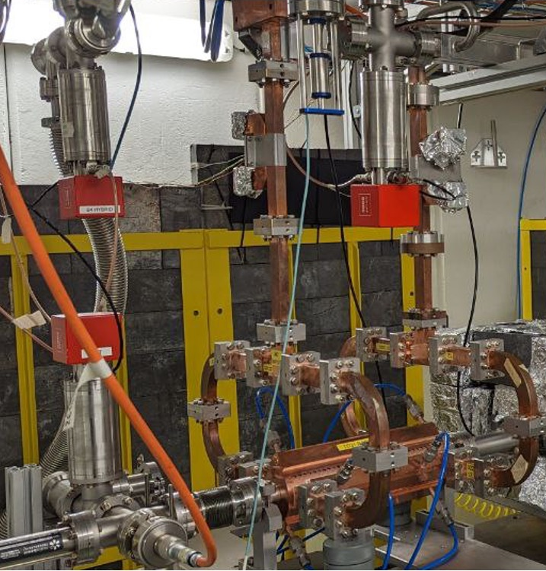
X-Box 2: TD31 N3 N4
X-Box 2 TD31 N3 N4: Structure A
Restarted 05.06.2023
100:1 ratio, all power to Structure A
Max. power ~45 MW
Pulse width 200ns
Breakdowns w/o breakdown current

Slide 4
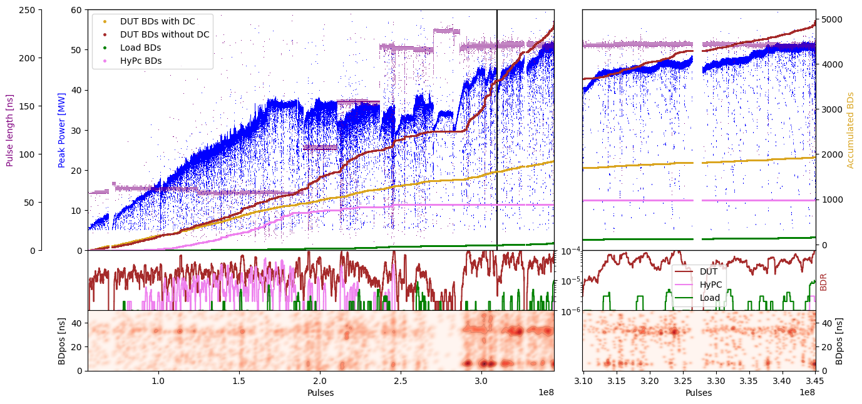
X-Box 2: TD31 N3 N4 Structure A – Peak Power

Slide 5
X-Box 2: TD31 N3 N4 Structure A – Gradient

Slide 6
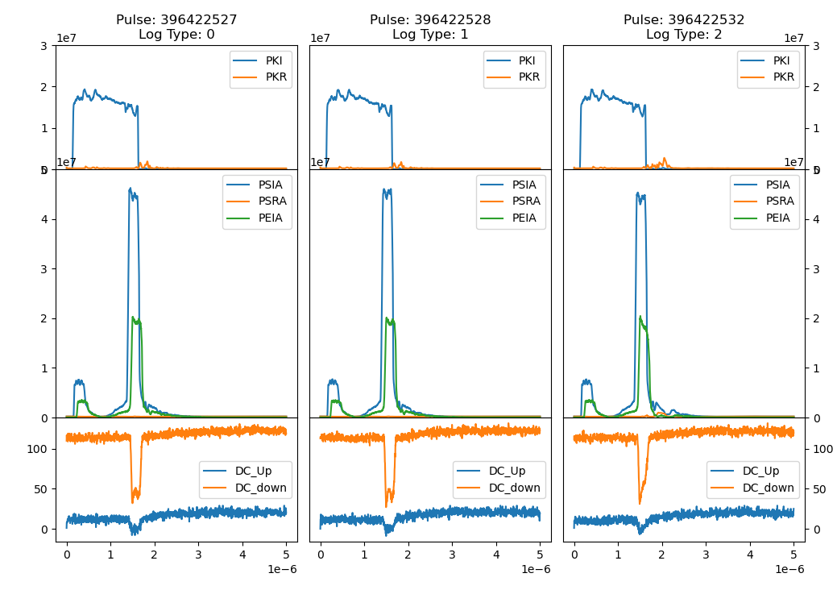
X-Box 2: 08 July 2023 Pulse 396422527

Slide 7
X-Box 2: TD31 N3 N4
X-Box 2 TD31 N3 N4: Structure B
Restarted 26.01.2024
100:1 ratio, all power to Structure B
Starting power ~25 MW
Pulse width 50ns
Running flat 44MW

Slide 8
X-Box 2: Reminder on BD classification
BD_Flag_PER_log
BD Load
TRUE
BD_Flag_DC_DOWN
DC Up >=140
DC Down>=100
BD DUT w. BDC
BD_Flag_DC_UP
FALSE
BD_Flag_PSR_log
BD DUT wo. BDC
BD_Flag_PKR_log
BD HyPC
No BD

Slide 9
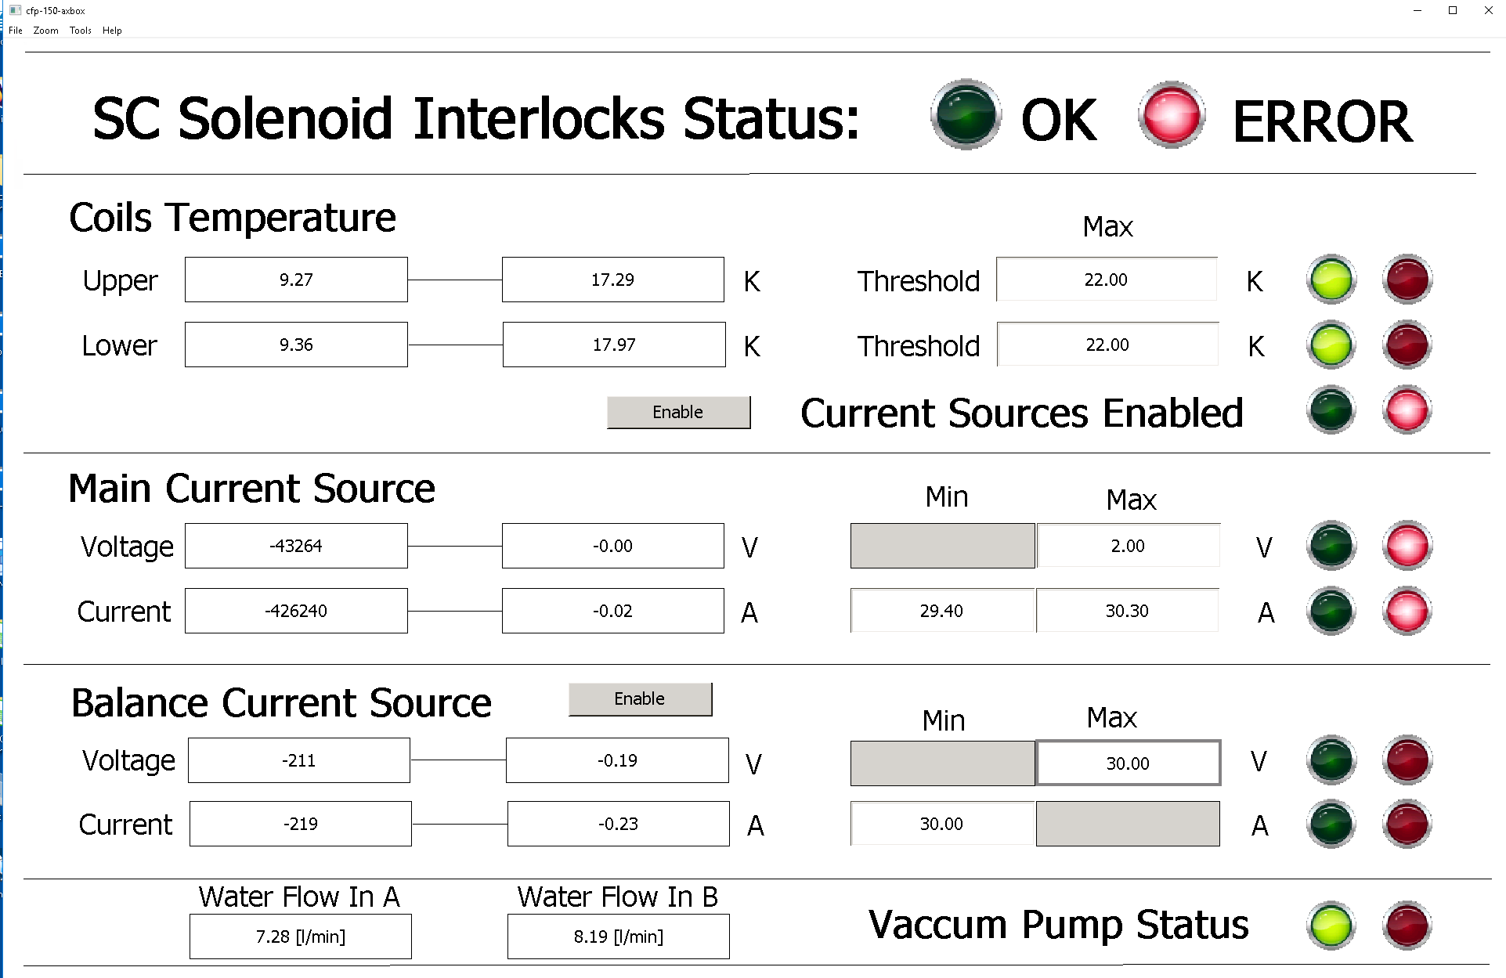
X-Box 2 - improvements
Done:
  Readout of water flow
  Addition of extra temperature channels
To do:
  Duplication of channel DC_DOWN_B, with and without attenuation

Slide 10
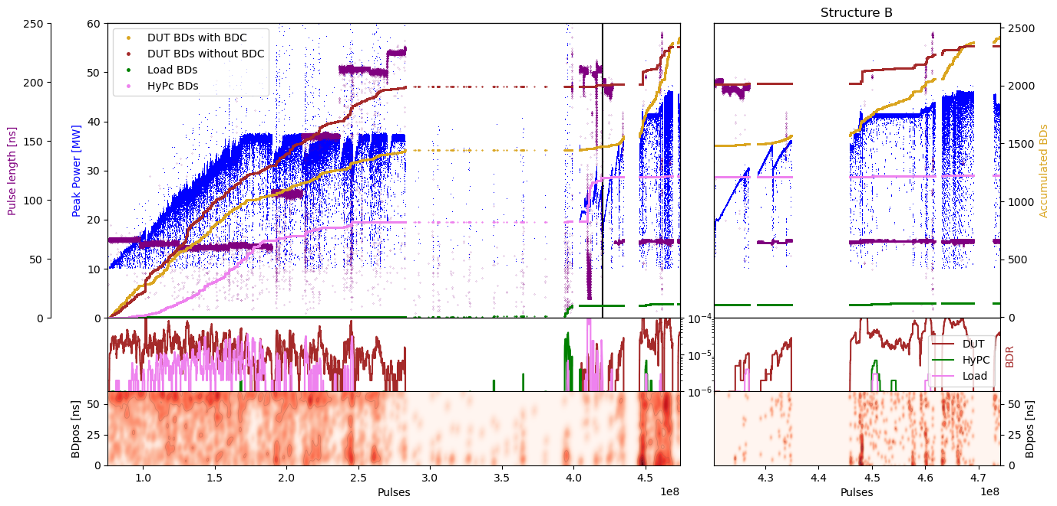
X-Box 2: TD31 N3 N4 Structure B – Peak Power
100:1 to structure A

Slide 11
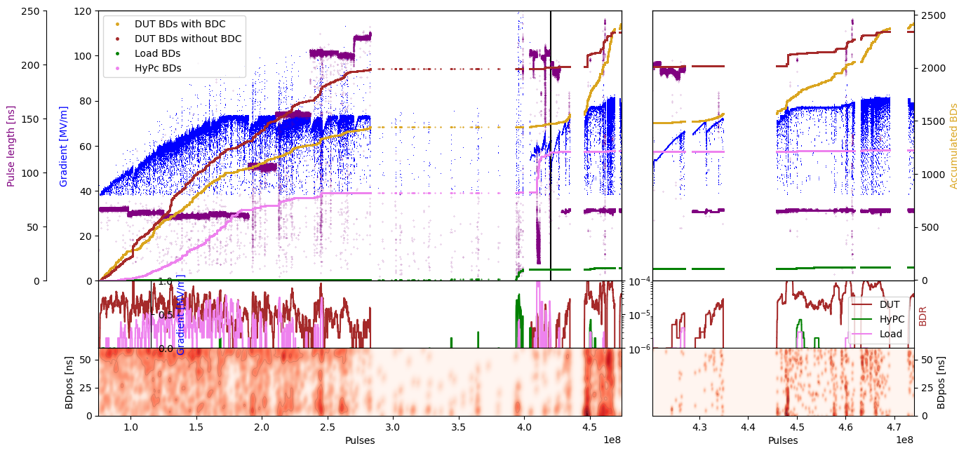
X-Box 2: TD31 N3 N4 Structure B – Gradient
100:1 to structure A

Slide 12
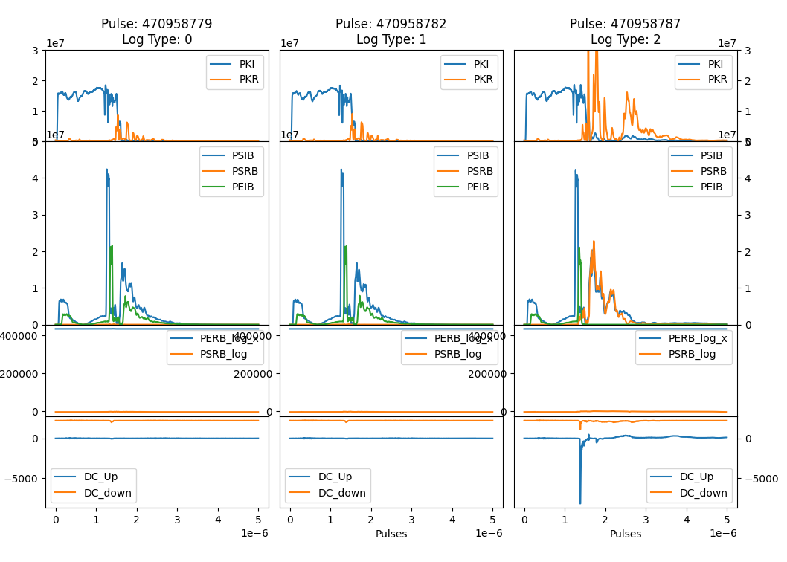
X-Box 2: 24 Feb 2024 Pulse 470958787

Slide 13
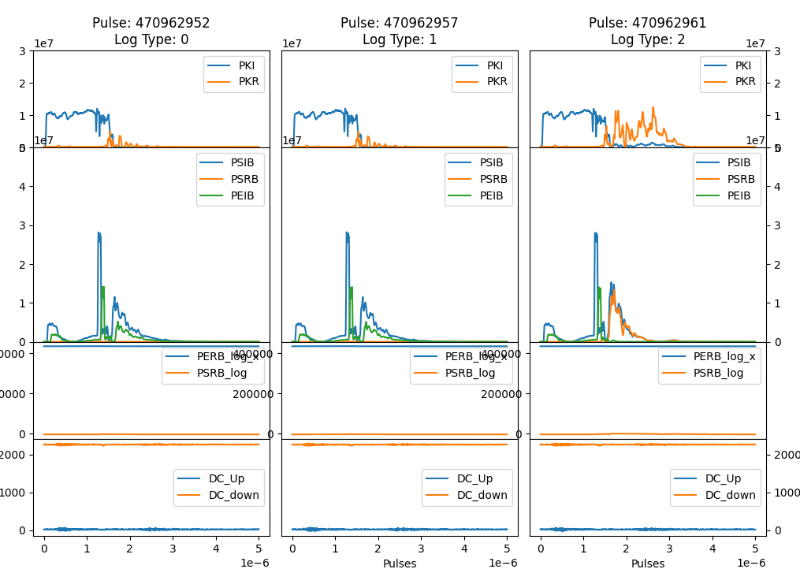
X-Box 2: 24 Feb 2024 Pulse 470962961

Slide 14
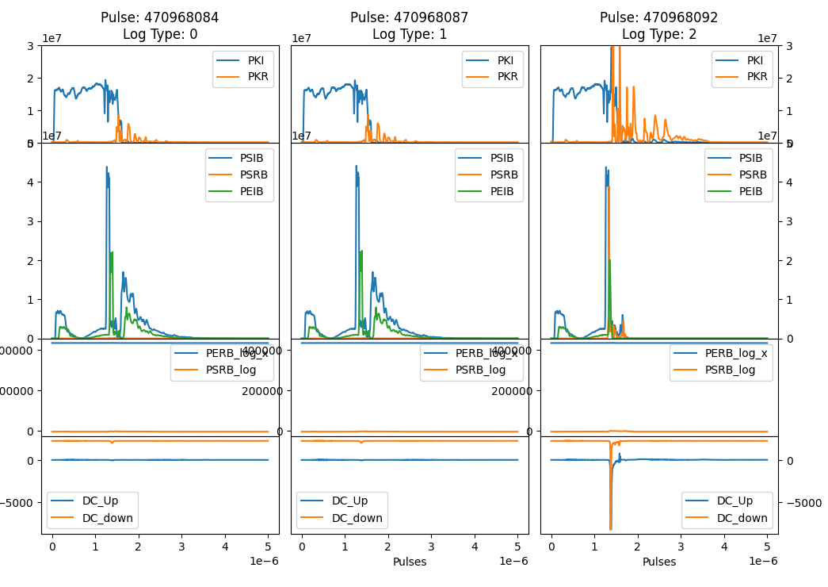
X-Box 2: 24 Feb 2024 Pulse 470968092

Slide 15
X-Box 2: 24 Feb 2024 Pulse 470968092

Slide 16
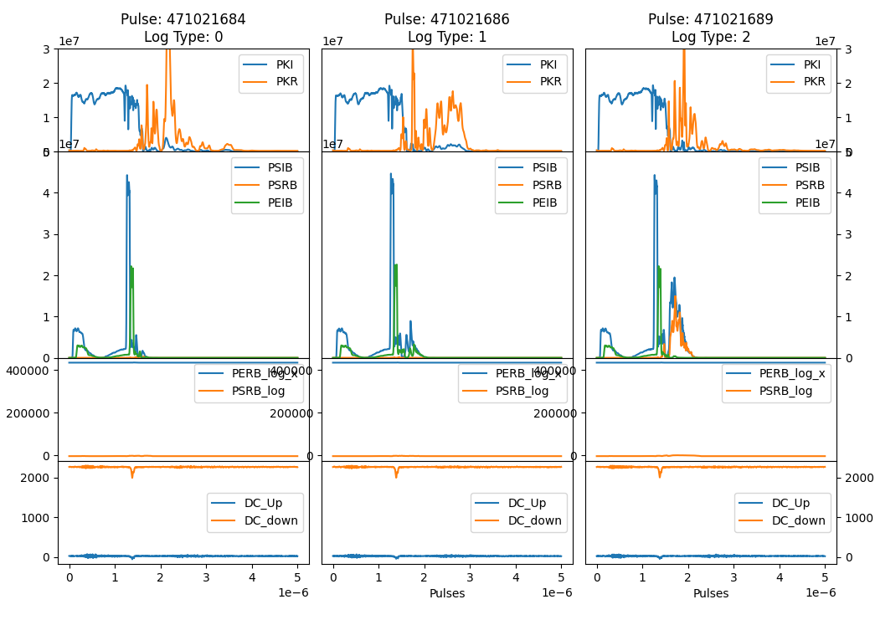
X-Box 2: 24 Feb 2024 Pulse 471021689

Slide 17
X-Box 2: Planning week 4-8 March 2024
Experiment at Xbox2
  Demonstration of operation mode using leading edge of modulator to amplify RF pulse (Ping simulations)
  Study on the dependency of the pulse ripple versus phase rising time

Slide 18
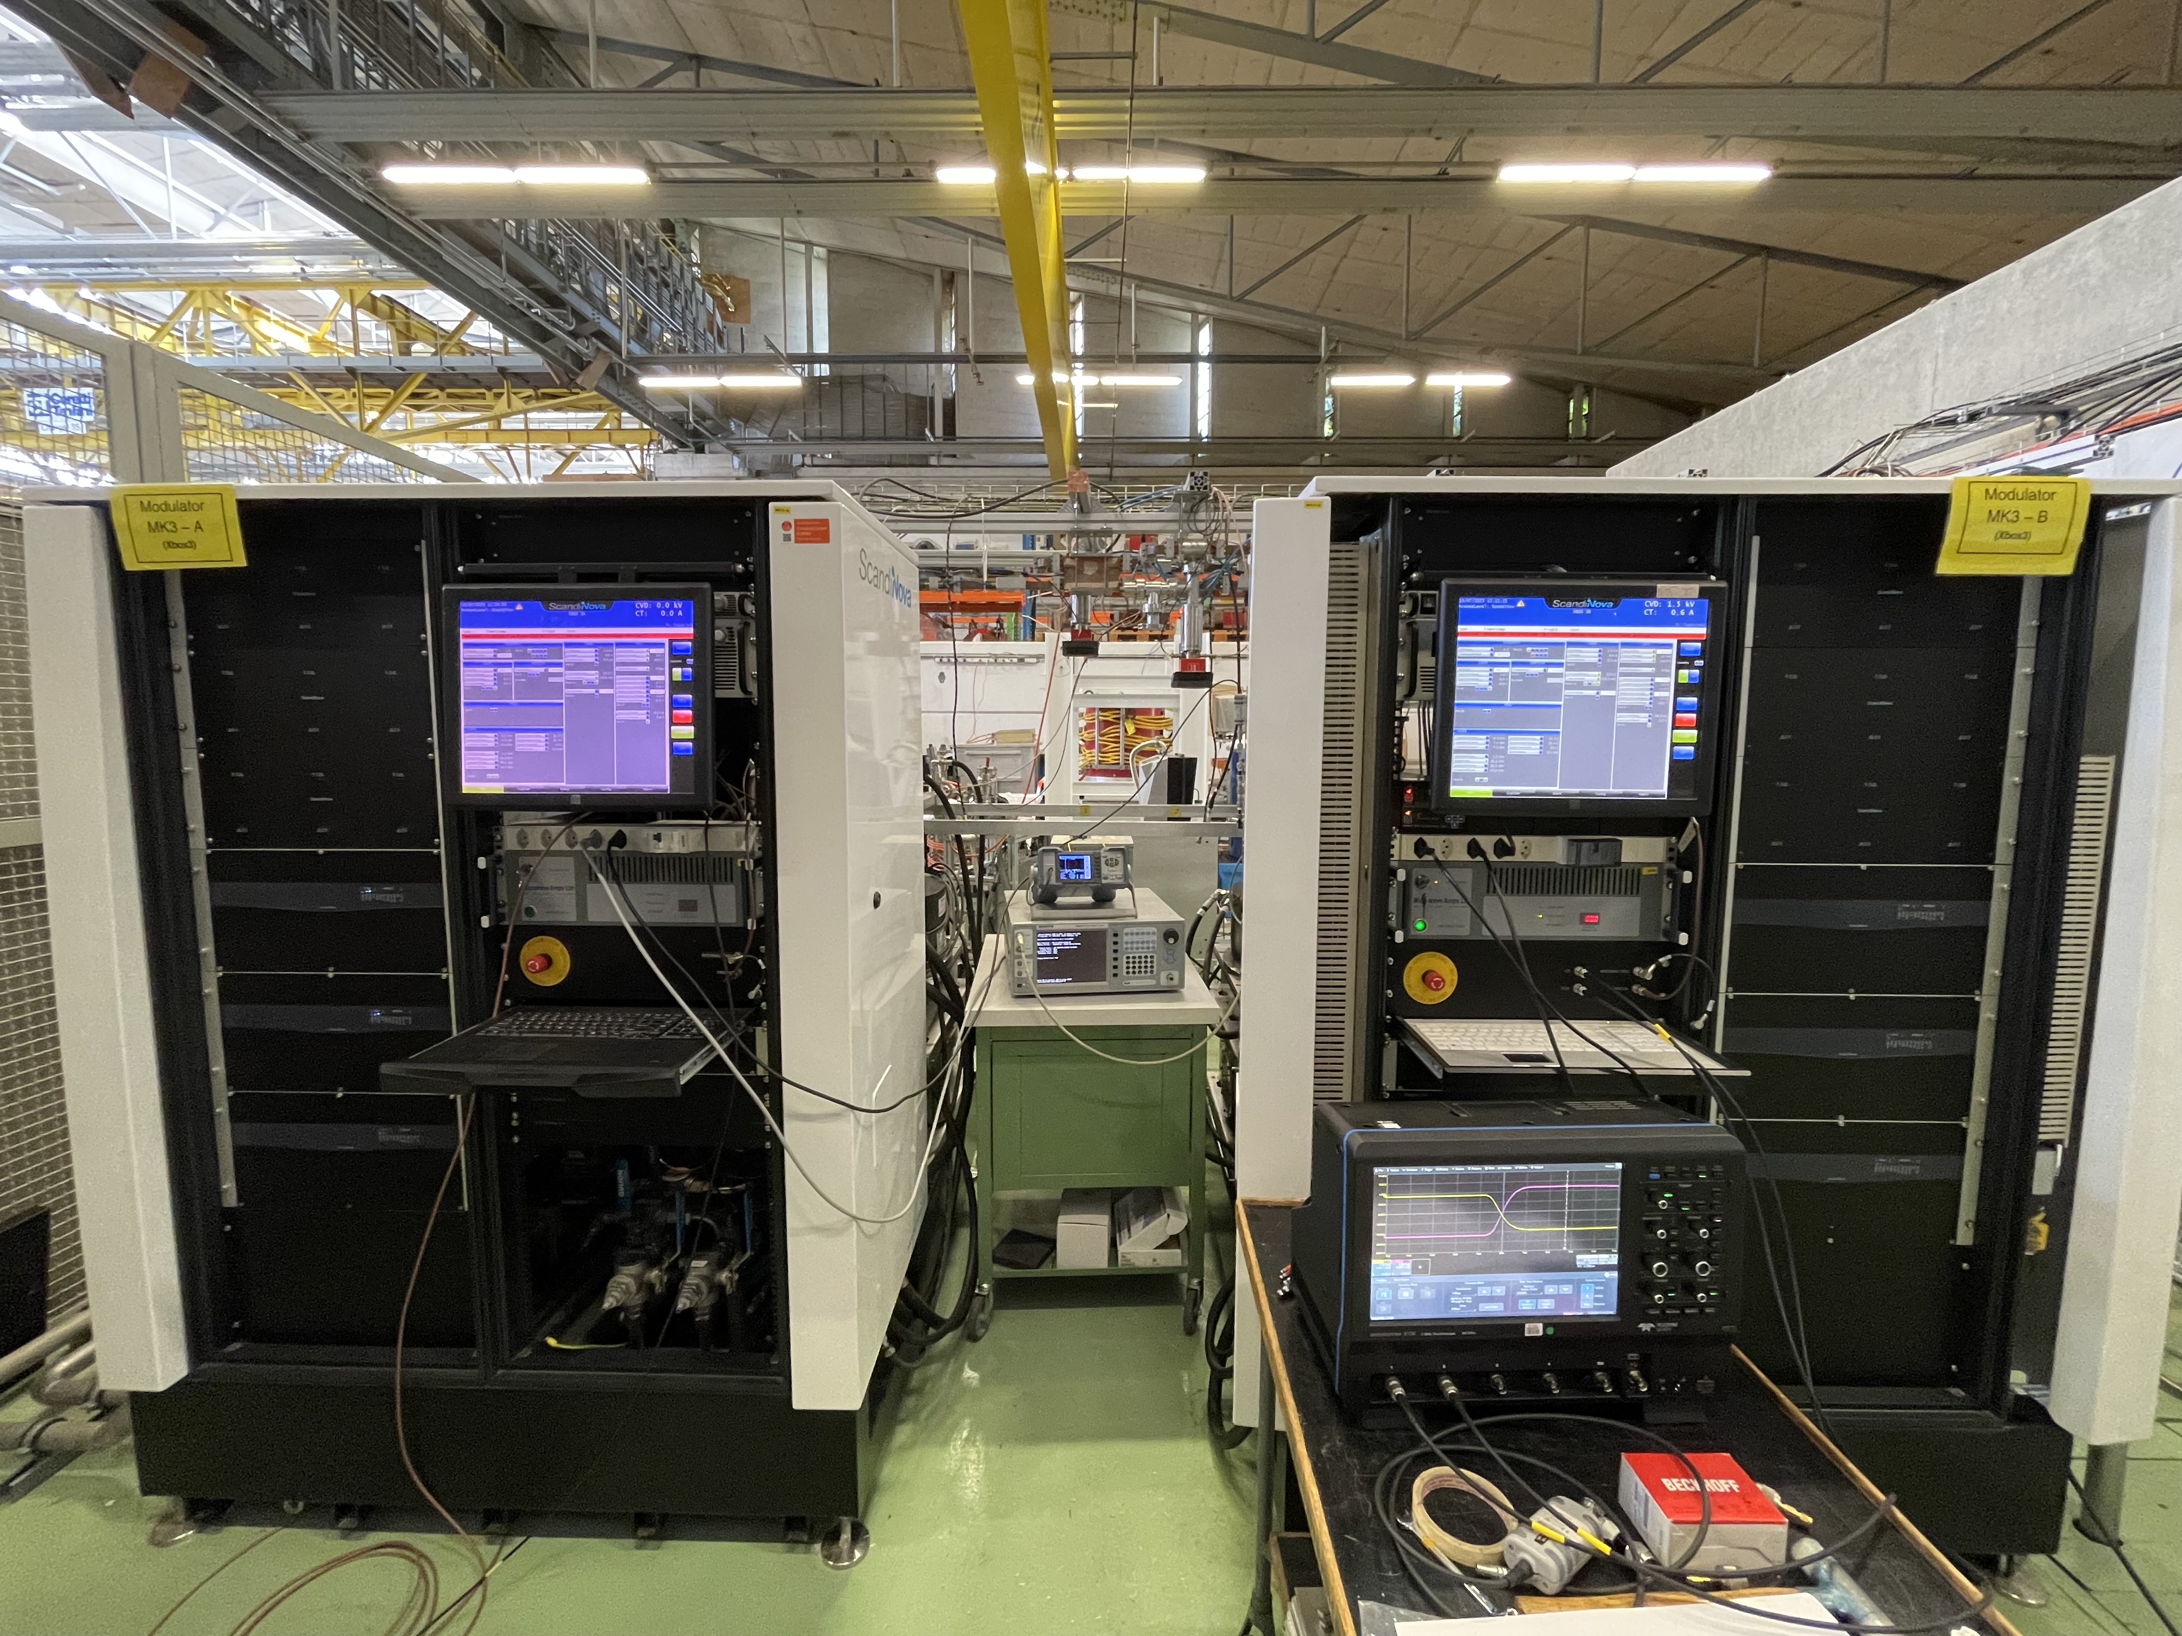
X-Box 3: High Efficiency Tubes Characterisation
New campaign based on calorimetry
  Temperature sensors are installed
  Still waiting for installation of flow meters (fittings)
Uncertainty sources in collector calorimetry
  Variations in temperature due to slow response of water station
  Variations in water flow
  Accuracy of the surface sensors
    May improve with PT1000 probes
TUBE1 22M001
CAV 22G002

Slide 19
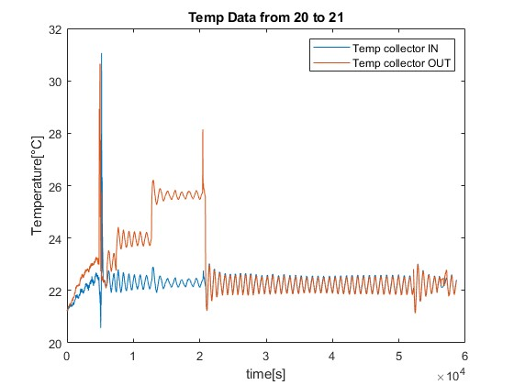
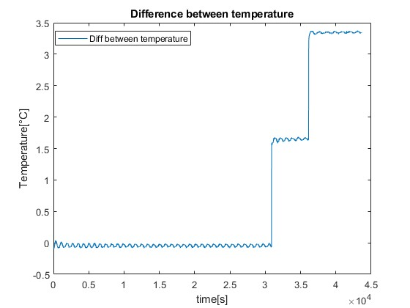
X-Box 3 HEK: Collector calorimetry

Slide 20
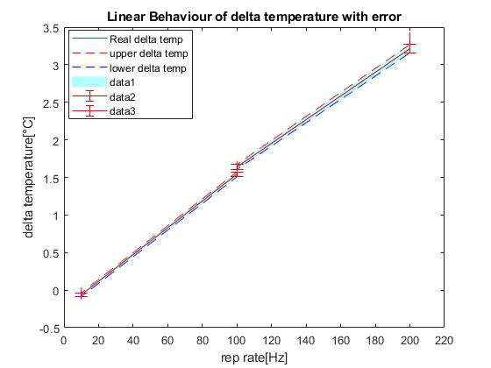
X-Box 3 HEK: Collector calorimetry

Slide 21
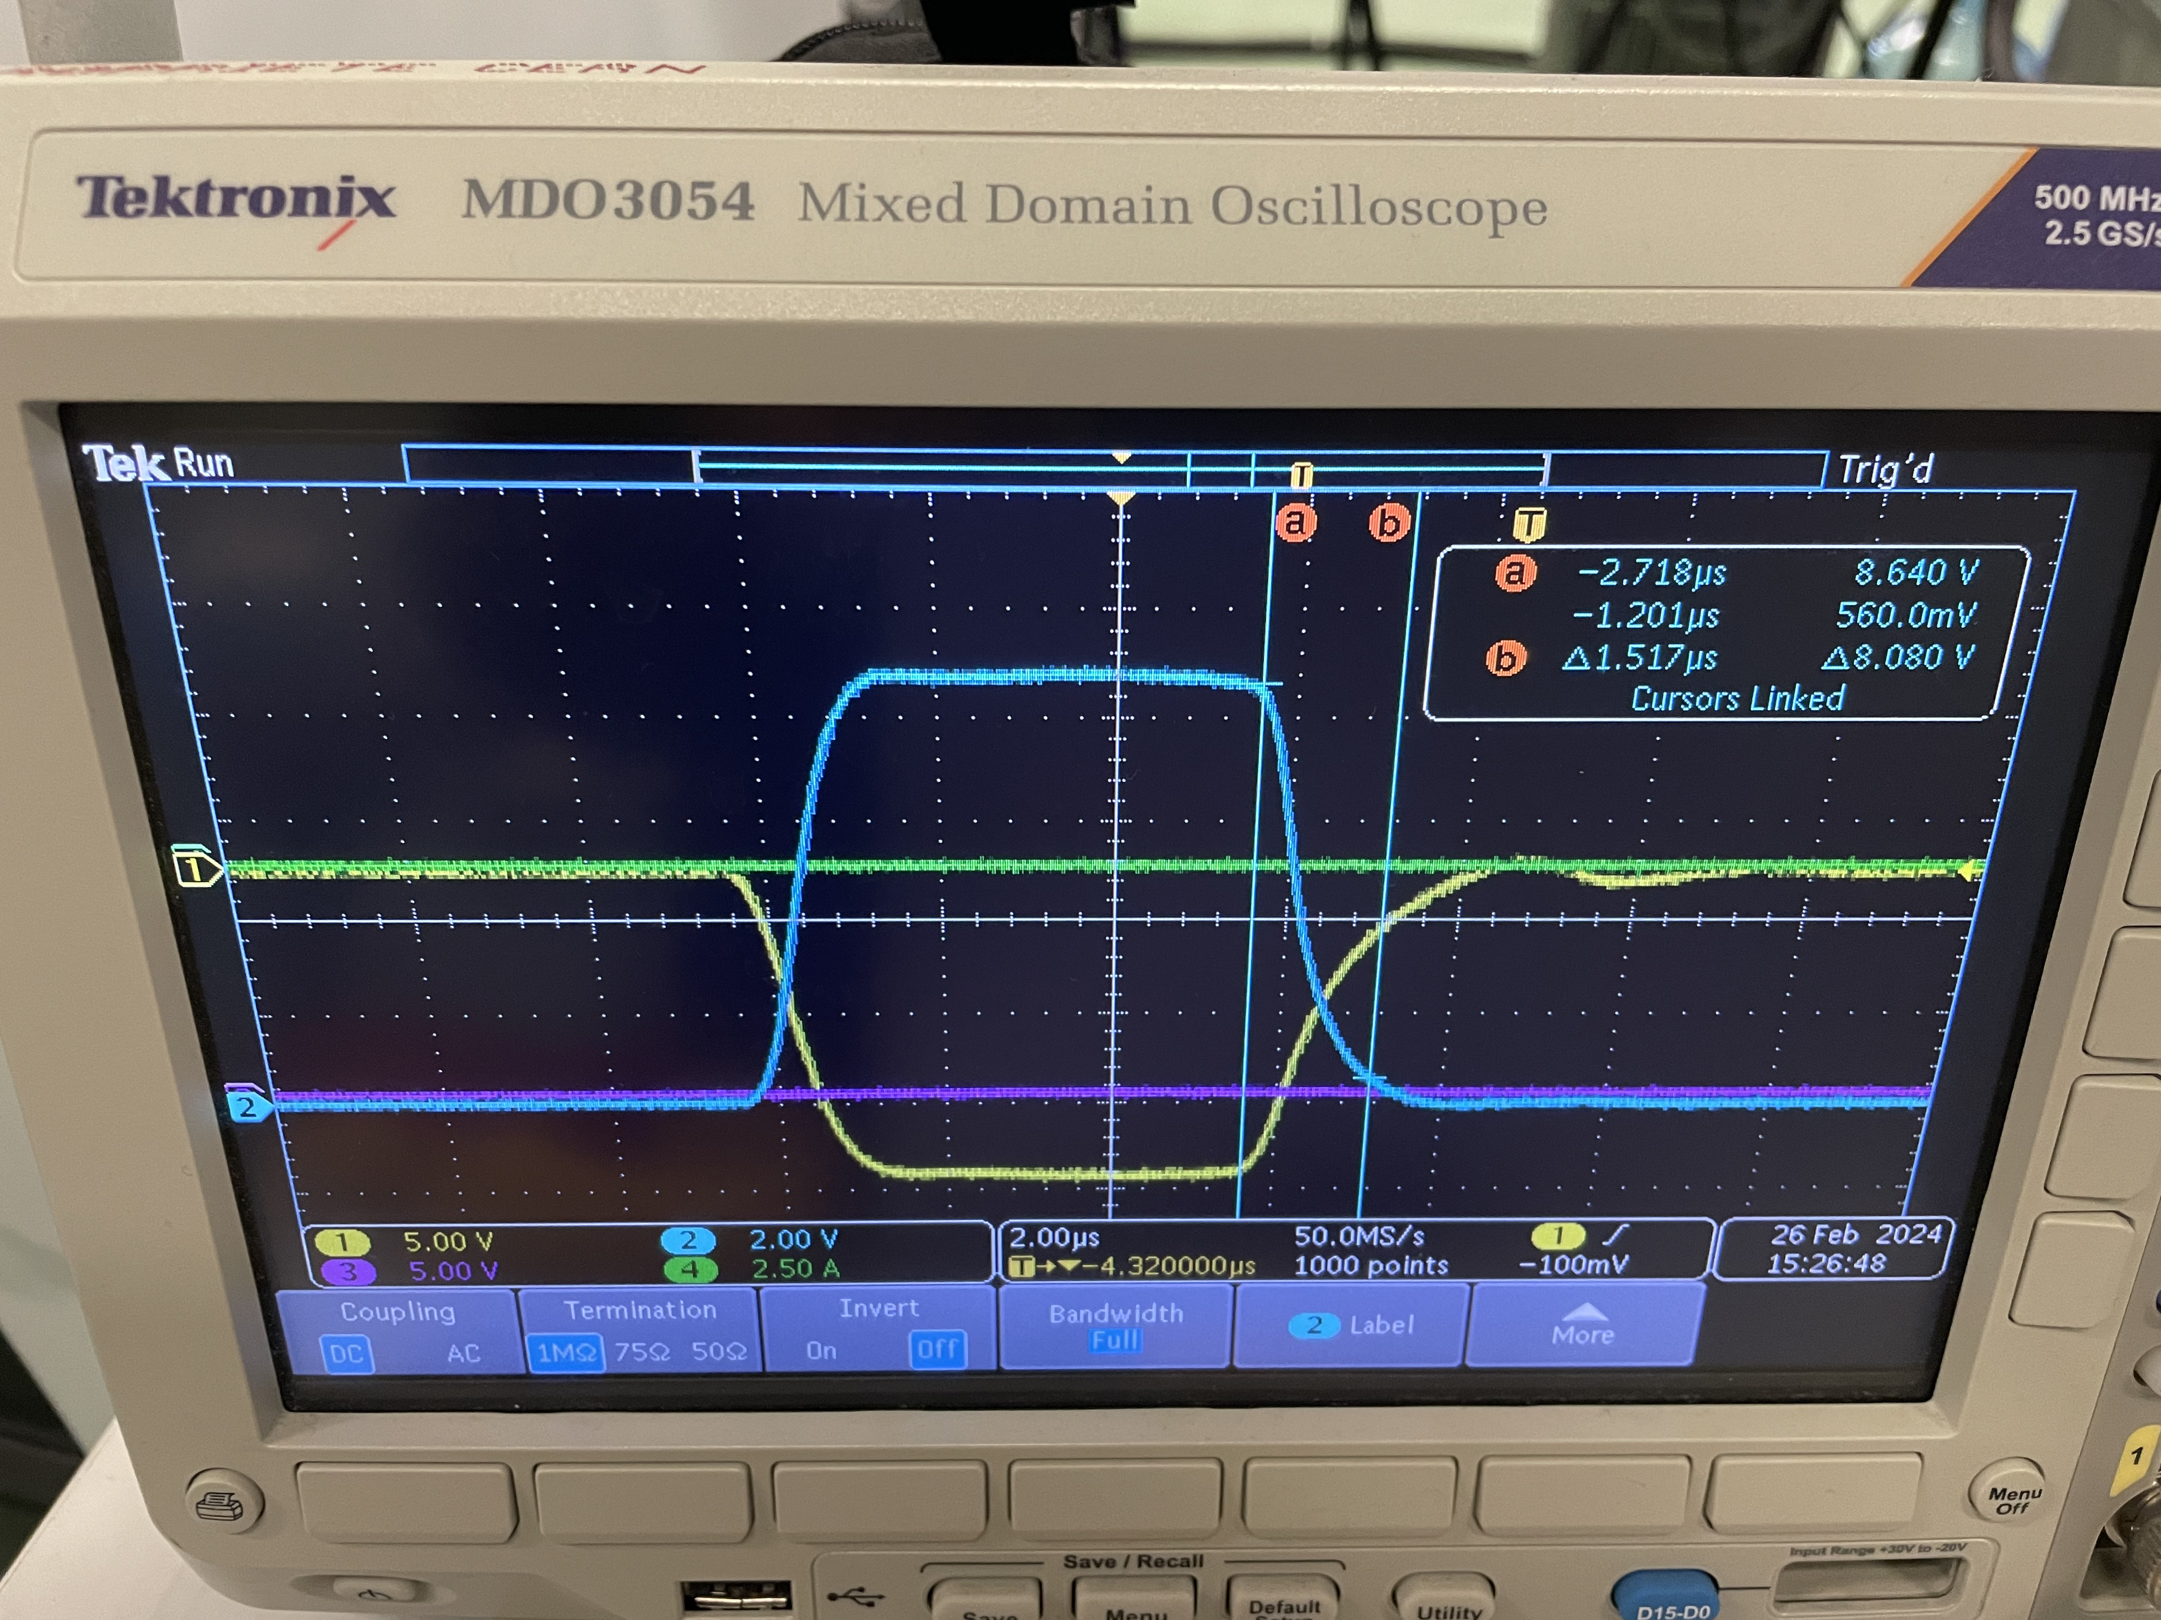
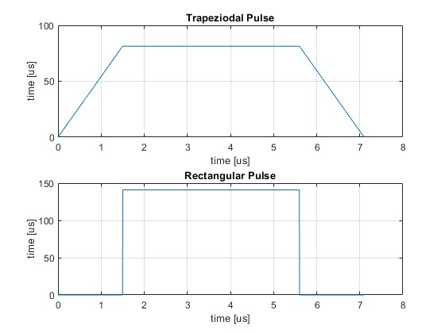
X-Box 3 HEK: Collector calorimetry
Meas. peak power (calorimetry) 10.801MW
Meas. beam current (scope) 81.2A
Calculated uPe=1.67

Slide 22
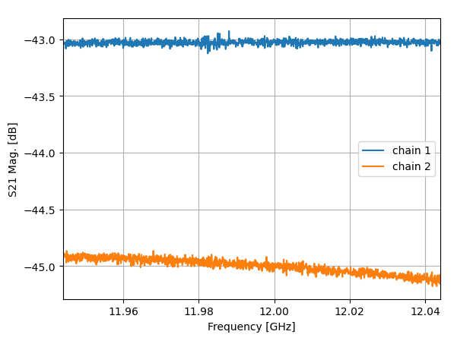
High Efficiency Tubes Characterisation
Measurement setup
Klystron
RF Gen
SSA
HP DC
Load
DC
Attenuation
Isolation + Transition + Attenuation
Power Meter 1 - PKI
Power Meter 2 - PKI

Slide 23
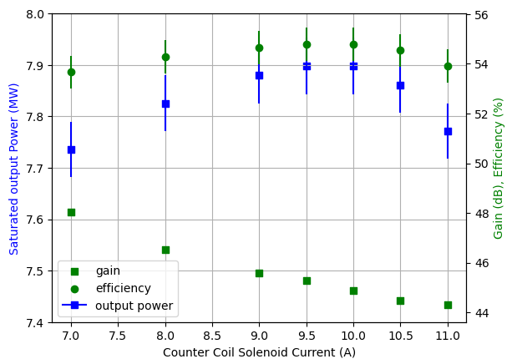
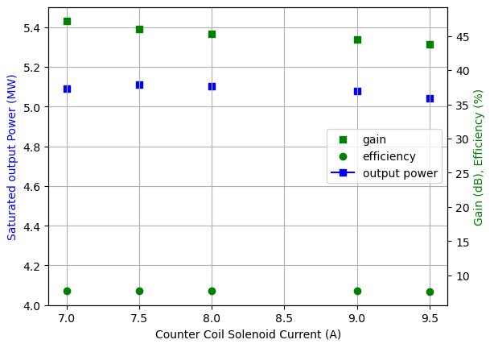
High Efficiency Tubes Characterisation
Gain curves vs Counter Coil Current
22M001 TUBE
22G002 CAV

Slide 24
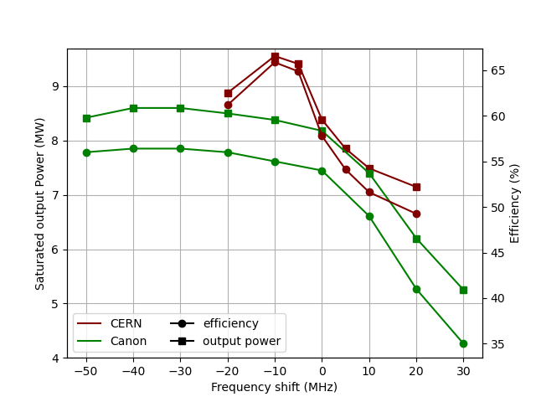
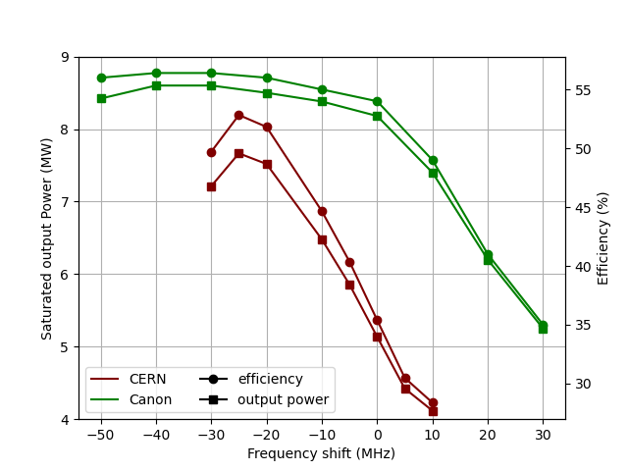
High Efficiency Tubes Characterisation
Frequency Behaviour
22M001 TUBE
22G002 CAV

Slide 25
High Efficiency Tubes Characterisation
Some problems with vacuum
  Last week before Christmas break this was solved
  Now both lines <1e-9 mbar
New measurement campaign, based on calorimetry
  Still waiting for flow meters and temperature sensors

