Slide 1

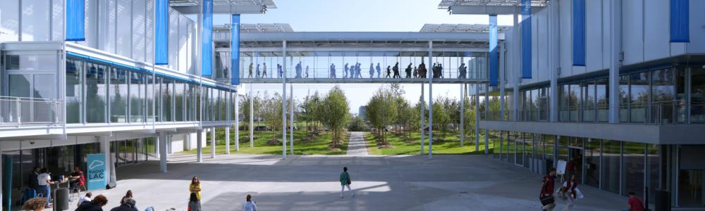
Origins and history of JUAS
Louis Rinolfi
27th November 2024
CERN Science Gateway
CERN Science Gateway

Slide 2
1989 - 1993
Origins of JUAS

Slide 3
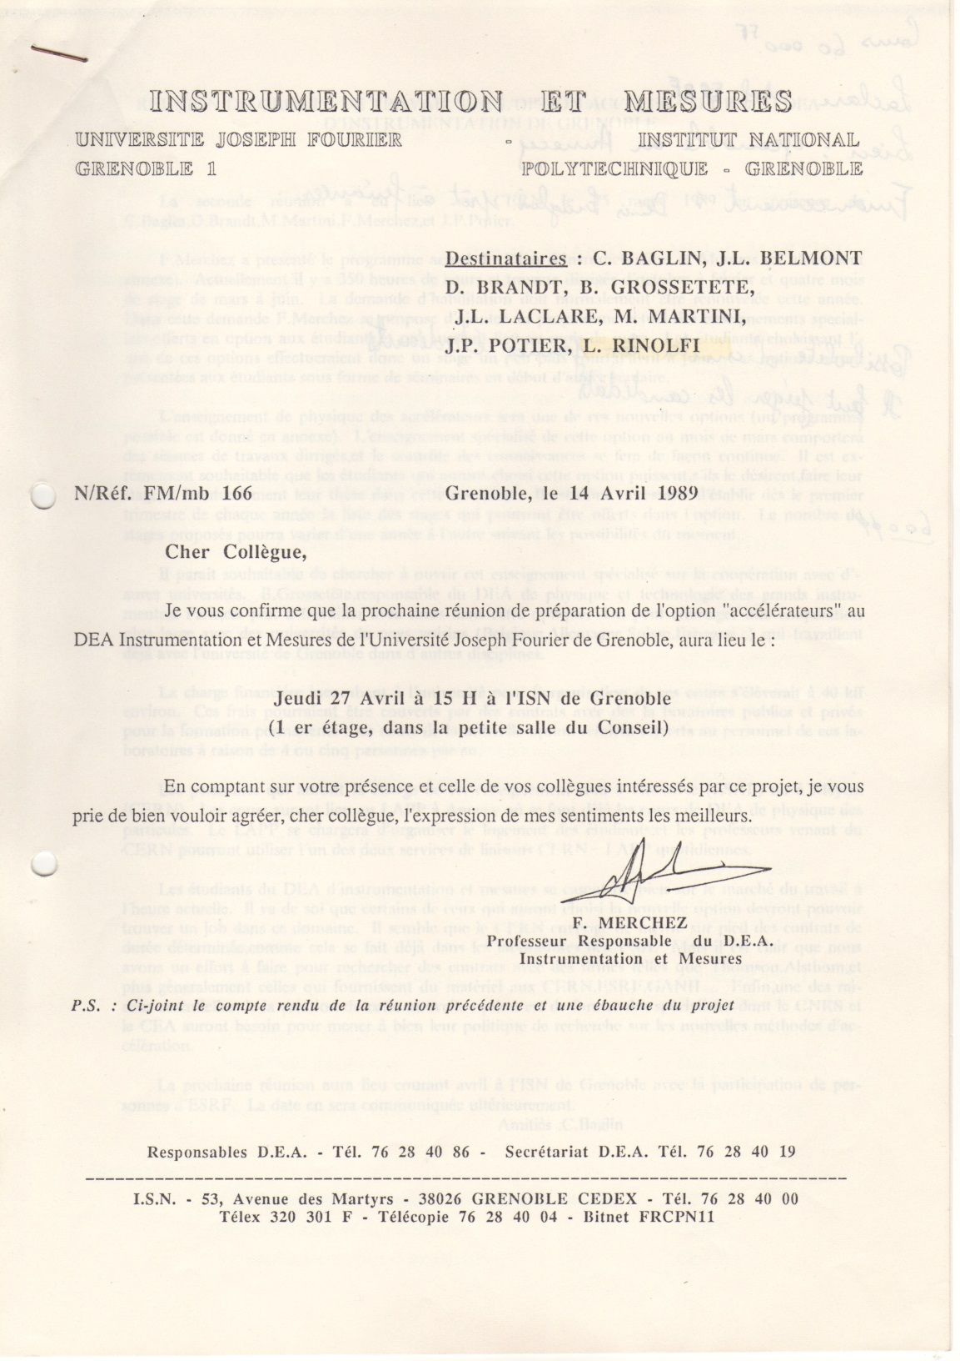
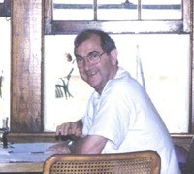

14th April 1989
CERN and ESRF accelerator physicists were invited by Prof. Fernand Merchez of the University Joseph Fourier, in Grenoble, to prepare a future course on
“Physics of Particle Accelerators”
Objective:
DEA (Diplôme d’Etudes Approfondies)
“Instrumentation et Mesures”

Slide 4
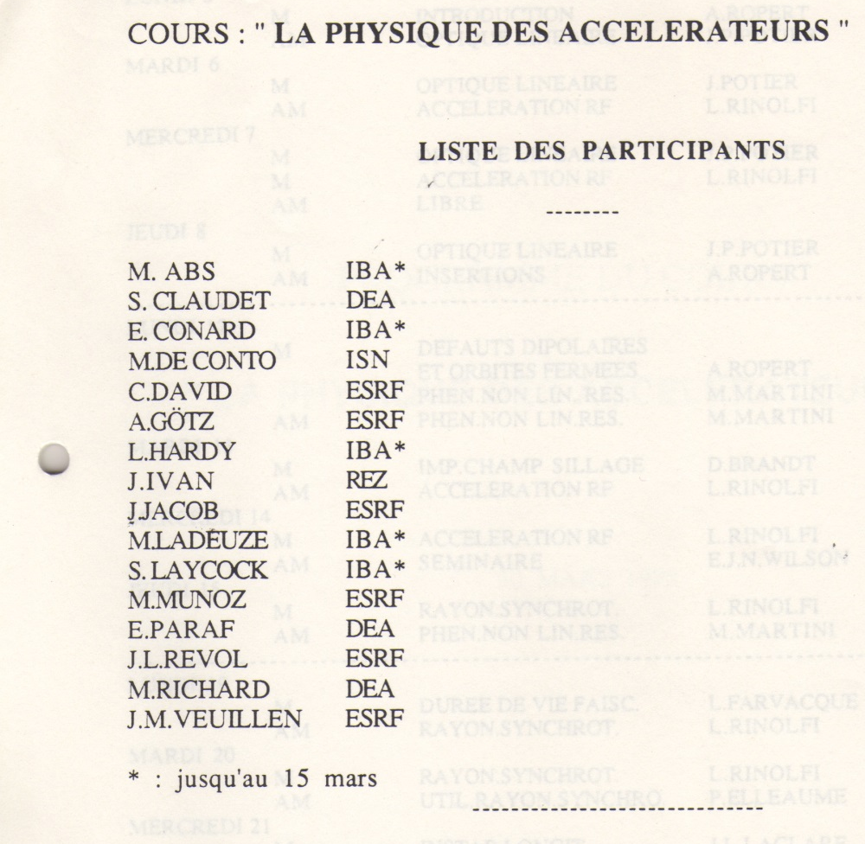
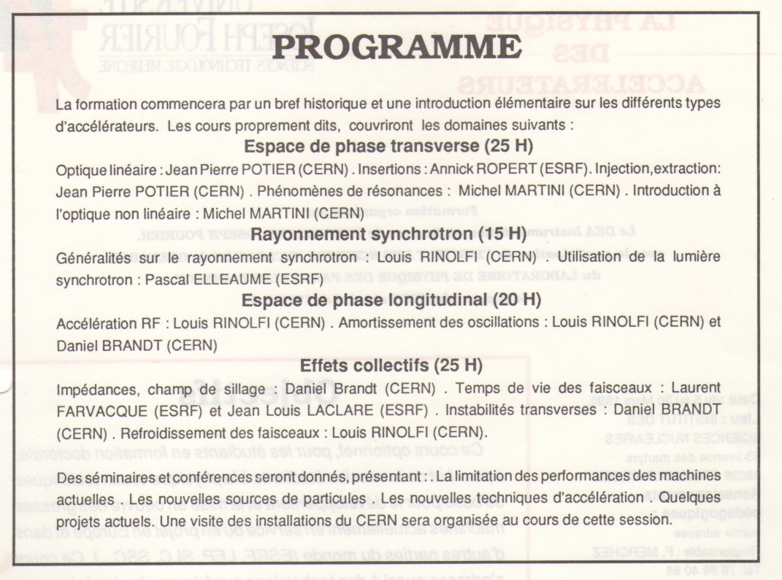
5th - 30th March 1990
A first course for this diploma on
Physics of Particle Accelerators
took place at Grenoble university
List of 16 students who attended the course
Enseignants:
CERN: ESRF:
D. Brandt P. Elleaume
M. Martini L. Farvacque
J.P. Potier J.L. Laclare
L. Rinolfi A. Ropert

Slide 5
18th December 1992
Letter sent by Prof. Maurice Renaud, President INPG to Carlo Rubbia, CERN DG
Four universities from France and Germany⁽¹⁾ are considering the possibility of organizing joint courses in Archamps where a university center is presently taking place …….
Courtesy Danièle Lajust

Slide 6
4th February 1993
Answer sent by Carlo Rubbia, CERN DG
to Prof. Maurice Renaud, President INPG
Your initiative …. to organise advanced courses in the vicinity of CERN appeals very much to me.
I would therefore welcome a first round of discussions …… which I would then submit to our Scientific Policy Committee.
Between 1990 and 1993, courses on Particle Accelerators, for the DEA, continue at Joseph Fourier university.

Slide 7
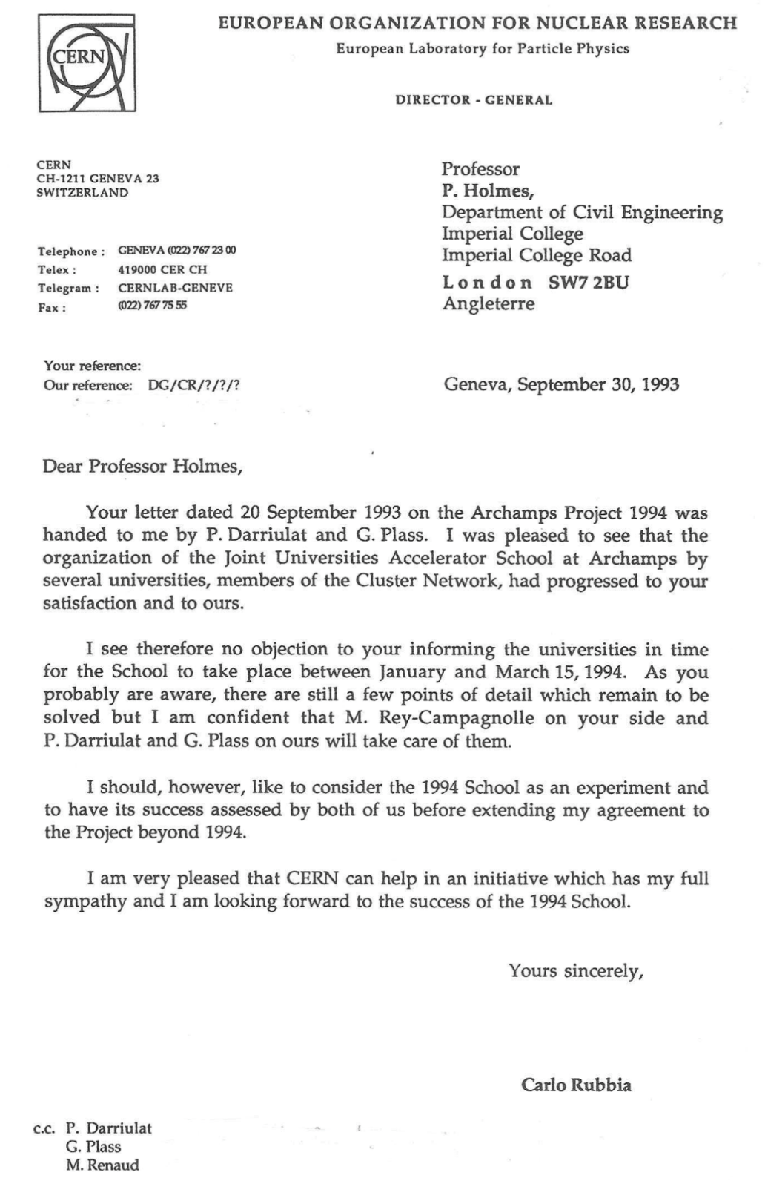
30th September 1993
Letter sent by Carlo Rubbia, CERN DG
to the Secretary-General of CLUSTER
Prof. Patrick Holmes, Imperial College, London
I was pleased to see that the organization of JUAS at Archamps by several universities, members of the Cluster Network, had progressed to your satisfaction and ours.
… I am confident that M. Rey-Campagnolle on your side and P. Darriulat and G. Plass on ours will take care….
I see therefore no objection informing the universities in time for the School to take place between January and March 15, 1994.

Slide 8
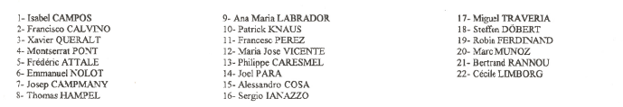
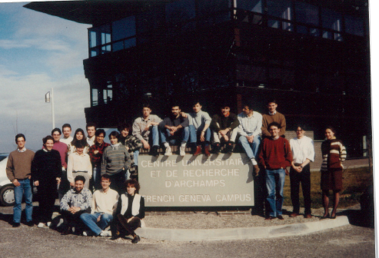
1994 JUAS was born
The first Joint Universities Accelerator School took place at Archamps from
January 24 to March 25, 1994. It was attended by 22 students and included 116 lectures
List of 22 JUAS students
Courtesy Marcelle Rey-Campagnolle

Slide 9
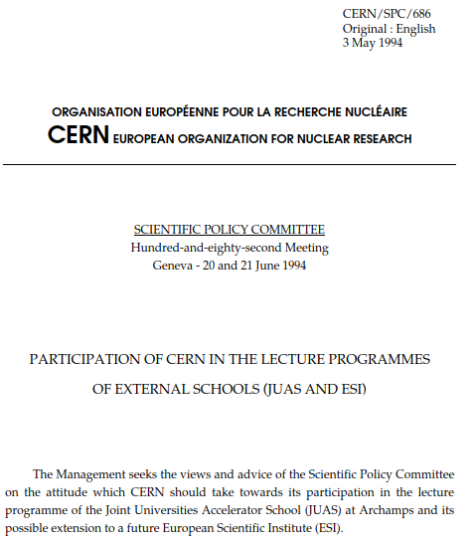
SPC document
after the first JUAS school 1994
… paragraphs inside the SPC document
3. In 1993, following a positive response of the Director-General to the principle of the initiative, contacts were established between representatives of the four universities and representatives of CERN.
4. A scheme which could satisfy both the wishes of the initiators of the project and the conditions set by CERN was rapidly worked out. The CLUSTER* network agreed to cover the project which was given the name of Joint Universities Accelerator School.
5. The Joint Universities Accelerator School has been considered extremely successful by both the students and the lecturers.
(*) The current members of the CLUSTER network are:
Technische Hochschule DARMSTADT
Trinity College DUBLIN
University of Technology EINDHOVEN
Institut Polytechnique de GRENOBLE
Universität (TH) KARLSRUHE
Ecole Polytechnique Fédérale de LAUSANNE
Imperial College LONDON
Université Catholique de LOUVAIN
Royal Institute of Technology STOCKHOLM
Politecnico di TORINO
Université Joseph Fourier de GRENOBLE is also supporting JUAS

Slide 10
1994 - 2024
History of JUAS

Slide 11
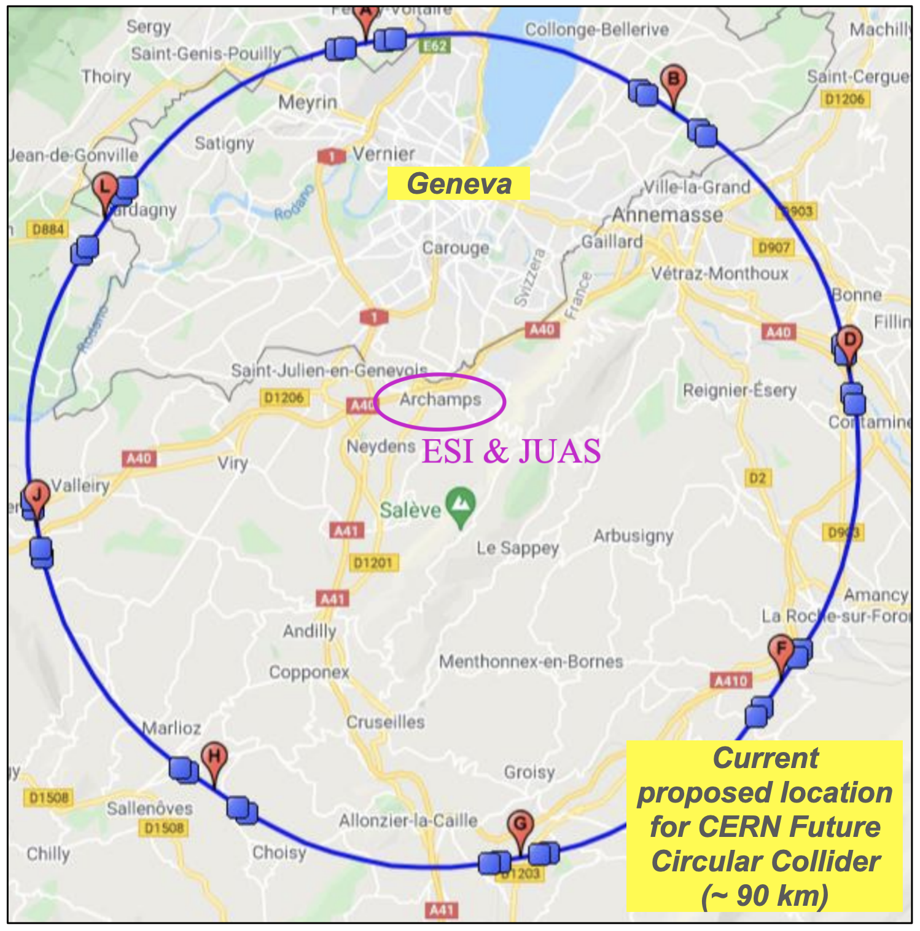
The European Scientific Institute is 20 km South of CERN
CERN
ESI
JUAS
E. Métral

Slide 12
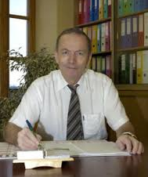
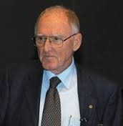
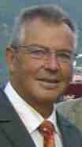

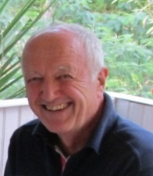
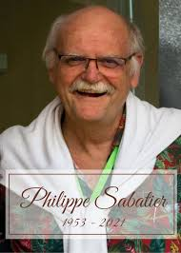
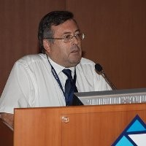

ESI was founded at Archamps under the auspices of a group of European physicists under the acronym GREISE (Groupe de Recherche et d’Etude pour un Institut Scientifique Européen) (see CERN/SPC/686)
1994 - 1999 : Denis Linglin
CNRS
1999 - 2002 : Giorgio Brianti / CERN
2002 - 2012: Manfred Buhler-Broglin / CERN
2012 - 2020: Hans Hoffmann / CERN
2020 - 2021: Philippe Sabatier / UGA
2021 - 2022: Philippe Lebrun / CERN
2022 - current: Jean-Michel Thénard / CNRS
ESI organizes “administratively” the JUAS and many other schools on the Archamps campus
ESI Presidents
Presentation Bob Holland

Slide 13
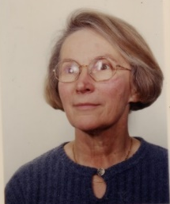
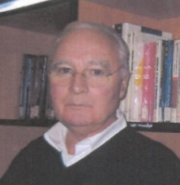
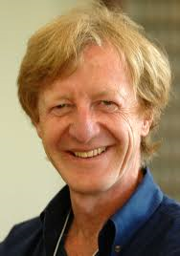
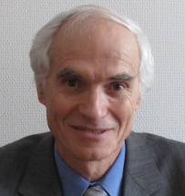
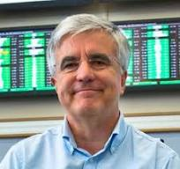
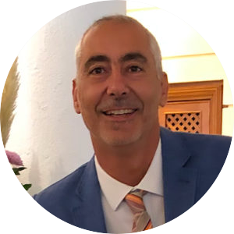
JUAS Directors
1994 – 2000 : Marcelle
Rey-Campagnolle
2001 – 2005 : Joël Le Duff
2006 – 2010 : François Méot
2011 – 2016: Louis Rinolfi
2017 – 2020: Philippe Lebrun
2021 – 2021: John Jowett
2022 – current: Elias Métral

Slide 14
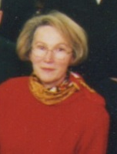
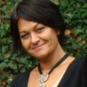
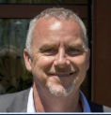
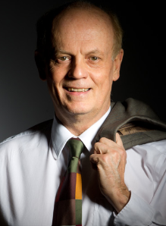
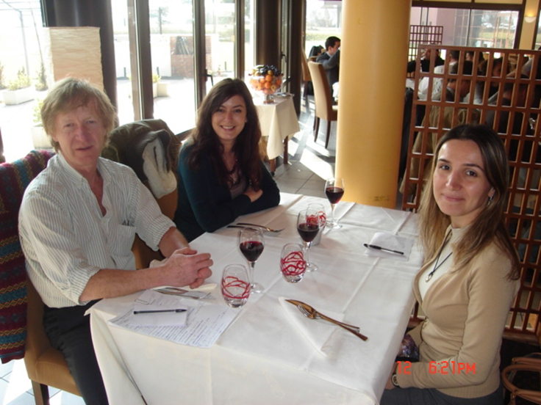
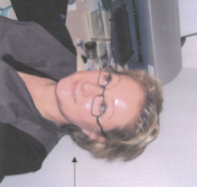
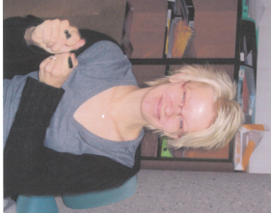
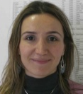
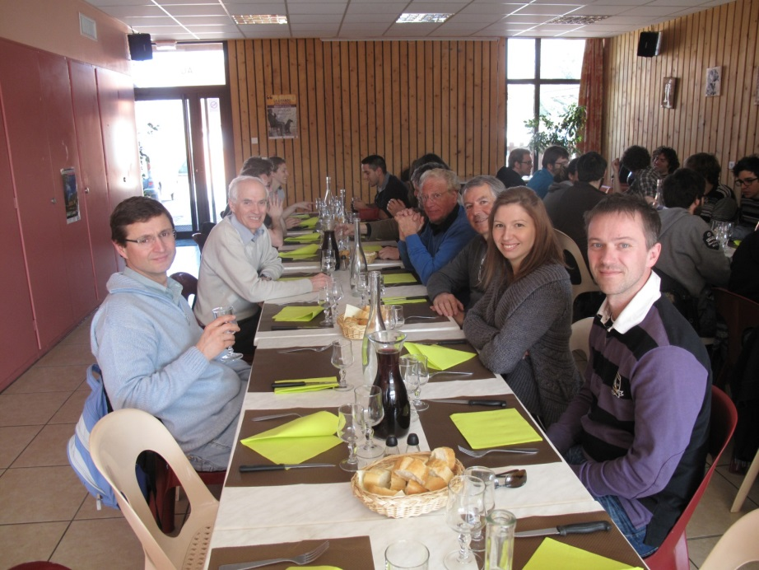
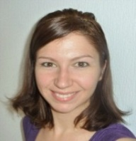
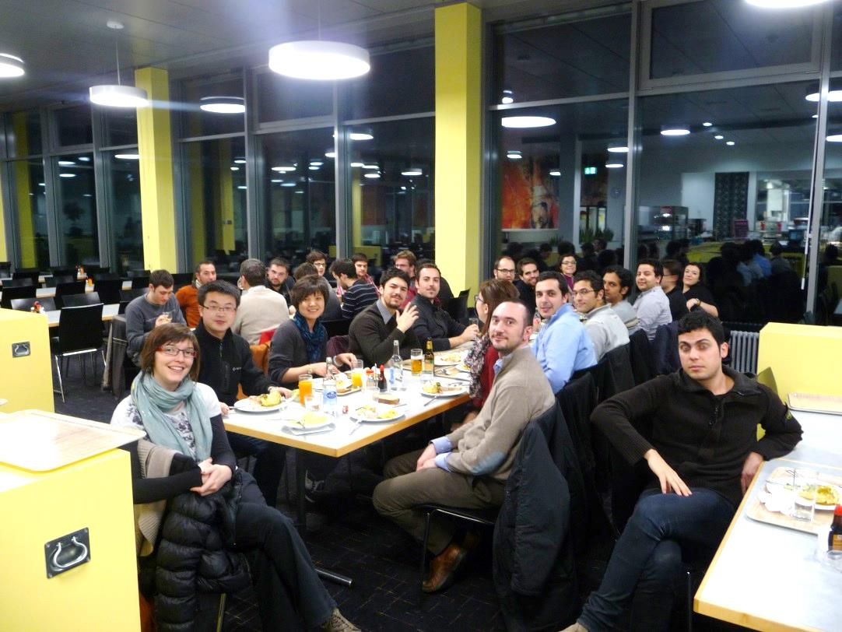
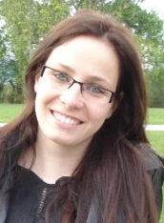
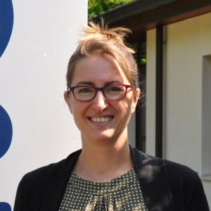
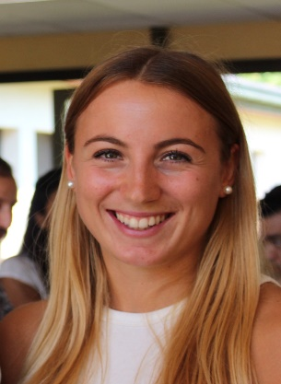
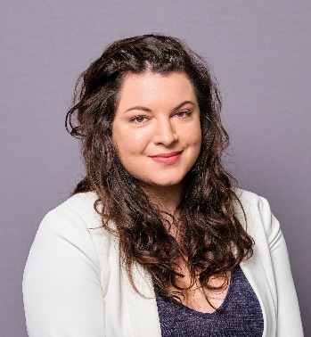
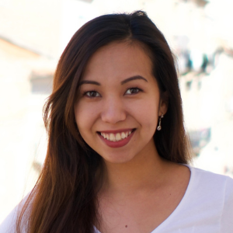
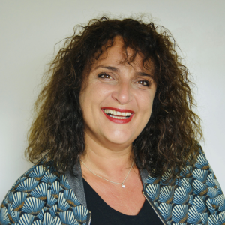
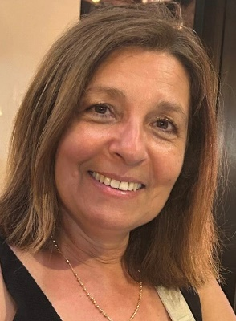
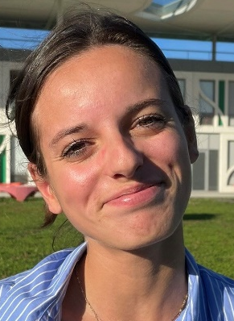
ESI administrative support over the 30 years
Marcelle
Valérie
Bob
Séverine
Jean
Tamara
Heidi
Filiz
Sébastien
Marie
Coline
Marjorie
Stéphanie
Darina
Florence
Lise
Mélanie
Grace
Laly

Slide 15






















France
JUAS past and present partner universities
Germany
Norway
Netherlands
Italy
Spain
Erasmus Mundus
United Kingdom
Presentation Joachim Enders

Slide 16






































JUAS past and present collaborating institutions and sponsors
France
Switzerland
Germany
UK
Spain
Italy
Presentations
Pierre Védrine
and François de Viry
Sweden
Belgium
16

Slide 17
Three JUAS Anniversaries
2004: 10th Anniversary in Archamps
2014: 20th Anniversary in Grenoble
2024: 30th Anniversary at CERN

Slide 18
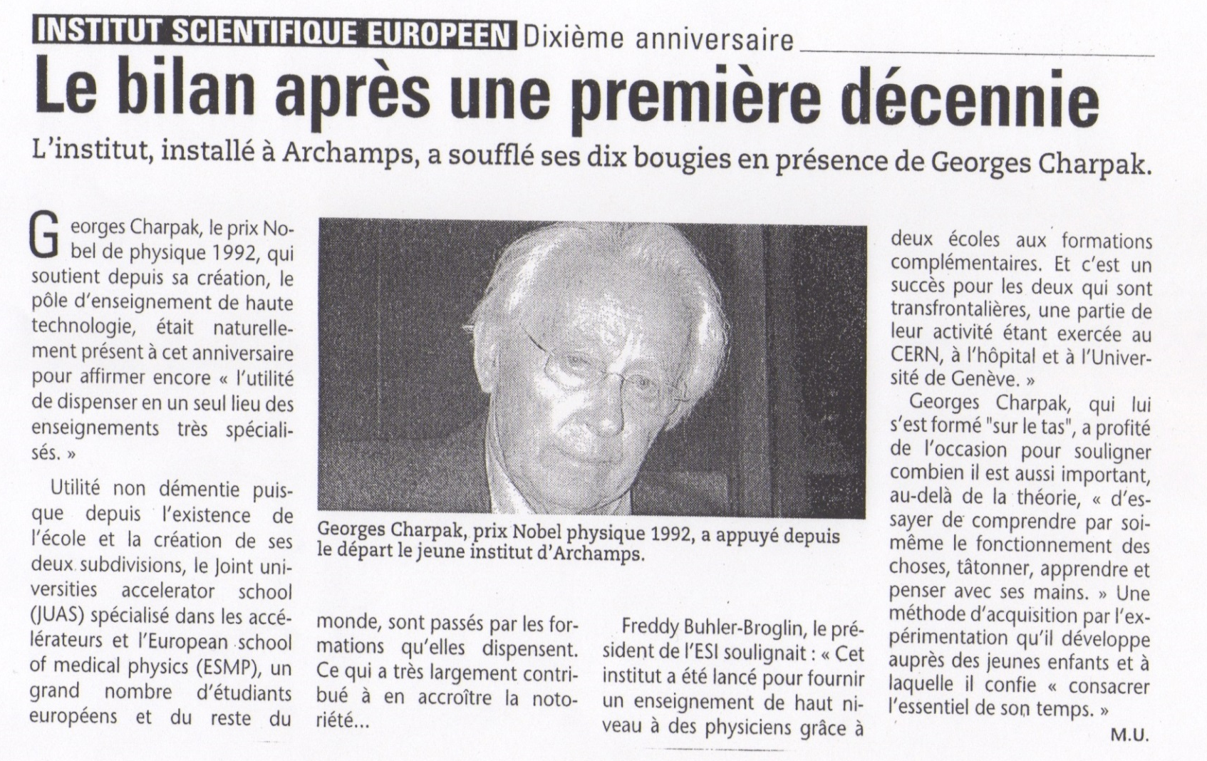
Archamps 2004: ESI /JUAS 10 years anniversary
L’ESSOR SAVOYARD /
LE MESSAGER Revue de Presse du jeudi 28 avril 2004

Slide 19
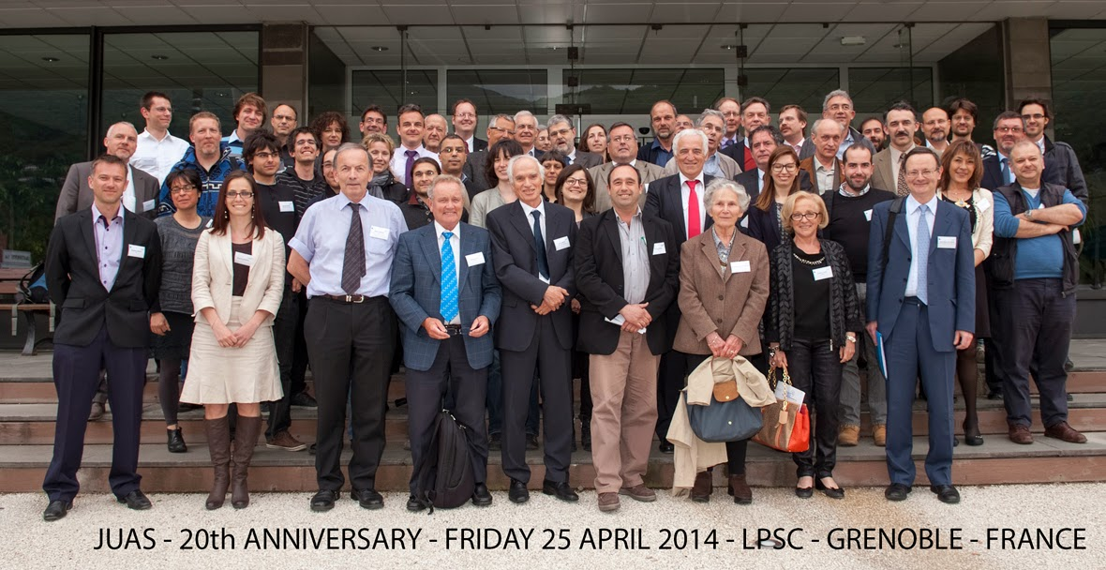
Grenoble 2014: JUAS 20 years anniversary

Slide 20

Brochure published for the 20 years anniversary
(8 pages)

Slide 21
CERN 2024: JUAS 30 years anniversary
A JUAS book published
(> 2000 pages)
(including lectures, exercises, solutions and history)
See Elias Métral presentation

Slide 22
One (subjective) slide per director to illustrate the JUAS school
Slides are extracted from the texts written by the directors in the book

Slide 23

JUAS 1994 – 2000
Inside the Linac 2 at CERN
Complementary to CAS (CERN Accelerator School), JUAS now enjoys the status of an Intensive Programme of higher education within the framework of the Socrates programme of the European Commission.
JUAS is a programme which no single university could set up on its own
Courtesy Marcelle Rey-Campagnolle

Slide 24
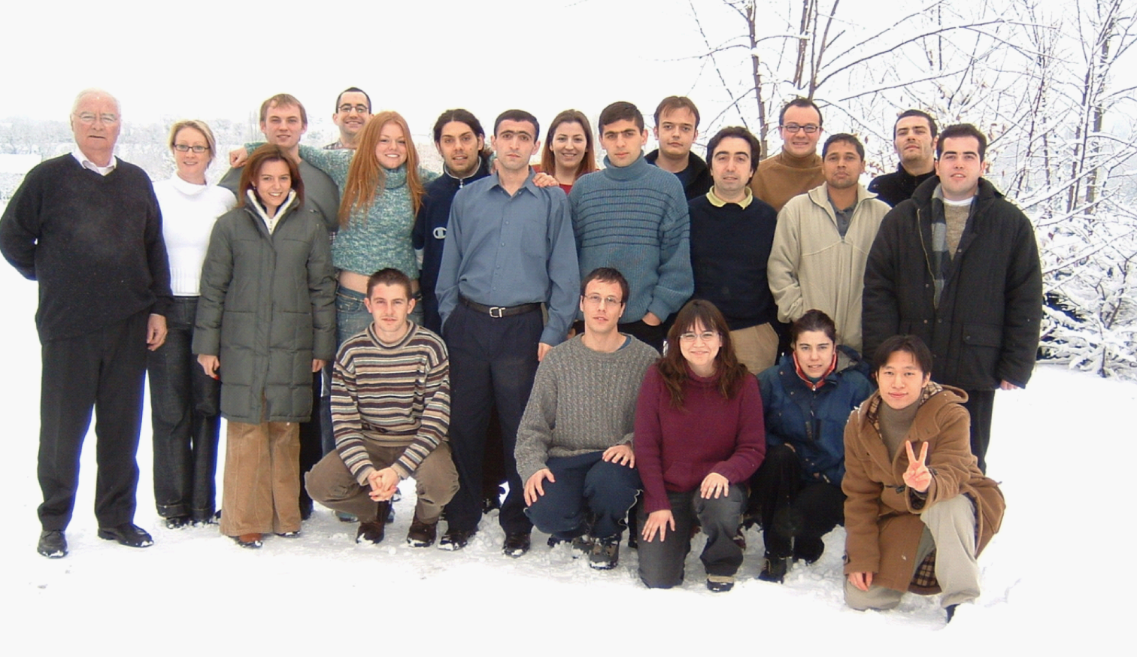
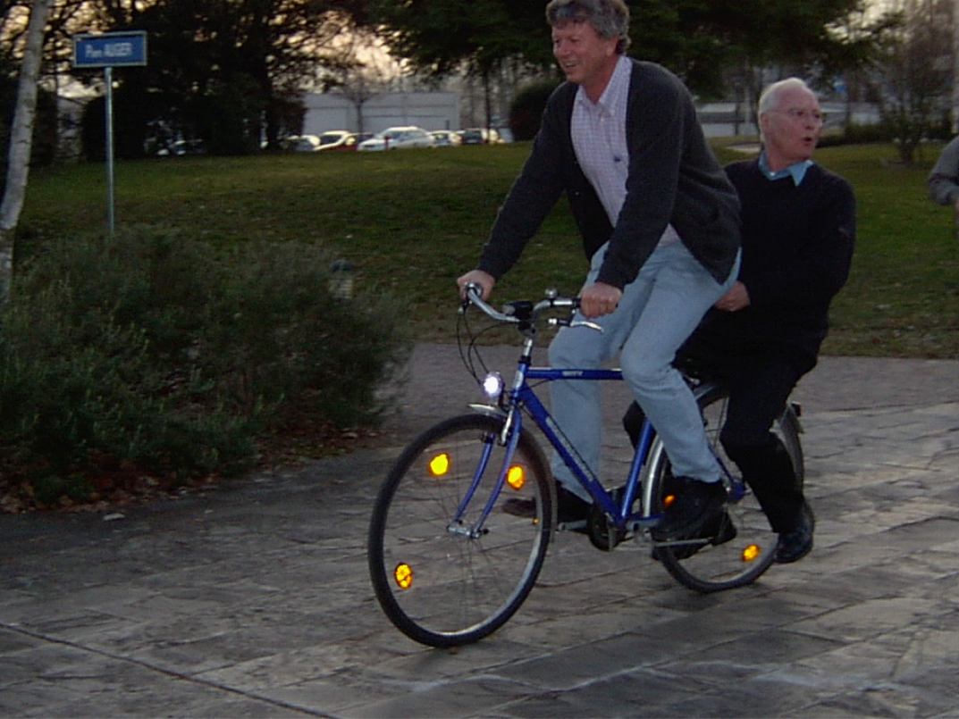
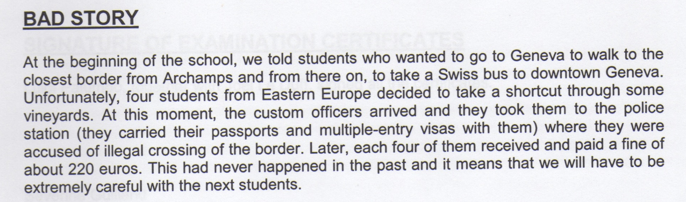
JUAS 2001 – 2005
Fritz Caspers
Joël le Duff
Green transportation
3 new partner universities joined JUAS: Berlin, Genoa, Valencia
Courtesy Joël Le Duff

Slide 25
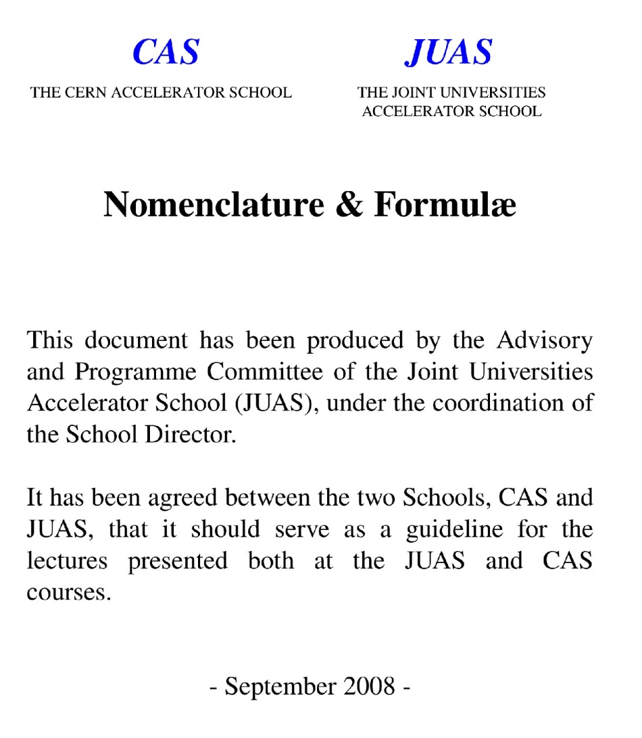
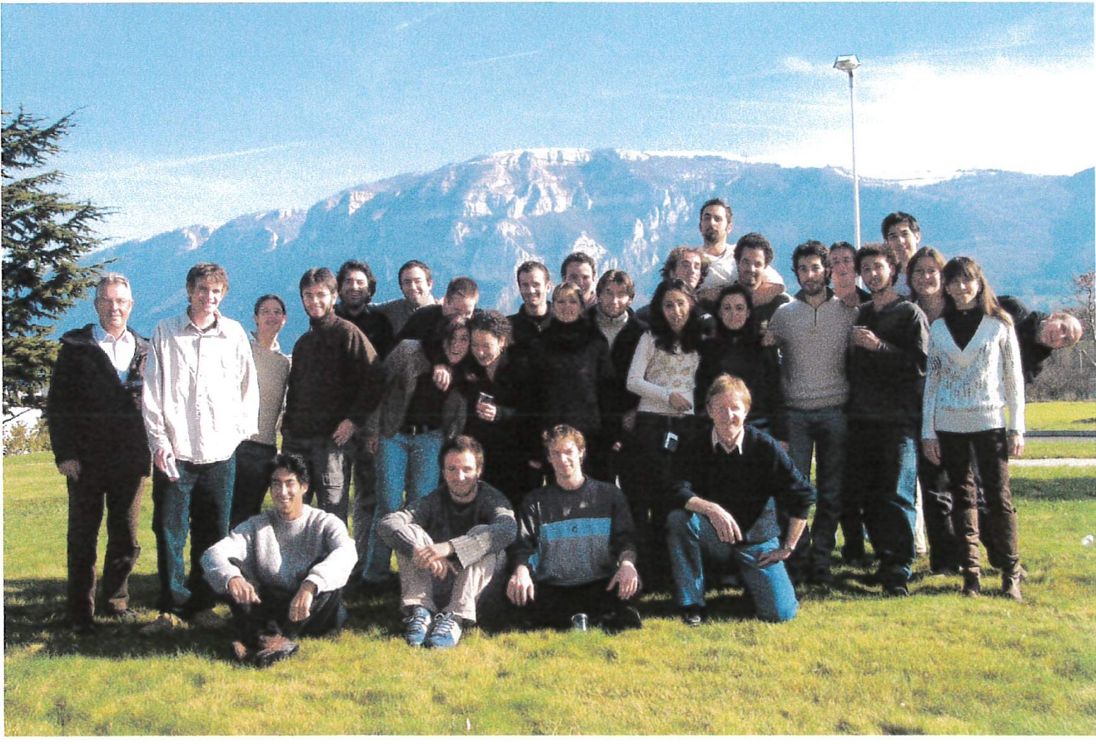
JUAS 2006 – 2010
Restart the visit at PSI
Directors: Daniel Brandt François Méot
1 new partner university joined JUAS:
Heidelberg
Introduce one practical day at CERN (4 activities)
Introduce a new practical magnet calculation at JUAS
Introduce one practical day in Bergoz company
Courtesy François Méot
25

Slide 26

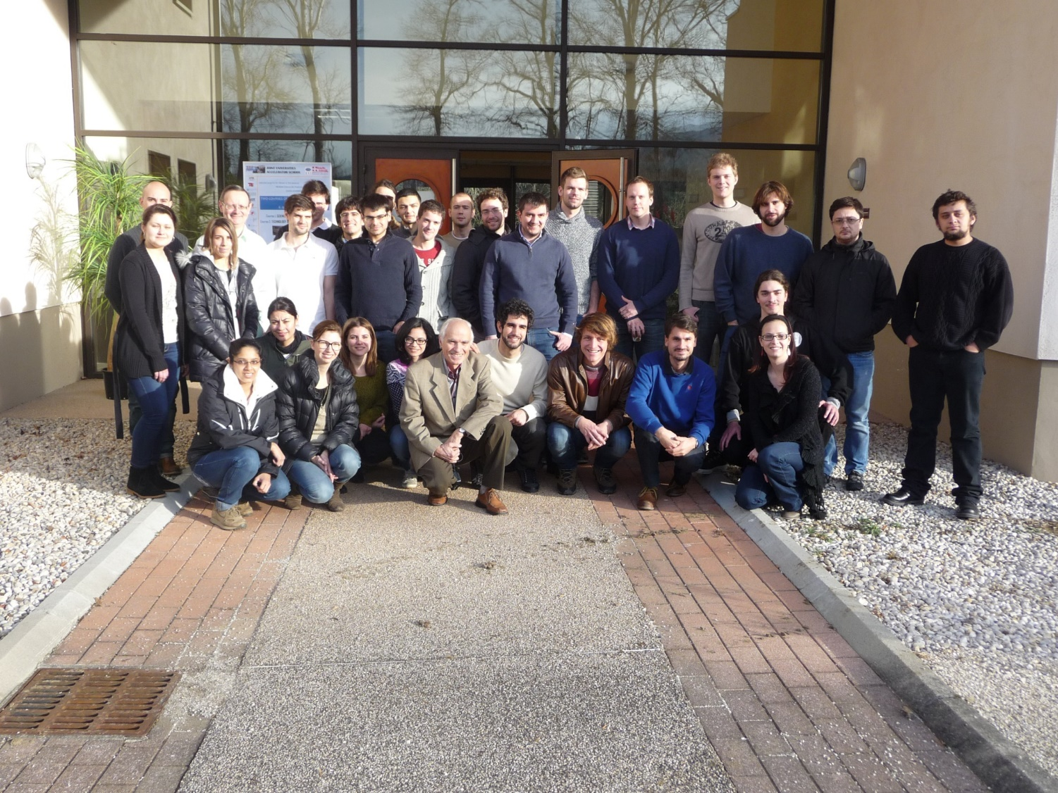
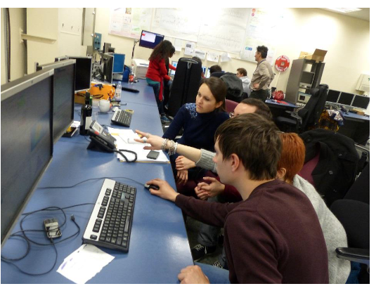
JUAS 2011 – 2016
A new computing infrastructure with CERN-IT Department
A new web site created
Organization of the 20th Anniversary in Grenoble
Introduction of a practical day in the control rooms
5 new partner universities joined JUAS:
Liverpool, Rostock, Oxford, Oslo, Paris-Sud-Orsay (today Paris-Saclay)
JUAS students “turning knobs and pushing buttons” on real electron beam
Beam measurements performed in the CTF3 control room
JUAS students 2014
L.R.

Slide 27


JUAS 2017 – 2020
A special, well-attended event, was organized in 2018 to celebrate the 25th session of JUAS.
The school was presented orally in several national and international events: CERN–US–Japan–Russia
Accelerator School, FCC weeks, SFP and ECFA meetings.
JUAS and ESIPAP were the subject of letters submitted to the European Particle Physics Strategy Update in 2018, and to Snowmass exercise in the USA in 2020.
JUAS students 2020
Courtesy Philippe Lebrun

Slide 28



JUAS 2021
During the COVID pandemic there was no presence at Archamps and for the first time, the JUAS faculty, ESI support and all collaborators organised all lectures, practical work, visits and exams entirely online.
No compromise of academic standards.
Rasmus Ischebeck
Jérémie Bauche
Courtesy John Jowett

Slide 29


JUAS 2022 – 2024
Special relativity and electromagnetic using MOOC videos
Reorganized schedule with a redistribution of the exams
Organizing a student’s tutoring session at IPAC 23 conference
CERN Yellow Reports: School Proceedings
1 new partner university joined JUAS:
University of Medical Center Groningen
JUAS students 2024
Courtesy Elias Métral

Slide 30
A brief JUAS overview
Our impact over three decades
1420 students trained: Building the future of accelerator science and technology.
250 professors, lecturers and assistants: Sharing expertise and inspiring new generations.
20 European partner universities: A network of academic excellence across the continent.
30+ collaborating institutes: Providing essential support and fostering innovation
Comprehensive training for real-world applications
Hand-on practical work at leading facilities: CERN, SOLEIL, ESRF, Bergoz and more
Regular site visits to pioneering institutions: CERN, ESRF, PSI, HUG, EPFL
Support for student participation at IPAC conferences through EPS-AG
Preserving knowledge and excellence
Recognition through ECTS credits at partner universities: Validating student achievements.
Publication of JUAS book: Over 2000 pages of lectures, exercises, solutions, and history.
30

Slide 31
Conclusion
Many exciting projects for particle accelerators are under study at CERN and around the world.
JUAS will continue to provide excellent training with a fruitful collaboration with partner universities, the financial contributions from collaborating institutes, the proactive support from CERN and the French local authorities and the remarkable support from ESI.
JUAS is a foundation built on collaboration, innovation, and education.
It looks to the future – ready to inspire the next 30 years.
Thank you for your attention

