Slide 1
J oint
U niversities
A ccelerator
S chool
Welcome address
on behalf of the partner universities
Joachim Enders
Technische Universität Darmstadt

Slide 2

Joint
Joint venture of European Universities
and European Large-scale Accelerator Facilities
addressing an interdisciplinary field
for a multitude of applications:
mutual benefit for labs, students and universities
International experience
Different programmes and situations
Student and expert level in accelerator science

Slide 3

Universities
Coherent M.Sc.-level education
Local recognition of JUAS exams
Broad coverage of topics
  different tasks and facilities
  at local institutions
  breaking down acclerator science
  in a scholarly fashion
  learning about impact
  on large-scale facilities
  from fundamentals to current applications:
  lectures – tutorials – practical days – seminars
Transverse
Beam
Dynamics
Longitudinal
Beam
Dynamics
Linacs
RF
Engineering
Beam
Diagnostics
Synchrotron
Radiation
pixabay.com, user molnar, pixabay content license
Ring
Accelerators
Vacuum Systems
Particle
Sources

Slide 4
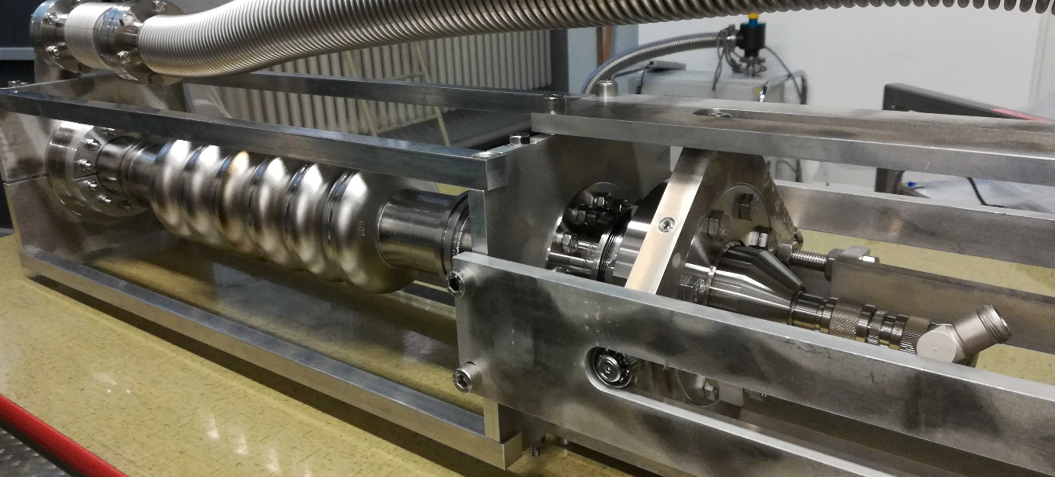


Accelerator
4 cm
LEP2 structure 352 MHz
picture from: J. Tückmantel, The LEP2 Superconducting RF System, Applied Superconductivity Conference, Desert Springs Resort, CA, USA, 13 - 18 Sep 1998, pp.270-275
S-DALINAC capture cavity 3 GHz
picture by S. Weih (JUAS 2015 Alumnus)
different scale, similar problems
topic driven by science and research

Slide 5
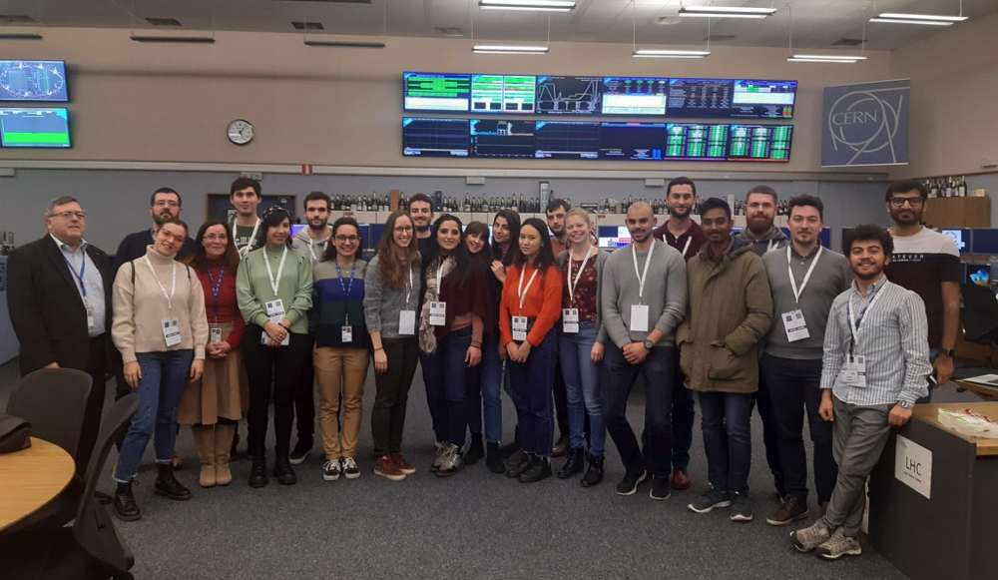
School
Training the next generation
particle-accelerator scientists
Theoretical and technical knowledge
as basis for
  reliability
  innovation
  leadership
non scholae sed vitae discimus
ESI/JUAS Web Page

Slide 6

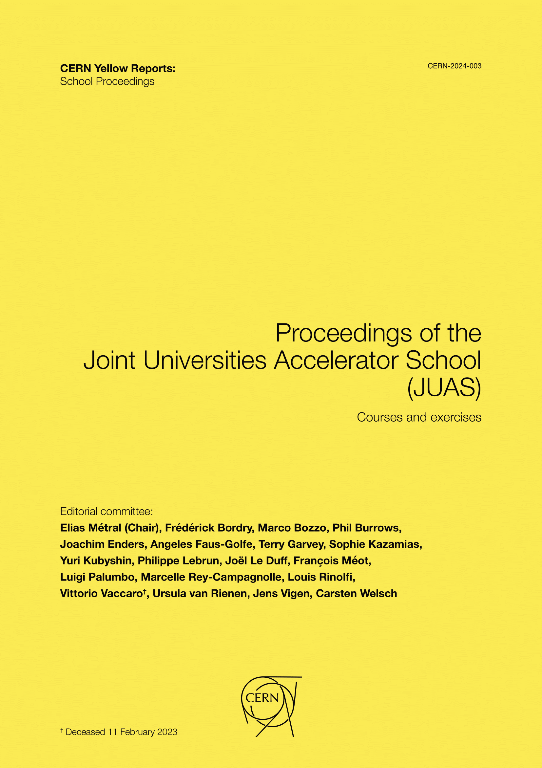
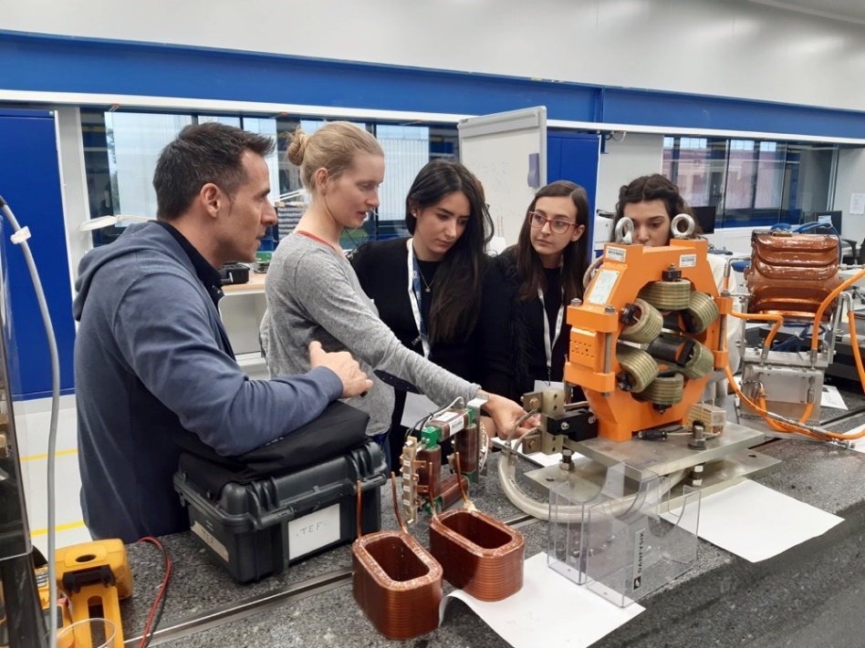
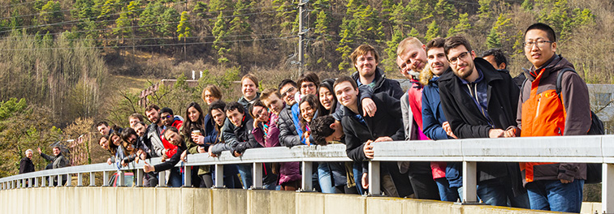
Happy Birthday, JUAS:
AD MULTOS ANNOS

