Slide 1







Benefits of supporting JUAS
for sponsors and collaborating institutions
Past and present
Pierre Vedrine
CEA Saclay
Representative from Sponsors/Collaborating Insitutions

Slide 2




































JUAS collaborative institutions and sponsors
France
Switzerland
Germany
UK
Spain
Italy
Sweden
Belgium

Slide 3
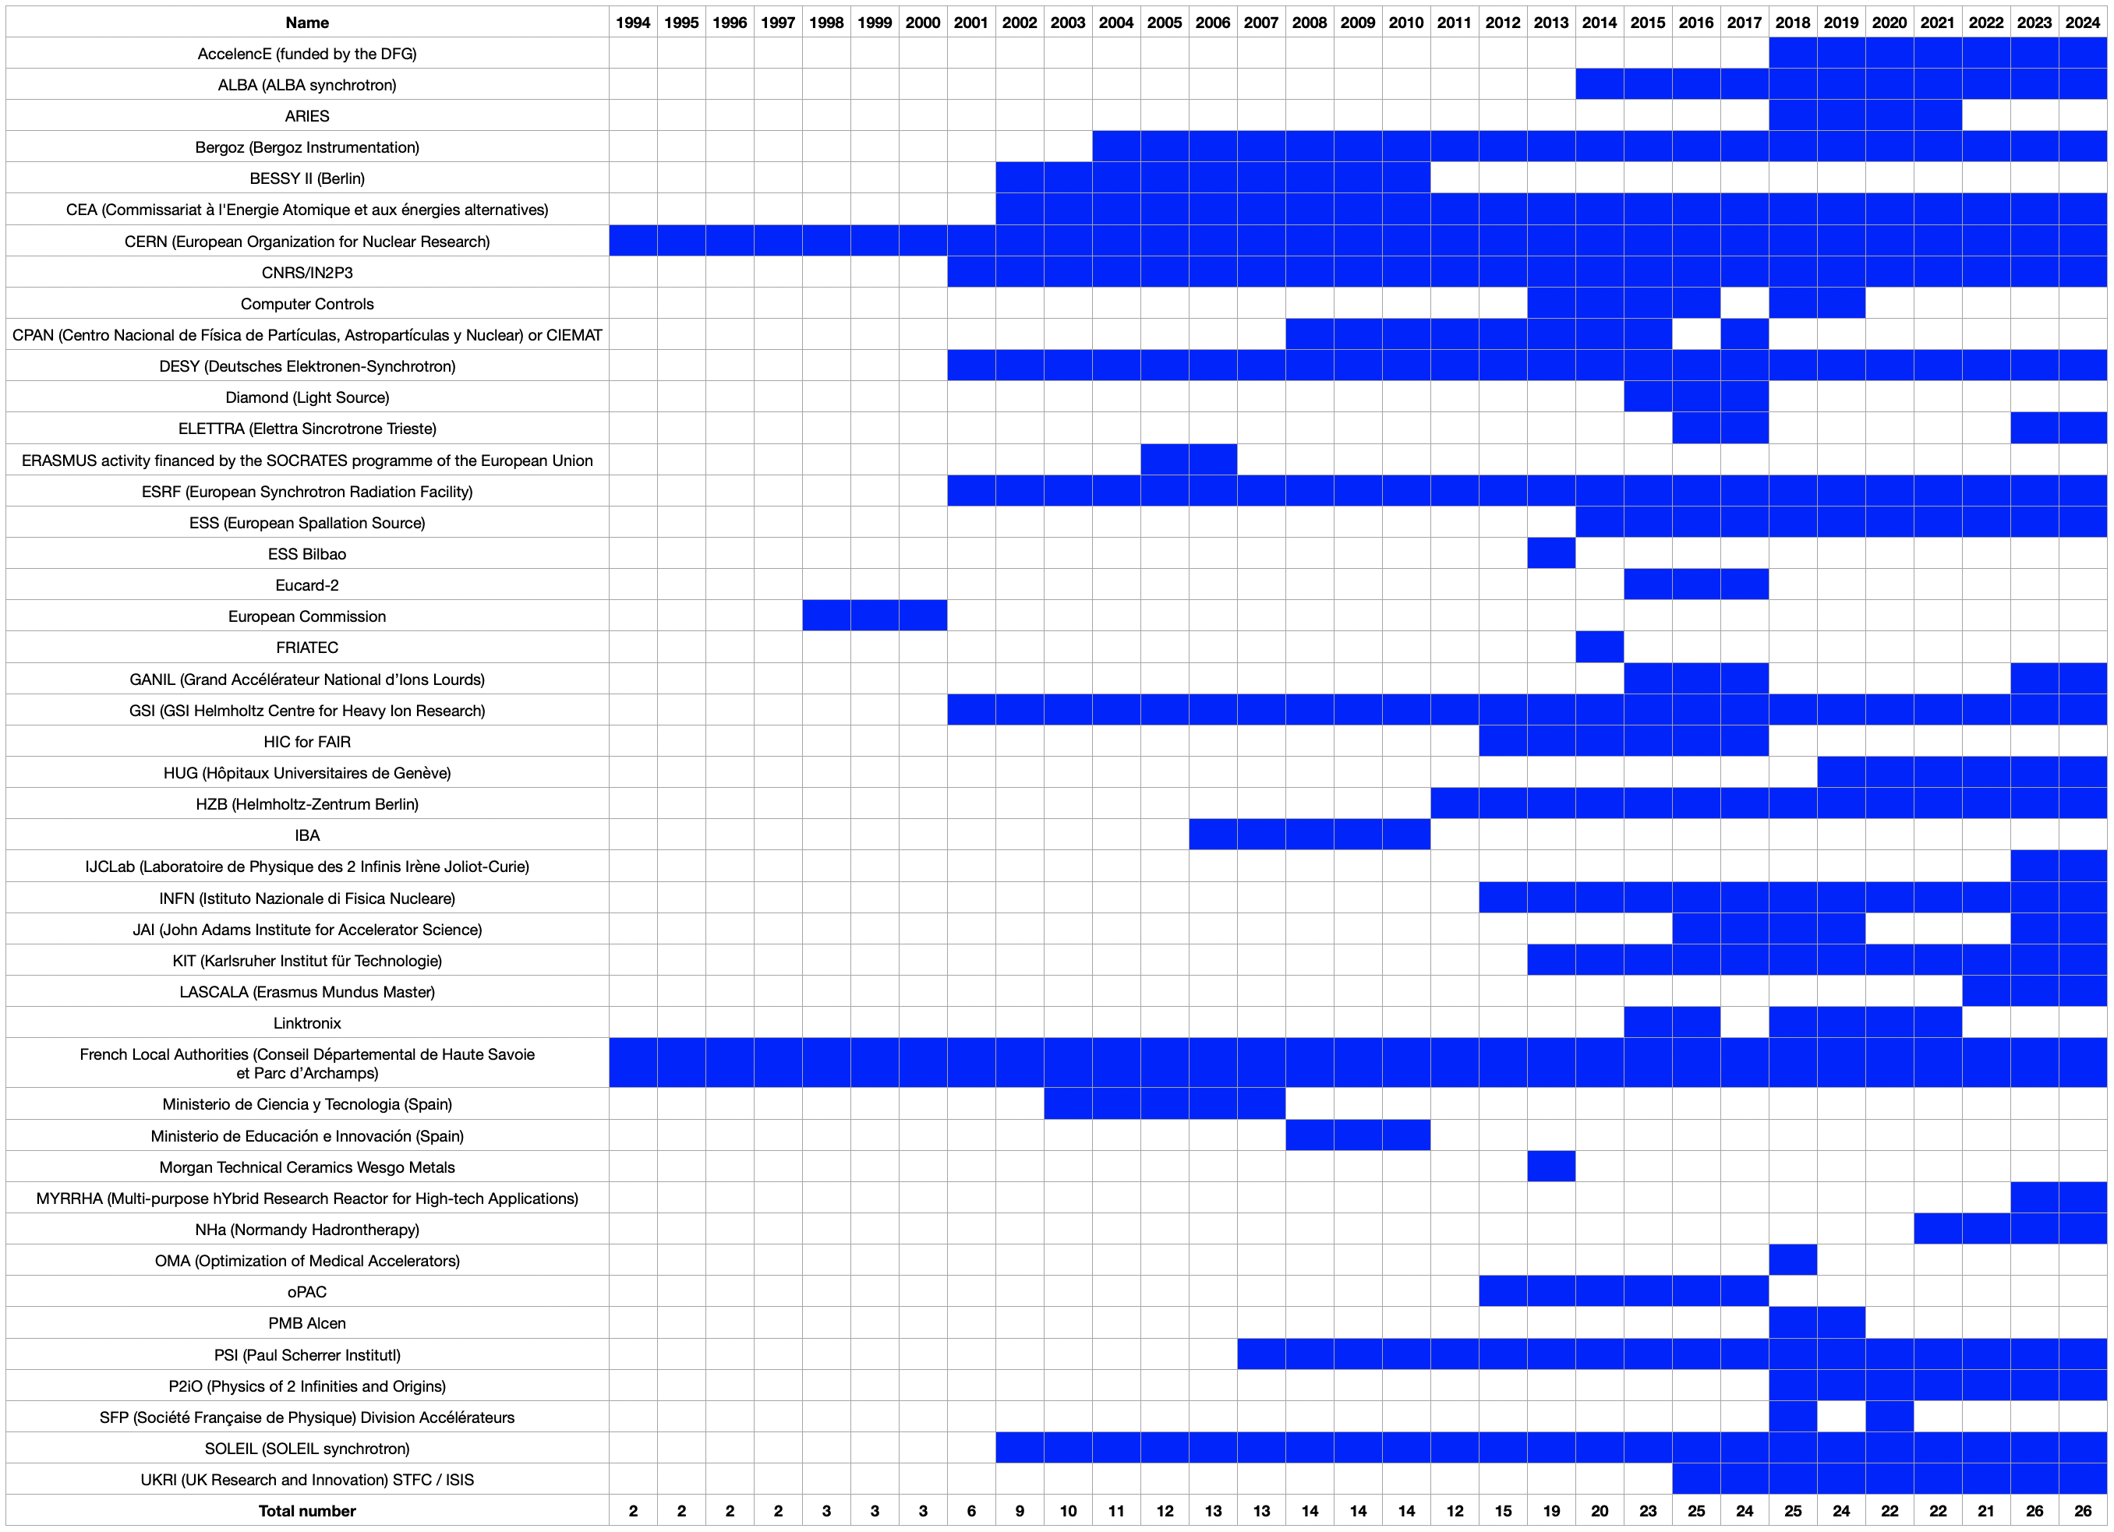
Long term support from Sponsors

Slide 4
Sponsorship initiatives for JUAS
Financial Support:
  Funding assistance to support organization of the JUAS courses.
Access to Expertise:
  Provide qualified lecturers and tutors to deliver teaching and support throughout the course.
  Include the directors of JUAS.
Hands-On Learning:
  Help to conduct practical sessions integrated within the course, by providing equipment and tutors.
Laboratory Access and Engagement:
    Recreational visits to see science in action.
    Seminars to deepen knowledge and stimulate discussion.
    Interactive laboratory work to encourage experience-based learning and to develop skills.

Slide 5
Benefits of Participating in JUAS sponsorship
Inspiring Future Scientists: JUAS trainings play a crucial role in encouraging students to pursue careers in accelerator physics and technologies. The hands-on experience and exposure to cutting-edge research can ignite a passion for these fields, leading to a more diverse and skilled workforce for us in the future.
Investment in Future Expertise: By supporting JUAS, laboratories are actively contributing to the development of the next generation of scientists and engineers who will drive innovation in accelerator physics and technology. This investment ensures a pipeline of highly skilled individuals ready to design, implement and operate state-of-the-art facilities
Increased Visibility:
Sponsorship gives laboratories valuable exposure, helping them attract top talent in accelerator science at the master's level. JUAS provides a platform to showcase our research, our capabilities and our commitment to advancing research.

Slide 6
Benefits of Participating in JUAS sponsorship
Directly Applicable Skills: The course provides students with a strong solid knowledge base and practical skills that are immediately transferable to the laboratory environment. This hands-on approach ensures that graduates are well equipped for real-world applications.
Recruitment Advantage:
Many people from the sponsoring laboratories have successfully completed the JUAS training programme. This demonstrates the value of the school in training a skilled workforce.
When recruiting new staff, their participation in JUAS is often cited as a significant advantage, demonstrating their expertise and commitment to the field.
Professional development:
The knowledge acquired through JUAS training helps students to work more successfully in our laboratories. This demonstrates the value of the program in enhancing professional success.
- As people who received similar training at the start of our careers, we can testify to the impact these programs have had on our professional development.

Slide 7
Benefits of Participating in JUAS sponsorship
Networking Opportunities:
- Students make valuable connections with peers from diverse backgrounds. These networks often remain active after graduation, providing ongoing support and opportunities for collaboration.
- The established network benefits both individual students and their laboratories by facilitating new collaborations and nurturing existing relationships.
International Exchange:
Lecturers from sponsoring laboratories benefit from interaction with colleagues - both students and lecturers - from around the world. This exchange fosters a global perspective and promotes cross-cultural learning.

Slide 8
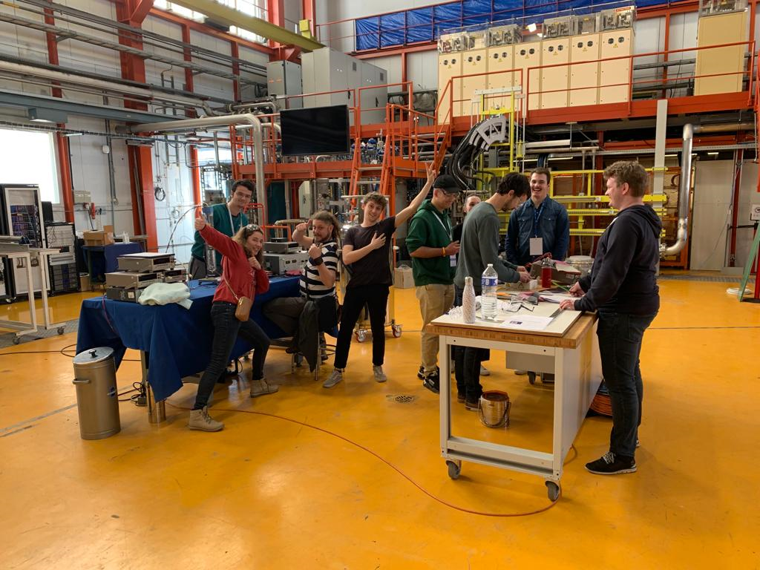
Best Rewards for Sponsors
Happiness of trainees

Slide 9

Thank you for your attention

