Slide 1

C4F10 Recovery
R134a recuperation - M. Bruno
D.Galassi
Weekly Summary 15/01/2024

Slide 2
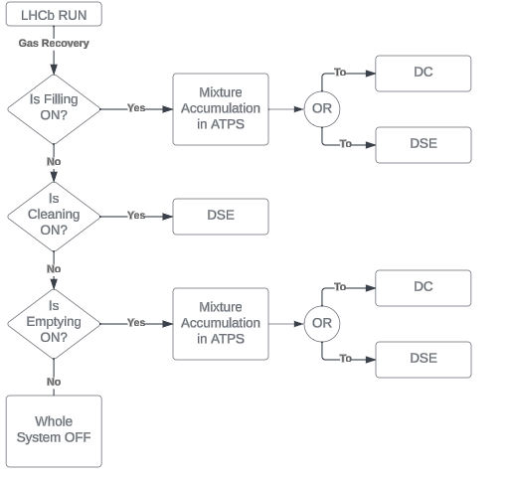
The Phases
These are the possible situations we can encounter during the fuctioning of the plant.
DSE = Double Stage Equilibrium (aka «Standard» system)
DC = Distillation Columns (aka «Innovative» system
ATPS = Accumulation Tank & Pumping Station
DC and DSE have been thought to be interchangable, or in future also to work in parallel.

Slide 3
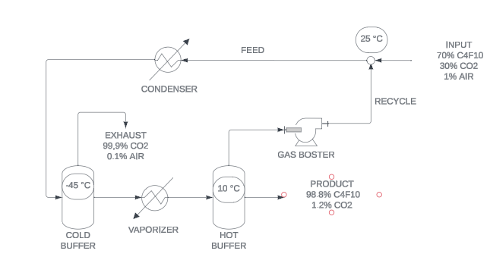
The DSE
The DSE works as the old system (with some addictions)
The INPUT is mixed mixed with the RECYCLE and undergoes cooling
The gas is exhausted and the condensate goes to the vaporizer
The vaporized condensate (now gas) is the RECYCLE (still rich in C4F10). The «still» liquid condensate is the product (almost pure C4F10)

Slide 4
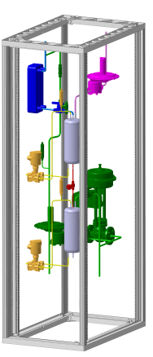
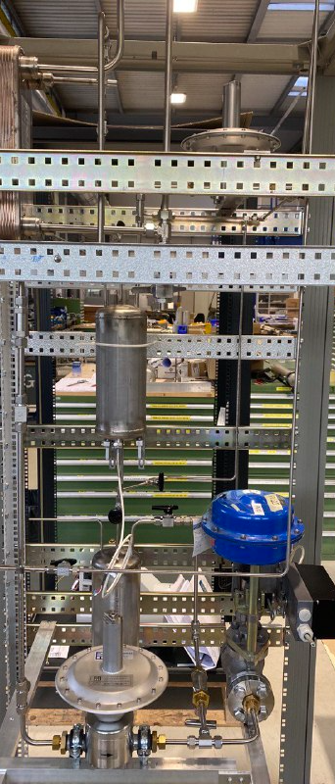
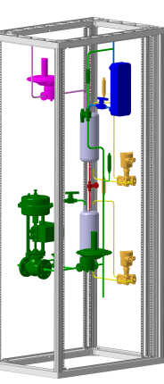
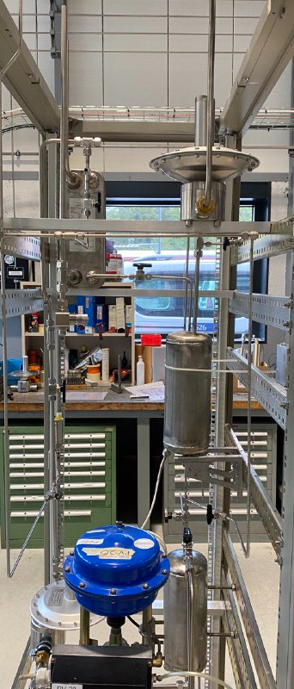
The DSE: where are we?
The costruction of the system is almost done (missing the substitution of a regulation valve and inserting the comrpessor)
Followings weeks dedicated to:
- Insulation
-Electrics and Software logic
- Leak tests

Slide 5
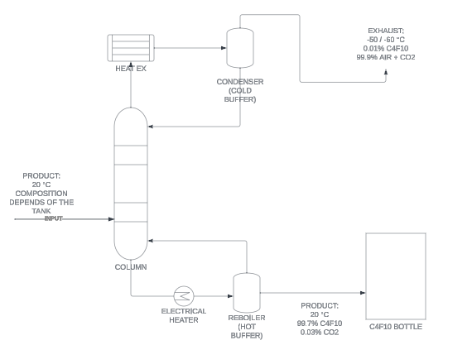
The DC
The DC follows the use of a packed distillation column.
The INPUT enters the column, the C4F10 (heavier) liquifies while raising as a gas. Thus, the C4F10 liquid falls down. As a consequence it is hard for the C4F10 to reach the top of the column s a gas
The CO2 act the opposite way, if liquified at the condenser (being light) it vaporizes when going down as the liquid. Thus, the CO2 almost never reches the bottom of the column

Slide 6
The DC… explained
CO2 out as gas
COOLER
COLUMN’S HEIGHT
To better understand you can see this plot: Height vs Temperature
- The cooler condenses some gas wich falls back down
- This liquid falling down evaporates (mostly CO2) because the lower part of the column is hotter
- The lower part is hotter because the heater vaporizes (some) the liquid which is able to fall down (mostly C4F10)
This exchange of heat is the separation driving-force!!!!
-55 (°C)
CO2 going back as liquid
C4F10 going back as gas
-20 (°C)
TEMPERATURE (°C)
HEATER
C4F10 out as Liquid

Slide 7
What is next?
WHAT | DSE | DC
BUILD UP | DONE | TBD
CLEANING | DONE | TBD
SOFTWARE | IN PROGRESS | IN PROGRESS
INSULATION | TBD | TBD
ELECTRICAL | TBD | TBD
*TBD = TO BE DETERMINED

