Slide 1

DRD1 Task 4: CIEMAT and ICTEA-U. Oviedo
C. F. Bedoya on behalf CIEMAT and ICTEA – U.Oviedo
DRD 1 WP1 Miniworkshop – March 7th, 2024

Slide 2
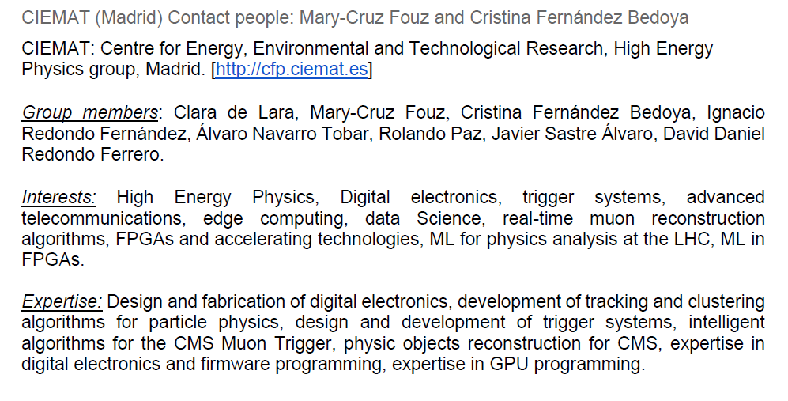
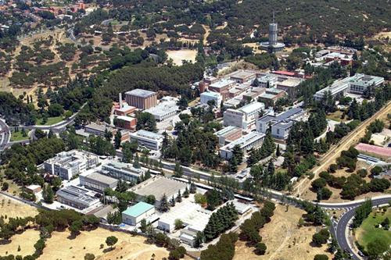

CIEMAT (Madrid)
Cristina Fernández Bedoya and Mary-Cruz Fouz
C. F. Bedoya
DRD1 – March, 2024
2

Slide 3
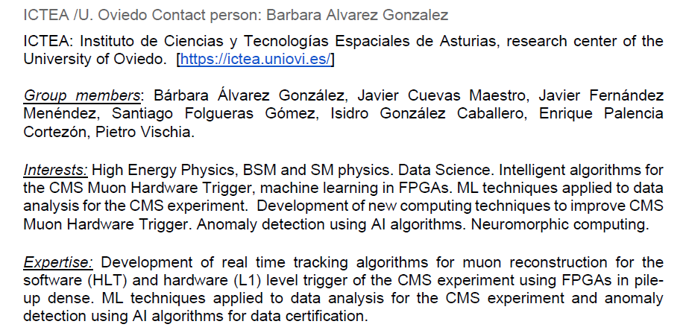


ICTEA - University of Oviedo
C. F. Bedoya
DRD1 – March, 2024
3

Slide 4
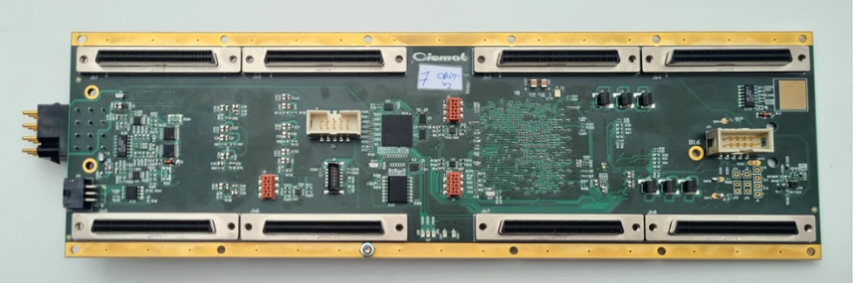

Time digitization readout electronics
CIEMAT has recently developed an FPGA-based readout board
    Performs time digitization of up to 228 channels
    At present, 800 ps resolution
    Built around Microsemi PolarFire PFGA
    lpGBT CERN transceiver (10.24 Gbps),
    And 2 VTRX+: up to 6 high speed lanes fully available (61,44 Gbps)
    Radiation tolerant
O(200) boards are being produced for its HL-LHC Upgrade and will need to operate to high standard of reliability (CMS Muon DT upgrade)
Modifications of present board to accommodate to future detector designs can be envisioned and will be studied.
Interconnection with additional electronics or modification of the board could also provide dE/dx capability building on the TDC on FPGA already implemented.
Goal: understand potential detectors that could benefit from this development and study the best way of adapting/redesigning if needed
C. F. Bedoya
DRD1 – March, 2024
4

Slide 5
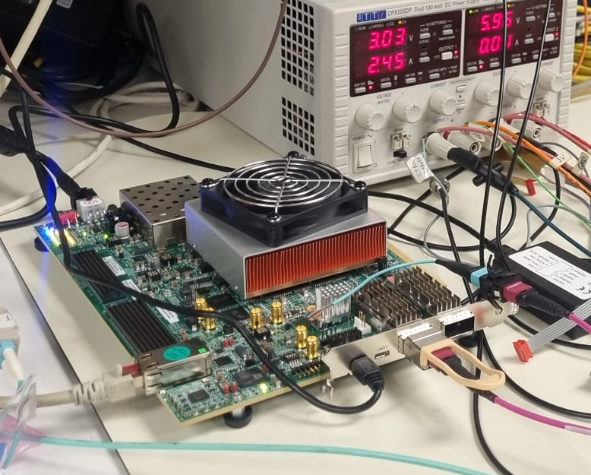
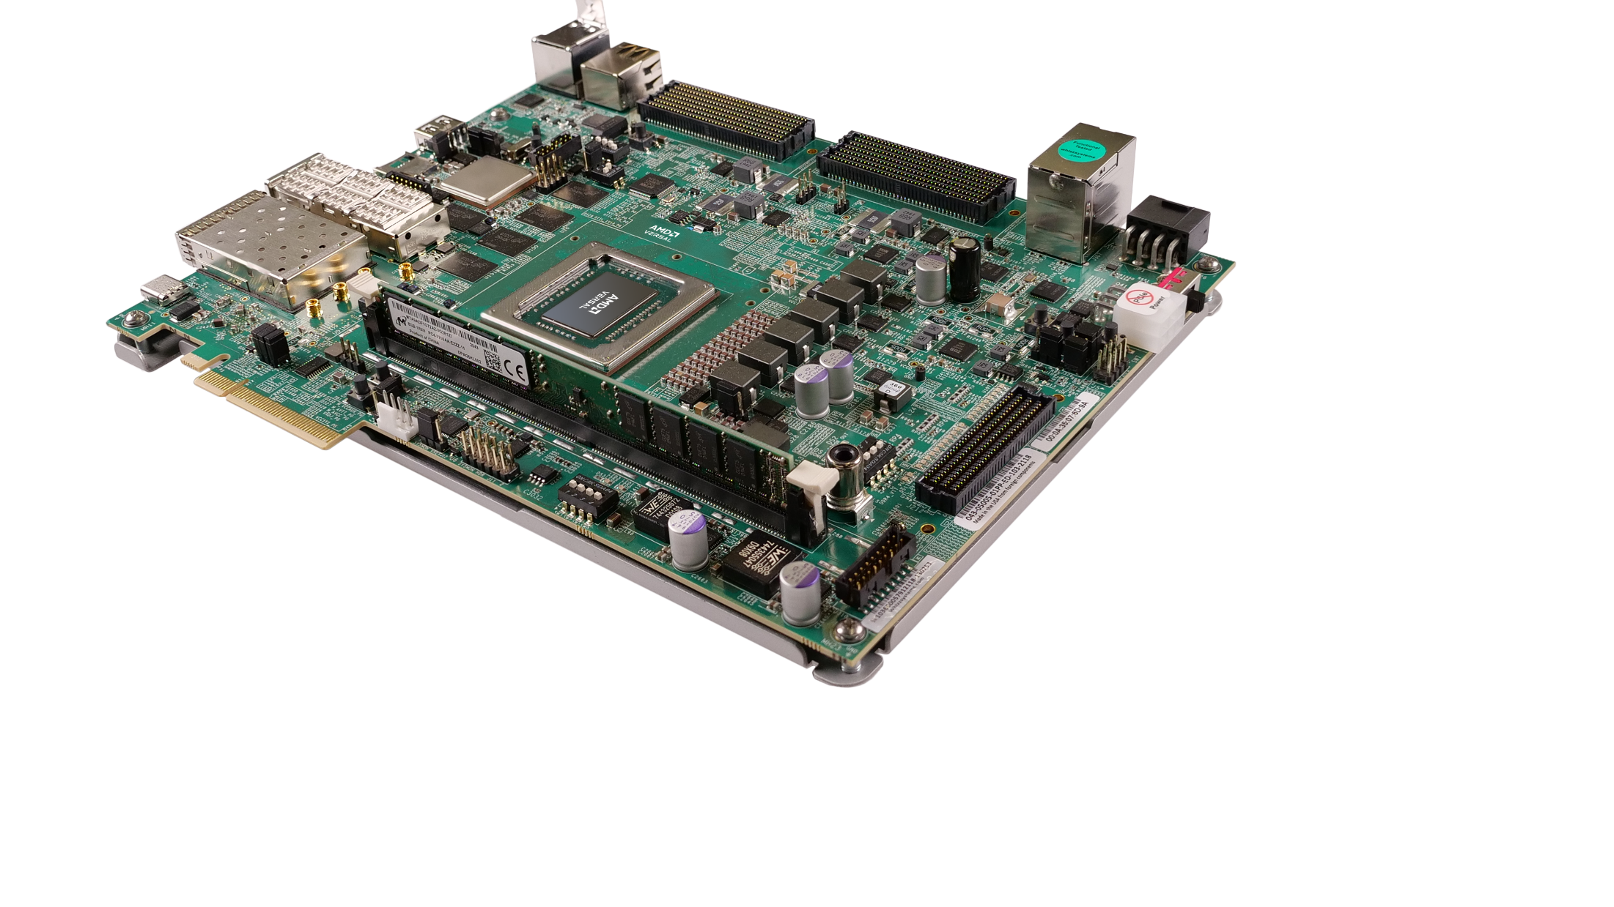
Scalable Readout systems
Xilinx Versal
Virtex Ultrascale+
We can support the development of DAQ systems for R&D and application in small- to mid-size experiments
Testbenches are available to benchmark the designed algorithms on different platforms including Xilinx Versal and Virtex Ultrascale+ devices
Large variety of firmware modules developed for readout and trigger systems.
C. F. Bedoya
DRD1 – March, 2024
5

Slide 6
Back up
C. F. Bedoya
DRD1 – March, 2024
6

Slide 7
Tasks
T1: Radiation-hard multichannel TDC board.
• D1.1: Evaluate capability of interfacing between OBDT and new detectors.
  o M1.1.1: Study of the required architecture and interfaces.
  o M1.1.2: Develop first prototype FWs with improved performance.
  o M1.1.3: Characterize limits to TDC performance.
  o M1.1.4: Integrate with low jitter clock time distributions.
T2: Integration of TDC board in a detector setup.
• D2.1: Construction of test stand for appropriate application identified.
  o M2.1.1: Build parts required to construct a test stand.
  o M2.1.2: Develop required online software, data acquisition system and analysis framework.
  o M2.1.3: Study system performance.
C. F. Bedoya
DRD1 – March, 2024
7

