Slide 1


Rome Tor Vergata Group
Task 6 - manufacturing
A. Rocchi on behalf of Rome Tor Vergata group

Slide 2
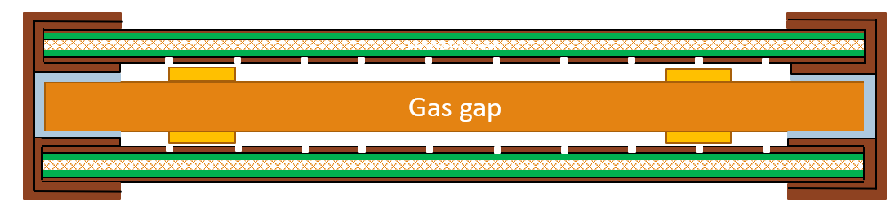
Singlet stratigraphy
The BIS and BIL singlets prototypes have the same stratigraphy:
the gas volume is contained between two readout panels with strips oriented along the long side of the chamber.
small circular dots are glued at the pillars to ensure that the pressure applied by the panels does not compress the gas gap
the sandwich composed of read-out panels and gas volume is closed in a Faraday cage made up of layers of coppered FR4 and copper tape on the edges
Total singlet thickness 13.02 [± 0.90] mm.
FR4
Copper tape thickness : 65 µm
Kapton tape thickness: 70 ± 3 µm
Paper stickers thickness: 150 [± 70] µm
Gas-gap thickness: 4.48 mm
Read-out panel thickness: 3.94 ± 0.2mm
Copper tape
Honeycomb
Kapton
Gas gap
Honeycomb
Gas gap
Paper Sticker

Slide 3
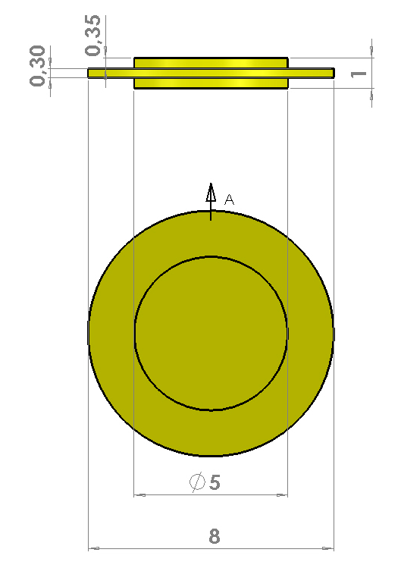
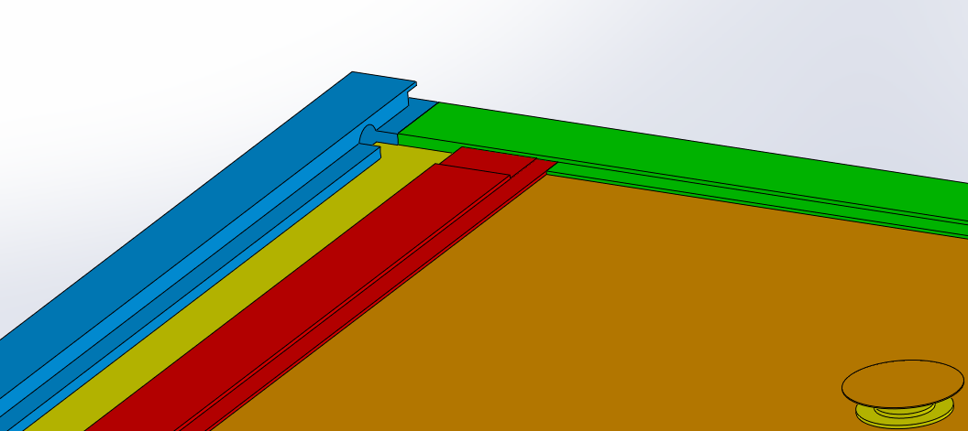
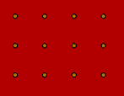
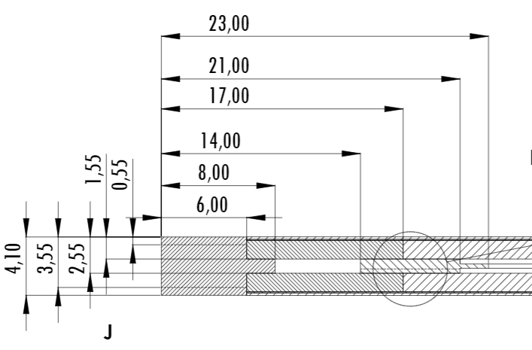
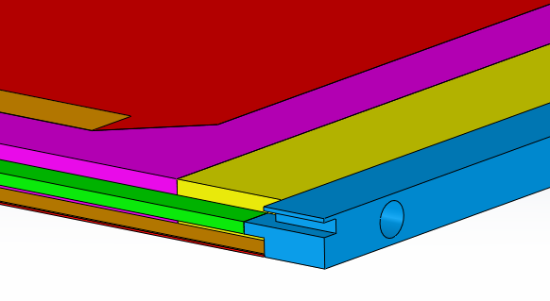
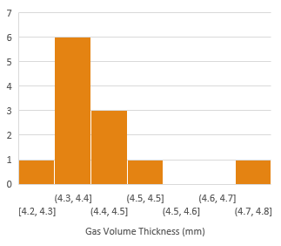
Gas volume layout
The gas volume consists of two HPL plates 1.5 mm nominal thick with resistivity of about 5 x 10 ^ 9 Ω cm, separated by 1 mm thick pillars. The pillars have the same geometry as those used for the BIS78 and are arranged on a grid with a pitch of 7 cm. The HV is distributed on the HPL panel through a graphite layer with resistivity of approx 350 kΩ/□. The power cables, certified up to 15 kV DC, are connected to the graphite layer by means of a thin copper sheet anchored to low resistivity cords, and housed in a recess created on the frame of the chamber filled with hot melt. The gas is distributed along the short side of the gas gap.
The overall tolerances on the gas volume dimensions are +-1mm for length and width and +-0.2 mm for the thickness.
Gas In
70 mm
Gas Flow

Slide 4
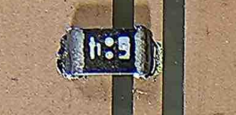
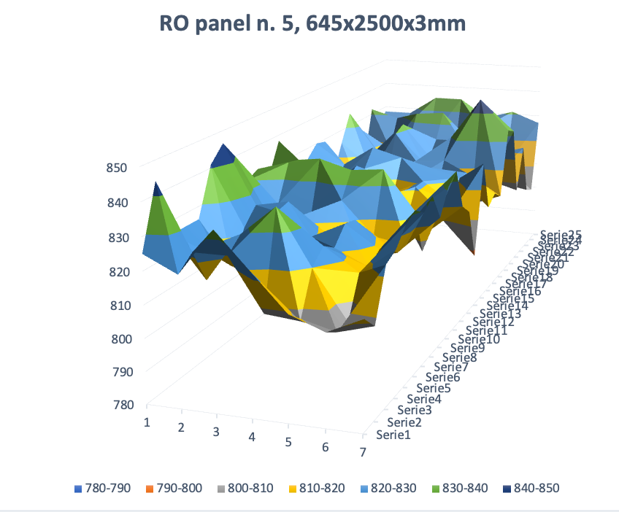
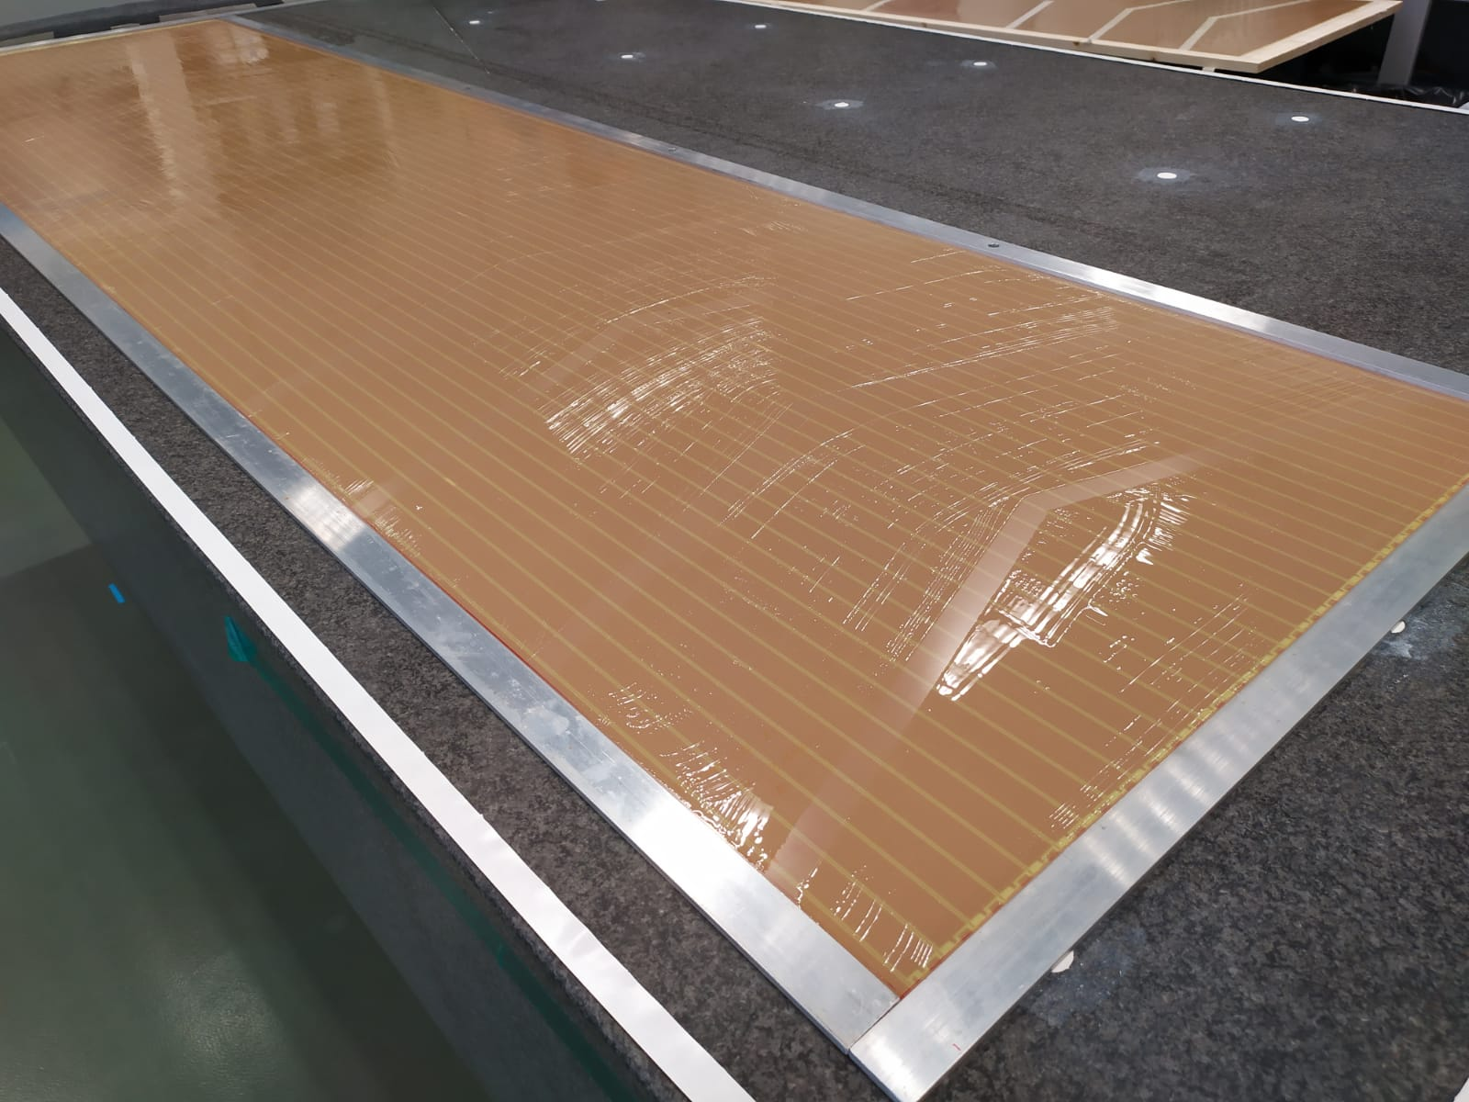
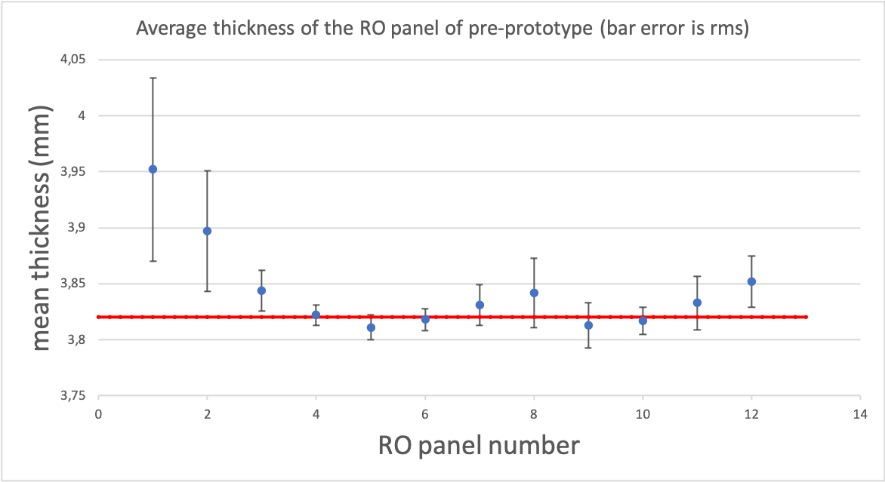
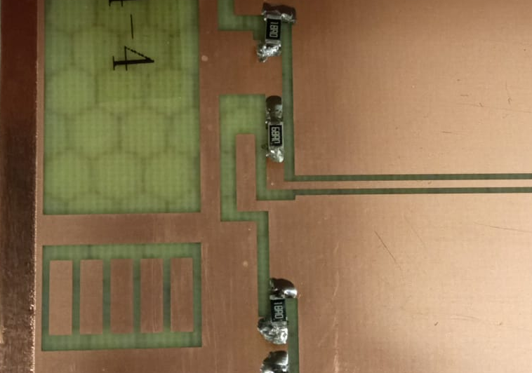
Read-out panels
A. Bruni, M. Schioppa
The read-out panels consist of three layers:
a 3 mm thick Nomex layer
two 0.4 mm thick coppered FR4 layers glued on the two opposite surfaces
The thickness and material of the panels are selected to optimize the impedance of the strips and the weight of the detector.
The read-out strips are made by photo-etching process on the surface of the panel facing the gas volume
A termination resistor is welded to the ends of each strip and each decoupling wire. The welding process of the resistances on the panel will be optimized using an automatic hot air jet machine

Slide 5
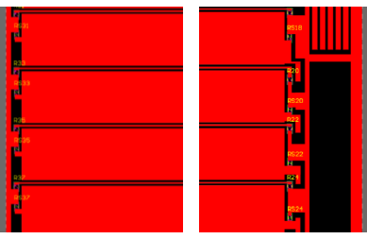
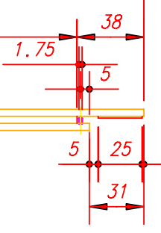
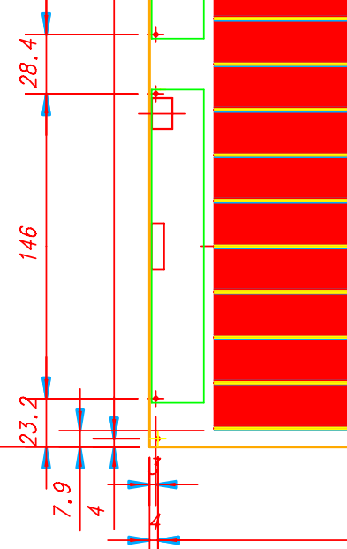
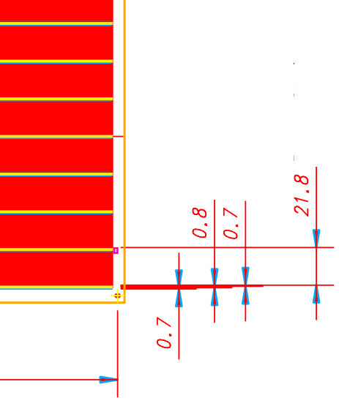
RO panels and FE Electronics
The FE Boards will host two connectors: one for the signals, one for the LV power and the TDC clock
two circular holes are positioned on two corners of the FEE for the alignment of the boards with the RO panel
The RO panels have two alignment holes for each FEE board
The RO panels have three holes placed on the corners (one circular and two elliptical) to obtain a submillimeter alignment during the production steps
The read-out panels will be shifted by 31 mm to access the FE board pad for welding
The Back End side will be widened by 1mm as respect to the firsts prototypes to ease the taping.
the read-out strip termination circuit will be designed once the FE Layout has been defined and will be optimized for the dissipationof the heat produced during the boards welding.
15 cm
LV/Clock
2 cm
2,5 cm
Chip

Slide 6
RO panel strips relative position
7 mm
2 mm
5 mm
Open question on the Ground frame layout
Cord 20kΩ/□
3 mm
Bachelite
Gas
Bachelite
Cord 20kΩ/□
3.9 mm
Ground
first strip
7.9 mm
The relative position between the first strip and the gas gap frame is the same for all the singlet types. The first strip starts 10.1 mm from the gas-volume/RO-panel side. The first and last strip width is defined in such a way to have the minimum number of pitch category
BIL A-B: 20 mm
BIS1: 22 mm (first and last strip 1mm tighter )
BIS 2-6: 21.8 mm
8.6 mm
9.4 mm
10.1 mm

Slide 7
Singlet tolerances
A gas gap with a length greater than the nominal values ​​can be used by reducing the access space for welding the FE.
This solution can only be adopted in extreme cases, as it has an impact on the soldering times of the boards, but it is an additional safety factor.
The length of the singlet would be shorter than the nominal value by an amount equal to the excess length of the gas gap
5 mm space to access the FE weld
38 mm
1736 mm
38 mm
1660 mm
1662 mm
1734 mm

Slide 8
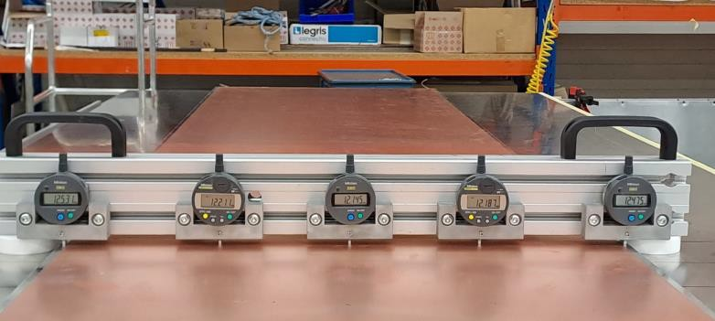
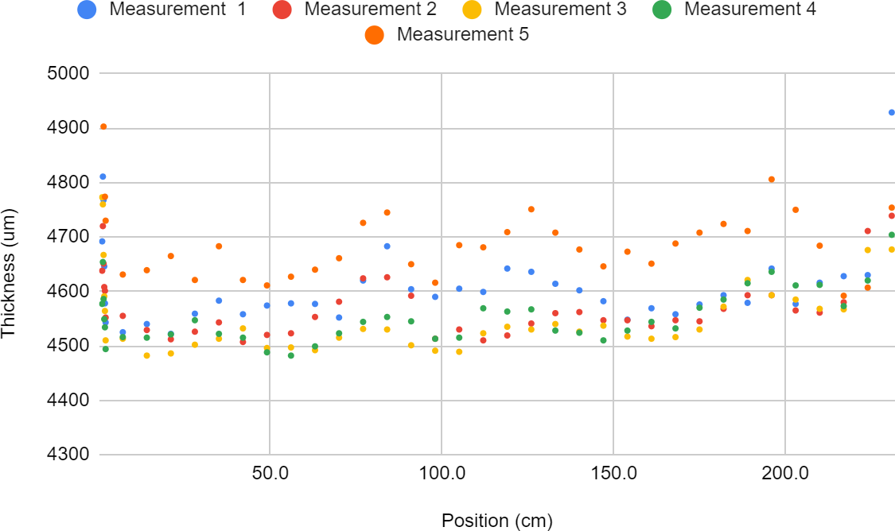
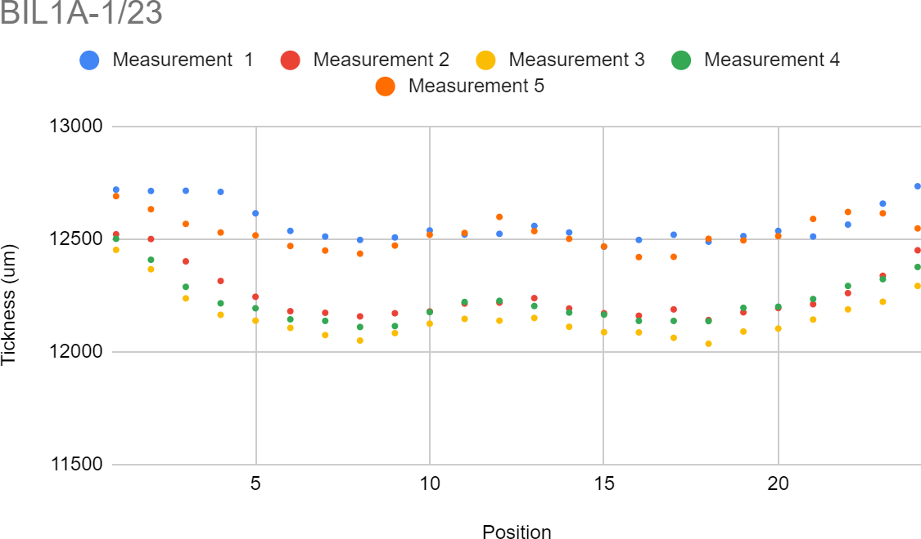
Mass production optimization for phase2 ATLAS detectors
4 chamber types
  BIL A
  BIL B
  BIS 1
  BIS 2-6
𝑁𝑜𝑚𝑖𝑛𝑎𝑙 𝑣𝑎𝑙𝑢𝑒 4.66 𝑚𝑚
Atlas Attività 2023

Slide 9
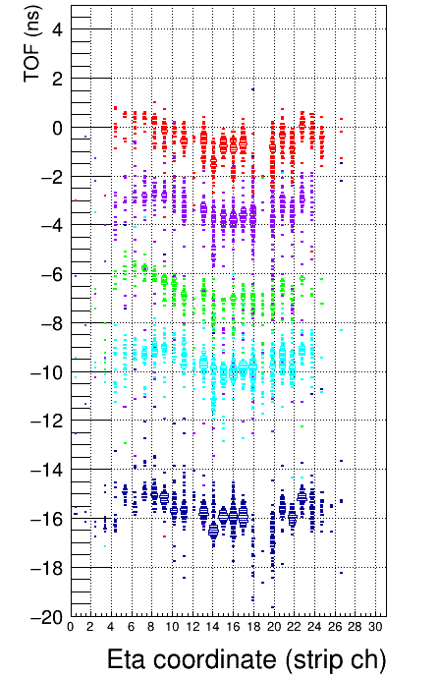
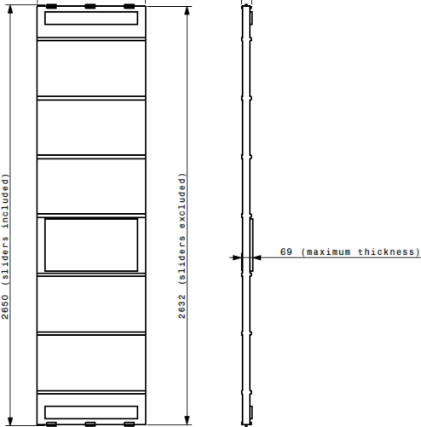
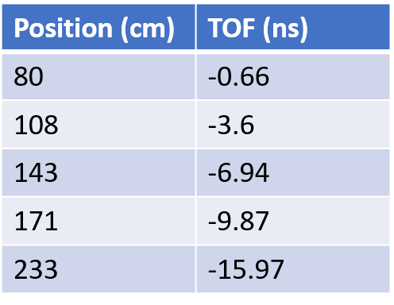
Optimization of the mechanical frame
Measurement of the propagation speed
Second coordinate performance
30 cm
~ 8 cm
Distance (cm)
SC1 & SC2 (2 cm x 30 cm x 1 cm)
0
0
50
100
150
-2
-4
y = -0.0988x R² = 0.9995
-6
-8
-10
Delay (ns)
-12
𝒗~ 𝟐𝟎. 𝟐𝟒 𝒄𝒎/𝒏𝒔
-14
-16
Atlas Attività 2023

Slide 10
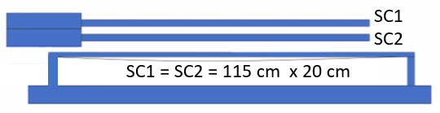
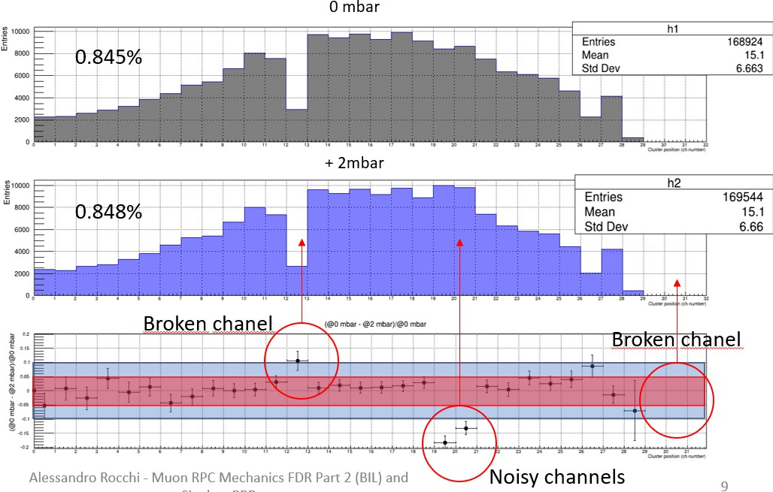
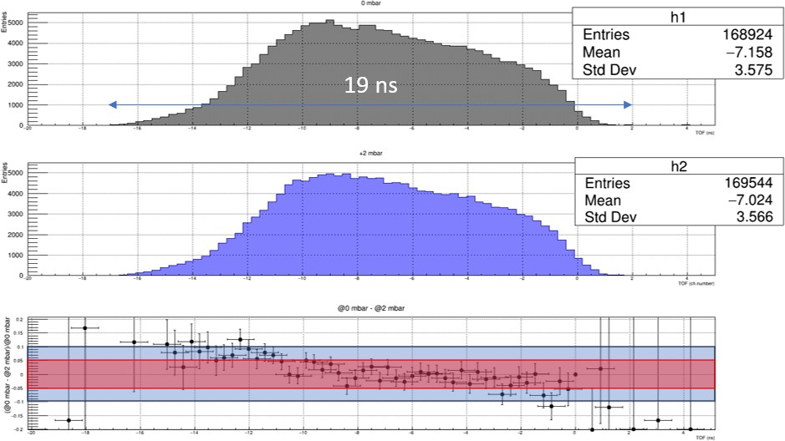
Half glued gas gap test
Half glued gas gap has to with with internal pressure of 2 mbar
Overpressure test Phi Coordinate
Overpressure test Eta coordinate
0 mbar
+2 mbar
Atlas Attività 2023

Slide 11
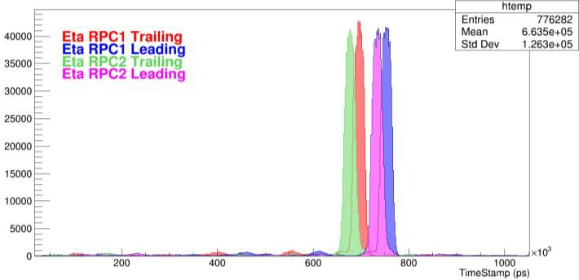
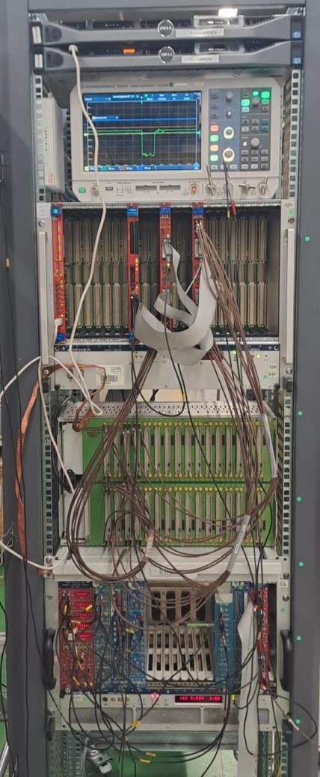
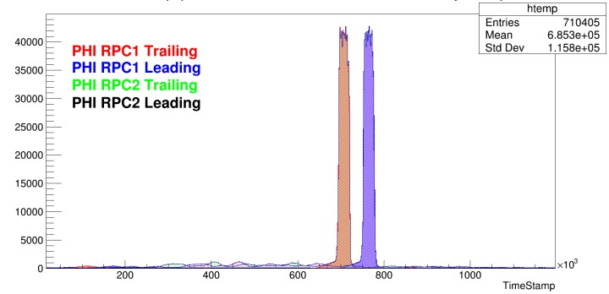
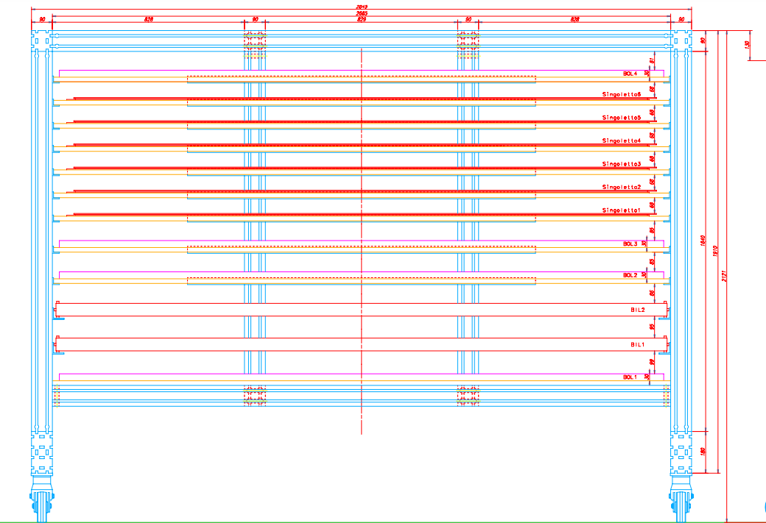
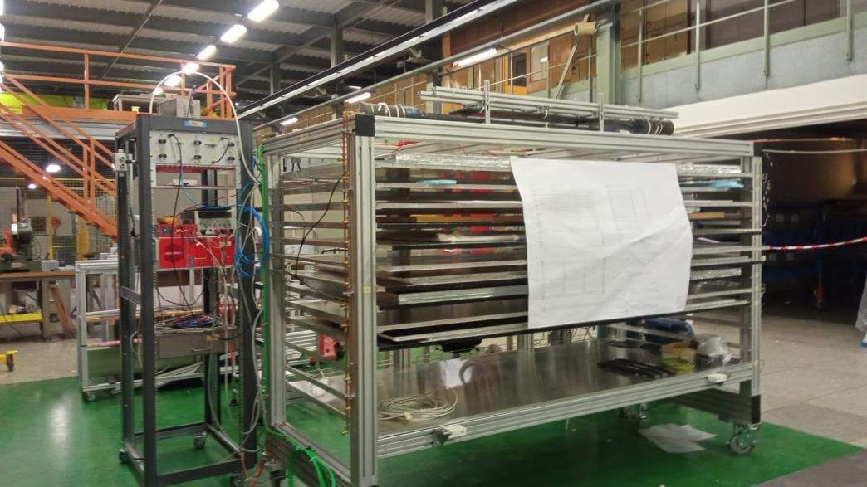
CR stand at CERN
Tile 3
Triplet sector
Tile 4
Atlas Attività 2023

Slide 12
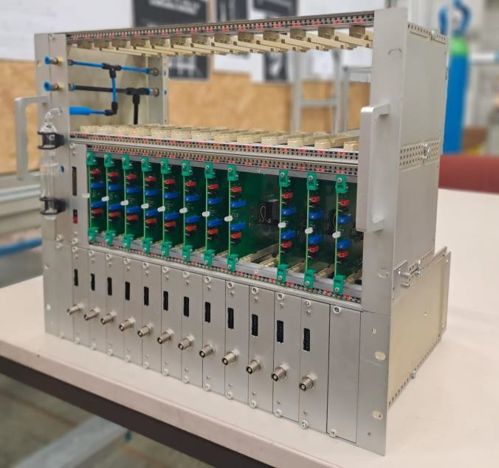
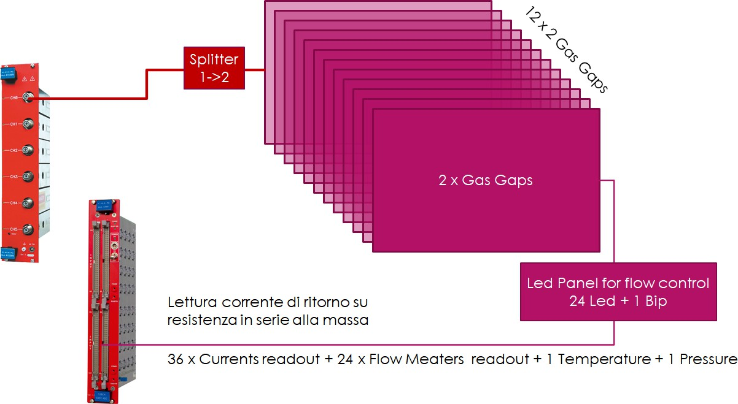
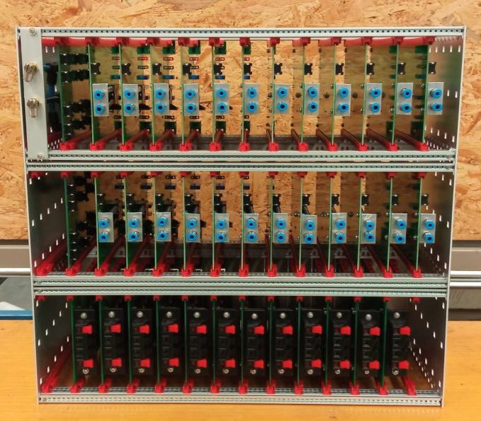

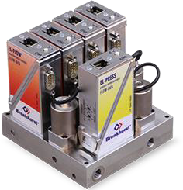

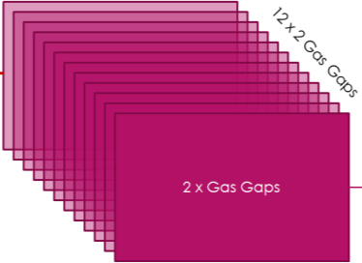

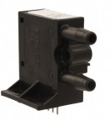
MINICRATES
Mass production test tools
HV system
M
a n y f o l d
Gas system
Atlas Attività 2023
1212

