Slide 1
The Resistive Cylindrical Chamber, a new detector based on the generalization of the RPC detectors to the quasi-planar field
G. Aielli on behalf of Rome Tor Vergata group

Slide 2
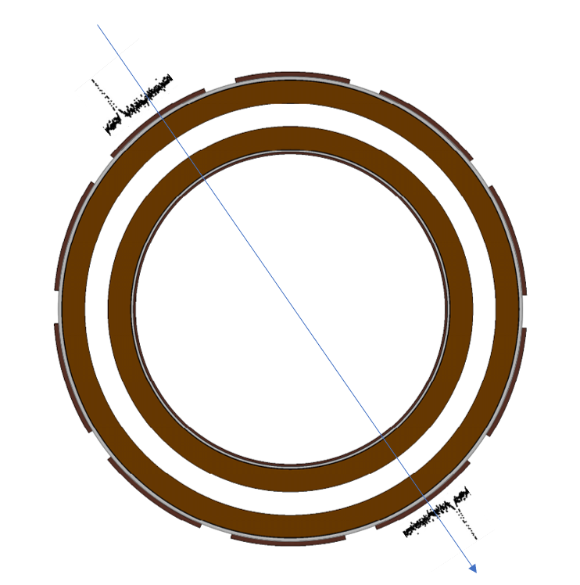
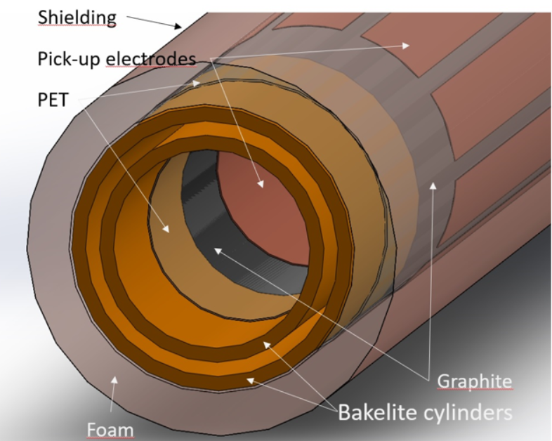
The Resistive Cylindrical Chamber
The RCC detector is a device consisting of two concentric cylinders of resistive material. The detector's stratigraphy is like that of an RPC, but the cylindrical geometry introduces new control parameters on the detector's response, as well as extending its use to hostile environments thanks to the high strength mechanical structure
Gas pressurization :
Increase the gas target density, with a consequent increase in intrinsic efficiency
  → MRPC time response with thin single gap configuration
  → light eco-friendly CO₂ based gas mixtures
Use the detector in hostile environments
The electric field gradient, depending on the polarization allows to
Contribute to the gas discharge quenching
  → new eco-friendly gas components
Increase the charge collection efficiency enhancing the multiplication in the initial part of the gas gap
Study the dependencies and optimize the time resolution
Double gap:
Tracking capability
Improvement in time resolution and efficiency

Slide 3
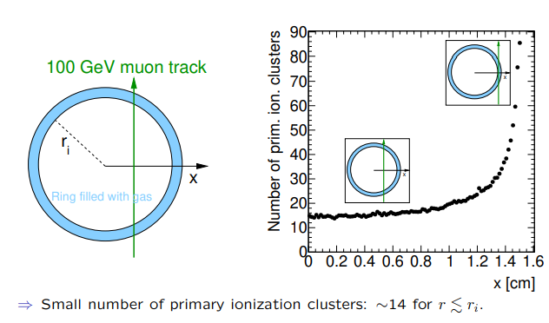
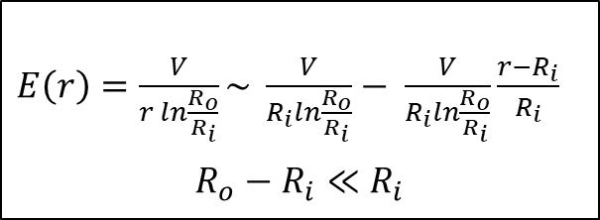
Simulation: electric field gradient and primary ionization
In the RCC detector the electric field has a cylindrical geometry and is much more approximable to a planar field as the gas-gap is negligible with respect to the radius of the internal electrode. This feature allows to design detectors with different responses according to the experimental needs:
$E\left(r\right)=\frac{V}{r ln\frac{R_{o}}{R_{i}}}\sim \frac{V}{R_{i}ln\frac{R_{o}}{R_{i}}}− \frac{V}{R_{i}ln\frac{R_{o}}{R_{i}}}\frac{r−R_{i}}{R_{i}}$
$$R_{o}−R_{i}≪R_{i}$$
weak dependence on thin gas gaps
it is possible to reproduce the same performances of an RPC in an easily pressurized cylindrical structure;
it is possible to design a detector with a non-negligible field gradient to increase the time resolution and suppress the transition to the streamer regime
Gas-gap 0.3 mm
The RCC detector has a double gap structure, which can be exploited for tracking measurements and to increase efficiency and time resolution
Gas-gap 1 mm
D_{ext}=6 mm
D_{ext}=8 mm
Primary ionization with pressurized CO₂
D_{ext}=16 mm
Lower field
D_{ext}=18 mm
-
-
Higher field
[Simulation of the avalanche creation in resitive circular chambers
Oliver Kortner, XVI Workshop on Resistive Plate Chambers and Related Detectors]
Position (mm)

Slide 4
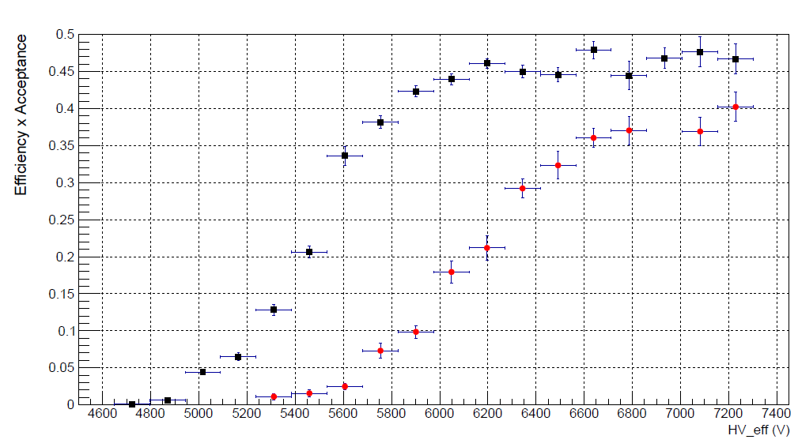
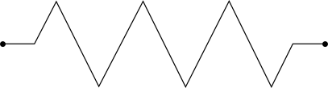
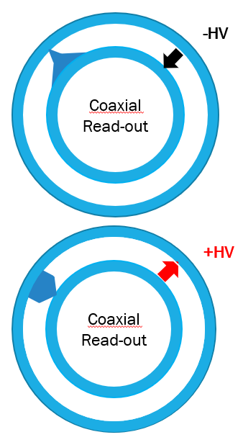
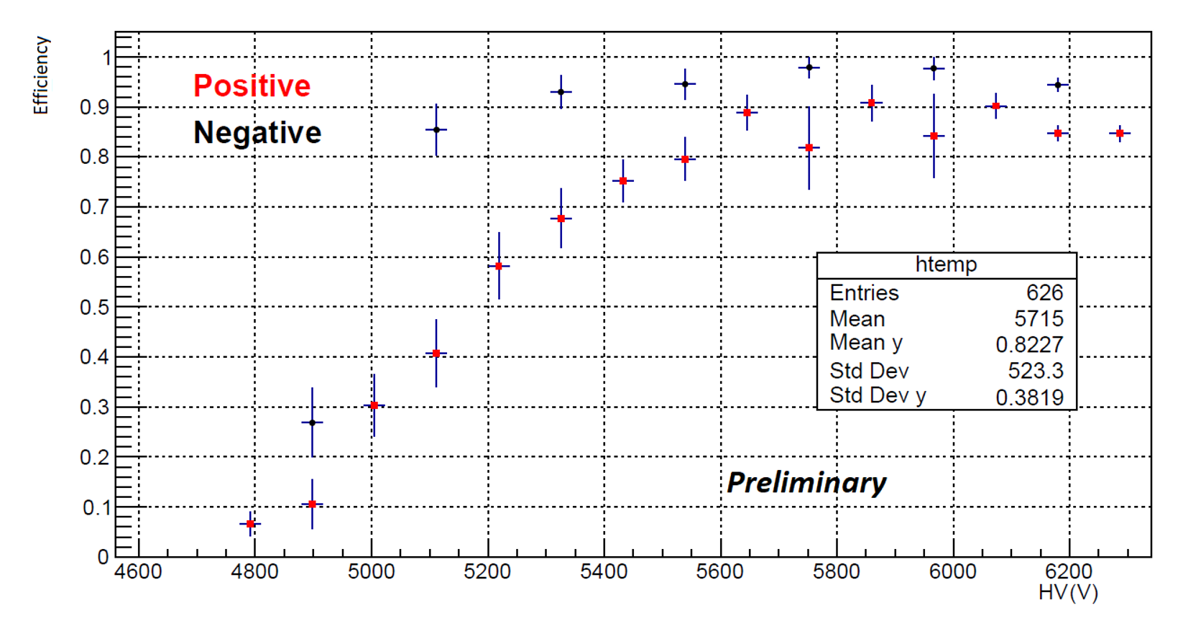
Detector description and reliminary results
(1 mm gas-gap)
[Development of Resistive Cylindrical Chambers, R. Cardarelli, XVI Workshop on Resistive Plate Chambers and Related Detectors]
[Moderation of the avalanche gas discharge through a quasi-uniform electric field device: the Resistive Cylindrical Chamber, A. Rocchi, VCI2022]
Caen V1742
The response of a 1 mm gas-gap RCC was studied with the detector described in figure. The smaller radius electrode consists of an aluminum cylinder. A significant separation is observed between the working points of the detector in the different polarities. The intrinsic efficiency is lower in the case of positive polarization as if the useful gas-gap decreases.
Bakelite electrode
Graphite
Gas mixture
94.7% TFE + 5% iC4H10 + 0.3% SF6
Shielding
OUT
Alluminium
electorde
4 mm
The time resolution was measured using an RPC detector with two coupled 0.2mm gaps as a reference.
The time resolution improve as the applied voltage increases and for high field values ​​it is systematically better in the case of positive polarization, in which multiplication occurs mainly near the cathode (behavior like that of a thinner gap).
6 mm
Insulator
Gas-gap 1 mm
FE-Electronics + Caen V1742
+
In this measure a UFSD pixel detector was used to optimize geometric acceptance at the expense of statistics .
-

Slide 5
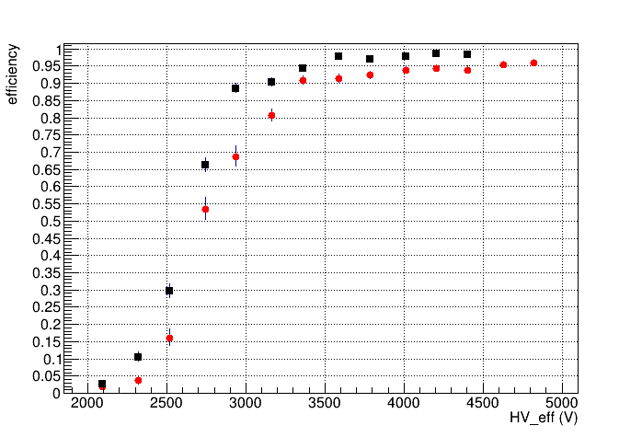
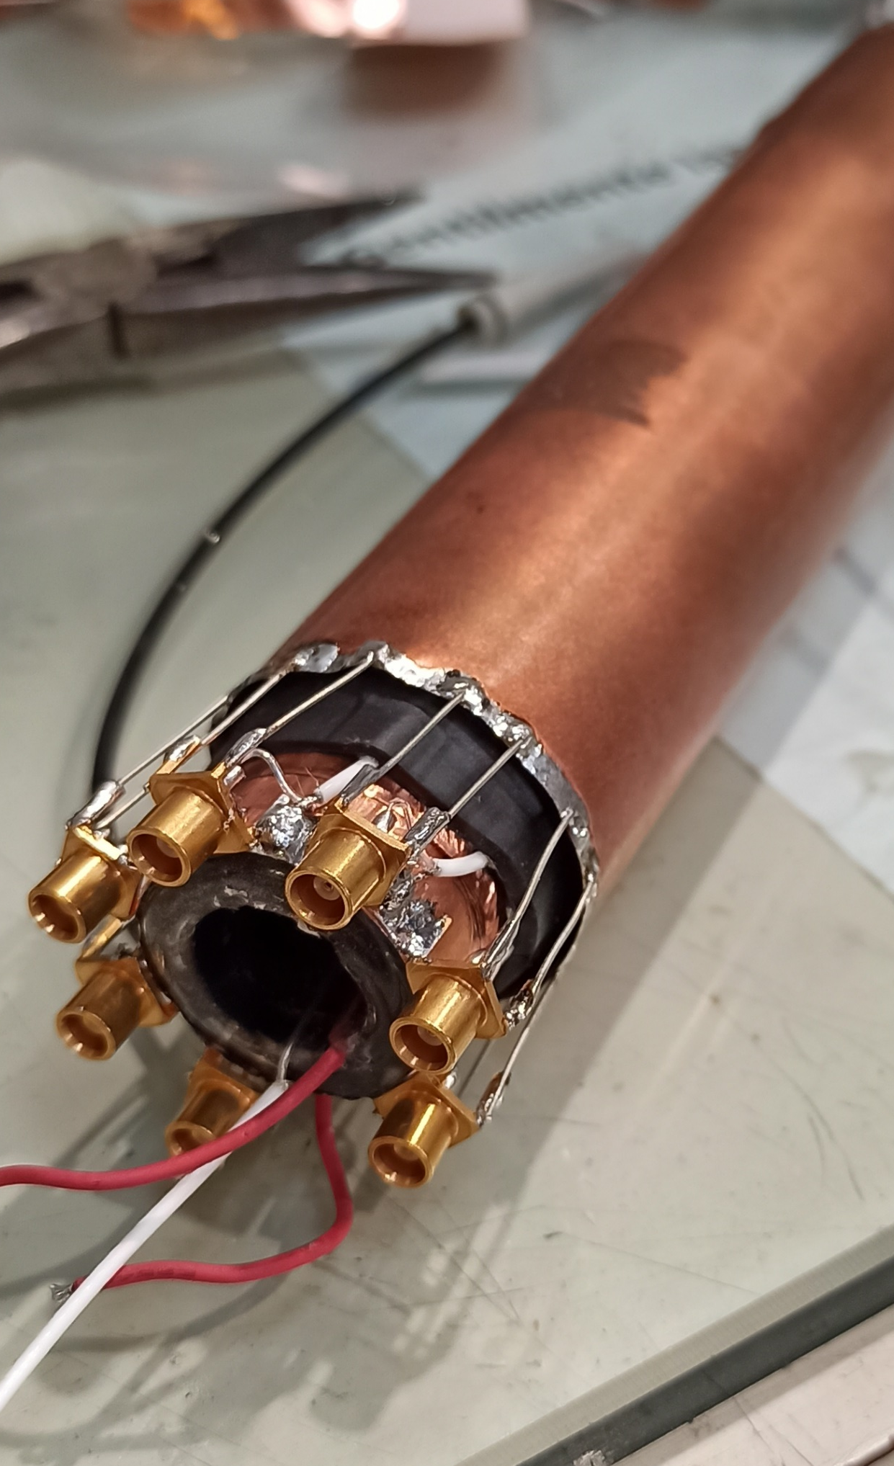
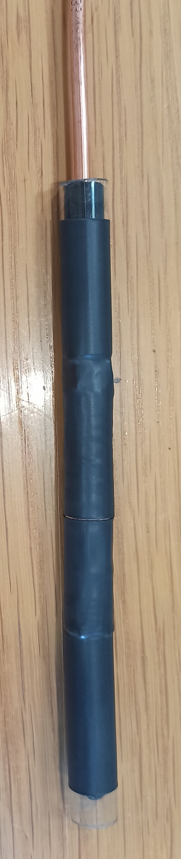
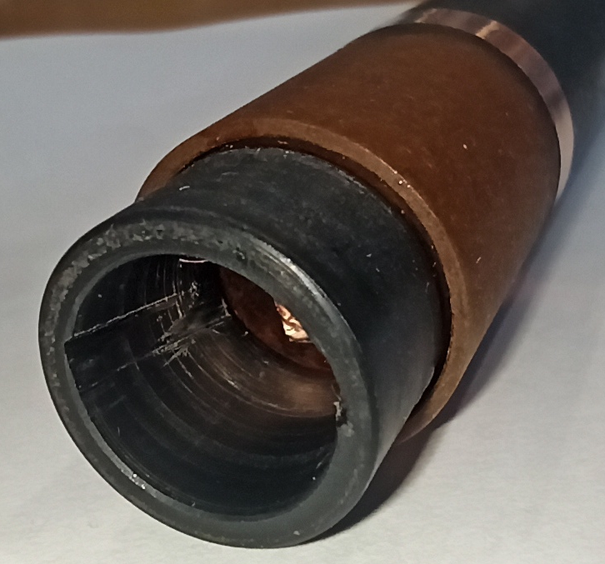
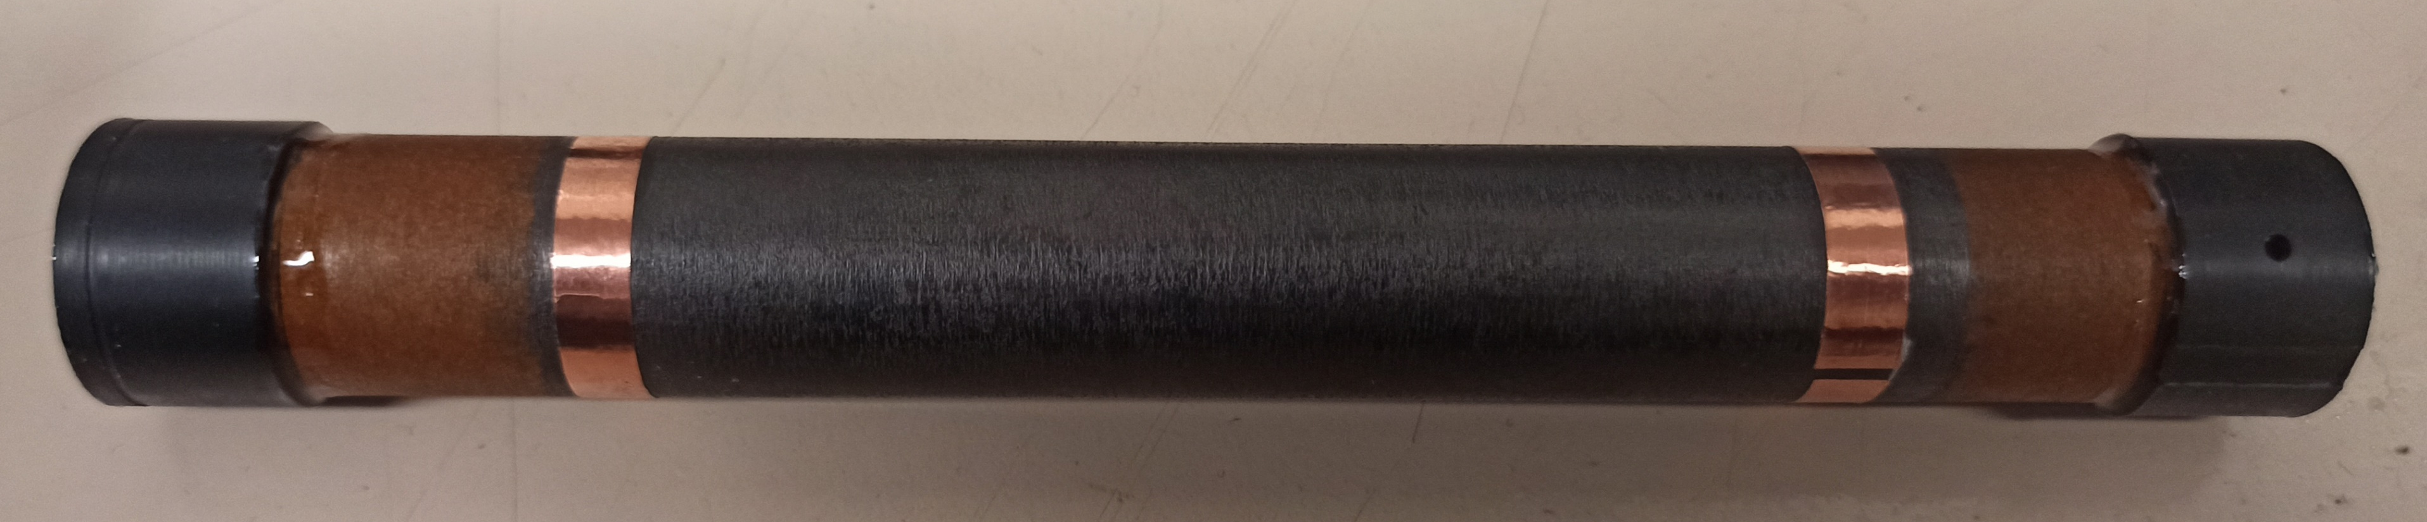
Detector description and reliminary results
(0.3 mm gas-gap)
[Thanks to Alessandro Paoloni for the SIPM detector and electroinics]
The detector described in figure was characterized with muons of 180 GeV / c.
A small difference can be observed between the working points in different polarities. Also In this configuration the detector has a lower intrinsic efficiency in positive polarity.
The internal detector made it possible to close the angle of acceptance and discriminate the tangential traces
Insulator
Gas mixture
94.7% TFE + 5% iC4H10 + 0.3% SF6
Shielding
Bakelite
SIPM+
Scintillator
Gas
Graphite
Strips 7 ch
-
+
Cylindrical
Pad
+
-

Slide 6
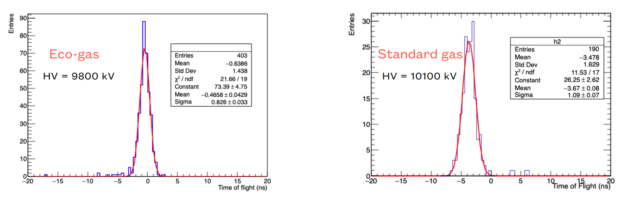
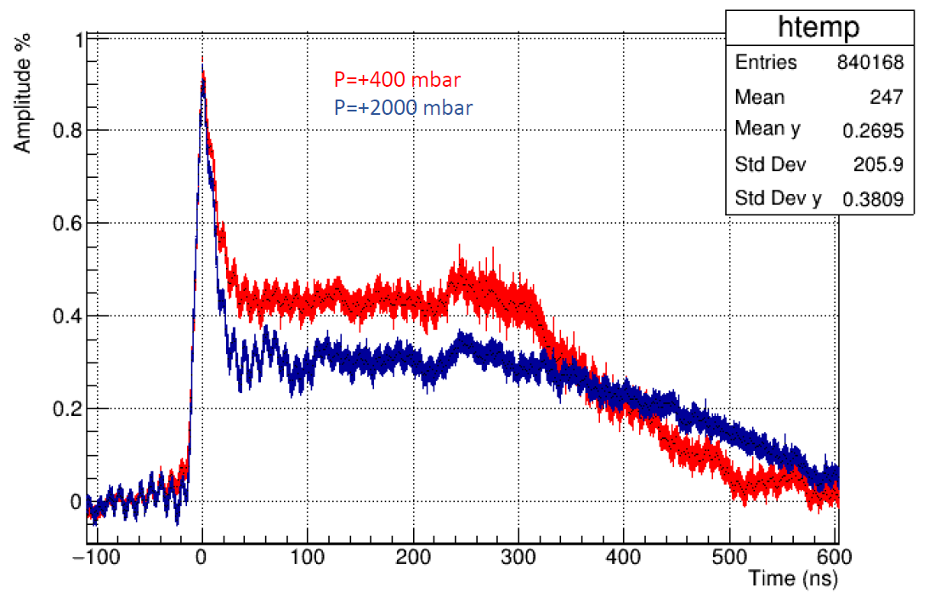
Study with high pressurized CO₂
[On a new environment-friendly gas mixture for Resistive Plate Chambers,
G. Proto, XVI Workshop on Resistive Plate Chambers and Related Detectors]
Studies on new eco-friendly gas mixtures show that mixtures with a high concentration of CO₂ lead to an improvement in the time resolution at expense of the intrinsic efficiency of the detector.
The RCC thanks to the pressurization of the gas-gap allows to increase the density of the gas recovering the loss of efficiency even for thin gas gaps
The effect of the pressure is visible from the ion signal profile:
as the pressure increases, the instantaneous current decreases as the drift speed of the ions decreases and the duration of the signal increases accordingly. The amplitude of the electronic signal is unchanged
σ_{Eco} = (0.83 ± 0.03) ns
σ_{STD} = (1.09 ± 0.07) ns
Average profile of normalized signals

Slide 7
Conclusions
The functionality of the detector has been demonstrated with prototypes of different structures (1 mm gas-gap, 0.3 mm gas-gap)
As expected, the asymmetry in the detector response with respect to the polarity of the applied voltage increases when the thickness of the gap increases with respect to the internal radius
The effect of suppression of the avalanche in positive polarization leads to a reduction of the intrinsic efficiency but to an improvement in the time resolution, as if the useful gas-gap were thinner
This effect can also be studied to suppress the transition to the streamer regime in gas mixtures with low quenching potential
Perspectives
Systematic study of RCC detectors with different radius and gas-gaps
Study of the response with high concentration of CO₂

