Slide 1
Workshop banquet
(Hopefully) “Japanese cuisine”
  unless you have specified something else. ☺
  If you have specified something else, do not touch the dishes pre-prepared until you have been instructed.
We have an entertainment from local amusement, “TAKASHIBA HYOTTOKO-ODORI”

Slide 2
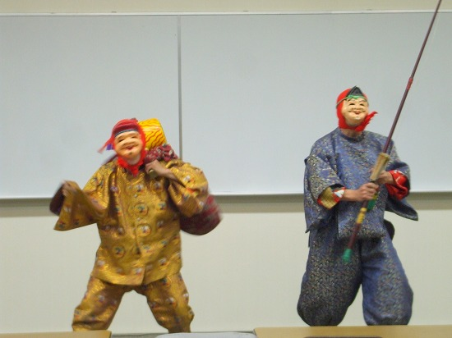
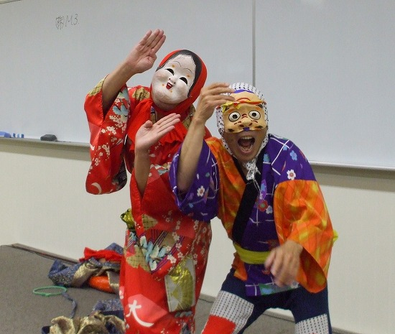
TAKASHIBA HYOTOKO-ODORI
Play of pray for good harvest, good prosperity in business, good health of family, traditionally kept in TAKASHIBA district
We thank the actors for coming and celebrating the workshop

Slide 3
Time and Place
19:00 – 21:00
“BANDAI” (the same room we have the breakfast), but it must have re-modeled to be the “Tatami” room☺☺
  You will sit on the tatami floor.

