Slide 1
Status of the ATLAS Pixel Detector at the LHC and its performance after three years of operation
PIXEL2012
Inawashiro – 3-7 September 2012
Attilio Andreazza
Università di Milano and INFN
for the ATLAS Collaboration.
With special thanks to P. Morettini, K. Lantsch and B. Di Girolamo

Slide 2
Layout
The ATLAS Detector at the LHC
The Pixel Detector
In situ calibrations and performance
Status and operation in 2012
  Operational efficiency
  Radiation effects
  on silicon and electronics
Tracking performances
Summary and perspectives
Some preview of the posters:
Track and vertex reconstruction in the ATLAS Inner Detector
Monitoring radiation damage in the ATLAS Pixel Detector
Neural network based cluster creation in the ATLAS silicon Pixel Detector

Slide 3

A Toroidal LHC Apparatus
25 m
45 m

Slide 4
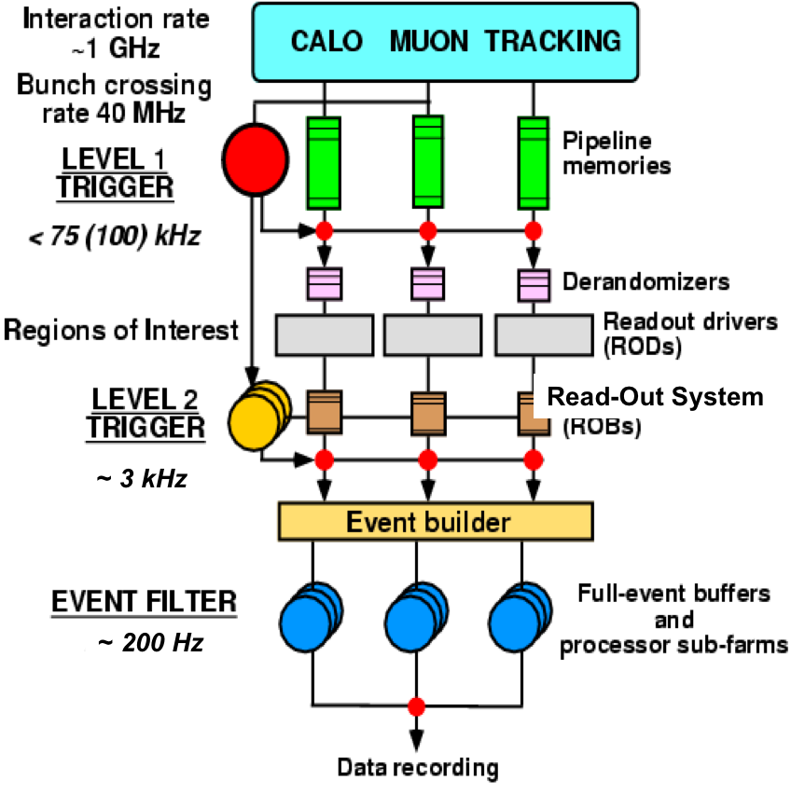
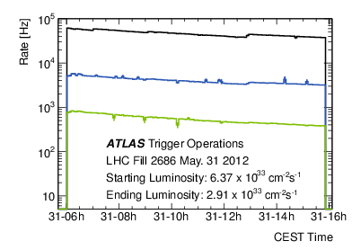
Trigger and data processing
Three level trigger system:
Level 1, hardware
  2.5 μs latency
Level 2 + Event Filter, software
Prescales adjusted according to instantaneous
beam conditions
Sustained output rate up to 400 Hz
Level 1
Level 2
Event filter

Slide 5
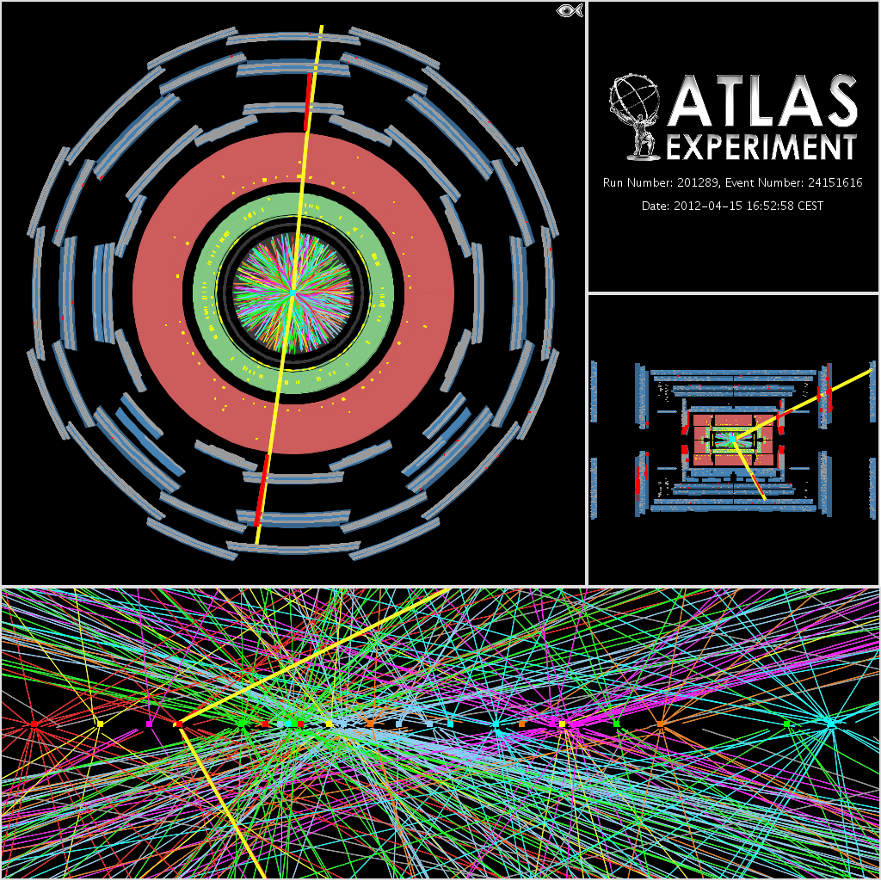
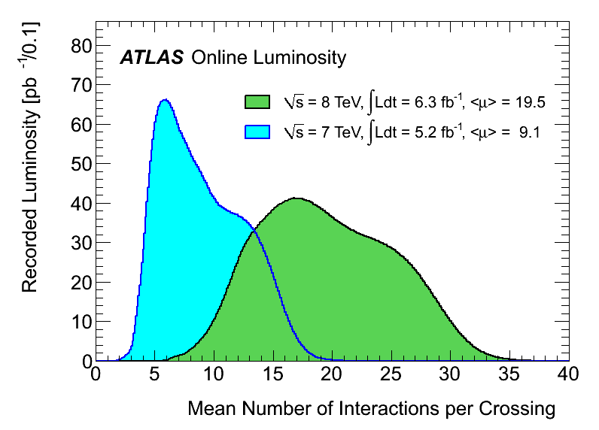
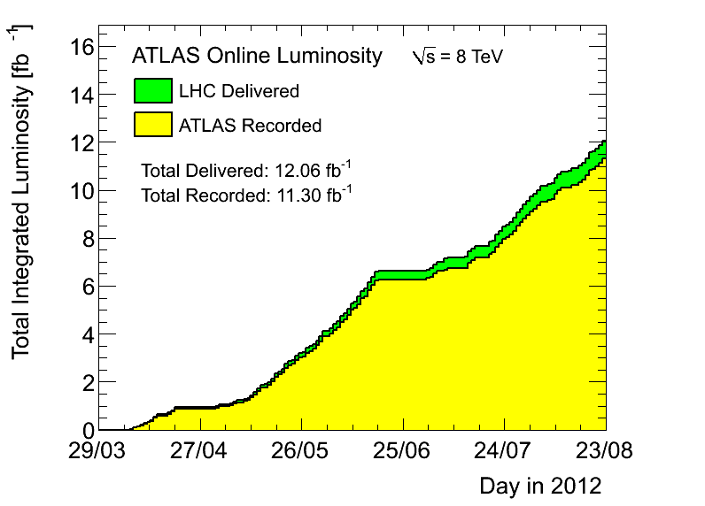
Running conditions
LHC is performing extremely well
  Luminosity > 7 × 10³³ cm⁻²s⁻¹
  almost at its design value.
  Bunch spacing at 50 ns
  ⇒ a lot of pile-up!

Slide 6
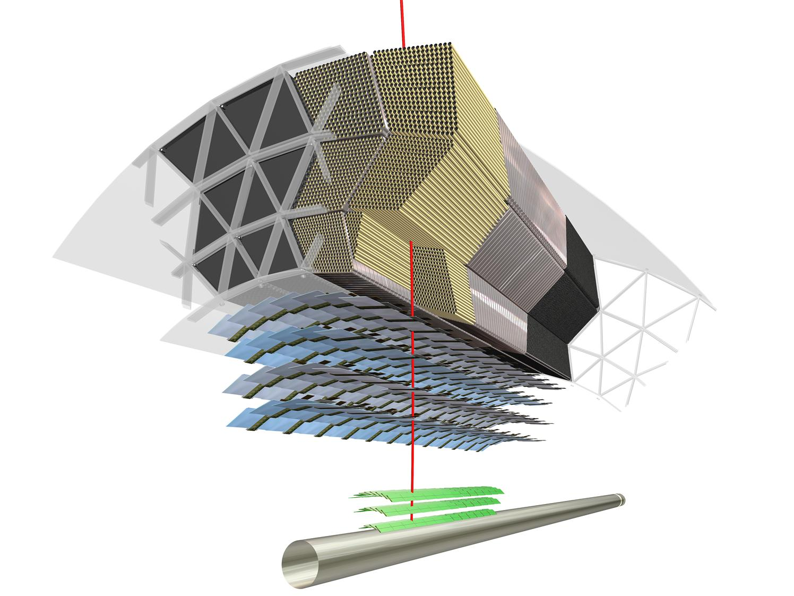
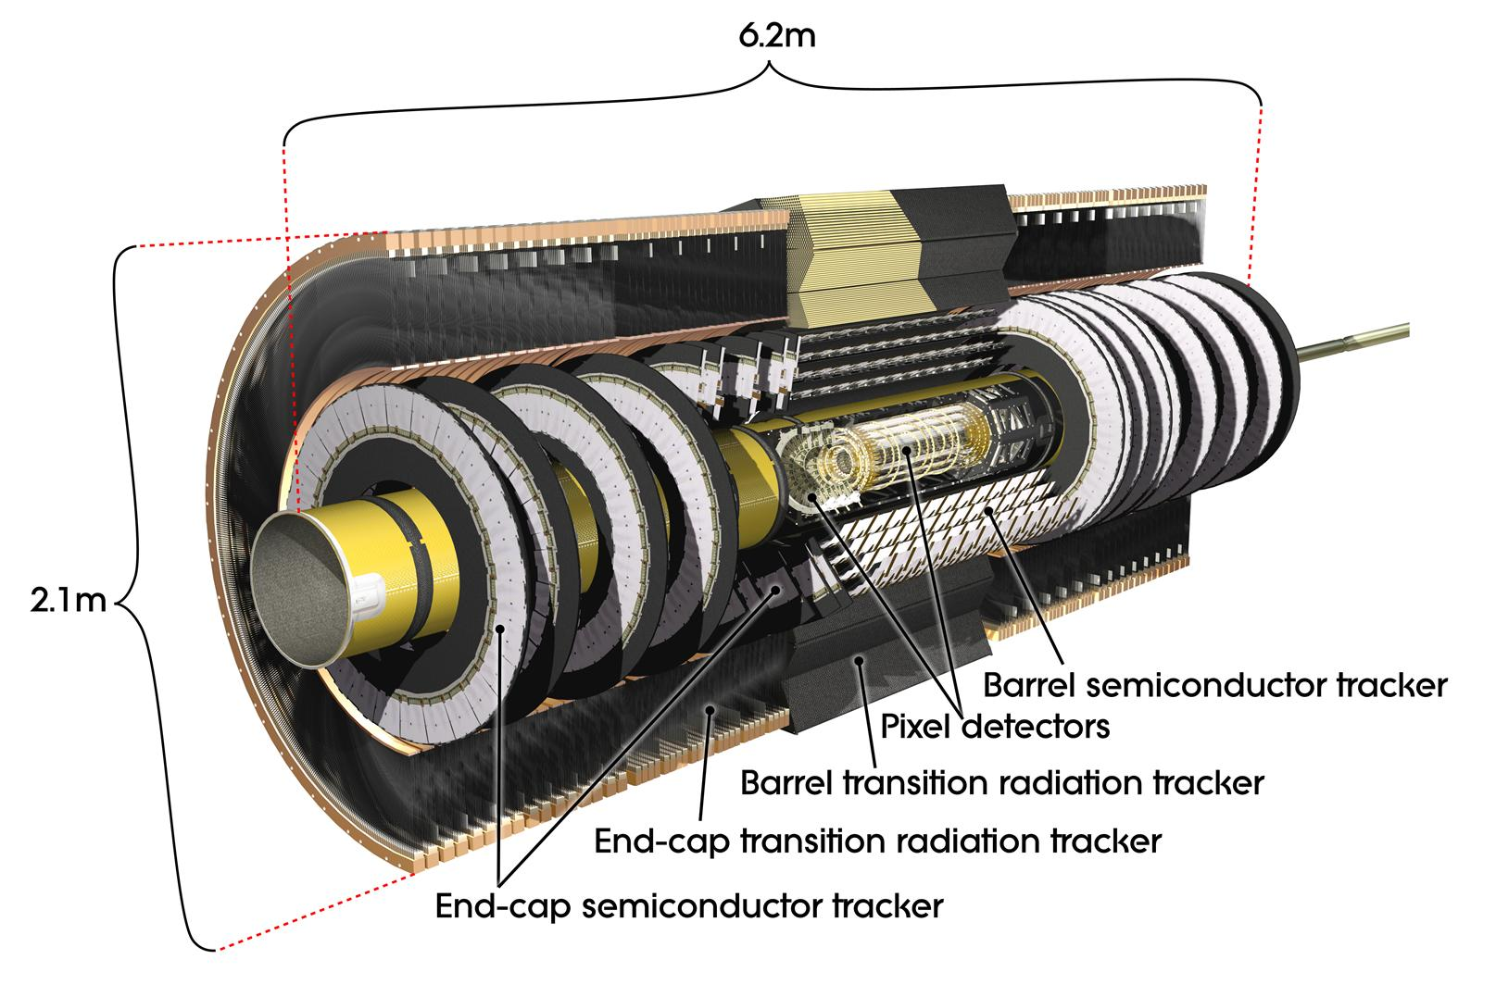
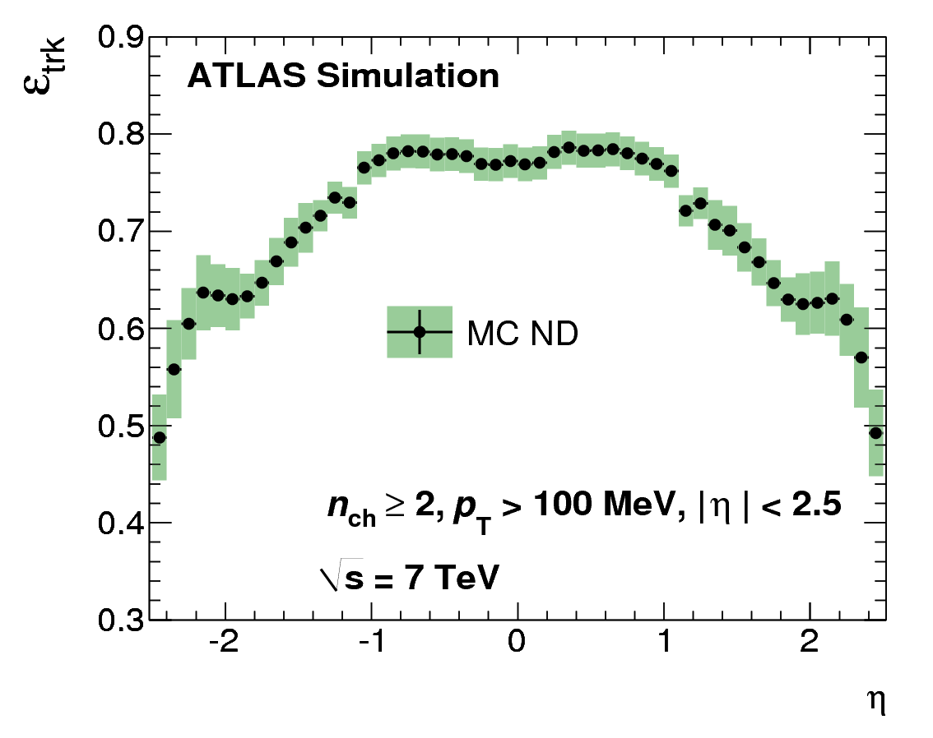
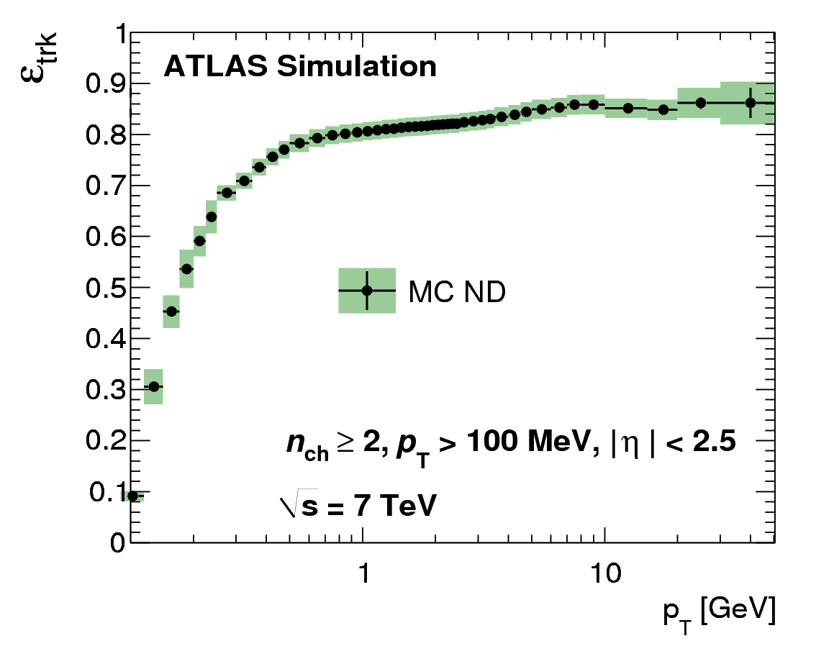
ATLAS Inner Detector
Composite tracking system:
  Transition Radiation Tracker
  Silicon Strips: 80 μm pitch/stereo
  Silicon Pixels: 50 μm × 400 μm
2 T solenoidal magnetic field
Track reconstruction:
  Acceptance |η|<2.5 (|η|<2 for TRT)
  Reconstruction possible down
  to p_{T}≈100 MeV
See Kenji Hamano’s poster for
ATLAS tracking performance

Slide 7
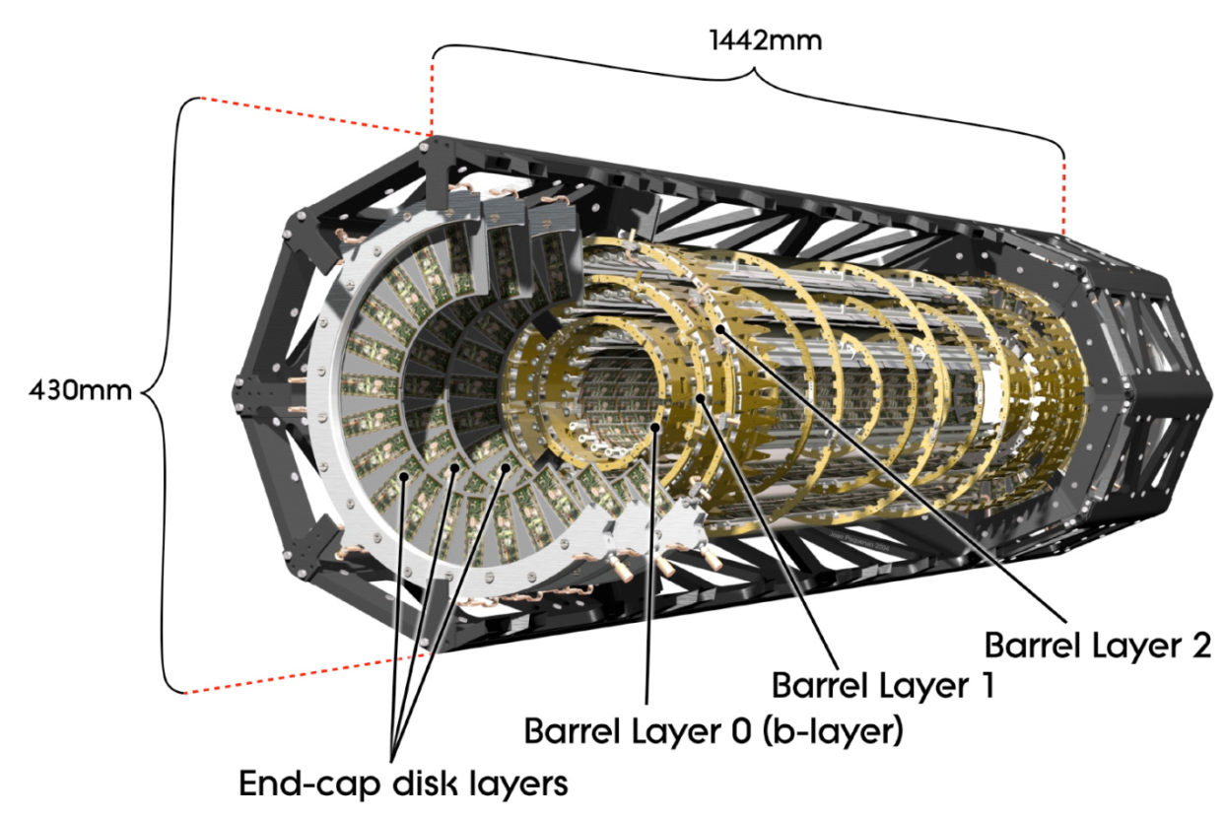
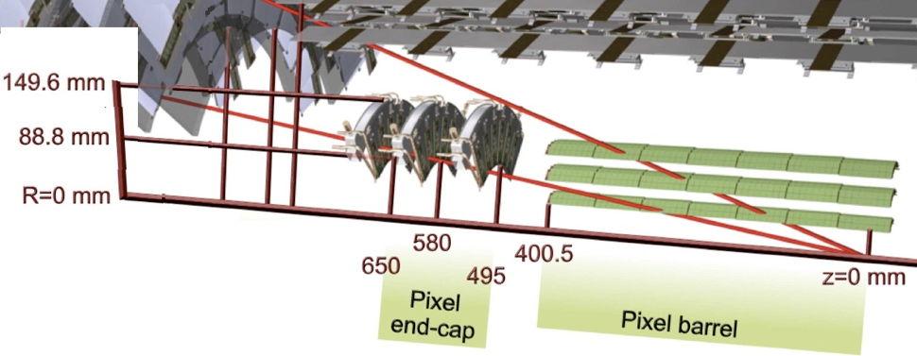
The ATLAS Pixel Detector
Three barrel layers:
  R= 5 cm (B-Layer),
  9 cm (Layer-1), 12 cm (Layer-2)
  modules tilted by 20º in the Rφ plane to overcompensate the Lorentz angle.
Two endcaps:
  three disks each
  48 modules/disk
Three precise measurement points up to ⏐η⏐<2.5:
  RΦ resolution:10 μm
  η (R or z) resolution: 115 μm
1456 barrel modules and 288 forward modules, for a total of 80 million channels and a sensitive area of 1.7 m².
  Environmental temperature
  about -13 ºC

Slide 8
Module overview
Sensor
  47232 n-on-n pixels with moderated p-spray insulation
  250 μm thickness
  50 μm (RΦ) × 400 μm (η)
  328 rows (x_{local})
  × 144 columns (y_{local})
16 FE chips
  bump bonded to sensor
Flex Hybrid
  passive components
  Module Controller Chip
  to perform distribution of commands and event building.
Radiation-hard design:
  Dose 500 kGy
  NIEL 10¹⁵ n_{eq}/cm² fluence
60.8 mm
16.4 mm
5 years at 10³⁴ cm⁻²s⁻¹

Slide 9
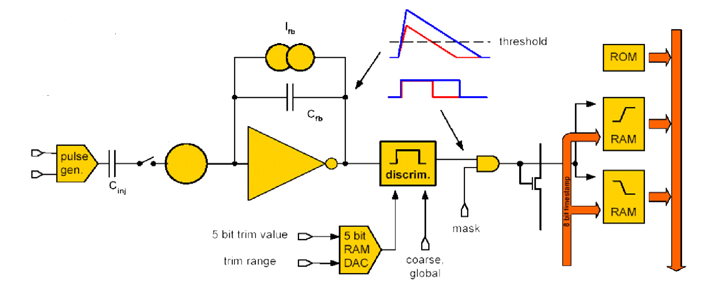
Structure of the pixel read-out cell
The Pixel Detector FE cell:
a constant (adjustable) feedback current pre-amp
a discriminator with 7 bit DAC to adjust threshold
circuitry to measure Time over Threshold (ToT)
analog and digital injection points for calibration
End of Column:
storage of hits during the Level-1 trigger latency time
64 memory buffers for each column pair of 2×160 pixels
pixel ID + timestamp + ToT

Slide 10
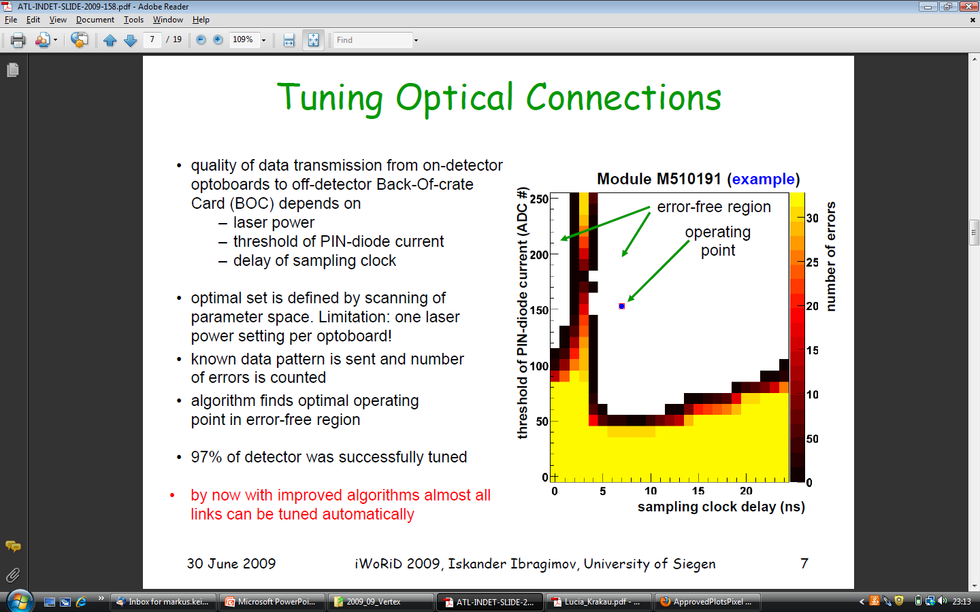
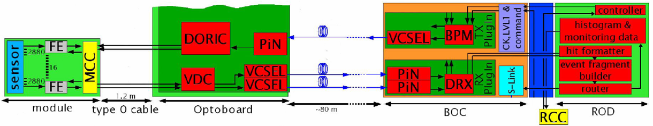
Optical links
A module is connected to the external world via a low mass cable providing all the required services:
Bias: HV + analog and digital LV
Temperature measurement
Clock, serial command and data output lines
Data connection between on- and off-detector readout electronics is through an optical link.
Each link can be tuned by setting:
  signal phase
  threshold

Slide 11
Calibration procedures
Given the enormous number of channels and free parameters to tune, the read-out electronics and the DAQ software were designed with particular attention to the calibration procedures.
Using the internal front-end electronics self-test and charge injection capabilities:
  Tune the custom rad-hard opto-link parameters to guarantee error free data transmission.
  Adjust the discriminator threshold of each channel to minimize threshold dispersion.
  Measure the noise of each channel.
  Tune the time-over-threshold.

Slide 12
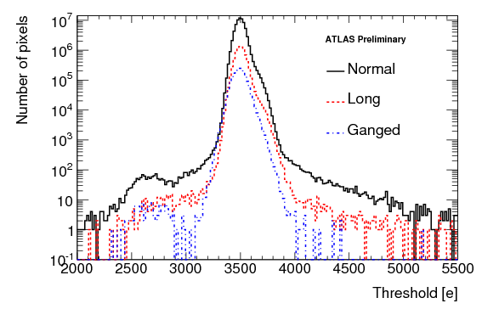
Calibration procedures
Given the enormous number of channels and free parameters to tune, the read-out electronics and the DAQ software were designed with particular attention to the calibration procedures.
Using the internal front-end electronics self-test and charge injection capabilities:
  Tune the custom rad-hard opto-link parameters to guarantee error free data transmission.
  Adjust the discriminator threshold of each channel to minimize threshold dispersion.
  Measure the noise of each channel.
  Tune the time-over-threshold.
Threshold and noise are determined by measuring the discriminator response as a function of the injected charge.
The Pixel Detector is operated at 3500 e threshold, with a dispersion of few tens of electrons.

Slide 13
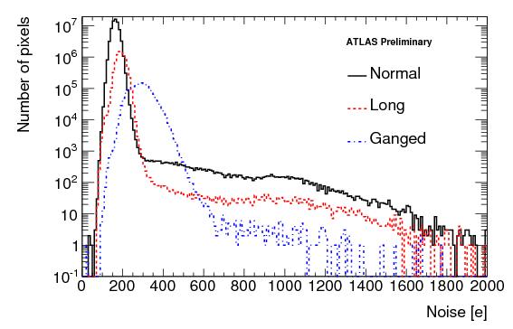
Calibration procedures
Given the enormous number of channels and free parameters to tune, the read-out electronics and the DAQ software were designed with particular attention to the calibration procedures.
Using the internal front-end electronics self-test and charge injection capabilities:
  Tune the custom rad-hard opto-link parameters to guarantee error free data transmission.
  Adjust the discriminator threshold of each channel to minimize threshold dispersion.
  Measure the noise of each channel.
  Tune the time-over-threshold.
  The typical noise of normal size pixels is below 200 e.
  The large signal over noise ratio guarantee a good stability margin even for the pixels at the edge of the array. A lower threshold (2000 e or even below) could be used if needed.

Slide 14
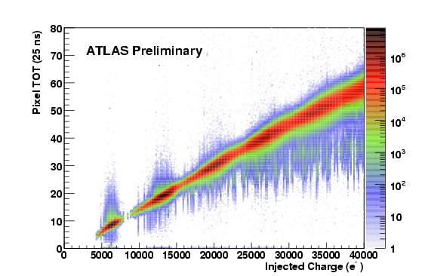
Calibration procedures
Given the enormous number of channels and free parameters to tune, the read-out electronics and the DAQ software were designed with particular attention to the calibration procedures.
Using the internal front-end electronics self-test and charge injection capabilities:
  Tune the custom rad-hard opto-link parameters to guarantee error free data transmission.
  Adjust the discriminator threshold of each channel to minimize threshold dispersion.
  Measure the noise of each channel.
  Tune the time-over-threshold.
The pixel read-out cell can measure (in 25 ns units) the time the discriminator input remains over threshold. This is correlated with the deposited charge.
The pixel cell pre-amp feedback current can be adjusted to equalize the ToT response.
Tuning point

Slide 15
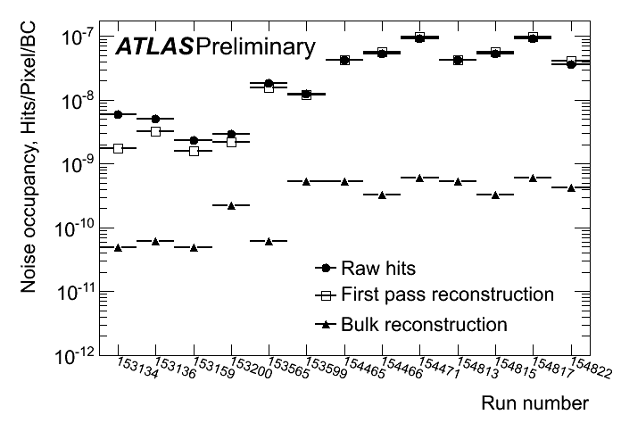
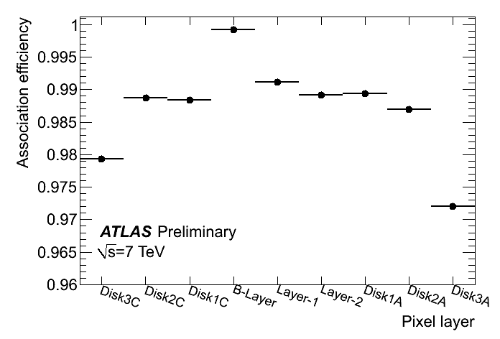
Noise occupancy and efficiency
The occupancy due to noise can be calculated from the noise measured with the charge injection, or derived directly with a random trigger.
The agreement between the two methods is good and the occupancy per pixel/BC is below ~10⁻⁹, masking less than 0.02% of the pixels.
The hit efficiency of each silicon layer can be measured performing a track fit without that layer and looking for hits aligned with the resultant tracks. Typical hit inefficiencies are of the order of 0.2%.
(excluding the effect of dead modules)
The Pixel Detector is the primary tool for selecting primary vs. secondary particles (converted photons for example) and suppressing fake tracks.
√s=7 TeV

Slide 16
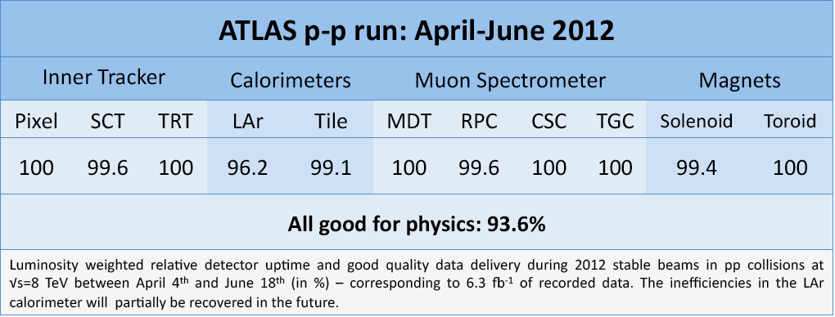
Detector status in 2012
Currently 77 non operable modules
(out of 1744, i.e. 4.4%)
In 2008, after the installation, we had 25 non operable modules. So, in average, we have a failure increase of 0.6-0.7% per year. Outermost layer seems to be more fragile.
Failures are highly correlated with cooling stops. We tried to reduce the thermal shock whenever possible.
Not always possible to identify the exact reason for the malfunctioning. Most common failures are broken wire-bonds or dark optical links.
Very stable operation: fully efficient D(A)Q
D 3.5%
B 3.1%
L1 2.0%
L2 6.7%

Slide 17
Read-out capabilities
Col pairs
..9..
EOC buffer
and logic
16 x 40 Mb/s
FE/MCC links
.
.
. 16 FE
.
.
MCC
ROD
40, 80 or 160 Mb/s
MCC/ROD links
..16..
MCC buffers
ROD buffers
Many elements in the read-out chain, and, in particular conditions, each buffer or link can be saturated.
The MCC/ROD link is a weak element, especially for the outermost layer which is connected at 40 Mb/s.
The end of column buffers will saturate at pixel occupancies around 1.6 10⁻³.

Slide 18
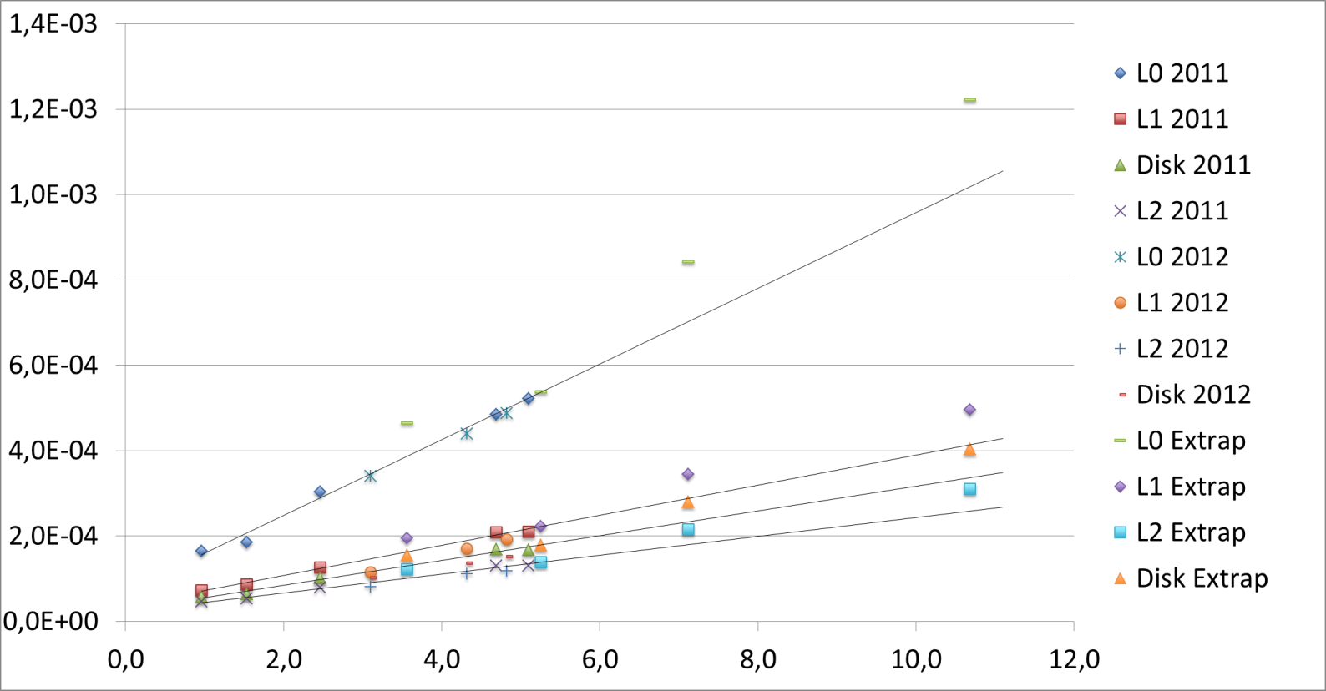
Occupancy extrapolation
The Pixel Detector is now operating in a very reliable way at 7 10³³cm⁻²s⁻¹ @ 50 ns. But after the shutdown LHC luminosity will increase. Extrapolations of the expected occupancies due to minimum bias are done for 3 LHC luminosities: 1, 2 and 3 10³⁴ cm⁻²s⁻¹@ 25 ns (2015-2017).
ATLAS Preliminary
Pixel Detector
Minimum bias occupancy
Pixel occupancy
2 10³⁴
14 TeV
3 10³⁴
14 TeV
10³⁴
14 TeV
Now
Bunch lumi (1E30)
For the 2015-2017 points we assume (13) 14 TeV, so the occupancies are scaled up by 20% to take into account the increase in minimum bias cross section. We can see that today’s occupancy is larger than the one expected at design luminosity. But even at 3 times the design luminosity, the occupancy looks tolerable for the read-out system.

Slide 19
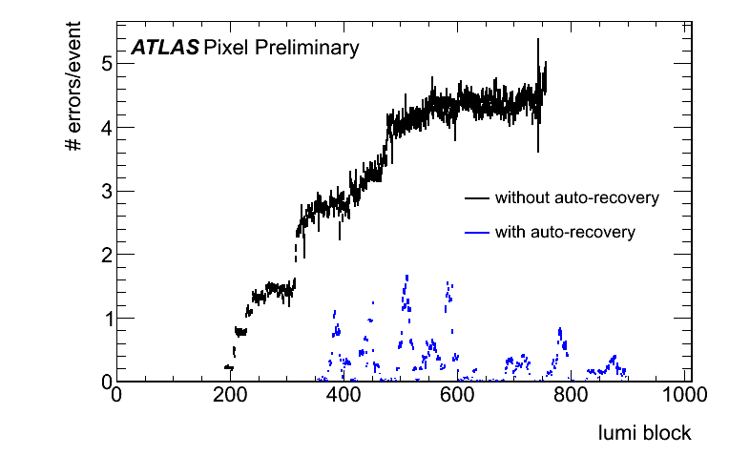
Facing high luminosities
The Pixel Detector was designed for 10³⁴cm⁻²s⁻¹, but extrapolations of the present running conditions indicate the it can be operated at 2-3 10³⁴cm⁻²s⁻¹.
We are continuously improving our procedures to maximize data taking efficiency and minimize the risk of permanent damage.
Specific tuning (e.g. higher threshold or faster shaping time) could be beneficial at high luminosity (possibility to reduce the load on the read-out system at the expense of the track quality).
Synchronization errors vs run time
One aspect that is potentially dangerous as the luminosity increases is the effect of SEU, that are clearly visible even now. For example, we observe an increased rate in module de-synchronizations at the beginning of each LHC fill. We are exploiting all the capabilities of the read-out electronics to detect and correct these effects in real-time.

Slide 20
Radiation damage
The sensors of the ATLAS Pixel Detector were designed to be still operational after a fluence of 10¹⁵ n_{eq}/cm².
That would correspond to ~300 fb⁻¹ of integrated luminosity for the innermost layer.
Today, at ~15 fb⁻¹, the detector is still in its infancy...
But effects are starting to be measurable:
  Increase of leakage current
  Depletion voltage
See Andree Schorlemmer’s poster for
more details about radiation damage

Slide 21
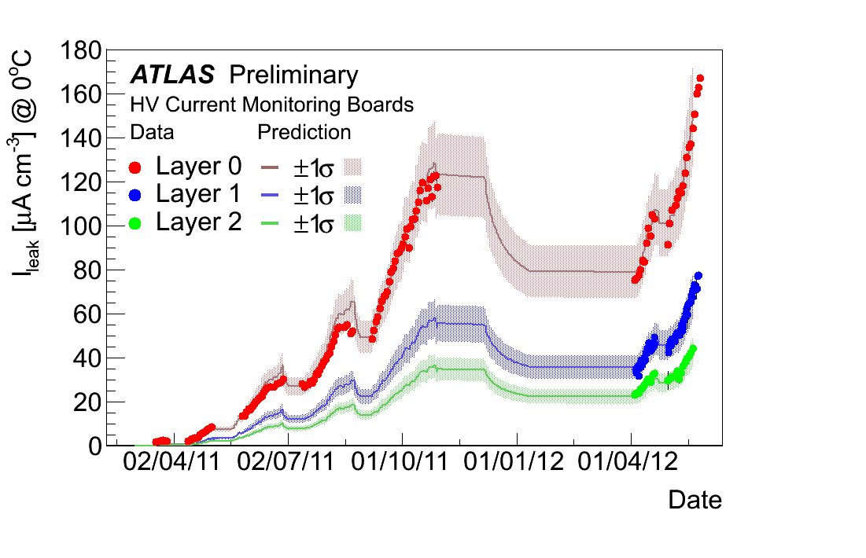
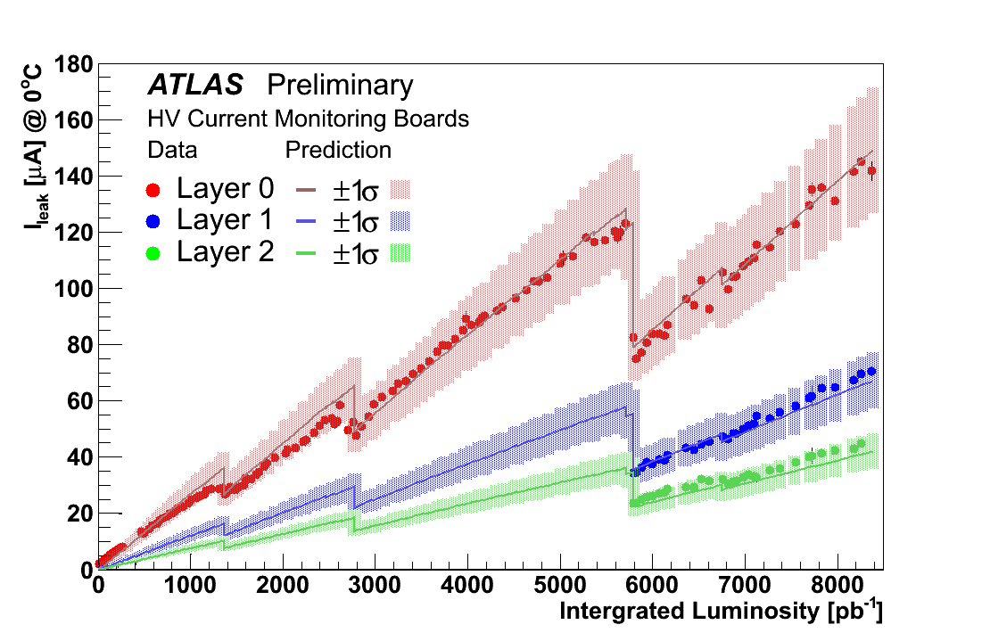
Leakage current measurements
Three available tools:
With the power supply, per group of 6/7 modules, with a precision of ~80 nA.
For a single modules, with dedicated hardware. The precision is ~10 nA, available for a limited number of modules.
At the pixel level, with a specific feature implemented in the FE chip. Useful in particular to map non homogeneous current distributions.
The three methods agree well, and clearly show the increase with luminosity and the effect of the annealing.
Predictions based on the “Dortmund” model (O. Krasel) underestimates the data by 15-25%.

Slide 22
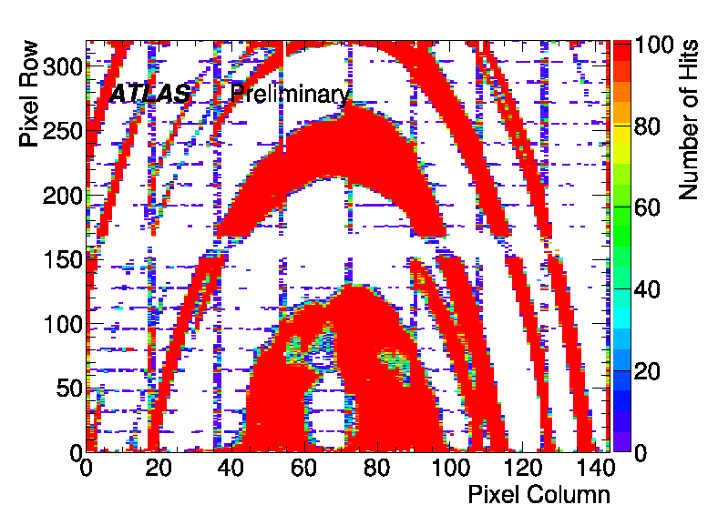
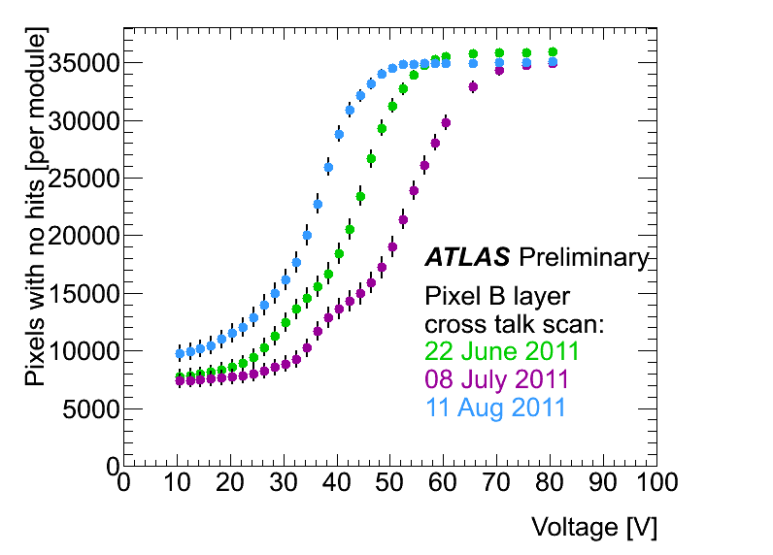
Depletion voltage measurement
Before type-inversion, can be measured looking at the pixel cross-talk during a voltage scan, as the undepleted region creates a resistive path.
  Number of pixels showing cross-talk hits decreases with increasing HV
  Sensor structures are visible near full depletion.
The depletion voltage decreases with the accumulated dose, as we are about type-inversion for the innermost layer.
The annealing effect due to cooling stops is clearly visible.
The depletion depth can also be measured off-line, correlating the track incidence angle with the cluster size.

Slide 23
Position reconstruction
If particles leave signal in more than one pixel, the point resolution can be improved, with respect to a simple geometric center of cluster, using the pulse height measurements.
Classical approach:
  Charge sharing variables:
  Cluster position correction:
Cluster may assume complex structures:
  Ovelapping particles, in high density environments (core of jets)
  δ-ray production or hadronic interactions
  Need to fully exploit the detector information.
See the neural betwork reconstruction poster for
more details about position resolution

Slide 24
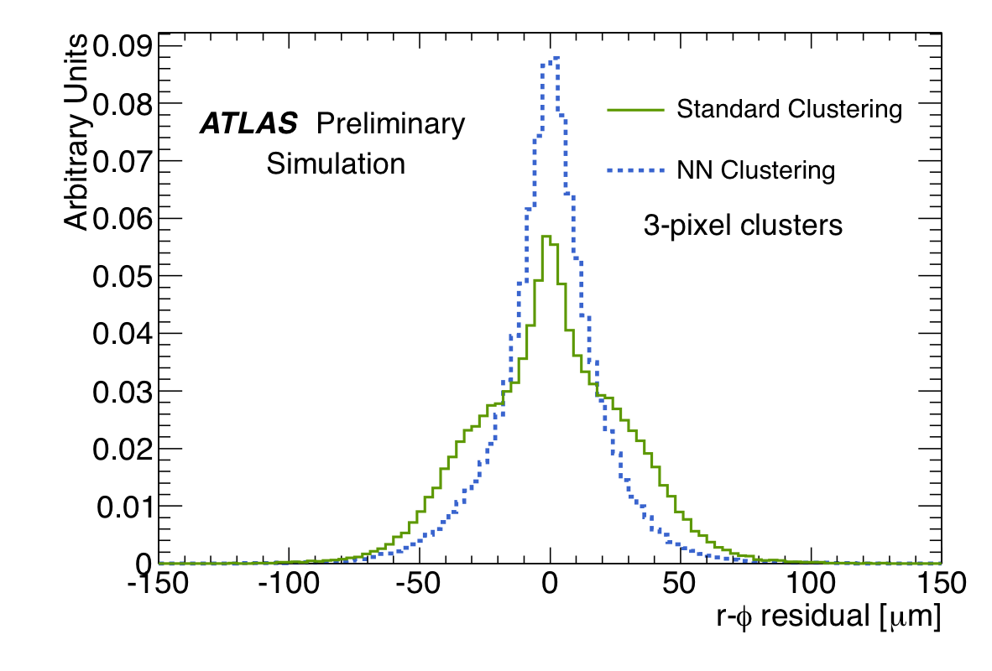
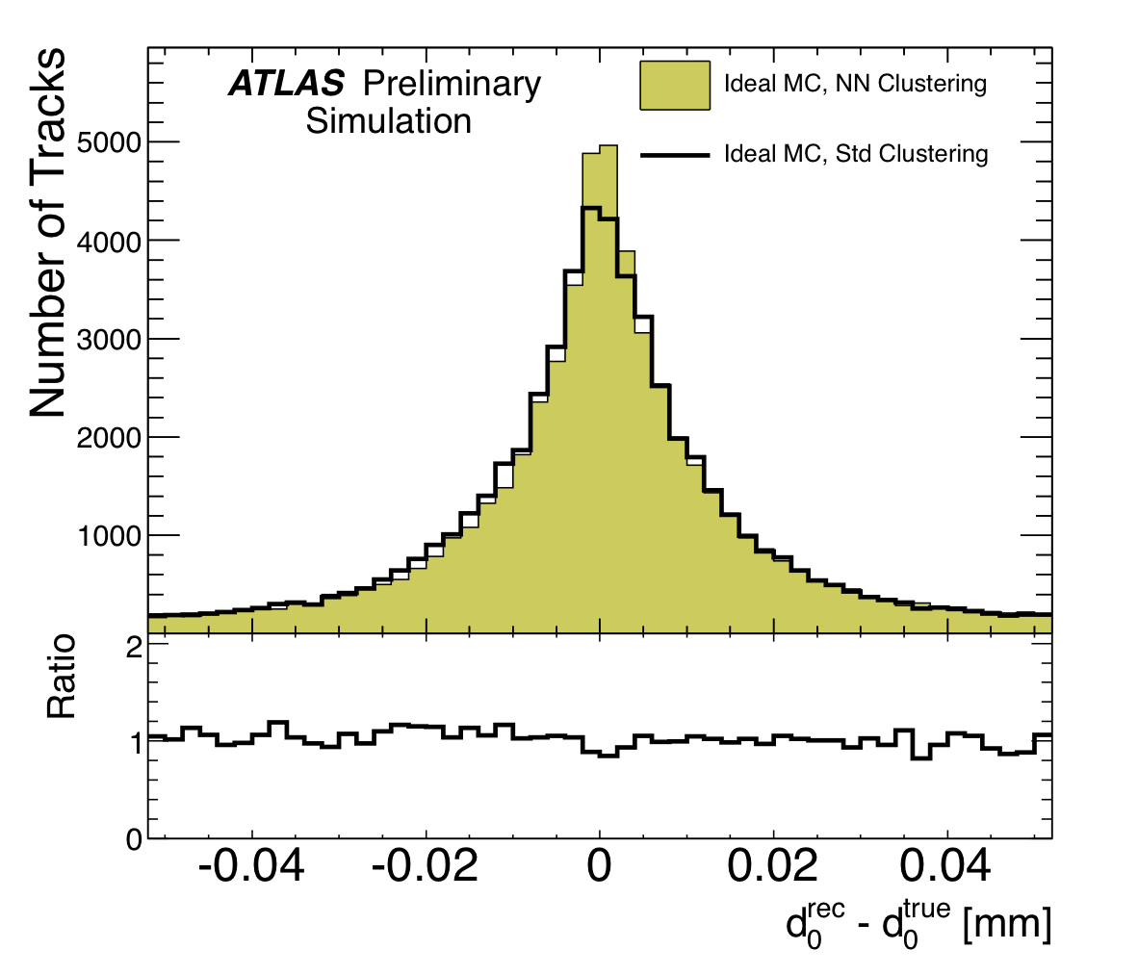
Neural network processing
A neural network is used to process the full cluster shape:
  Recognizes hits from multiple particles
  Non-linear interpolation of charge distribution.
Trained on simulation of high density events:
  High p_{T}-jets
Very significant improvement in performance:
  Recover tails in cluster position.
  Reduced by an order of magnitude the ambiguities in cluster-to-track association
  Recovery of tails and improved association efficiency results in 15% improvement in impact parameter resolution.

Slide 25
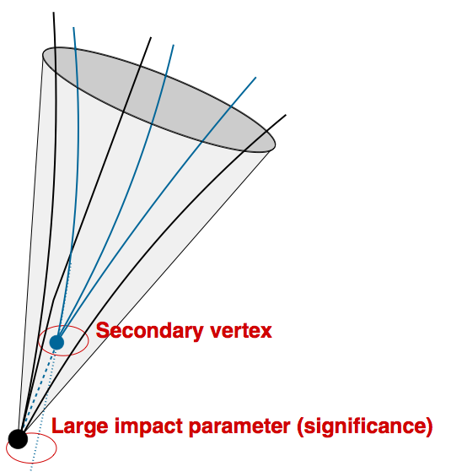
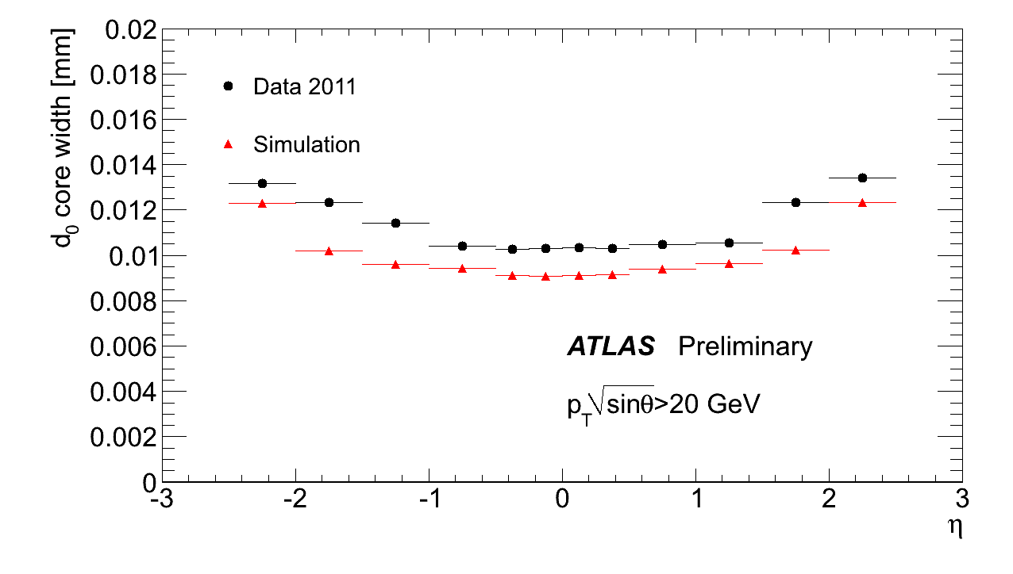
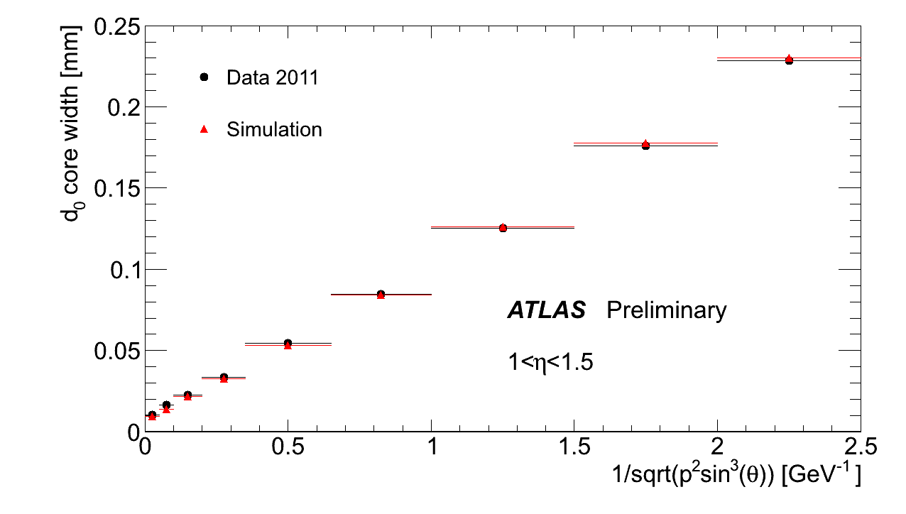
Impact parameter resolution
Impact parameter is used to discriminate primary from secondary particles.
Key ingredient in the reconstruction of heavy flavours
(b, c, τ)
Resolution is dominated by the first measurement on track.
  At high p, intrinsic detector resolution and alignment.
  10 μm resolution in barrel region
  At low p, detector material.
  Material effects extremely well described.

Slide 26


Summary and perspectives
The performance of the ATLAS Pixel Detector has been extremely satisfactory in the first years of LHC data taking:
Meeting or even exceeding design specifications.
Since the very beginning of data taking (with cosmic rays in 2008), the detector has been operating in a stable and smooth way, delivering high quality data.
Coping well with the increasing occupancy and luminosity by a steady improvements of DAQ, calibration and data reconstruction.
Radiation effects are observable, but matching expectations.
We expect the detector to operate well during the whole LHC phase 1, i.e. up to 2017. Some improvement is however needed…
Preparing for the next steps during the 2013-2014 LHC shutdown
See Ole’s talk for the status of the 4th layer of the ATLAS Pixel Detector (IBL).
The extraction of the detector for the installation of new service panels is under study:
  Allows the recovery of some dead modules.
  Improves the performance at high luminosity.

Slide 27
BACKUP

Slide 28
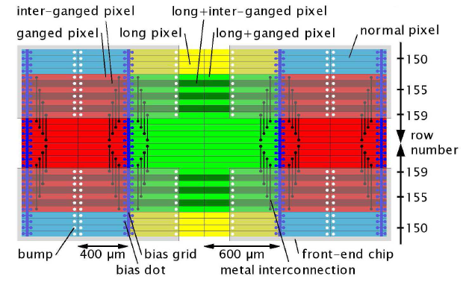
Pixel types
For ganged pixels, the spacing in the inter-chip region and in the chip-edge regions are different:
for multiple-pixel clusters it is possible to disentangle in which region it was generated.

Slide 29
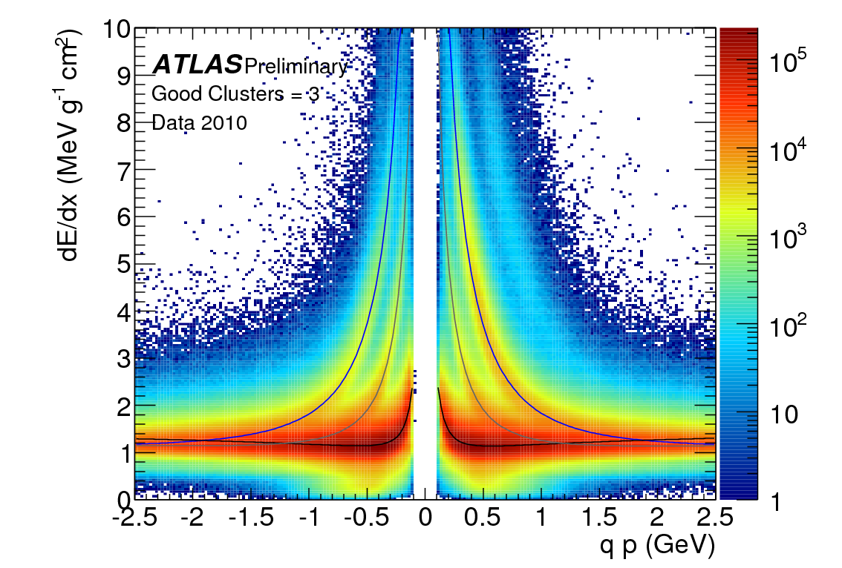
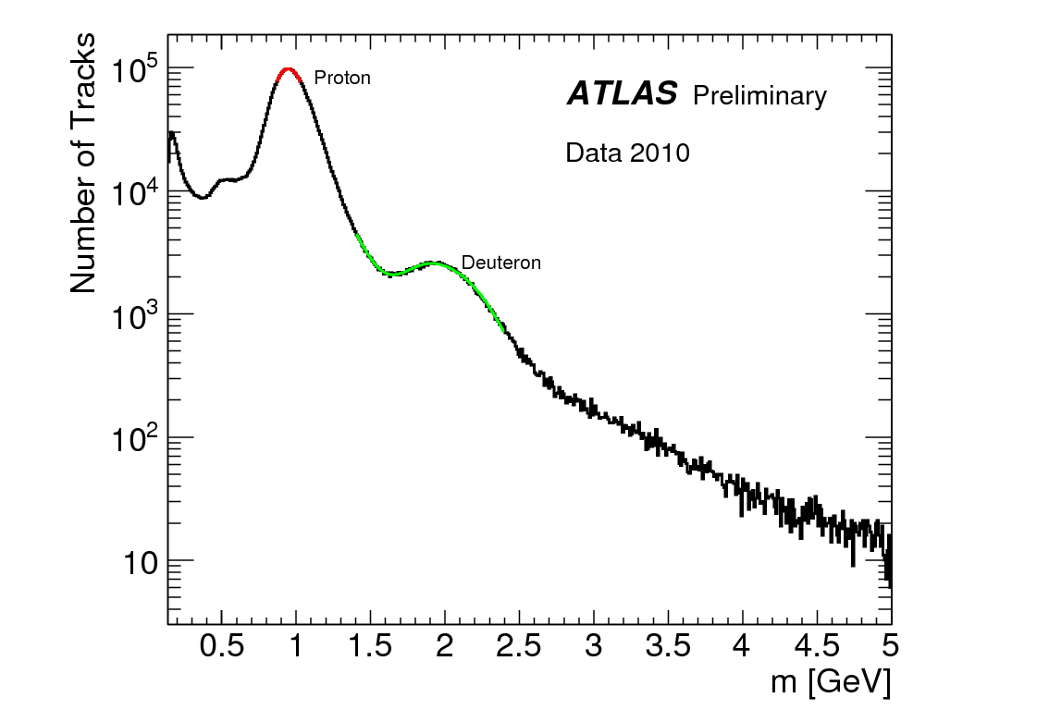
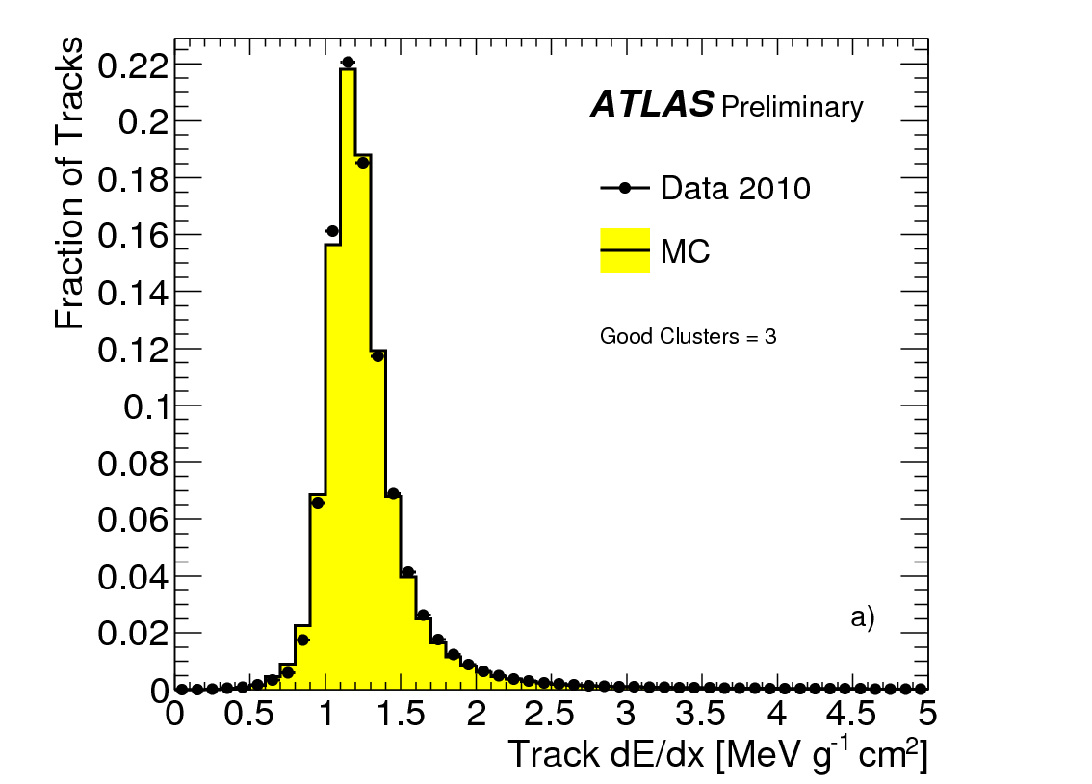
dE/dx at work
p
K
d
π
Mass determination inverting
Bethe-Bloch energy loss relation
~12% dE/dx resolution

Slide 30
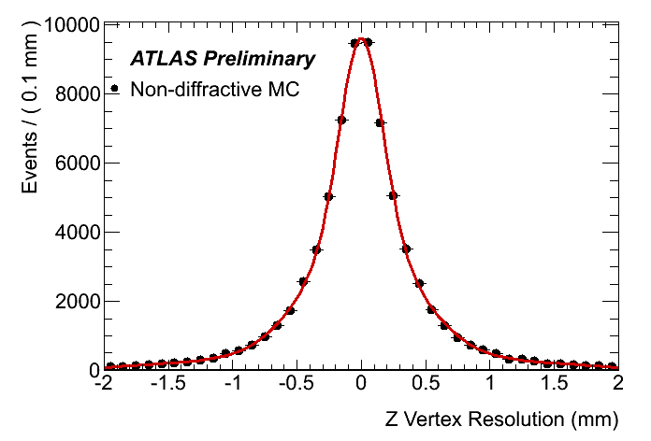
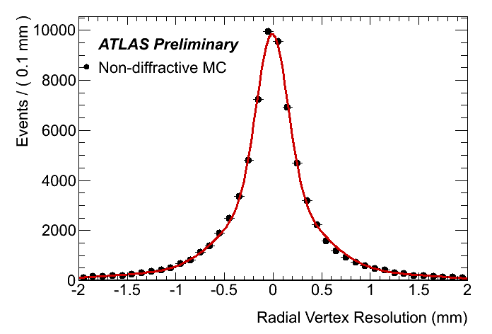
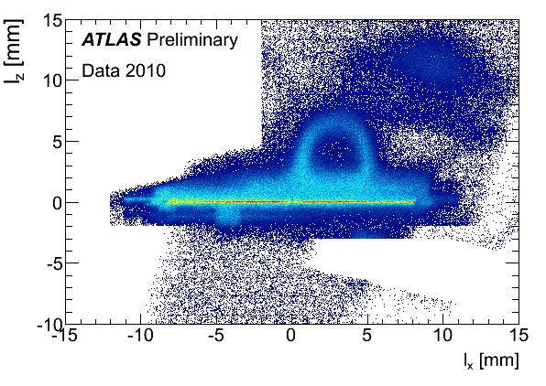
Hadro-graphy
Material mapping usually
performed by photon conversions
Hadronic interactions can reach a better position resolution:
  larger opening angle
  σ=160 μm at Layer-0
Very accurate detector mapping!
Applications:
  Average λ_{I} measurement
  Positioning of non-sensitive material
  (beam pipe, support structures)
Cables bundle
Cooling pipe
Decoupling capacitors
Active Si
C-C support

