Slide 1
VeloPix ASIC developments for the
LHCb VELO upgrade
5 September 2012
Martin van Beuzekom
On behalf of the LHCb VELO upgrade group
& VeloPix design team
Introduction to pixel chip for the VELO
Timepix3 -> VeloPix
Off-detector electronics
Summary

Slide 2
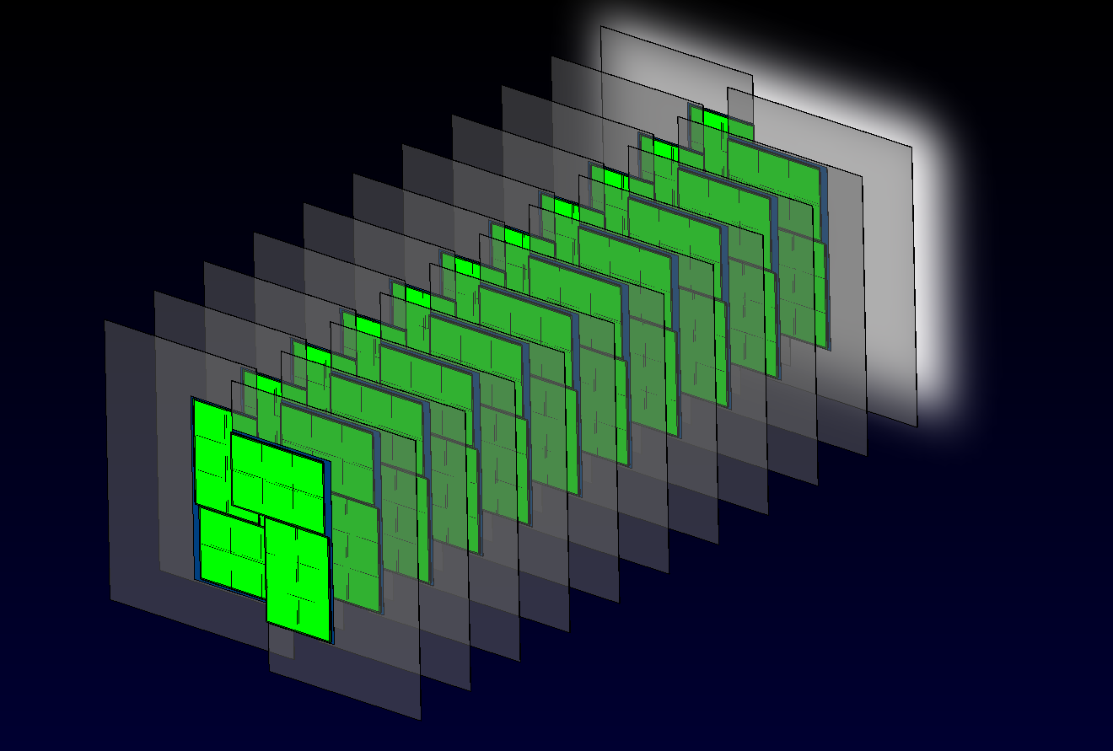
VeloPix detector overview
One of the options for the upgrade of the LHCb Vertex Locator is a pixel detector
  A strip detector option is also being investigated, but not reported here
The detector will consist of 26 sensor planes transverse to the beam
Specifications not yet fully frozen
Baseline luminosity = 2x10³³ cm⁻²s⁻¹
Distance of nearest pixel to beam = 7 mm
  Further reduction of distance under study
Read out complete detector for every
bunch crossing

Slide 3
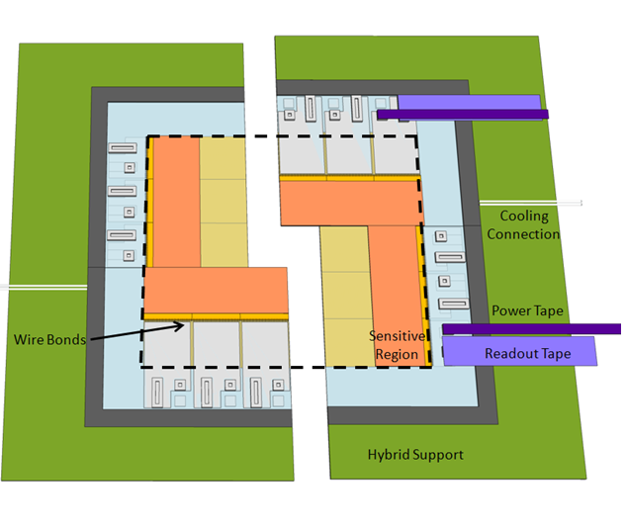
VELO pixel option overview
~43mm
ASIC
Distance to the
closest chip 7 mm.
Sensor tile :
ASIC
~15mm
Beam
ASIC
4 sensors per side
One sensor, 3 chips
Each chip has 256x256 pixels
55 x 55 μm²
cross section
Cooling
channel
Bot Sensor 200um
ASIC150um
Substrate 400um
ASIC150um
Connector
Top Sensor 200um

Slide 4
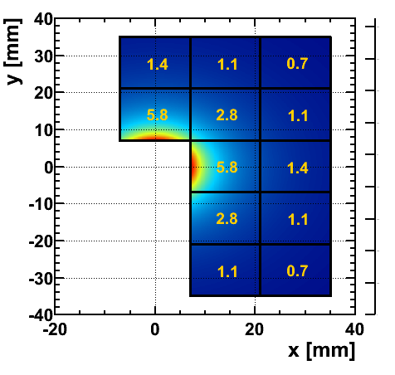
The environment
Radiation:
order of 370 Mrad in 10 year lifetime
and about 8.10¹⁵ 1 MeV n_{eq} cm⁻²s⁻¹
Highly non-uniform occupancy per chip
Average # particles / chip / bx (25 ns)
Hottest chip sees 5.8*40 = ~230 Mtrack/s
Each track has 2.2 hits on average
-> ~ 500 Mhits/s per chip
Other:
To be operated in vacuum
  Cooling and outgassing challenge
  See Jan Buytaert’s talk on micro-channel cooling on Thursday afternoon
Moveable structure
  Constraints on the cabling

Slide 5
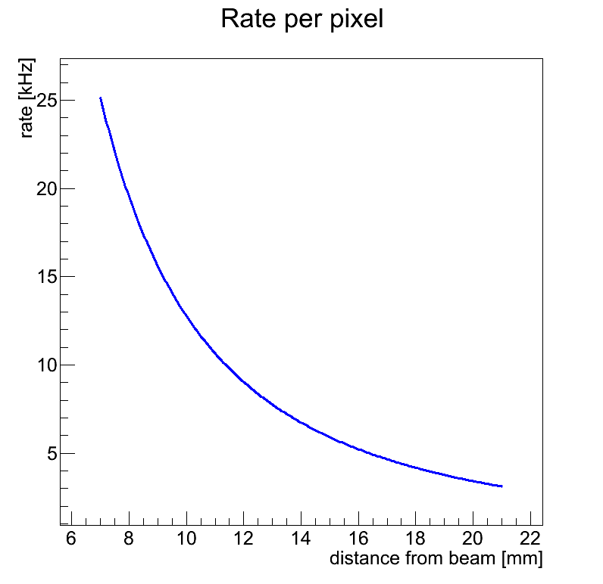
Occupancy per pixel
For each hit a pixel will:
  Timestamp the arrival time of the hit (ToA): capture the bunch-id counter
  Measure the energy deposition with 4-bit resolution
Once a hit is captured it will grouped with neighbouring hits
  Which arrived in the same bunch crossing
  Reduces amount of duplicate information compared sending each pixel individually
  grouping of 4x4 pixel in a super-pixel
And sent off chip immediately
  Data driven (data push) architecture
  Data in random order
Hit-rate of the hottest pixel is ~25 kHz
Available area per pixel: 55 x 55 μm²

Slide 6
Timepix3 -> VeloPix
VeloPix is based on Timepix3 (which is the successor of the Timepix)
TPX3 is a general purpose chip (paid by the Medipix3 collaboration)
  Many aspects of the design driven by VELO Upgrade requirements
  Some compromises coming from the need to accommodate many different applications, the technology choice, and the schedule.
  Re-use of MPX3 IP blocks, and use of CERN high density cell library
  130 nm technology, radiation hardness to > 400 MRad proven
TPX3 chip designed by CERN, Nikhef and Bonn university
  Submission expected end of this year
Many specifications of TPX3 are the same for VeloPix
  Fast front-end: Timewalk < 25 ns
  Simultaneous ToA and ToT measurements
  Data driven readout: Each hit is time-stamped, labeled and sent off chip immediately
Velopix hit-rate = 10 x Timepix3 rate
VeloPix designed by CERN & Nikhef

Slide 7
Specifications
VeloPix Features (L=2x10³³ cm⁻²s⁻¹)
Pixel size | 55 μm x 55 μm
Pixel matrix array | 256 x 256
Super pixel size | 4 x 4 pixels
Dynamic range | 50 ke⁻
Timewalk | < 25 ns (@ 1ke⁻)
Time stamp (Bunch ID) | 40 MHz (25ns resolution)
Operation modes of pixel | 4-bit Time-over-Threshold (+ counting mode)
Bunch ID range | 12b (102.4 μs)
Packet-based and zero suppressed | YES, no frame based mode
Max. sustainable hit rate | 500 MHits/s (av. 2.2 hits per superpixel)
Power consumption | 3 Watts per chip @ 1.5V (1.5 W/cm²)
Output bandwidth | min. 12.2 Gbit/s
Radiation tolerance | > 400 MRad

Slide 8
Pre-amplifier
Based on Krummenacher scheme
Constant current discharge -> charge = Time-Over-Threshold
Vdd=1.5V
Preamp Output
Qin=2 ke⁻ to 30 ke⁻ @Ikrum = 10nA
Ikrum
source current
Single-stage
OPAMP
Preamp_in
Preamp_out
0.36V
0.8V
Cd
lpnfet
current sink
Cfb=3fF
0.37V
Ck
High gain (50 mV / 1 ke-)
Low noise ( σ ≈ 75 e⁻ @ Cd=25 fF)
power 4.5 μW ( @1.5 V)

Slide 9
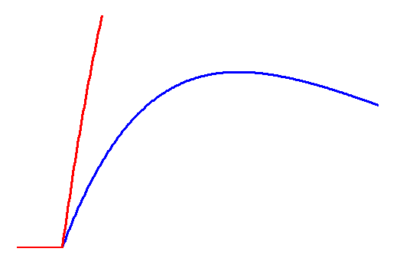
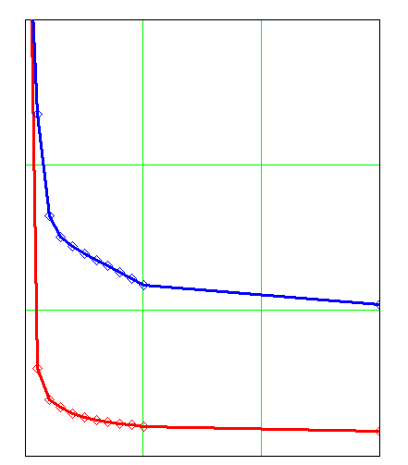
Preamp + discriminator
THR
∆t1
discriminator output
∆t2
4-bit threshold tune per pixel
Mismatch after equalisation ~ 10 e⁻
Time-over-Threshold linear up to >100 ke⁻
Timewalk for 1 ke⁻ < 25 ns
Power 6 μW ( @ 1.5 V)
9
6
3
0
Propagation delay
∆t,
ns
discriminator output
preamp output
0 -10k -20k -30k
Qin, e⁻

Slide 10
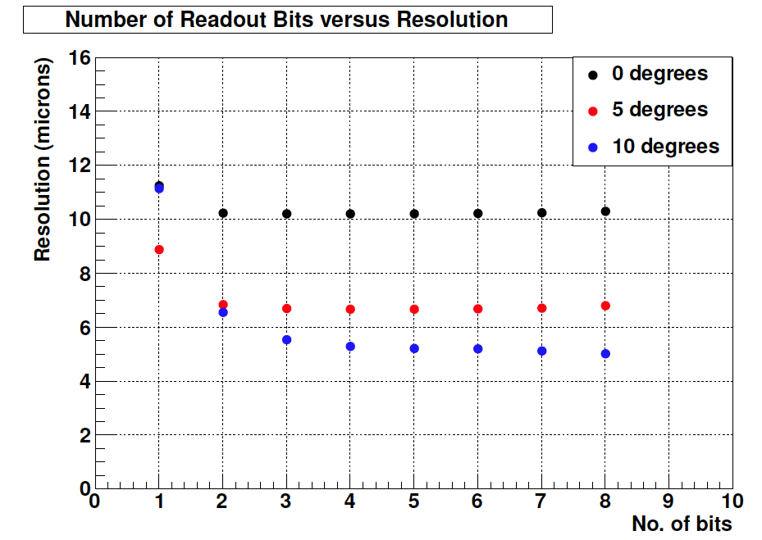
Time-Over-Threshold versus resolution
ToT: granularity of charge measurement determined by discharge current
  Counting ToT with 40 MHz clock
  Faster discharge -> less granularity
  But also shorter occupation of Front-end
  And less buffering needed in superpixel
Reduce ToT to minimum, without sacrificing position resolution (charge sharing)
Study based on testbeam data with Timepix chip: 4 bit is sufficient
4-bit ToT = max. 400 ns conversion time
=> dead-time < 1% for hottest pixel (25 kHz)
and negligible for pixel further from beam

Slide 11
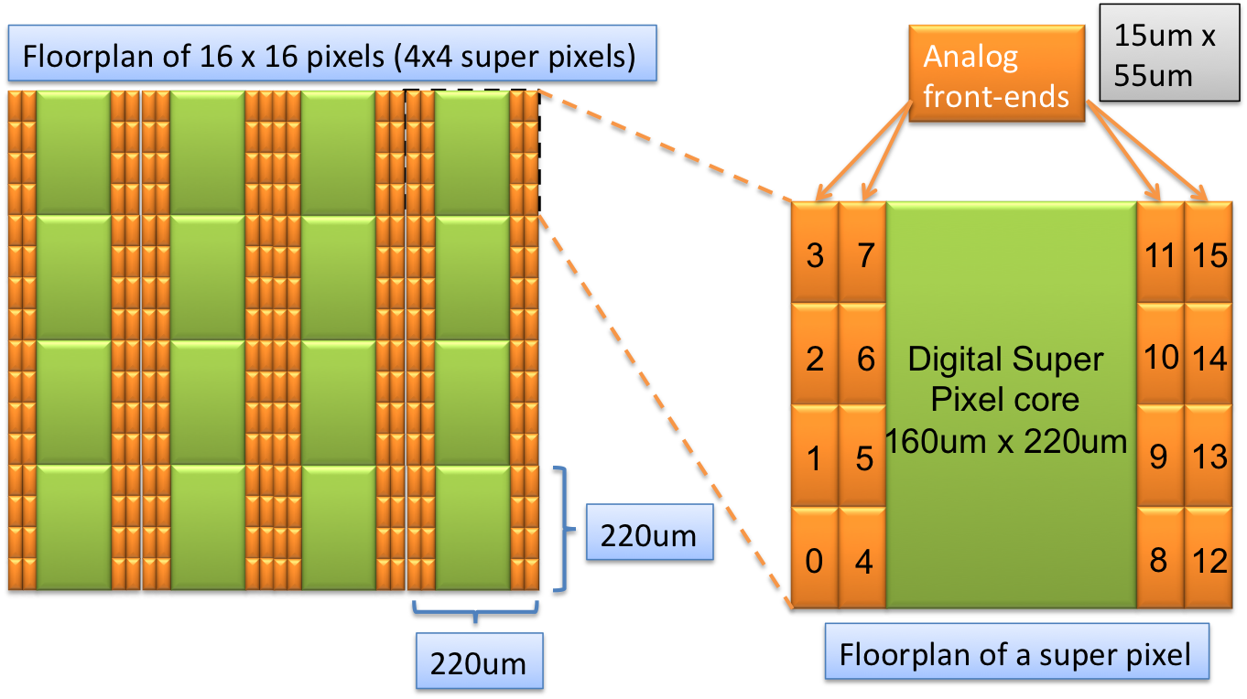
Super pixel
Grouping of 4x4 pixels in super pixel
Pack info of hits in super pixel in the same data-packet
  Collect by time stamp
Removes duplicate information -> save 25% bandwidth
Reshuffling position of analog front-ends

Slide 12
Super pixel logic
ToT
Register0
16x 4b
Discriminator
outputs
Sync.
Logic
0
1
ToT data
ToT
Register1
16x 4b
Super pixel
Front-end FSM
Req/
Done
control
Hitmap
Buffer
(FIFO)
2x 28b
Rising/
falling
edge
0
1
Header
Timestamp
+ hit map
Super pixel can buffer 2 “clusters”
Additional resource sharing between groups of super pixel (work in progress)
  Zero suppression, bus arbitration, additional buffering

Slide 13
Data format super pixel packets
Common time stamp
shared by all hits
Number of hits in
the payload
single pixel : 36 bit
dual pixel : 44 bit
etc: 28+n*8
BCID 12b
address 12b
# hits 4b
Payload 8b – 128b
Up to 16 hits in the payload
Address of 4x4
super pixel
Address 4b
ToT 4b
Address 4b
ToT 4b
8b per pixel hit in the payload
Format optimized for decoding in off-detector electronics FPGAs
Hottest chip generates ~300 Million super-pixel packets per second
Data rate of 12.2 Gbps for L=2x10³³ cm⁻²s⁻¹

Slide 14
Data flow in VeloPix
8x
Super Pixel
Column
8x
Super Pixel
Column
8x
8x
Super Pixel
Column
8x
Super Pixel
Column
- - -
- - -
2.56 Gbps
- - -
EoC Region0
EoC Region1
- - -
EoC Region6
EoC Region7
Eff. bandwidth
22* 160 MHz =
3.52 Gbps
EoC Bus
EoC Bus
EoC Bus
EoC Bus
- - -
Region
Rx/Tx0
Region
Rx/Tx1
Region
Rx/Tx6
Region
Rx/Tx7
- - -
Output Bus0 16b @ 320 MHz
Output Bus3 16b @ 320 MHz
Buffer depths to be optimized
Complete packet sent to a single link
Internal bandwidth > output bandwidth
Bandwidth limited by 4 GBT-like links
  GBT = CERN standard link , 4.8 Gbit/s link speed
  3.2 Gbit/s effective bandwidth due to error correction
  Plain 8B/10B will increase effective bandwidth
4x4
Crossbar
Switch
To serial output links

Slide 15
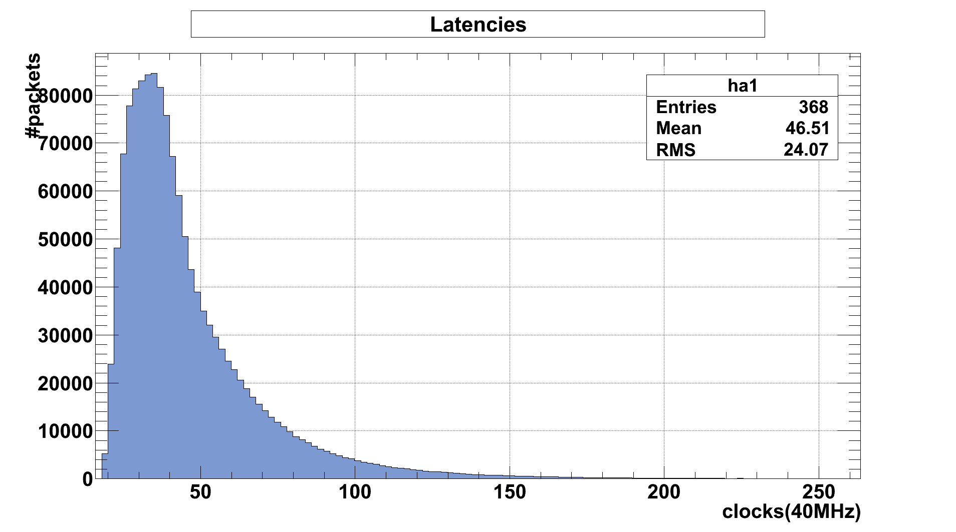
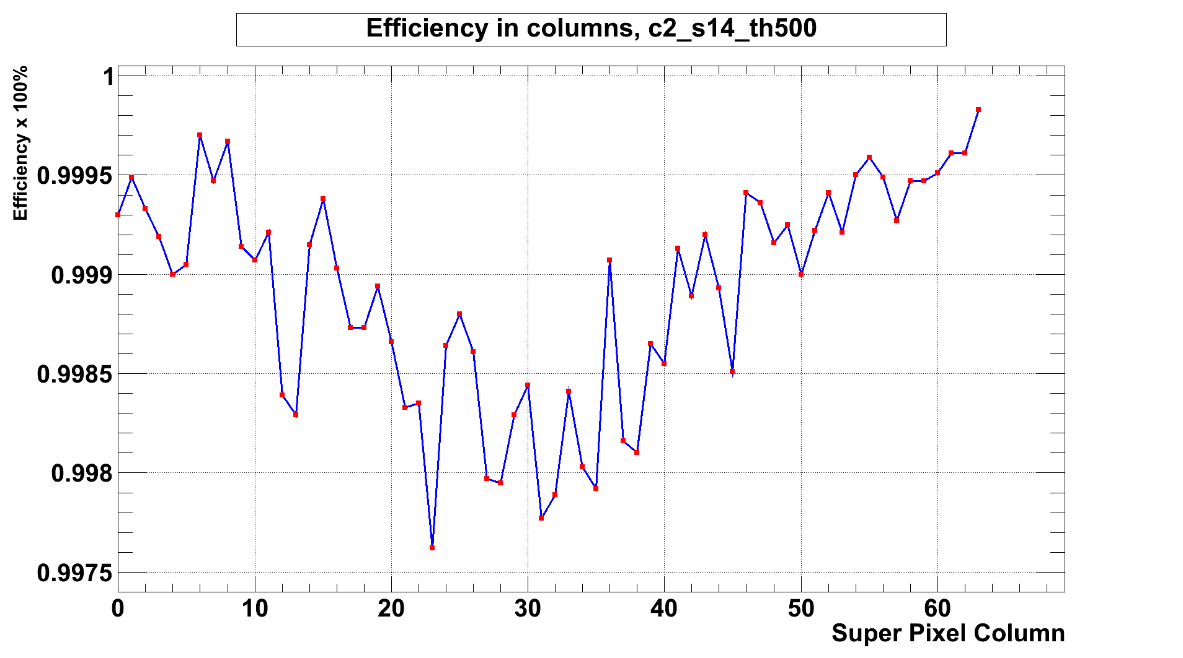
data-packet latency
Advantage of data driven readout is modest buffer requirements on chip
Almost no data loss at L = 2x10³³ cm⁻²s⁻¹, but close to bandwidth limit
Drawback is that data packets are not ordered in time
Reordering required before other processing steps like clustering can be done
Demanding for off-detector electronics (FPGAs)

Slide 16
Data acquisition overview
LHCb common DAQ boards (TELL40)
  ACTA standard
4 mezzanines with powerful FPGA
24 optical links in, max. 12 x 10 Gigabit Ethernet out
Electrical to optical conversion outside of vacuum tank
  Lower radiation level
  Easier accessible
TELL40 (ATCA)
24 optical links
FGPA
24 diff.
Copper links
24 optical links
FGPA
vacuum feedthrough
electrical -> optical
CPU farm
vacuum feedtrhough
24 optical links
24 diff.
Copper links
FGPA
24 optical links
FGPA
~1 m
~60 m

Slide 17
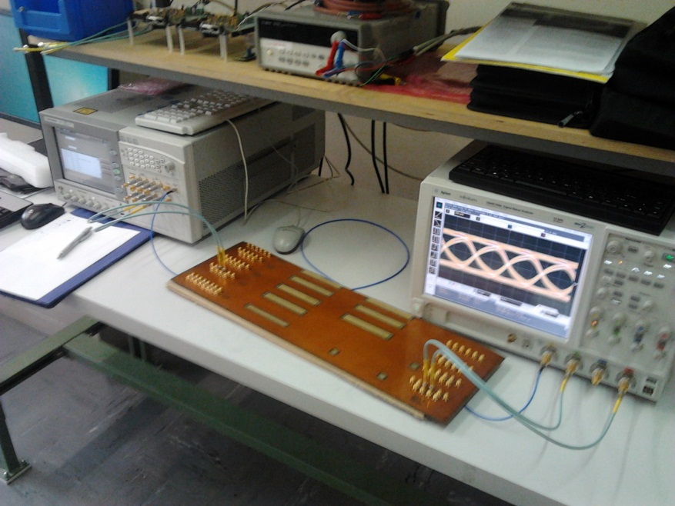
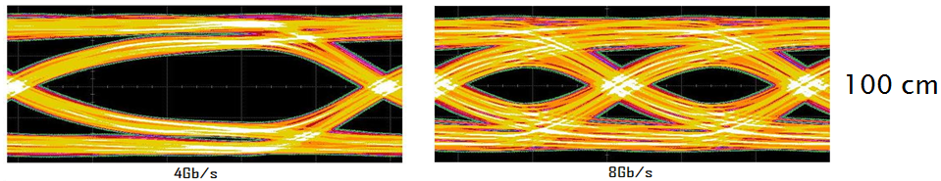
Gbit/s copper links in vacuum
Must be radhard, low outgassing, flexible
Using Dupont Pyralux AP-plus ‘kapton’
  Specially designed for HF applications
Measurements compared to simulations with 3D ADS momentum simulator
Transmission promising for 0.5 -1 m of cable but mechanically rigid
Eye diagram for 100 cm length

Slide 18
FPGA processing
24 Serial input streams
decoding(GBT or 8b/10b)
One Stratix-V device for 24 links
Data rate = ~ 68 Gbit/s
Time re-ordering + sorting is resource intensive
What processing can we achieve
  Reduce load on the CPU farm
Collecting/grouping all hits of a cluster
  Grouping in VeloPix only in fixed 4x4 group
  Many cluster will cross super-pixel boundary
  Algorithm being developed, K-d tree?
Clustering (centre-of-gravity)
  Not yet clear what cost/benefit ratio is
Time(or event)
Re-ordering
Other 3 links
Processing ?
Processing ?
Processing ?
Processing ?
Processing ?
Processing ?
Event building & formatting
(‘linking’)
Event storage (external memory)
& event filtering (L0)
MEP building &
Ethernet framing

Slide 19

Timeline
Submission of full scale Timepix3 expected end of this year
  Readout system developed in parallel
  Bench tests + beam-tests in 2013 + early 2014
  Qualification of VeloPix front-end and proof of principle for data driven read-out
VeloPix design predominantly at high level simulation (TLM)
  Some blocks evaluated at RTL level + first order layout check
  Will re-use many periphery blocks from TPX3
  High speed serial link is essential block, prototype in MPW
  Large increase in manpower when TPX3 is submitted (same design team)
Ambitious plan to have a first chip in 2014
  Leaves time for at least one more iteration in 2015

Slide 20
Summary
The requirements for the LHCb VELO upgrade are demanding
  Baseline L=2x10³³ cm⁻²s⁻¹, minimum radius of 7 mm
Pixel detector option being developed in parallel to strip option
VeloPix shares many features with general purpose Timepix3 chip
  Fast front-end, zero-suppression, data driven readout
  Timepix3 submission expected by end of this year
  Timepix3 can be considered a real version-0 VeloPix
Rate capability of VeloPix factor 10 more than Timepix3
  High level simulation shows feasibility, details to be worked out
  Dominant bottle-neck is output bandwidth
  Investigating higher bandwidth options
Outlook:
Requirements for VELO (and hence chip) not yet fully frozen
  Wish to go closer to beam -> rate goes up quickly
  Decision on on minimum distance by end of the year

Slide 21
Thank you for your attention

