Slide 1
Welcome

Slide 2
PIXEL Workshop
This conference was originated in 1988 by E. Heijne et al. as “Workshop on Semiconductor Pixel Detectors”.
Since the year 2000, it has been reformed as “International Workshop on Semiconductor Pixel Detectors for Particles and Imaging (Pixel2000), and then held every 2-3 years.
The year, site, and the number of participants were
  1988, Louvain, Belgium, 64 people
  1990, Louvain, Belgium, 86 peoples
  1996 Bari, Italy, 100 peoples
  Pixel 2000, Genova, Italy, 84 peoples
  Pixel 2002, Camel, USA, 55 peoples
  Pixel 2005, Bonn, Germany, 107 peoples
  Pixel 2008, Fermilab, USA, 83 peoples
  Pixel 2010, Grindelwald, Switzerland, 93 peoples

Slide 3
PIXEL2012
This year, 6th of the “PIXEL”, is now held in Asia, first time.
The number of participants is about 120.
Also, this year is a special, after not only the incident of the “once every 1000 yrs” earthquake which Richter scale was 9.0, and resulting big, very big “Tsunami”, but also the historic incident of “Nuclear Power Plant” in Fukushima.
We have the opening session with two special presentations for the Nuclear accident.
In all, we have 64 ORAL and 40 POSTER presentations, thanks to all who have contributed to the workshop and make it successful.

Slide 4
Social events
In addition to diligent sessions, we have social events to refresh your brain and body,
  “Kurhaus” (Hot spring baths/pools), don’t miss it (but we have no luxury time, use the break after the afternoon session and the beginning of dinners, at 19:00.)
    Don’t forget to bring your PIXEL2012 name tag, as it is the pass.
    Kurhaus opening time: 10:00-20:00 (last entry)
    Big Japanese-style bath, in-door and open-air: 05:00-24:00
  Dinners: BBQ (Tue.), Excursion (Wed.), Banquet (Thu)
  Excursion (Wed):
    City of Aizu-Wakamatsu, including a free time for strolling the city.
    Two tour buses, at entrance, 12:30 to leave, a lunch box in the bus
    Re-join at 18:30 at the restaurant, “TAKINO”

Slide 5
Social events –cont’d
Workshop photo
  Wed. morning, before the morning coffee break, around 10:20, at Femmenette terrace
Wireless LAN, Secretariat office, …
  1F Lounge, B1F foyer
    SSDI: risuairlan01, Key: risuairlan
  Some of you may have received an old floor plan in the kit. The latest one has a change in
    PIXEL2012+Computing room is 2F “YOSHIKIRI”, a sign at the door.
    SSID: PIXEL2012, Key: inawashiro

Slide 6
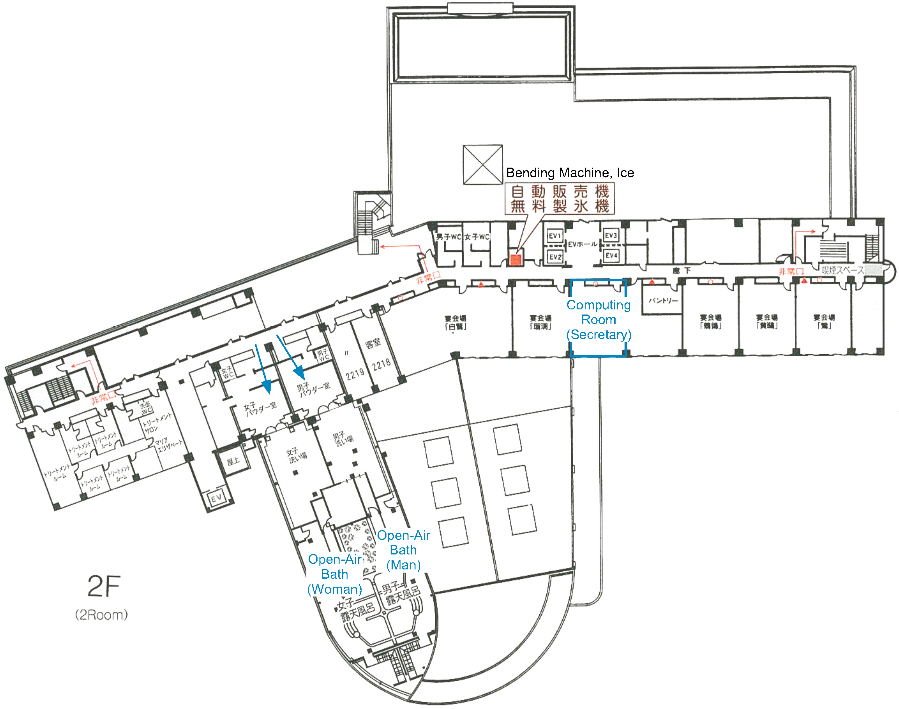
2F Floor Plan
Secretariat-Computing room
WiFi LAN
  PIXEL2012
  Key: inawashiro

Slide 7
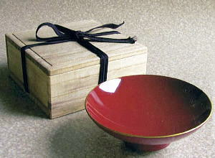
Japan Special – in the kit,
Wooden “SAKAZUKI” (Sake cup), with “japan” lacquer and gold fringe painting, for the memory of “PIXEL2012” workshop.
Aizu area is one of the famous area of the “japan” lacquer wares.

Slide 8
From organizers
Enjoy the hotel: Hot baths, pools, BBQ, …
Enjoy the nature (but you can’t go too far on your foot, sorry.)
The sessions are to start at 8:30 in the morning.
ORAL presenters should upload the slides to the indico at least one session ahead, or bring the USB stick to the session secretary.
If you have questions, concerns, the organizers and secretariat are on standby at 2F PIXEL2012 room.
  Enjoy the workshop!

