Slide 1






First tests of CHERWELL, a Monolithic Active Pixel Sensor.
A CMOS Image Sensor (CIS) using 180 nm technology
James Mylroie-Smith
Queen Mary, University of London
for the Arachnid Collaboration

Slide 2
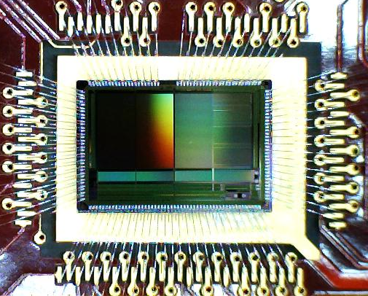
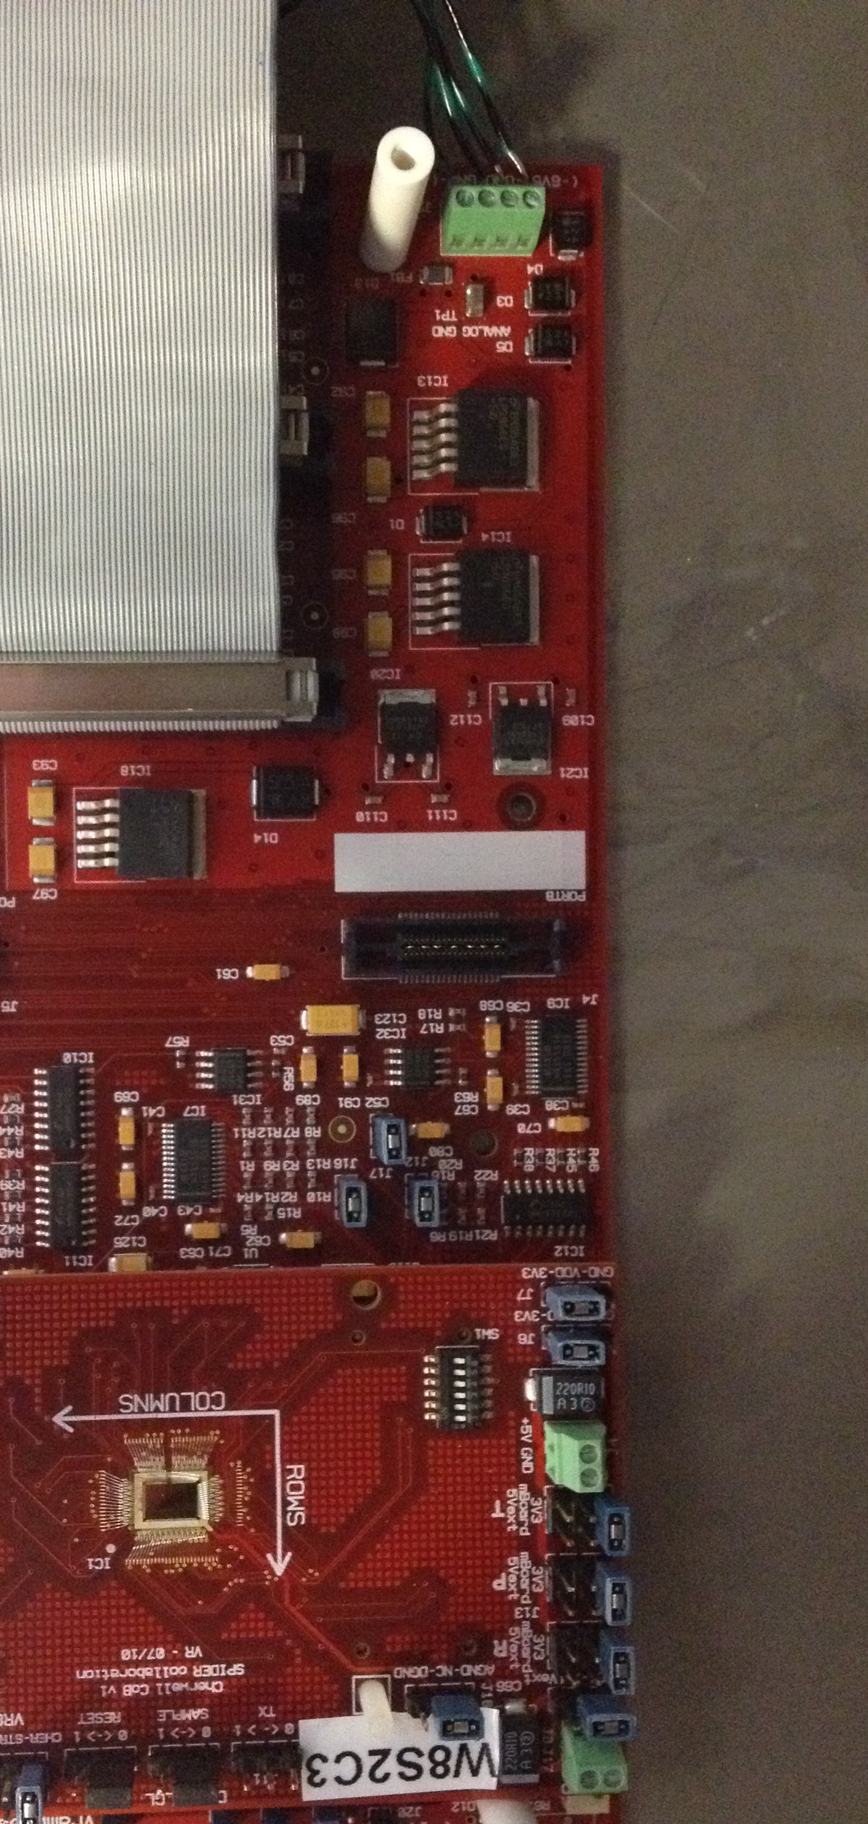
Outline
CHERWELL
4T MAPS
Deep P-Well
First Results
Future Plans
Summary

Slide 3
Origins
Past
Present
Future
TPAC
Digital Calorimiter using INMAPS CMOS technology
Linear Colider?
FORTIS
4T CMOS sensor for tracking and vertexing
CHERWELL
SuperB?
Alice?
Calorimetry
+ ...... ?
Tracking

Slide 4
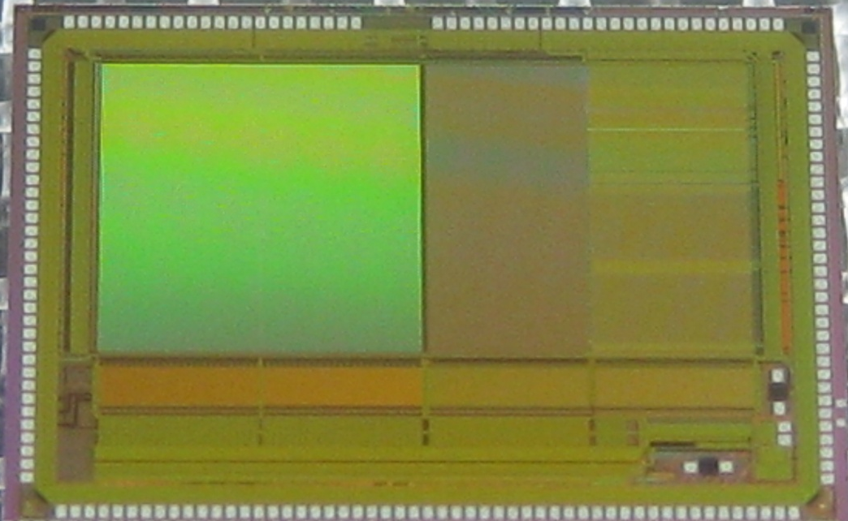
CHERWELL
DECAL 25
DECAL 50
Ref Pixel
STRIXEL
For tracking/vertexing and calorimetetry
180nm CMOS image sensor
4 types of pixel:
    DECAL25
    DECAL50
    Reference Pixel
    Strixel
Internal, column-parallel ADC
12um thick epitaxial layer
Standard and High resistivity
5mm
SUM
ADC
ADC
ADC
5mm

Slide 5
CHERWELL
DECAL 25
DECAL 50
Ref Pixel
STRIXEL
5mm
Cherwell
Digital Calorimetry (DECAL)
“4T” pixels with triggered global shutter and in-pixel CDS
25um pixel pitch 2x2 pixel summing at column base
50um pixel pitch
Vertex/Tracking
Standard “4T” pixels
Reference pixel array 12 bit ramp ADC implemented at column base
“Strixel” array 12 bit ramp ADC embedded in pixel array
SUM
ADC
ADC
ADC
5mm

Slide 6
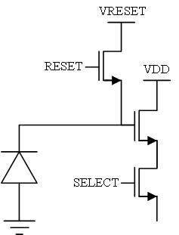
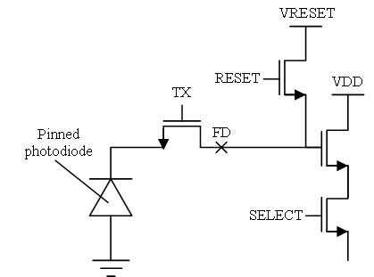
4T Technology
3T CMOS
  readout and charge collection node are the same
  No CDS
4T CMOS
  3 additional elements
  Readout and charge collection at different points
Benefits
  Low noise from capacitance of the floating diffusion
  Low noise and in pixel CDS
  High gain
3T
4T

Slide 7
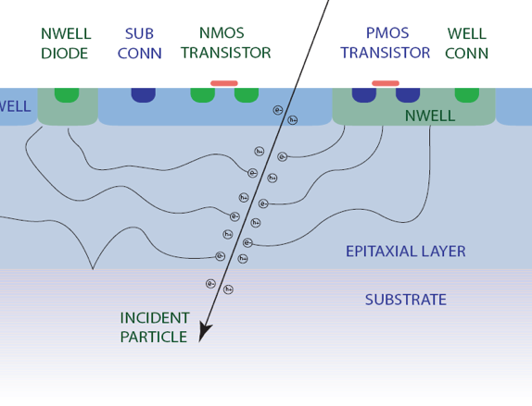
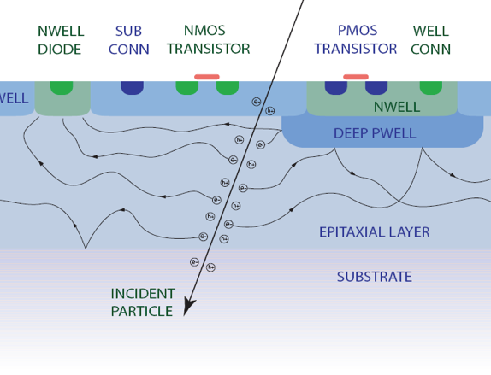
Deep P Well Implants
PMOS Transistors require an n-well
PMOS n-well competes with n-well diode
reducing the charge collection
To improve charge collection efficiency a deep p-well is implanted
Reflects charge back into the epitaxial layer
STANDARD CMOS
INMAPS

Slide 8
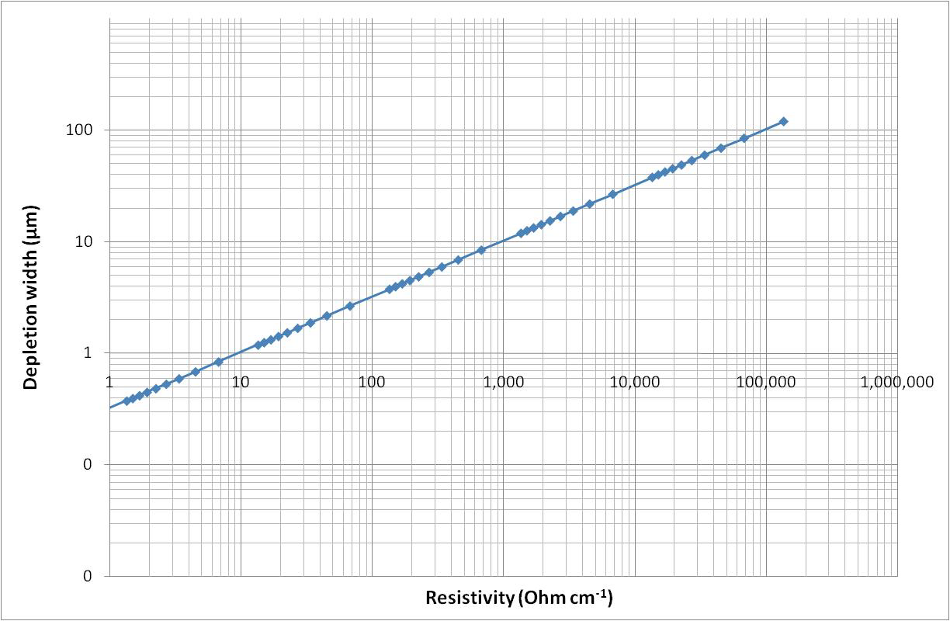
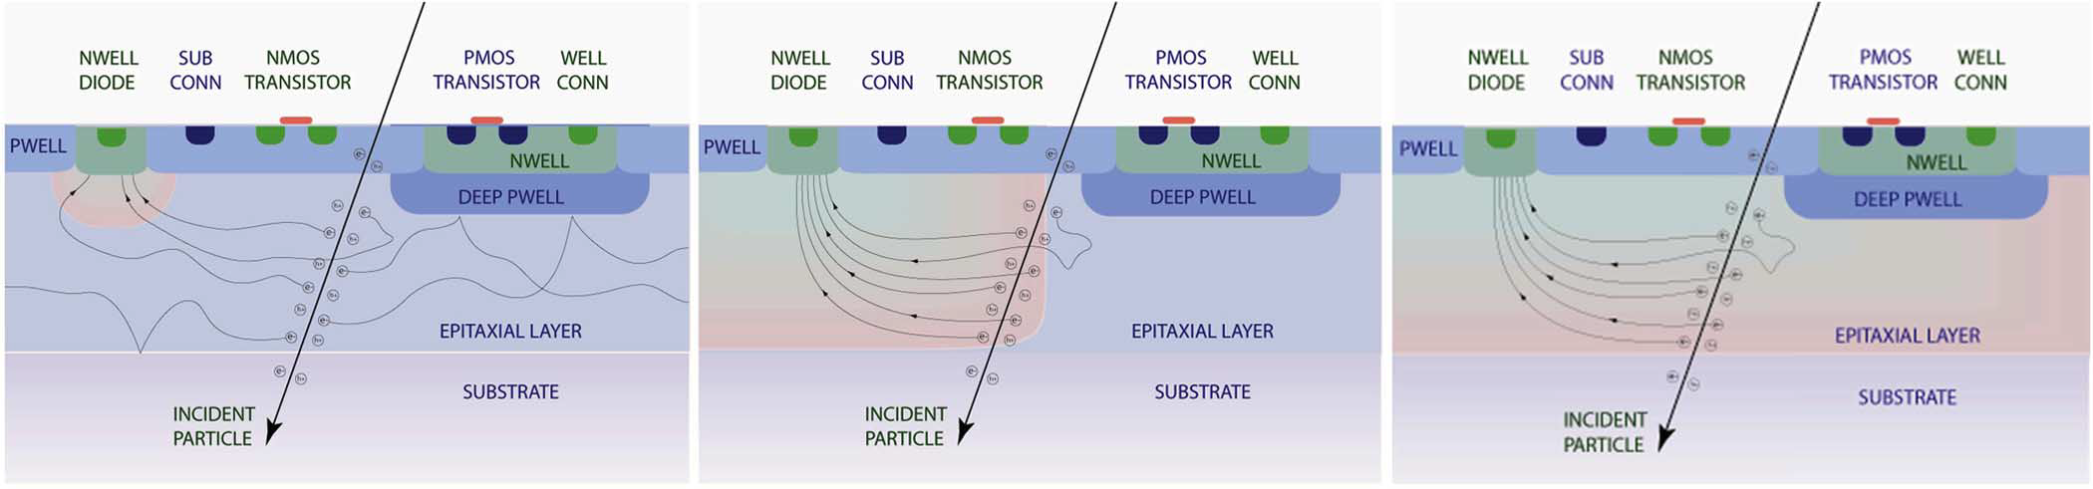
High Resistivity
High resistivity
1-10kΩcm
We have sensors using standard and high resistivity epitaxial layers
Benefits of high res:
  Faster charge collection
  Reduced charge spread
  Increased radiation hardness
Typical resistivity
10-100Ωcm

Slide 9
Initial test
The sensor type:
  Standard resistivity
  Reference pixels(48x96)
Understand performance:
  PTC
  Pedestals
  Noise and Gain
  Pedestals and noise with temperature
  ⁵⁵Fe Spectrum

Slide 10
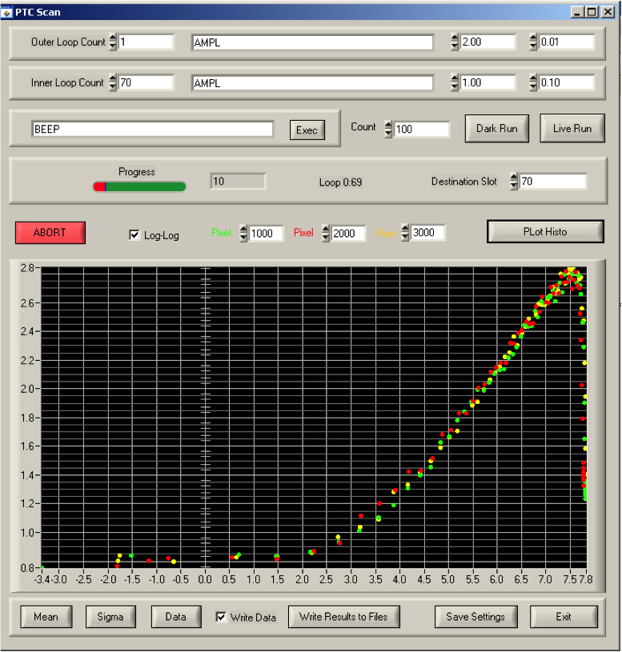
Photon Transfer Curve
PTC scan controlled by computer
IR LED uses programmable generator to give uniform illumination
Sensor read back to computer and data complied into PTC and results plotted

Slide 11
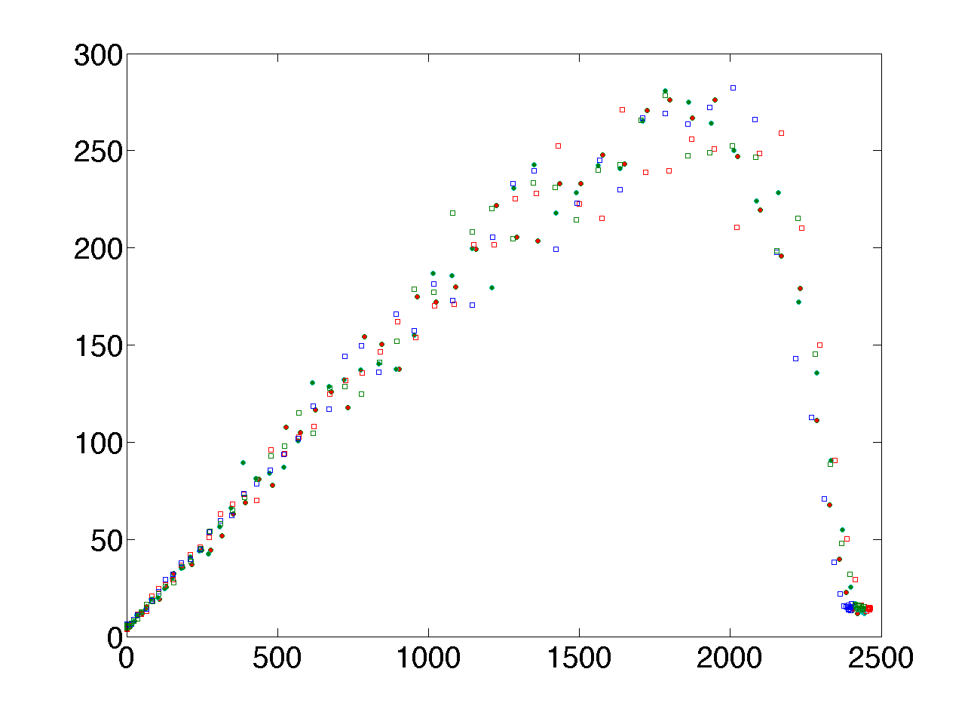
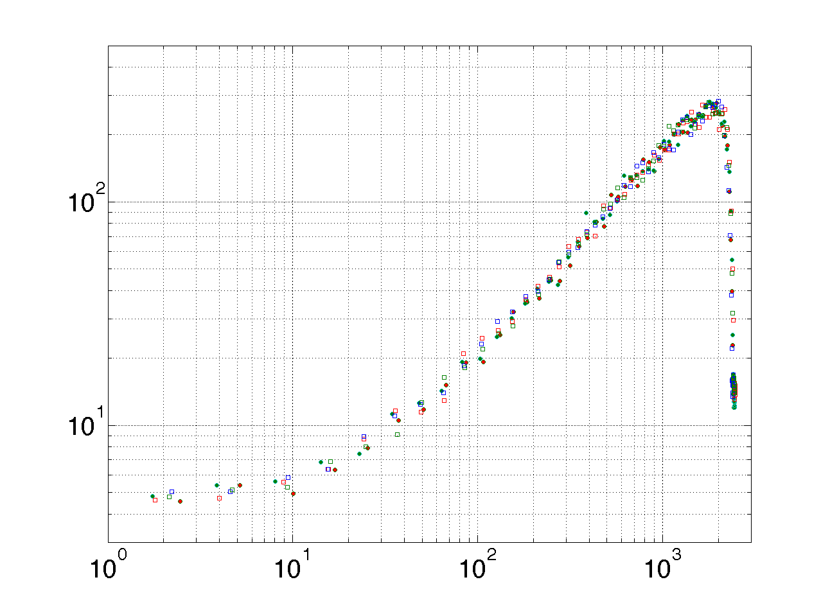
PTC Results
PTC performed using IR illumination
Results show good uniformity across the pixels
Gain ≈ 0.17 ADC/e
Noise ≈ 12e rms
Linear full well ≈ 11500e
Maximum full well ≈ 14700e
Noise²
Log(Noise²)
Signal
Log(Signal)

Slide 12
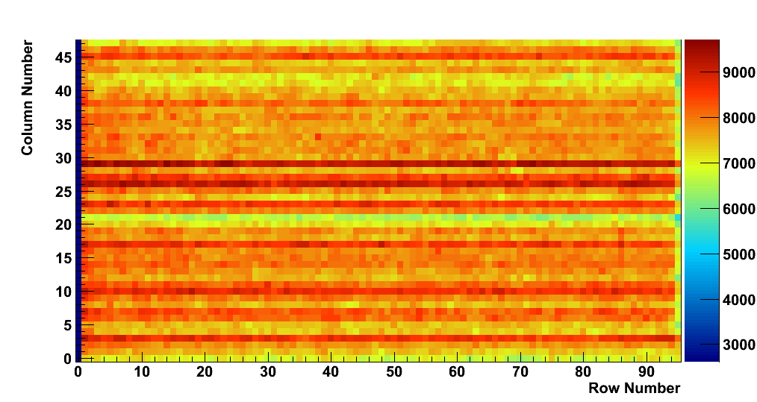
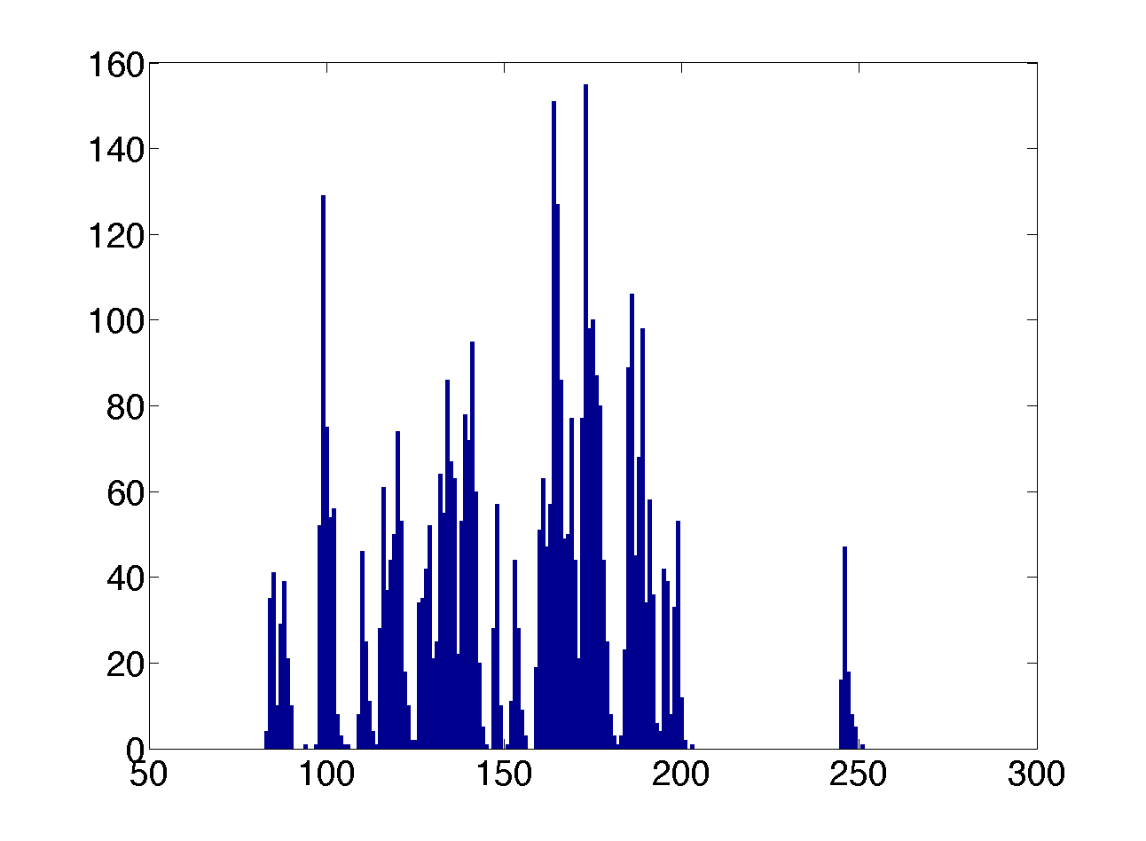
Pedestals
Readout is performed on a column by column basis
Shows common noise in columns
Pedestal Value (ADC counts)

Slide 13
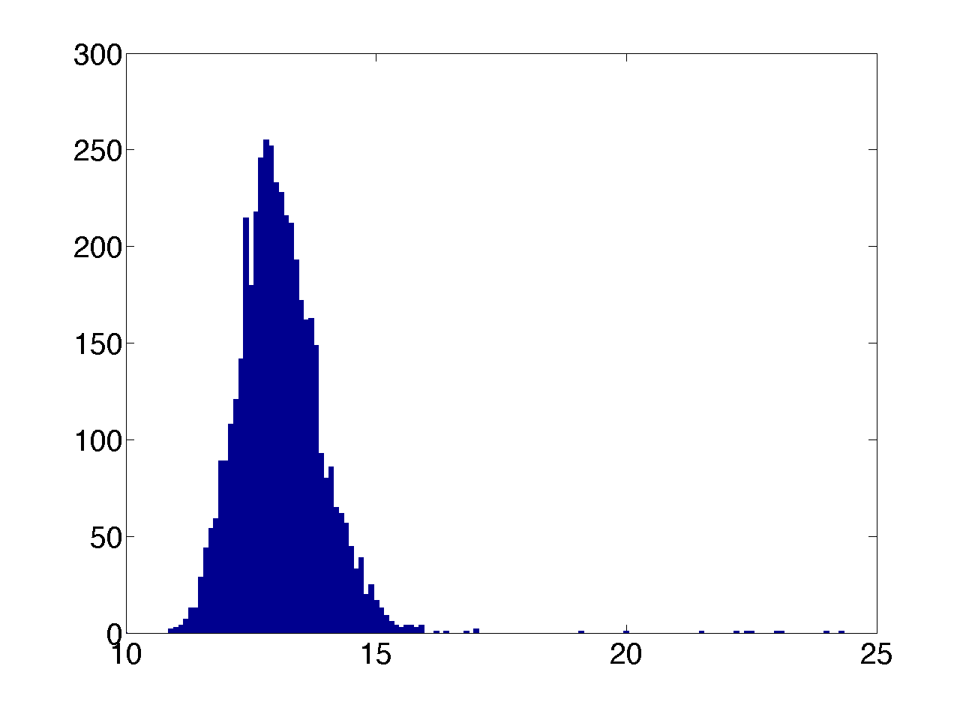
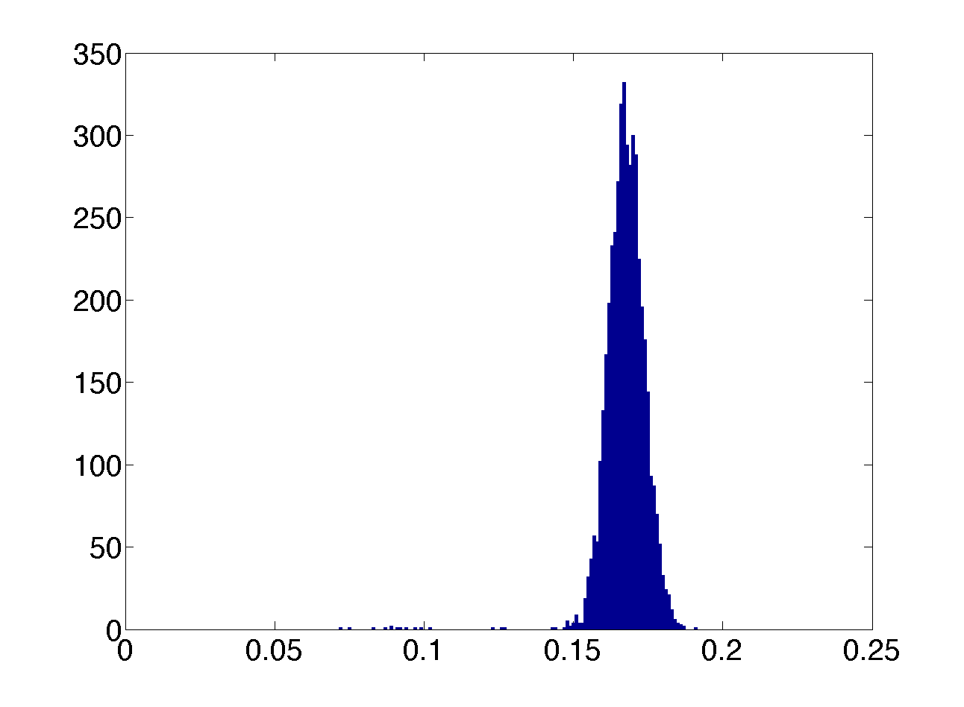
Noise and Gain
Noise and gain are uniform across the sensor
Average noise value ~12 e rms
Average gain value 0.17 => 51𝜇V/e
Noise from each pixel
Gain from each pixel
RMS Noise(e)
Gain(ADCs)

Slide 14
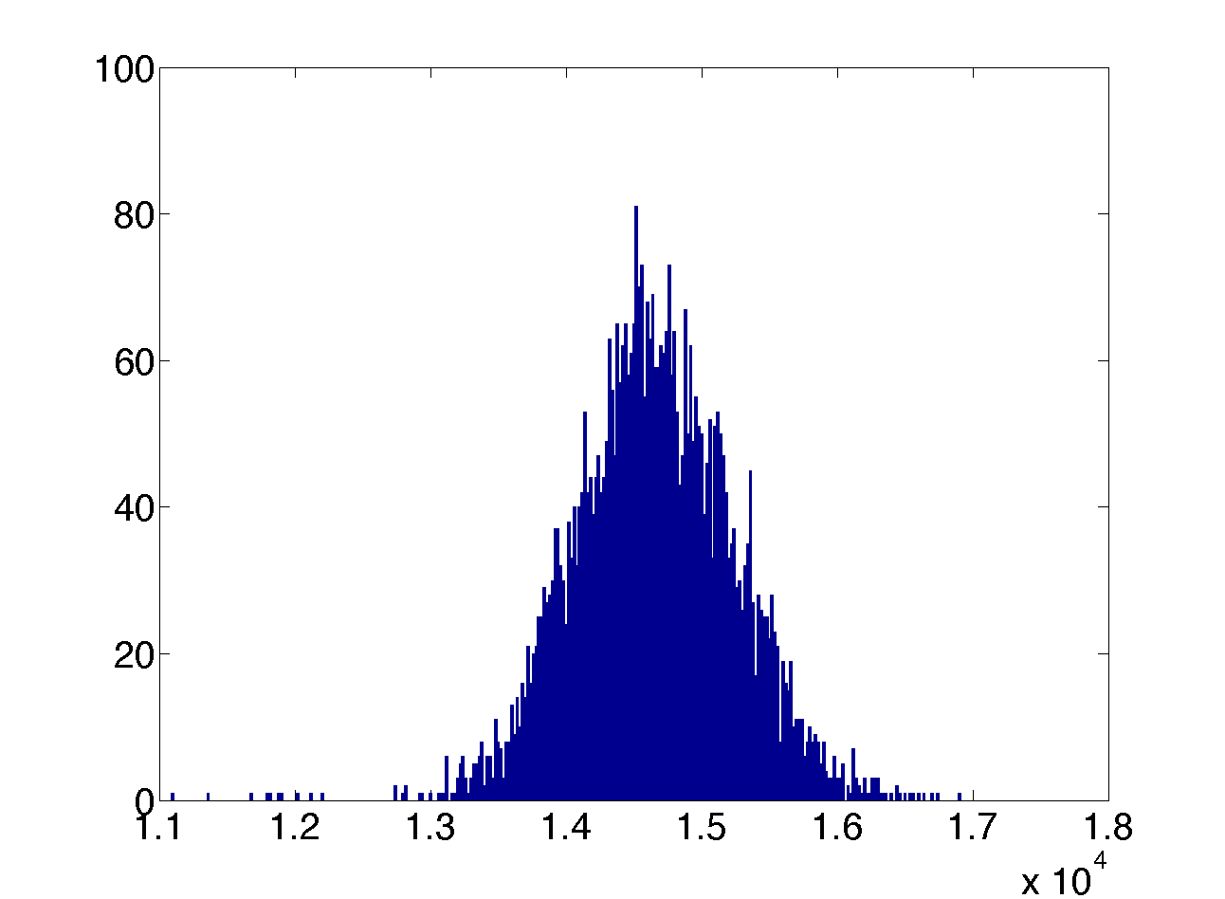
Maximum Full Well Capacity
Full well capacity ~ 14,700e
Consistent across the sensor
Linear full well ~11,500e
Full well(e⁻)

Slide 15
Noise vs Temperature
^{Noise}
At 50C the noise becomes large.
Increase in noise at 20C
Noise (ADCs)
^{Pedestal}
ZOOM
Noise (ADCs)
Temperature (C)
Temperature (C)

Slide 16
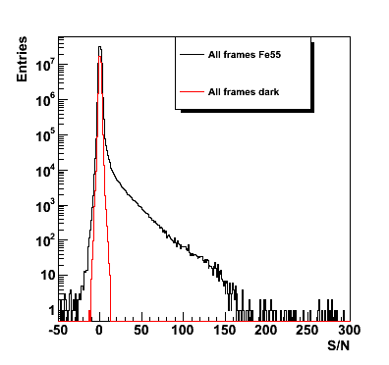
Fe55
Fe55 spectrum shows a sharp cut-off
Consistent with noise and gain from PTC
Good S/N up to 150

Slide 17
Future Plans
Full test and comparison of on-chip ADC with on-board ADC
Characterisation of the STRIXELs
Comparison of different resistivity chips
Testbeam at CERN planned for November
Radiation damage studies
New chip design planned – discussions with CERN

Slide 18
Summary
Cherwell chip is working well
Noise and gain as expected
Showing good uniformity in noise and gain
Obtained Fe55 spectrum
Measured noise as a function of temperature
Detailed characterisation is underway
On course for testbeam in November

