Slide 1

Monolithic Active pixel Matrix with Binary cOunters
(MAMBO)
Farah Khalid, Gregory Deptuch, Alpana Shenai, Scott Holm, Ron Lipton
Fermi National Accelerator Laboratory

Slide 2
Presentation outline
Nested well structure
MAMBO pixel electronics
Test results
Conclusions
- Fermi National Accelerator Laboratory is operated by Fermi Research Alliance, LLC under Contract DE-AC02-07CH11359 with the U.S. Department of Energy.
- ASIC submission was covered by US-Japan Collaboration funds in collaboration with KEK, Japan

Slide 3
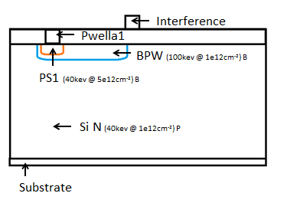
Characteristics of Buried P well (BPW)
Si (n-type) (40keV @ 1e¹²cm⁻²) P

Slide 4
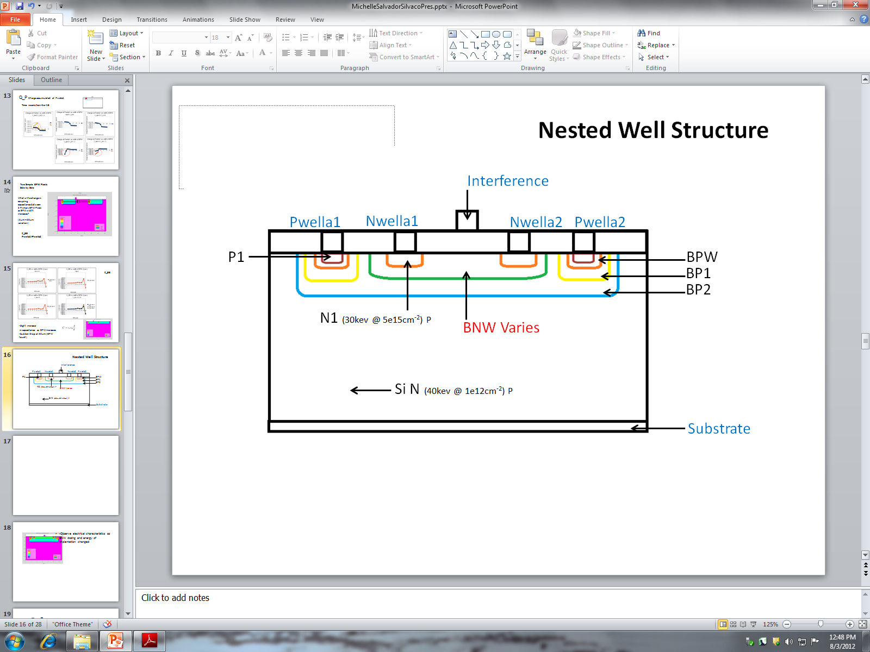
Characteristics of Nested Well structure
C_N: Capacitance between interference metal and n well contact increases with increasing BNW dose, but reduces by increasing BNW implantation energy.
C_P: Capacitance between interference metal and p well contact decreases with increasing BNW dose and by increasing BNW implantation energy.
C_P: lower for nested well compared to just BPW
n (30keV @ 5e¹⁵cm⁻²) P
Si (n-type) (40keV @ 1e¹²cm⁻²) P
BNW energy (keV)
BNW energy (keV)

Slide 5
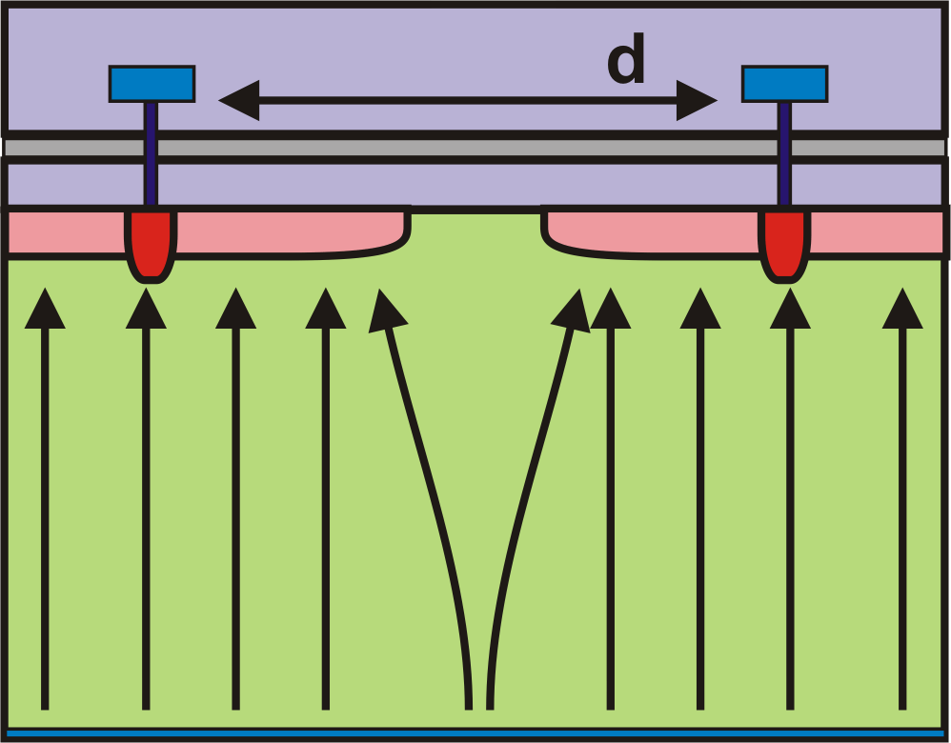
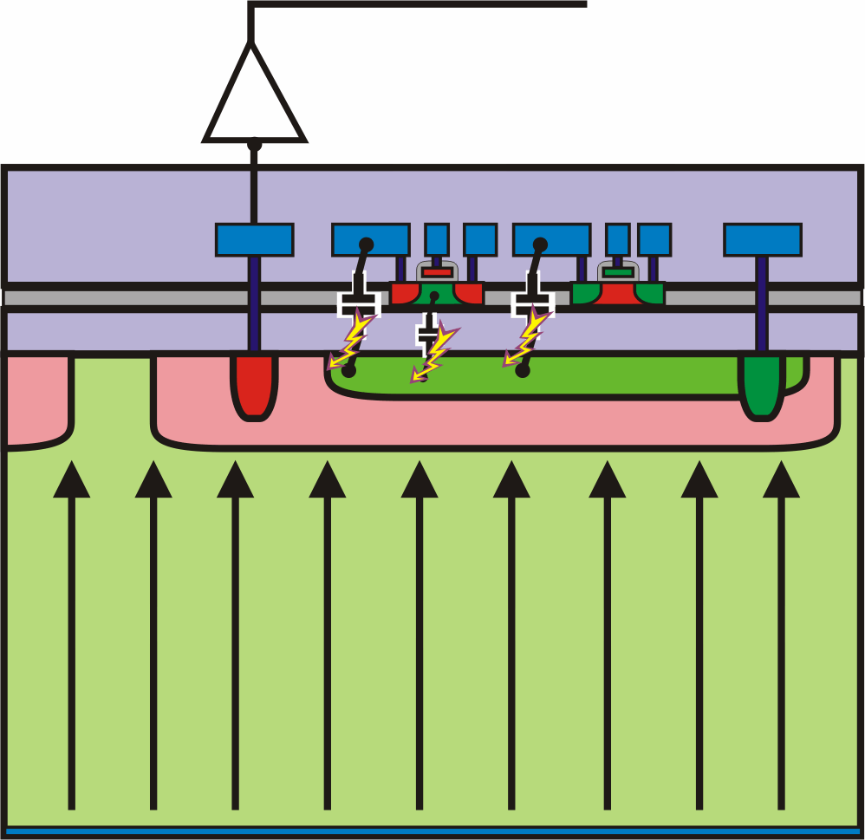
SOI technology for detectors
BPW
Nested BNW/BPW
BPW
BNW
BPW
  electric potential under any circuitry may be kept constant or change very little only by voltage from integrated charge
  gives increased C-to-V node capacitance
  works with charge integrating pixels (3T-like), gain may be nonlinear,
  charge injections due to electronics activity may be cancel out by sequential readout with exactly repeated patterns for control signals and CDS
  full isolation of the electronics and the detector charge collection node,
  electric potential under any circuitry is kept constant (AC ground)
  allows designs with amplification stages and virtual ground (CSA)
  Removes parasitics feedbacks and instabilities,
  Unfortunately increases input capacitance of CSA

Slide 6
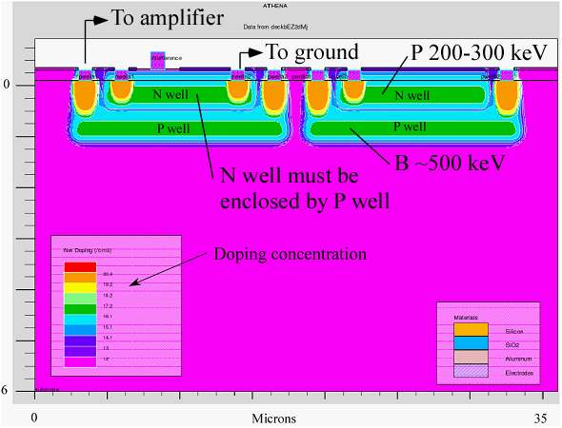
Purpose of the nested well structure
  Shielding:
  Tripple role of shielding between the SOI electronics and detector layer:
to avoid back-gating in transistors (DC potential underneath the BOX shifts threshold of transistors),
to avoid injection of parasitic charges from the SOI electronics to detector,
to avoid strong electric field in BOX that results in accelerated radiation damage.
Developed at Fermilab with KEK and OKI/Lapis
This well collects the charge carriers
This well separates digital circuits
from sensor substrate and
prevents back gating effects
SILVACO
process simulatiom

Slide 7
MAMBO = Monolithic Active Pixel Matrix with Binary Counters
MAMBO IV & V
pixel design with window discriminator and per pixel counter
integrating CSA w/ p-z
network,
shaping filter CR-RC²
with τ_{p}=200ns;
gain=~100 μV/e⁻,
ripple counter
reconfigurable
into shift register,
DACs for threshold
adjustment,
control logic for testability
SOI LAPIS/OKI Semiconductor 0.2μm process

Slide 8
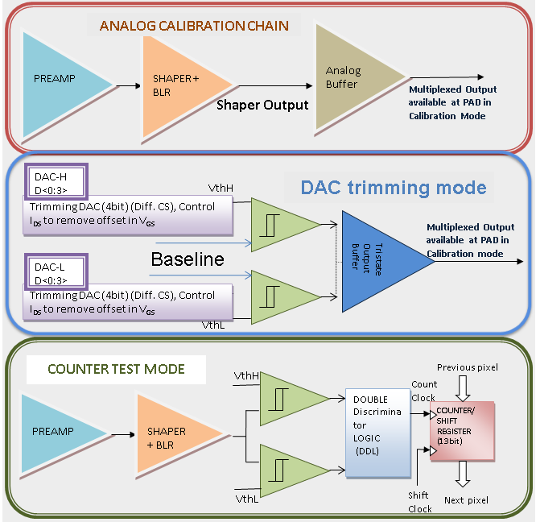
MAMBO test modes
Single pixel under test
Selectable modes for analysis & characterization of various blocks
  Analogue test mode; analyses: noise, linearity and Dynamic Range
  Counter test mode
  DAC trimming mode
  Pixel disable mode
  Normal Operation mode
MAMBO V 50×52 pixels-
testability at pixel level
for statistics analyzes

Slide 9
Preamplifier
Regulated Cascode with extra current boosting to increase gm of input transistor
Leakage current compensation
1.7fF I/P test capacitance
Shaper coupling capacitance
Regulated cascode
Input
strobe1
In_test1
strobe2
Cfs=14fF, Cc=140fF
Protection diode at Input
In_test2

Slide 10
Shaper and Baseline Restorer
CR-RC² shaper
Regulated cascode to match preamplifier
Shaping time =200ns
Clamping diodes
Regulated
Cascode
With gain
boosting
Feedback capacitance
In
baseline
Feedback resistance
shaperOut

Slide 11
Comparator
Hysteresis Comparator
Connected to in_Vref during normal operation
OR
Connected to baseline for trimming
OR
Connected to gnd! when disabled

Slide 12
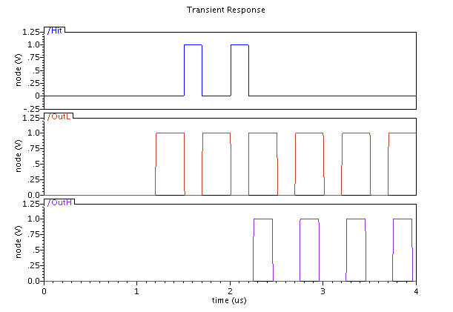
Double Discriminator Logic
Output of the Lower Threshold comparator behaves as a clock
Output of the Upper Threshold comparator behaves as a Reset
When both comparators fire the hit is not counted
Hits counted

Slide 13
Counter /Shift Register
12 bit ripple counter
Count switch disconnects counter from comparator while shifting
CK_READ is external clock used for shifting data

Slide 14
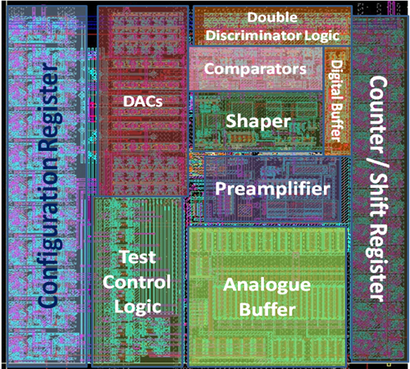
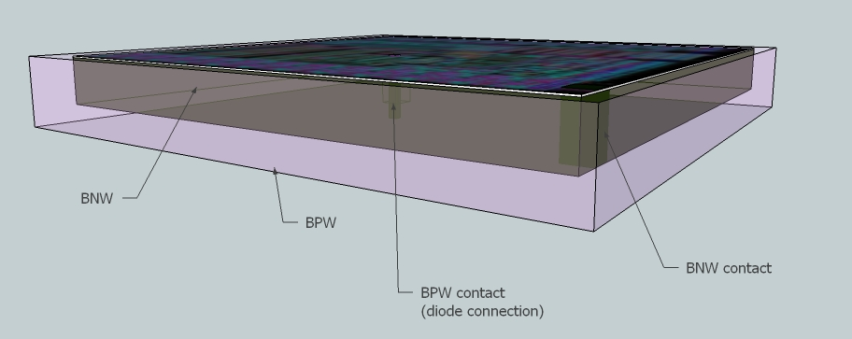
Pixel Layout
105 μm
Nested well conceptual view

Slide 15
MAMBO: TEST RESULTS

Slide 16
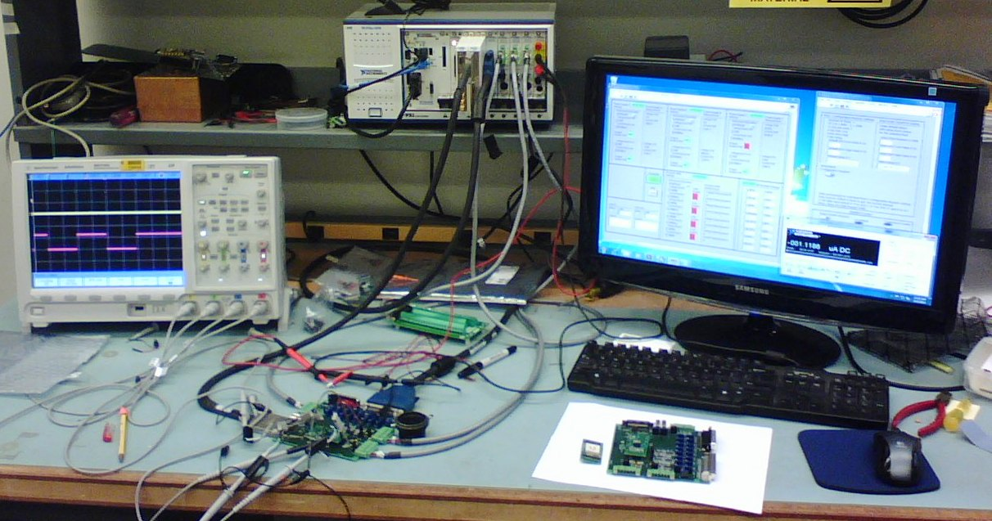
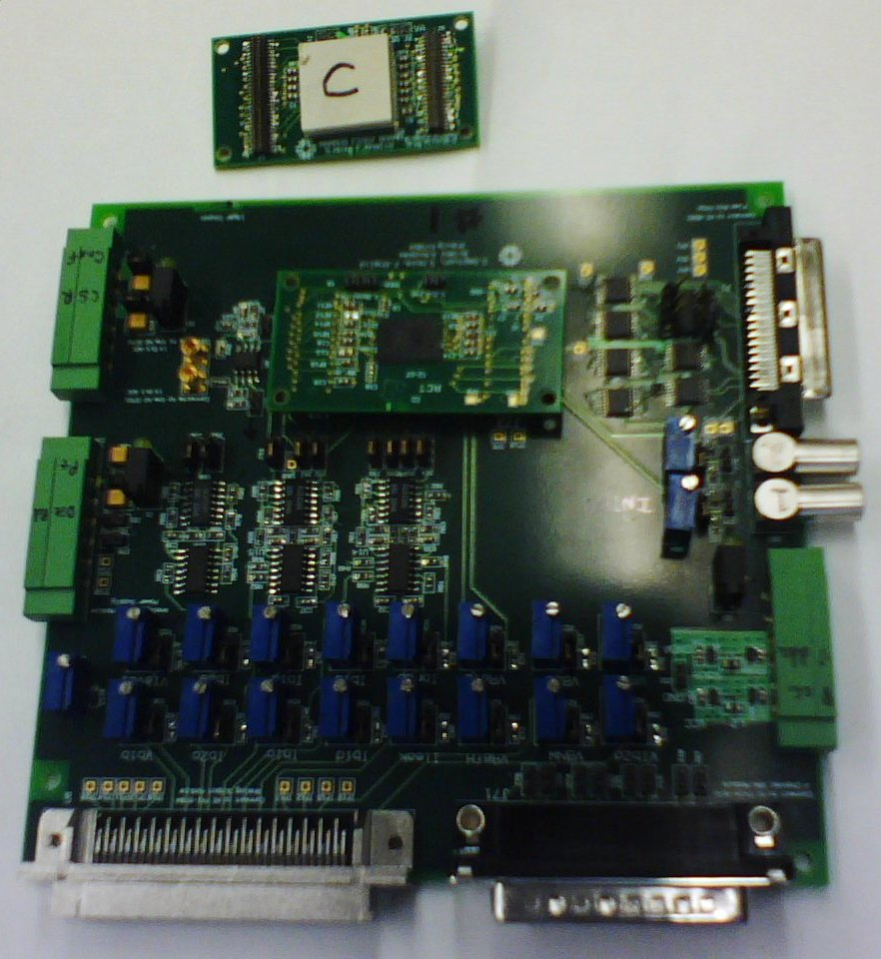
Test Setup

Slide 17
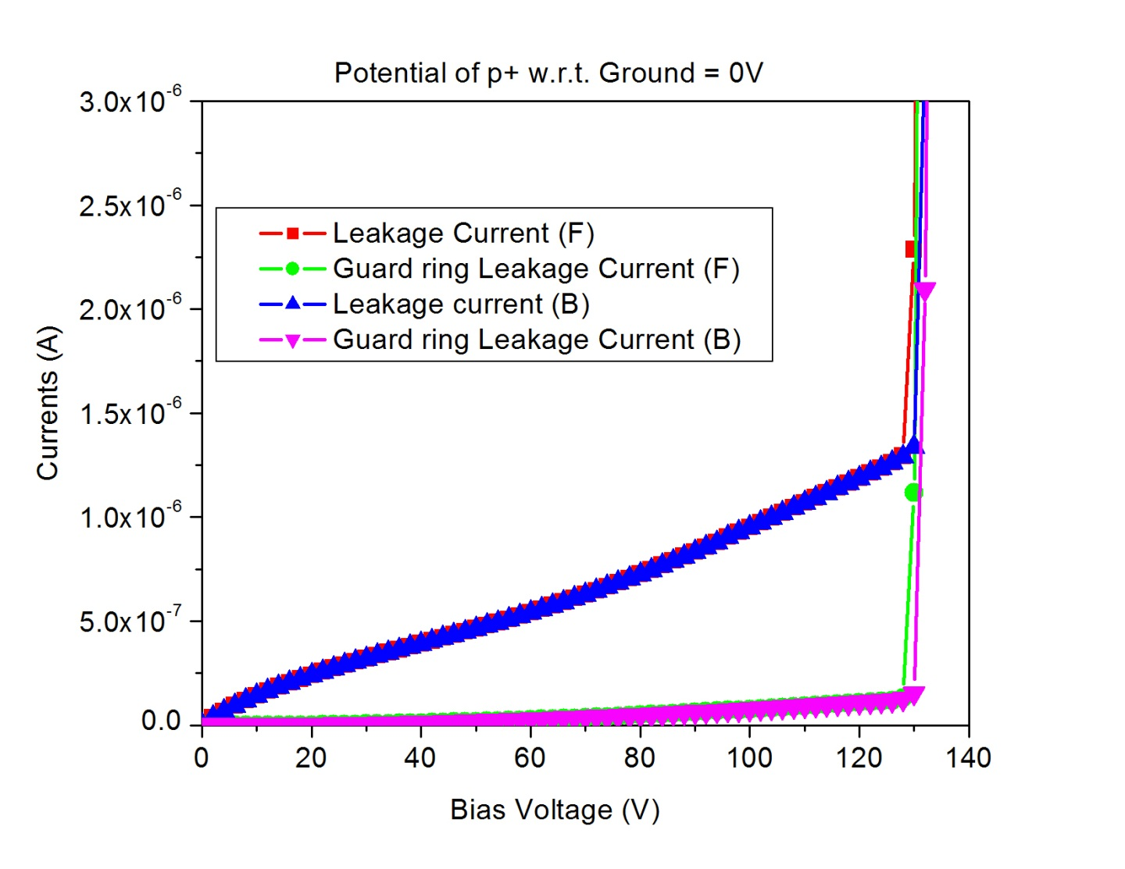
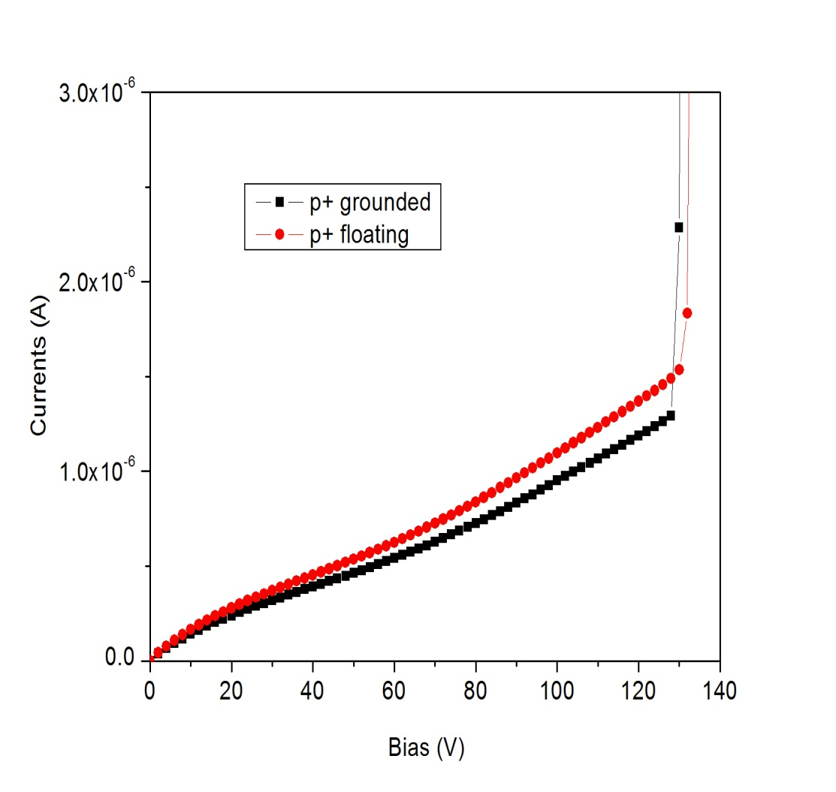
MAMBO V nested BNW/BPW:
C-V & 1/C² – V plots: HR1 substrate 325µm
Voltage breakdown around 130V
Leakage current is 3 times larger compared to previous wafer (FZ)

Slide 18
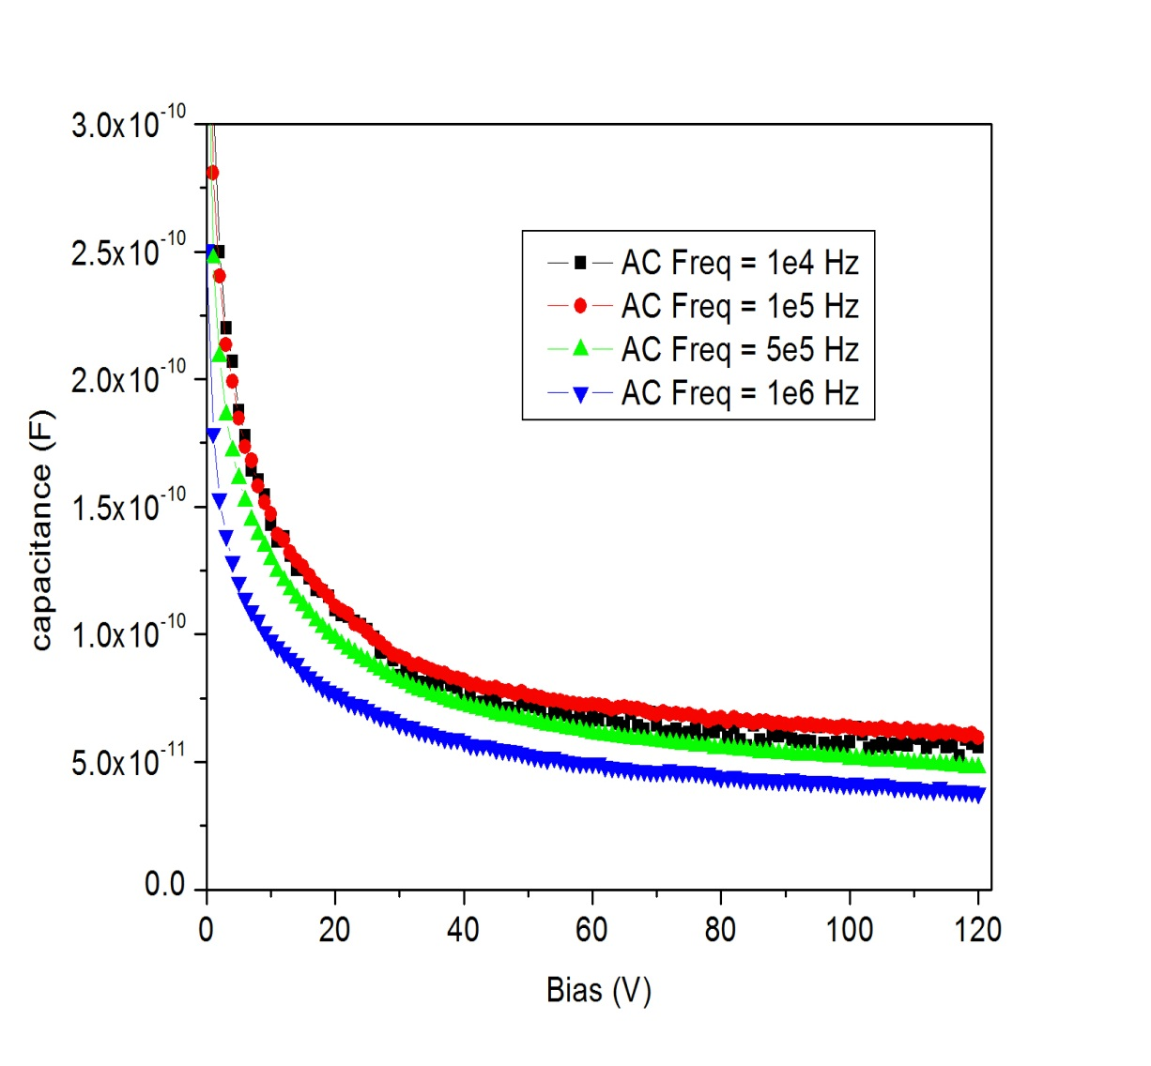
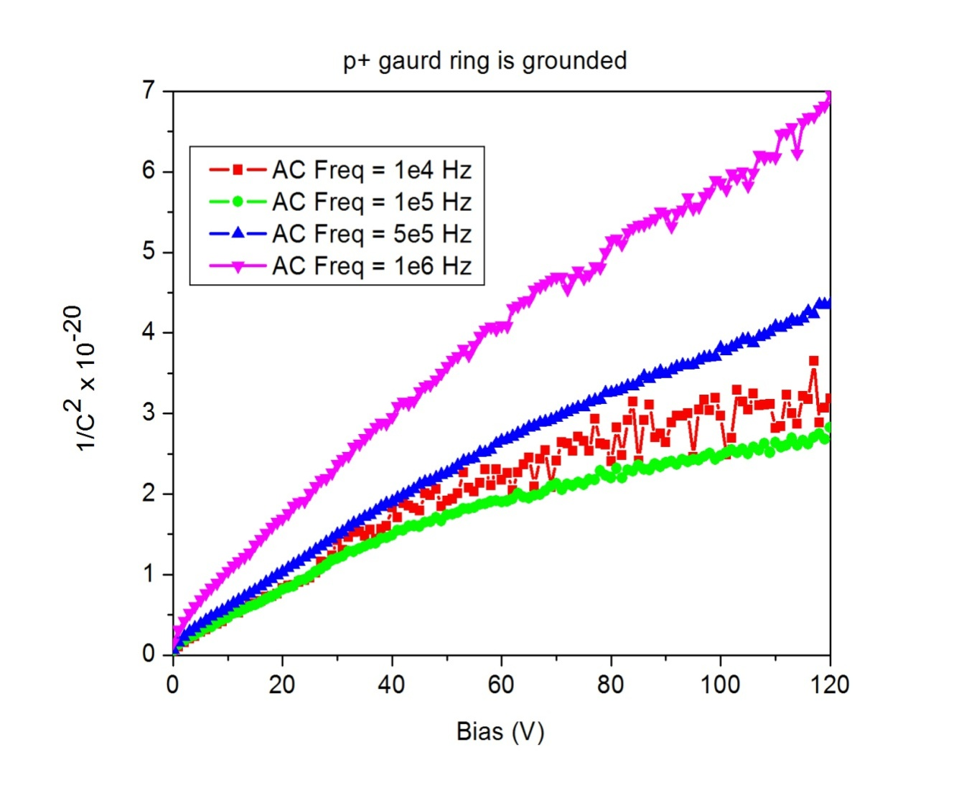
MAMBO V nested BNW/BPW:
C-V & 1/C²-V plots: HR1 substrate < 1kΩ area (5.3 x 5.3 mm²)
Voltage breakdown occurs before full depletion is achieved
Doping levels of substrate is not adequate (higher resistivity is desired)

Slide 19
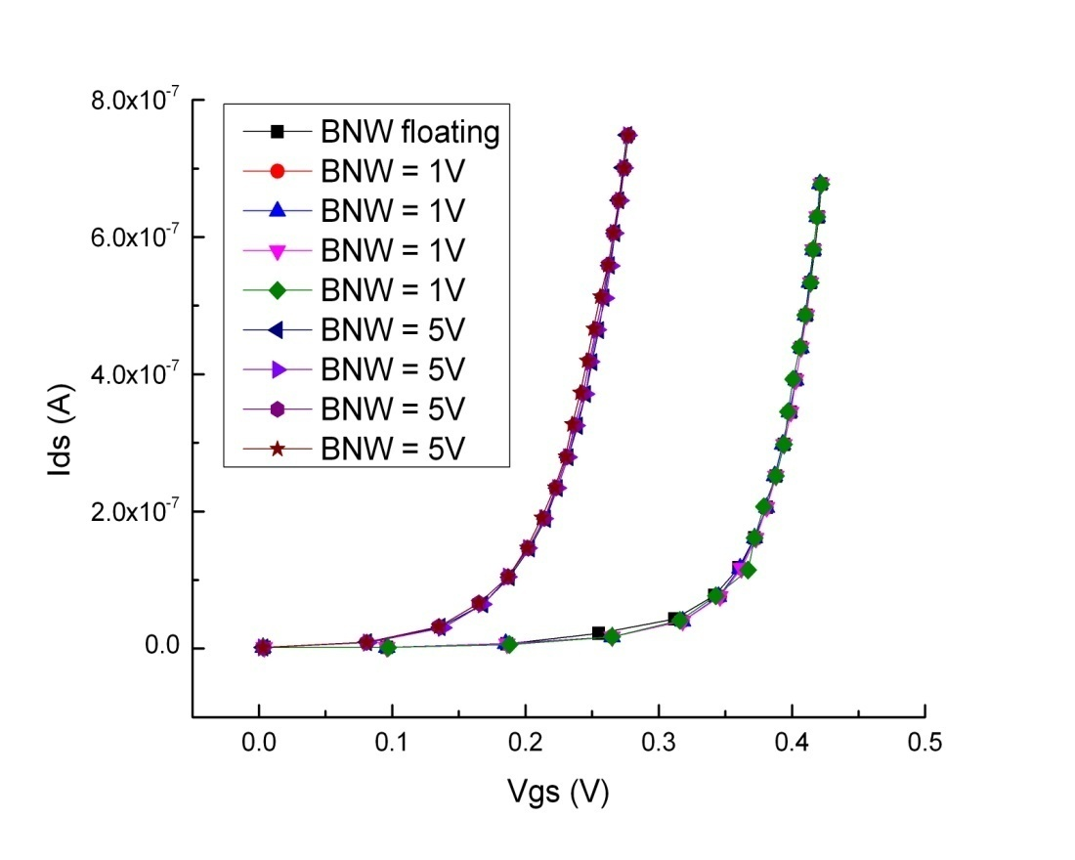
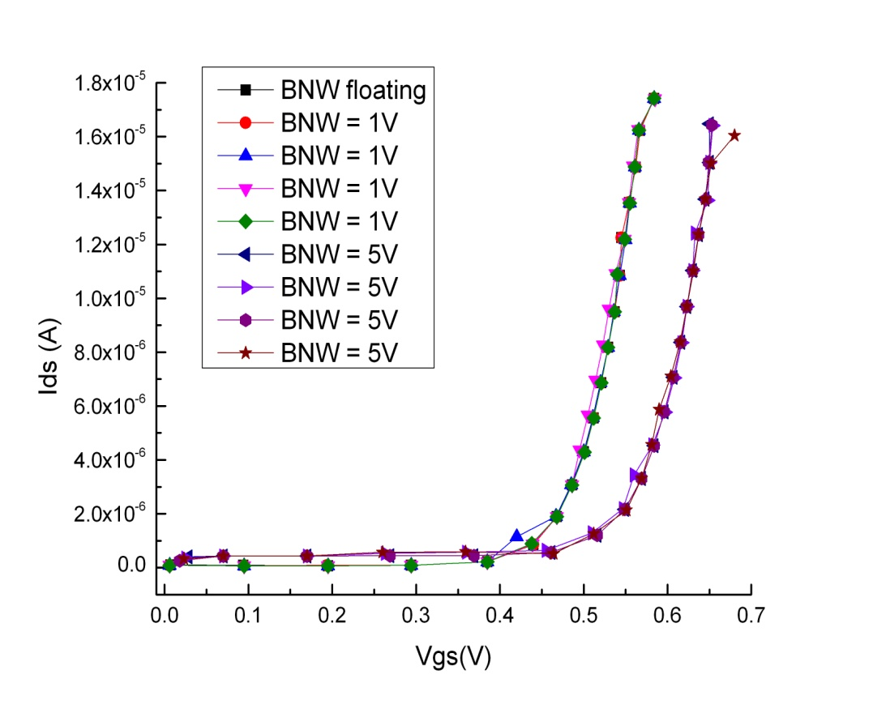
Example of MAMBO IV results:
no shift of PMOS & NMOS transistor I_{DS}/V_{GS} in nested wells at back-gate biases ranging from 0 to 100V
DP = 5V
DP = 10V
DP = 50V
DP = 100V
DP = 5V
DP = 10V
DP = 50V
DP = 100V
DP = 5V
DP = 10V
DP = 50V
DP = 100V
DP = 5V
DP = 10V
DP = 50V
DP = 100V
For an NMOS transistor of size 41x(0.64µm/ 0.8µm) and PMOS transistor of size 41x(2µm/0.5µm) the plots indicate that there is no threshold voltage shifts on increasing the voltage on the die pad (V_{DP}) from 0-100V
whereas on increasing the voltage of BNW (V_{BNW}) from 1-5V threshold voltage shifts of approximately 100mV for PMOS and 150mV for NMOS transistors is observed.
Japan-US Cooperative Research Program Workshop, Dec. 20, 2011

Slide 20
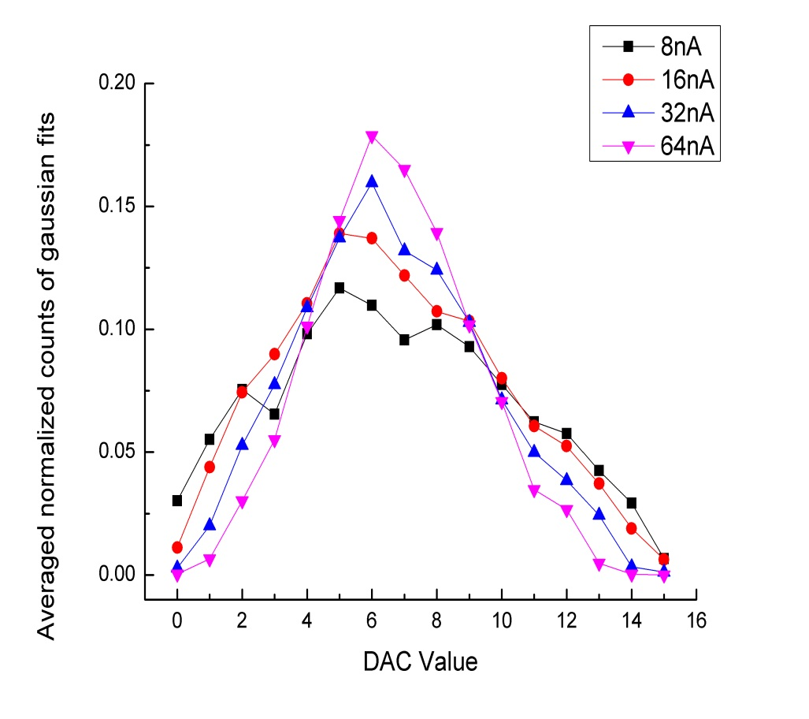
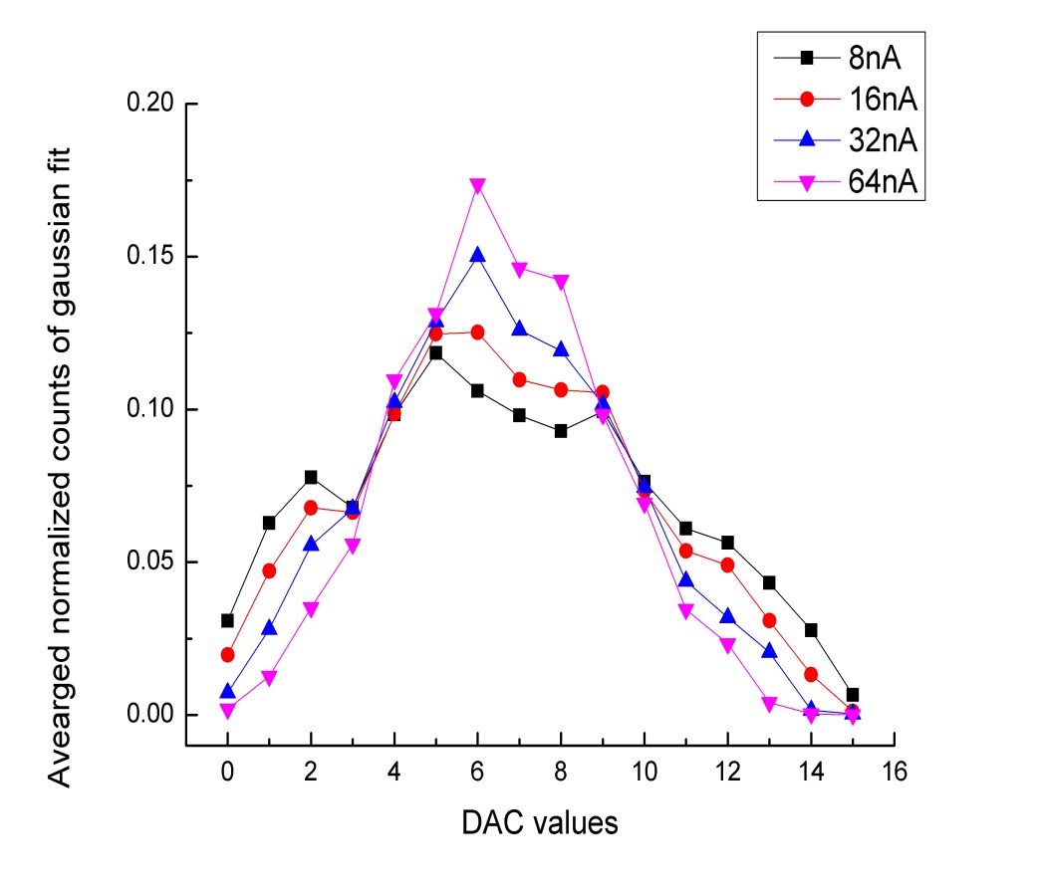
Trimming DAC threshold scans
Detector bias at 20V
Detector bias at 2V
For DAC current settings of 8nA to 64nA, with average non-linear LSB of 12mV to 27mV,corresponds to a voltage spread of ±90mV to ± 200mV respectively
Digital circuit response independent of detector bias

Slide 21
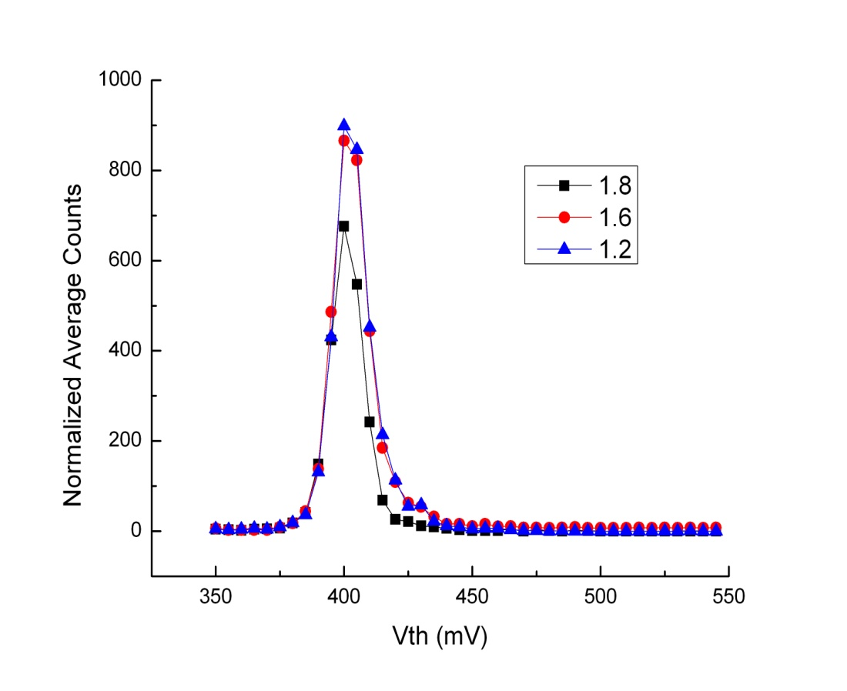
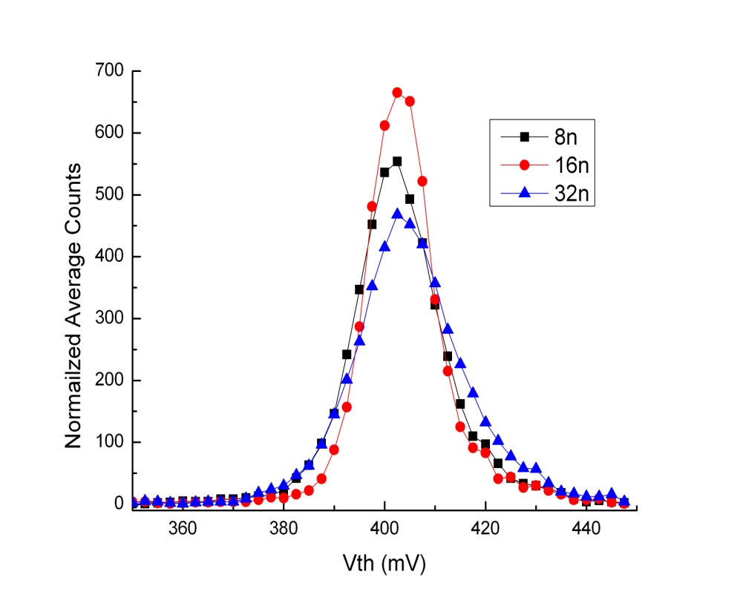
DAC Scans: Count vs. Threshold (VthL)
Varying Counter voltage
Varying DAC current
Baseline set at 400mV
VthL scanned from 350mV to 475mV

Slide 22
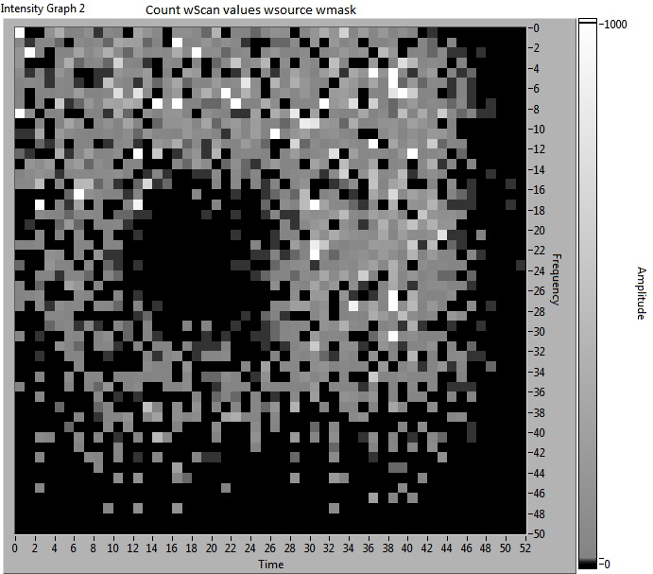
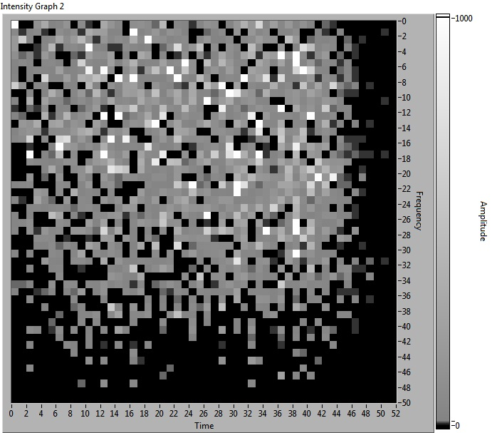
IMAGE with Cd¹⁰⁹ source (22keV)
(1.9mm x 1.9mm) square mask
without mask

Slide 23
BNW resistance simulation
BNW dose
BNW dose, energy
Shallow and lower concentration of BNW produces higher resistance across the N well contacts
The resistance is independent of the Die pad voltage

Slide 24
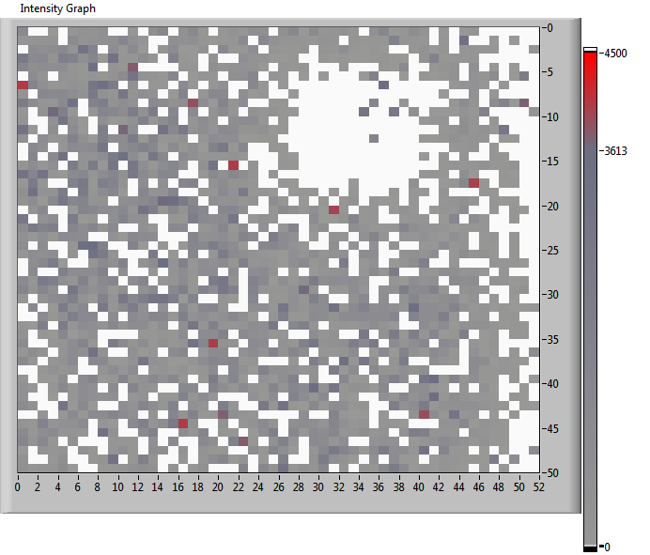
IMAGE with Cd¹⁰⁹ source (22keV) with DiePad at 9V
(1.9mm x 1.9mm) square mask
Analogue oscillations when Diepad voltage is increased beyond 3V
Hypothesis: highly resistive BNW, requires more contacts
Preamplifier gain reduced by operating front-end below 1V
Image obtained with detector biased at 9V

Slide 25
Conclusions and Future Work
Extensions made to the process closer to obtain a fully functional
detector with all satisfactory parameters
Good effective collaboration with Lapis semiconductor
First counting pixel SOI ASIC operated successfully with shielding of sensor from electronics
Include more BNW contacts in the pixel layout to compensate for BNW resistivity.
Confirm and stabilize access to HR / FZ Si material
Optimize nested wells BNW-BPW to decrease input capacitance or implement alternative shielding method
Provide back processing (implantation and annealing); limit depth of implantation to allow entrance window for autoradiograpy at low energy of particle (w or w/o back Al)
Optimize thickness of wafers for actual application 50-100μm for tracking 500 - 700μm or more for X-ray imaging
Notes:
STAR experiment from BNL is looking at SOI PIXELs for vertex upgrade

Slide 26
Questions?

