Slide 1






Funded by the European Union (EU). Views and opinions expressed are however those of the author only and do not necessarily reflect those of the EU or European Research Executive Agency (REA). Neither the EU nor the REA can be held responsible for them.
Muon Collider – Target and Capture status review
Antti Kolehmainen
CERN EN-MME
With input from many colleagues

Slide 2
INTRODUCTION
Follow-up of initial presentations in mmWG: https://indico.cern.ch/event/1239921/ and IMCC 2023
Based on the coil lay-out by A. Portone et al. introduced in annual meeting 2024
Radial build
Support systems
He cooling lay-out
Integration
Assembly sequence
NOTE: As a conceptual pre-study, the modelling is done up to a level sufficient for presentation. Some mismatches in geometry etc. exists.

Slide 3
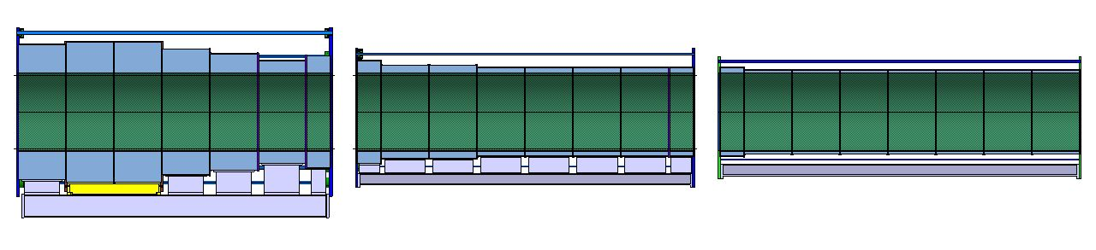
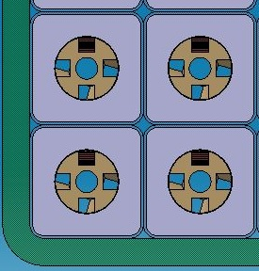
COILS & COLD MASS
Coils: 100 T
Steel work: 12 T
Coils: 26 T
Steel work: 6 T
Coils: 14 T
Steel work: 4 T
Coil gaps: 480 mm on the jacket
Coil bore: 1400 mm on the jacket
Ø1400
A. Portone et al.: Conductor & Jacket: 33.3 T & 80.7 T

Slide 4
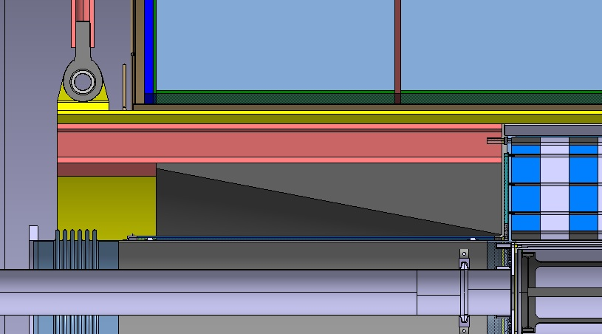
RADIAL BUILD
Ø1400
Ø1380
INNER Ø1238 / R619
Outer R586 in current 3D from STI
VACUUM GAPS: 20 mm
THICKNESS 12 mm

Slide 5
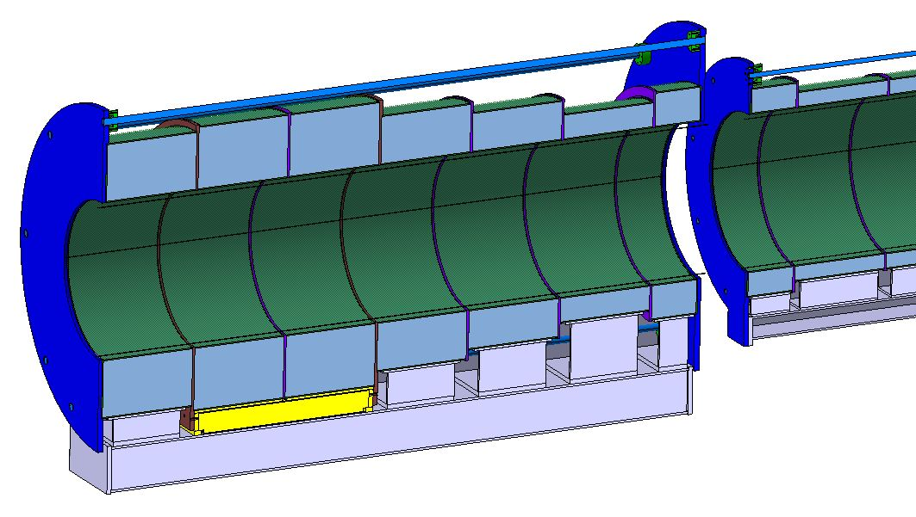
COLD MASS SUPPORTING
Tensioning system to keep the coils together
Calculations required, for them:
Coil alignment requirement for coil supports
Maximum load cases for support dimensioning(transport?)
Coil forces in all cases for the tensioning system
Individual coil supports – alignment of coils
Common support beam – interface for individual coil and cold supports

Slide 6
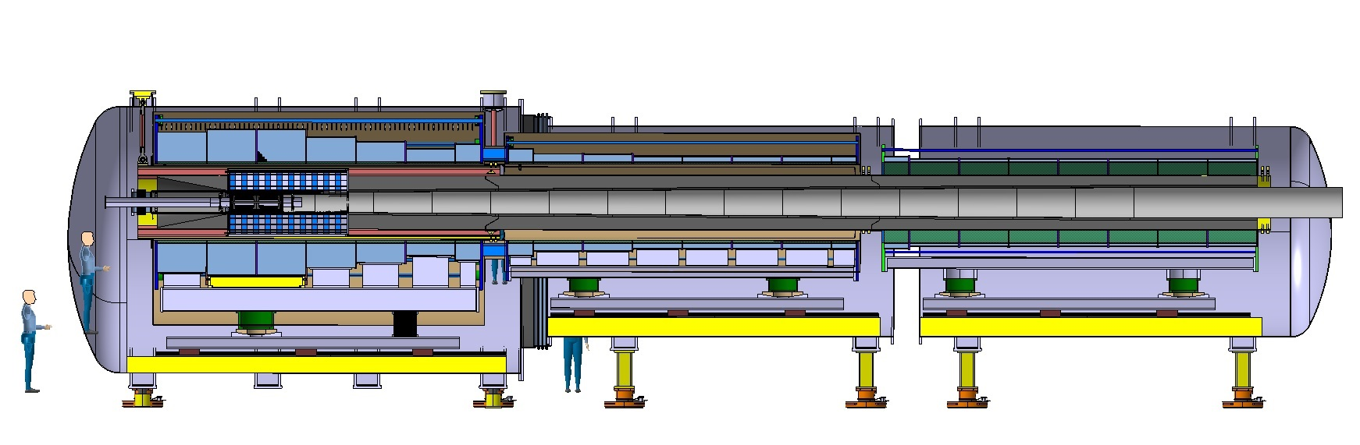
SUPPORT SYSTEM 20 K – 300K
INTERCONNECTION BARS - FOR COOLDOWN MOVEMENT AND MAGNETIC FORCE
COLD MASS
Calculations required, for them:
  Boundary conditions for cold supports, 300 K supports and interconnection bars(transport accelerations, thermal contraction, magnetic forces etc.)
Interconnection bars cannot support bending – an active cooling of internal cold mass supports may be needed!(maybe for cooldown time too)
300 K Supports
COLD SUPPORTS 20 K – 300 K
FIX POINT – ALL OTHER SLIDING POINTS

Slide 7
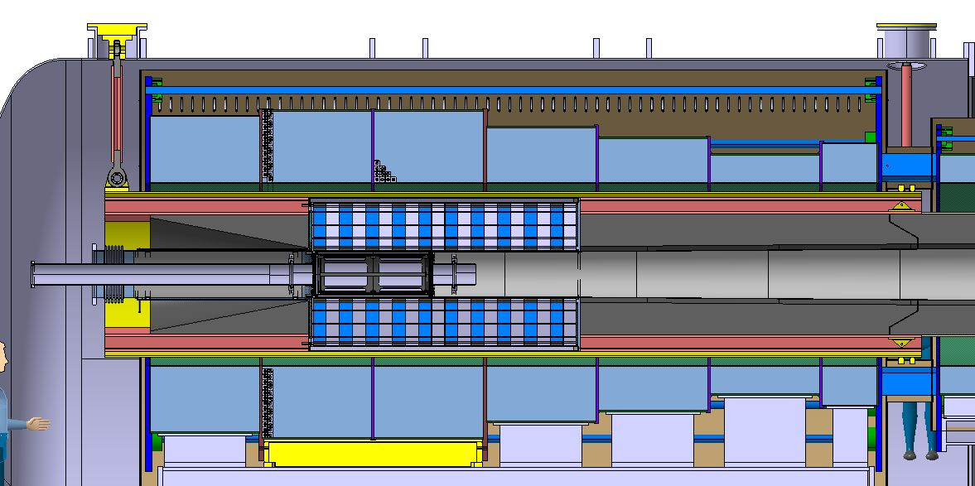
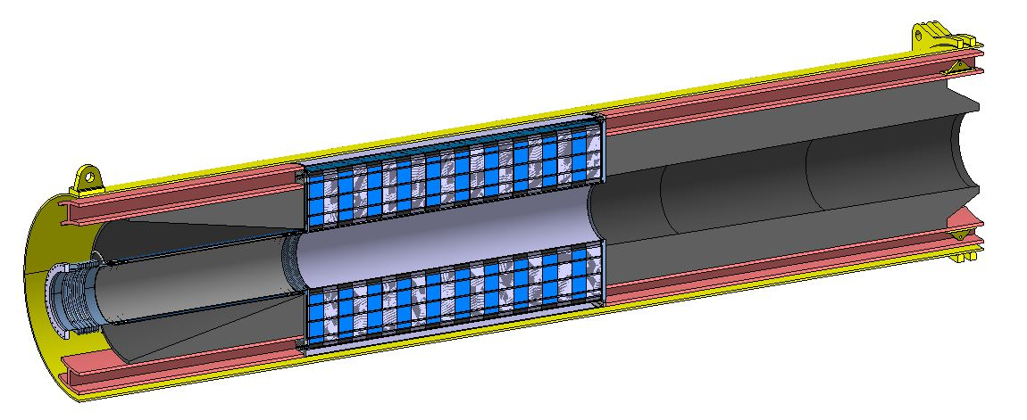
SUPPORT SYSTEM – W-SHIELD
30 T
(one end)
W-shield suspended from vacuum vessel
2x 30 T
(two ends)
Tungsten segments built inside a cylinder with support interface for suspension
Longitudinal supports to add
Keep section assemblies together with longitudinal rods
For deformation, cross-section MUST be uniform!(study by C. Accetura)

Slide 8
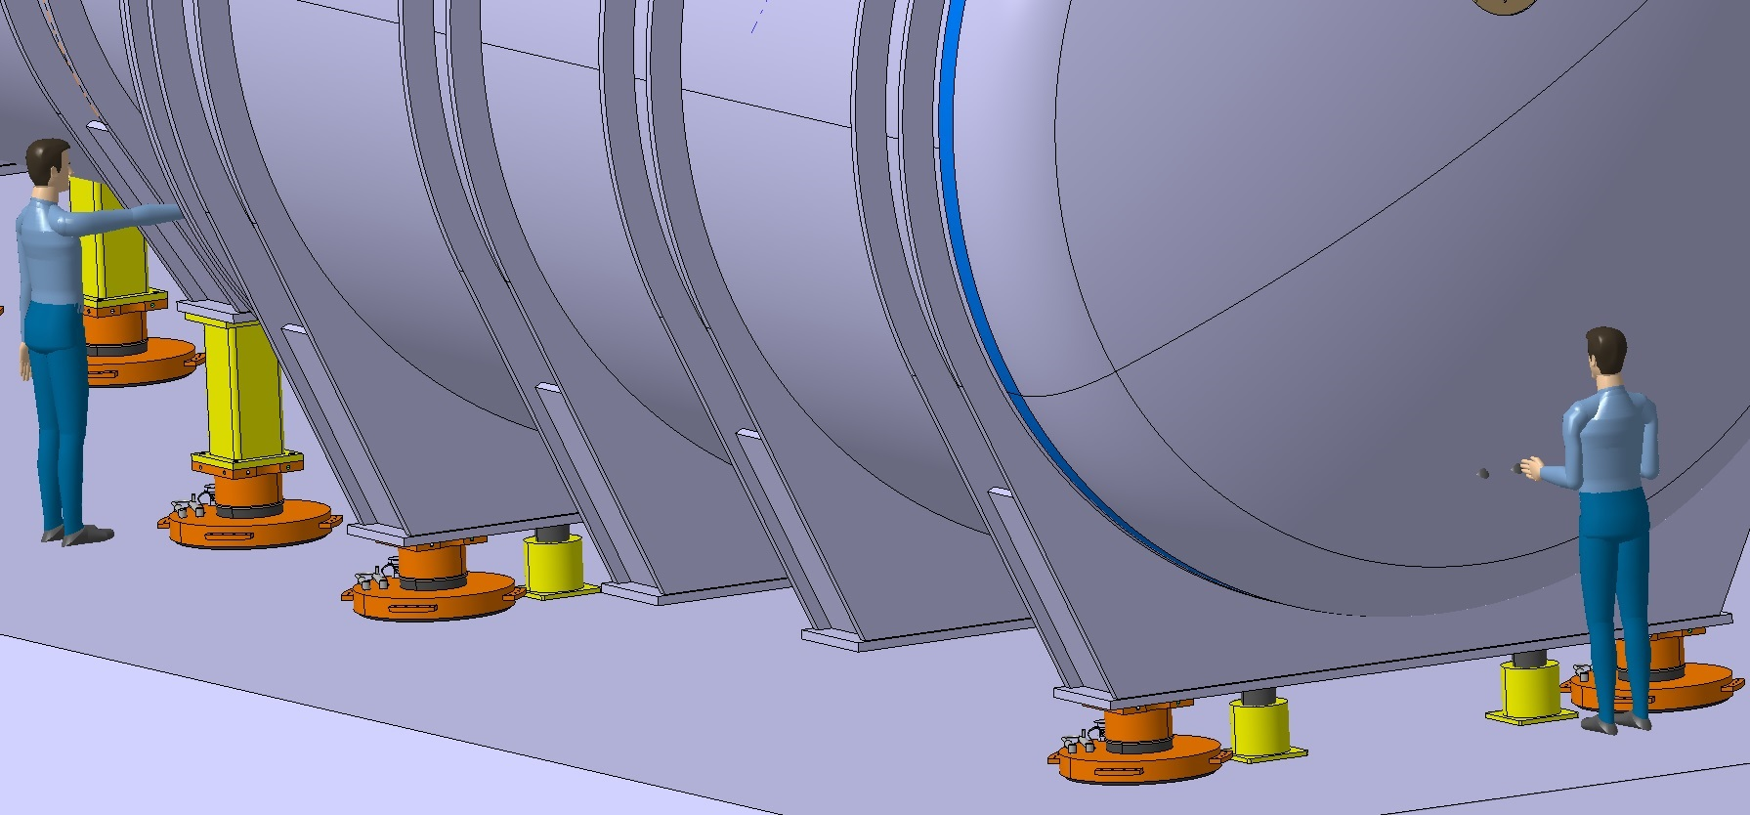
CRYOSTAT SUPPORTS
Vacuum vessel to have support interface and reinforcements to support both cold mass and W-shield
  Define boundary conditions for analysis
  Vacuum induced stresses must be added
ATLAS inspired support system – air pads and positioning jacks
Steel surfaces for air pads to minimize friction, air pads maybe removed after installation(not radiation hard)
Thanks to M. Raymond of ATLAS for sharing experience!

Slide 9
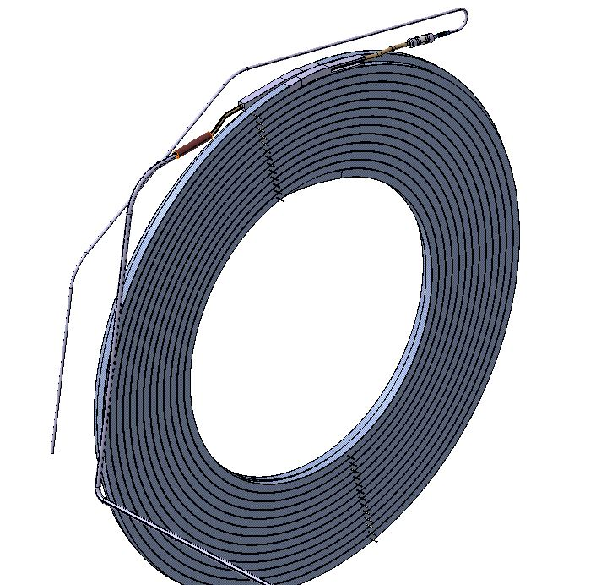
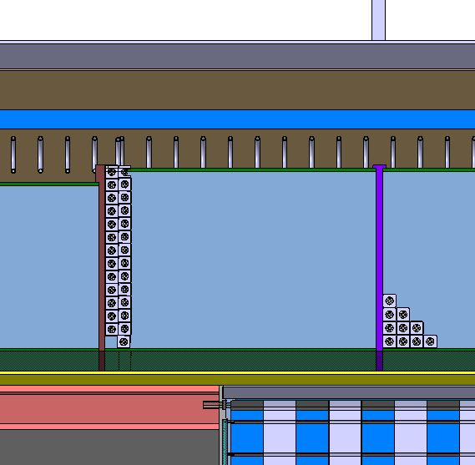
COILS
Electrical break
Splice
First and last pancake of a magnet have a current connection and isolated He connection, others only isolated He connections
Magnets build from pancake windings
He line
HTS
Cu former with Ø8 cooling hole
St. steel jacket
He cooled current lead

Slide 10
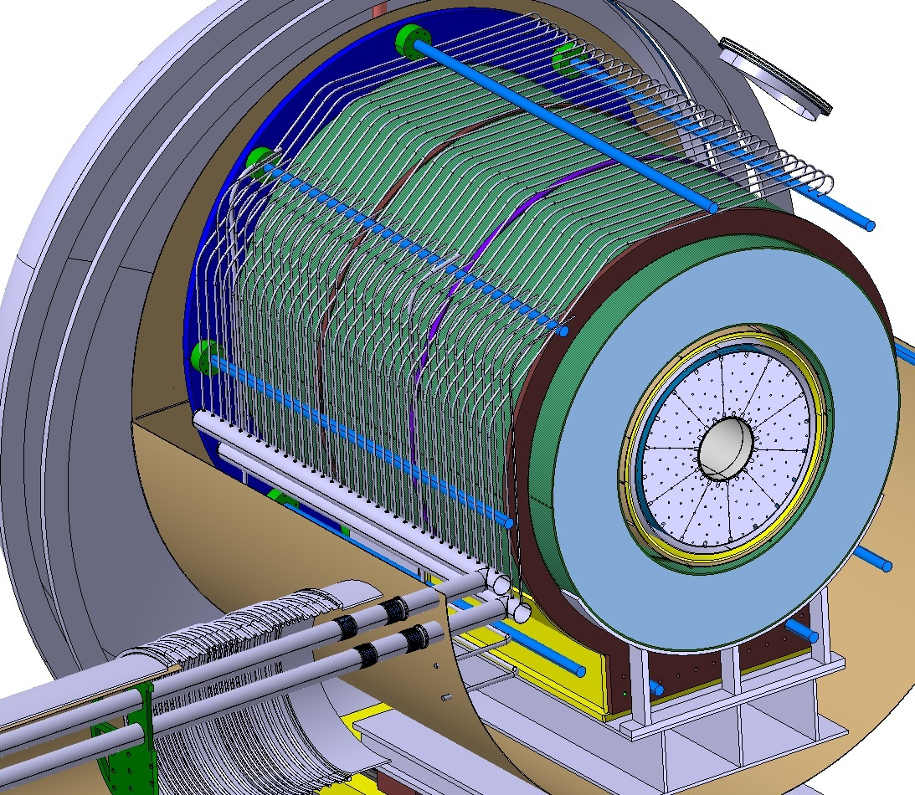
COIL COOLING LAY-OUT
He return
58 connections in section 1
Sections:
  1st: 6 long and 1 short magnets
  2nd: 6 long and 2 short magnets
  3rd : 7 long and 1 short magnets
Long magnet = 10 pancakes
Short magnet = 5 pancakes
Pancake = 2 connections
He supply
58 connections in section 1
NEXT:
Supports with fix points
Bellows
Calculations
Current Leads
2x seven leads for section 1
Isolating supports

Slide 11
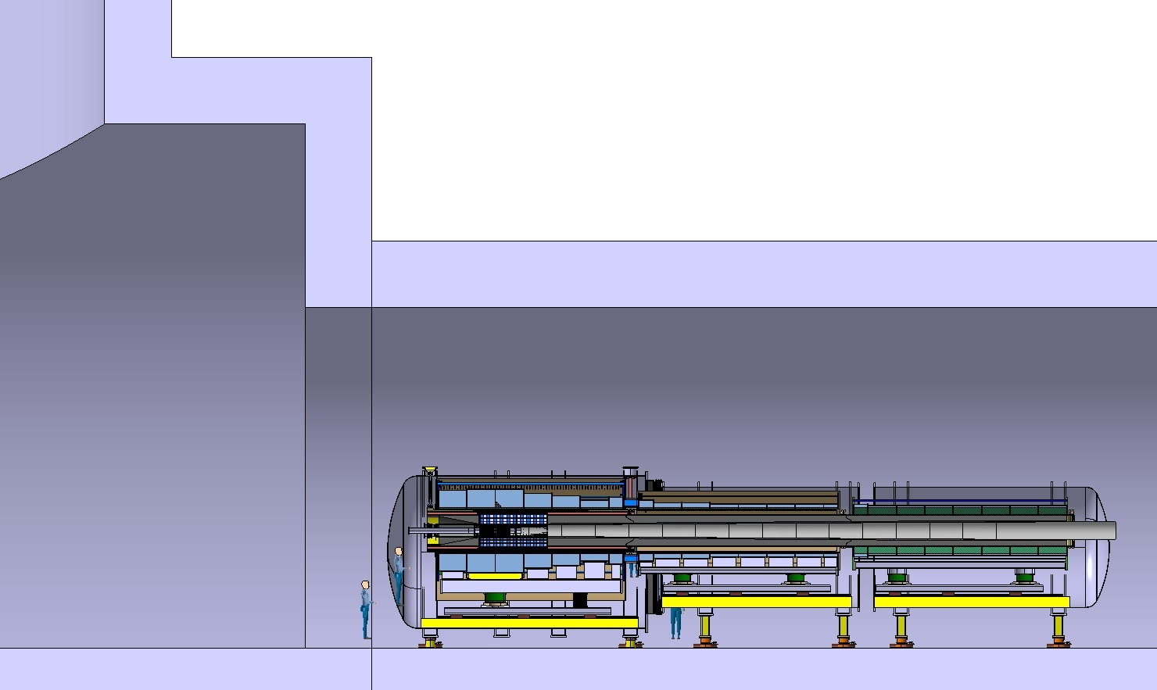
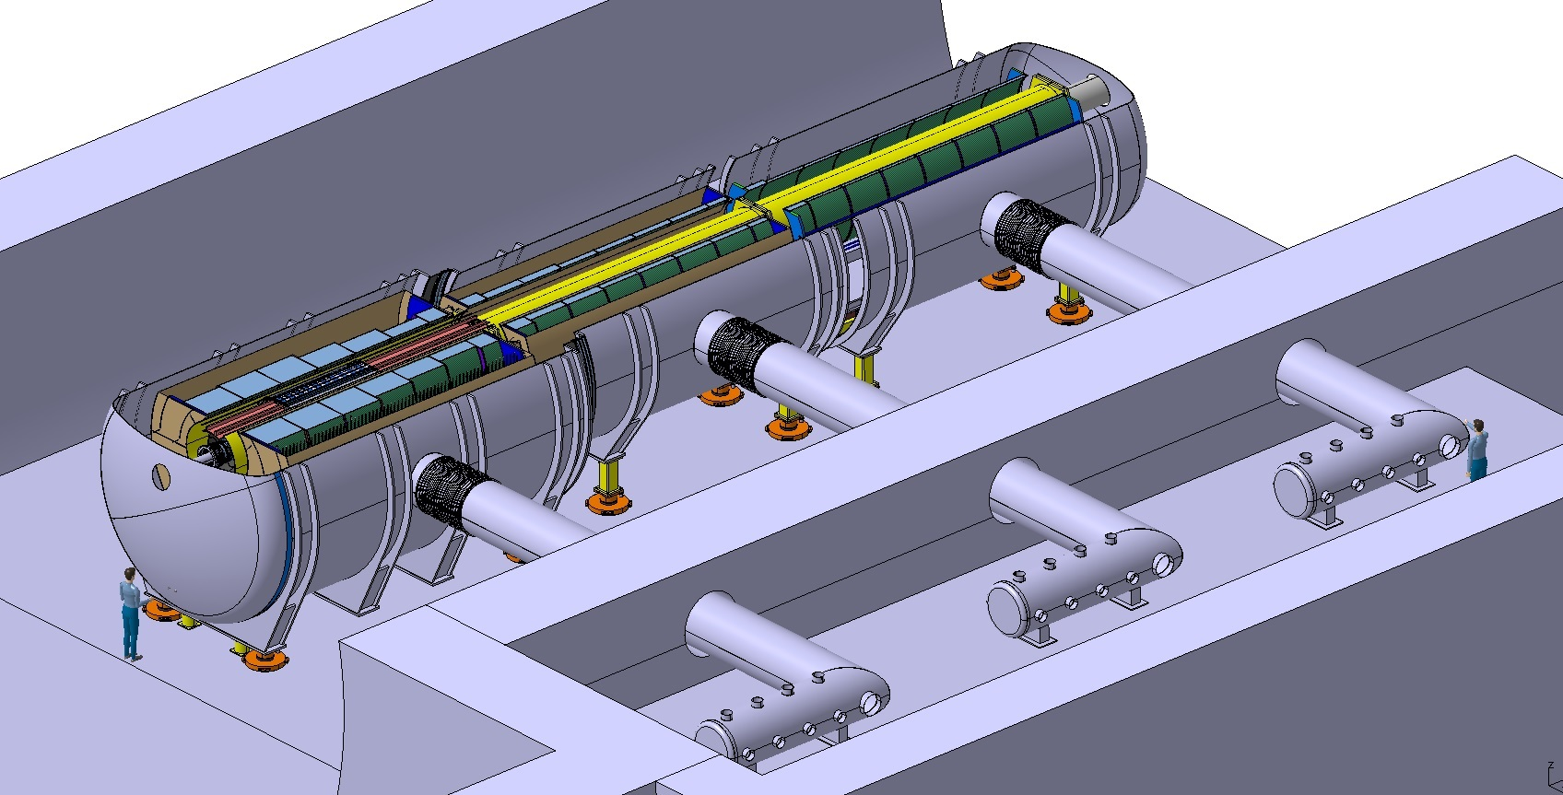
TUNNEL INTEGRATION
R7.5 m
10.2 m
27 m
6.5 m

Slide 12
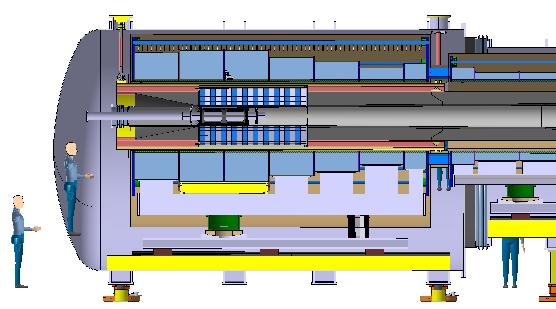
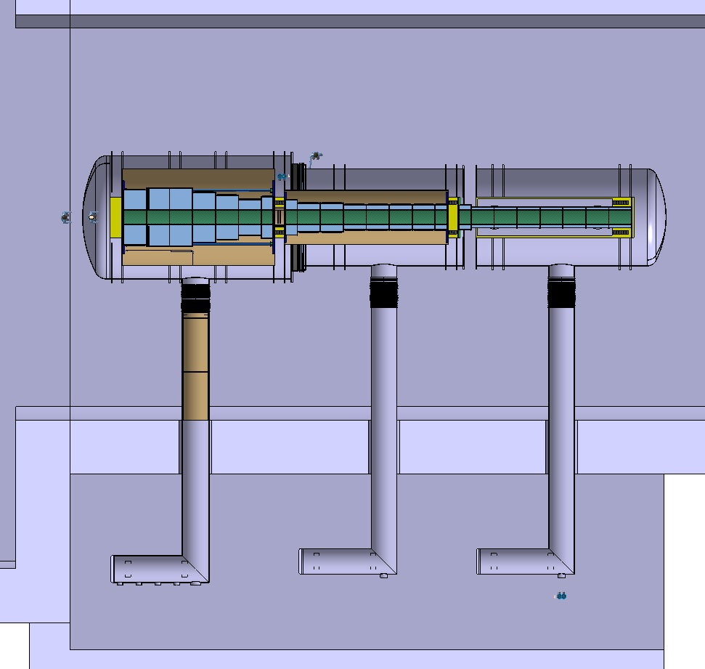
VACUUM
PUMPING(NOT STUDIED!):
Assumed to be done from distance due to stray field – see next slide
Shown satellite connections crowded with He lines and leads – add pumping connections
NOTE: Beam vacuum is still a simple pipe!
Ø4060
Ø4500
8000
Ø964
Vacuum vessel analysis
  Pressure difference and supporting of sub-assemblies
Bellows to address:
  Vacuum force on bellows = 1.3 MN
  Bellow supporting TO BE ADDED

Slide 13
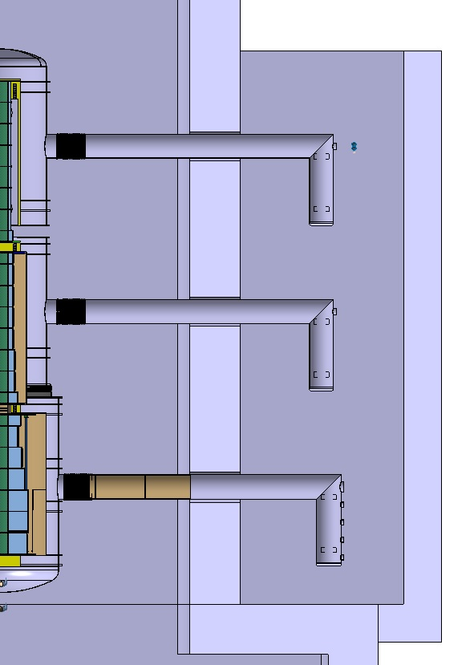
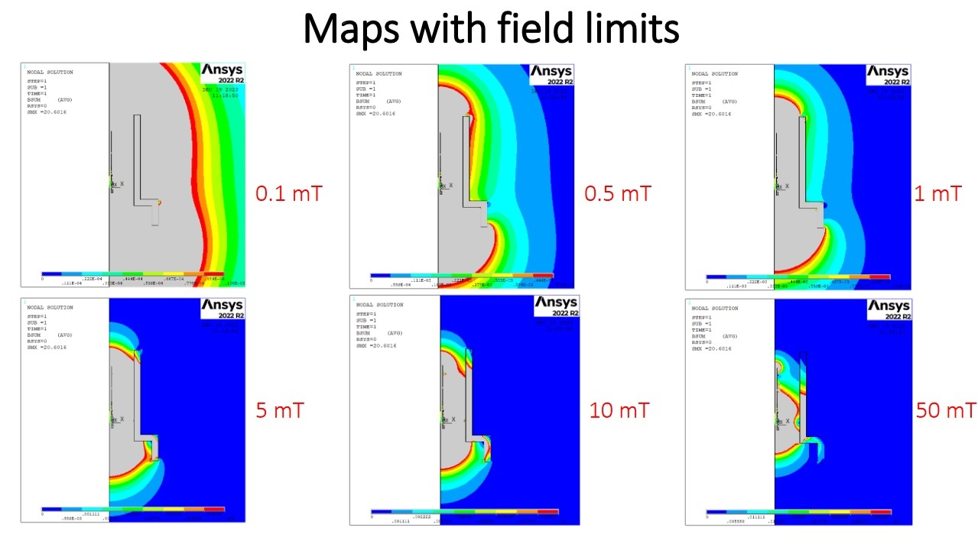
MAGNETIC FIELD SHIELDING
2000 mm
Courtesy of P. Testoni
Point raised in previous preview – high stray field
  Introduction of the satellites
Analysis assumes 30 % of steel in 2 m thick tunnel wall
30% STEEL

Slide 14
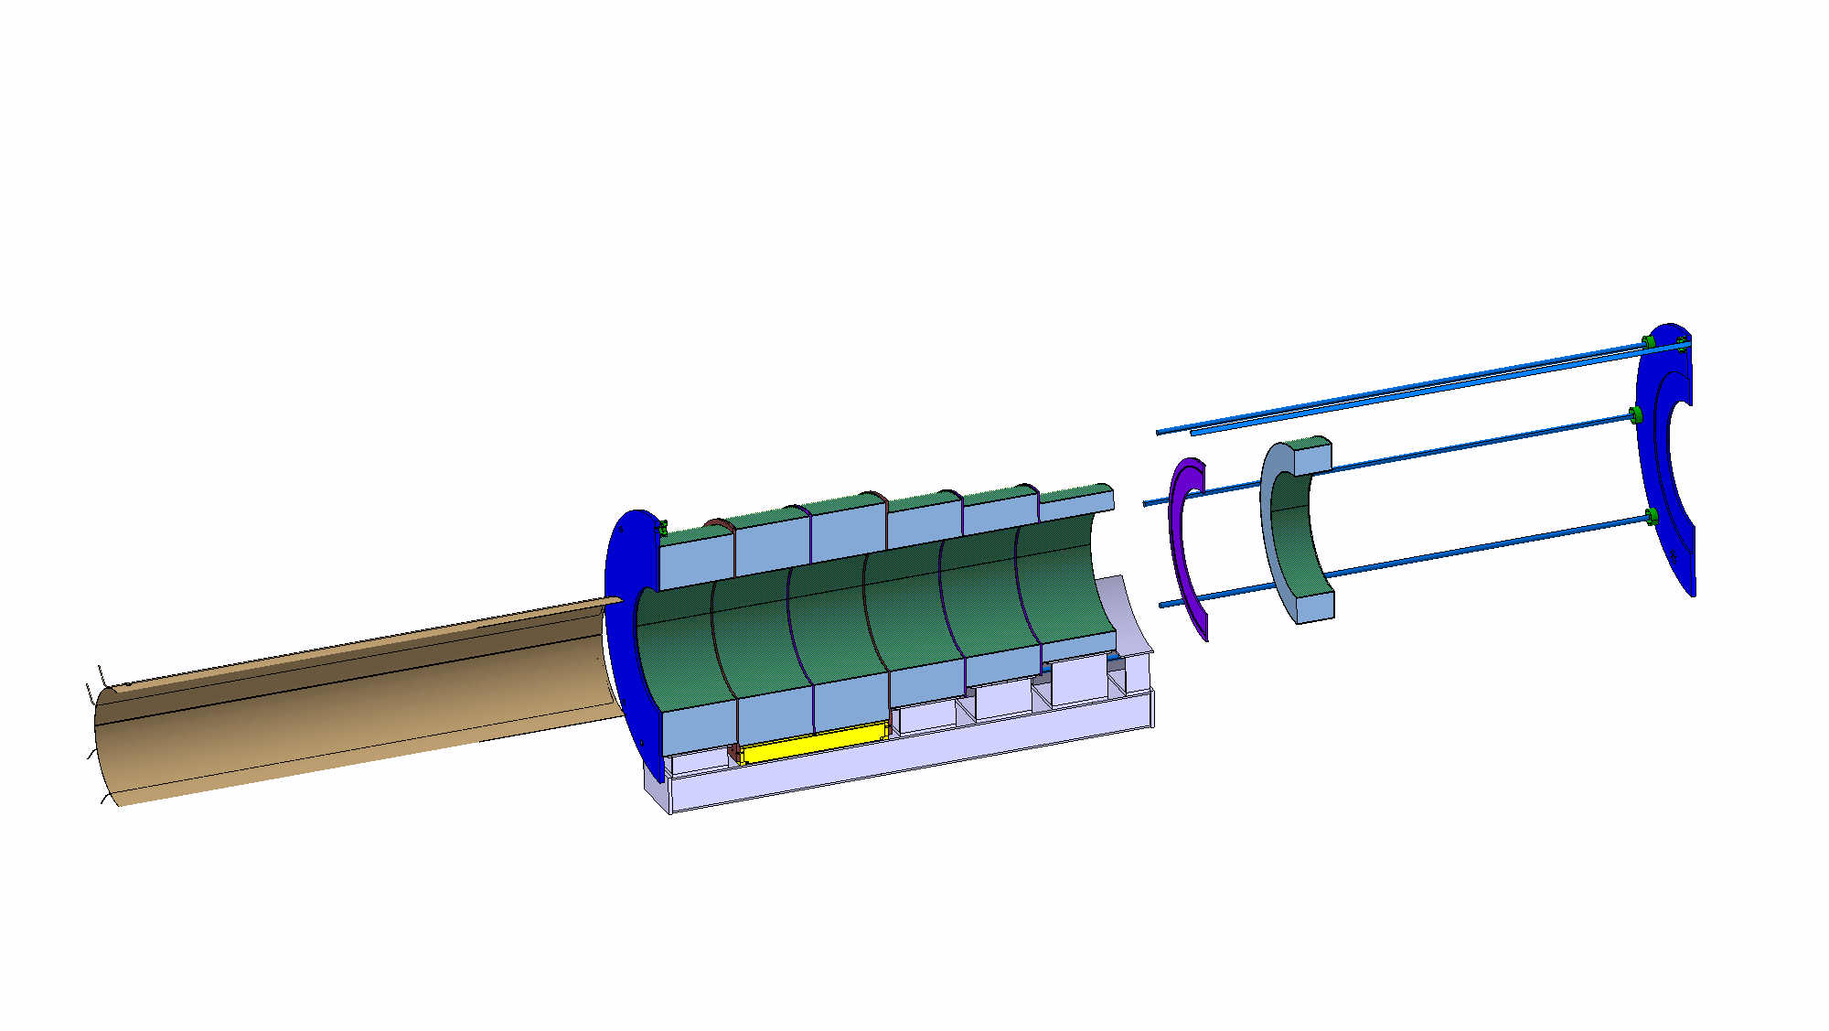
COLDMASS ASSEMBLY
2. Clamp coils together with the axial clamping system
3. Insert the internal thermal shield.
Temporary supports required.
1. Assemble coils on the common support beam with their respective supports. Place shims between coils
4. Install coil cooling lines and current leads, shown on the next slide

Slide 15
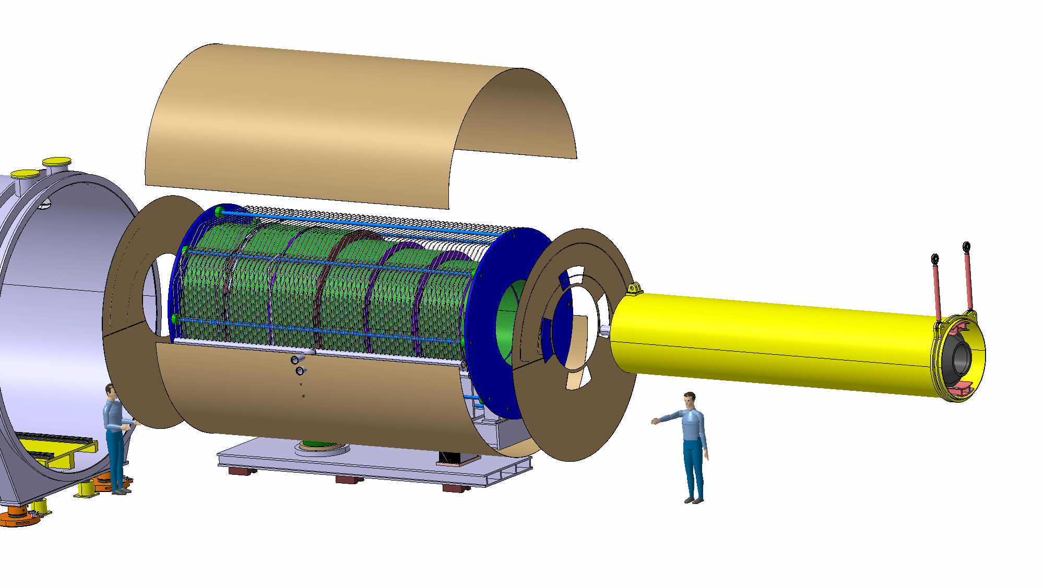
SHIELDS ASSEMBLY
3. Install remaining parts of the thermal screen. Internal thermal shield to be connected to the end plates
4. Insert tungsten shield. Tooling and temporary supports required
1. Lay coldmass on the cold supports and warm support platform
2. Install lower section of the thermal screen. Connect it to the cold supports

Slide 16
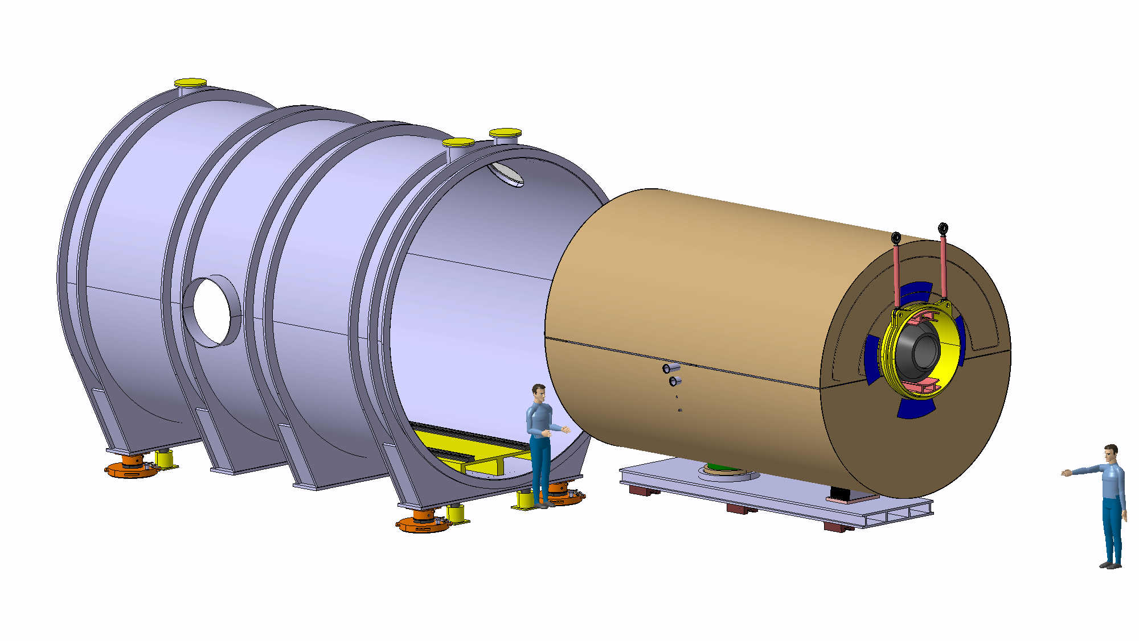
CRYOSTATING
3. Complete vacuum vessel front end, realize target connections etc.
2. Connect tungsten shield to the vacuum vessel with links. Remove temporary supports.
Full assembly ~ 170 T
Other sections can follow shown assembly sequence
Prepare sections as far as possible on surface?
  Tunnel work in parallel
  Large assemblies to transport
1. Install magnet assembly into the vacuum vessel with the linear guides. Fix the magnet assembly on the vacuum vessel
Tooling required

Slide 17
CONCLUSION
Coils updated, resulting radial build update done as well – limit for tungsten shield
A detailed coil winding available
Support system updated, boundary conditions in work, analysis work to be done
First lay-out for magnet cooling
Integration updated with satellite connections
Stray field studied
Assembly sequence proposal created
NEXT STEPS?

Slide 18
Thank you for your attention!
!/?
Your questions/remarks please

Slide 19
SPARE SLIDES

Slide 20
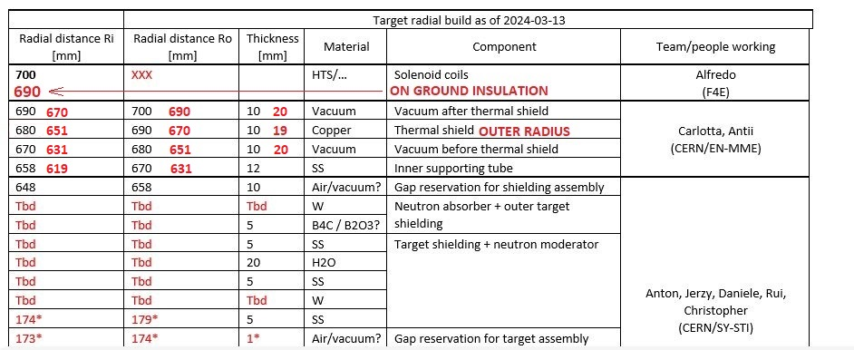
Radial build - VERSION 2

Slide 21
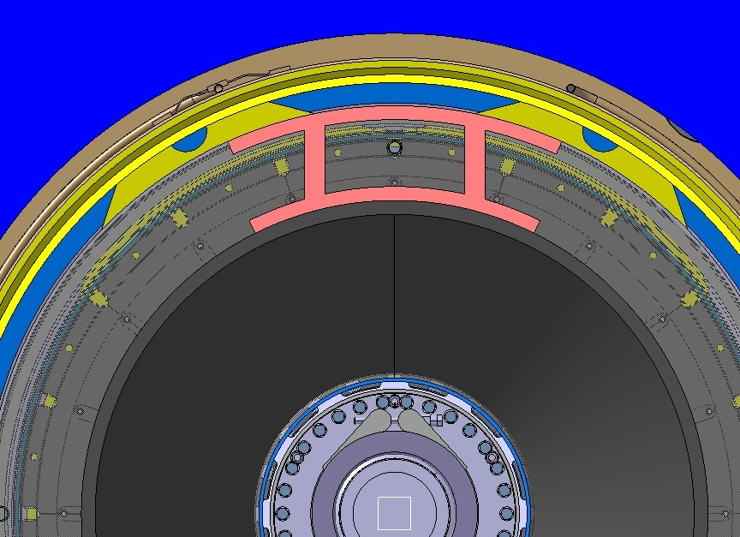
Radial build – VERSION 2
GAP 33 mm
VACUUM GAPS 20 mm
R619

Slide 22
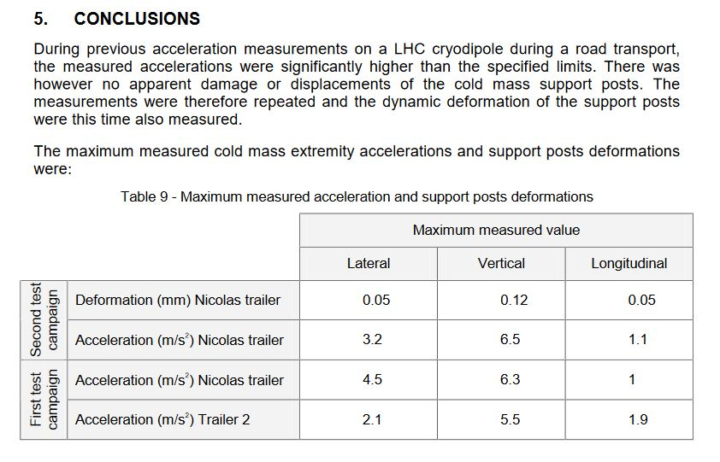
ACCELERATIONS DURING TRANSPORT
https://edms.cern.ch/document/350433/1.0

