Slide 1


Slide 2
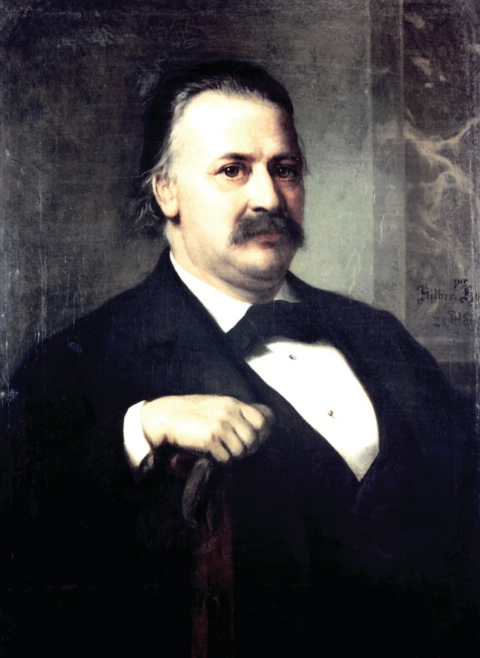
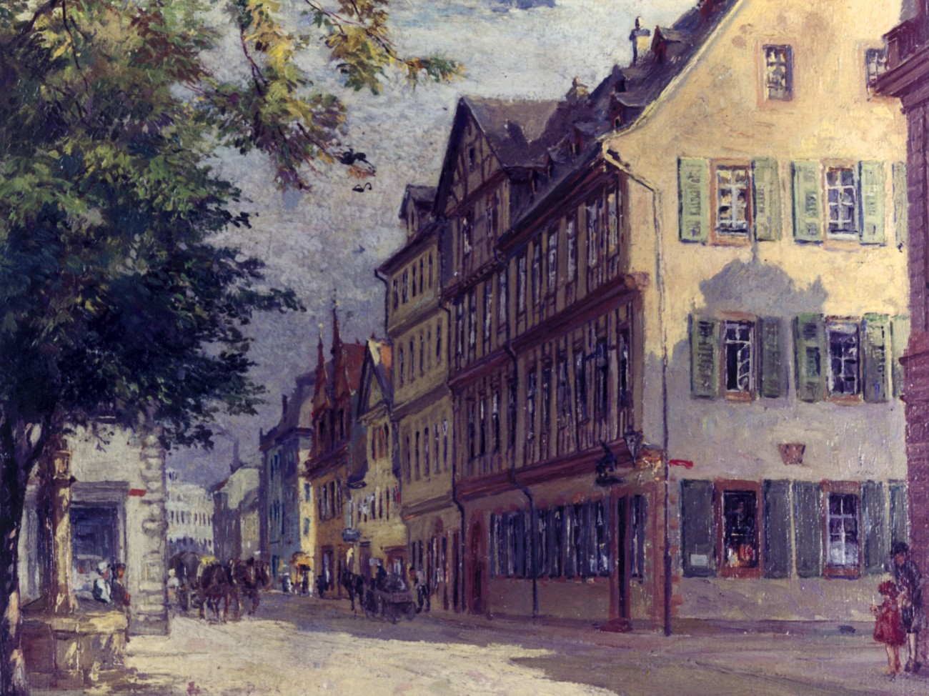
1851: Wilhelm Carl Heraeus in Hanau
1856: Melting of Platinum
1899: Void-free Quartz Glass

Slide 3
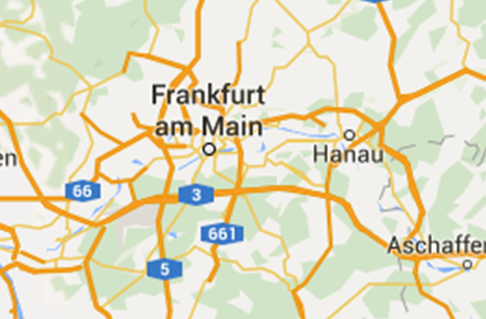
1851: Wilhelm Carl Heraeus in Hanau
1856: Melting of Platinum
1899: Void-free Quartz Glass

Slide 4
Wilhelm Heinrich Heraeus
born 1900
studied physics
completed his PhD in physics
in 1923 @ University Frankfurt

Slide 5
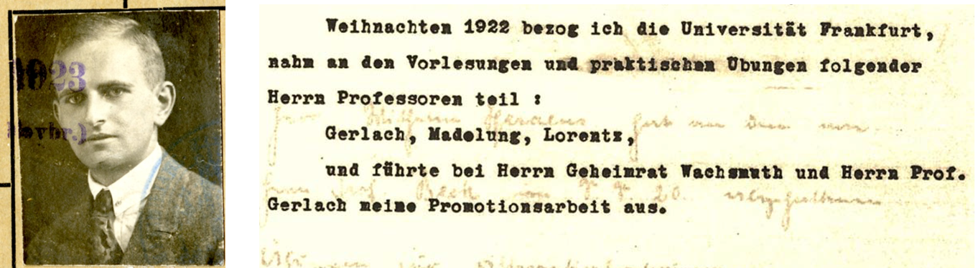
Wilhelm Heinrich Heraeus
born 1900
studied physics
completed his PhD in physics
in 1923 @ University Frankfurt

Slide 6
Wilhelm Heinrich Heraeus
born 1900
studied physics
completed his PhD in physics
in 1923 @ University Frankfurt
entered the company that his grandfather
had founded in 1851 in Hanau (still one of
the top-10 family owned companies in Germany),
where he spent his career as manager and entrepreneur
established, together with his wife Else, the WE-Heraeus-Foundation in 1963
after they passed away in the 1980ies, their company shares were transferred into the property of the foundation

Slide 7
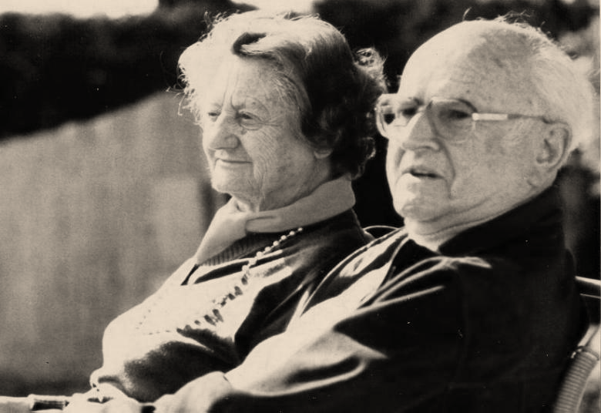
Else Heraeus
and
Dr. Wilhelm
Heinrich Heraeus

Slide 8
Purpose
Support of research and education in science, with emphasis on physics, by
funding school activities (e.g. school labs)
funding teacher training courses
supporting physics students (e.g. travel support to meetings of the German Physical Society - DPG)
organizing/funding scientific communication:
WE-Heraeus Seminars, Summer Schools, Research Retreats
cooperation with other non-profit institutions
(especially DPG)
awarding seniorprofessorships
special projects, prizes, etc.

Slide 9
Heraeus Group
globally active group
14.000 employees (approx. 5.300 in Germany)
revenues 2022: approx. 29 billion €
one of the top 10 family-owned companies in Germany
includes businesses in the environmental, electronics, health and industrial applications sectors

Slide 10
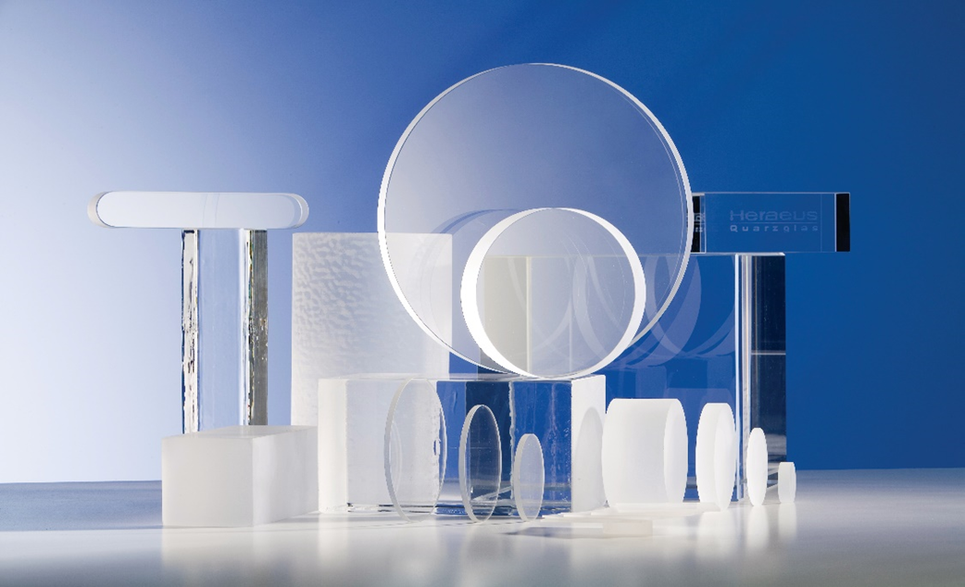

Slide 11
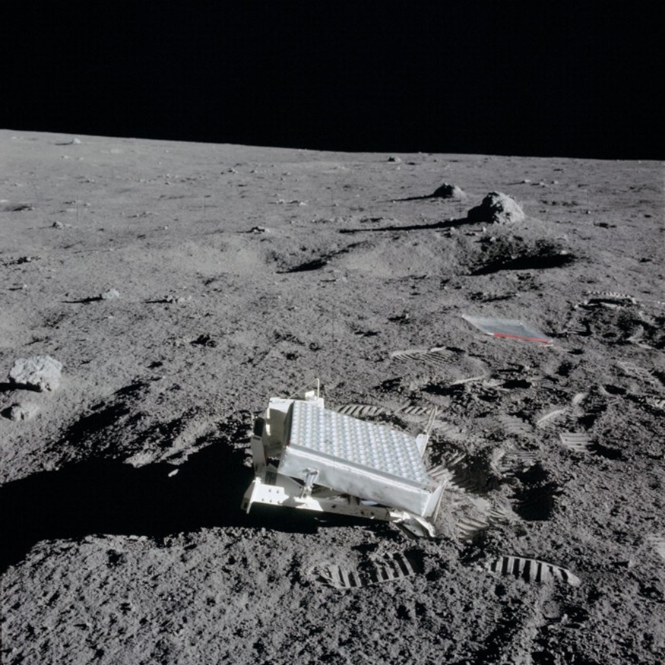

Slide 12
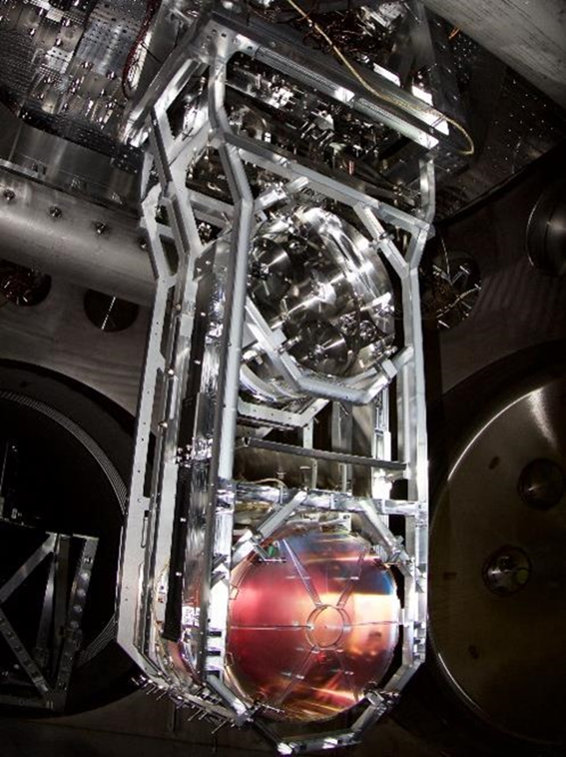

Slide 13


Slide 14
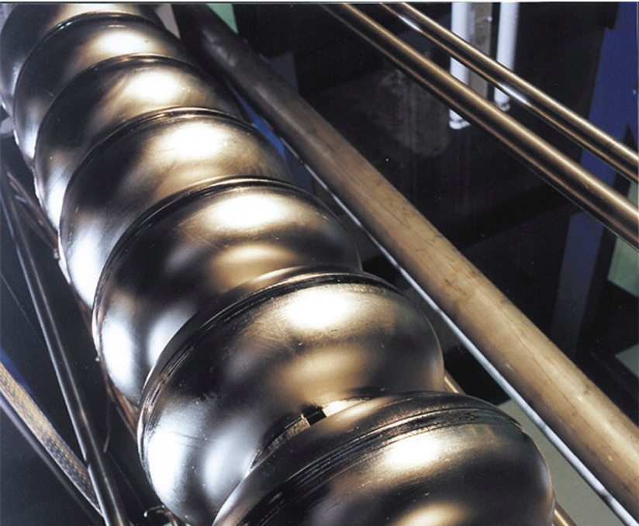

Slide 15
Scientific Communication
WE Heraeus Seminars
since 1975: > 800 / > 50.000 participants
WE Heraeus Physics Schools
since 1989: approx. 400, mainly on topics not yet covered in textbooks; recently also outside Germany → Karpacz!
WE Heraeus Research Group Retreats
since 2014, at i.e. mountain huts, with ample time to discuss about physics, embedded in social activities
Binational WE Heraeus Seminars
since 2019, foster existing cooperation or initiate new one between physicists in Germany and a partner country worldwide

Slide 16
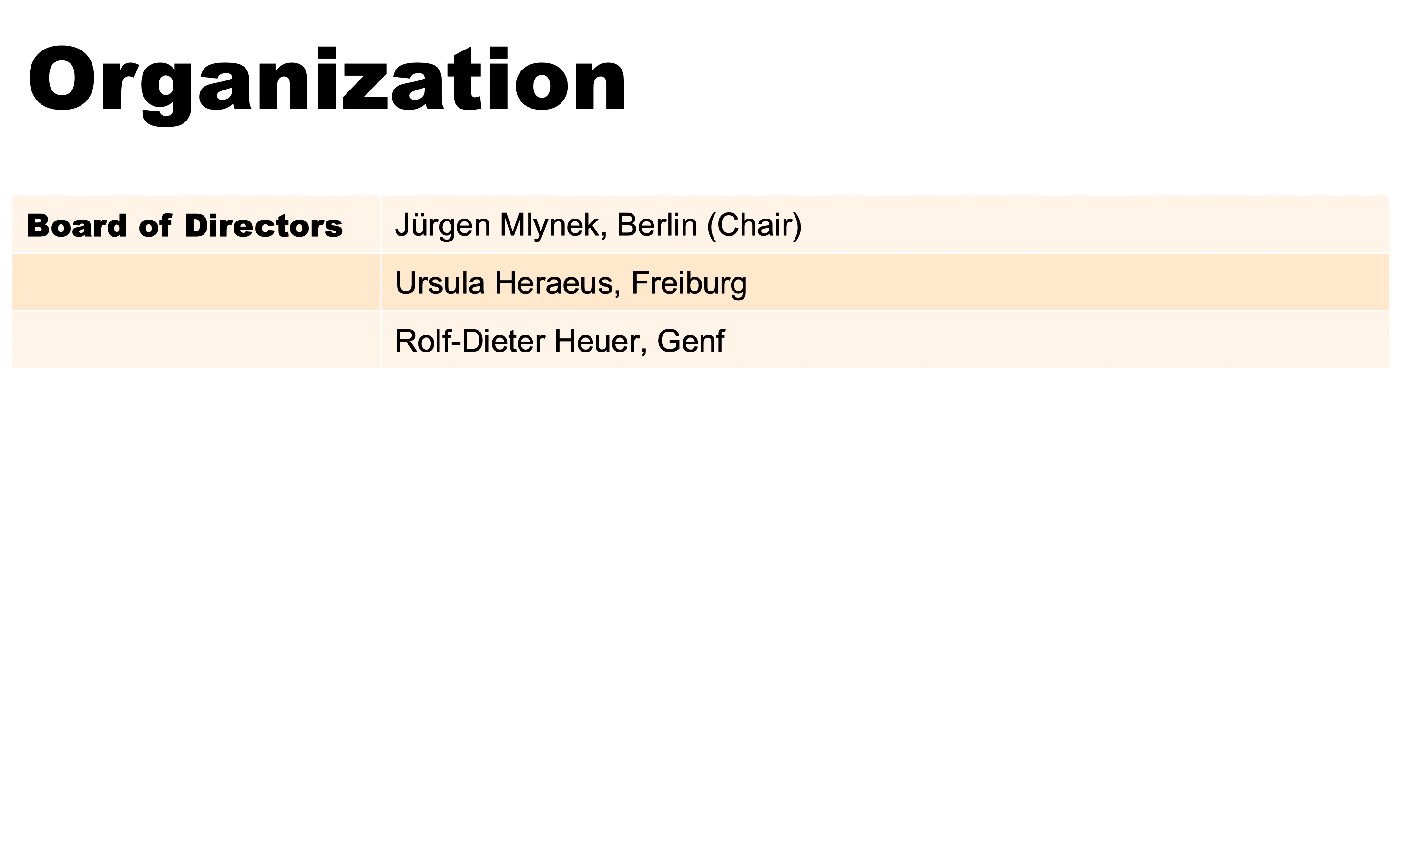

Slide 17
Organization
Scient. Advisory Board | Klaus Blaum, MPI for Nuclear Physics, Heidelberg
 | Klaus Dieterich, Stuttgart
 | Katharina Kohse-Höinghaus, Universität Bielefeld
 | Dieter Meschede, Universität Bonn, ex officio for DPG
 | Heike Riel, IBM Zürich
 | Wolfgang Schleich, Universität Ulm
 | Johanna Stachel, Universität Heidelberg
 | Claudia Steinem, Universität Göttingen
 | Matthias Steinmetz, Leibniz Institute for Astrophysics, Potsdam
 | Metin Tolan, Universität Dortmund
 | Roser Valentí, Universität Frankfurt
 | Michael Winkhaus, Fuhlrott-Gymnasium Wuppertal
Office | Stefan Jorda
 | Martina Albert, Jutta Lang, Elisabeth Nowotka, Mojca Peklaj

Slide 18
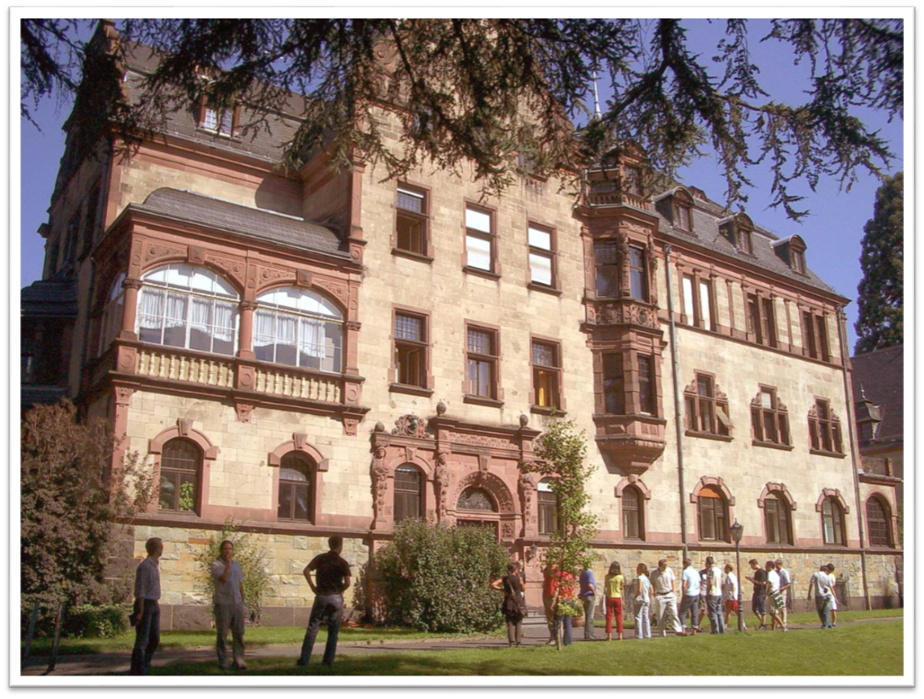
Preferred Venue
Physikzentrum Bad Honnef (near Bonn)

Slide 19
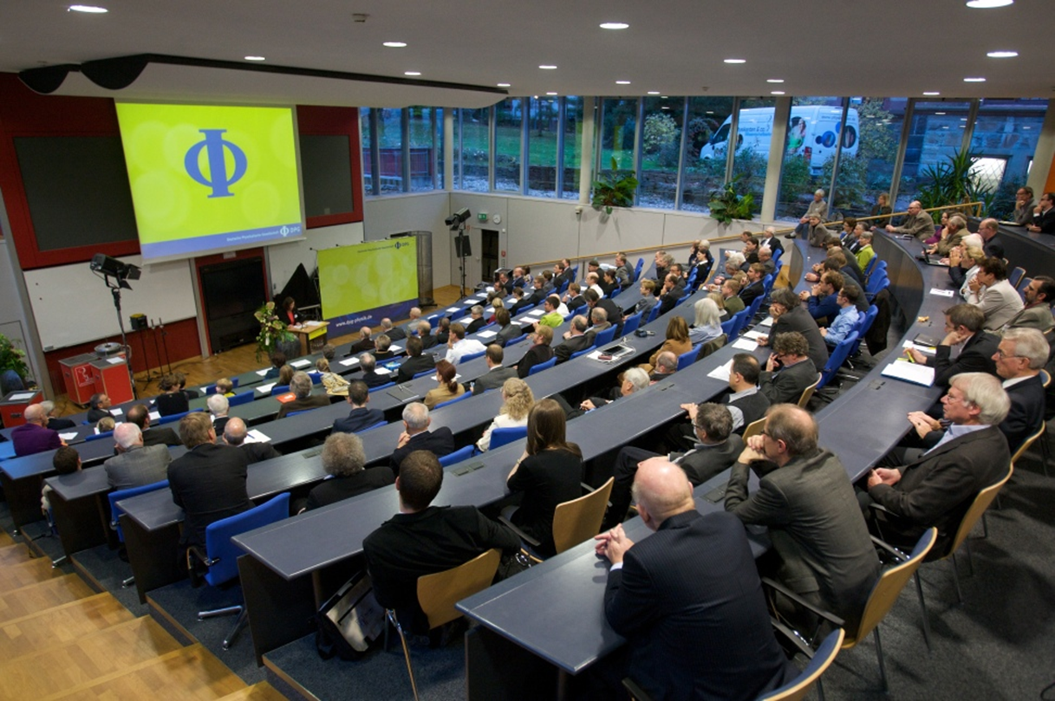
Preferred Venue
Physikzentrum Bad Honnef (near Bonn)

Slide 20
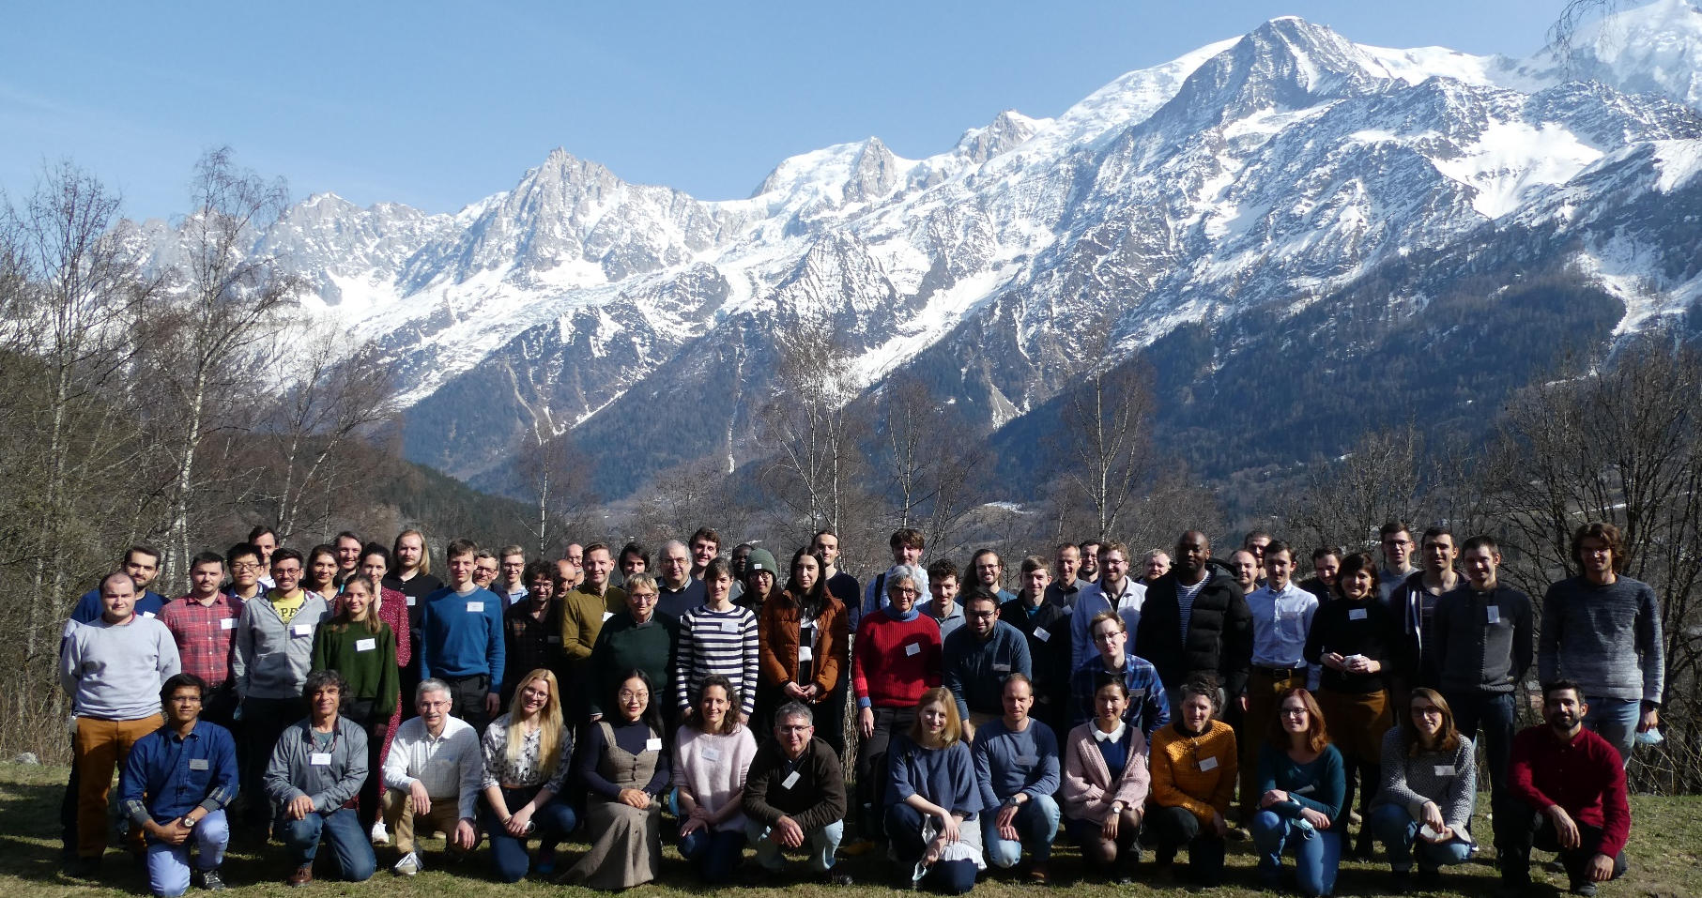
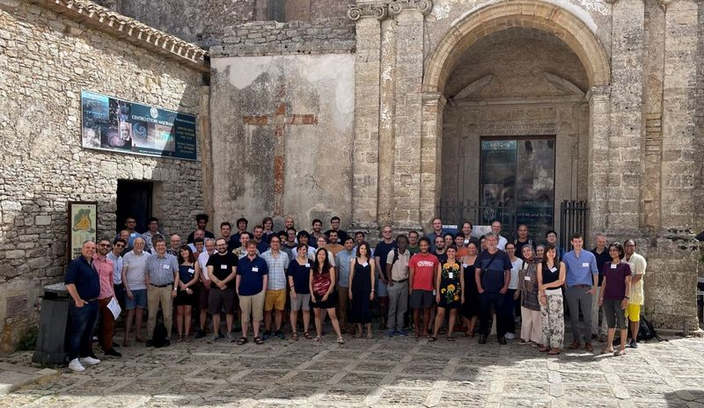
École de Physique @
Les Houches
Ettore Majorana Foundation
@ Erice
School of Physics „Enrico
Fermi“ @ Varenna
Institut d'Études
Scientifiques @ Cargèse

Slide 21
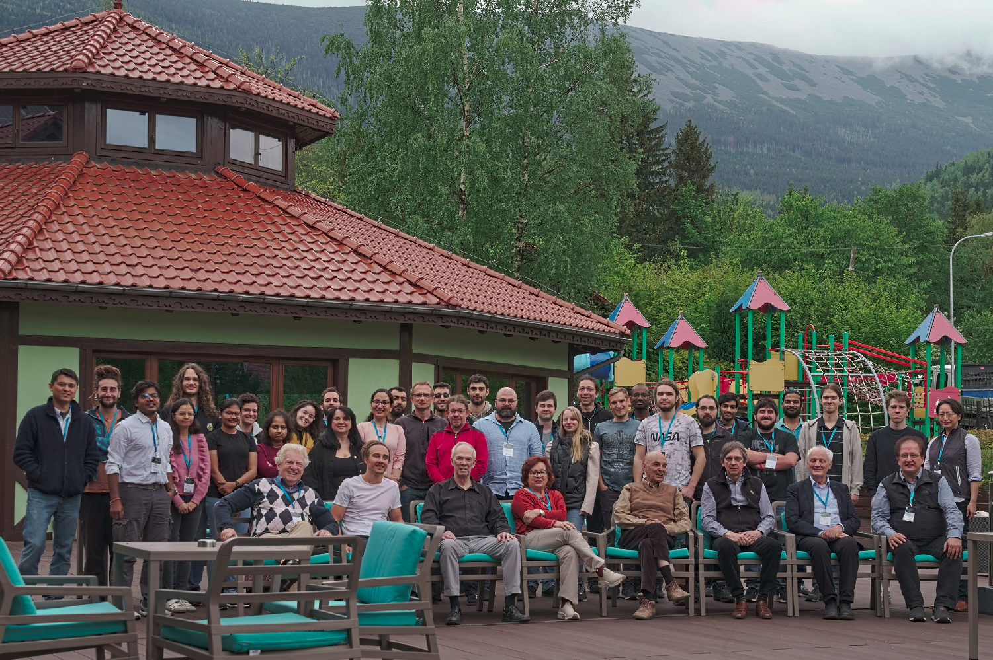
Winter School on Theoretical Physics @ Karpacz

Slide 22
Binational WE Heraeus Seminars
Initiate new or foster existing collaborations between research groups in Germany and another country (worldwide)
Scientists from Germany and the partner country can submit a joint proposal
Seminars can take place either in Germany or partner country
First ones with France, UK and Poland

Slide 23
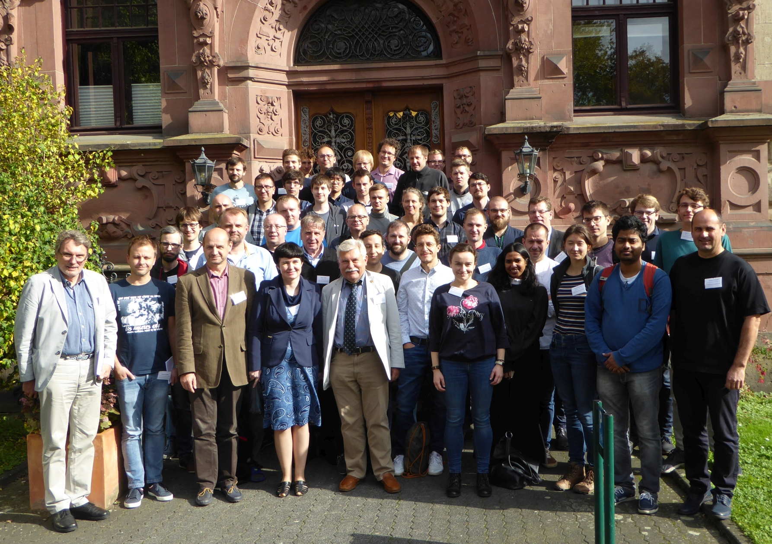

Slide 24
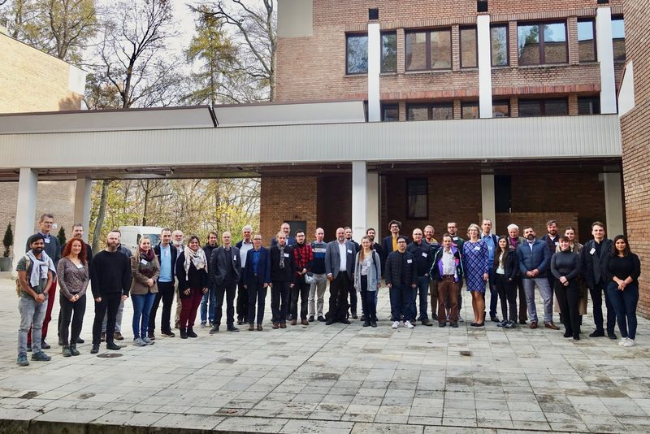

Slide 25
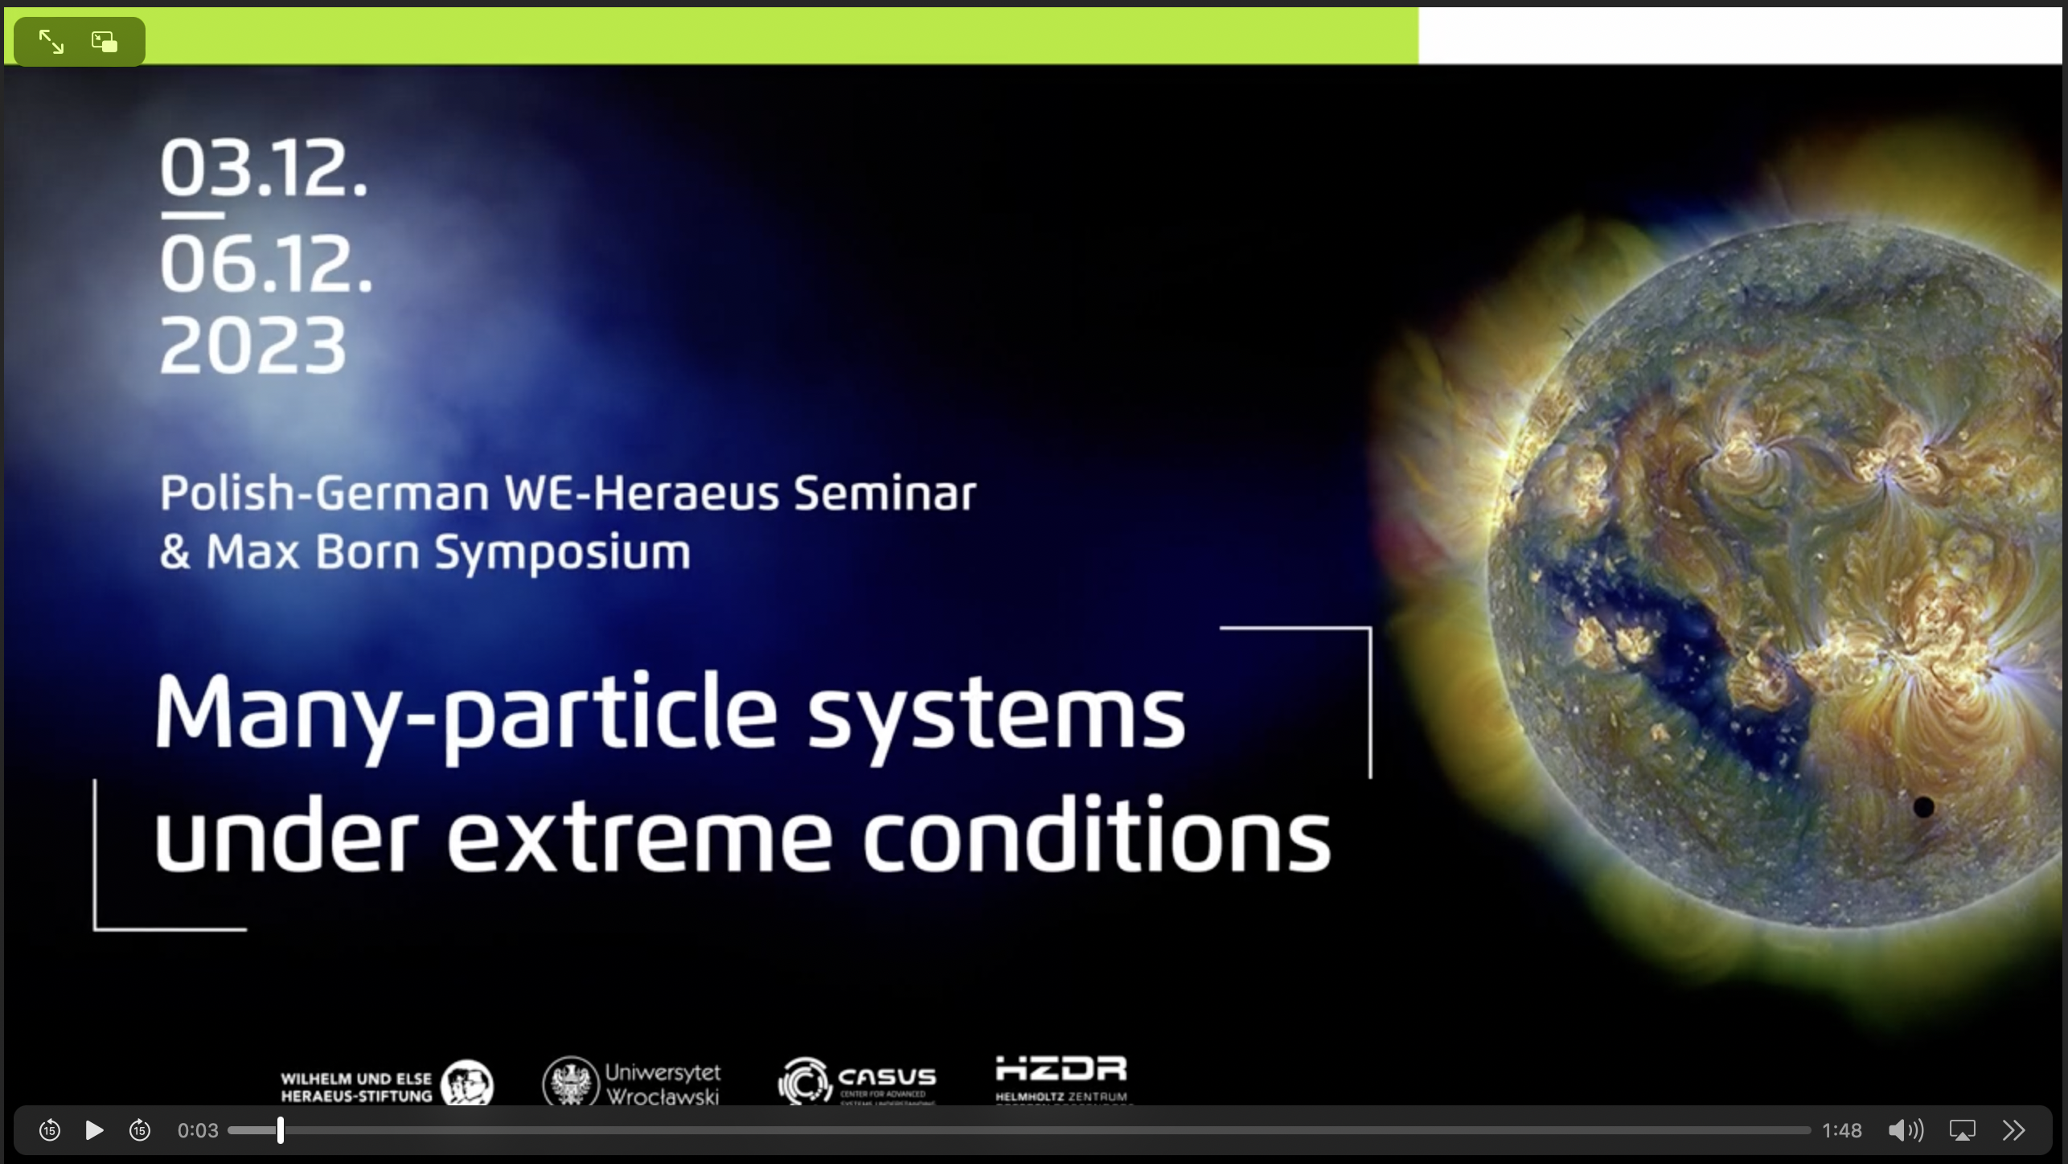
Polish-German WE Heraeus Seminar in Görlitz, Dec. 2023

Slide 26
Education
Financial support for exemplary projects designed to improve physics teaching at schools

Slide 27
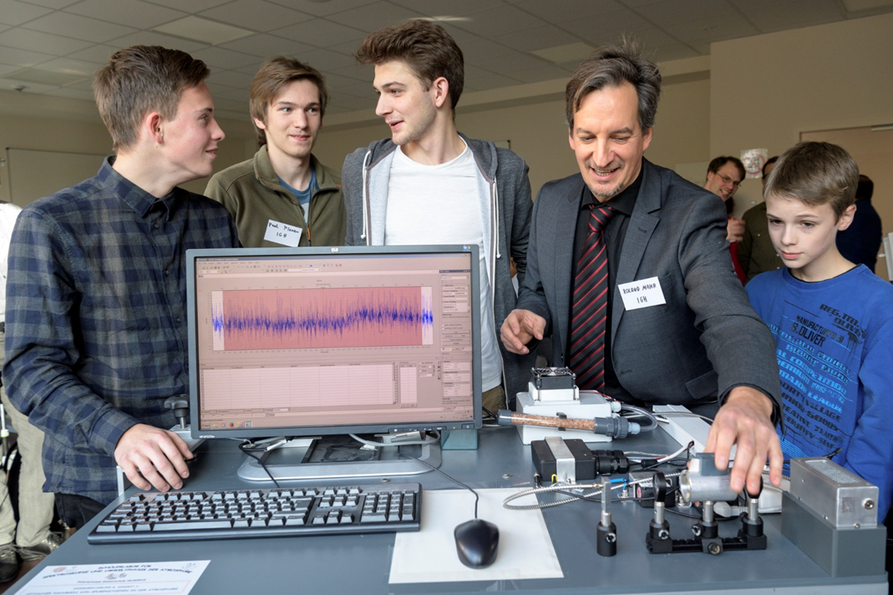
Education

Slide 28
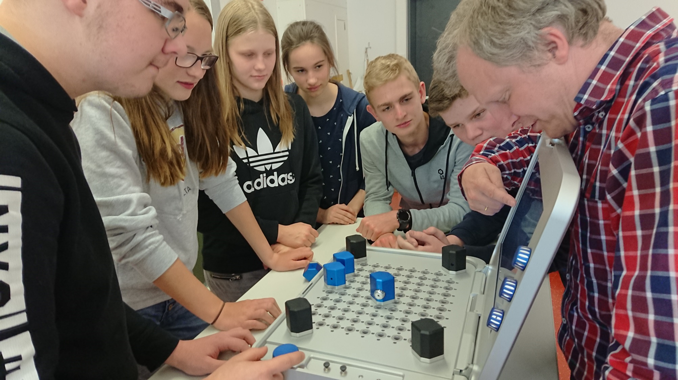
Education

Slide 29
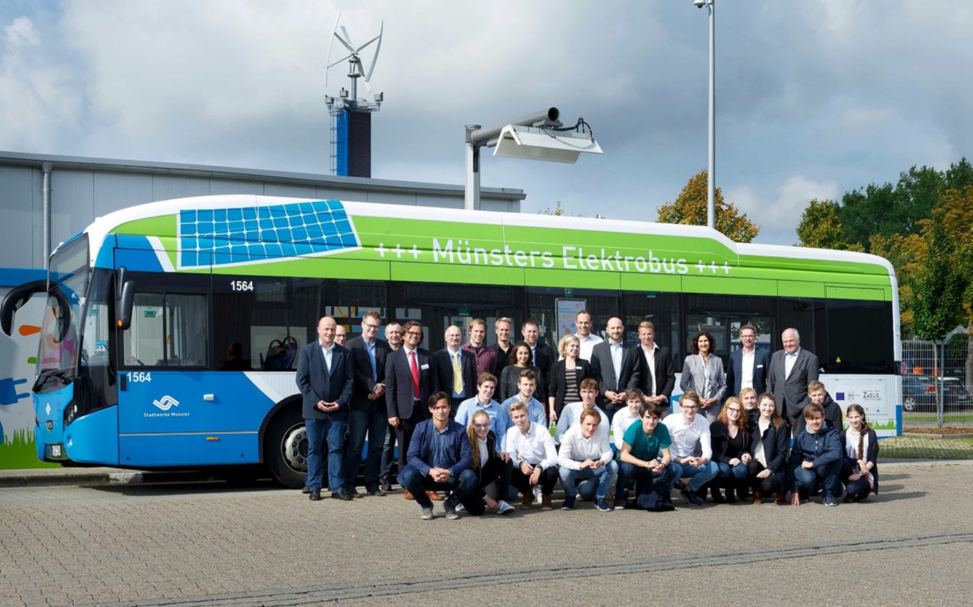
Education

Slide 30
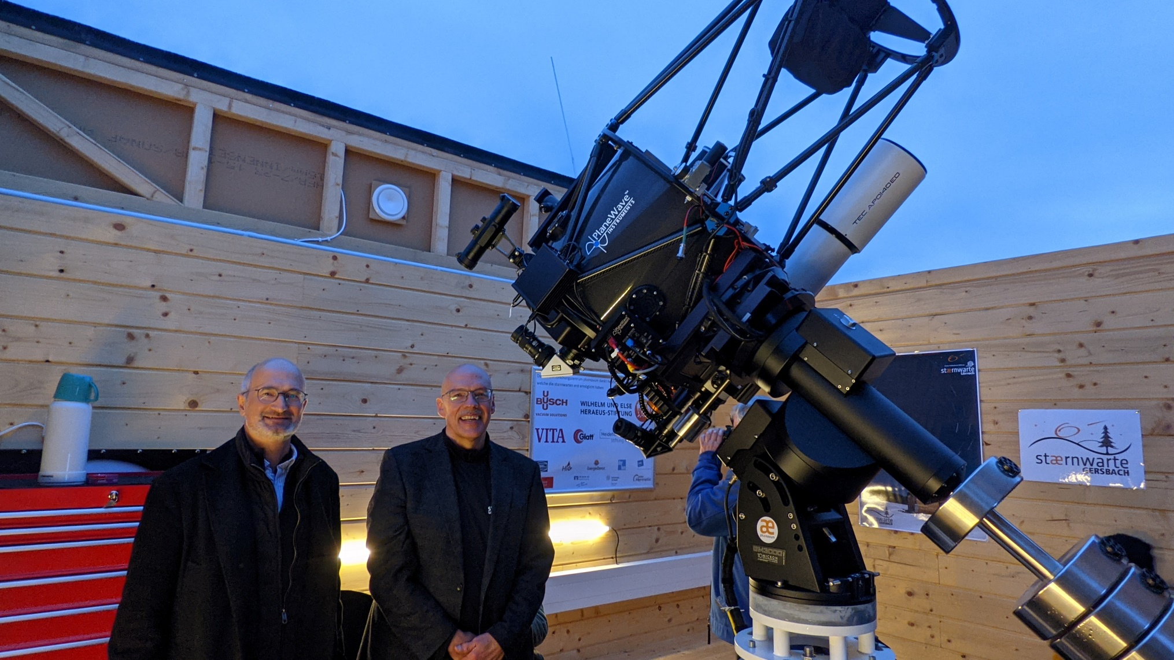
Education

Slide 31
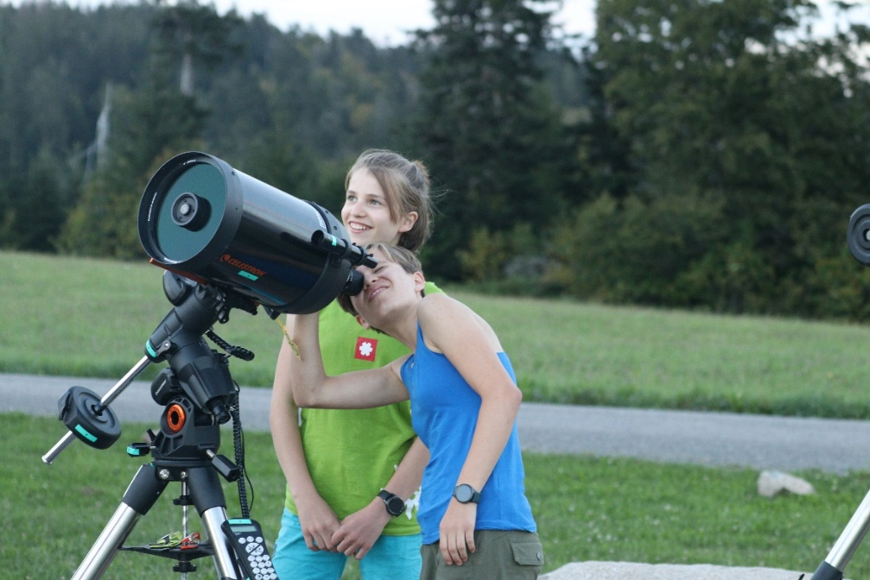
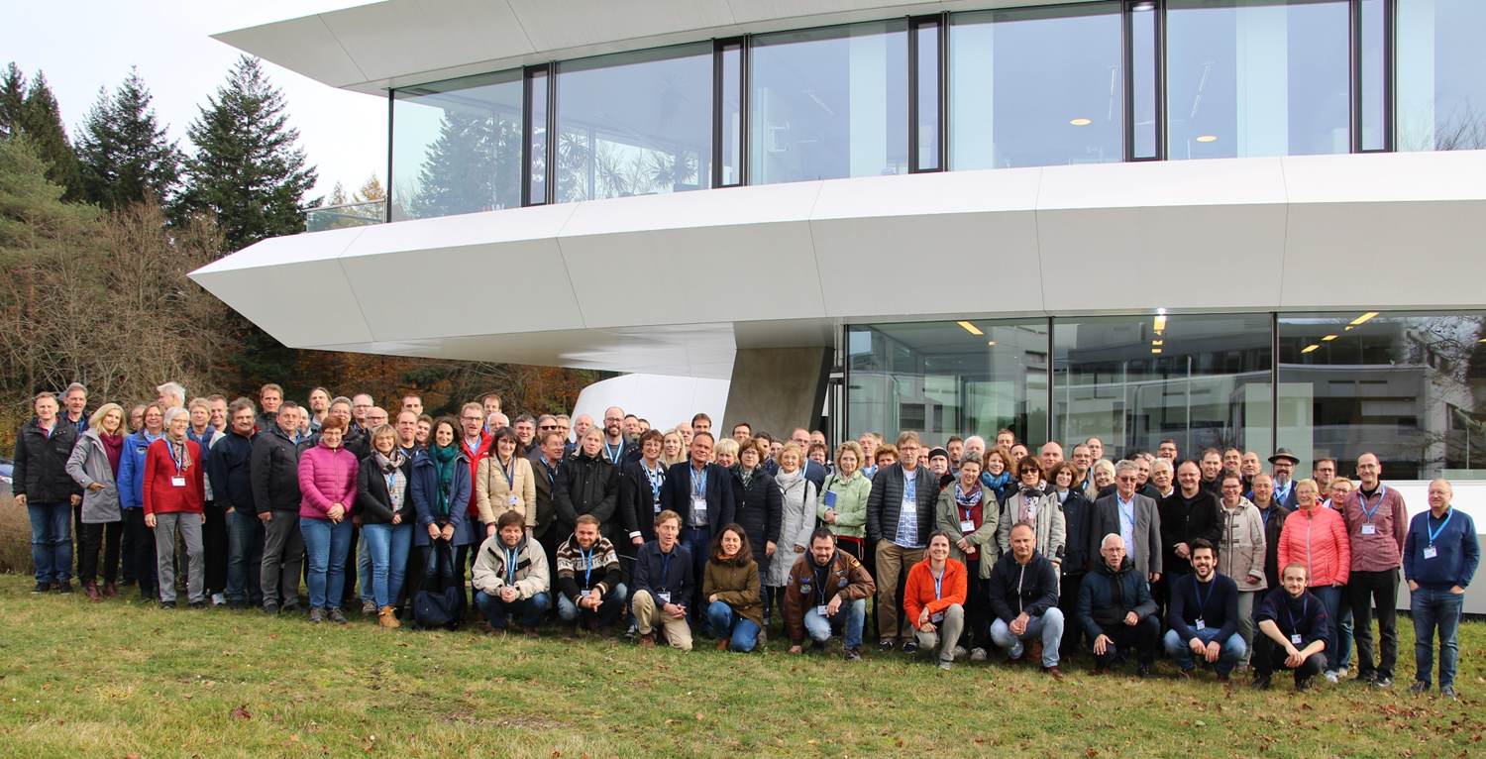
Education
Many activities related to e.g. Astronomy: school observatories, teacher training courses in Astronomy

Slide 32
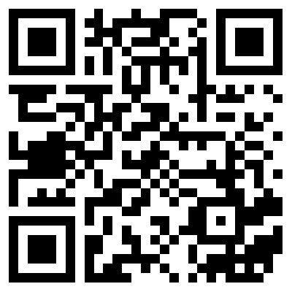
Further information

