Slide 1
Candidate Filtering:
A Guide to Daxtra

Slide 2

Summary
Access the Daxtra Tool
Initiating a Candidate Search
Reviewing Candidate Profiles
Sharing Candidate Profiles
Searching for Candidates from a Job

Slide 3
Access the Daxtra Tool

Slide 4

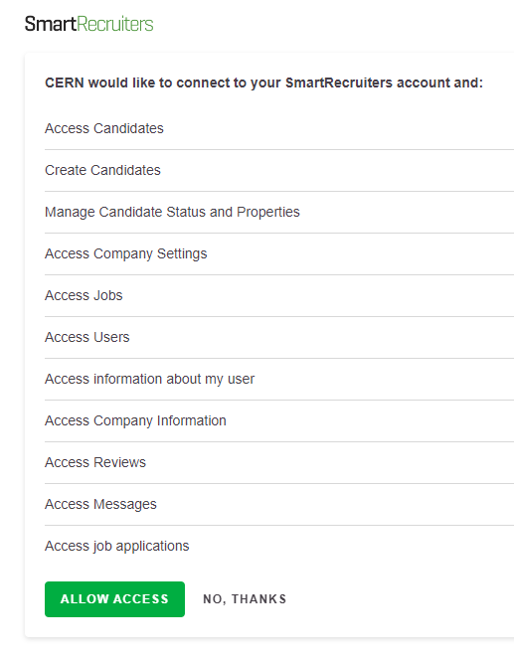
Go to SmartRecruiters.
In the main menu, locate the Daxtra button.
Simply click on it to launch the sourcing tool.
You will need to quickly accept the terms and conditions.

Slide 5
Initiating a Candidate Search

Slide 6
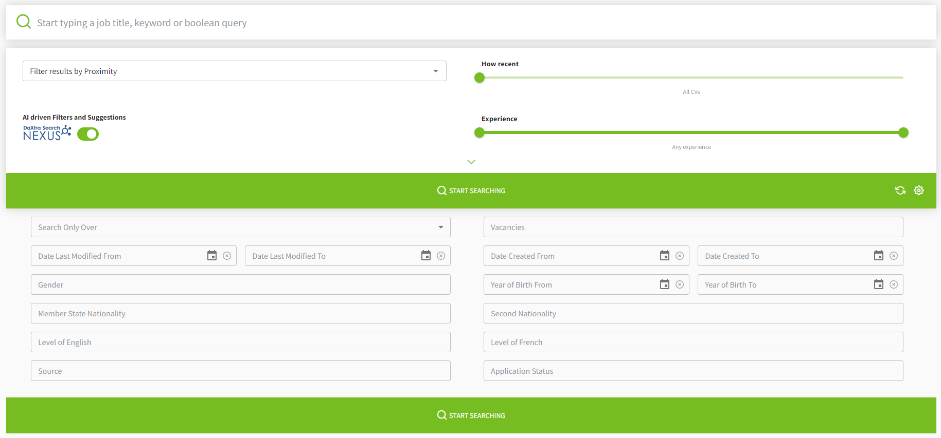
The search tool is divided into 3 main parts:
The main search bar.
Filters for Candidate and CV seniority.
Advanced filters, including diversity criteria.

Slide 7
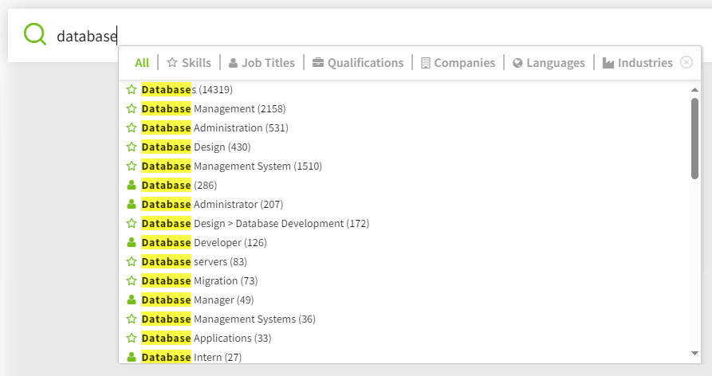
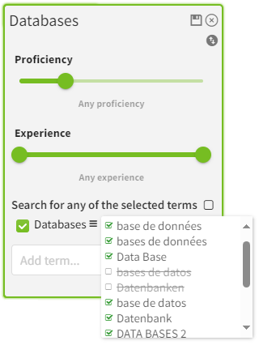
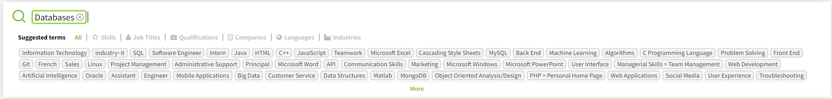
The search bar:
Use keywords (skills, technologies, ...).
Proposals will be displayed.
If necessary, fine-tune the use of this keyword in the search.
Upon selecting your keyword, related terms will also be suggested.

Slide 8
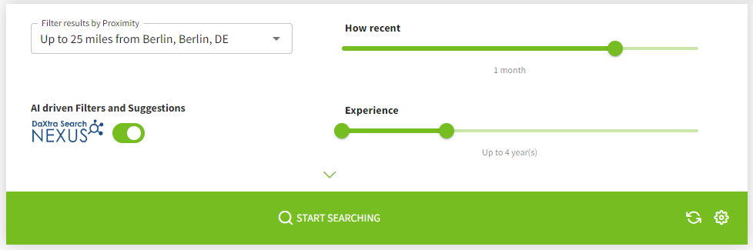
Filters for Candidate and CV seniority
Choose a specific city or postcode, if needed.
Specify the preferred CV age.
Specify the desired candidate experience.

Slide 9
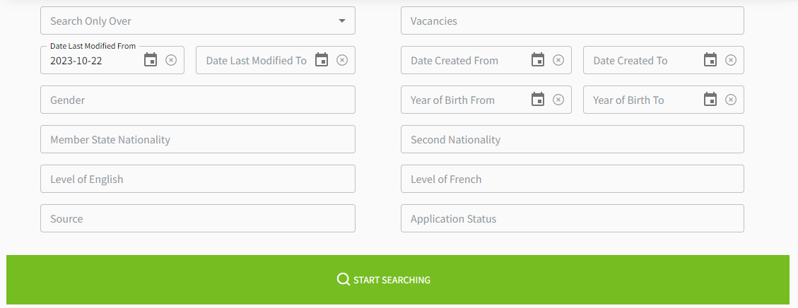
Advanced filters, including diversity criteria
Filter by job vacancy.
Filter by diversity criteria.
Filter by application status.

Slide 10
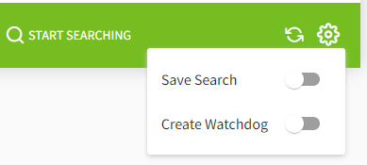
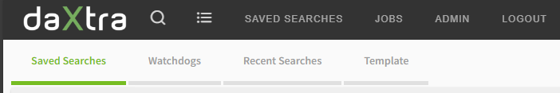
Save your search or create a watchdog:
Choose the backup type.
It will be saved below the main menu.

Slide 11
Reviewing Candidate Profiles

Slide 12
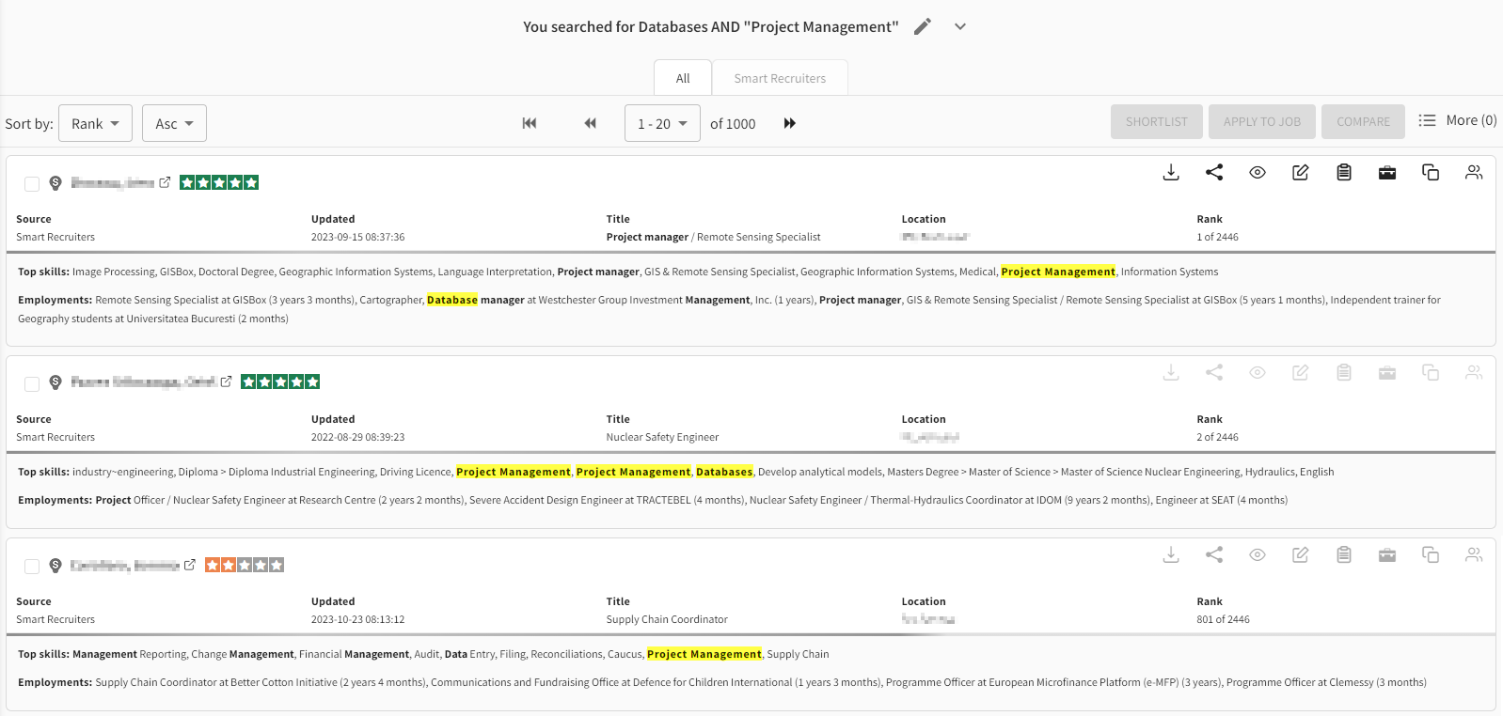
Search candidate list based on key words:
Brief summary for each candidate, highlighting top skills and employment history.
Search key words extracted from candidate profiles.
Relevance score of the candidate for the search.

Slide 13
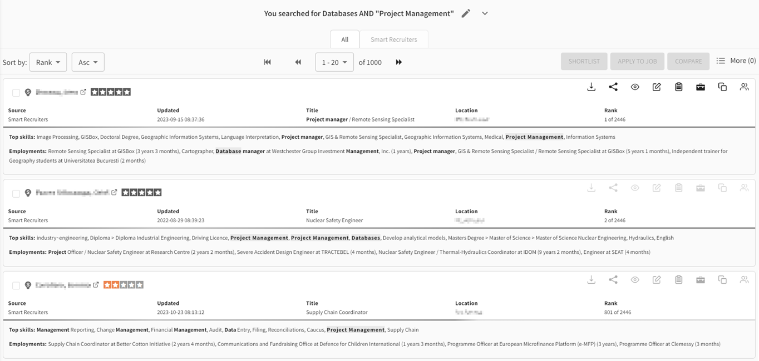
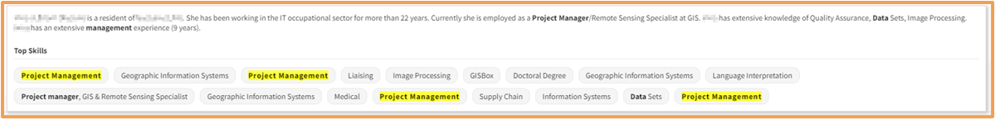

Short overview with some features from the search candidate list:
Hover the mouse over the name to view a brief overview of the candidate's career.
Hover the mouse over the score to access details based on your search keywords.

Slide 14
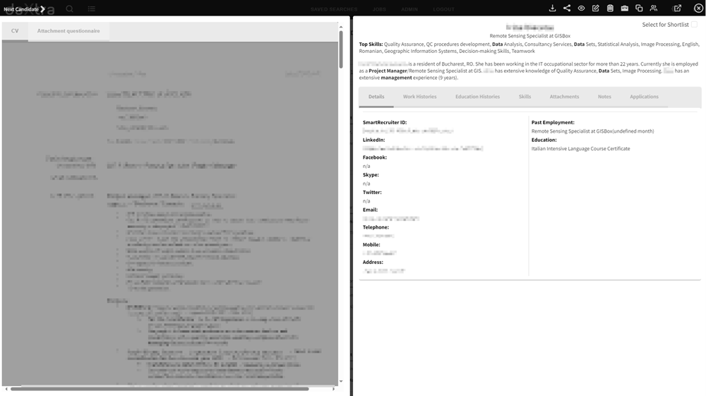
Candidate profile view within Daxtra:
Brief summary of the candidate.
Overview of CV and Job Screening Questions.
Extracted information from the candidate's career background, including experience, education, and skills; contact details and information from SmartRecruiters, such as attachments, notes, and applications.

Slide 15

On the top right, you have a tool bar:
Download the profile (don’t forget GDPR rules).
Share the profile with another SmartRecruiters user.
View the profile within SmartRecruiters.
Add a note within SmartRecruiters.
Smart options to match this profile with a vacancy or with other similar profiles.
Open the profile in a new tab.

Slide 16
Sharing Candidate Profiles

Slide 17
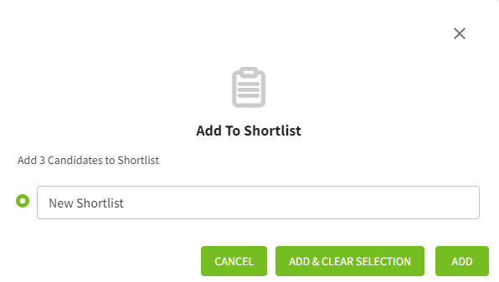

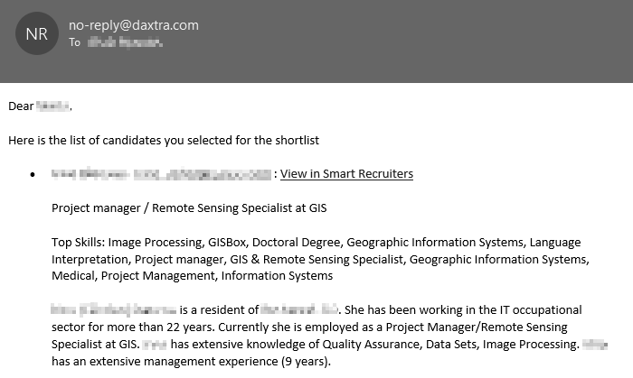
Add just one candidate to your shortlist:
Add the profile to your short-list.
Subsequently, you will receive an email with the candidate summary, which you can then forward to your HR-TA partner.

Slide 18
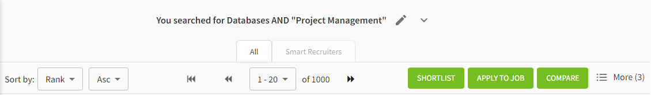
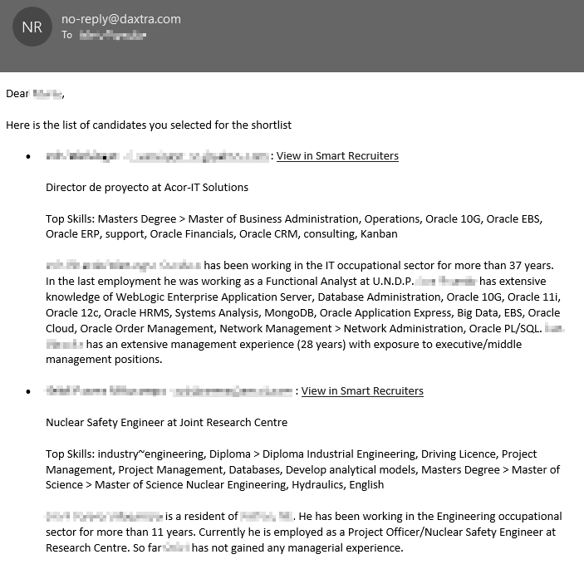
Add bulked candidates to your shortlist
Tick the profile you want to add.
Add these profiles to your short-list on the result page of your search.
Then, you will receive an email with candidate’s summaries that you can forward to your HR-TA partner.

Slide 19
Searching for Candidates from a Job

Slide 20
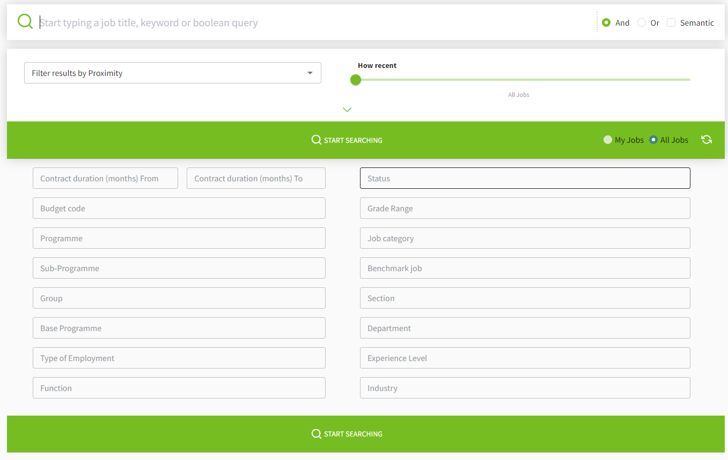
Specific tab to search by type of jobs/vacancies:
The main search bar.
Filters on job history.
Advanced filters about position (programmes, BMJ, …).

Slide 21
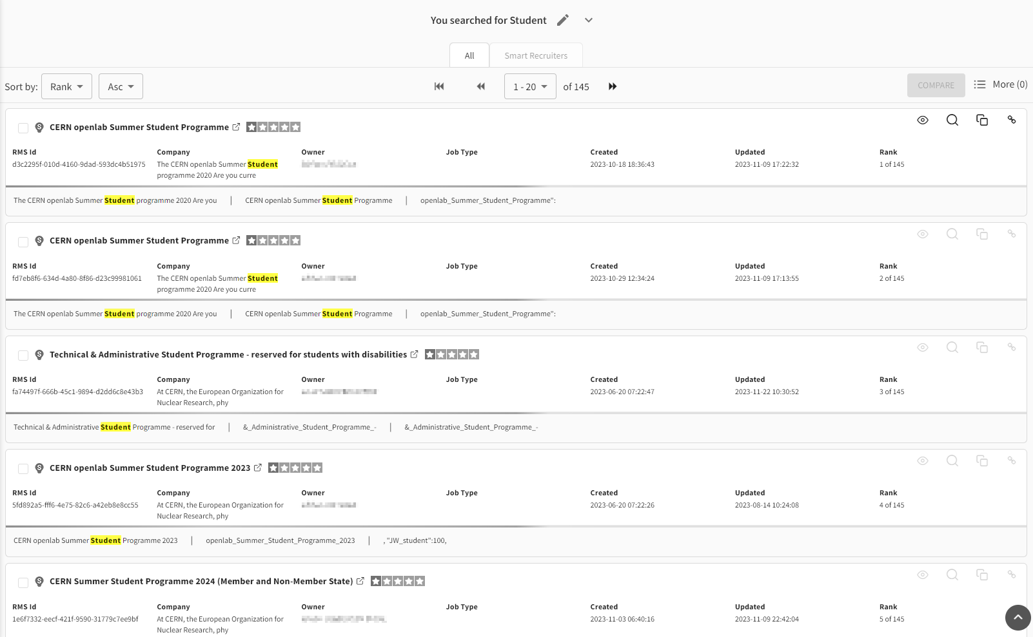
Similar overview as for candidates but with vacancies
Search key words extracted from candidate profiles.

Slide 22
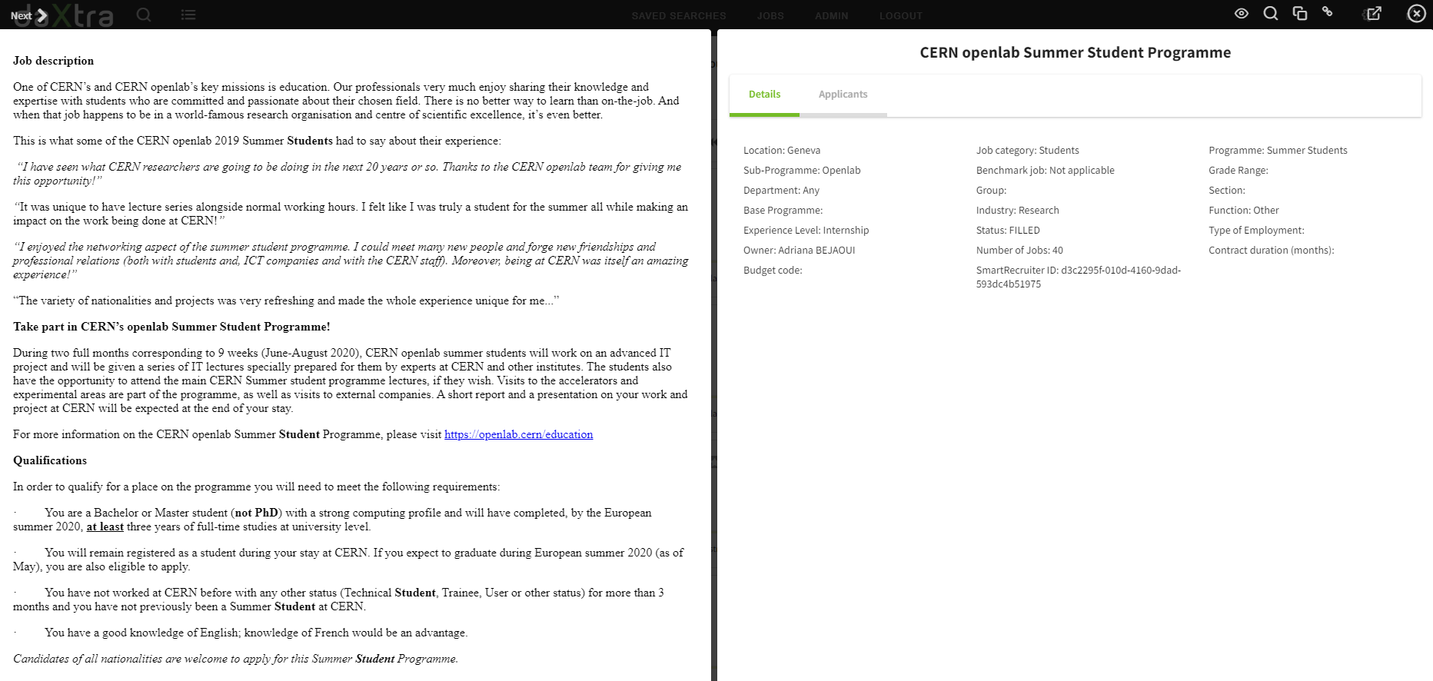

Switch between job details and candidates who applied to this position.
Job view within Daxtra, and its toolbar on top right:
Job advertisement.
View the job within SmartRecruiters.
Add a note within SmartRecruiters.
Smart options to add the criteria of this job in the search tool for candidates.
Open the vacancy in a new tab.

