Slide 1
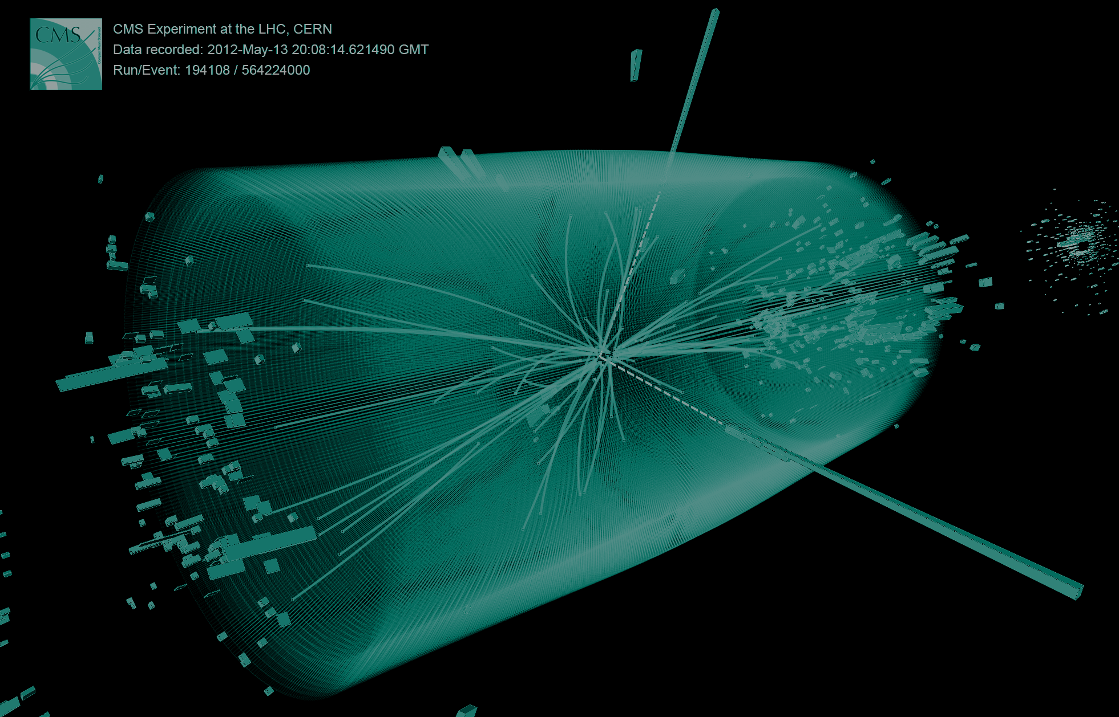


Search for long living bosons as candidates for dark matter in CMS
Workshop on medical and high energy physics at Sonora
22 May 2024

Slide 2
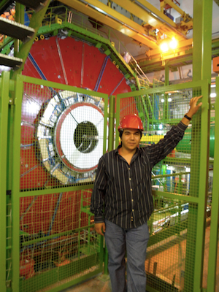
Dr. Alfredo Castaneda
Physics professor at Universidad de Sonora
Member of CMS collaboration
Search for BSM physics
Simulations for new detector technologies
Integration of AI algorithms in CMS experiment
Contacto: castaned@cern.ch
alfredo.castaneda@unison.mx
web: https://unison-cms.web

Slide 3
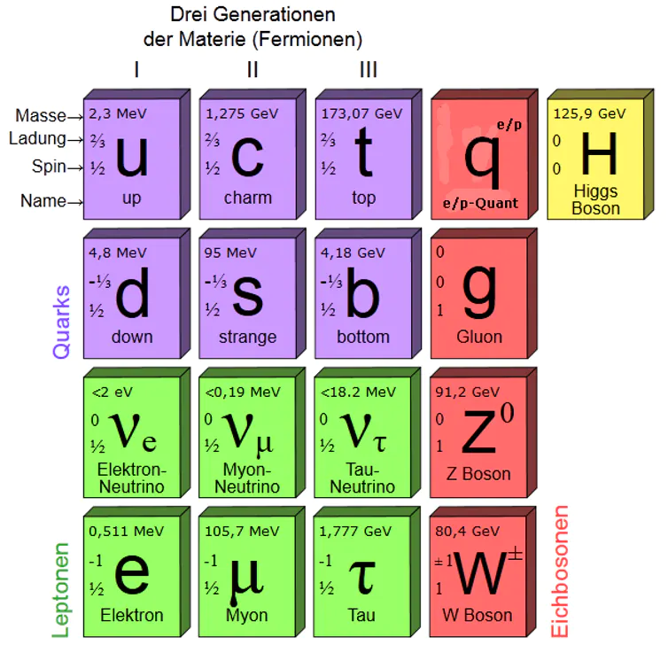
The Standard Model
Most precise model that describe interaction between elementary particles
It does not explain for instance:
  Dark matter
  Dark energy
  Matter-antimatter asymmetry

Slide 4
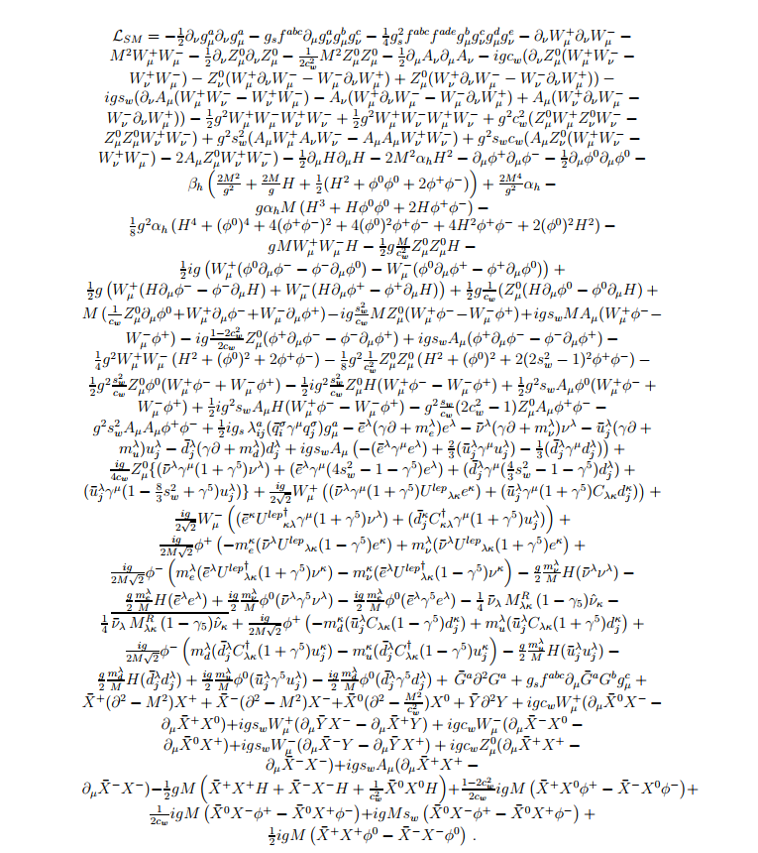
We have a mathematical representations of the SM
Lagrangians that describe interaction between particles and forces
New physics models should follow similar approach to describe interaction of new particles

Slide 5
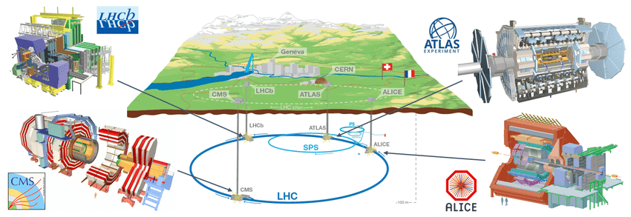
Large Hadron Collider
Most powerful particle accelerator (up to date)
Four main experiments
ATLAS and CMS multi-purpose experiments

Slide 6
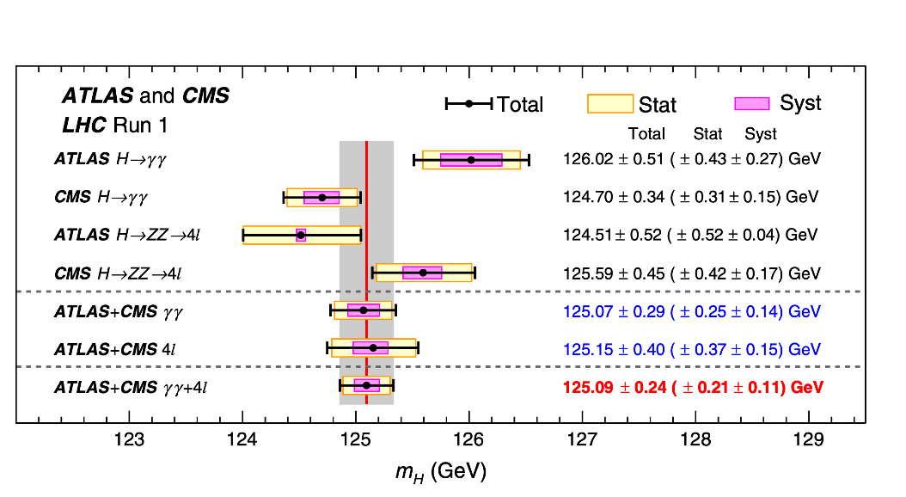
Compatibility with SM

Slide 7
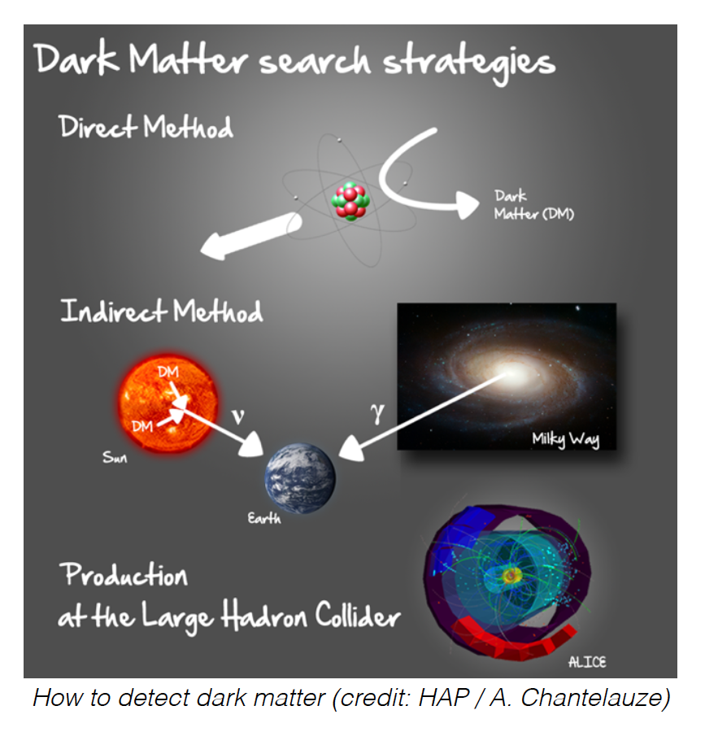
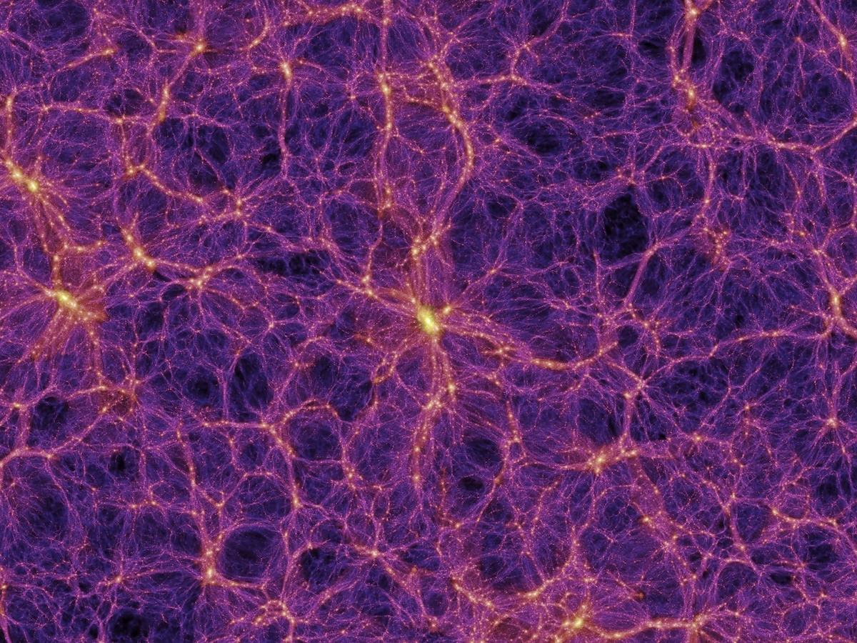
Dark matter search

Slide 8
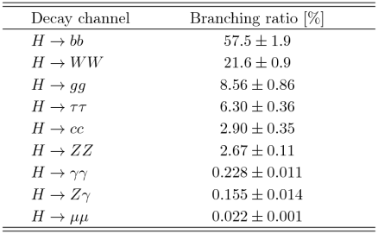
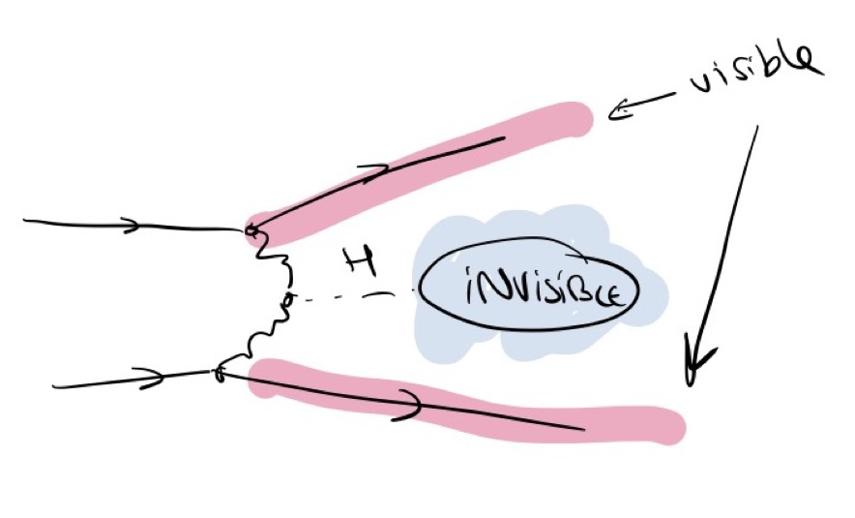
Invisible decays of the Higgs boson

Slide 9
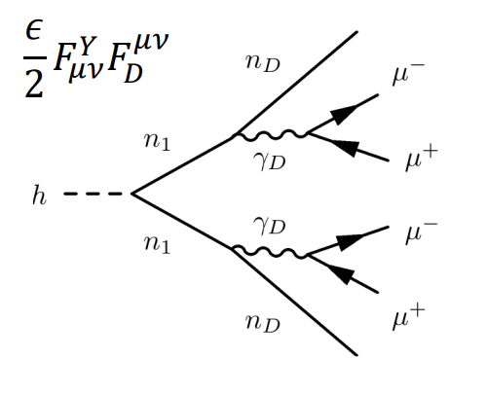
Higgs portal to dark matter
Higgs decay to particles in the “Dark Sector”
Dark-SUSY model allows the decay of the Higgs boson to SUSY particles, dark neutralinos and dark photons
Dark photons in this model have a substantial life-time (free parameter) and mass
One of the best signatures to study is through the decay of each dark photon to a pair of opposite charge muons (dimuons)

Slide 10
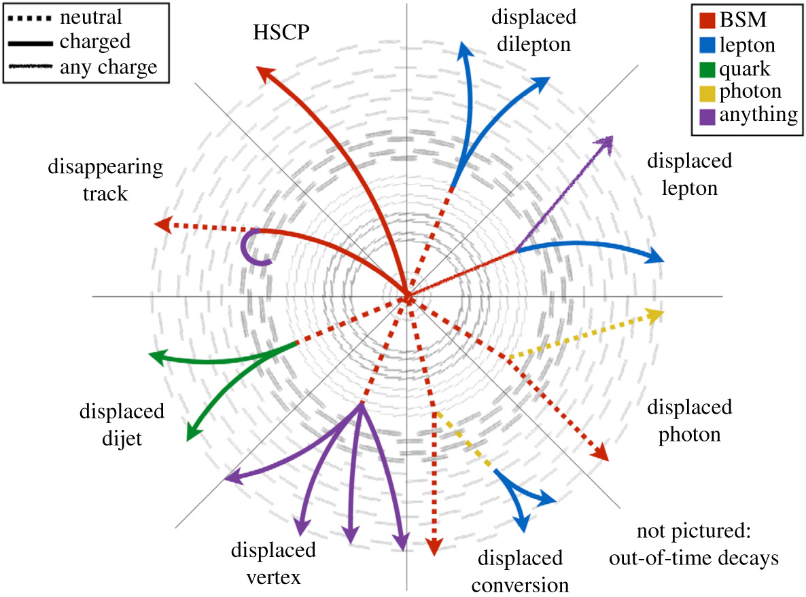
Reconstruction of long living particles
Higgs lifetime
1.6x10⁻²² segundos
B-quark lifetime
1.53x10⁻¹² segundos
Dark photon can travel several cm/m without being detected
Reconstruction of muons from dark photons is a challenge
New algorithms in triggering/reconstruction of long living signatures are currently under development

Slide 11
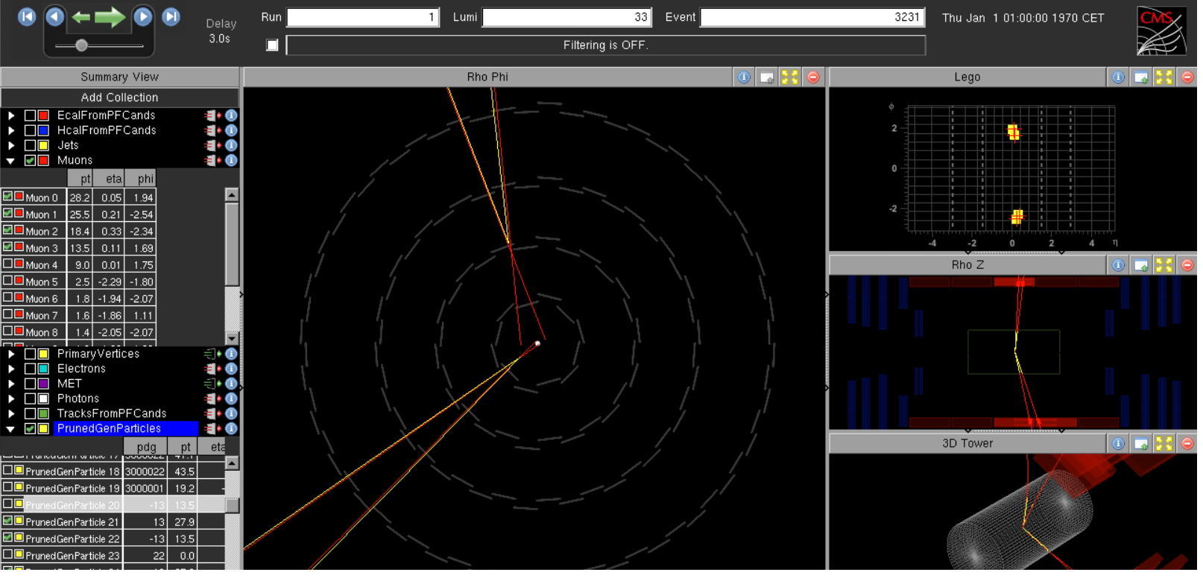
Typical signal event

Slide 12
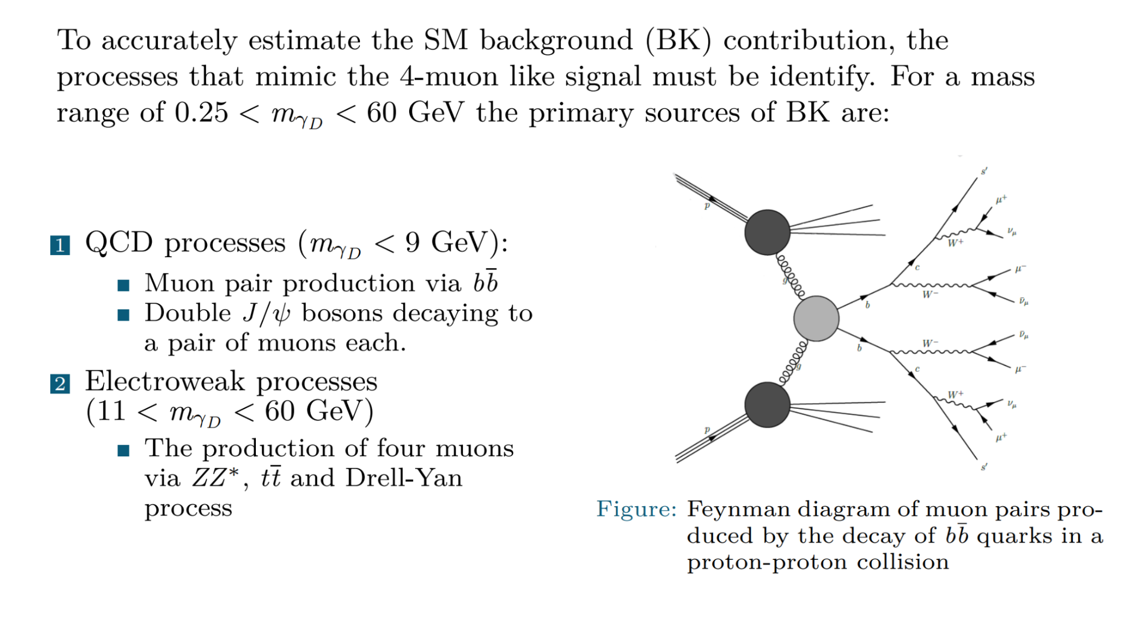
Backgrounds

Slide 13
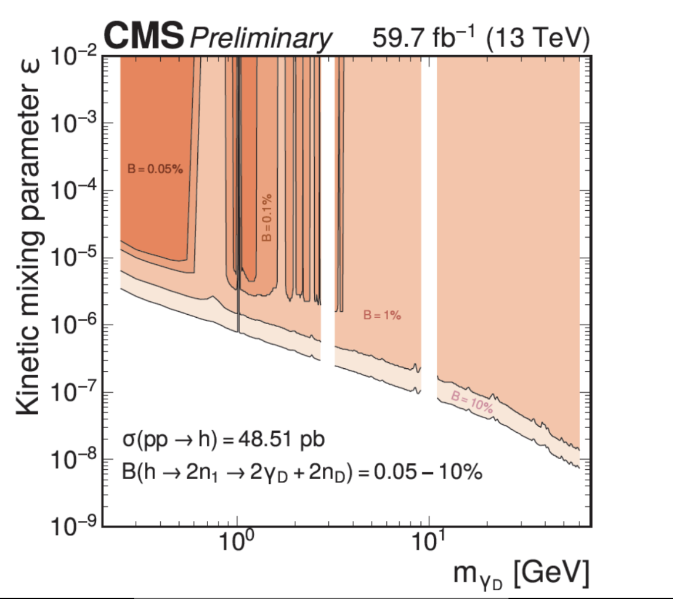
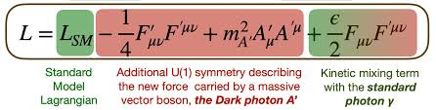
What we have found so far?
Limit setting on the kinetic mixing parameter and the mass of the dark photon
The different contours are related to the probability of the Higgs to decay to a dark photon (testing several options as this is unknown parameter)
To be published in JHEP

Slide 14
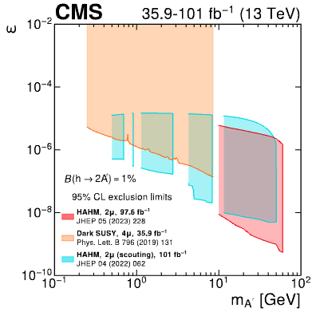
What CMS has found so far?
Results considering a probability of the Higgs to decay to dark photons of 1%
Several analysis considered, including or Dark-SUSY model (2019 paper) and other two analysis focusing on only displaced signature (only those that decay far from the interaction point)
The mass range is again considering up to 60 GeV
To be published in Physics Reports as part of the Physics in Dark Sector in CMS study

Slide 15
What is next
No evidence of dark photons coming from long living bosons so far observed in CMS
Several models are tested including those considering the exotic decay of Higgs boson to SUSY and Dark sector particles (Dark-SUSY)
Mass and lifetime are free parameters in the model, meaning we can try to increase the mass range in the search (however we are approaching the region of the Z boson peak)
Several improvements in trigger and reconstruction algorithms in Run-3 will allow to test again this kind of signatures

Slide 16
Thanks

