Slide 1





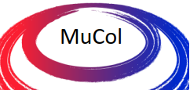
Muon magnet working group meeting
Recent progress on the models of power converters and resistive magnets
CERN, 15/02/2024
F. Boattini, M. Gast
Funded by the European Union under Grant Agreement n.101094300

Slide 2
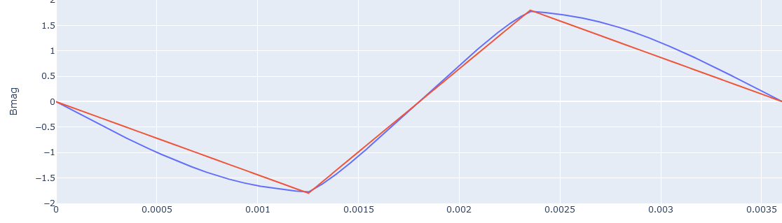
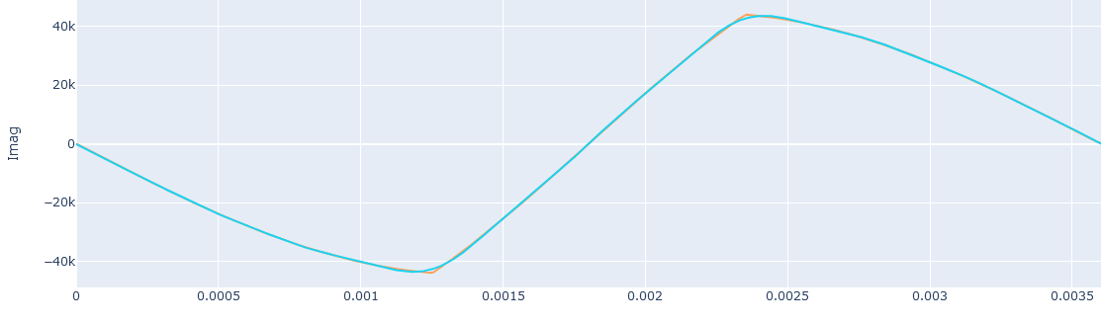
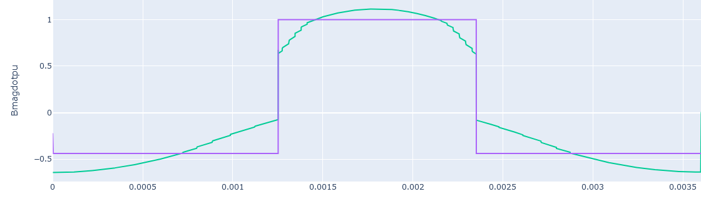
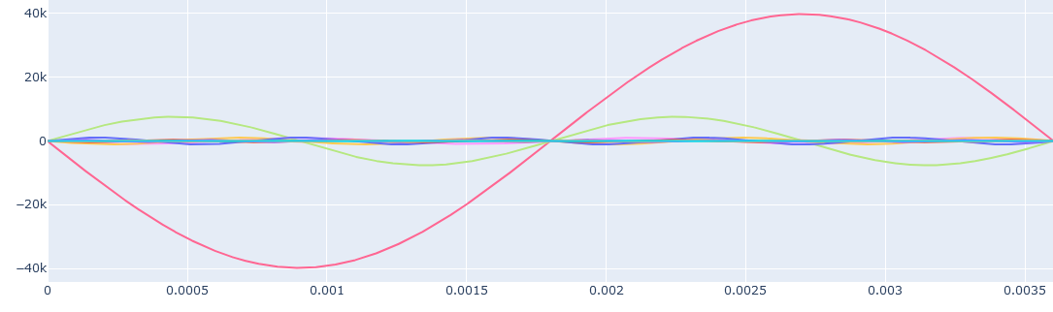
Setting the stage: some important definitions
Bref
Preload
Mmf current
Ramp
T_{pulse}
Preload
Bref dot
Mmf current harmonics
Bref_dot_{max}
The Bref is created by the connection of two different sinusoids named here Preload and Ramp. The power electronic does that.
Playing with the Preload circuit Tpulse can be varied;
Playing with the Boost circuit, Bref_dot max can be changed;
The first harmonic of the magnet current has a frequency of 1/T_{pulse}
The next most important harmonic is the second.
The magnet losses reported in this presentation are computed with AC simulation with the first harmonic only
Short T_{pulse} requires high power in the converter
Transient simulation necessary to simulate proper losses

Slide 3
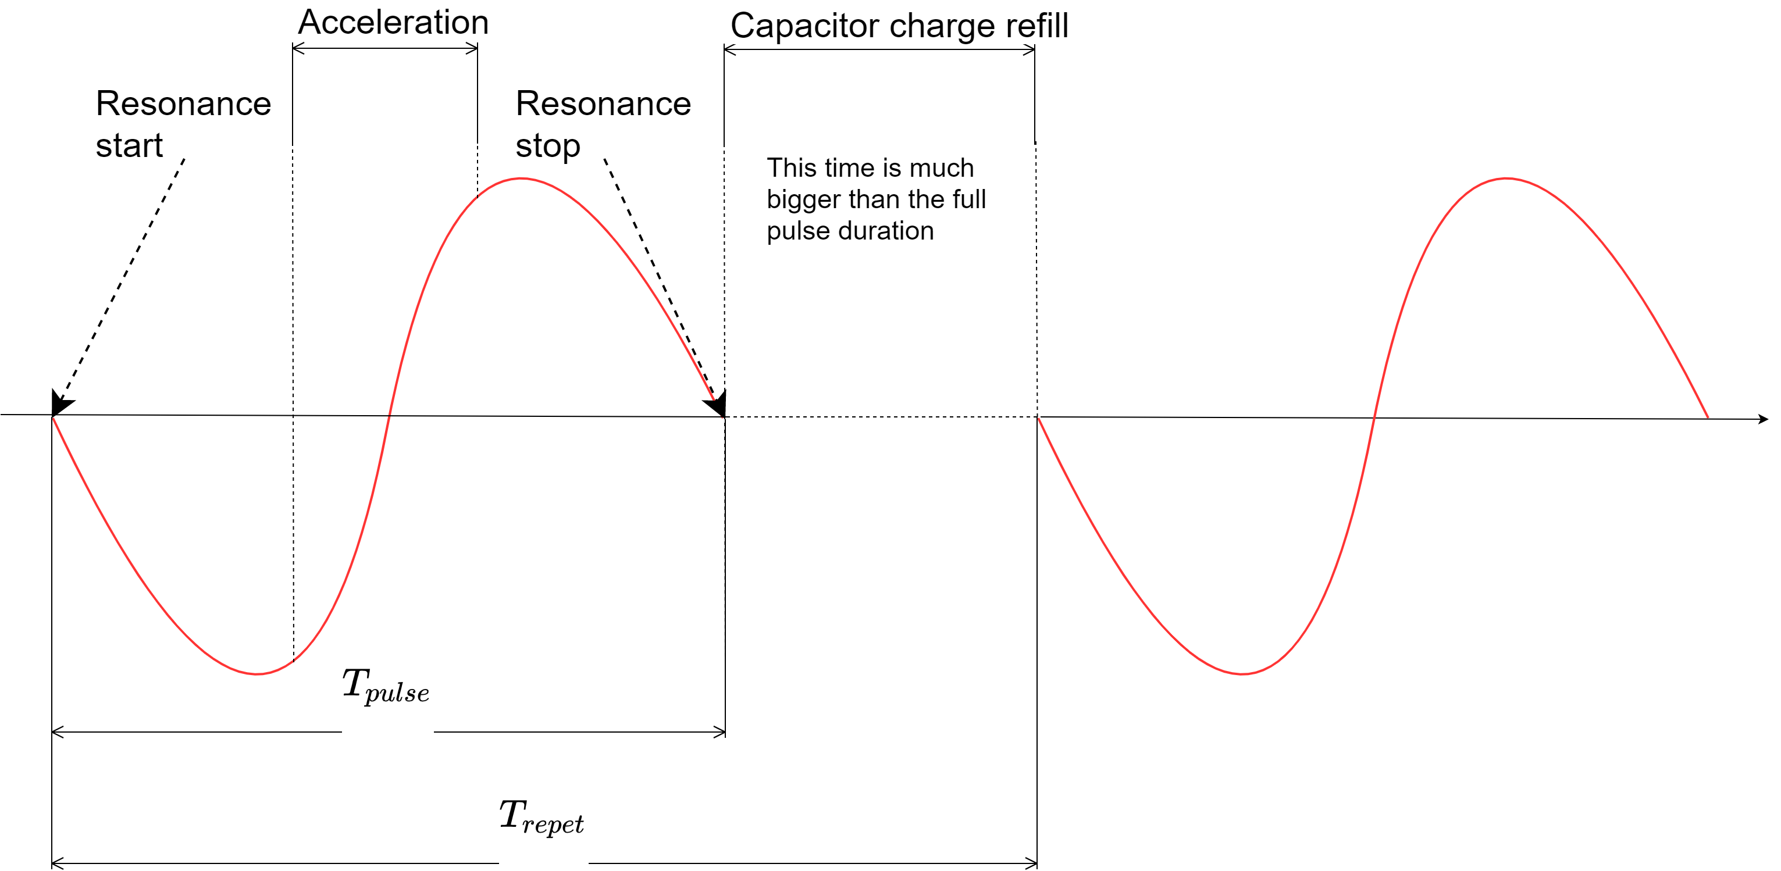


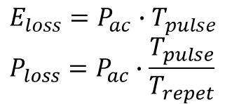
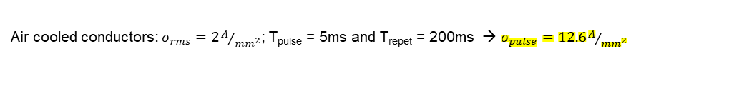

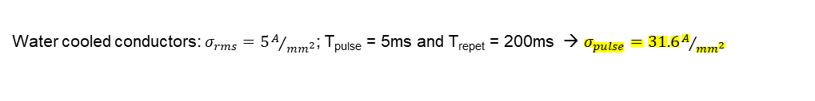

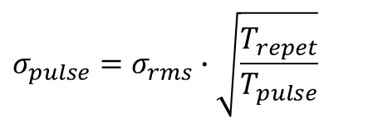


Setting the stage: some important definitions
Losses are calculated by considering the energy lost per cycle and per meter or the average power losses
$$Copper conductors:$$
$E_{loss}=P_{ac}$ $∙T_{pulse}$
$$P_{loss}=P_{ac}∙\frac{T_{pulse}}{T_{repet}}$$
$P_{ac}$ decreases less than linearly with T_{pulse}
$E_{loss}$ increases linearly with T_{pulse}
$$Iron:$$
$P_{ac}$ decreases more than linearly with T_{pulse}
$E_{loss}$ increases linearly with T_{pulse}
Magnetic dimension of the magnet
Conductor current density used for magnet design is defined as $σ_{pulse}$ this relates to the $σ_{rms}:$
$$σ_{pulse}=σ_{rms}∙\sqrt{\frac{T_{repet}}{T_{pulse}}}$$
Water cooled conductors: $σ_{rms}=5A/{{mm}^{2}}$; T_{pulse} = 5ms and T_{repet} = 200ms → $σ_{pulse}=31.6A/{{mm}^{2}}$
Air cooled conductors: $σ_{rms}=2A/{{mm}^{2}}$; T_{pulse} = 5ms and T_{repet} = 200ms → $σ_{pulse}=12.6A/{{mm}^{2}}$

Slide 4
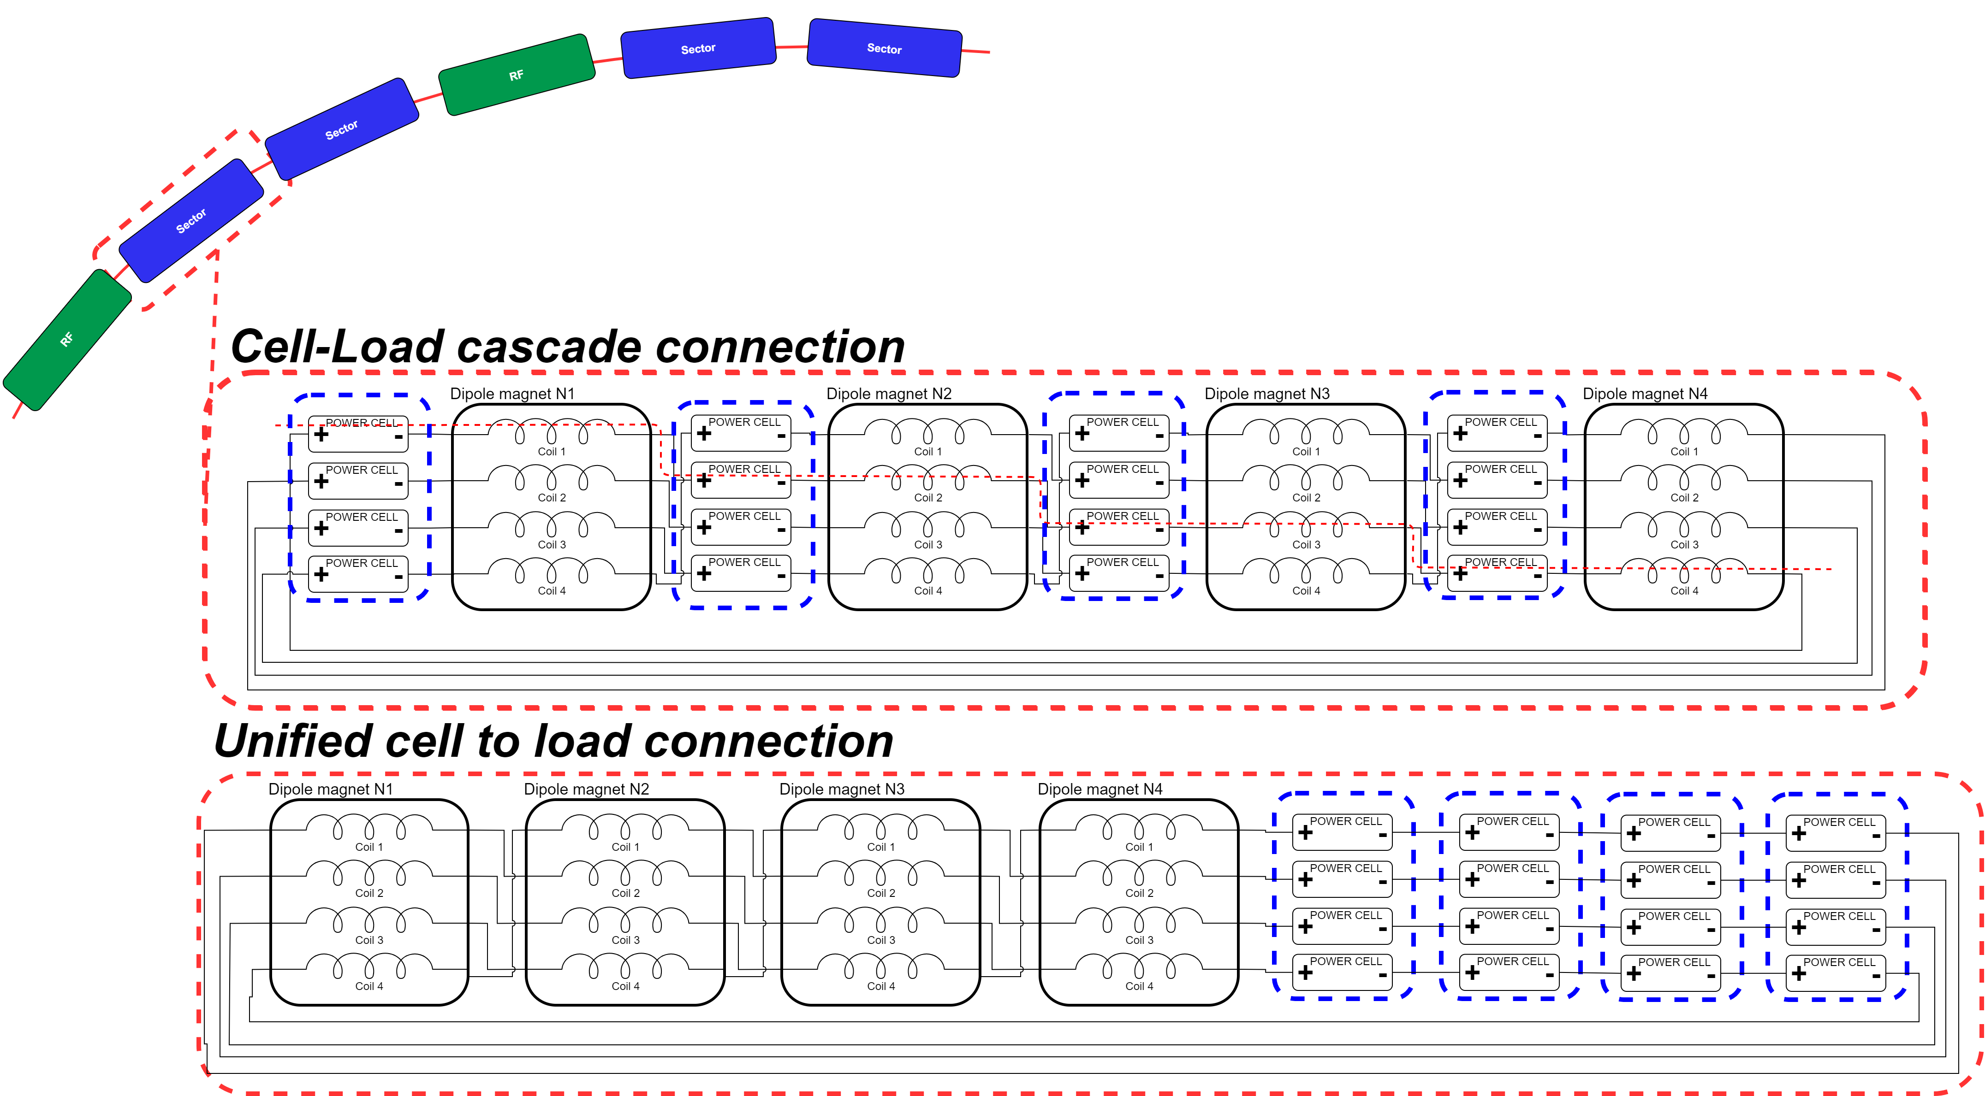
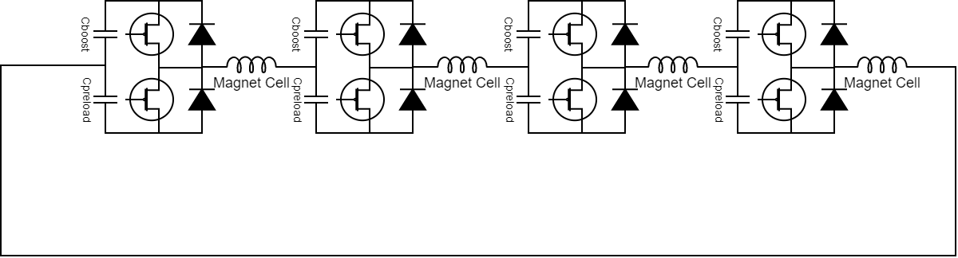
Setting the stage: Power Converters – magnets connection
Cell-load connection (SPS): the voltage to ground is limited by the PC voltage → can connect all mags of the accelerator in one single sector → current will be the same everywhere
Unified cell connection (LHC): the voltage to ground is the sum of series connected PC → must divide in several sectors → current will not be the same everywhere (control problem is harder)
Should be distributed into the tunnel to minimize cabling (and cable losses)
~5000V
~1’000’000V
…an MMC but at much higher frequency!
Interleaving connection makes the impedances of each circuit the same. We can treat the single circuit as if the same current was flowing and the same voltage applied (ideal case). We could treat FEM computation as current controlled in each circuit.

Slide 5
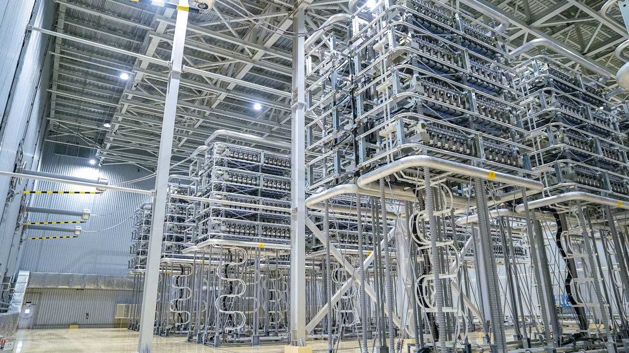
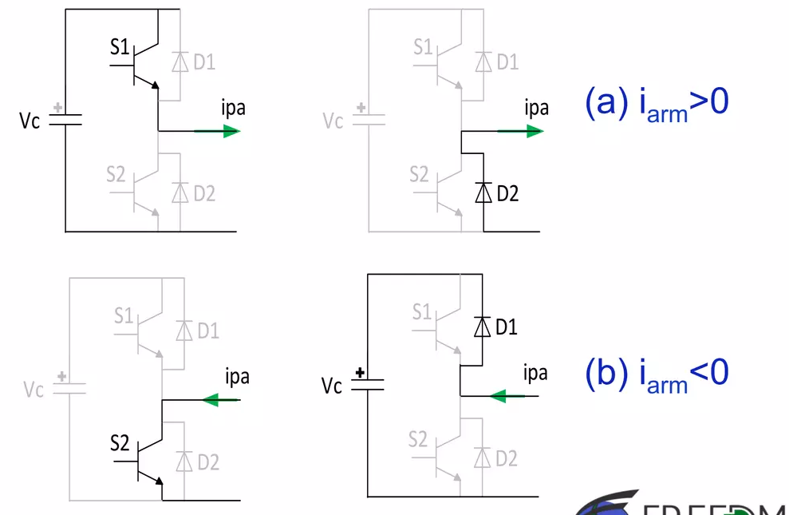
MMC: a similar topology for a different application
640 kVdc
2 GW
Hundreds of connected cells
Basic cell:

Slide 6
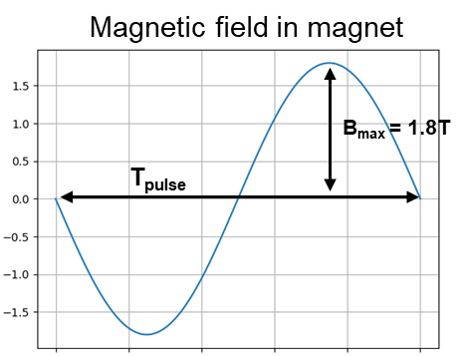
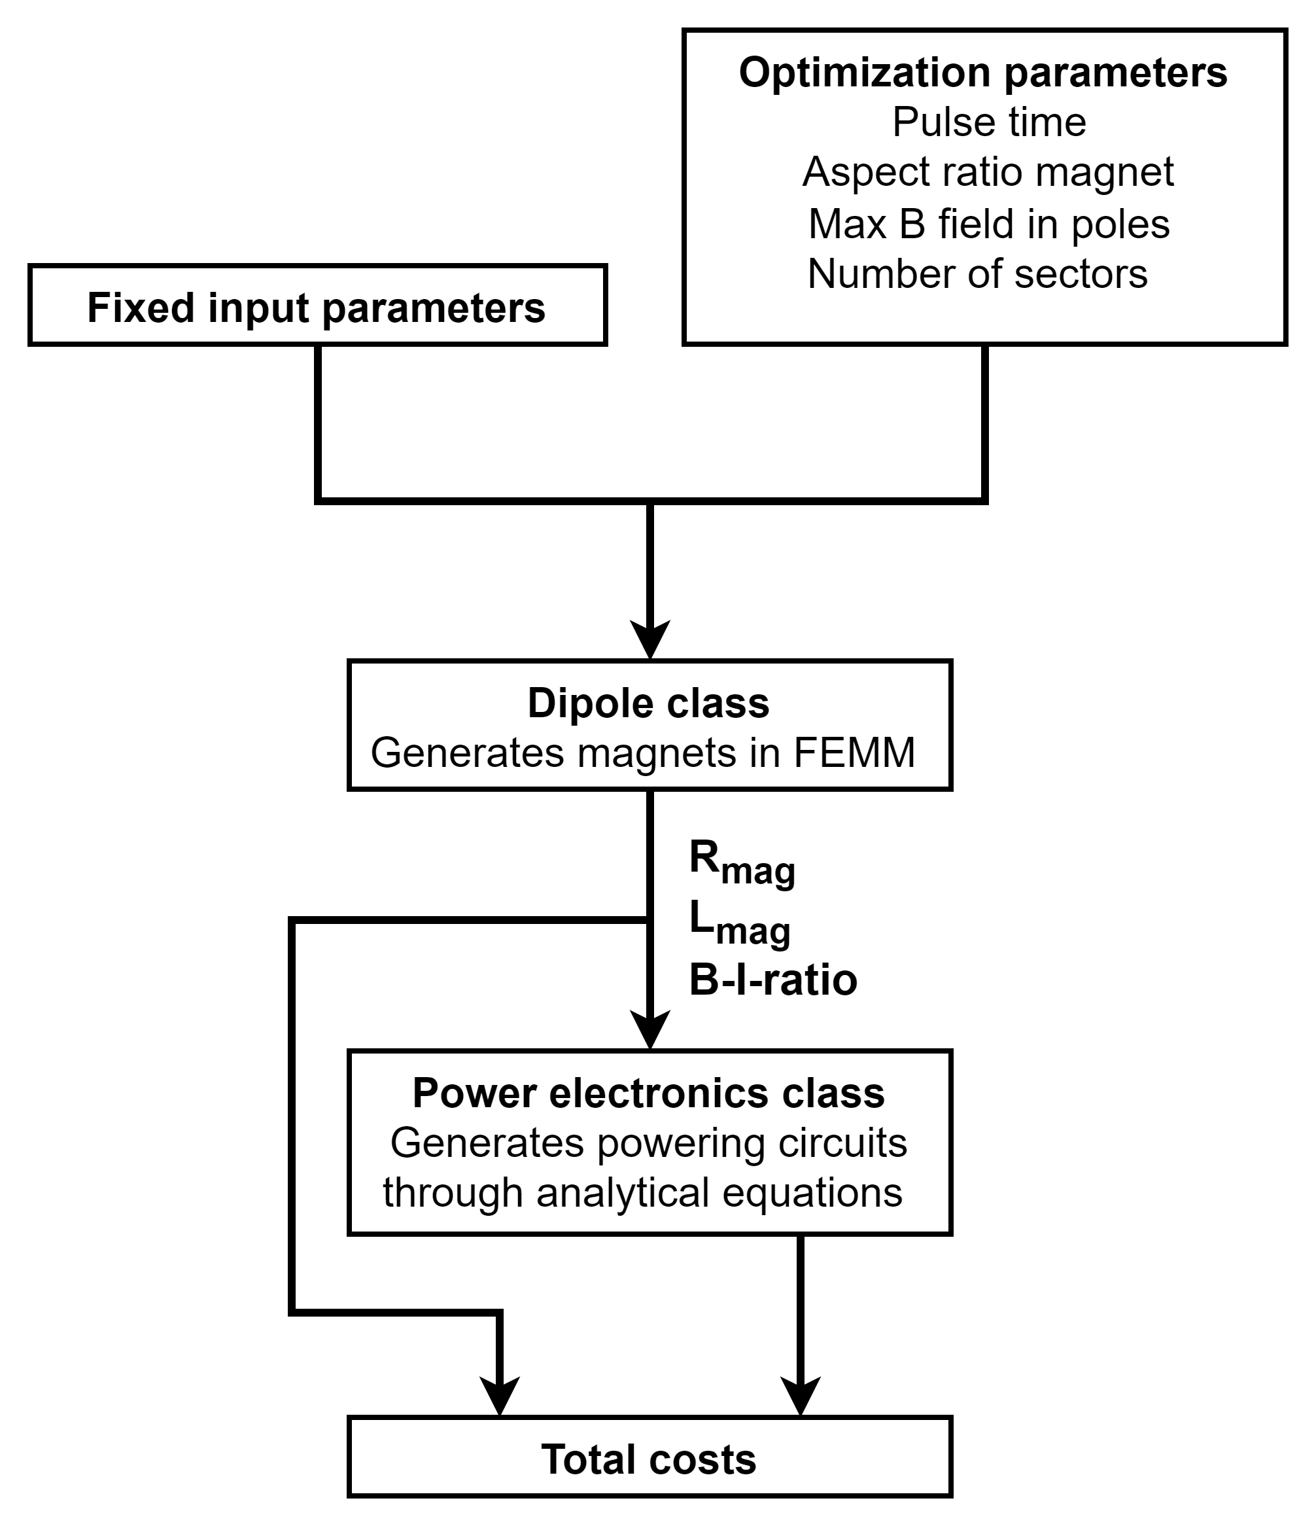
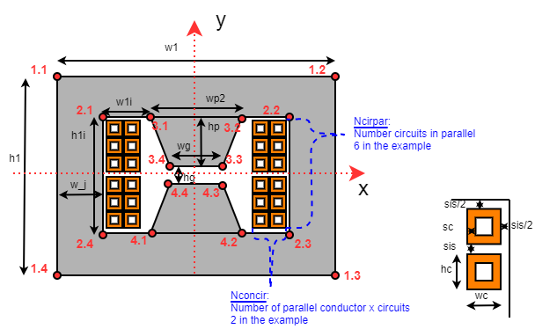
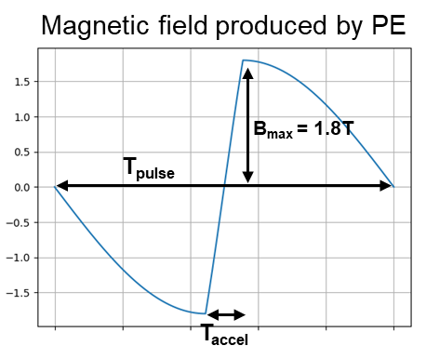
Optimization of power converters and dipole magnets
base_input_parameters={'Maximum B field in air[T]': 1.8,'Maximum B field in joke[T]': 1.4,
'B field ratio in poles[Bp/Bg]':0.6 ,'Total length of normal conducting dipoles [m]':2540,
'Number of sectors for powering': 48,'Number of parallel circuits': 8,
'Acceleration ramping time [s]':0.0011, 'Pulse cycling time [s]':0.2,'Pulse duration time [s]':0.007,
'RMS current density [A/mm2]':5,'Conductor thickness [m]':0.003,'Insulation thickness [m]':0.001,
'Joke steel type':"steel_M235_35A.json",'Poles steel type':"steel_M235_35A.json",'gap height [m]':0.03,
'gap width [m]':0.1,'Aspect ratio of conductor hc/wc':1,
'Aspect ratio of the conductor window h1i/w1i':3,'Cooling water flow in conductor [m3/h]':0.1,
'Cooling water speed in conductor [m/s]':3,'Filling factor of conductor window':0.5
All based on FEMM computing…very slow
The ultimate goal of the optimization is minimizing the overall costs. The following costs are included:
Magnet costs (material + manufacturing)
Capacitor costs including containers
Power electronics cost including peripherals and building (no cables)
Operational costs (Losses in magnets and IGBTs) for 20 years of operation with 6000h per year

Slide 7
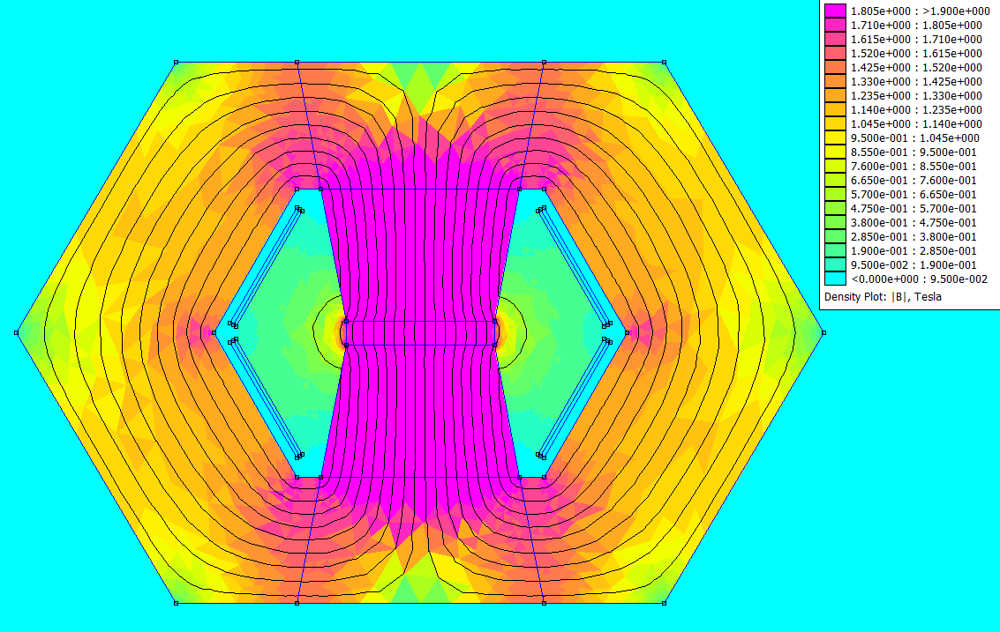
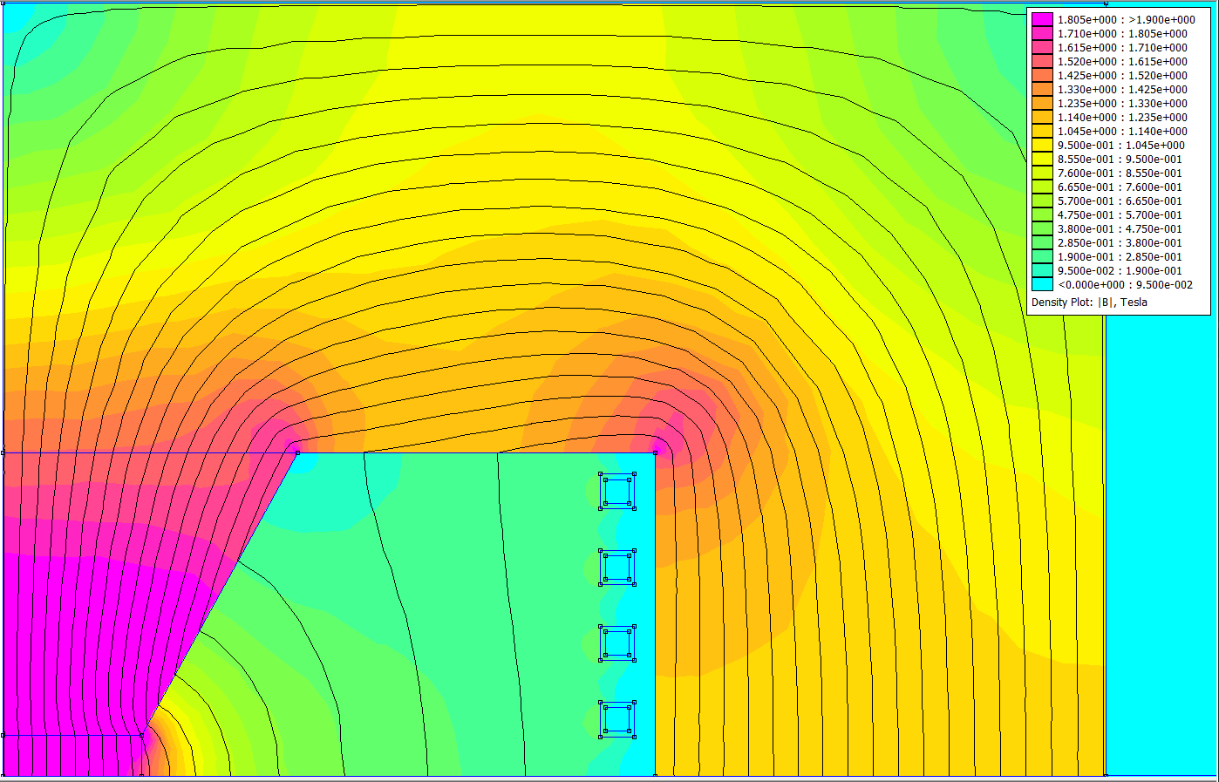
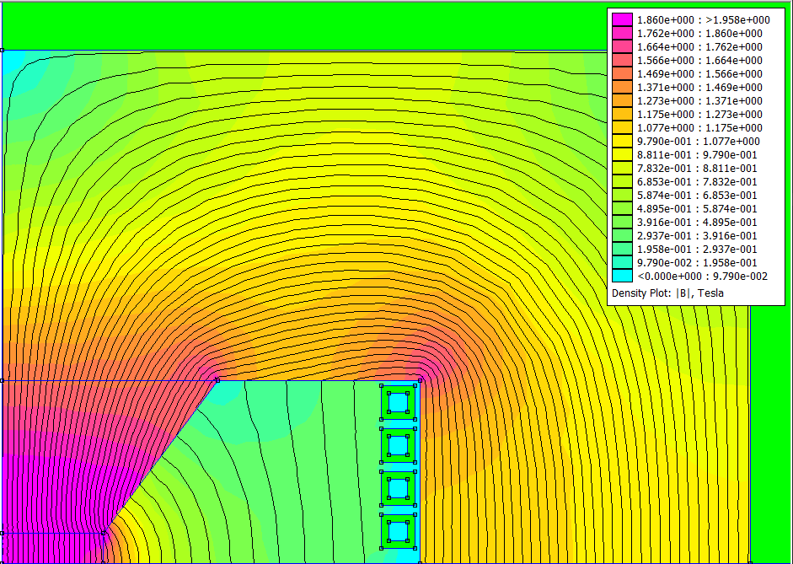
Optimization: minimize the losses of magnets only
Benchmark: Hourglass type with 30x100mm gap
Here T_{pulse} = 2 ms
Optimization Losses only: Bratio_pole, AsRatwdw
h1=560 mm
w1=800 mm
wj= 163mm
hc=12.5 mm
sc= 2 mm
sis=15 mm
T_{pulse}= 2 ms
σ_{rms}= 7 A
mmf= 47270 At
E_{lossIron}= 160 J/m/pulse
E_{losscu}= 196 J/m/pulse
NRG_{stored}= 7654 J/m
Optimization Losses only: sc, sis, water cooling section
h1=570 mm
w1=850 mm
wj= 163mm
hc=140 mm
sc= 2x3.5 mm
sis=10 mm
T_{pulse}= 2 ms
σ_{rms}= 2.3 A
mmf= 47270 At
E_{lossIron}= 220 J/m/pulse
E_{losscu}= 82 J/m/pulse
NRG_{stored}= 7051 J/m
h1=500 mm
w1=738 mm
wj= 163mm
hc=16.5 mm
sc= 3.8 mm
sis=4.8 mm
T_{pulse}= 2 ms
σ_{rms}= 3 A
mmf= 46115 At
E_{lossIron}= 136 J/m/pulse
E_{losscu}= 161 J/m/pulse
NRG_{stored}= 7577 J/m
We can have two dipole topologies:
Air cooled with flat conductors
Water cooled with hollow conductors

Slide 8
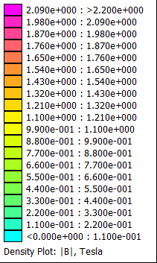
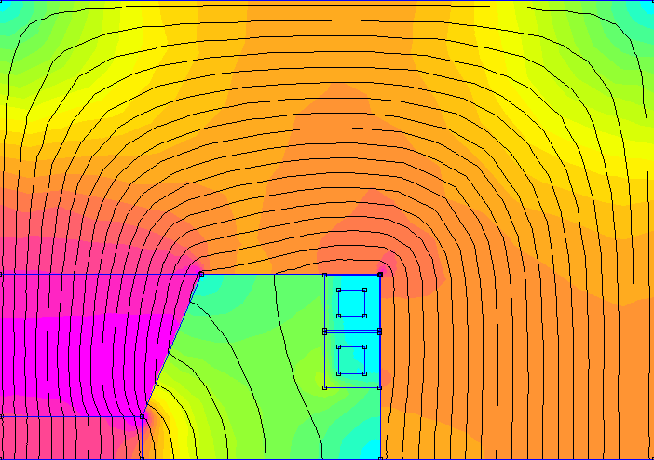
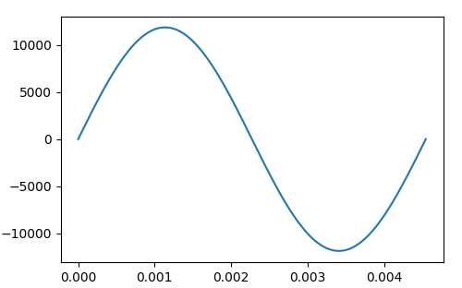
Optimization: minimize the total cost of Magnets and power converters
230 mm
Steel: M235-35A everywhere
External dimensions [mm x mm] | 460 x 322
Joke cross section [dm²] | 11.35
Pole cross section [dm²] | 1.21
Coil cross section [mm²] | 285.39
Number of parallel coils | 4
Bgap [T] | 1.80
Gap size [mm x mm] | 100 x 30
MMF [kAt] | 47.49
Sigma_RMS (pulse) [A / mm²] | 29.41
Sigma_RMS (cycle) [A / mm²] | 4.41
Iron losses (joke) [J / (cycle * m)] | 48.29
Iron losses (pole) [J / (cycle * m)] | 10.22
Coil losses [J / (cycle * m)] | 447.47
Total losses [J / (cycle * m)] | 505.98
Energy (total) [J / m] | 6386.12
Energy (gap) [J / m] | 3830.48
96 mm
Steel M235-35A
71 mm
161 mm
Steel
M235-35A
9.2 mm
19.2 mm
Here T_{pulse} = 4.5 ms
50 mm
96 mm
Coil current of
AC analysis
T_{pulse} = 4.5 ms
I_{peak} = 11.87 kA

Slide 9
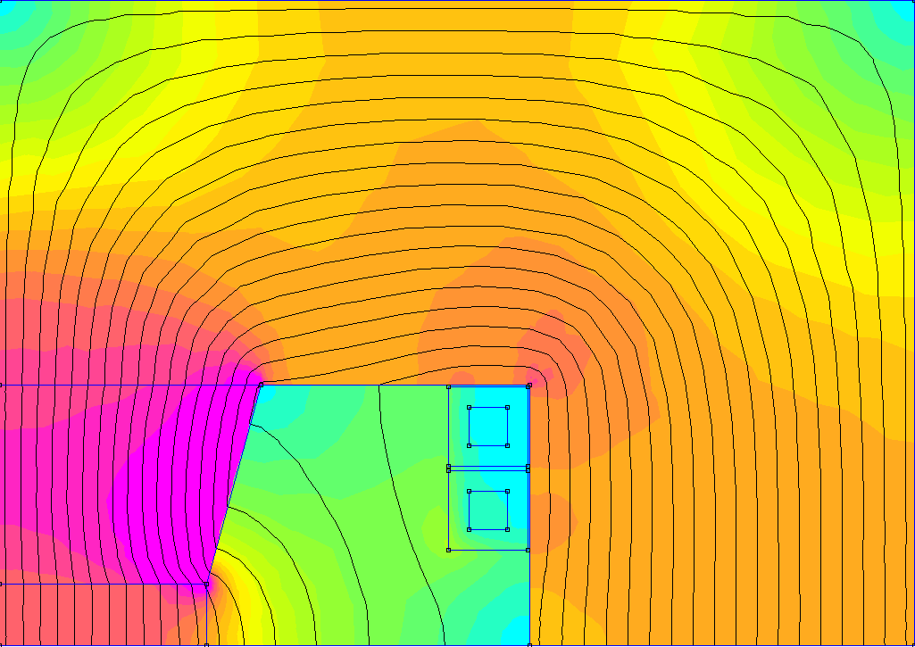
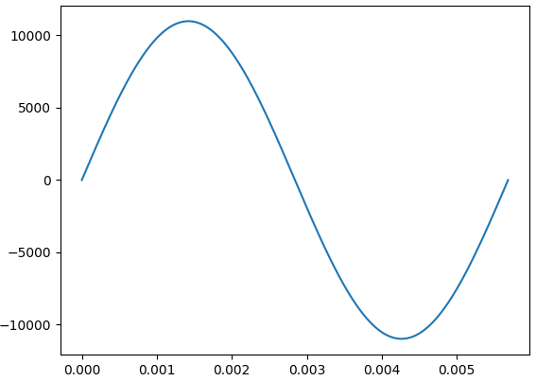
Optimization: minimize the total cost of Magnets and power converters
221 mm
Steel: M235-35A for the joke, Vacoflux 48 for the Poles
External dimensions [mm x mm] | 442 x 312
Joke cross section [dm²] | 10.55
Pole cross section [dm²] | 1.09
Coil cross section [mm²] | 285.39
Number of parallel coils | 4
Bgap [T] | 1.78
Gap size [mm x mm] | 100 x 30
MMF [kAt] | 43.92
Sigma_RMS (pulse) [A / mm²] | 27.20
Sigma_RMS (cycle) [A / mm²] | 4.59
Iron losses (joke) [J / (cycle * m)] | 38.12
Iron losses (pole) [J / (cycle * m)] | 8.70
Coil losses [J / (cycle * m)] | 434.89
Total losses [J / (cycle * m)] | 481.71
Energy (total) [J / m] | 5773.80
Energy (gap) [J / m] | 3702.65
93 mm
Steel M235-35A
63 mm
156 mm
Vacoflux 48
9.2 mm
19.2 mm
50 mm
93 mm
Here T_{pulse} = 5.6 ms
Coil current of
AC analysis
T_{pulse} = 5.6 ms
I_{peak} = 10.98 kA

Slide 10
Comparisons
Recomputed to T_{pulse}=5 ms
 | Hollow conductors water cooled |  | Flat conductors air cooled
 | Optimization for loss in magnets | Optimization for overall cost in Power Converters + Magnets | Flat conductors Hourglass. Not optimized
Total losses [J/m/pulse] | 381 | 506 | 235
Total NRG [J/m] (DC equivalent) | 7577 | 6386 | 7051
Outer Dimensions wxh [mm] | 738 x 500 | 442 x 312 | 850 x 163
T_{pulse} [ms] | 5 | ~ 5 | 5
Lower losses and higher NRG and dimensions
Higher losses and lower NRG and dimensions
A good compromise?

Slide 11
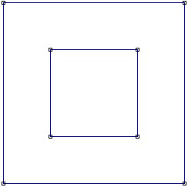
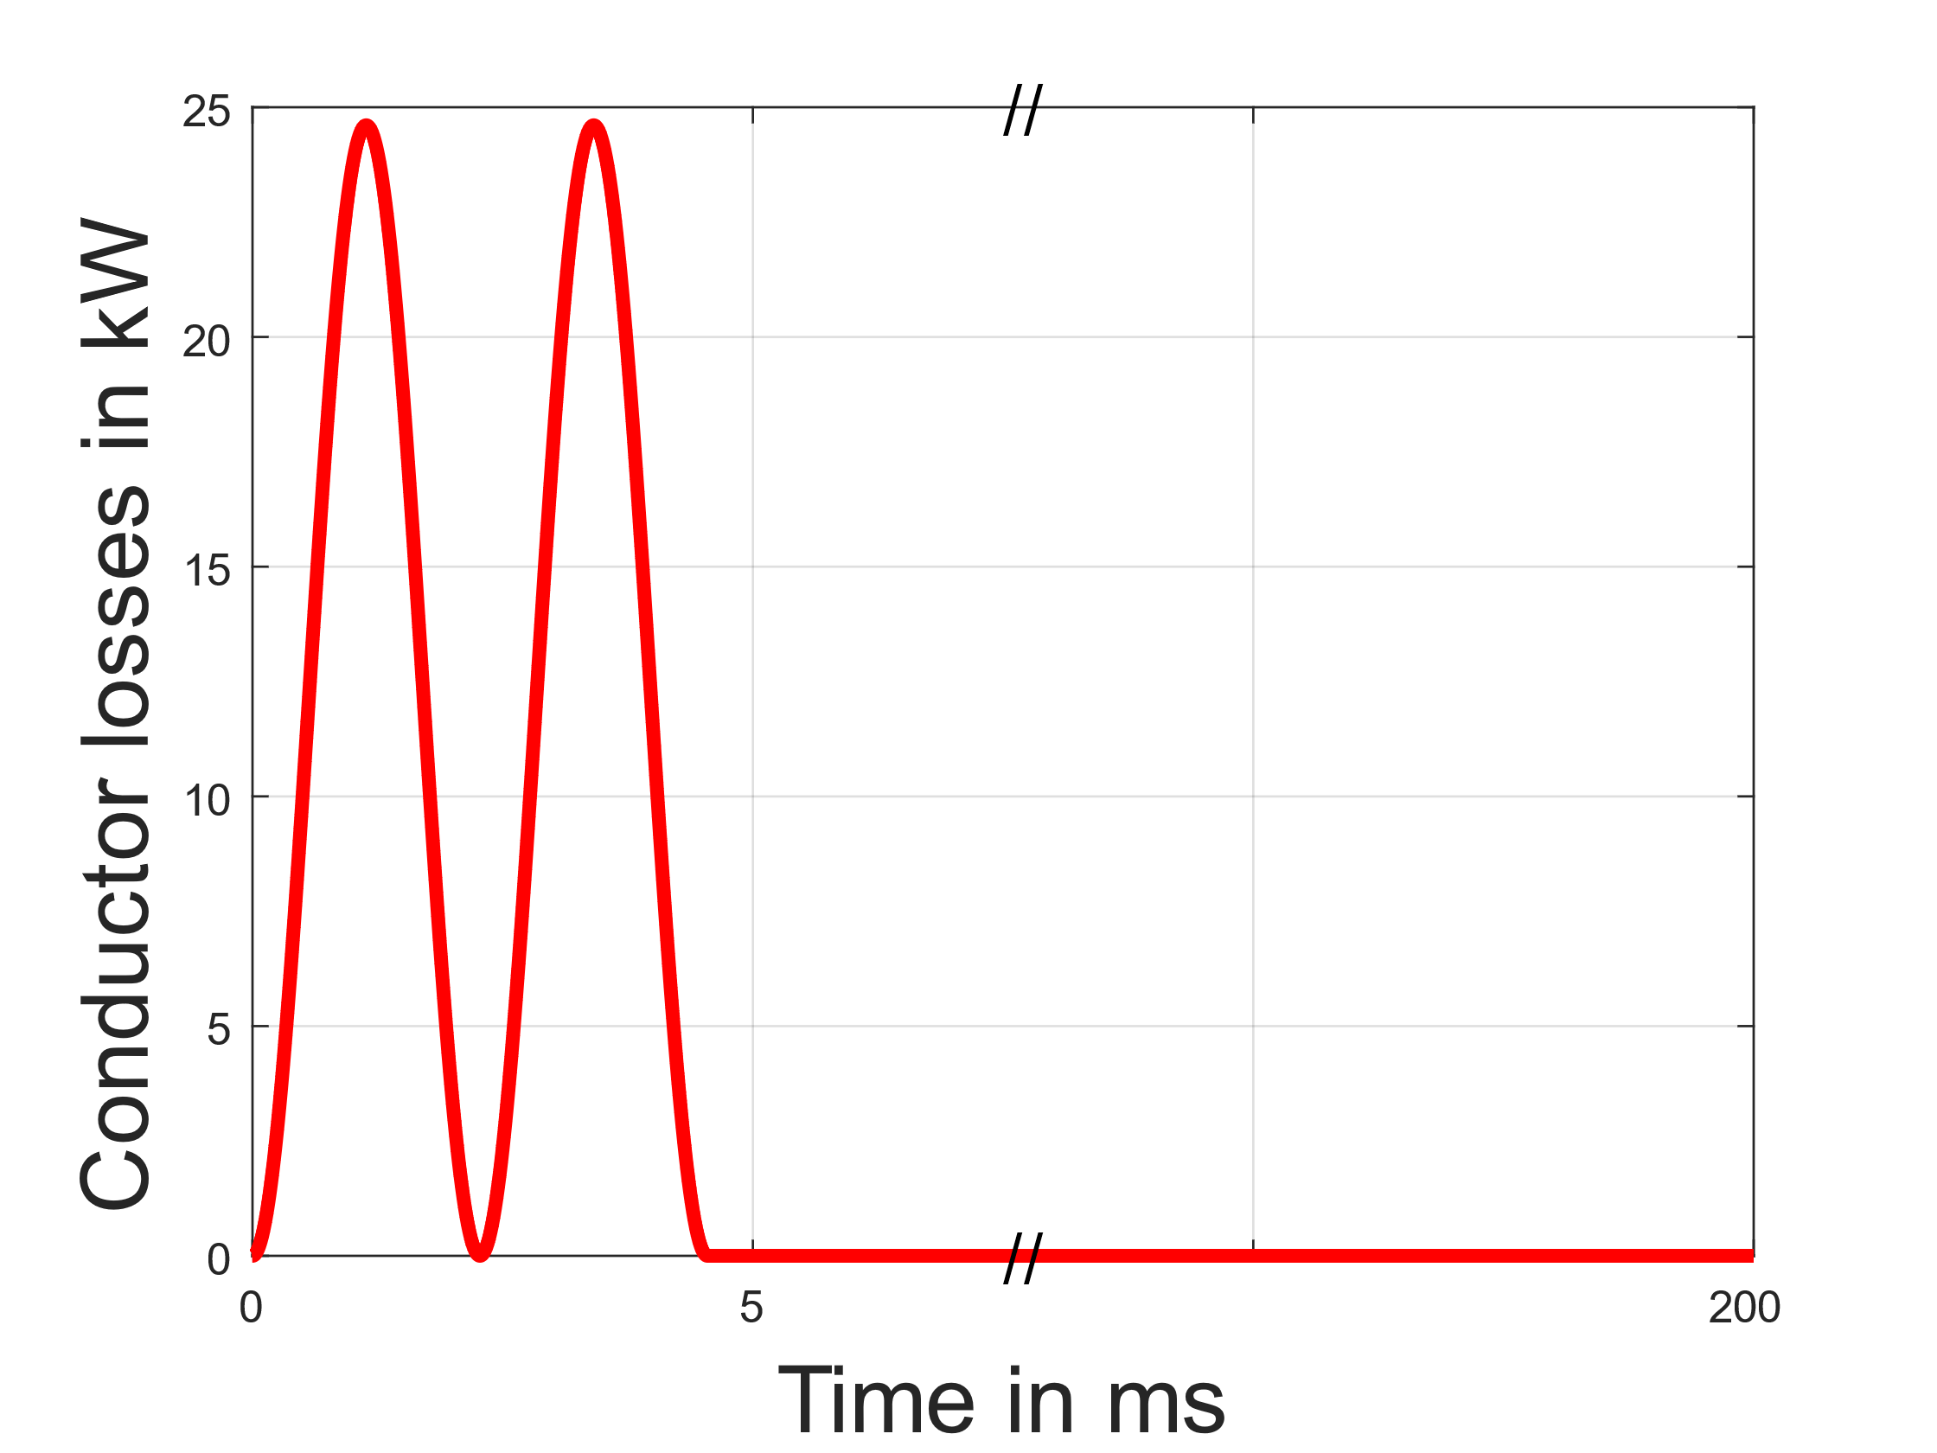
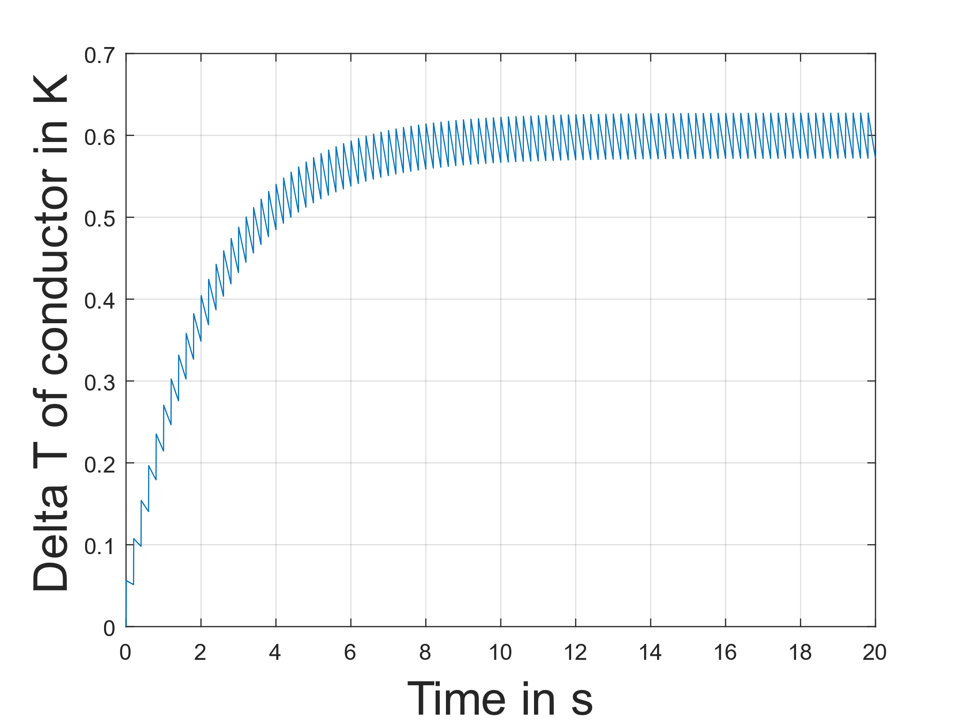
Cooling of hollow conductors
Source: http://dx.doi.org/10.1051/e3sconf/20171302008
One meter of a single conductor of the full steel H-type magnet is considered
Assumptions:
  Coil losses are equally distributed.
  Flow speed of water is 3 m/s.
  Only heat transfer from copper to water is considered.
  Cooling water stays at a steady temperature. Therefore, the temperature of the conductor doesn’t change along its length.
285 mm²
9.2 mm
19.2 mm
19.2 mm
Peak at 41.59 A/mm² with 24.6 kW
100 powering cycles simulated
Losses per cycle
and conductor:
447.47 J / 8 = 55.93 J
Sigma_RMS (cycle) = 4.41 A/mm²
T_{pulse}

Slide 12
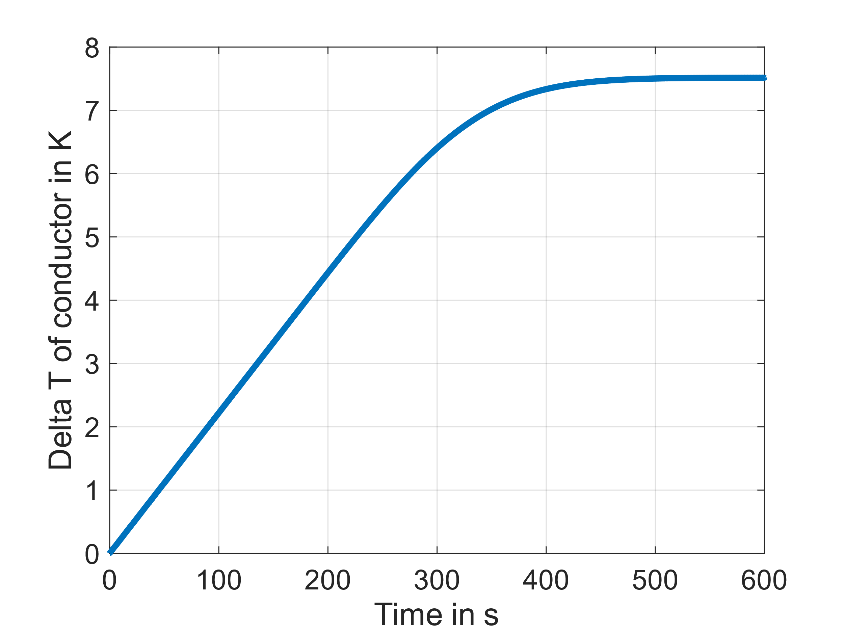
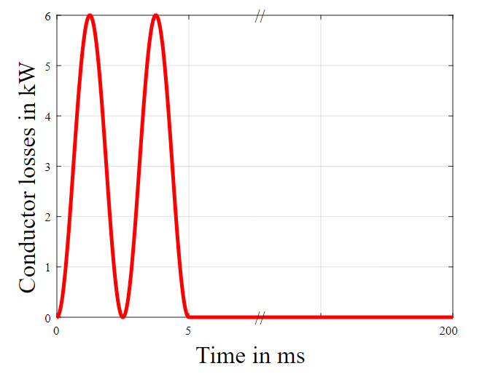
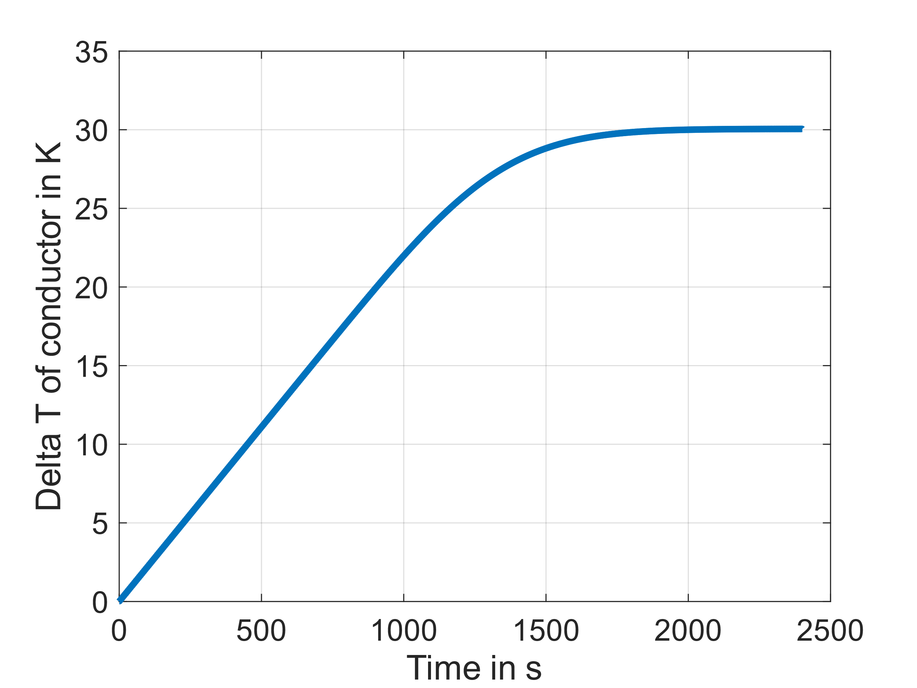
Cooling of bulk conductors
Values taken from Fulvio’s simulation of bulk conductors for 20kA peak per conductor and a frequency of 200 Hz. Pulse time is comparable to hollow conductor optimization.
Conductor length of 2m
7 mm
140 mm
What is the accepted Max T?
Peak at 23 A/mm² with 6 kW
Losses per cycle
and conductor:
30 J
Conductor length of 4m
Sigma_RMS (cycle) = 3.2 A/mm²
T_{pulse}

Slide 13
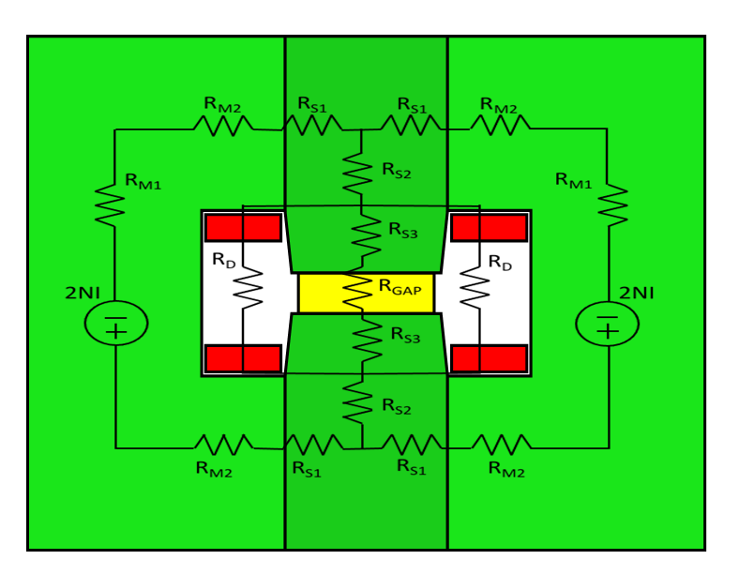
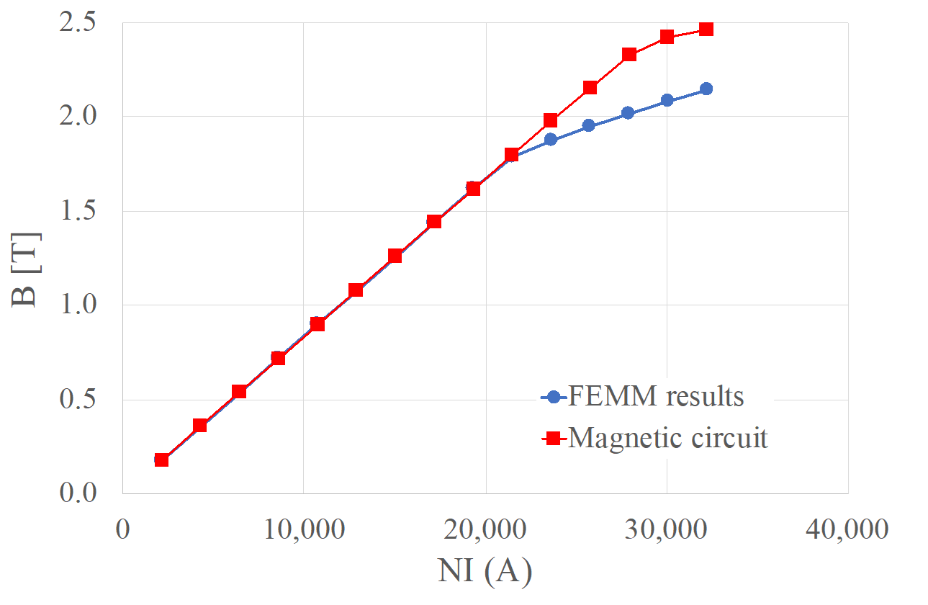
Analytical model for optimization speed-up
Combined optimizations required about 12 hours to converge. With UNIBO, we are developing analytical models to replace lengthy FEM computation in the optimization process
The model includes lumped reluctances which describe the various parts of the magnet
The non-linear reluctances depend on the value of the magnetic flux density: R (B) = l / m (B) S
The results of the FEMM model and of the equivalent non-linear magnetic circuit are in very good agreement before saturation
A discrepancy between the two models is observed above saturation
Improvements of the magnetic circuit were implemented to reduce this discrepancy

Slide 14
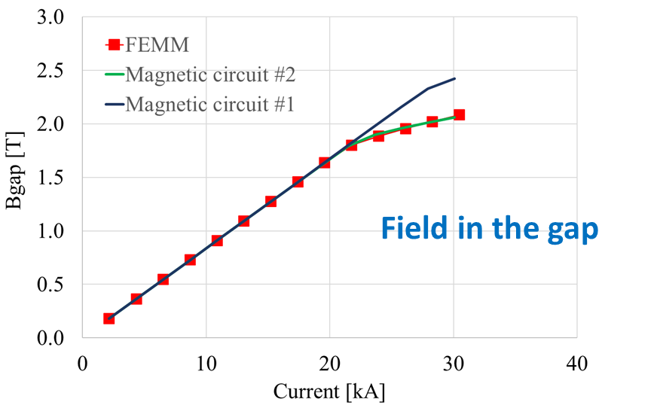
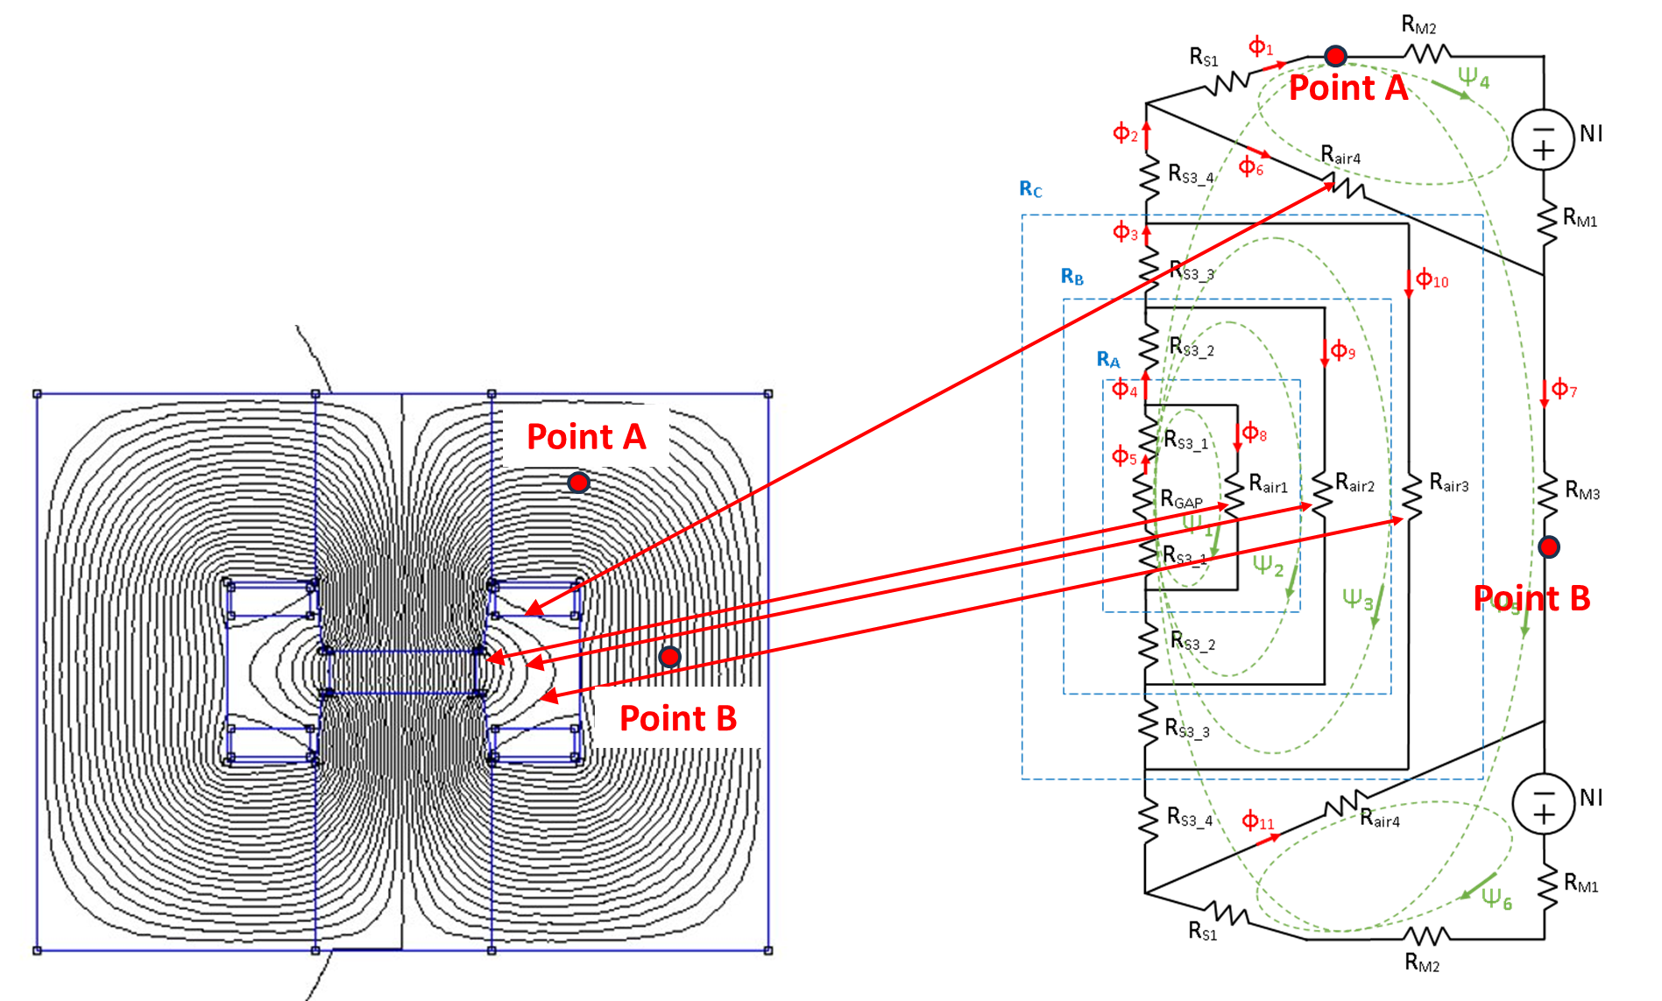
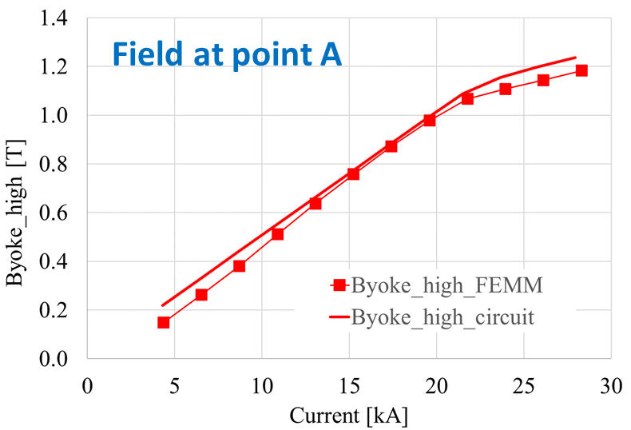
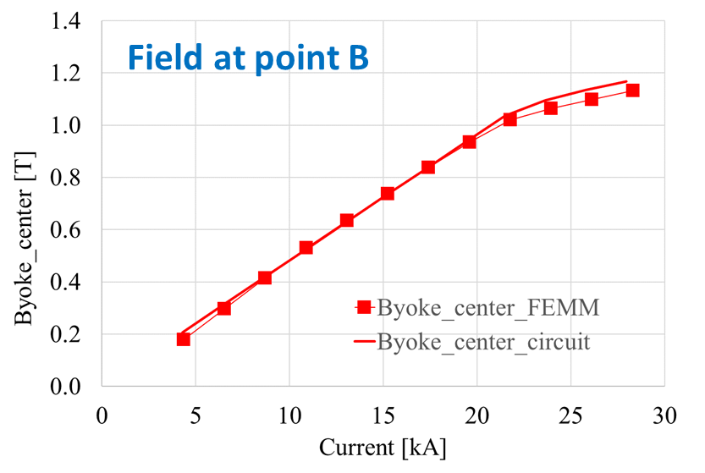
Analytical model for optimization speed-up
The possibility for flux lines to pass through the air outside the gap was considered with 4 additional reluctances in a more complex non-linear magnetic circuit model
The model was solved with the loop fluxes method
The novel circuit allows one to correctly compute the field in the gap at saturation
The field in other locations of the magnetic circuit is also computed with acceptable accuracy

Slide 15
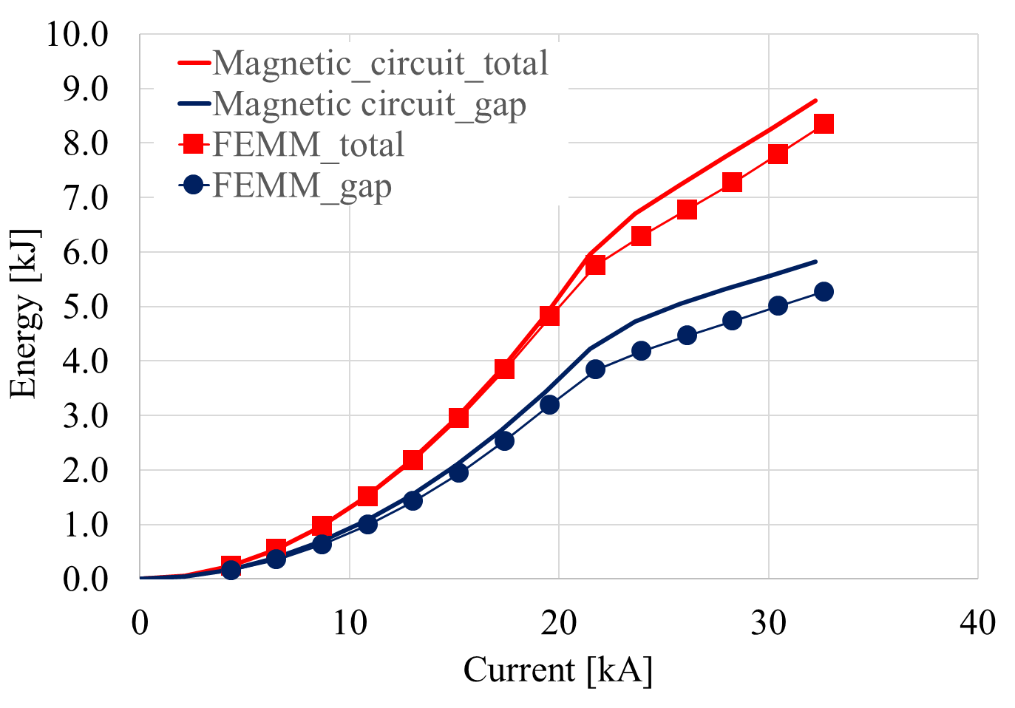
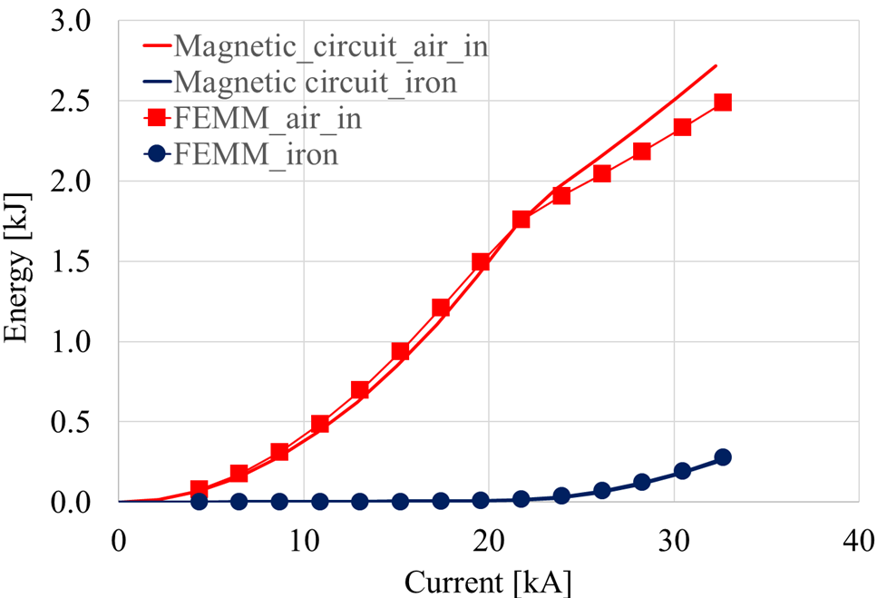
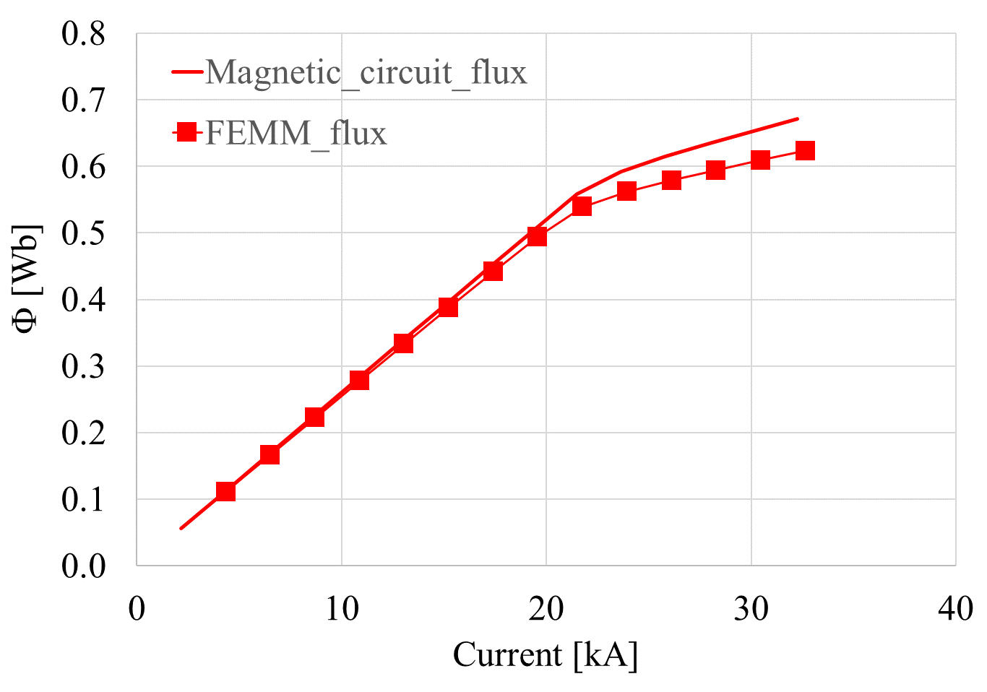
Analytical model for optimization speed-up
Total energy and gap energy: FEMM vs magnetic circuit
Energy in the air outside the gap and energy in the iron
Linked flux: FEMM vs magnetic circuit
The development of a magnetic circuit model of the resistive magnet is proceeding, with significant improvements in the calculation of magnetic field, magnetic energy and flux linked to the circuit
Further developments are foreseen to include in the model the analytical formulae for the iron and copper losses and for a simplified description of the cooling system

Slide 16
Now… Fasten your seat-belts We try with a cost model.
Please consider:
This is a first attempt. Future trials could lead to different values as the model progresses and include additional costs (like the cabling and the installation / testing FTE for example that are presently not included)
For the magnet, we discussed with an expert and applied the model that he suggested from this paper:“Basic design and engineering of normal-conducting, iron-dominated electromagnets” by Th. Zickler. The reliability of the calculations presented below, is quite low, because they have not been verified by a magnet expert.
The Power Converter cost model is a bottom up approach based on experience with power converters for large systems (POPS-POPSB). We intend to verify it with similar ones developed for the FCC.

Slide 17
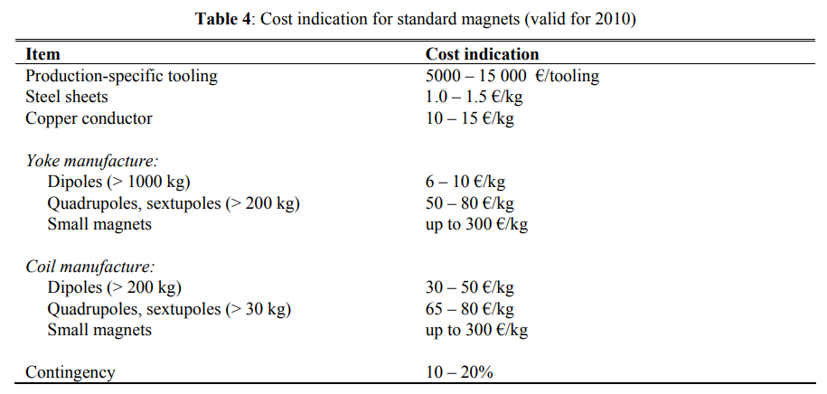
Dipole magnet cost model
The simplified cost approach is taken from “Basic design and engineering of normal-conducting, iron-dominated electromagnets” by Th. Zickler.
Cost figures are adapted for 3% of inflation over the last 14 years and the highest value of the range is taken.
The material costs for Vacoflux 48 are estimated values in consultation with magnet experts.
 | Cost material [U/kg] | Cost manufacturing [U/kg]
Steel yoke | 2.27 | 15.13
Vacoflux-48 yoke | 50.00 | 15.13
Copper conductors | 22.69 | 75.63

Slide 18
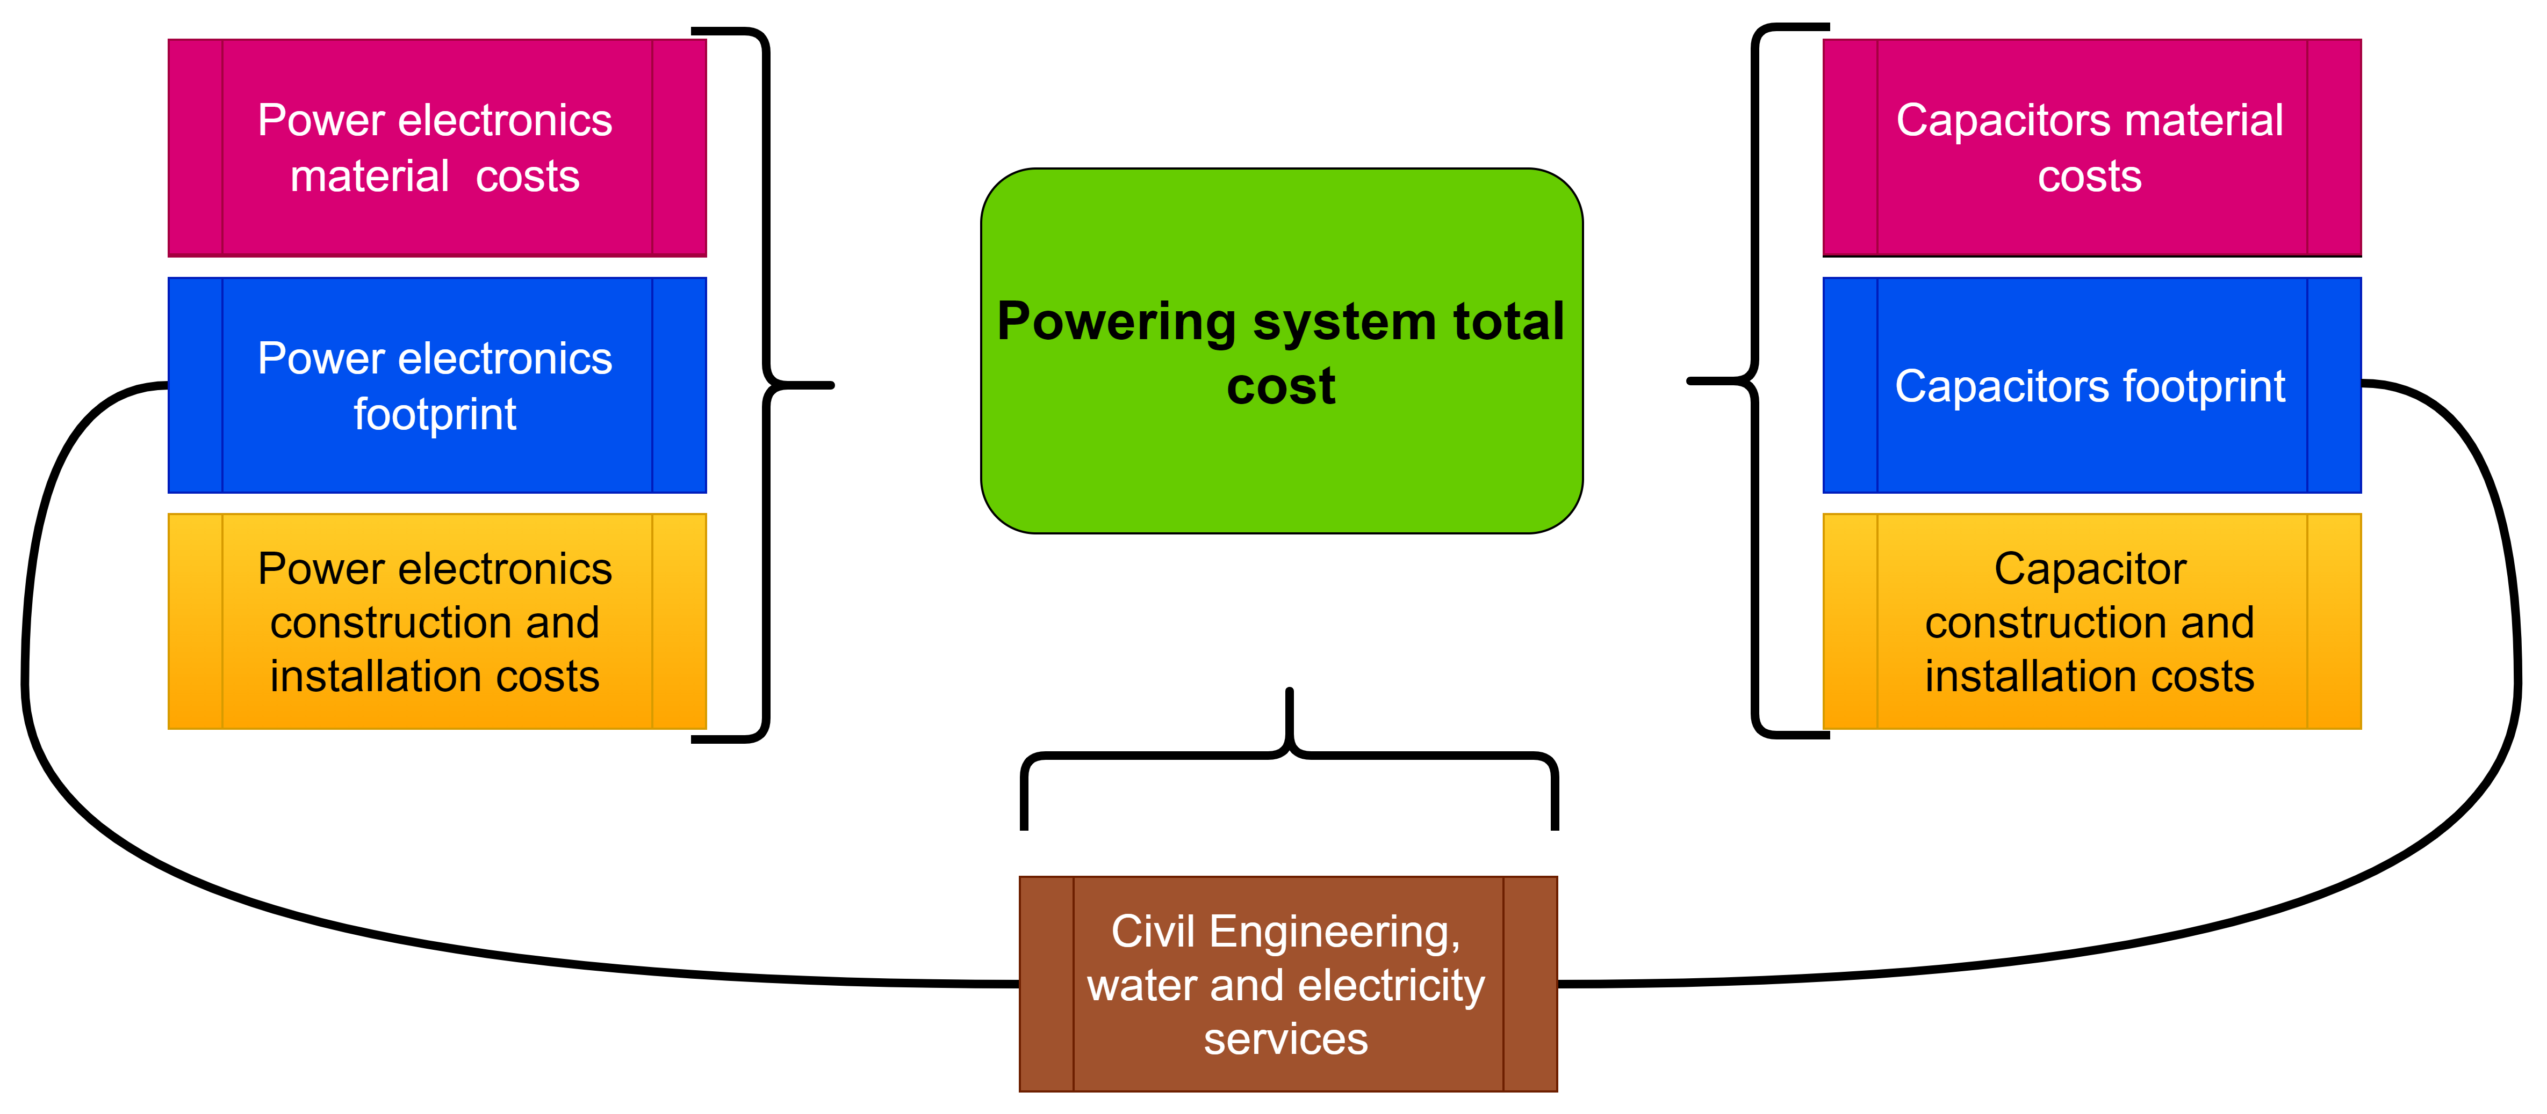
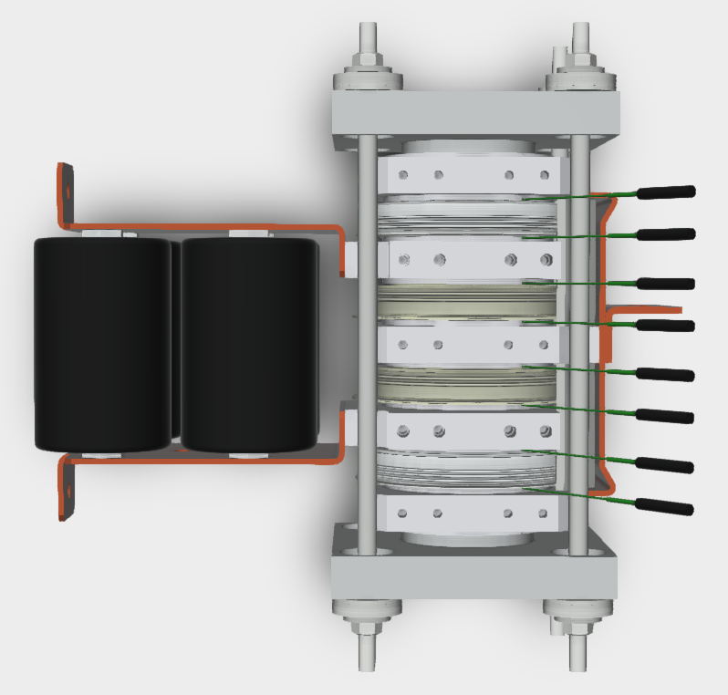
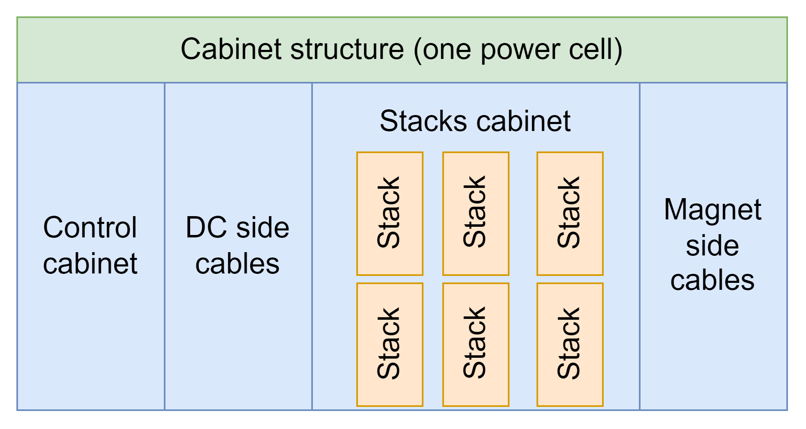
PE cost model
IGBTs\diodes
Cooling plates
Stack mechanics
PE cost model consists of:
  Capacitors + storing containers
  IGBTs\diodes + cooling plates + mechanics for stack
  Cabinets (space for cables, stacks and control)
  Control
  Buildings
  No cables included yet
PE cost model is a bottom-up model including discrete modelling of the IGBTs\diodes and the stacks. (A dictionary with different press-pack IGBTs is used as an input)

Slide 19

Results cost optimization
Costs are calculated for RCS2 which consists of 2540m of normal conducting dipole magnets.
 | H-type (full steel) | H-type (Vacoflux + steel)
Costs pole [pu] | 0.012 | 0.042
Costs joke [pu] | 0.111 | 0.103
Costs conductors [pu] | 0.019 | 0.019
Total magnet costs [pu] | 0.142 | 0.164
Costs capacitors [pu] | 0.050 | 0.047
Costs power electronics¹ [pu] | 0.611 | 0.567
Cost losses magnets² [pu] | 0.151 | 0.150
Cost losses PE² [pu] | 0.041 | 0.043
Total costs [pu] | 0.995 | 0.971
¹ Due to the discrete IGBT model in the overall cost model the costs are slightly overestimated and probably can be reduced by 30% to 40%.
² Operational costs are considered only for the losses in the IGBTs and the magnet (no cables). The assumption is 20 years of operation with 6000h per year and costs of 90 U/MWh.

Slide 20
Conclusions
Optimal dipole: we have just scratched the surface. More optimization exercises are required. Dipole class is too slow. Analytical models from UNIBO will help speeding it up; A quick computation of conductor losses could come from integral of the energy in the conductor (UNILAVAL). Can we implement this analytically?
Resistance and Inductance modeling: We assumed sinusoidal excitation. It is an approximation. We need transient approach to input the real current shape;
Cost model: Basic implementation is done. Cables should be included but how? Is installation in tunnels possible? Also, validation of the magnet model by a magnet expert is required;

Slide 21
END
Questions?

Slide 22

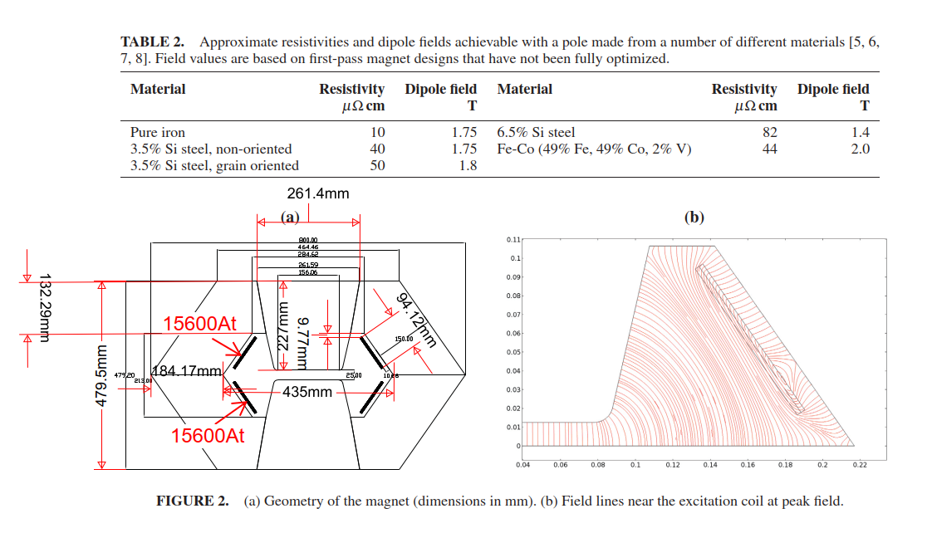
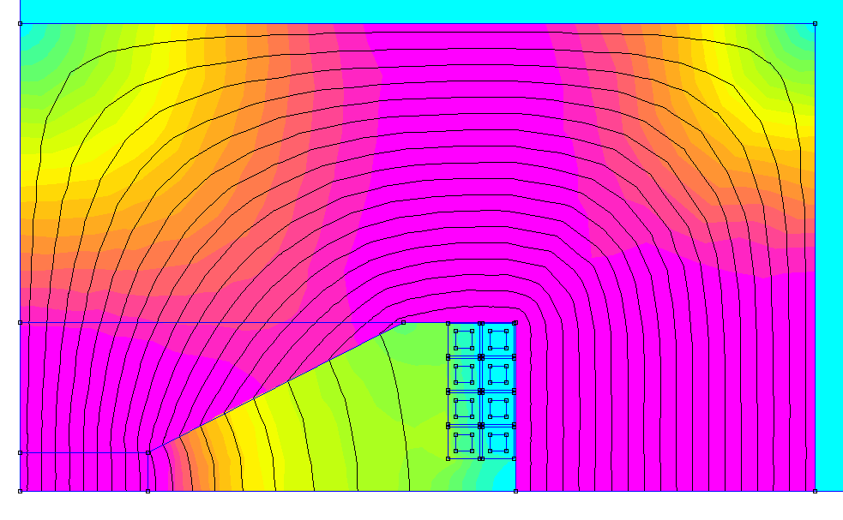

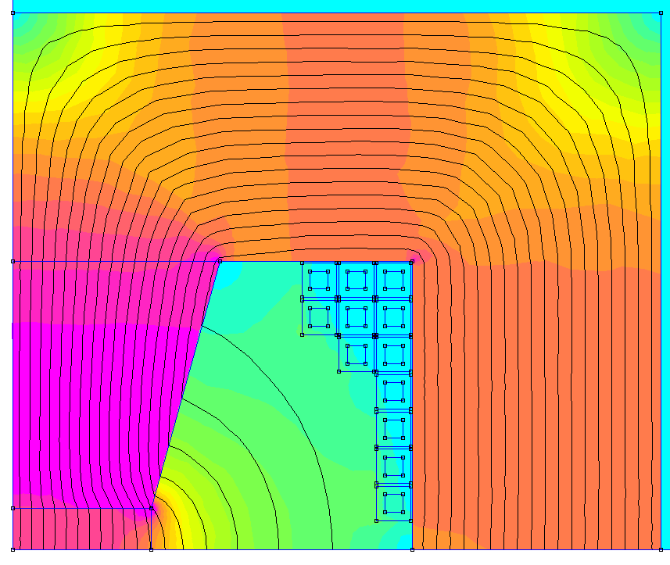
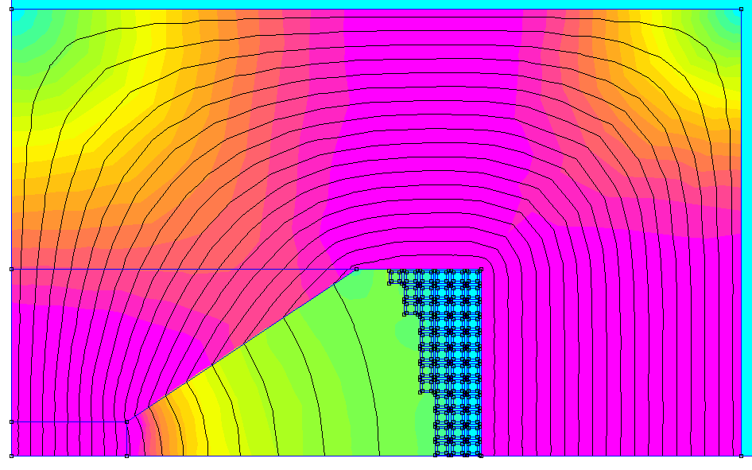

We can have two dipole topologies:
Air cooled with flat conductors
Water cooled with hollow conductors
Flat air-cooled conductors
The dipole class cannot generate flat conductor configurations. I’d like to implement this feature
The dipole class can generate all sort of configuration with hollow conductors as shown here. The strong asymmetrical ones shall be removed. A modification of the Dipole class is required
Hollow water-cooled conductors
Total width: 0.62m
0.47m
0.63m
Total Height: 0.37m
0.39m
0.39m
0.12m
0.11m
0.09m
13.5mm
Mmf=47070 At;
Sigmapulse=20 A;
IronLosses: 68 J/m/pulse
joke: 59 J/m/pulse
poles: 9 J/m/pulse
Coil Losses: 506 J/m/pulse
Tot NRG: 8500 J/m
Mmf=47700 At;
Sigmapulse=20 A;
IronLosses: 72 J/m/pulse
joke: 61 J/m/pulse
poles: 11 J/m/pulse
Coil Losses: 8300 J/m/pulse
13.5mm
6.8mm
Mmf=52950 At;
Sigmapulse=15 A;
IronLosses: 62 J/m/pulse
joke: 47 J/m/pulse
poles: 15 J/m/pulse
Coil Losses: 392 J/m/pulse
Tot NRG: 6500 J/m
13.5mm
3mm
13.5mm
6.8mm
3mm
1mm

