Slide 1


The Target Solenoid – Cooling margin and quench protection
L. Bottura, C. Accettura, A. Kolehmainen, CERN
J. Lorenzo Gomez, A. Portone, P. Testoni, F4E
mmWG 18 April 2024
Partly funded by the European Union under
Grant Agreement n. 101094300

Slide 2
Outline
Re-cap on the target and capture solenoid magnet design (v.2022)
Cooling at 20 K
Conductor analyses
Conclusions

Slide 3
Outline
Re-cap on the target and capture solenoid magnet design (v.2022)
Cooling at 20 K
Conductor analyses
Conclusions

Slide 4
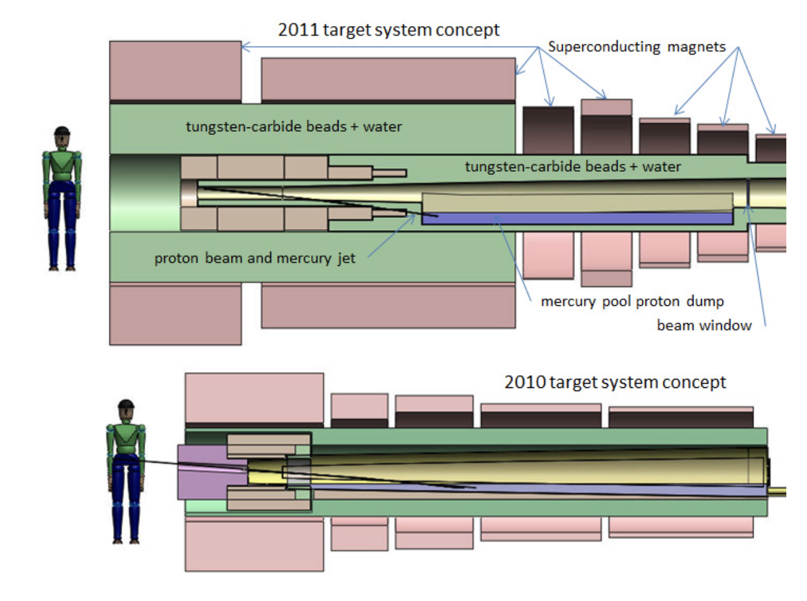
Target and capture solenoid – 1/4
Superconducting (LTS) outsert
Rad-hard resistive insert
Field on target 20 T, 150 mm
Beam power on target: 1…2 MW
Large stored energy o(2) GJ, mass o(300) tons, cost o(100) M

Slide 5
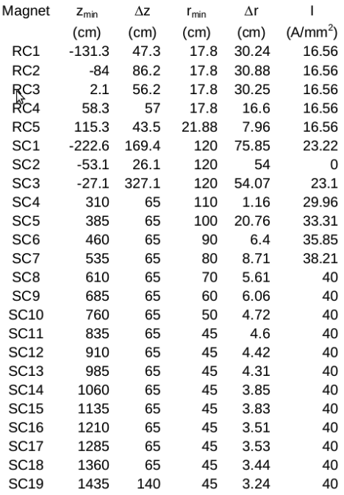
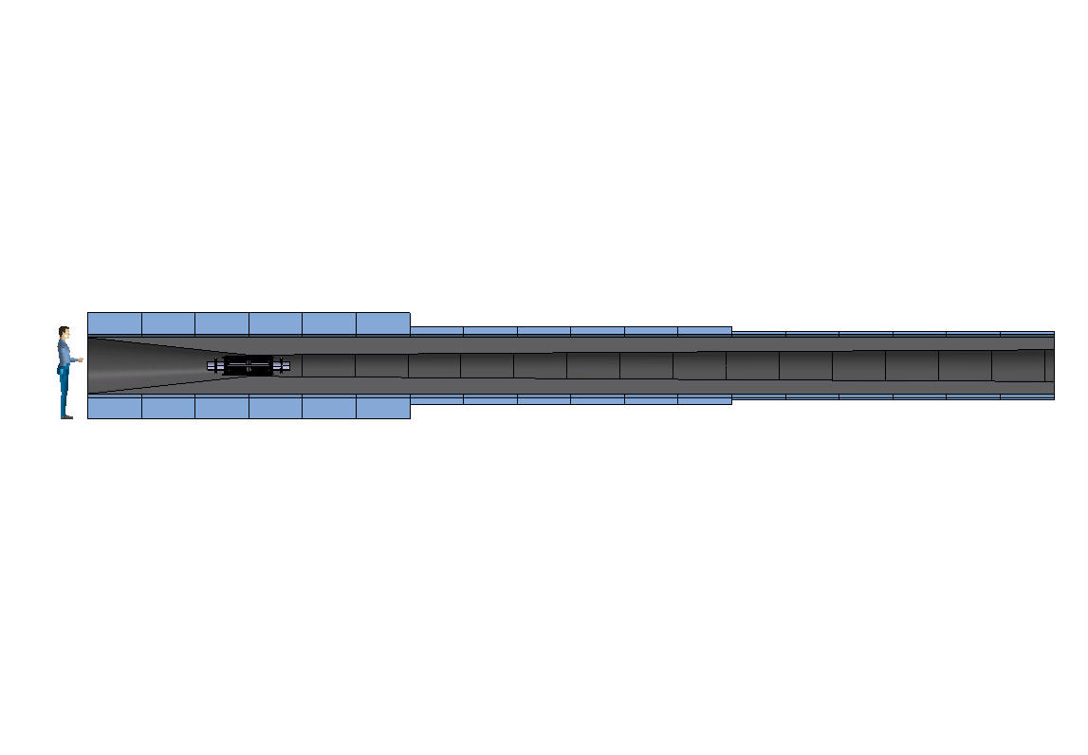
Target and capture – 2/4
Reduce the mass (CAPEX) of the system, and increase operating temperature to improve cryogenic CoP (OPEX)
US-MAP 2010 design
LTS (14 T) + NC (6 T)
US-MAP 2011 design
LTS (14 T) + NC (6 T)
H.G. Kirk, PAC 2011
MuCol 2022 design
HTS (20 T, 20 K)

Slide 6
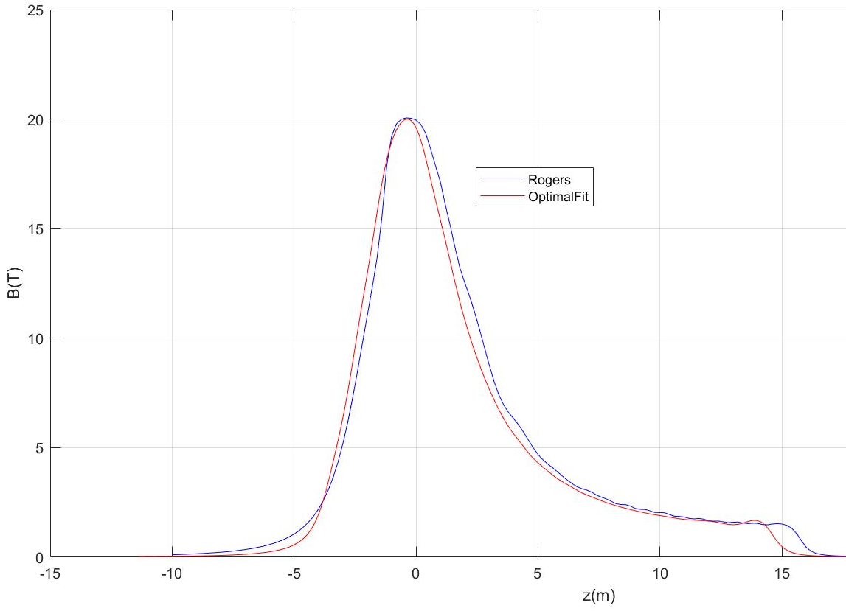
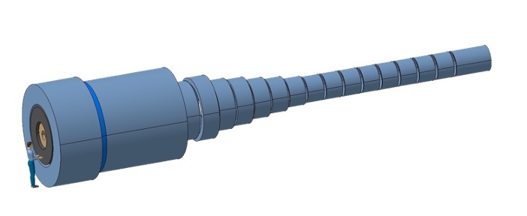
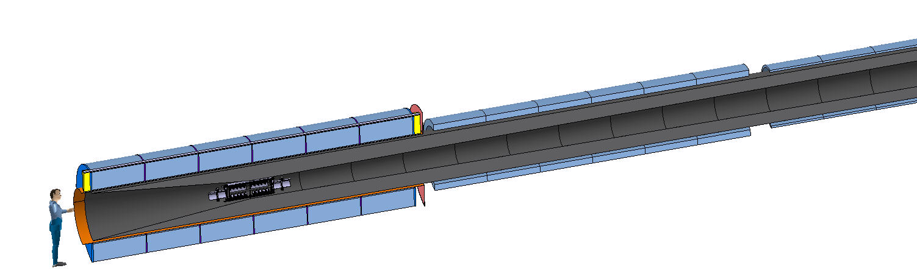
Target and capture – 3/4
E_{M} = 2.9 GJ
T_{op} = 4.2 K
M_{coils} = 200 tons
M_{shield} = 300 tons
P = 12 MW
Field profile matches the requirements from beam optics
US-MAP
Proposal
Remove resistive insert (10 MW)
Use HTS to achieve field of 20 T
Reduce shield thicknes, accepting higher heat load at 20 K
E_{M} = 1 GJ
T_{op} = 10…20 K
M_{coils} = 110 tons
M_{shield} = 196 tons
P = 1MW

Slide 7
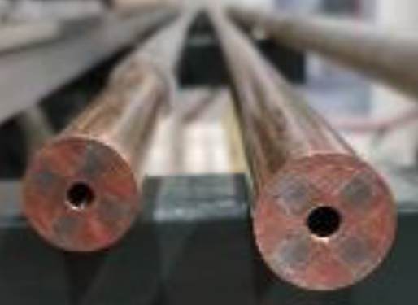
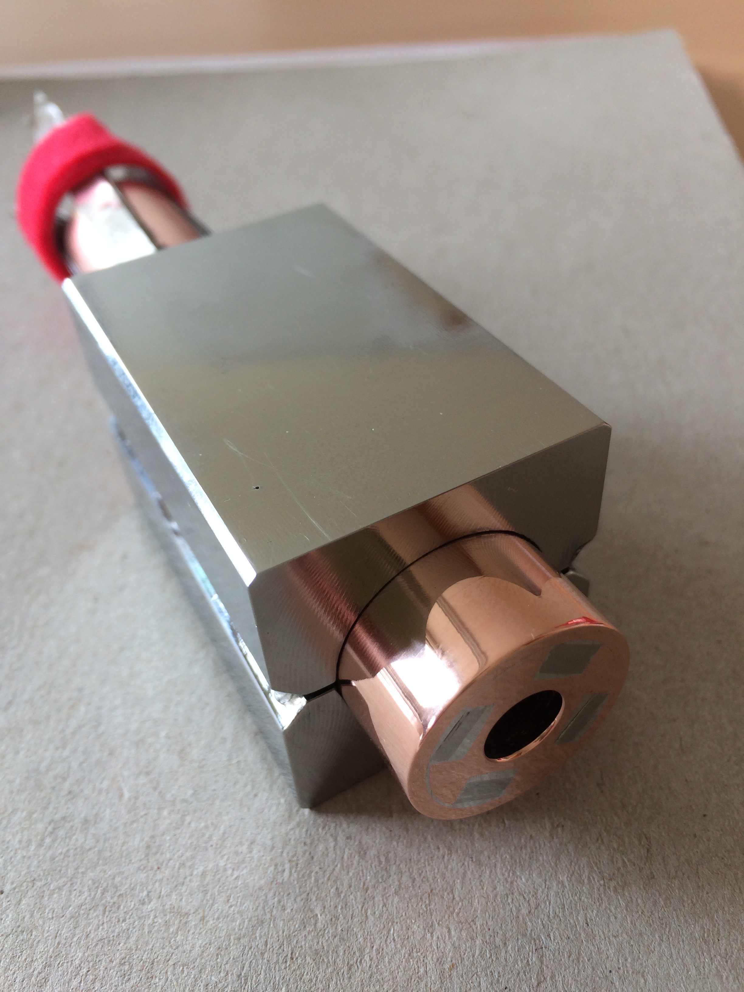
Target and capture – 4/4
Operating current: 58 kA
Operating field: 20 T
Operating temperature: 20 K
MIT “VIPER” conductor
HTS conductor design
STAINLESS STEEL JACKET
STAINLESS STEEL WRAP
COPPER FORMER
SOLDERED HTS STACK
COOLING CHANNEL
M. Takayasu et al., IEEE TAS, 21 (2011) 2340
Z. S. Hartwig et al., SUST, 33 (2020) 11LT01
8
23.5
39.5
Looks much like an HTS magnet for fusion !!!

Slide 8
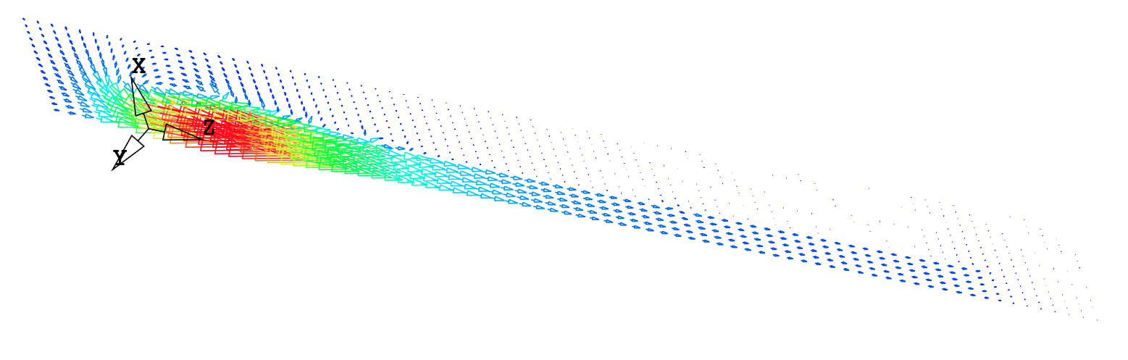
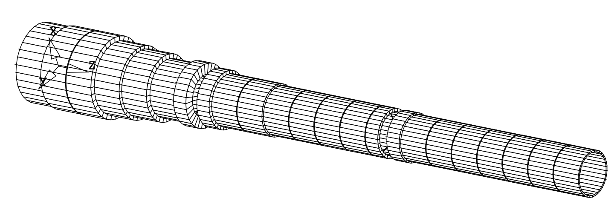
Coil geometry
Coil | Rc (m) | Zc (m) | dR (m) | dZ (m) | Layers (-) | Pancakes (-) | Iconductor (A) | Turns (-) | Icoil (MA-turn) | Lpancake (m)
1 | 0.849 | -0.185 | 0.498 | 0.83 | 12 | 20 | 58905 | 240 | 14.14 | 64.0
2 | 0.87 | 0.665 | 0.54 | 0.83 | 13 | 20 | 60710 | 260 | 15.78 | 71.1
3 | 0.87 | 1.515 | 0.54 | 0.83 | 13 | 20 | 60392 | 260 | 15.70 | 71.1
4 | 0.808 | 2.365 | 0.415 | 0.83 | 10 | 20 | 51654 | 200 | 10.33 | 50.8
5 | 0.766 | 3.215 | 0.332 | 0.83 | 8 | 20 | 47469 | 160 | 7.60 | 38.5
6 | 0.704 | 4.065 | 0.208 | 0.83 | 5 | 20 | 46504 | 100 | 4.65 | 22.1
7 | 0.745 | 4.708 | 0.291 | 0.415 | 7 | 10 | 46293 | 70 | 3.24 | 32.8
8 | 0.704 | 5.423 | 0.208 | 0.415 | 5 | 10 | 53168 | 50 | 2.66 | 22.1
9 | 0.662 | 6.065 | 0.125 | 0.83 | 3 | 20 | 43280 | 60 | 2.60 | 12.5
10 | 0.662 | 6.915 | 0.125 | 0.83 | 3 | 20 | 42146 | 60 | 2.53 | 12.5
11 | 0.642 | 7.765 | 0.083 | 0.83 | 2 | 20 | 49452 | 40 | 1.98 | 8.1
12 | 0.642 | 8.615 | 0.083 | 0.83 | 2 | 20 | 44183 | 40 | 1.77 | 8.1
13 | 0.642 | 9.465 | 0.083 | 0.83 | 2 | 20 | 39567 | 40 | 1.58 | 8.1
14 | 0.642 | 10.315 | 0.083 | 0.83 | 2 | 20 | 32713 | 40 | 1.31 | 8.1
15 | 0.642 | 10.958 | 0.083 | 0.415 | 2 | 10 | 46717 | 20 | 0.93 | 8.1
16 | 0.642 | 11.673 | 0.083 | 0.415 | 2 | 10 | 45905 | 20 | 0.92 | 8.1
17 | 0.621 | 12.315 | 0.042 | 0.83 | 1 | 20 | 52310 | 20 | 1.05 | 3.9
18 | 0.621 | 13.165 | 0.042 | 0.83 | 1 | 20 | 56056 | 20 | 1.12 | 3.9
19 | 0.621 | 14.015 | 0.042 | 0.83 | 1 | 20 | 51602 | 20 | 1.03 | 3.9
20 | 0.621 | 14.865 | 0.042 | 0.83 | 1 | 20 | 51376 | 20 | 1.03 | 3.9
21 | 0.621 | 15.715 | 0.042 | 0.83 | 1 | 20 | 50471 | 20 | 1.01 | 3.9
22 | 0.621 | 16.565 | 0.042 | 0.83 | 1 | 20 | 52861 | 20 | 1.06 | 3.9
23 | 0.621 | 17.415 | 0.042 | 0.83 | 1 | 20 | 57438 | 20 | 1.15 | 3.9
Focus on coil C02 (highest current, highest field, higest energy)

Slide 9
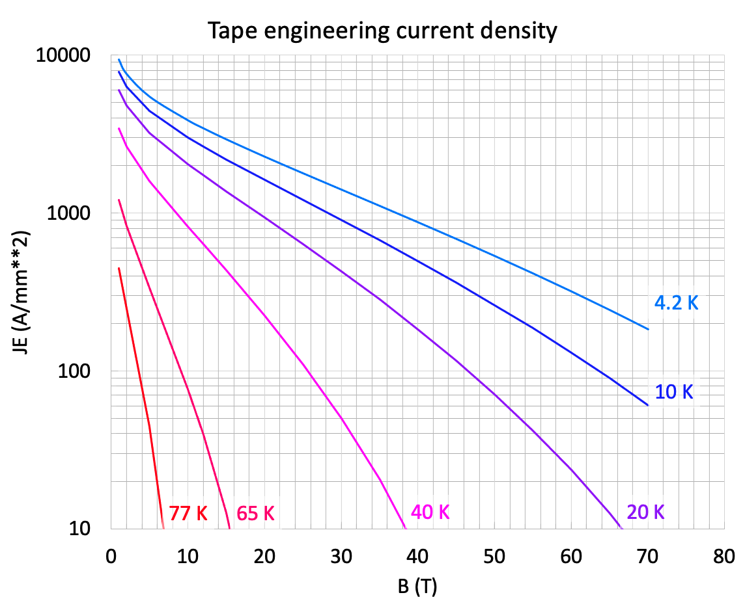

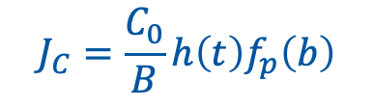




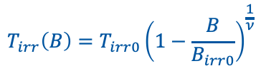
Conductor design
$$J_{C}=\frac{C_{0}}{B}h\left(t\right)f_{p}\left(b\right)$$
HTS tape thickness | (mm) | 62
HTS tapes | (-) | 80
HTS stack width | (mm) | 6
HTS stack thickness | (mm) | 5
HTS stack width | (mm) | 6
HTS tapes | (-) | 80
Number of HTS stacks | (-) | 4
Copper diameter | (mm) | 23
Hole diameter | (mm) | 8
Wetted perimeter | (mm) | 25
Wrap thickness | (mm) | 0.25
Jacket outer dimension | (mm) | 39.5
A_{SC} | (mm²) | 4.2
A_{Substrate} | (mm²) | 77
A_{Cu} | (mm²) | 361
A_{Helium} | (mm²) | 50
A _{Wrap} | (mm²) | 18
A_{Jacket} | (mm²) | 1127
A_{Cable Space} | (mm²) | 511
A_{Conductor} | (mm²) | 1560
$$B_{irr}\left(T\right)=B_{irr0}\left(1−{\frac{T}{T_{irr0}}}^{ν}\right)$$
930 A/mm²
$$T_{irr}\left(B\right)=T_{irr0}{\left(1−\frac{B}{B_{irr0}}\right)}^{\frac{1}{ν}}$$
$$h\left(t\right)=\left(1−t^{ν}\right)\left(1−t^{m}\right)$$
$$f_{p}\left(b\right)=b^{p}{\left(1−b\right)}^{q}$$
$$t=\frac{T}{T_{irr0}}$$
$$b=\frac{B}{B_{irr}\left(T\right)}$$
I_{op} = 61 kA
B_{op} = 20 T
T_{op} = 20 K
T_{cs} = 29.7 K

Slide 10
Outline
Re-cap on the target and capture solenoid magnet design (v.2022)
Cooling at 20 K
Conductor analyses
Conclusions

Slide 11
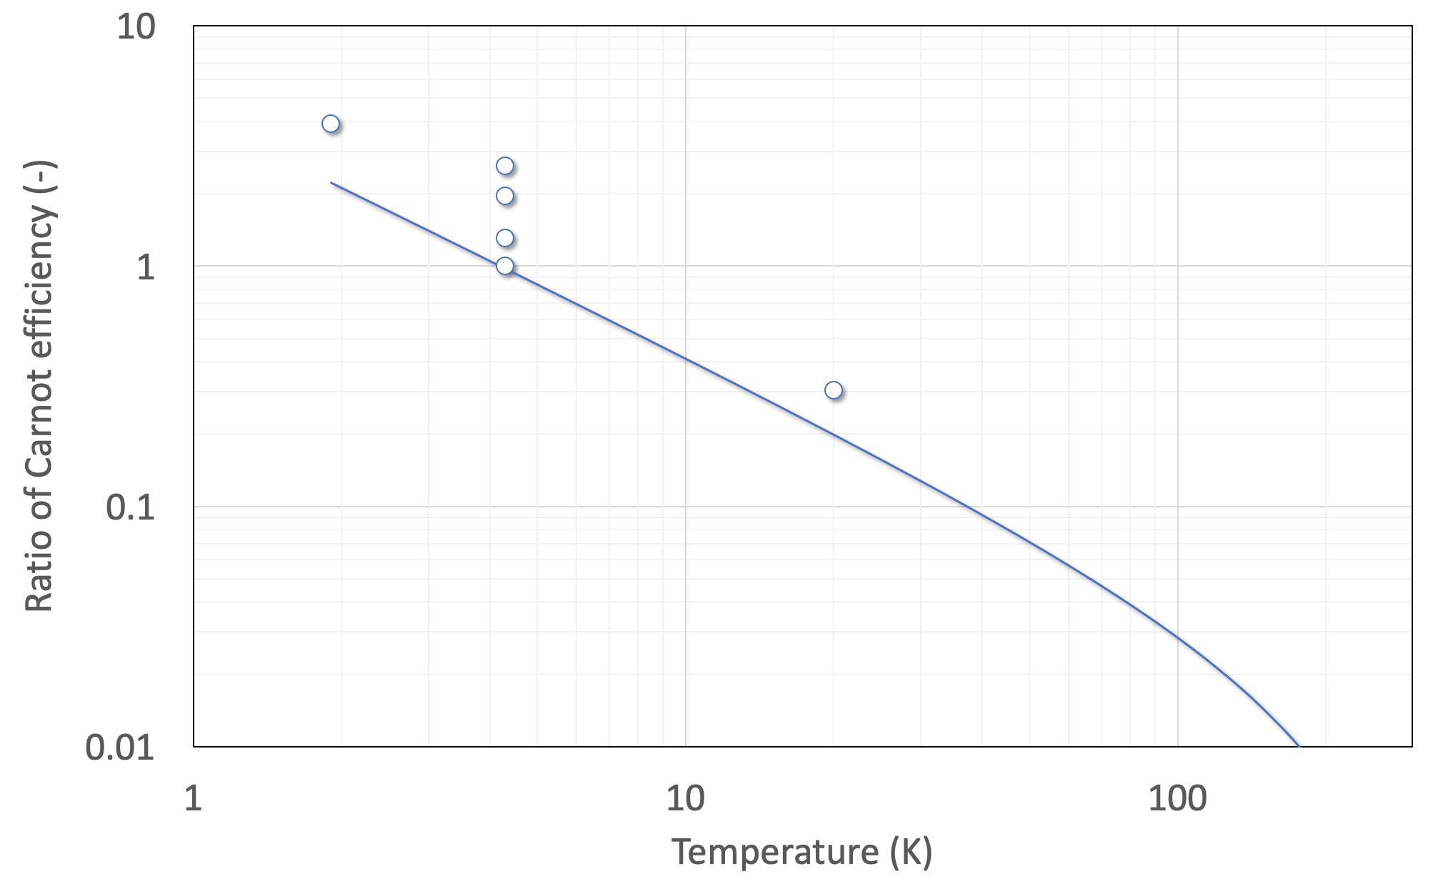
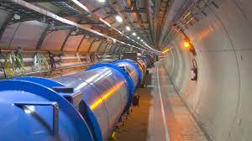
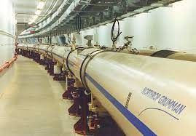
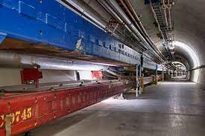
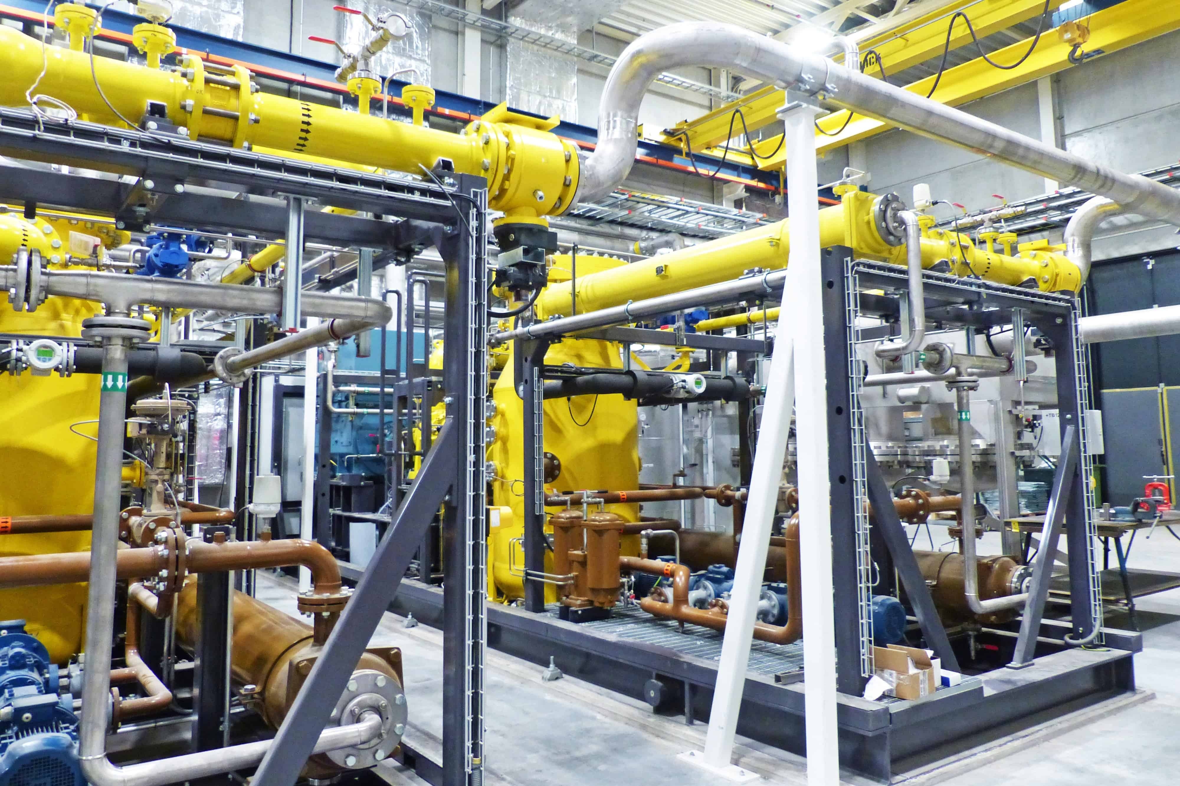
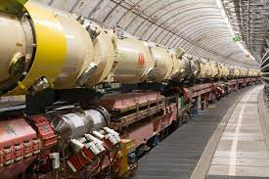
Energy efficient cryogenics
W/Q = (T_{h}-T_{c})/T_{c}
Credits to P. De Sousa and R. Van Weelderen, CERN
LHC
(FCC)
Need efficient cryo-plant and heat removal scheme in the range of 10…20 K (see work at ESS)
RHIC
Tevatron
HERA
LHC
Nb-Ti
8T
5T
ESS
The 60…80 K range would be a dream…
Nb₃Sn
16T
12…14T
This could be the best range of operating temperature of a future HEP collider
HTS
40…60T
20…40T
a few T
1.9
4.2
77
HTS may be the only path towards a future collider

Slide 12
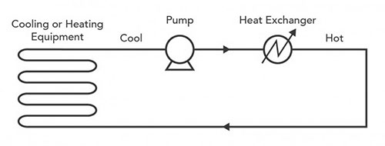
Cooling in closed loop
Work
Heat removed
Coil
Re-circulator
Heat
exchanger
Heat load
The work performed by the pump to circulate the coolant appears at the heat exchanger as an additional heat load

Slide 13
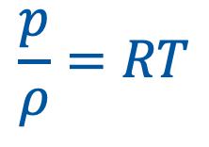
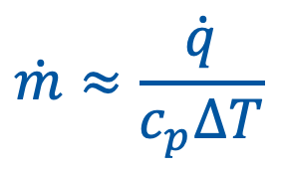
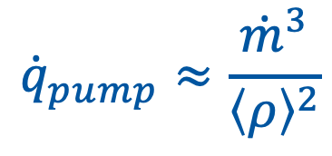

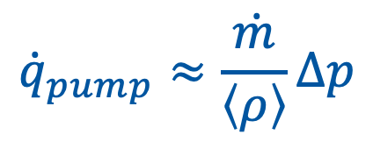
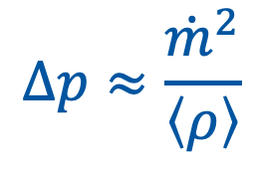
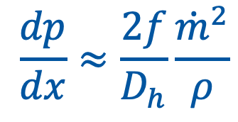
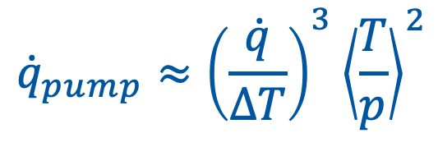
Heat load from recirculation
State equation
$$\frac{p}{ρ}=RT$$
Heat removed
$$\dot{m}≈\frac{\dot{q}}{c_{p}ΔT}$$
Pressure drop
$$\dot{m}Δh=\dot{q}$$
$$\frac{dp}{dx}≈\frac{2f}{D_{h}}\frac{{\dot{m}}^{2}}{ρ}$$
$$Δp≈\frac{{\dot{m}}^{2}}{\left\langle ρ\right\rangle }$$
$${\dot{q}}_{pump}≈\frac{\dot{m}}{\left\langle ρ\right\rangle }Δp$$
$${\dot{q}}_{pump}≈\frac{{\dot{m}}^{3}}{{\left\langle ρ\right\rangle }^{2}}$$
$${\dot{q}}_{pump}≈{\left(\frac{\dot{q}}{ΔT}\right)}^{3}{\left\langle \frac{T}{p}\right\rangle }^{2}$$

Slide 14
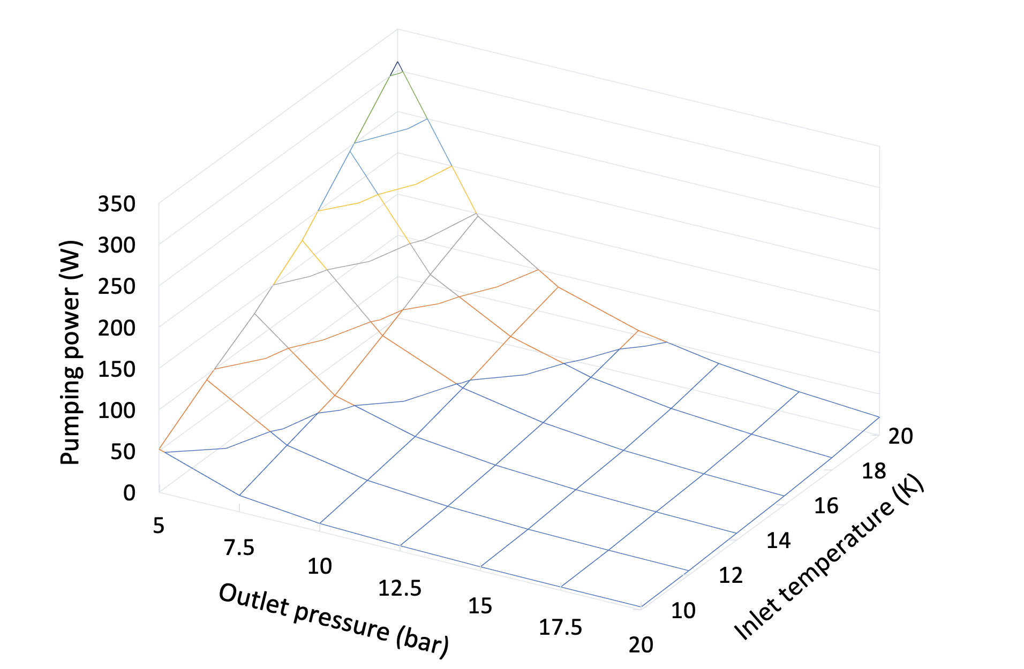
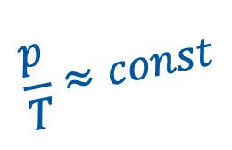
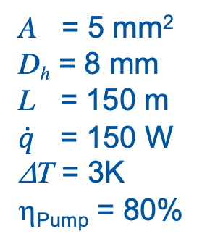

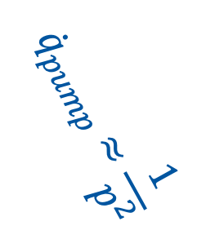
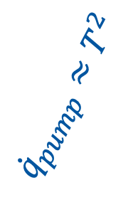
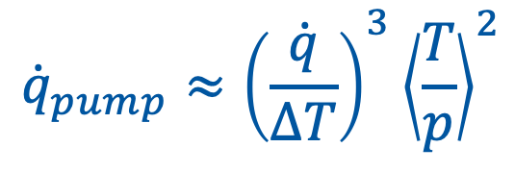
Parametric study
$${\dot{q}}_{pump}≈{\left(\frac{\dot{q}}{ΔT}\right)}^{3}{\left\langle \frac{T}{p}\right\rangle }^{2}$$
A = 5 mm²
D_{h} = 8 mm
L = 150 m
$\dot{q}$ = 150 W
ΔT = 3K
η_{Pump} = 80%
$${\dot{q}}_{pump}≈\frac{1}{p^{2}}$$
$${\dot{q}}_{pump}≈T^{2}$$
$$\frac{p}{T}≈const$$
$${\dot{q}}_{pump}≈const$$

Slide 15
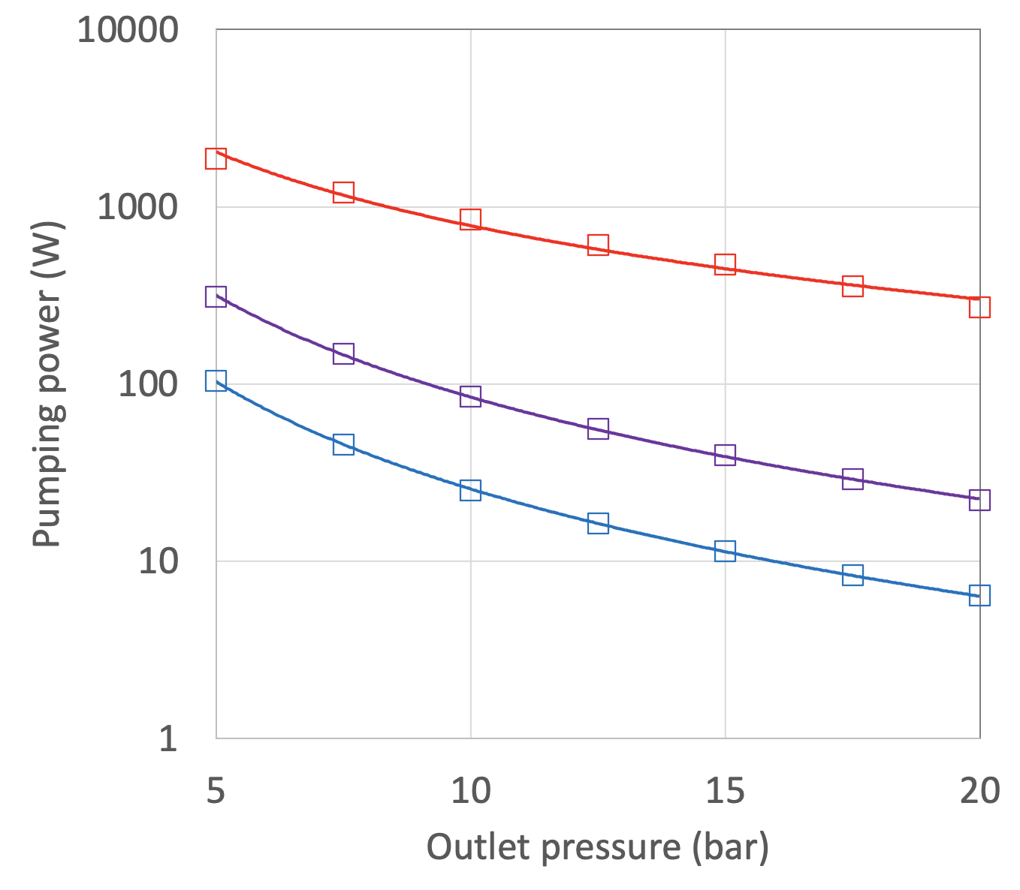
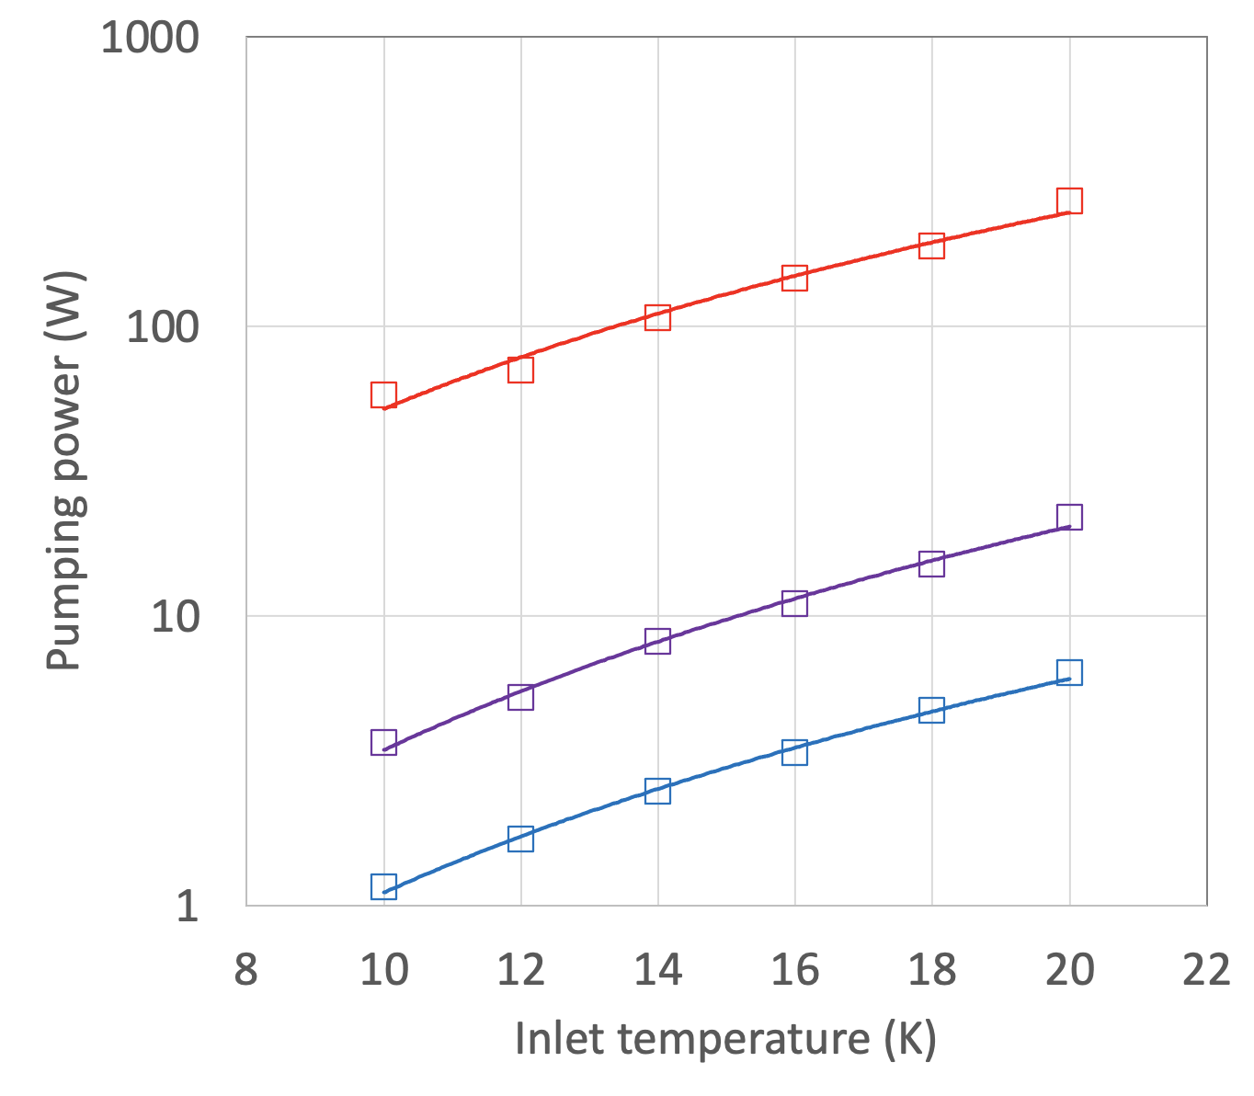
Optimal cooling conditions
150 W
20 bar outlet
ΔT = 1 K
ΔT = 1 K
ΔT = 3 K
ΔT = 3 K
150 W
20 K inlet
ΔT = 5 K
ΔT = 5 K
Compared to typical conditions at 4.5 K, operation at 20 K implies
  High pressure, o(20) bar
  Large temperature increase, o(3) K

Slide 16
Outline
Re-cap on the target and capture solenoid magnet design (v.2022)
Cooling at 20 K
Conductor analyses
Conclusions

Slide 17
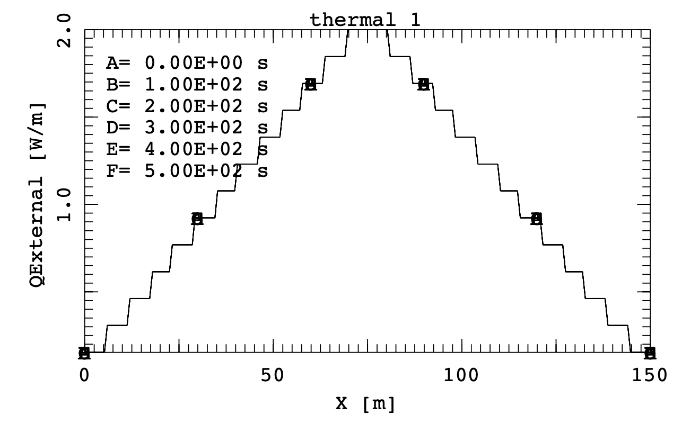
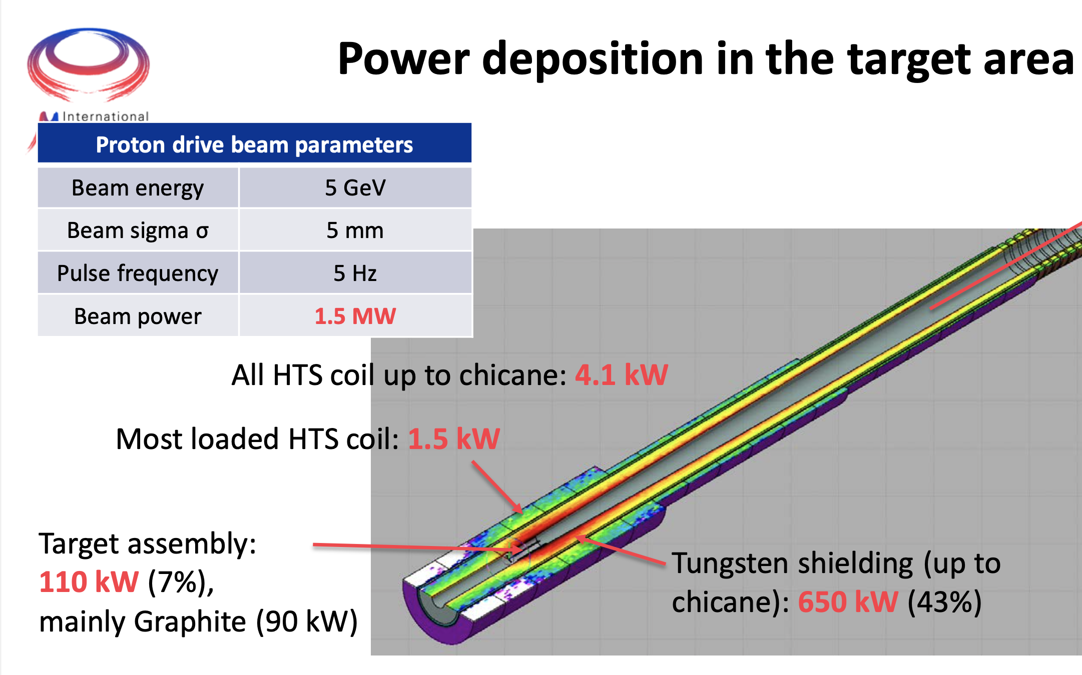
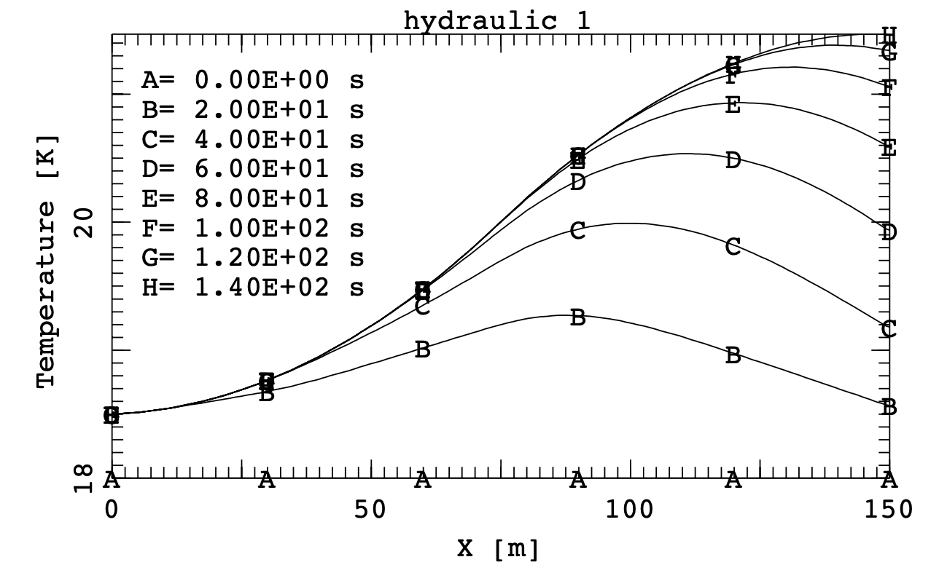
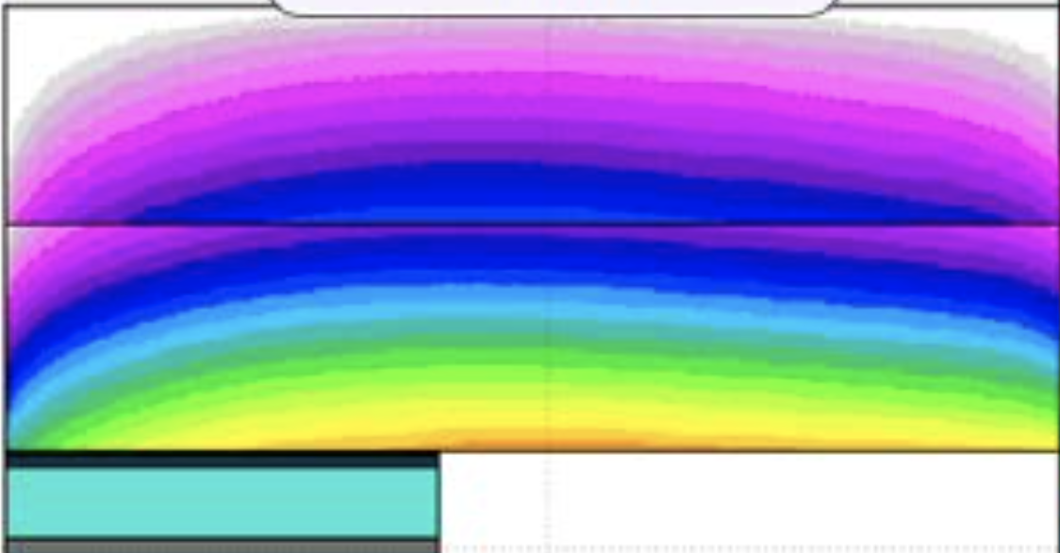
Cooling
NOTE: time stucture ignored
2 W/m peak
total heat
150 W
Innermost turns
13 layers
13 layers
Low field
Double pancake length (m)
Low field
in
out
in
out
High field
in
out
in
out
in
out
Total heat in the coil 4.1 kW
in
out
in
out
in
out
coil
3 K
shield
Proton beam
target
D. Calzolari and A. Lechner, CERN
Double pancake length (m)

Slide 18
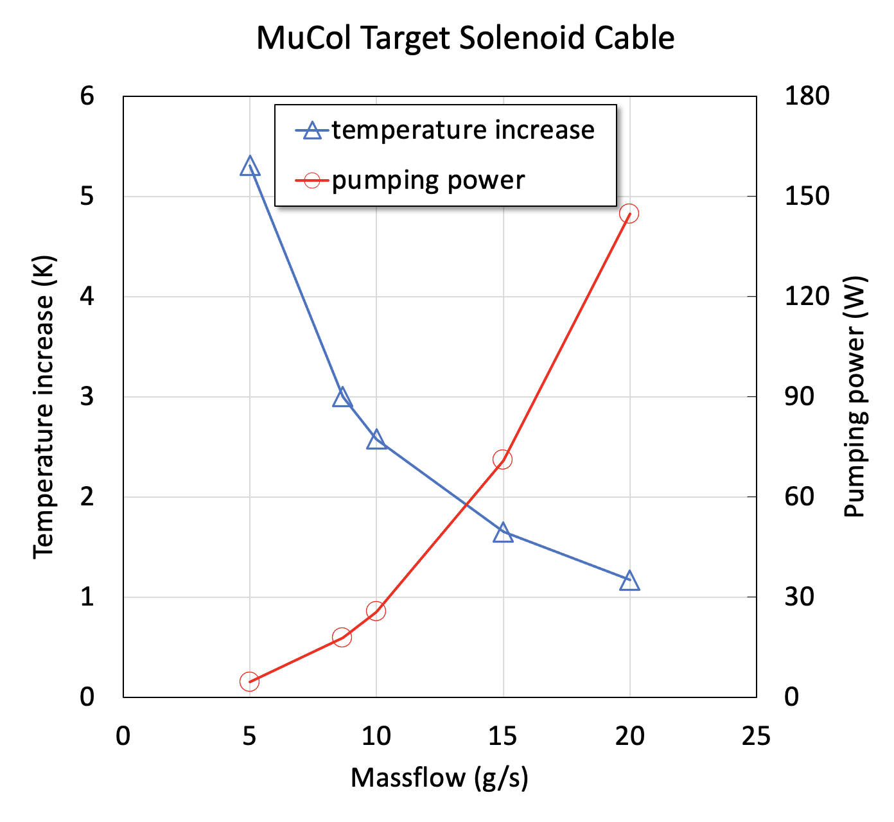
Nominal cooling condition
A flow dm/dt of approximately 8 g/s is required to remove a nuclear heat load of 150 W with a temperature increase ΔT of 3 K
With this flow the pumping loss is about 20 W (considering an adiabatic efficiency η_{pump} of 80 %)
This is about 13 % of the nuclear heat load, and is an acceptable overhead
It would be possible to remove higher heat loads under the same temperature increase, but the pumping loss grows rapidly, approximately like (dm/dt)³
3 K
8.66 g/s
17.8 W

Slide 19
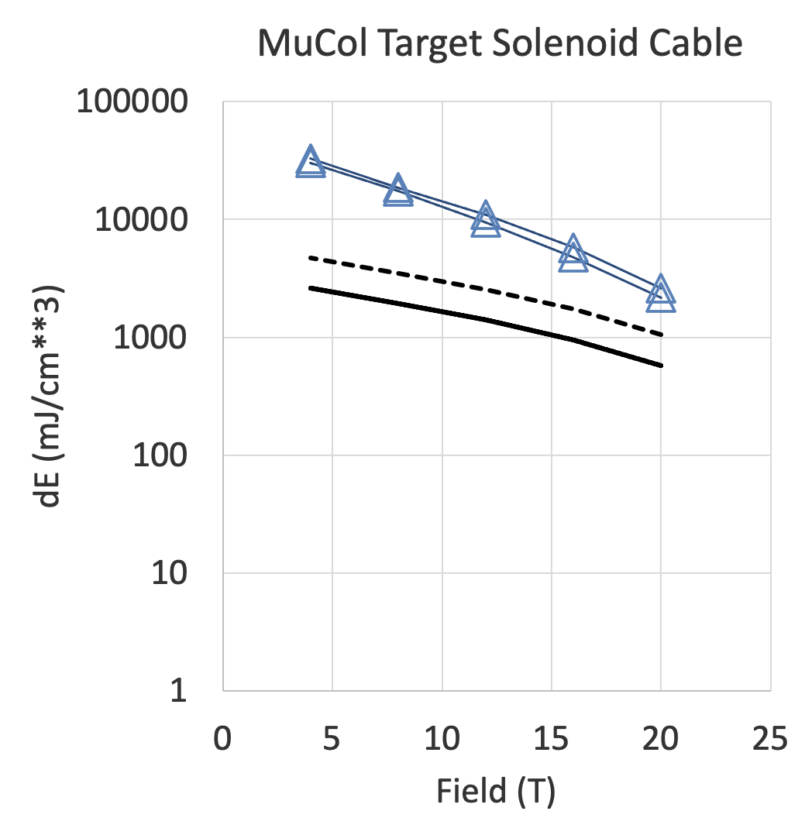
Margin and stability – 1/3
Values of stability margin are (as expected) very high ! It is very unlikely that the cable will quench because of transient heat inputs
The stability margin is well above the enthalpy reserve of the cable, also including helium. The reason is that the transient is slow, and there is time to conduct and convect heat away even for very large INZ lengths
This effect is even more marked at low field (high temperature margin)
INZ = 0.1 m
INZ = 1 m
Cable+He enthalpy
Cable enthalpy
Operating current 61 kA
Operating temperature 20 K

Slide 20
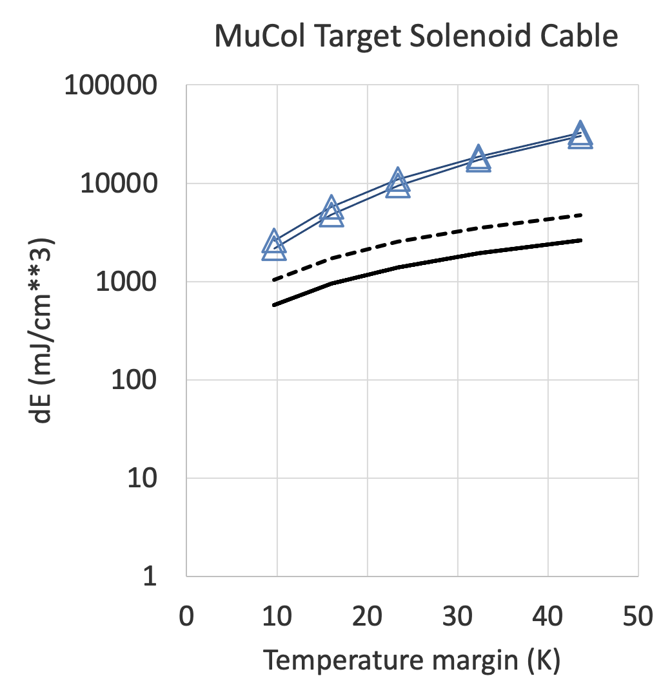
Margin and stability – 2/3
The temperature margin ΔT is about 10 K at nominal conditions of current, field and temperature
  I_{op} = 61 kA
  B_{op} = 20 T
  T_{op} = 20 K
In the low field regions of the coil (e.g. 4 T) the temperature margin is above 40 K
The large stability in the low field region may make protection difficult ?
8 T
4 T
12 T
16 T
Cable+He enthalpy
20 T
Cable enthalpy
Operating current 61 kA
Operating temperature 20 K

Slide 21
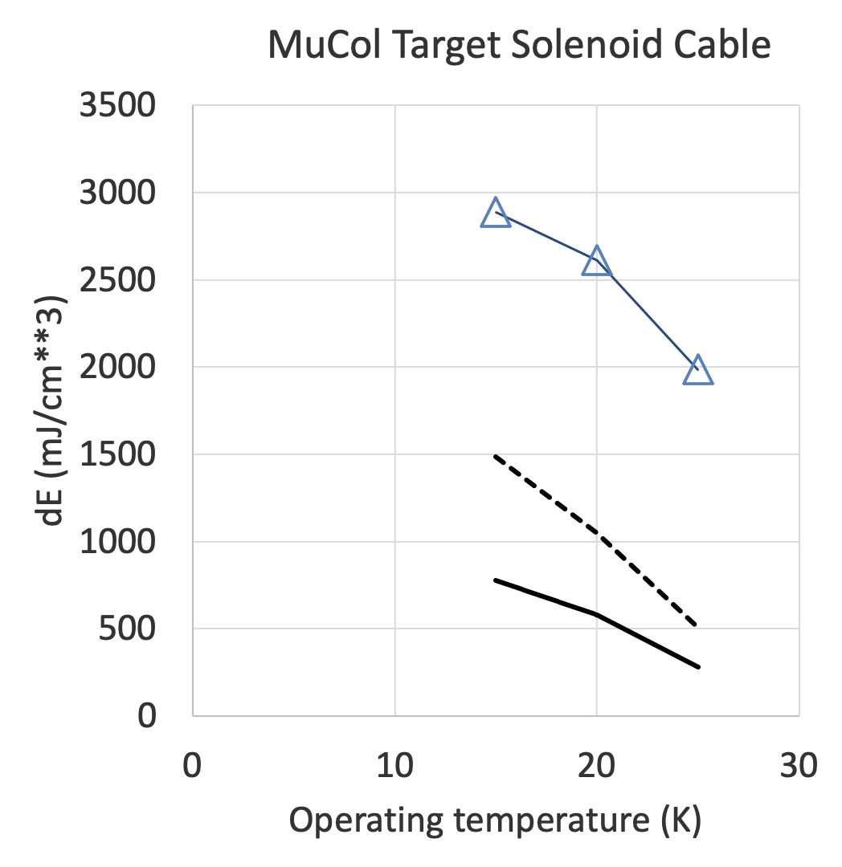
Margin and stability – 3/3
Operating at higher temperature than 20 K (e.g. 25 K) may still be an option, the energy margin is substantial
Operating at lower temperature than 20 K (e.g. 15 K) does not bring a substantial benefit in energy margin
  Recall that the heat capacity drops dramatically at low temperature
Operating current 61 kA
Operating field 20 T
Cable+He enthalpy
Cable enthalpy

Slide 22
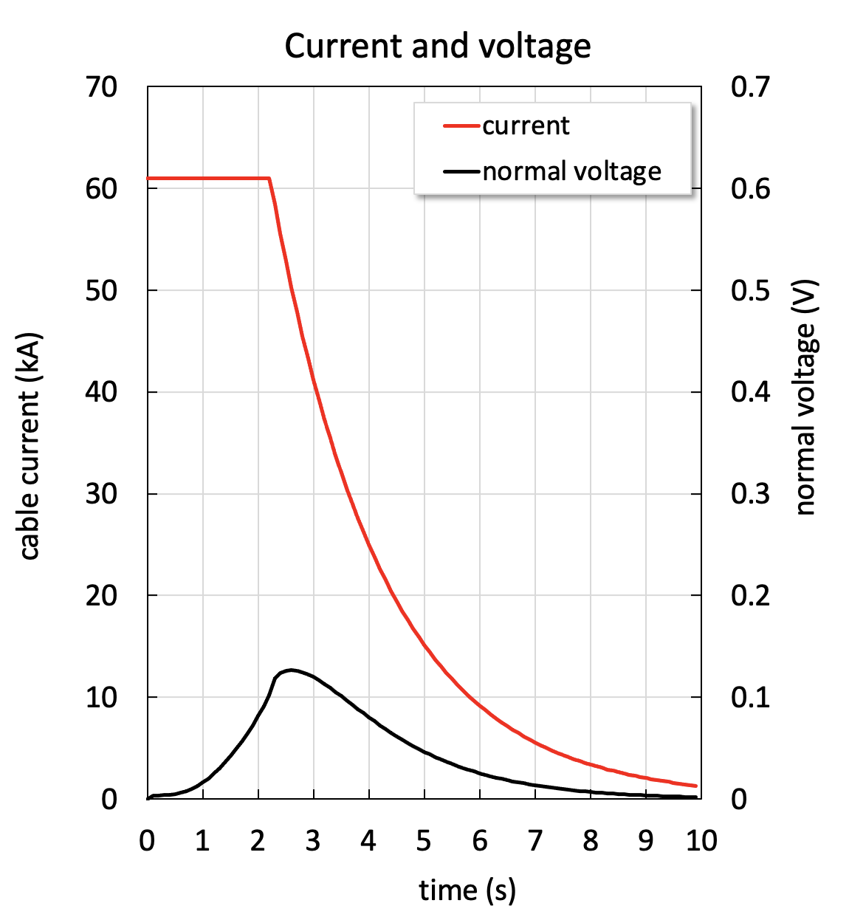
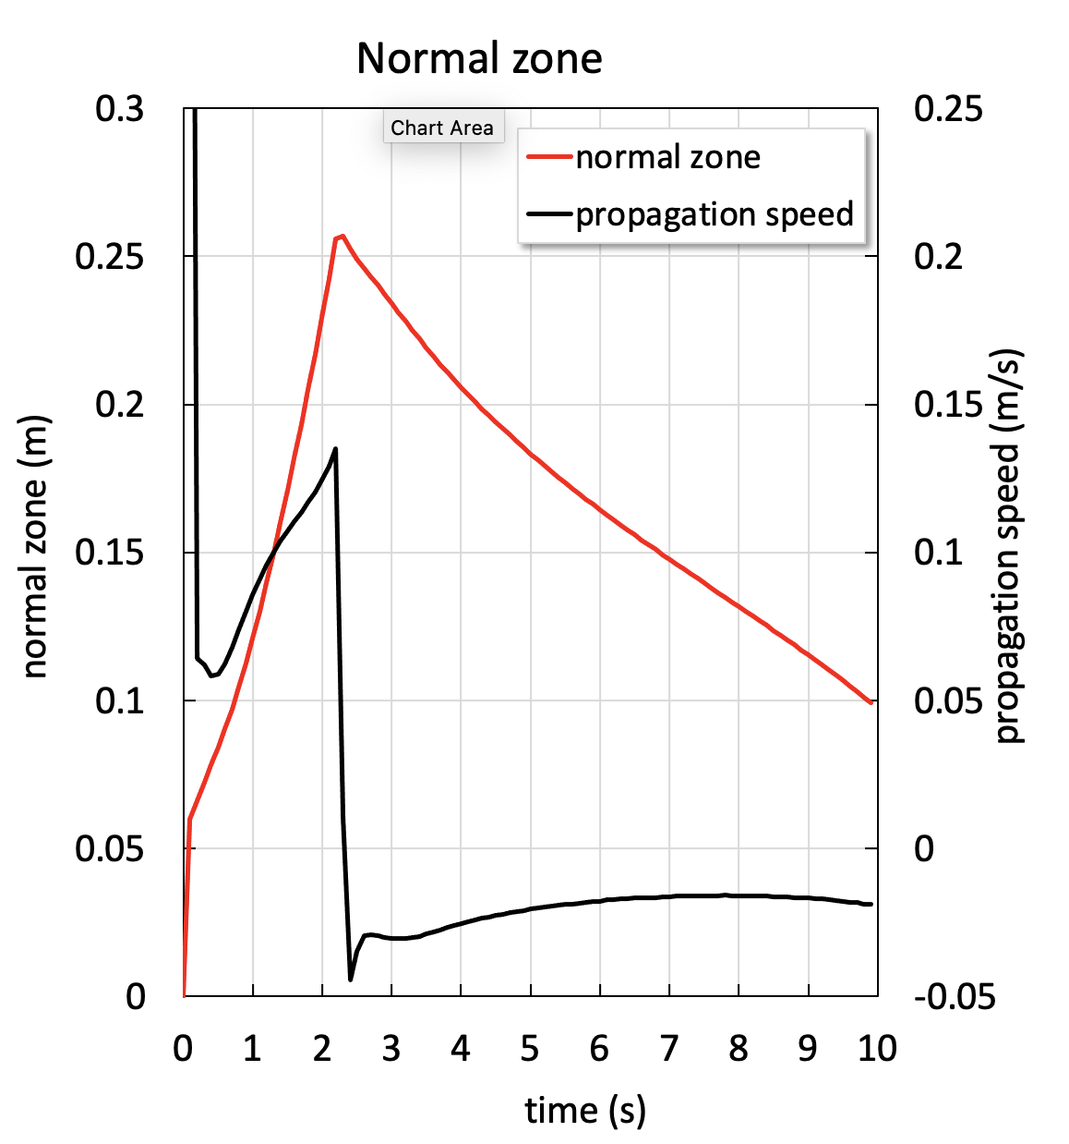
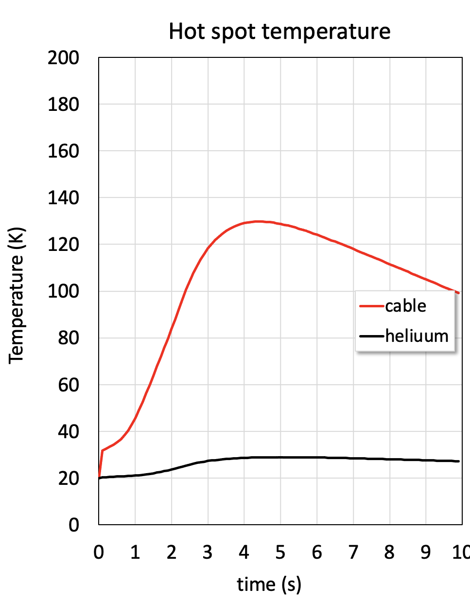
Detection and protection – 1/3
Coil Module 2 (high field and current)
Single coil stored energy: 165 MJ
Coulped stored energy: 299.7 MJ
Dump voltage: 5 kV
INZ in the center of the double pancake
10 cm length quenched
Exponential dump following trigger
130 K
0.15 m/s
Two sided
trigger
Detect at 100 mV
2.2 s

Slide 23
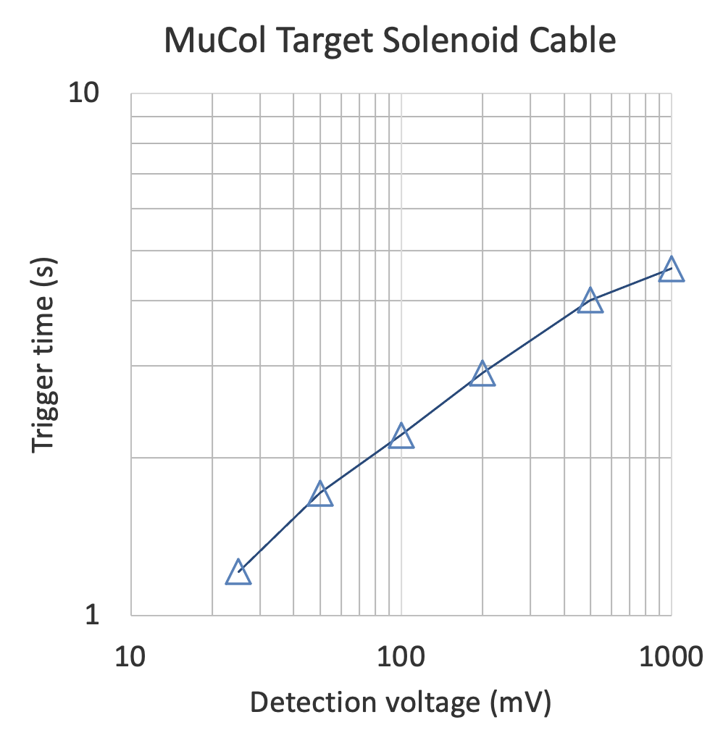
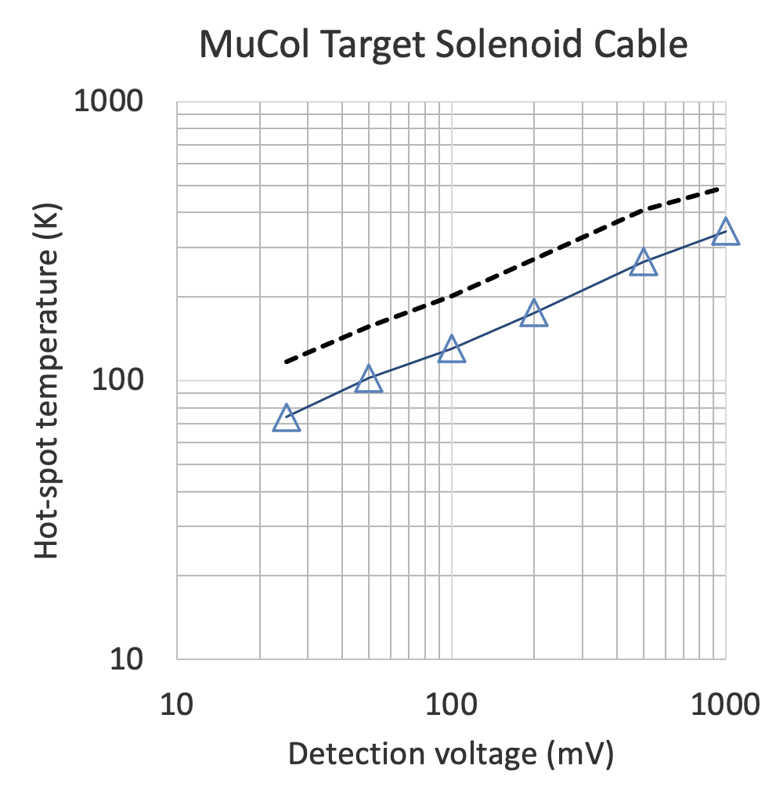
Detection and protection – 2/3
Wilson’s Gamma function
Detection with “reasonable” voltage values appears to work !

Slide 24
Detection and protection – 3/3
Study the detection and dump for quenches in the low field region or at low current/field
  The low field region at nomnal current seems to be most dangerous
  Low current/low field (e.g. during ramp) implies long detection times, but this appears compatible with modest hot-spot limits
I_{op} (kA) | B_{op} (T) | t_{Detection} (s) | T_{max} (K)
61 | 20 | 2.2 | 130
61 | 4 | 2.8 | 172
30 | 9.84 | 14.8 | 140

Slide 25
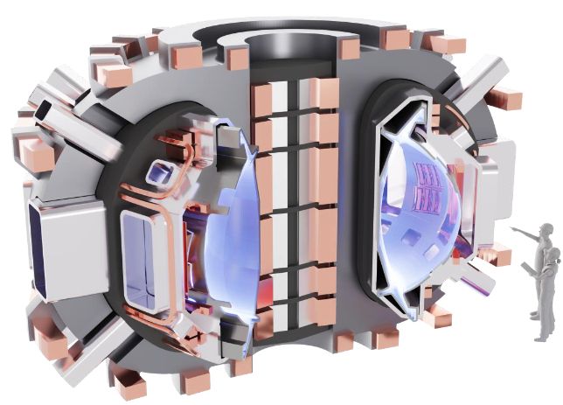

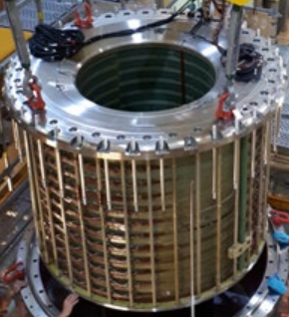


Opportunities and perspective
We are looking for a solution to the design of the target and capture channel of the Muon Collider, which needs a peak field of 20 T on axis, based on an HTS force-flow cooled cable operating at 20 K
  Lower footprint, mass, stored energy and cost than a LTS/NC hybrid
  Better energy efficiency than a 4.5 K system
Though there is much work to do, the design selected seems not too far from being feasible !
This is also interesting because of implications for
    Compact fusion machines
    Hybrid UHF magnets for science
Notes:
The reason for this talk is that we have received a strong recommendation from the group that proposes priority for particle physics in Europe. The recommendation, received in March 2020 and approved at the Council session of June 2020, contains a very strong statement on the need to ramp-up R&D effort on high-field accelerator magnets

Slide 26
Outline
Re-cap on the target and capture solenoid magnet design (v.2022)
Cooling at 20 K
Conductor analyses
Conclusions

Slide 27
Conclusions
Feasibility
  An internally cooled target solenoid, operating at 20 K and 20 bar, appears to match all requirements from the point of view of conductor cooling, margin and quench protection
Alternatives
  Other configurations are surely possible, e.g. different conductor designs. However, cooling at high radiation load may be best achieved by circulating the cryogen in the coil (internally cooled)
Perspective
  The coil cross section is undergoing adjustment (bore, access, conductor arrangement, …). Changes are relatively small, and will not change the conclusions above
  The fridge is a non-standard cryogenic machine and should be looked at, as well as options for alternative refrigerants

