Slide 1
Report on Procurement for 2023- ILO Forum
Cristina Lara - Head of Procurement
1

Slide 2
Agenda
Annual procurement report
Activity 2023
Annual expenditure 2000-2023
Examples of contracts placed or finalized in 2023
Industrial Return to Member States, supplies
Status from 1 March 2024 – 28 February 2025
Feedback on 2023 thematic days
2
Notes:
a reminder on the structure of the document.

Slide 3
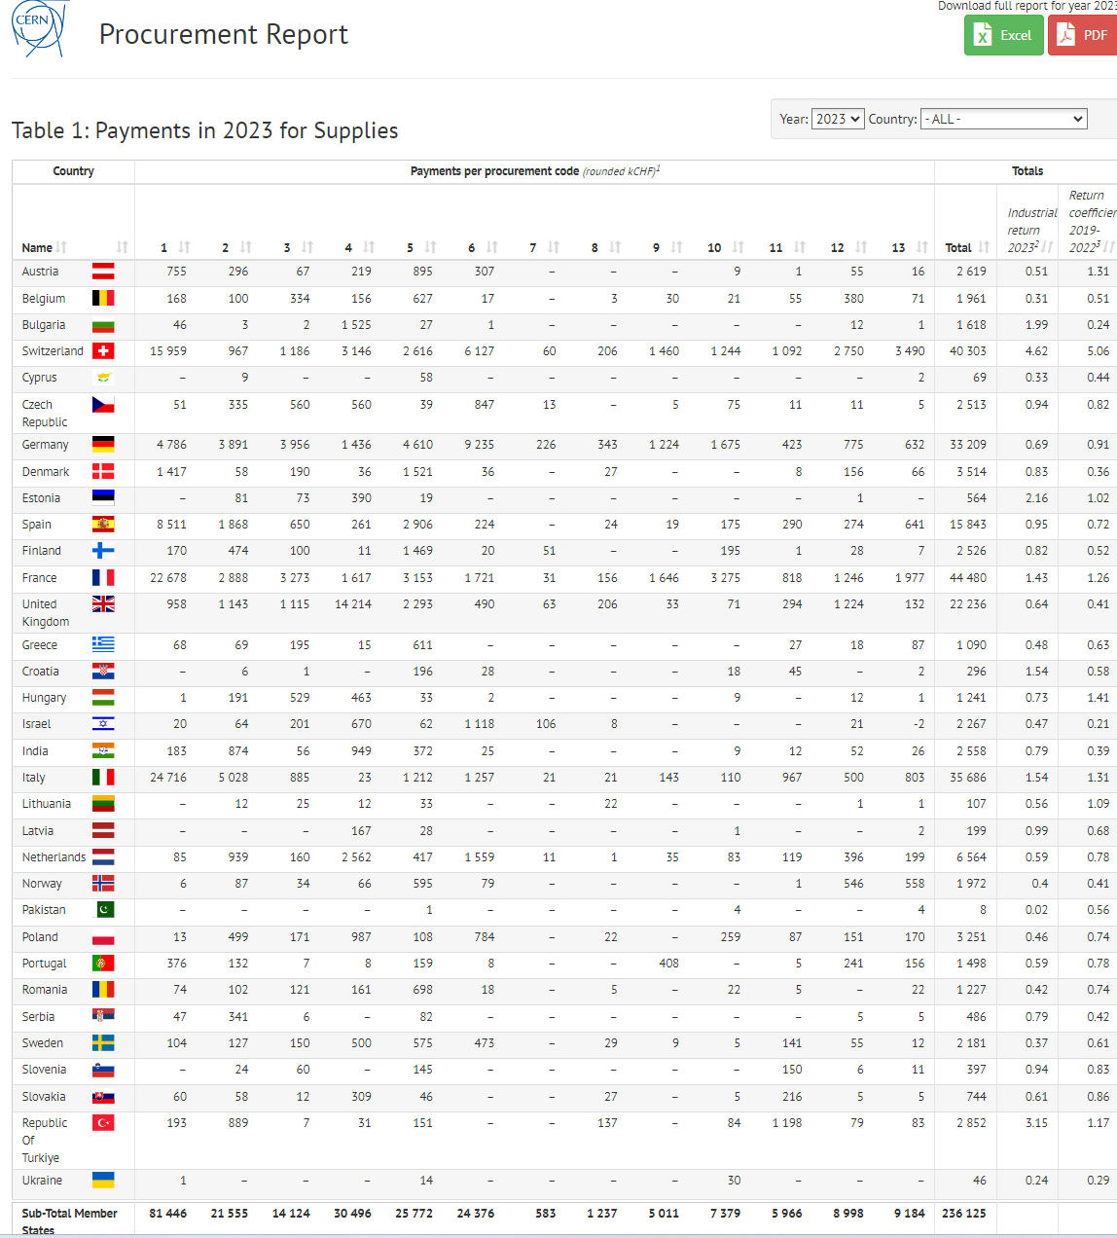
2023 Annual procurement report
Detailed information about:
- payments for Supplies and Services and per contract range
- payments funded by non-MS contributions
- status of MS from 1st March
- overall return coef (supplies+services+utilities)
- orders <1kCHF
- list of utilities
- alignment cases
- BVFM adjudications
- list of B and X contracts
- list of orders >50kCHF (commitments)
Summary in paper Format
Full report presented through 13 tables in the web page available here
3
Notes:
a reminder on the structure of the document.

Slide 4
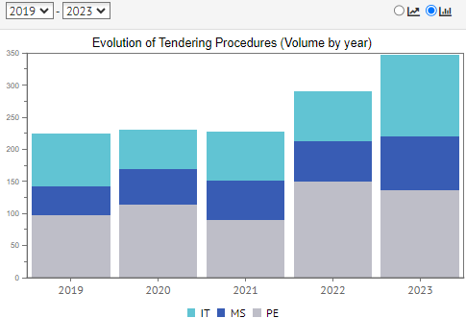
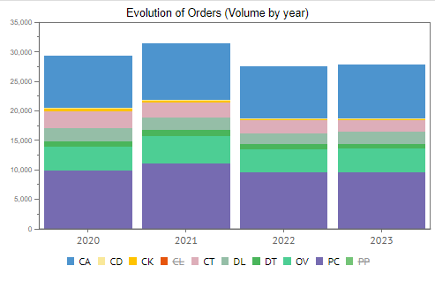
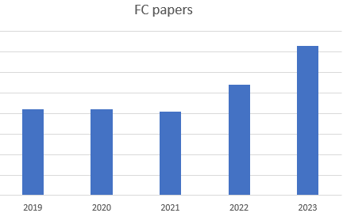
Activity 2023
Tendering procedures:
63% more ITs than in 2022
36% more MSs than in 2022
10% less DOs than in 2022 (lack of time)
35% increase
35% increase
4
Notes:
a reminder on the structure of the document.

Slide 5
Annual expenditure 2000-2023
20% more than in 2022: mainly due to electricity consumption
5
Notes:
a reminder on the structure of the document.

Slide 6

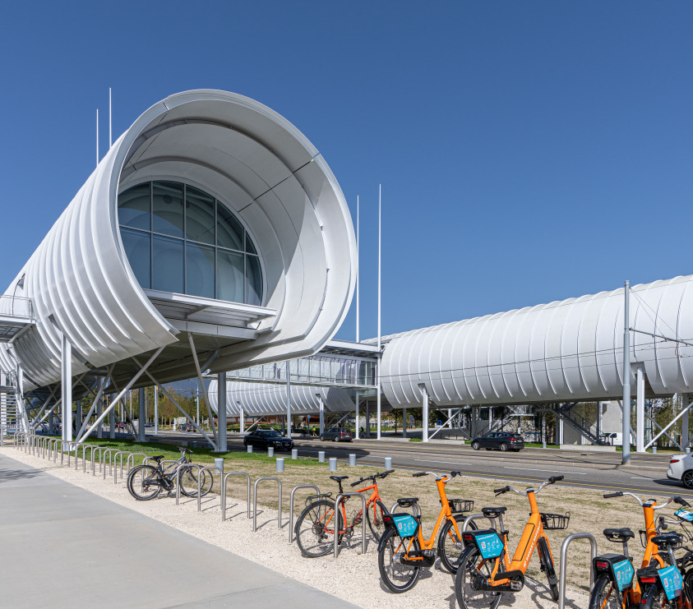
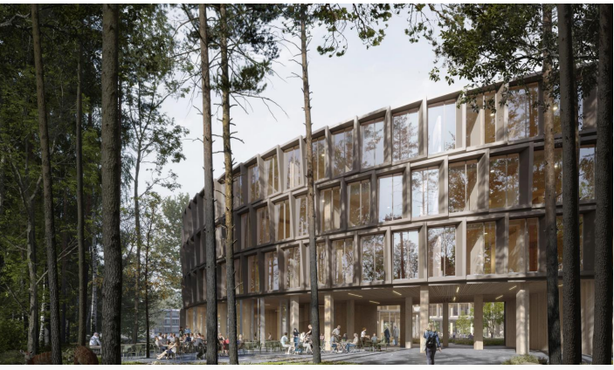
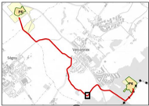
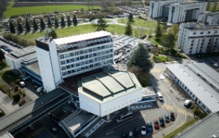
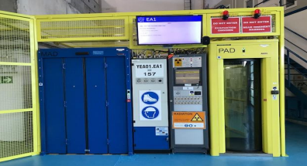
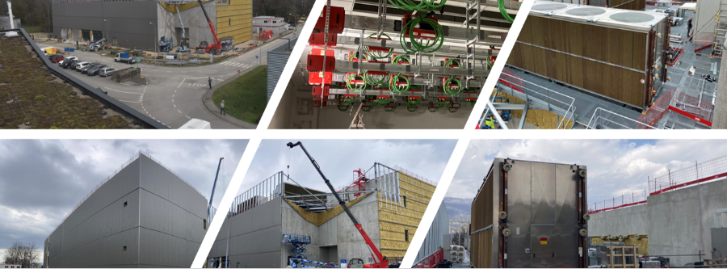
Examples of contracts placed or finalized in 2023
Inauguration of SGW in Oct 2023
Architectural and consultancy services for Bld 777
66kV substation, powerline P6-P5
- Retendering of FSU contracts
Retendering of other service contracts:
- cleaning on Swiss part,
- ICT support
- industrial controls, etc.
Extensive use of temporary labour services across CERN
Renovation of Bld 60
Prévessin Computing Centre
6
Notes:
a reminder on the structure of the document.

Slide 7

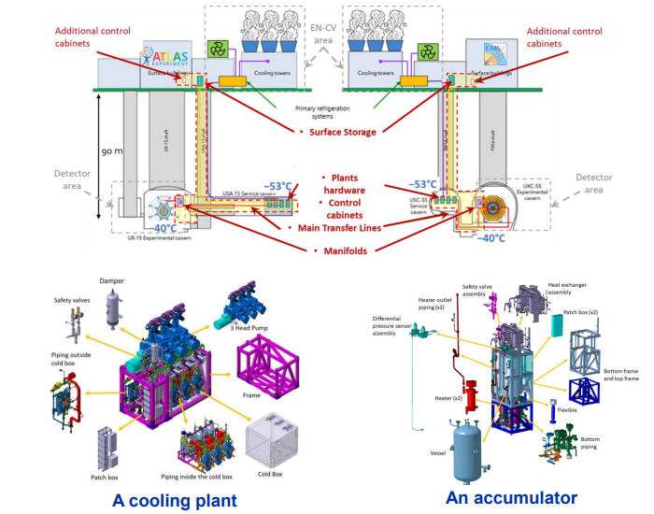
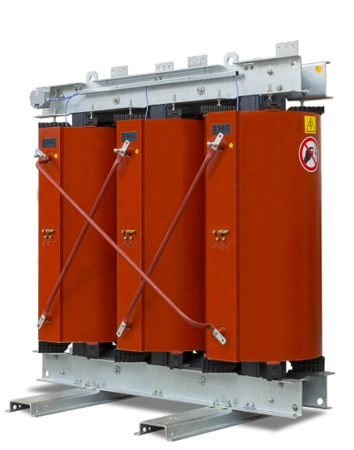
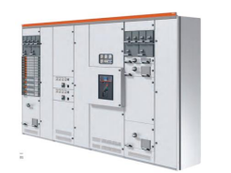
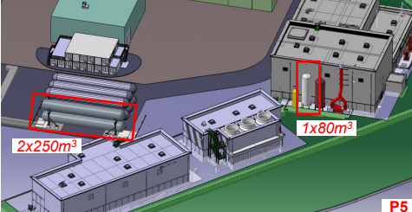
Accelerators and Experiments Programme
Cast-resin dry-type power transformers and switchboards
Vessels for gaseous helium at P1 and P5
2 contracts for 16 CO₂ cooling plants and14 accumulators for ATLAS & CMS upgrades
7
Notes:
a reminder on the structure of the document.

Slide 8
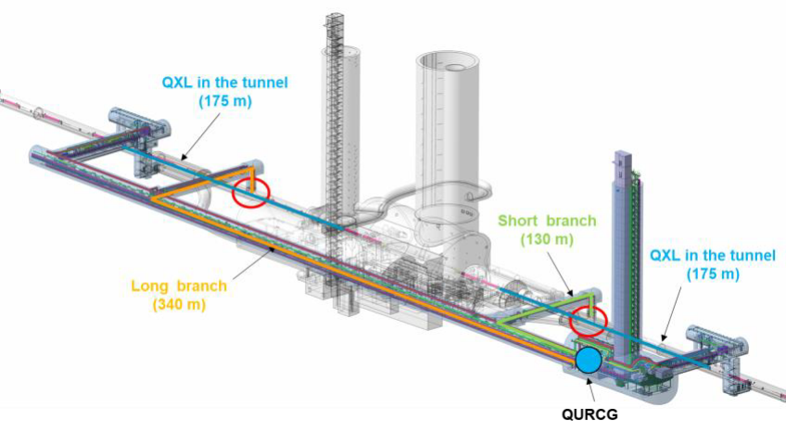
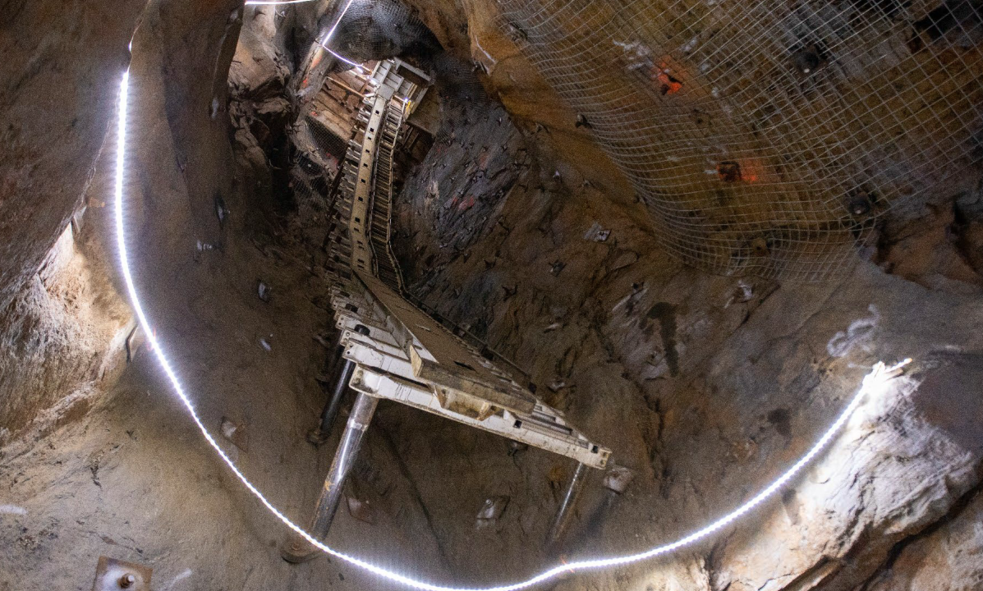
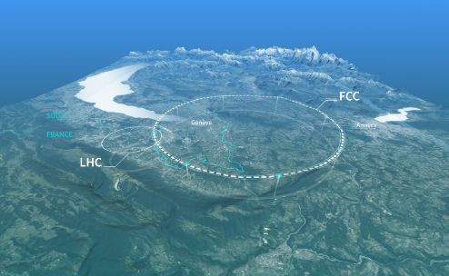
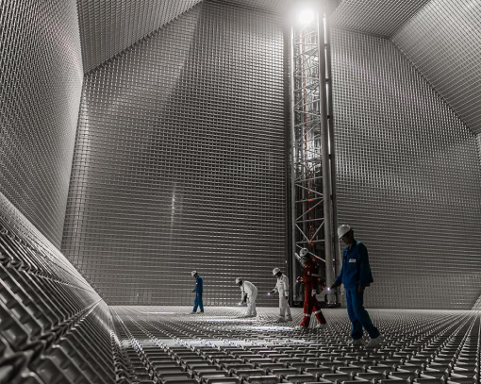
Accelerators and Experiments Programme
CERN in-kind contribution to DUNE
FCC feasibility studies (2 contracts approved for site investigation work)
North Area consolidation
8
Notes:
a reminder on the structure of the document.

Slide 9
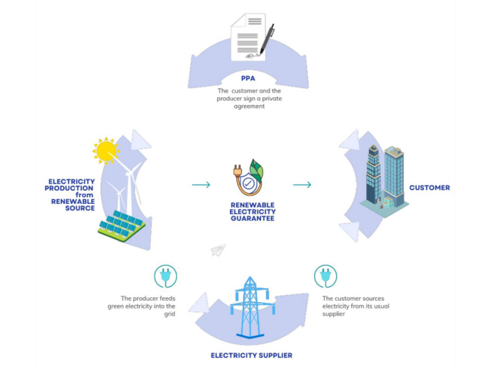
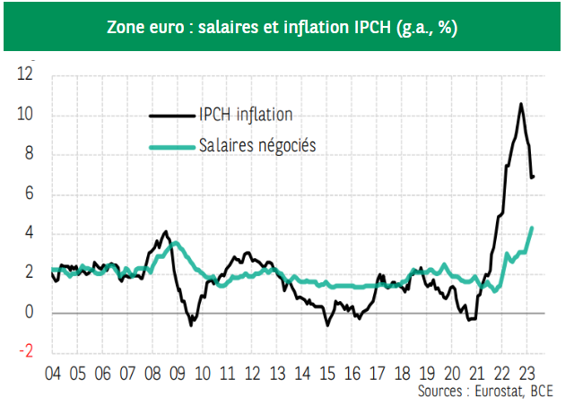
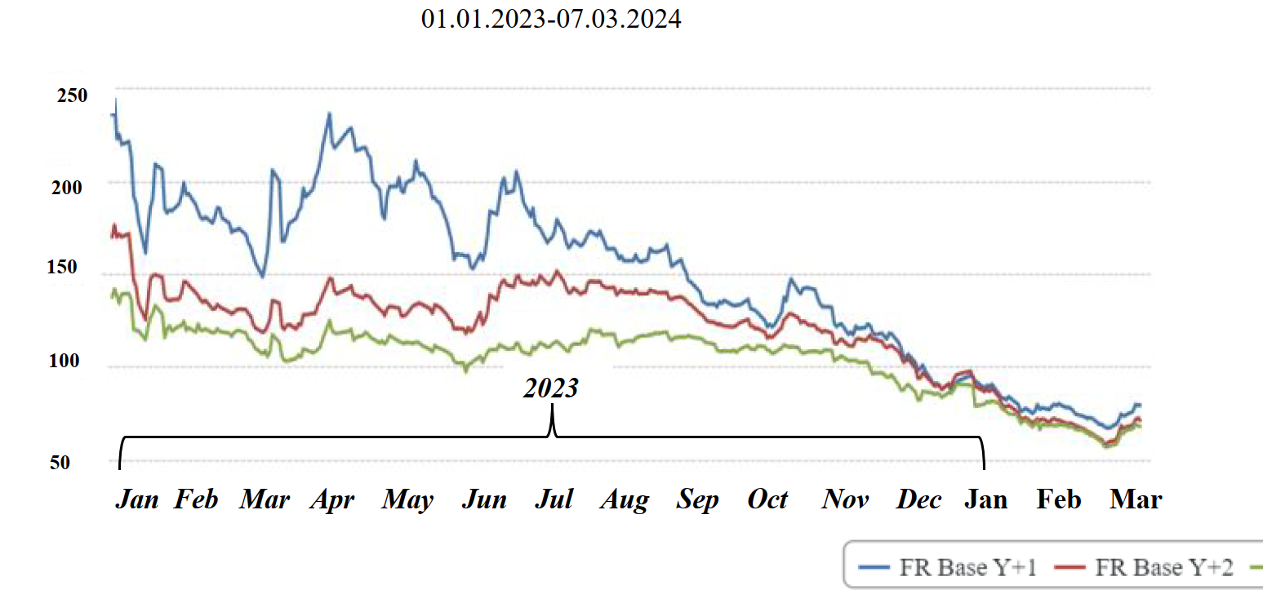
But also…
Significant negotiations on inflation and price revisions on existing contracts , contract follow up
ISO50001 implementation
Follow-up of electricity consumption contract
2 solar PPAs approved for 2027
9
Notes:
a reminder on the structure of the document.

Slide 10
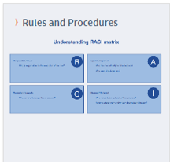
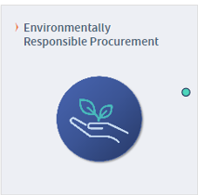
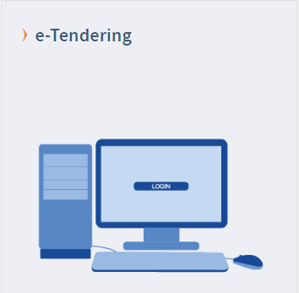
Improving how we deliver
New General Conditions of CERN Contracts and IT
(May 2023)
Templates services
Changes to Procurement Rules proposed
Policy approved in June 2023
Implementation plan in Dec 2023:
Training
Assess supplier’s maturity
Carry out pilot projects
Tools, digitisation :
TRELLO
New platform for DOs<50kCHF
New MS platform (soon available)
10
Notes:
a reminder on the structure of the document.

Slide 11
Industrial return coefficient for supplies
Based on payments
Industrial return
coefficient
For Supply contracts and for a 12-month period starting on 1st March, defined as:
“The ratio between a Member State's percentage share of the value of all Supply contracts during the preceding 4 years and that Member State's percentage contribution to the CERN Budget over the same period”.
Excluding:
Purchases funded by non-Member States (i.e. non CERN money)
Purchases originated in non-Member States (US, CN, etc)
Status definition
Over a 4-year period:
Very poorly balanced : < 0.40 (not defined in PR as such)
Poorly balanced (PB) : 0.40 ≥ x < 1
Well balanced (WB): ≥ 1
11
Notes:
a reminder on the structure of the document.

Slide 12
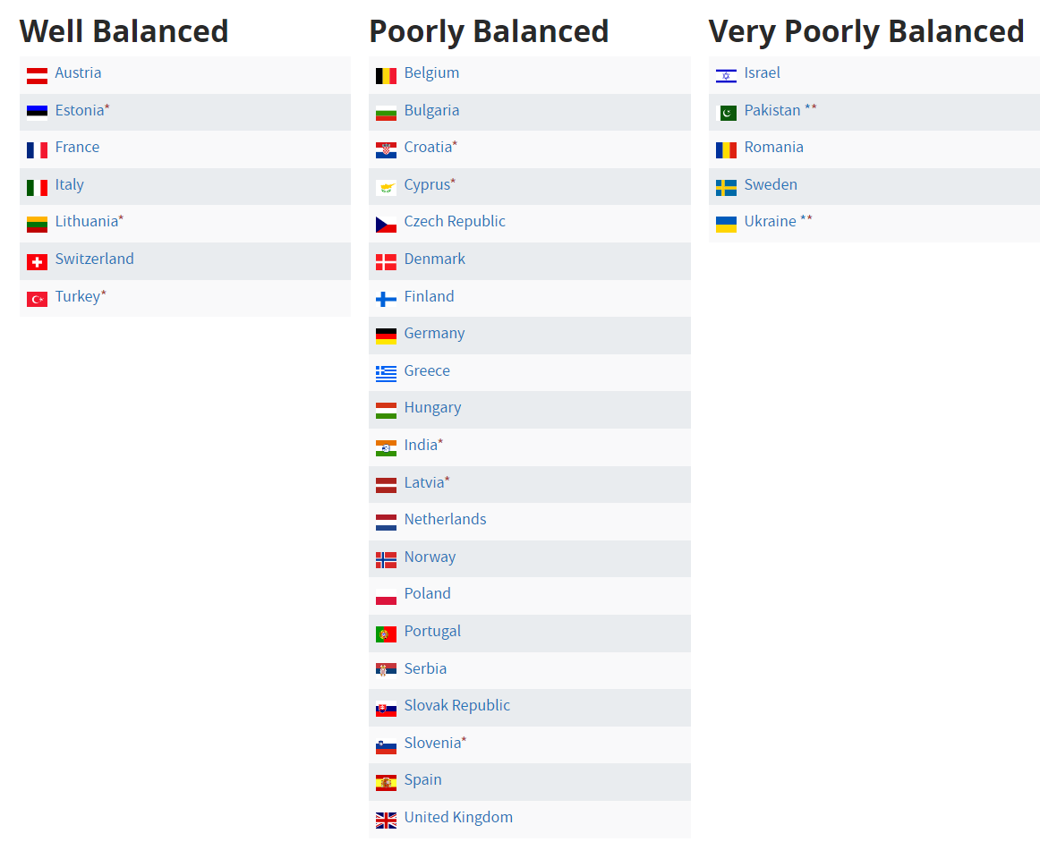
Industrial Return to Member States, supplies
Status from 1 March 2024 – 28 February 2025
12
Notes:
a reminder on the structure of the document.

Slide 13
Industrial Return to Member States, supplies
Status from 1 March 2024 – 28 February 2025
New Procurement Rules should help with enhanced Limited Tendering mechanism
Same number of VPB than last year BUT PK and UA have reached their “ceiling” in 2024, no new contracts will be placed in 2024
CERN objective for 2025 (max 3 VPBMS) is well on track, taken into account UA and IL situation, as well as AMSes reaching their ceiling
WB
PB
VPB
13
Notes:
a reminder on the structure of the document.

Slide 14
Feedback on 2023 thematic days
Date | Event Type | Format | Participants
25 - 26 May 2023 | Civil engineering Business Forum | Hybrid | 92 companies (48 on site, 44 remote)
28 Nov 2023 | PCB and Electronics Card Assembly | On Line | Registration opened throughB2Match platform

Slide 15
Feedback from CE Business Forum
Participation and statistics:
  48 companies on site (with a majority of local FR(14) and CH(20) considering the specific characteristics of construction works)
  49 companies virtual
  12 countries represented with following breakdown
  Min of 50 on-site one-to-one meetings between companies and CERN representatives but also between companies
Row Labels | On-site participants | Remote participants
Belgium | 1 | 9
Denmark | 1
France | 19 | 7
Italy | 2 | 5
Netherlands |  | 1
Poland | 11 | 2
Portugal | 2 | 11
Serbia | 1 | 1
Slovenia |  | 1
Spain | 6 | 5
Switzerland | 37 | 2
Turkey |  | 2
United Kingdom |  | 3
Grand Total of Participants (Company+Other) | 80 | 49

Slide 16
Feedback from PCB and Electronic Cards assembly Manufacturing
On-line Participation and statistics:
  59 companies attended
  17 countries represented with following breakdown
  64 one-to-one meetings between companies and CERN representatives but also between companies
Note:
Lighter Process : Selection prior invitation of firms based on a questionnaire on B2Match Platform
 | Remote
Belgium | 2
Croatia | 1
Finland | 1
France | 4
Germany | 7
Greece | 1
India | 3
Italy | 7
Netherlands | 2
Norway | 4
Poland | 3
Portugal | 1
Slovakia | 1
Slovenia | 11
Spain | 6
Sweden | 1
United Kingdom | 4
Grand Total | 59

