Slide 1
Study of gain of LGAD
Gabriele Giacomini
1/31/2024

Slide 2
Gain Characterization
Use of a low-noise Charge Sensitive pre-amplifier (Amptek A250) to determine the gain of several families of LGADs exposed to different radiation sources (⁹⁰Sr, ²⁴¹Am, ⁵⁵Fe, Alphas).
In this presentation, OLD BNL LGAD (shallow gain implant), new BNL LGAD (deeper implant), HPK (deep gain implant) - we submitted a paper on NIM (soon on arxiv.org)
All BNL fabricated LGAD/AC-LGAD will undergo the same tests.

Slide 3
Betas from ⁹⁰Sr

Slide 4
Gamma rays from ²⁴¹Am

Slide 5
X rays from ⁵⁵Fe

Slide 6
Alphas from ²⁴¹Am

Slide 7
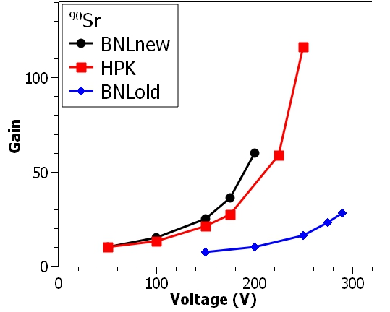
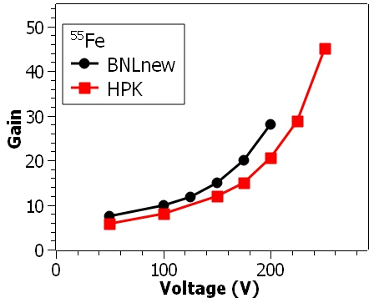
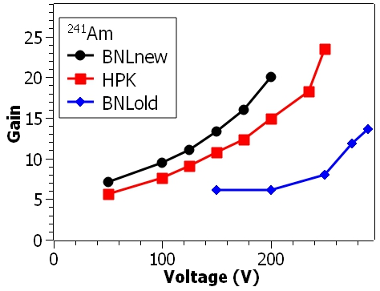
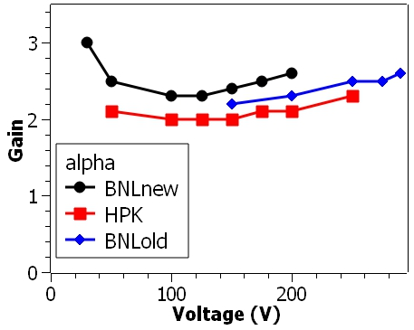
Gain
Easy calibration with PIN diode or with C_{inj} (2.1pF)
Max gain for betas: effects of charge cloud shape clearly visible

Slide 8
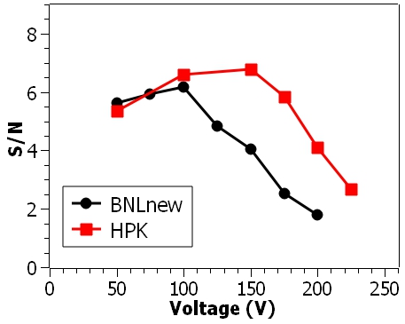
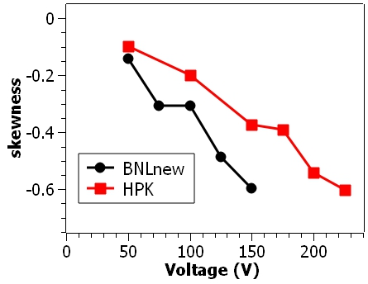
Spectroscopic parameters (⁵⁵Fe)
Multiplication noise dominant at higher gains
Low-gain shoulder in spectra

Slide 9
Laser Tests
Searching for effects of gain saturation in LGADs hit by laser
  scan in laser threshold
  Scan in voltage
  Diode and LGAD coming from same wafer
  FNAL board
  Mip generates charge along small radius track and instantaneously
  vs
  Laser focused at 15um and signal ~350ps long at high threshold (longer at lower threshold).
  → Laser track is order of magnitudes less dense.
  Still, interesting to see saturation effects with laser injection.
  A lot of data acquired so far, still interpreting them.
  Much more soon.

