Slide 2
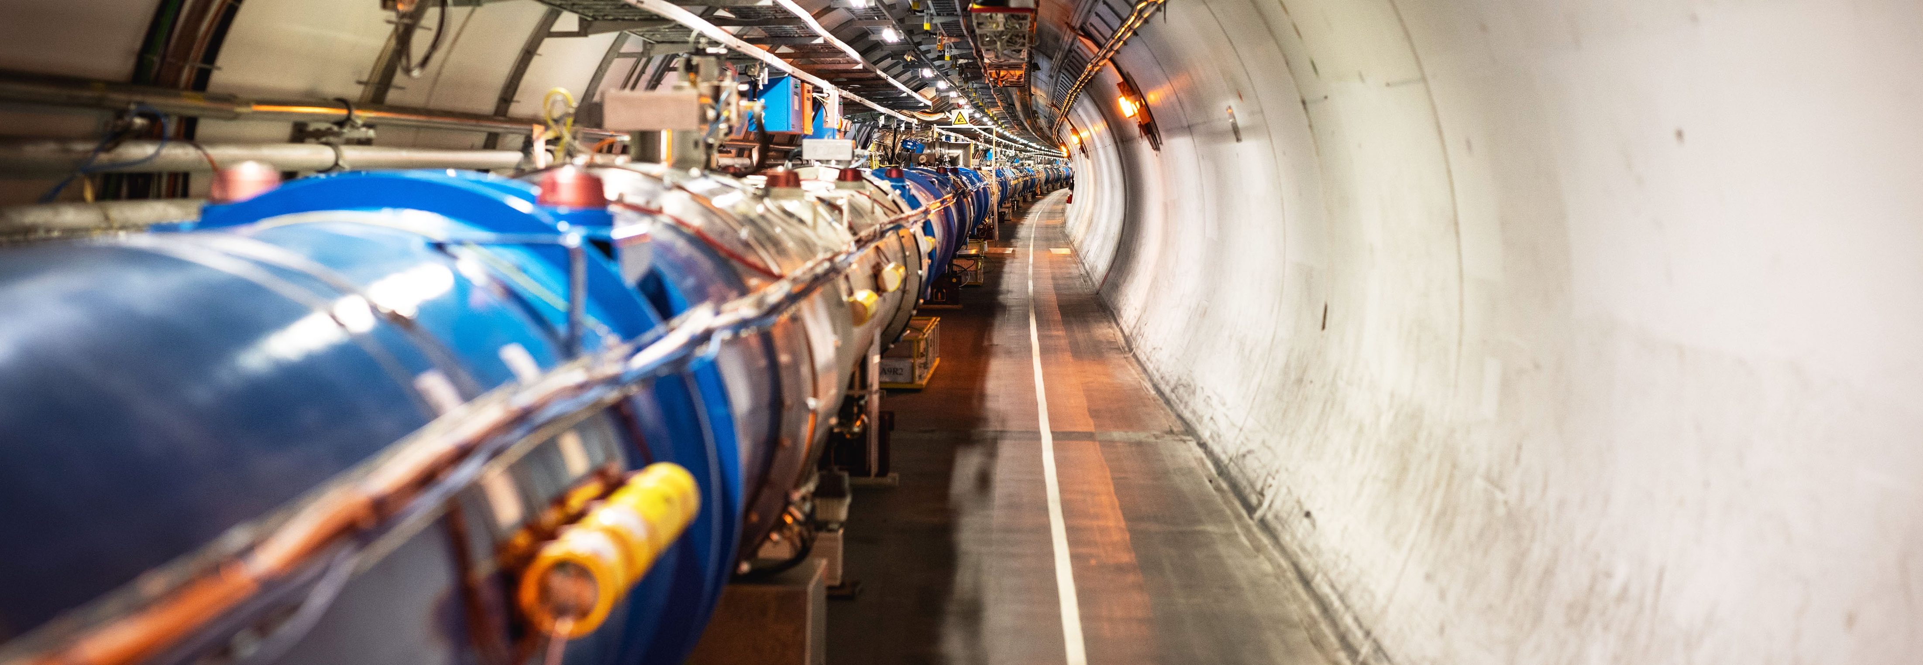
WELCOME TO CERN
Manfred Krammer
Head of the Experimental Physics Department
Notes:
THE WELCOME SLIDE
With this slide the speaker:
Introduces him/herself
Describes how this brief presentation aims to give an overview of CERN, as an introduction to the visit that will follow.

Slide 3
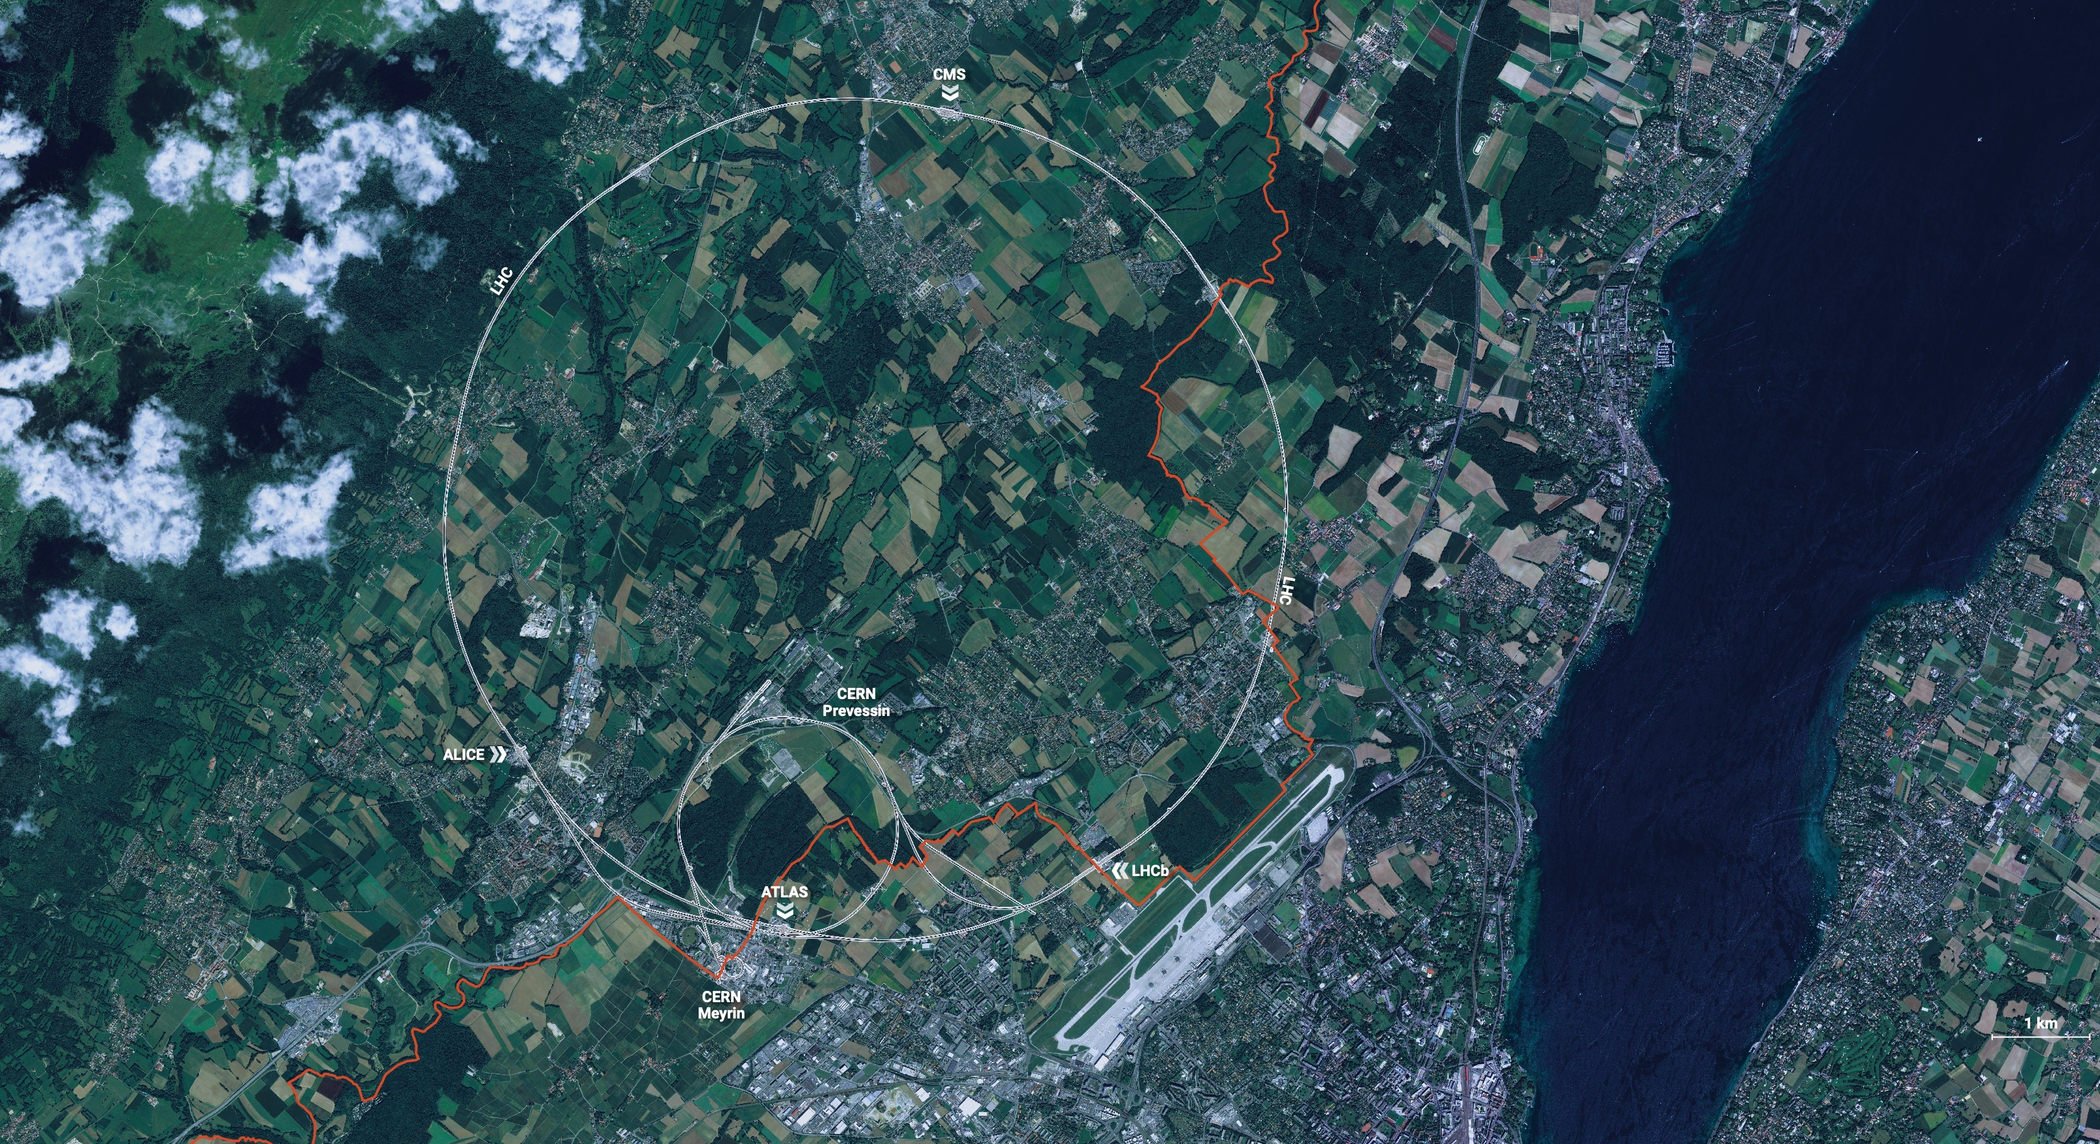
CERN is the world’s biggest laboratory
for particle physics.
Our goal is to understand the most fundamental particles and laws
of the universe.

Slide 4
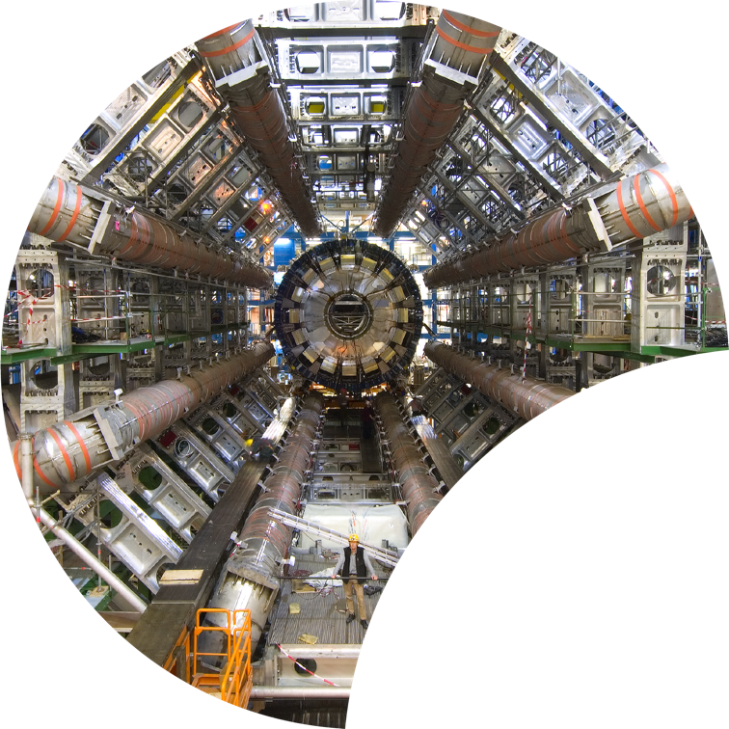
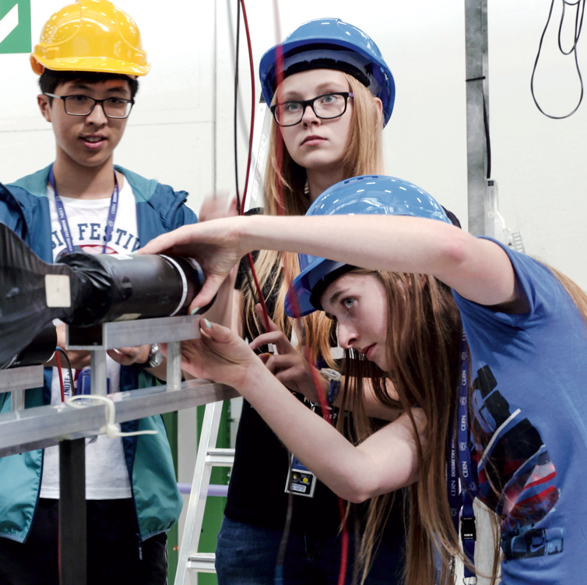

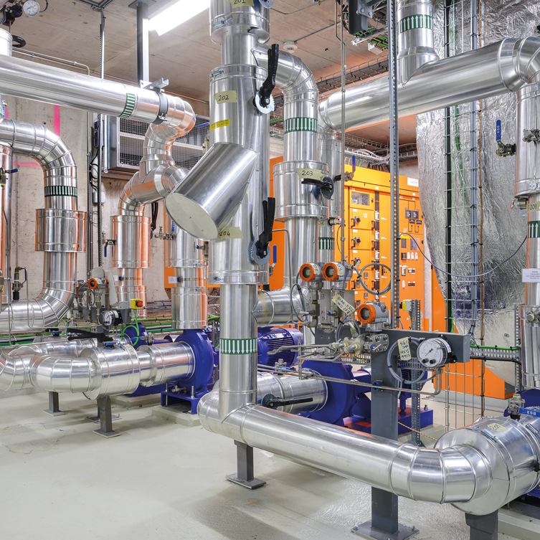

Four pillars underpin CERN’s mission
RESEARCH
EDUCATION
& TRAINING
COLLABORATION
TECHNOLOGY
& INNOVATION
Notes:
This slide introduces the four pillars that underpin CERN’s mission:
Research: To perform world-class research in experimental and theoretical particle physics; and to provide the particle physics community a range of accelerators that enable that research
Collaboration: To unite people from all over the world in the common goal of advancing the frontiers of human knowledge, in a spirit of equal collaboration and openness
Innovation: To push the technology underpinning accelerators, detectors and computing, to drive innovation in order to transfer knowledge to other scientific and technological areas, for the benefit of society
Education and Training: To train future physicists and engineers, to promote careers in science and engineering, and to foster citizens’ engagement in particle physics and in fundamental research.
FROM THIS POINT FORWARD, THE PRESENTATION IS DIVIDED INTO FOUR SECTIONS: ONE SECTION PER PILLAR

Slide 5

COLLABORATION
Notes:
This is the title slide for the section on “International Collaboration”.
It should be shown for just enough time for the speaker to place it in the context of the four pillars mentioned at the start of the presentation (as a form of ”signposting”)
(THIS SECTION HAS 4 SLIDES)

Slide 6

Science for peace
CERN was founded in 1954 with 12 European Member States
CERN’s annual budget
is 1200 MCHF (equivalent
to a medium-sized European university)
23 Member States
Austria – Belgium – Bulgaria – Czech Republic
Denmark – Finland – France – Germany – Greece Hungary – Israel – Italy – Netherlands – Norway
Poland – Portugal – Romania – Serbia – Slovakia Spain – Sweden – Switzerland – United Kingdom
As of 31 December 2022
Employees:
2658 staff, 900 fellows
Associates:
11 860 users, 1516 others
3 Associate Member States
in the pre-stage to membership
Cyprus – Estonia – Slovenia
7 Associate Member States
Croatia – India – Latvia – Lithuania – Pakistan
Türkiye – Ukraine
6 Observers
Japan – Russia (suspended) – USA
European Union – JINR (suspended) – UNESCO
Around 50 Cooperation Agreements
with non-Member States and Territories
Albania – Algeria – Argentina – Armenia – Australia – Azerbaijan – Bangladesh – Belarus – Bolivia
Bosnia and Herzegovina – Brazil – Canada – Chile – Colombia – Costa Rica – Ecuador – Egypt – Georgia – Honduras
Iceland – Iran – Jordan – Kazakhstan – Lebanon – Malta – Mexico – Mongolia – Montenegro – Morocco – Nepal
New Zealand – North Macedonia – Palestine – Paraguay – People's Republic of China – Peru – Philippines – Qatar
Republic of Korea – Saudi Arabia – Sri Lanka – South Africa – Thailand – Tunisia – United Arab Emirates – Vietnam
Notes:
The speaker can highlight CERN’s second mission as stated when it was established: to foster peaceful collaborations between nations that had recently been at war.
Additional information (OPTIONAL)
More than 40% of CERN’s budget is returned to industry through materials, utilities and services

Slide 7
A laboratory for people around the world
Distribution of all CERN Users by the country of their home institutes as of 31 December 2022
Geographical & cultural diversity
Users of 110 nationalities
19.4% women
Personnel by nationality
as of 31 December 2022
  89 users
  56 staff
  14 fellows
Numbers for country
Member States 7147
Austria 85 – Belgium 129 – Bulgaria 43 – Czech Republic 244 Denmark 49 – Finland 90 – France 844 – Germany 1225 Greece 119 – Hungary 73 – Israel 64 – Italy 1527
Netherlands 169 – Norway 79 – Poland 305 – Portugal 100 Romania 109 – Serbia 33 – Slovakia 70 – Spain 383
Sweden 103 – Switzerland 406 – United Kingdom 898
Associate Member States
in the pre-stage to membership 69
Cyprus 15 – Estonia 30 – Slovenia 24
Associate Member States 382
Croatia 38 – India 132 – Latvia 16 – Lithuania 14 – Pakistan 35
Türkiye 122 – Ukraine 25
Observers 2991
Japan 216 – Russia (suspended) 873 – United States of America 1902
Non-Member States and Territories 1271
Algeria 2 – Argentina 13 – Armenia 8 – Australia 21 – Azerbaijan 2 – Bahrain 4 – Belarus 18 – Brazil 122
Canada 199 – Chile 34 – Colombia 21 – Costa Rica 2 – Cuba 3 – Ecuador 4 – Egypt 20 – Georgia 32
Hong Kong 15 – Iceland 3 – Indonesia 5 – Iran 11 – Ireland 5 – Jordan 5 – Kuwait 4 – Lebanon 13 – Madagascar 1
Malaysia 4 – Malta 1 – Mexico 49 – Montenegro 4 – Morocco 19 – New Zealand 5 – Nigeria 1 – Oman 1
Palestine 1 – People’s Republic of China 333 – Peru 2 – Philippines 1 – Republic of Korea 147 – Singapore 2 South Africa 52 – Sri Lanka 10 – Taiwan 45 – Thailand 17 – Tunisia 2 – United Arab Emirates 7 – Viet Nam 1
Notes:
THIS SLIDE WILL INCLUDE THE NUMBER OF MEMBERS OF PERSONNEL OF THE VISITORS’ COUNTRY OF ORIGIN

Slide 8
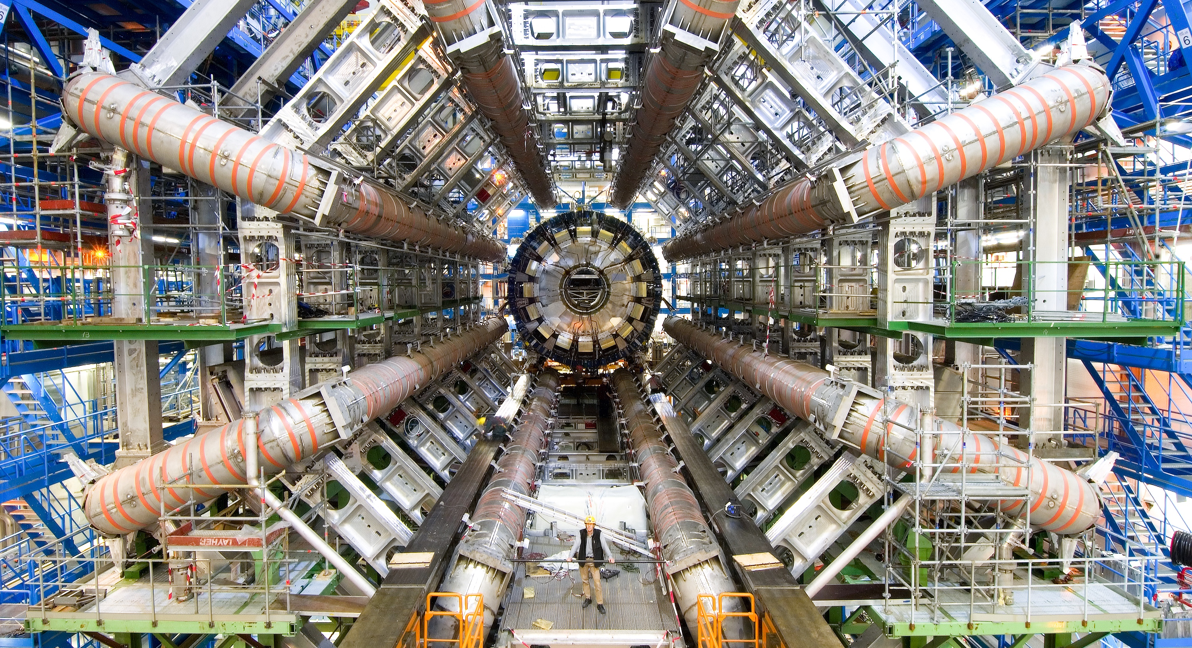
RESEARCH
Notes:
This is the title slide for the section on “Research”.
It can be shown for just enough time for viewers to take in the beauty and impact of the image.
(THIS SECTION HAS 13 SLIDES, INCLUDING ONE OPTIONAL SLIDE)

Slide 9
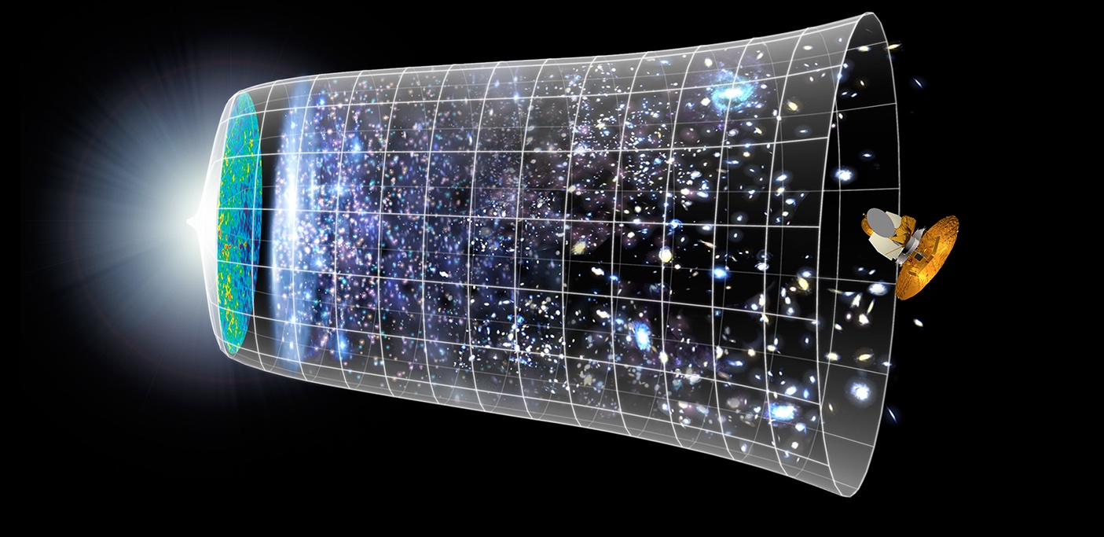

How did the universe begin?
Big Bang
We reproduce the conditions a fraction of
a second after the Big Bang, to gain insight into the structure and evolution
of the universe.
Telescopes
Accelerators
380 000 years
13.8 Billion Years
Today
10²⁸ cm
Notes:
The other question that underpins research in particle physics is “How did the Universe begin?”
We gain insight into the structure and evolution of the Universe, from the first billionth of a second (10⁻¹²s) after the Big Bang.
From the very small (particle physics at modern accelerators allows us to study the fundamental laws of nature on scales down to smaller than 10⁻¹⁸ m) to the very big (telescope-based astrophysics), we gain knowledge about the laws and evolution of the universe.

Slide 10
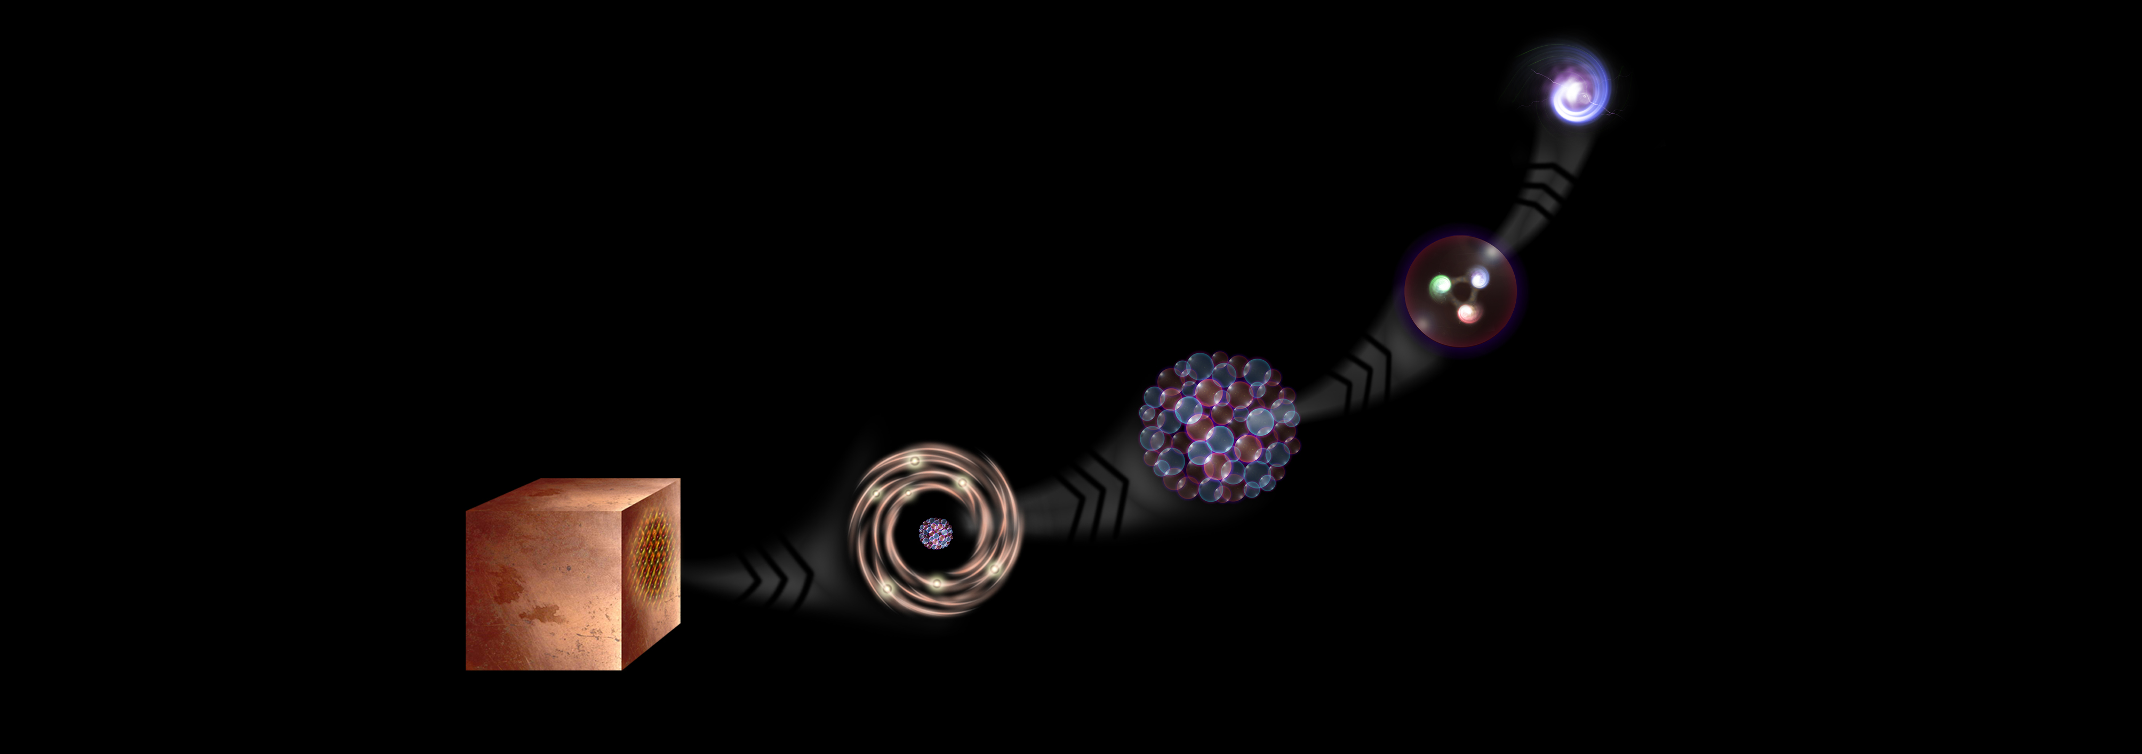
What is the universe made of?
We study the elementary building blocks of matter and the forces that control their behaviour
Quark
<10⁻¹⁸ m
Proton
~10⁻¹⁵ m
Nucleus
~10⁻¹⁴ m
Electron
Matter
0,1 m
Atom
~10⁻¹⁰ m
Notes:
This slide and the next address the questions that underpin research in particle physics.
One of the questions is “What are we made of?”
To answer this question, we study the fundamental particles that make up matter.
The speaker takes the visitors on a brief journey from visible matter to the electron and the quark: electrons and quarks are the fundamental particles of matter

Slide 11

The Standard Model of Particle Physics
Fermions (spin ½) quarks and leptons: the building blocks of matter
Bosons (integer spin) carry the forces: electromagnetic (Photon), weak force (W, Z) and strong force (Gluons)
Higgs Boson (spin 0), gives mass to particles
Notes:
This slide and the next address the questions that underpin research in particle physics.
One of the questions is “What are we made of?”
To answer this question, we study the fundamental particles that make up matter.
The speaker takes the visitors on a brief journey from visible matter to the electron and the quark: electrons and quarks are the fundamental particles of matter

Slide 12
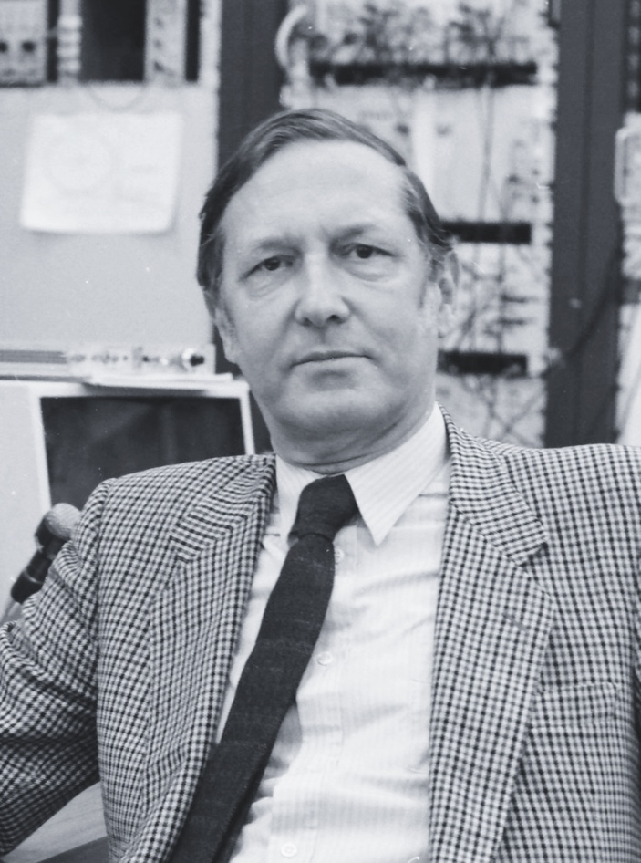
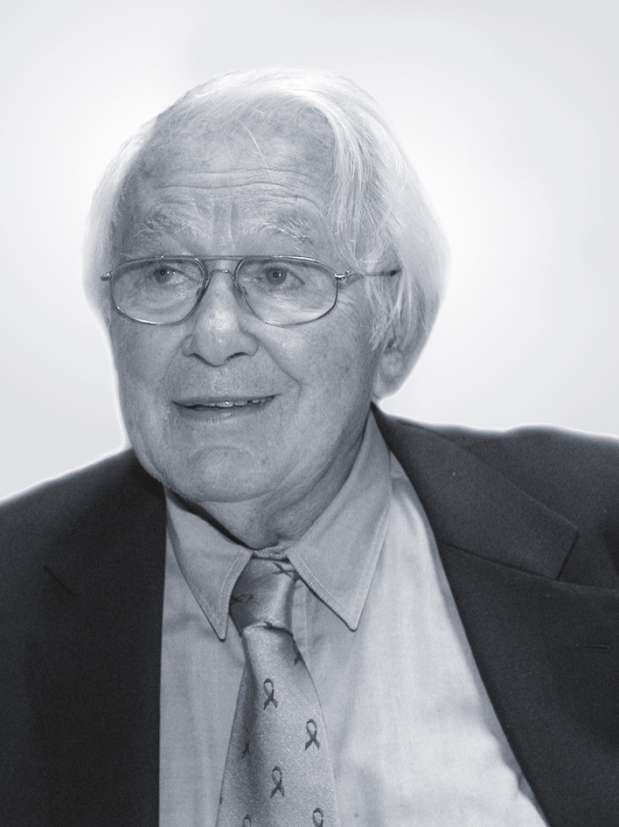
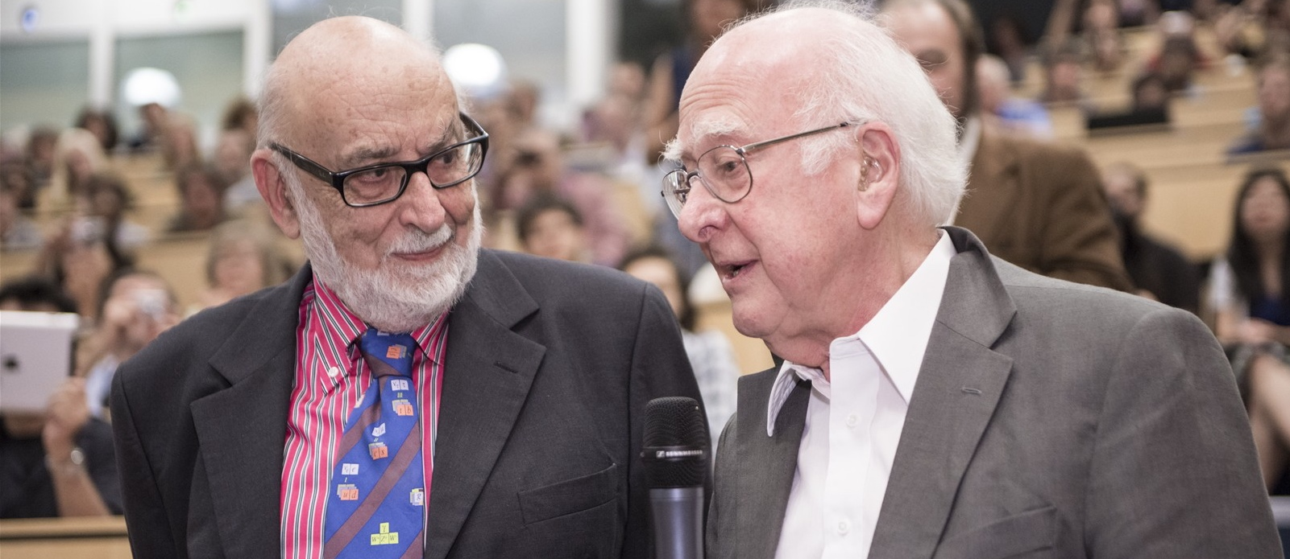
At CERN we help to answer these questions
The Higgs boson was discovered in 2012; without it fundamental particles would be massless
and atoms could not form.
Carlo Rubbia
Simon Van der Meer
Georges Charpak
Several CERN scientists have received
Nobel Prizes for key discoveries
in particle physics.
François Englert and Peter Higgs. With Robert Brout, they proposed the mechanism in 1964.
Notes:
The key message of this slide is “CERN is the place to answer these questions”:
Several key discoveries in particle physics have been made at CERN, acknowledged by the Physics Nobel Prize.
In 2012, two experiments at CERN – ATLAS and CMS – announced the discovery of the elusive Higgs boson, the until-then missing piece of the Standard Model, which encapsulates our best understanding of the behaviour of all fundamental particles in the universe.
The Higgs boson is a unique particle: it raises profound questions about the fundamental laws of the Universe, and is simultaneousy a powerful tool to study them. Questions such as:
Why do fundamental particles have the masses that they do?
How does the Higgs boson itself gain mass?
Can the Higgs boson help explain the existence of dark matter?
The photo of Englert and Higgs was taken at the seminar on 4 July 2012 when the Higgs Boson discovery was announced by ATLAS and CMS.

Slide 13
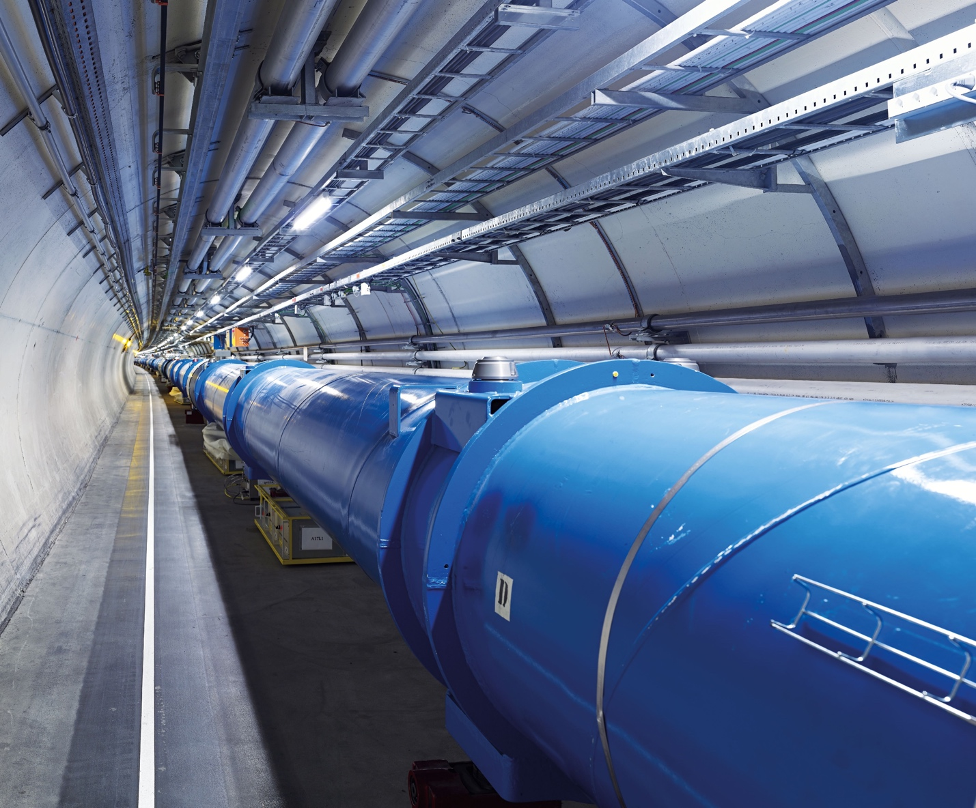
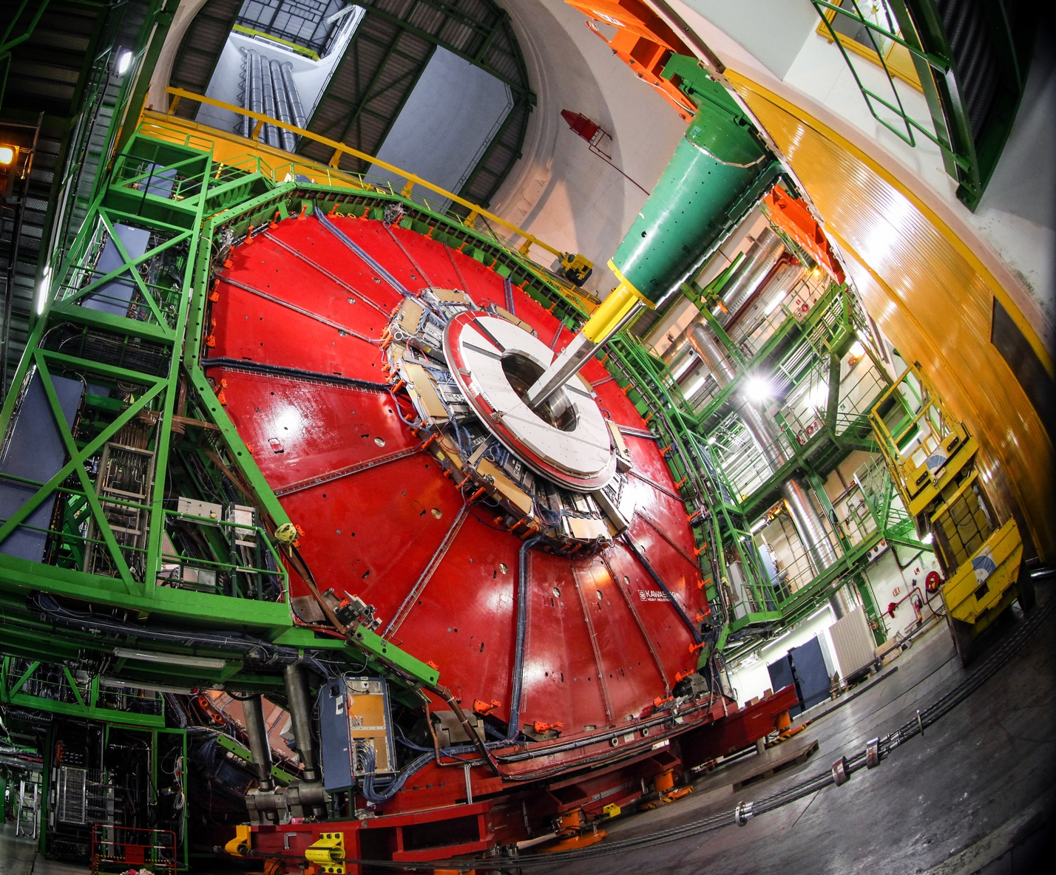
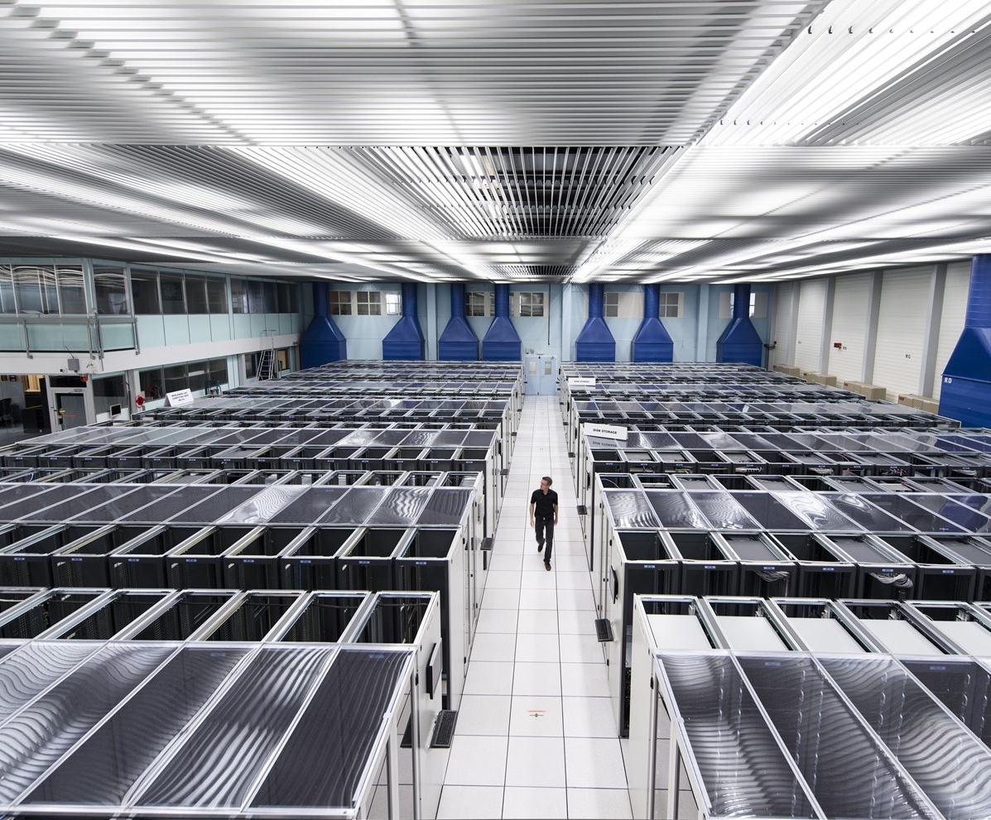
We develop technologies in three key areas
ACCELERATORS
DETECTORS
COMPUTING
Notes:
This slide presents the three technological fields that allow CERN to answer the questions presented earlier.
The following slides focus on each of these fields, so here the speaker may give a 1-2 sentence description of each.
For example:
Accelerators - We build and maintain a range of particle accelerator facilities, where particles are accelerated to almost the speed of light
Detectors – built by consortia of physicists and engineers from across the globe, this is where collisions occur and where new, hitherto unknown particles may be formed, and new interactions between particles identified.
Computing – experiments at CERN generate enormous amounts of data. This data is collected at CERN and sent around the world to be processed and stored.

Slide 14
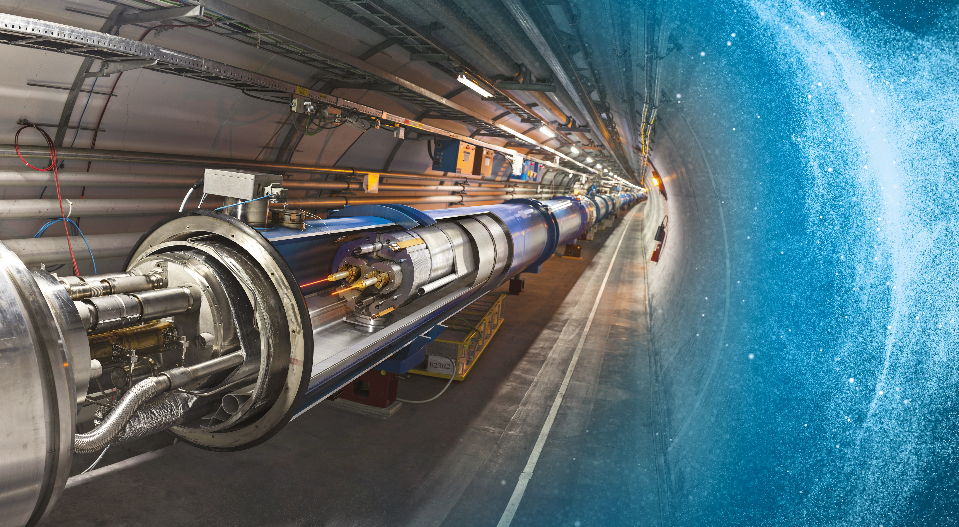
Large Hadron Collider (LHC)
27 km in circumference
About 100 m underground
Superconducting magnets steer the particles around the ring
Particles are accelerated
to close to the speed
of light
Notes:
The LHC is CERN’s flagship accelerator.
Possible additional information to complement what is on the slide (TIME PERMITTING):
It is the world’s largest and most powerful particle accelerator
Protons (and lead ions) circulate in two beams, which travel in opposite directions in two separate beam pipes
Protons are accelerated to 99.9999991% the speed of light (11 245 turns/second)
The beam pipes are under ultrahigh vacuum, to avoid collisions between the particles and gas molecules. The vacuum in the beam pipes is 10⁻¹³ atm – similar to the atmosphere on the moon (10⁻¹⁵ atm)
It is one of the coldest places in the Universe (1.9K; -271.3°C)
Superconducting magnets are used to focus the beam (quadrupole magnets) and bend the beam around the circular accelerator (dipole magnets)
The LHC is built in the same tunnel where CERN’s previous flagship accelerator was located – LEP, which accelerated electrons

Slide 15
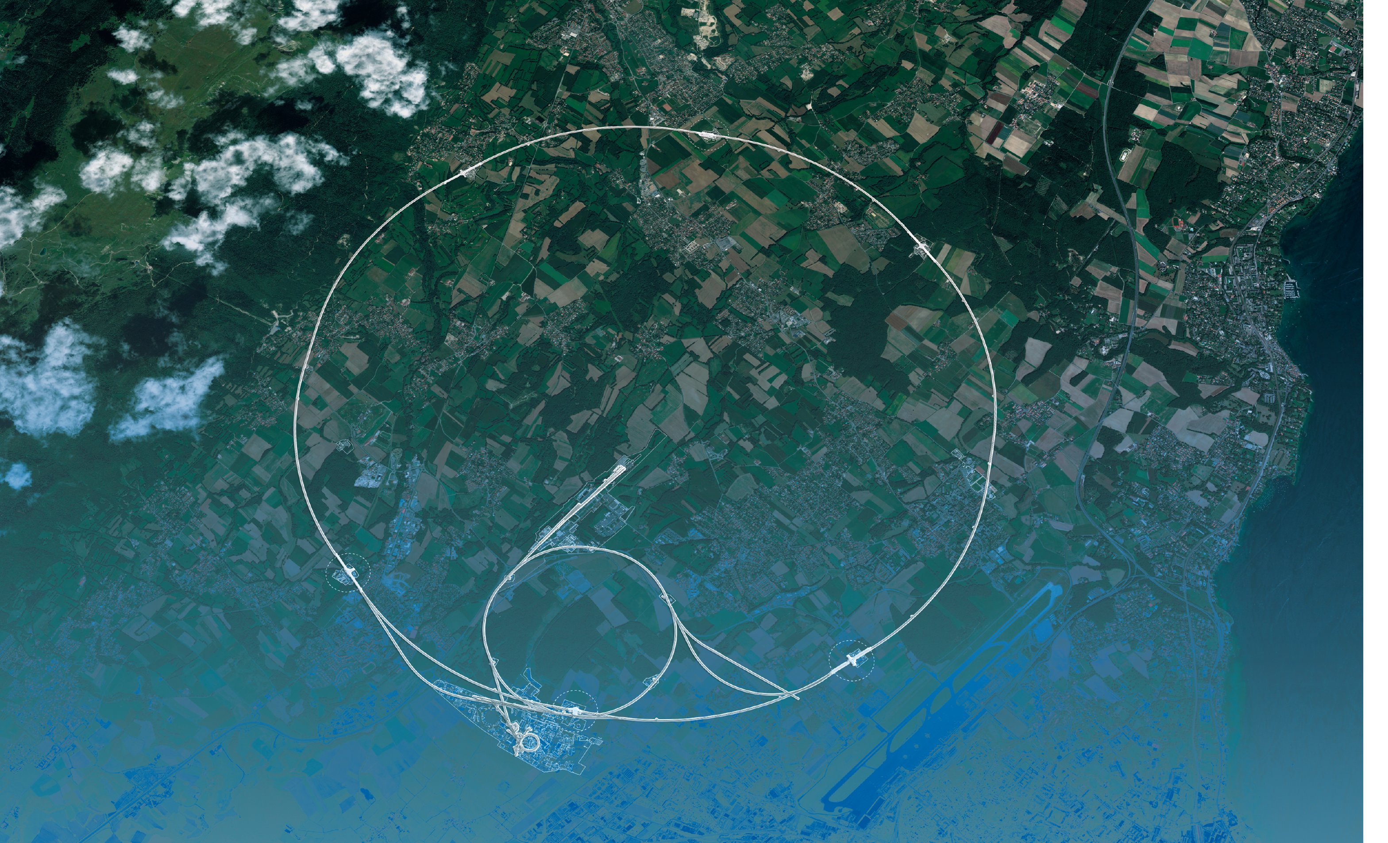
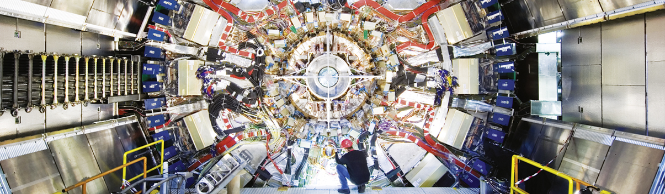
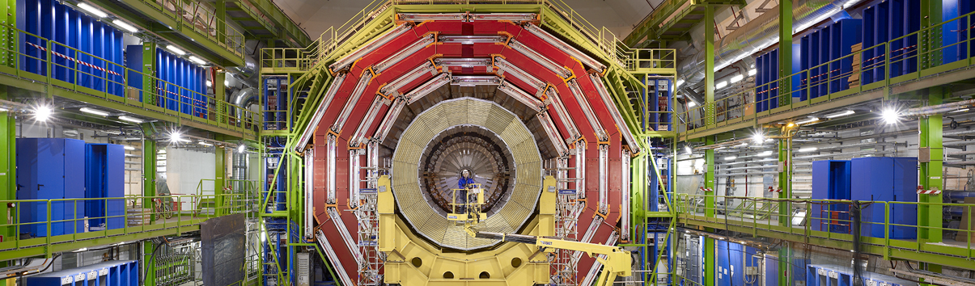
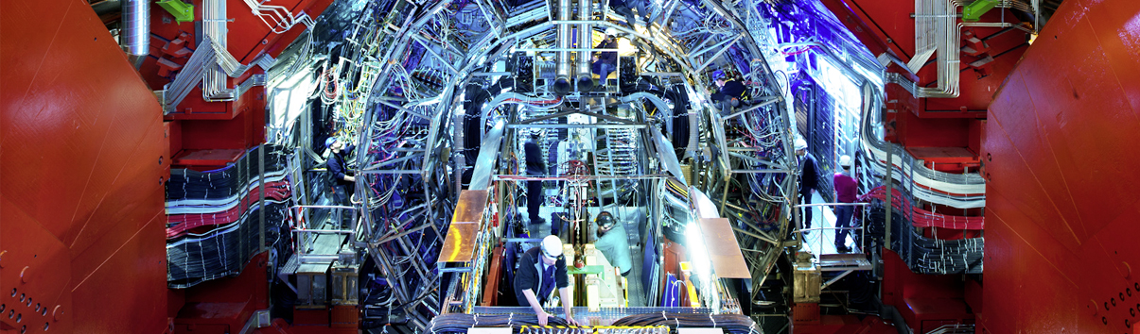
Giant detectors record the particles formed at the four collision points
ATLAS
CMS
CMS
ALICE
ALICE
ATLAS
LHCb
LHCb
+ TOTEM, LHCf, MoEDAL-MAPP, FASER, SND@LHC
Notes:
This slide allows the speaker to describe the accelerator complex and the four main LHC detectors.
About the accelerator complex (OPTIONAL)
The LHC is the last in a chain of particle accelerators, which gradually accelerate particles at increasing energy until they enter the LHC
Particles collide at four points on the LHC, where detectors register the collisions.
(ON CLICK)
About the four detectors, the speaker may give a 1-2 sentence description of the goal of each detector (TIME PERMITTING):
ATLAS – is a general-purpose detector, designed to carry out research ranging from precise measurements of the Higgs boson to searches for new physics beyond the Standard Model, similar to CMS. It is the largest collider-detector ever built (44m in length and 25m in diameter).
CMS - is a general-purpose detector, similar to ATLAS. It is one of the detectors, with ATLAS, where evidence for the Higgs boson was discovered and announced in 2012. It is the heaviest collider-detector (12.5 tonnes).
ALICE – studies the properties of the so-called quark-gluon plasma, a state of matter that probably existed just after the Big Bang, before protons and neutrons were formed.
LHCb – studies the asymmetry between matter and antimatter in interactions of particles containing the so-called b quark. This may help understand why our Universe is made up of only matter.

Slide 16
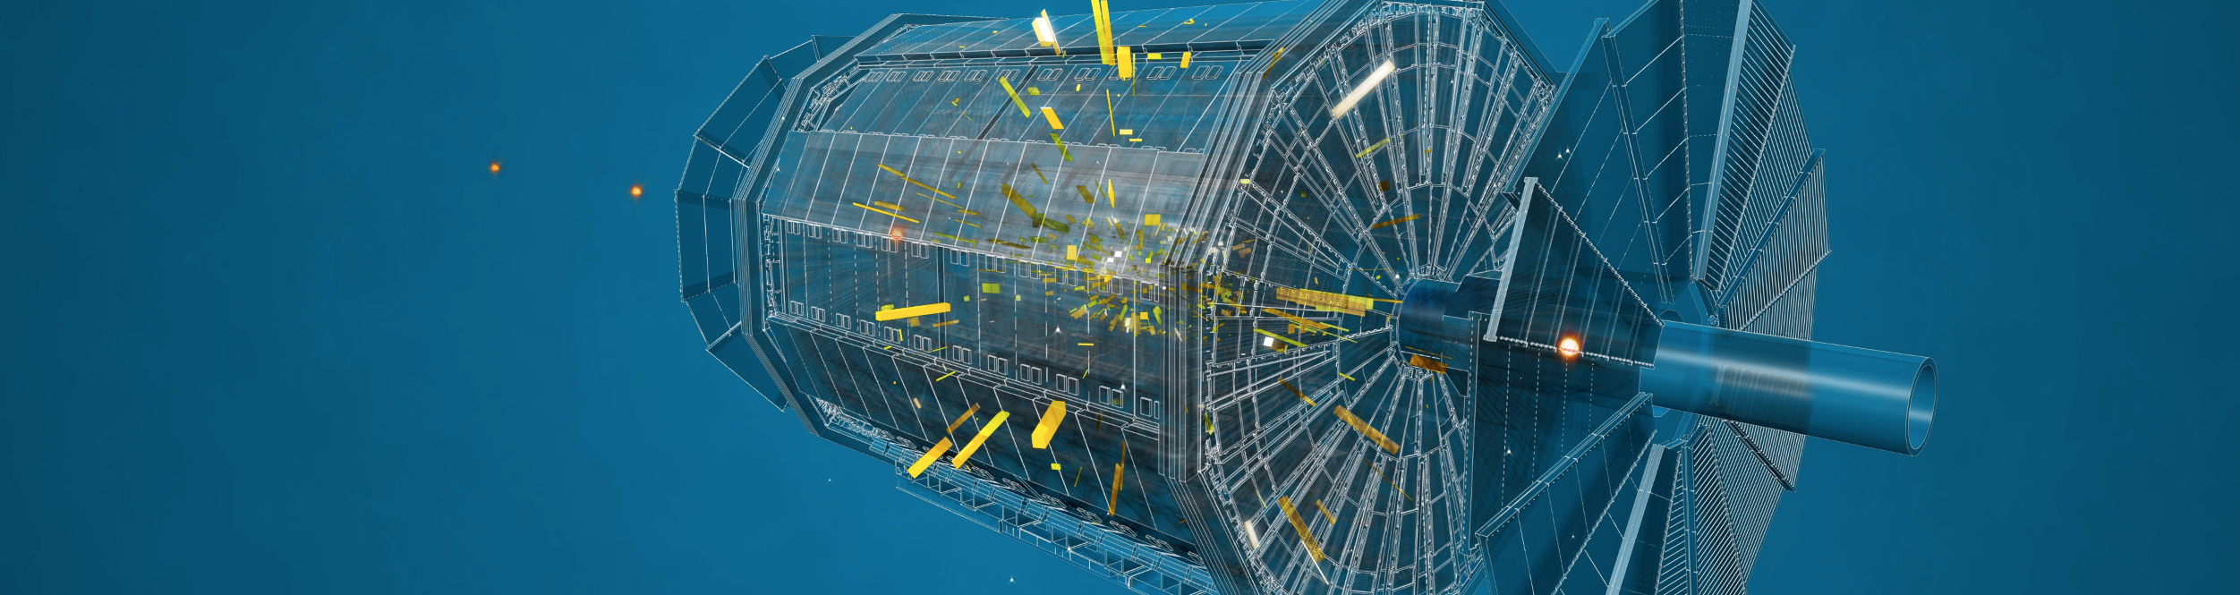



The LHC detectors are analogous to
3D cameras
The detectors measure the energy, direction and charge of new
particles formed.
They take 40 million pictures
a second. Only 1000 are
recorded and stored.
The LHC detectors have been built by international collaborations covering all regions of the Globe.
Notes:
OPTIONAL SLIDE –
MAY BE USED TO GIVE MORE INFORMATION ON DETECTORS AND COLLABORATIONS

Slide 17
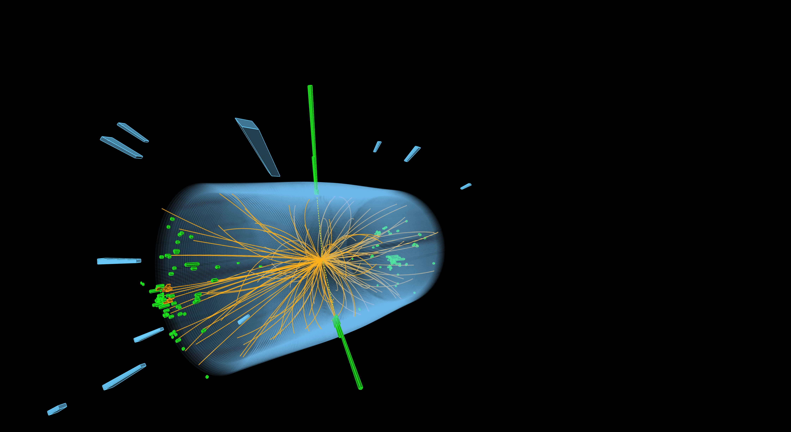
The LHC produces more than 1 billion particle collisions per second
The energy of the particles in collision is converted into new particles.
Notes:
Possible complementary information (TIME PERMITTING)
- At collision point, the energy density or temperature is equivalent to 10⁻¹²s after Big Bang (10¹⁶°C).
- The two proton beams collide at a combined energy of 13 TeV. A flying mosquito has about 4 trillion electronvolts of energy, so a collision in the LHC generates the energy of about 3 flying mosquitoes. But the energy is crammed into a space about 1 trillion times smaller across than the insect.
Nowhere else on Earth can we concentrate energy to that extent.

Slide 18
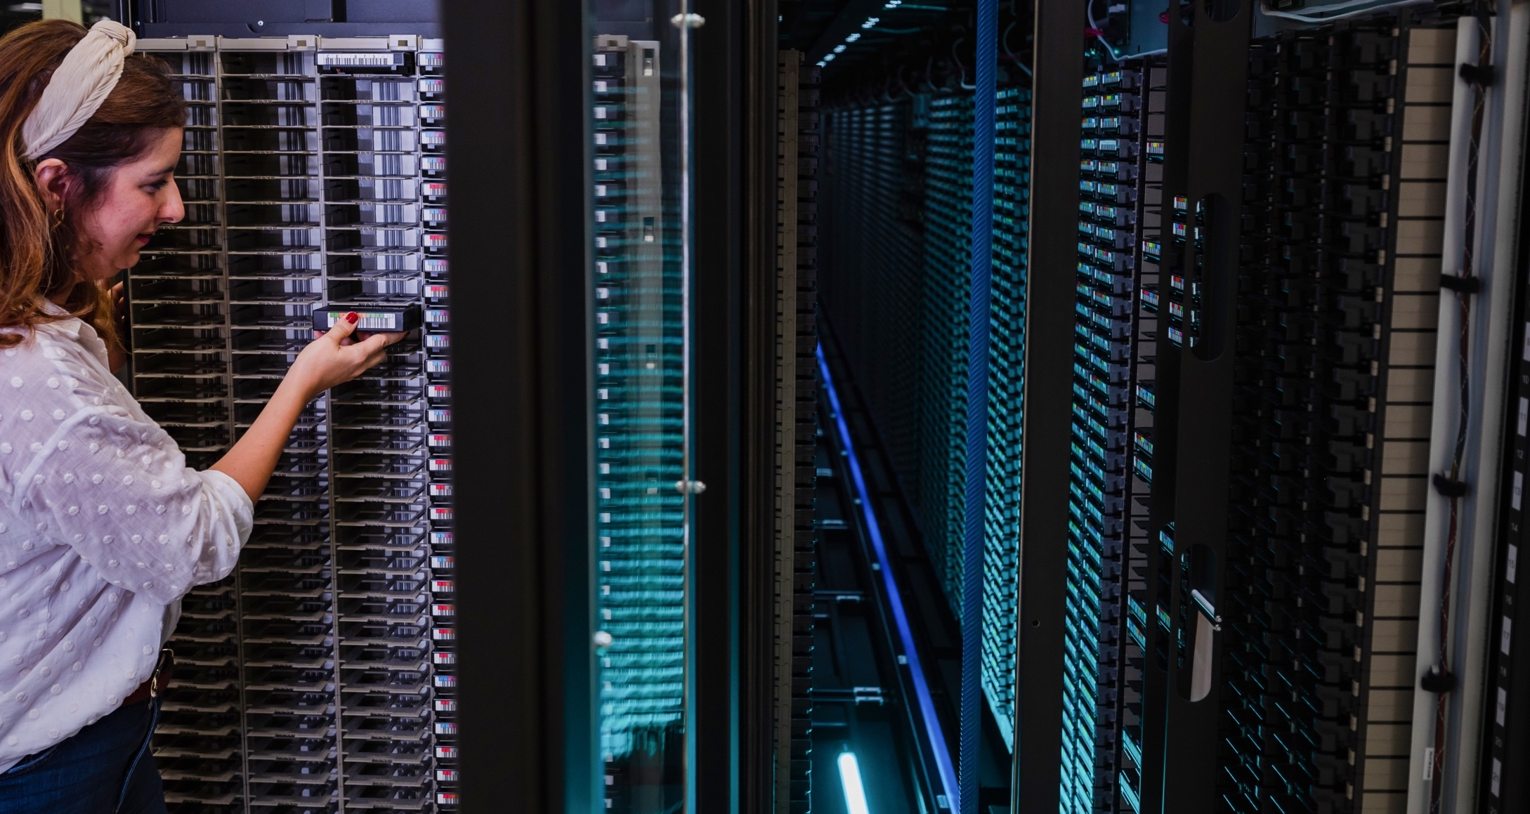
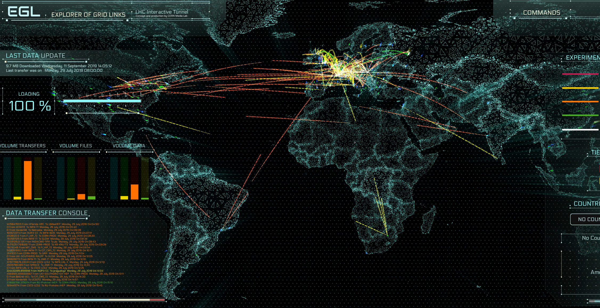
The Worldwide LHC Computing Grid (WLCG)
Used to store, distribute, process and analyse data.
1 million processing cores in about 170 data centres
and 42 countries.
More than 1000 Petabytes of CERN data stored world-wide.
Notes:
Latest facts and figures on the CERN Data Centre:
https://information-technology.web.cern.ch/about/data-centre
Additional interesting facts (optional):
- The total amount of storage used globally is around 1 Exabyte, split almost equally between tape and disk media.
- Close to 1 million computer cores are available to the LHC experiments.

Slide 19
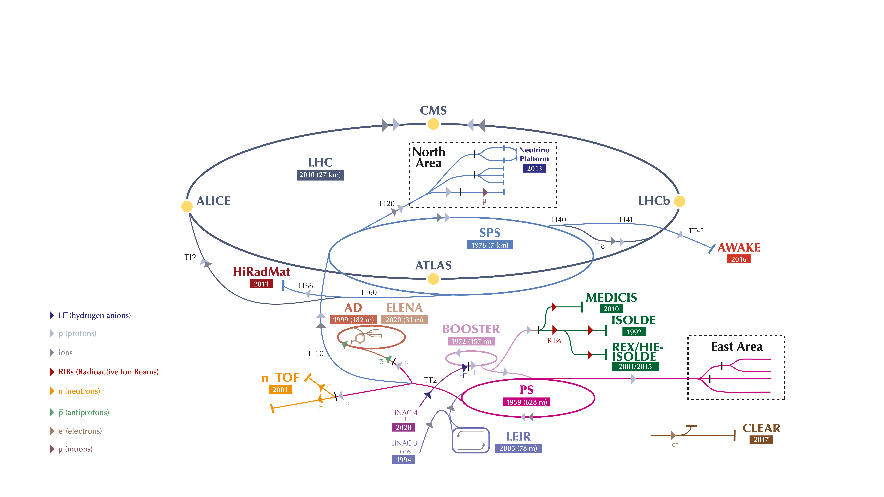
The CERN accelerator complex
Notes:
Latest facts and figures on the CERN Data Centre:
https://information-technology.web.cern.ch/about/data-centre
Additional interesting facts (optional):
- The total amount of storage used globally is around 1 Exabyte, split almost equally between tape and disk media.
- Close to 1 million computer cores are available to the LHC experiments.

Slide 20
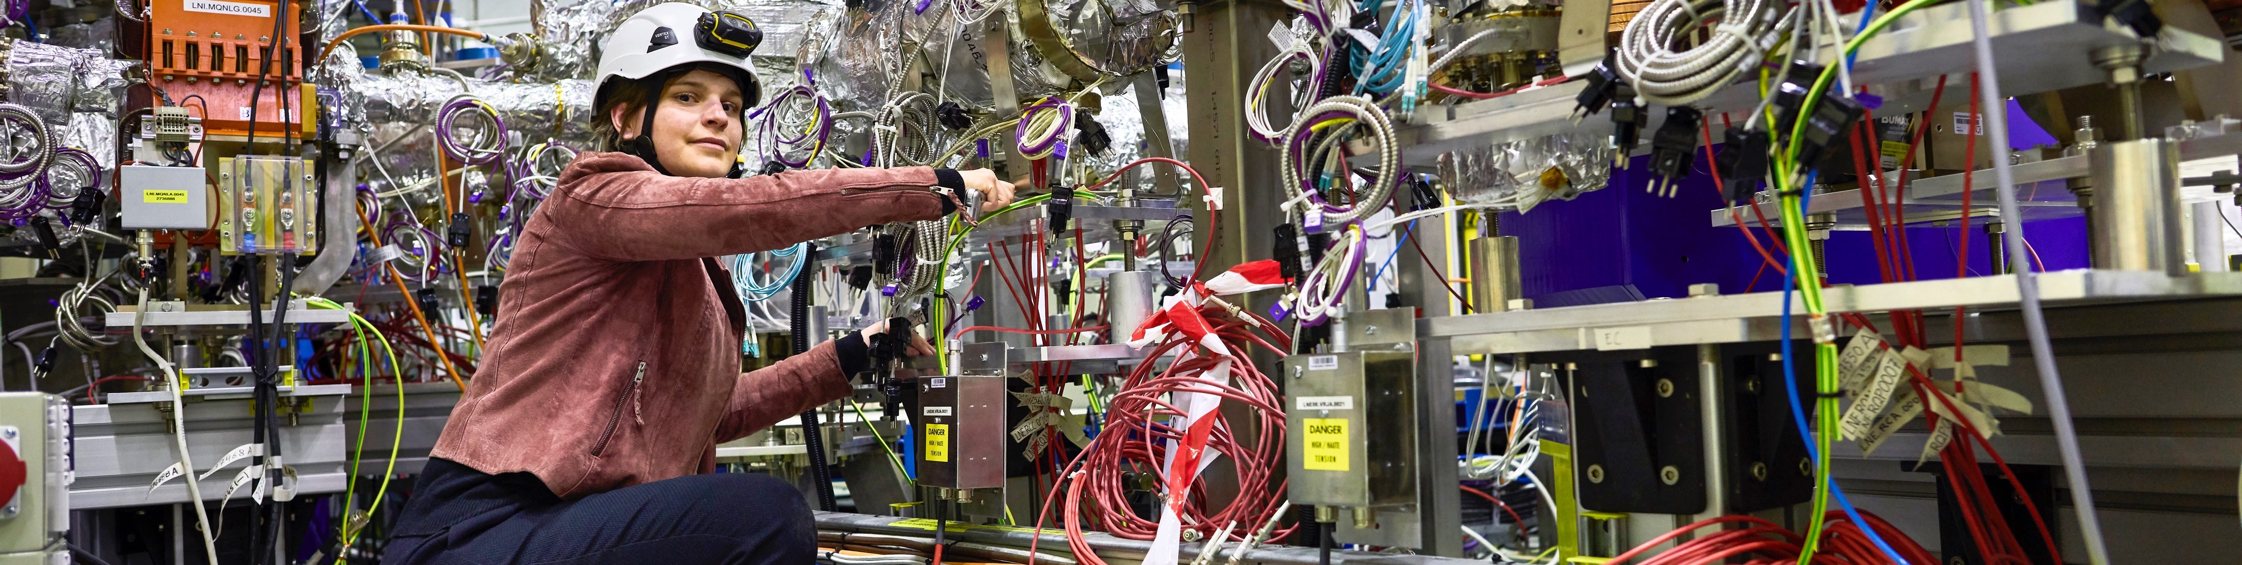
CERN has a diverse scientific programme
Nuclear Physics
(ISOLDE)
Antimatter Research
(Antiproton Decelerator)
Cosmic rays and cloud formation
(CLOUD)
Fixed-target experiments,
which include searches for rare phenomena
Contribution to the Long Baseline
Neutrino Facility in the USA (LBNF)
CERN Theory Programme
Notes:
Key messages:
While the Large Hadron Collider (LHC) is the flagship of CERN’s accelerator complex and the results of the LHC experiments are often in the limelight, CERN has a very diverse research programme
This programme covers a wide range of physics topics, from the Standard Model to supersymmetry, from dark matter to cosmic rays.
Experiments at other accelerators and facilities both on-site and off are an equally important part of the Laboratory’s activities.
THE SPEAKER SHOULD AVOID DESCRIBING EACH OF THE EXPERIMENTS SHOWN ON THE SLIDE BUT RATHER FOCUS ON THE MESSAGES ABOVE.

Slide 21
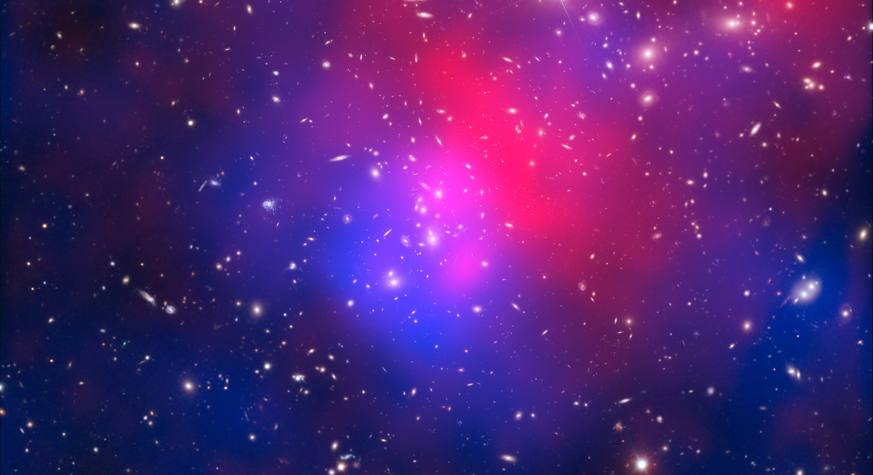
There are many unanswered questions in fundamental physics
Including
What is the unknown 95% of the mass
and energy
of the universe?
Is there only one Higgs boson, and does it behave exactly as expected?
Why is the universe made only of matter, with hardly any antimatter?
Why is gravity so weak compared to the other forces?
Notes:
This slide is a preamble to the following two slides, which focus on CERN’s future projects, aimed at moving closer to answering the questions shown on the slide (and others).

Slide 22
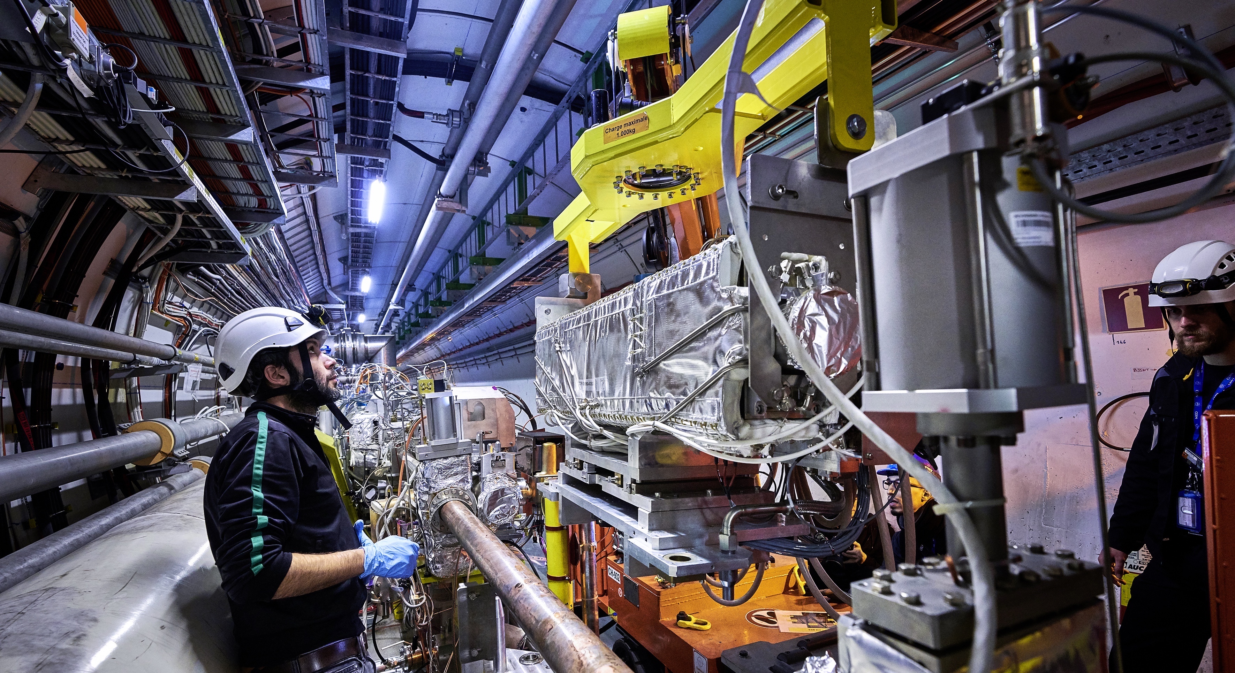
Upgrade to the
High-Luminosity LHC is under way
The HL-LHC will use new technologies to provide
10 times more collisions
than the LHC.
It will give access to rare phenomena, greater precision and discovery potential.
It will start operating in 2029, and run until approx. 2041.
Notes:
Additional information (OPTIONAL, TIME PERMITTING)
Key innovations in HL-LHC:
1) Powerful superconducting quadrupole magnets (12 Tesla) will be installed on either side of the ATLAS and CMS experiments to focus the particle bunches. These magnets will be made using niobium-tin (Nb₃Sn), used for the first time in an accelerator (instead of niobium-titanium)
2) Crab cavities for tilting the beams (16 in total) - give the head and tail of the particle bunches opposite-sign transverse momentum before they meet, enlarging the overlap area of the two bunches and thus increasing the probability of collisions.
3) One hundred new, more effective collimators will be installed: these devices absorb particles that stray from the beam trajectory and might otherwise damage the machine.
4) More compact and powerful bending magnets (11 Tesla), also made using the niobium-tin superconductor.
5) Innovative superconducting power lines will connect the power converters to the accelerator; will be able to carry currents of record intensities, up to 100 000 amps!

Slide 23

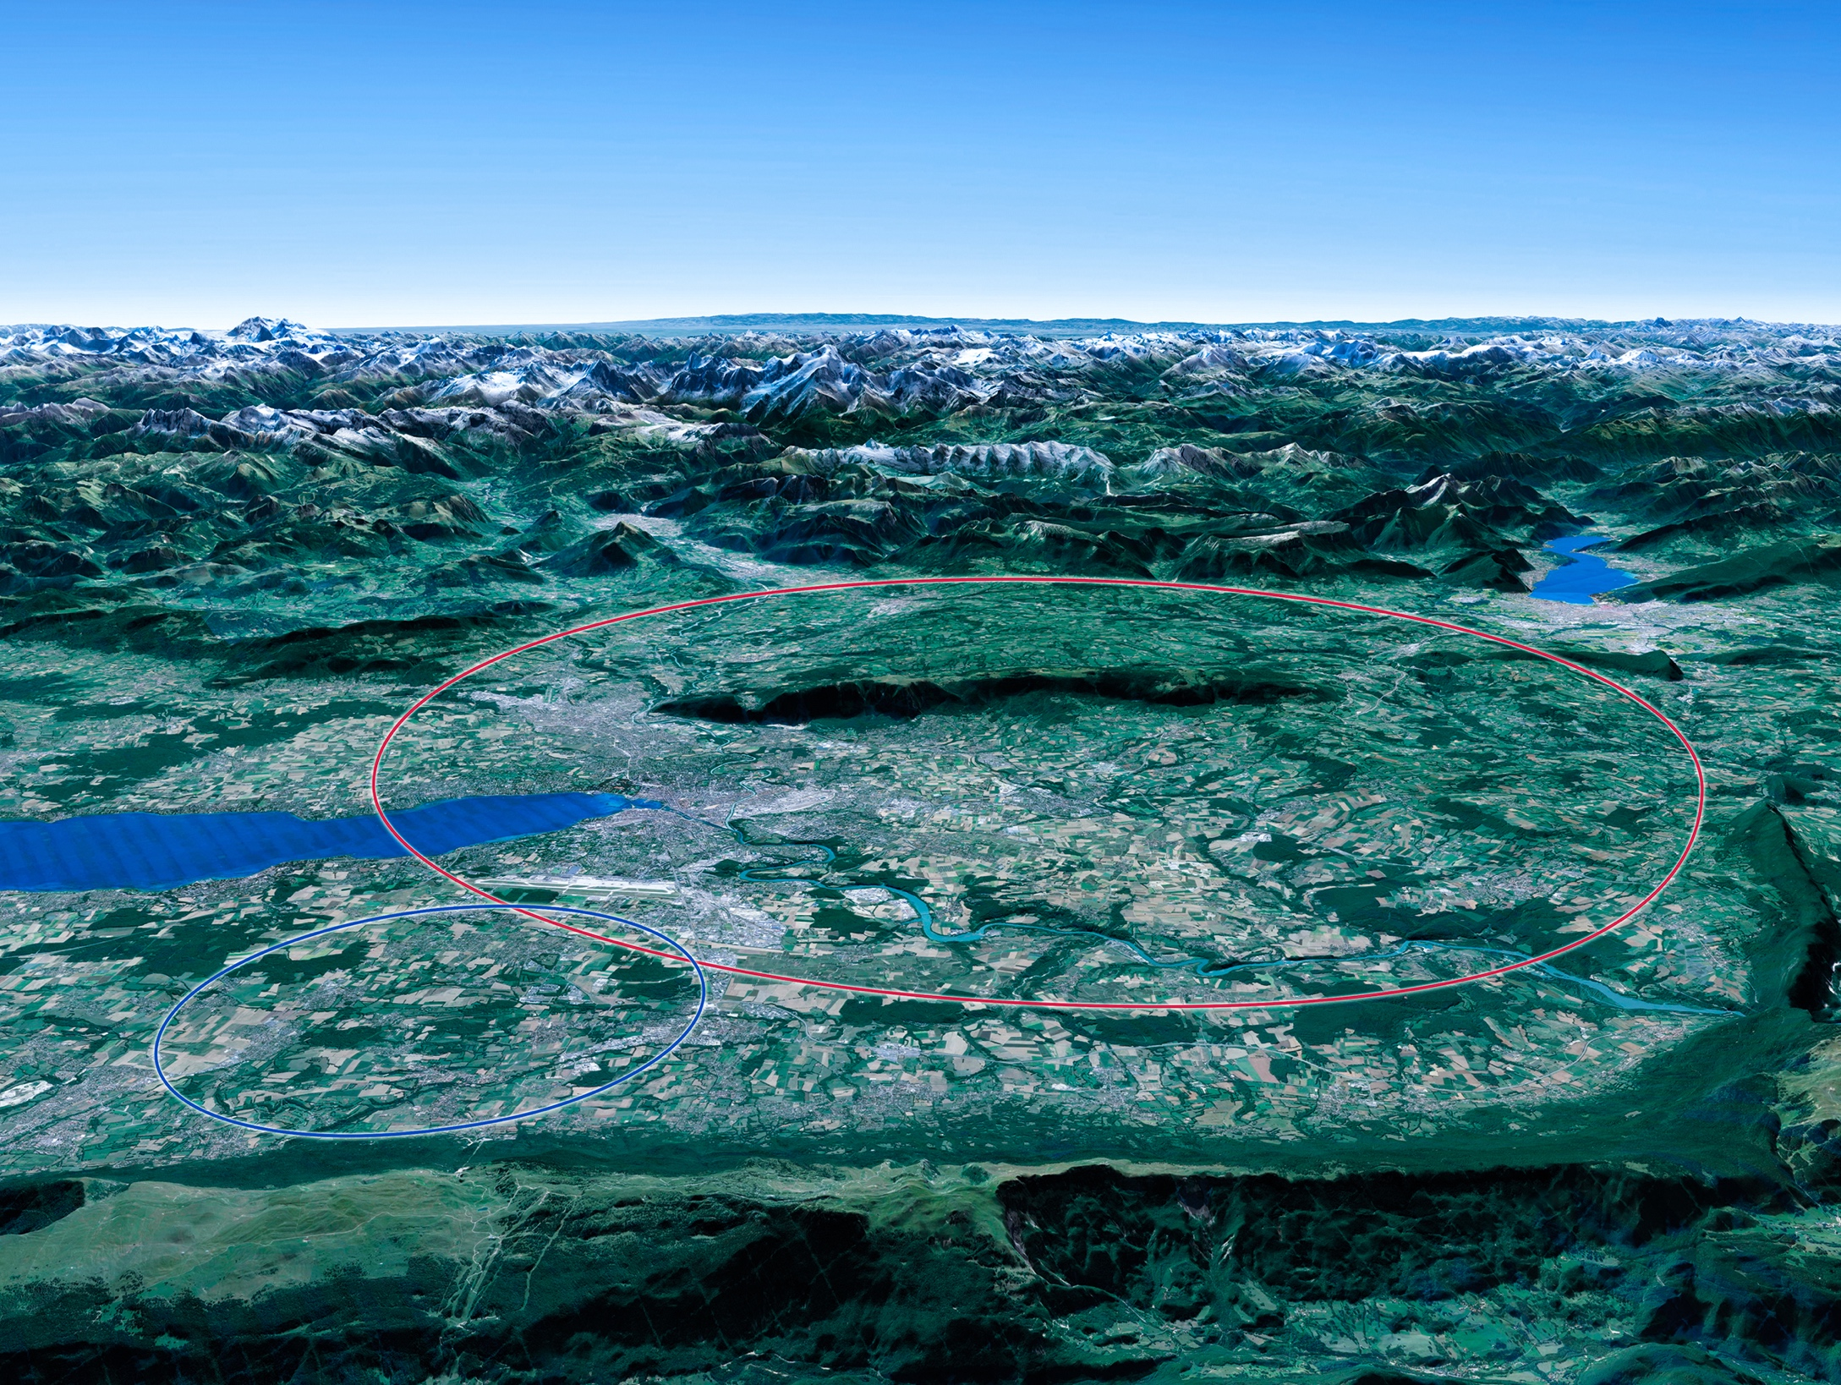

Scientific priorities for the future
Implementation of the recommendations
of the 2020 Update of the European Strategy
for Particle Physics:
• Fully exploit the HL-LHC
• Build a Higgs factory to further understand this unique particle
• Investigate the technical and financial feasibility of a future energy-frontier 100 km collider at CERN
• Ramp up relevant R&D
• Continue supporting other projects around
the world
LHC
Notes:
For information, the ESPPU recommendations in more detail:
Full exploitation of the HL-LHC
An electron-positron Higgs factory is the highest priority after the LHC
Ramp up R&D efforts for advanced accelerator technologies
Support long-baseline neutrino projects in Japan and US
Investigation of feasibility of a future 100 TeV hadron collider at CERN
THIS IS THE LAST SLIDE IN THE “RESEARCH” SECTION

Slide 24
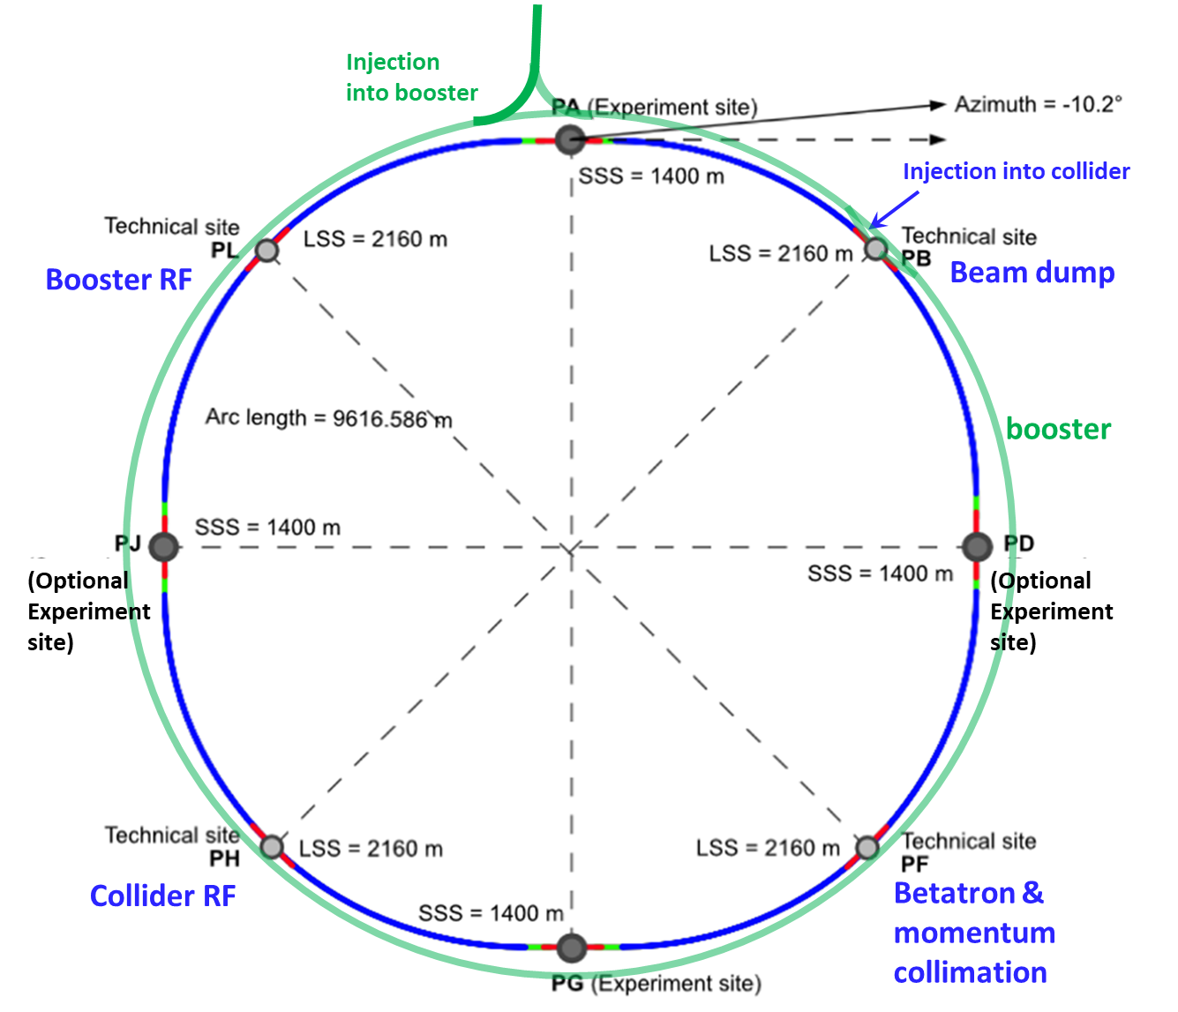
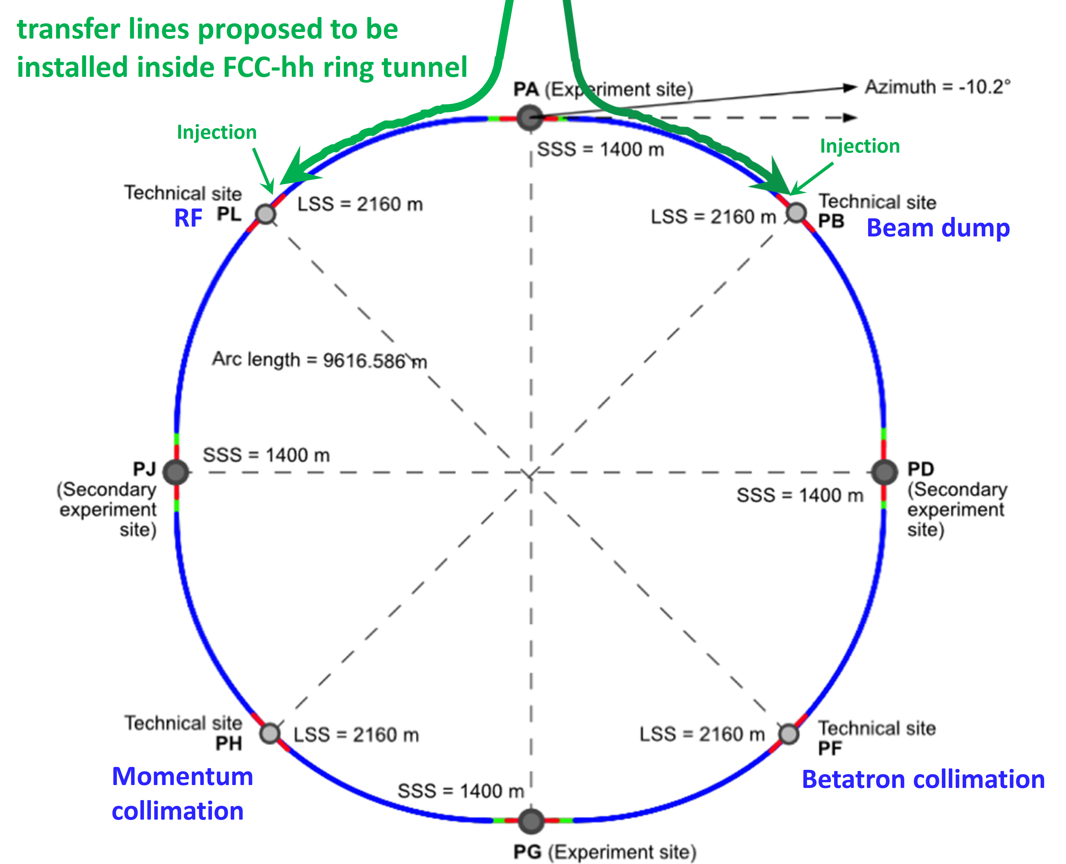

Future Circular Collider
Comprehensive long-term program maximizing physics opportunities
stage 1: FCC-ee (Z, W, H, $\text{t}\overline{\text{t}}$) as Higgs factory, electroweak & top factory at highest luminosities
stage 2: FCC-hh (~100 TeV) as natural continuation at energy frontier, pp & AA collisions; e-h option
Common civil engineering and technical infrastructures, building on and reusing CERN’s existing infrastructure
FCC integrated project allows the start of a new, major facility at CERN within a few years of the end of HL-LHC
Realistic schedule:
2025 FCC Feasibility Study delivered
~2028 Project approval by CERN Council
~2030 Construction of tunnel and FCC-ee starts
~2041 HL-LHC ends
2045-2048 Operation of FCC-ee
15 years physics operation
~2070 Operation of FCC-hh starts
  ~20 years physics operation
FCC-ee
FCC-hh
LHC
LHC
2020 - 2040
2045 - 2063
2070 - 2095
Presentation STRONG-2020
20 November 2023
24
Notes:
THIS IS THE LAST SLIDE IN THE “RESEARCH” SECTION

Slide 25
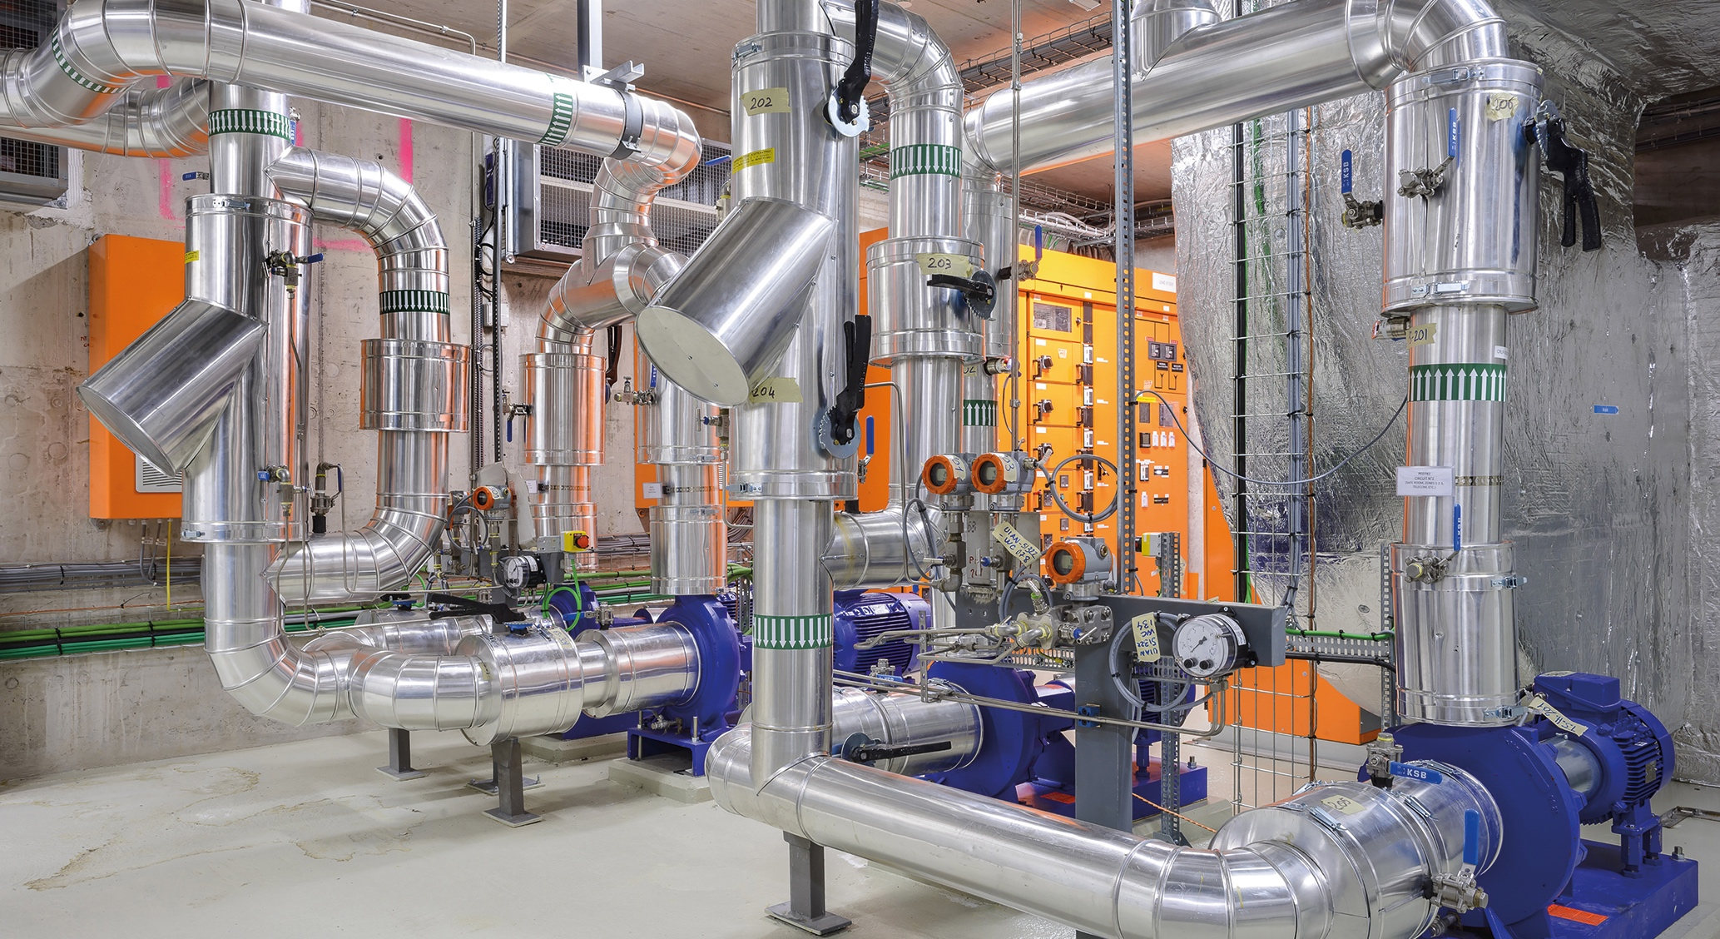
TECHNOLOGY & INNOVATION
Notes:
This is the title slide for the section on “Innovation” (Knowledge Transfer).
It should be shown for just enough time for the speaker to place it in the context of the four pillars mentioned at the start of the presentation (as a form of ”signposting”)
(THIS SECTION HAS 3 SLIDES)

Slide 26
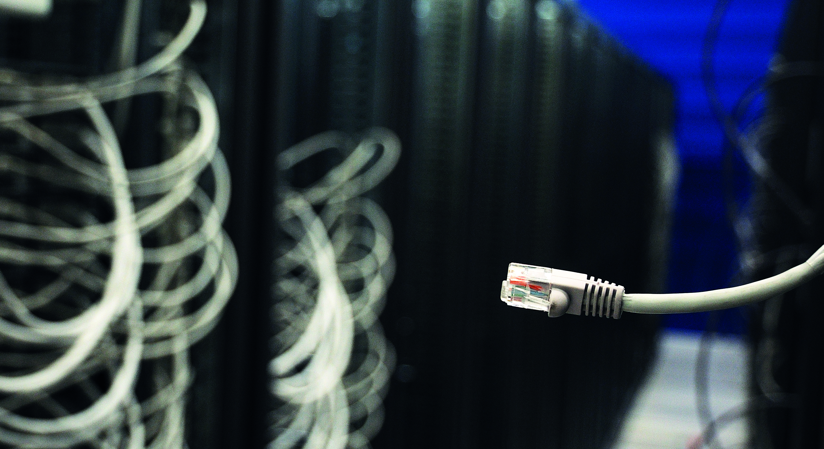
CERN’s technological innovations have applications in many fields
CERN is the birthplace of the World Wide Web
And there are many more examples
Medical imaging, cancer therapy, material science, cultural heritage, aerospace, automotive, environment, health & safety, industrial processes.
Notes:
Key message:
- CERN not only drives existing technology to its limits in order to develop the accelerators, detectors and computing power needed for its research, but the technologies it develops or improves on have applications beyond particle physics research.
- We start with the best-known example: the World Wide Web, but there are more, in areas ranging from the environment to medical applications (the focus of the next slide)

Slide 27
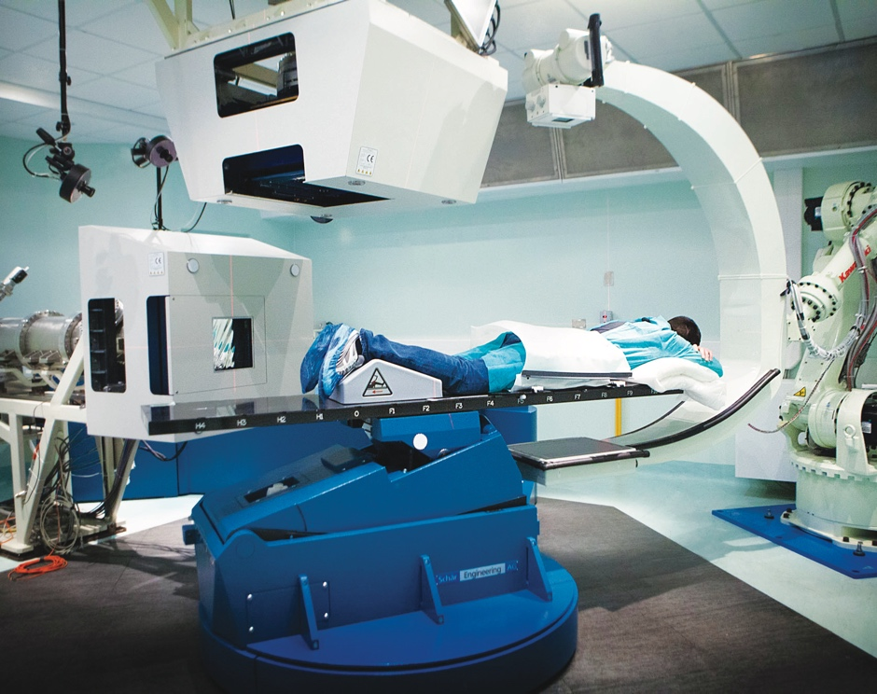
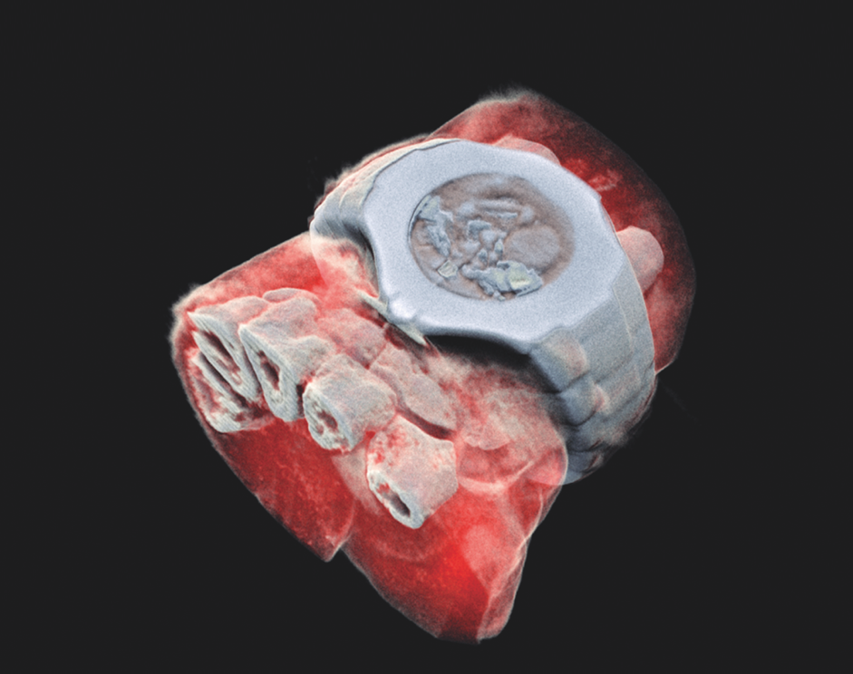
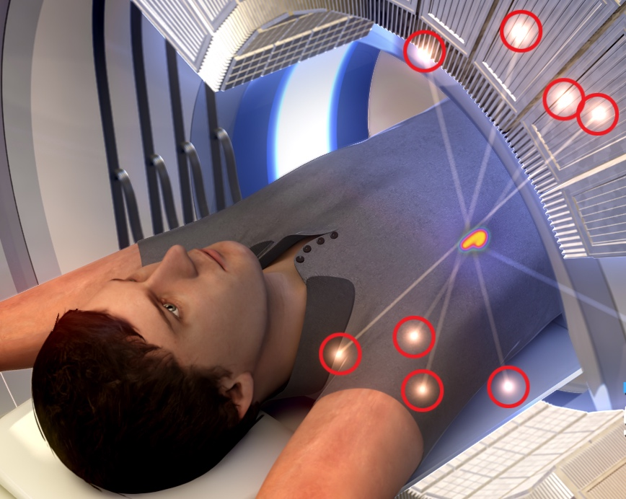
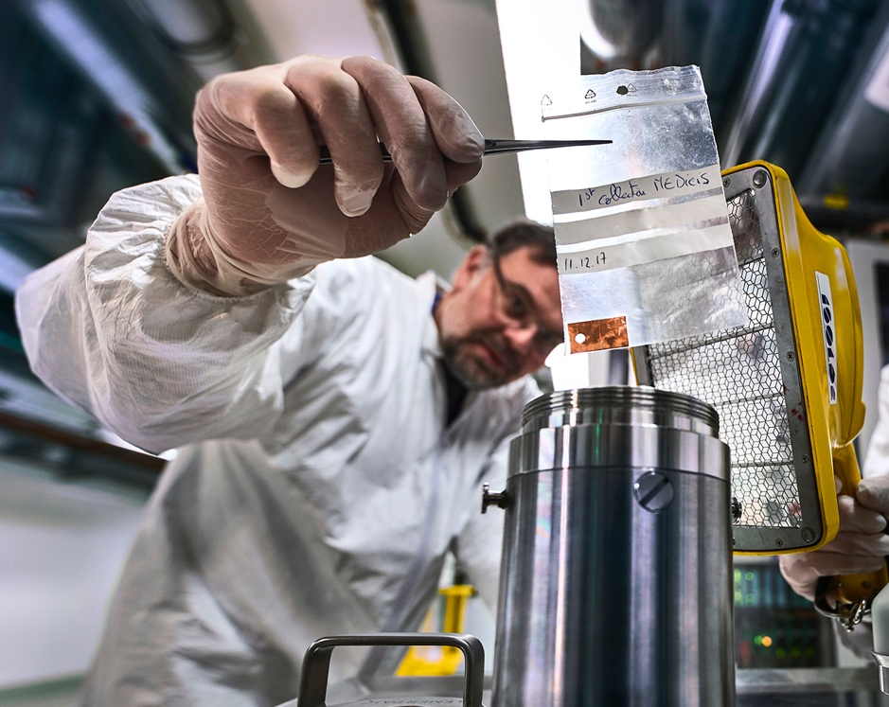
CERN’s technological innovations have important applications in medicine and healthcare
Technologies applied
at CERN are also used in PET, for medical imaging and diagnostics.
CERN produces innovative radioisotopes for nuclear medicine research.
© marsbioimaging
© CNAO
© ENVISION / ENLIGHT
Accelerator technologies are applied in cancer radiotherapy with protons, ions and electrons.
Pixel detector technologies are
used for high resolution
3D colour X-ray imaging.
Notes:
Background information (THE SPEAKER SHOULD NOT GO INTO THE DETAIL BELOW; THE INFORMATION IS PROVIDED AS SUPPORT FOR QUESTIONS AND, IF TIME PERMITS, TO ADD TO THE KEY INFROMATION ON THE SLIDE:
Cancer radiotherapy using protons and other ions instead of photons (used in conventional radiotherapy):
CERN has contributed to the birth of the proton- and carbon-ion treatment centres CNAO, in Italy, and MedAustron, in Austria, and continues to collaborate with them;
CERN also developed an RFQ technology now used by a company in an innovative linac for proton therapy (2021, system under test at STFC Daresbury);
CERN is now involved in the development of cutting-edge technologies for next-generation ion therapy facilities and of a facility for treating tumours with very high-energy electrons at ultra-high dose rates (FLASH therapy, with CHUV Lausanne)
Medical imaging:
CERN contributed to early developments in PET instrumentation (70s-80s);
Since 1995, the Crystal Clear collaboration has been engaged in the development of several organ-specific (breast, pancreas, prostate) and animal-dedicated PET scanner prototypes, and in pushing the limit of coincidence time resolution for time-of-flight (TOF) PET;
overall, the requirements of large-scale physics experiments often drive the mass production for specific equipment (e.g. the BGO crystals for the L3 detector at LEP), and make it possible for other applications to obtain the technology at a reasonable cost for e.g. building PET scanners.
New 3D colour X-rays of human extremities (2018) using CERN-developed Medipix 3 technology, by a start-up in New Zealand.
Nuclear medicine
CERN-MEDICIS (Medical Isotopes Collected from ISOLDE) is a one-of-a kind infrastructure designed to produce a new generation of non-conventional radioisotopes with potential applications in precision medicine and theranostics. Since December 2017, MEDICIS has been providing innovative radioisotopes to partner research institutes. MEDICIS aims to increase the range of radioisotopes available for biomedical research, thanks to its unique set-up that includes an irradiation station on a high energy proton beam and a radioisotope mass-separation beam-line.
THIS IS THE LAST SLIDE IN THE “TECHNOLOGY AND INNOVATION” SECTION

Slide 28
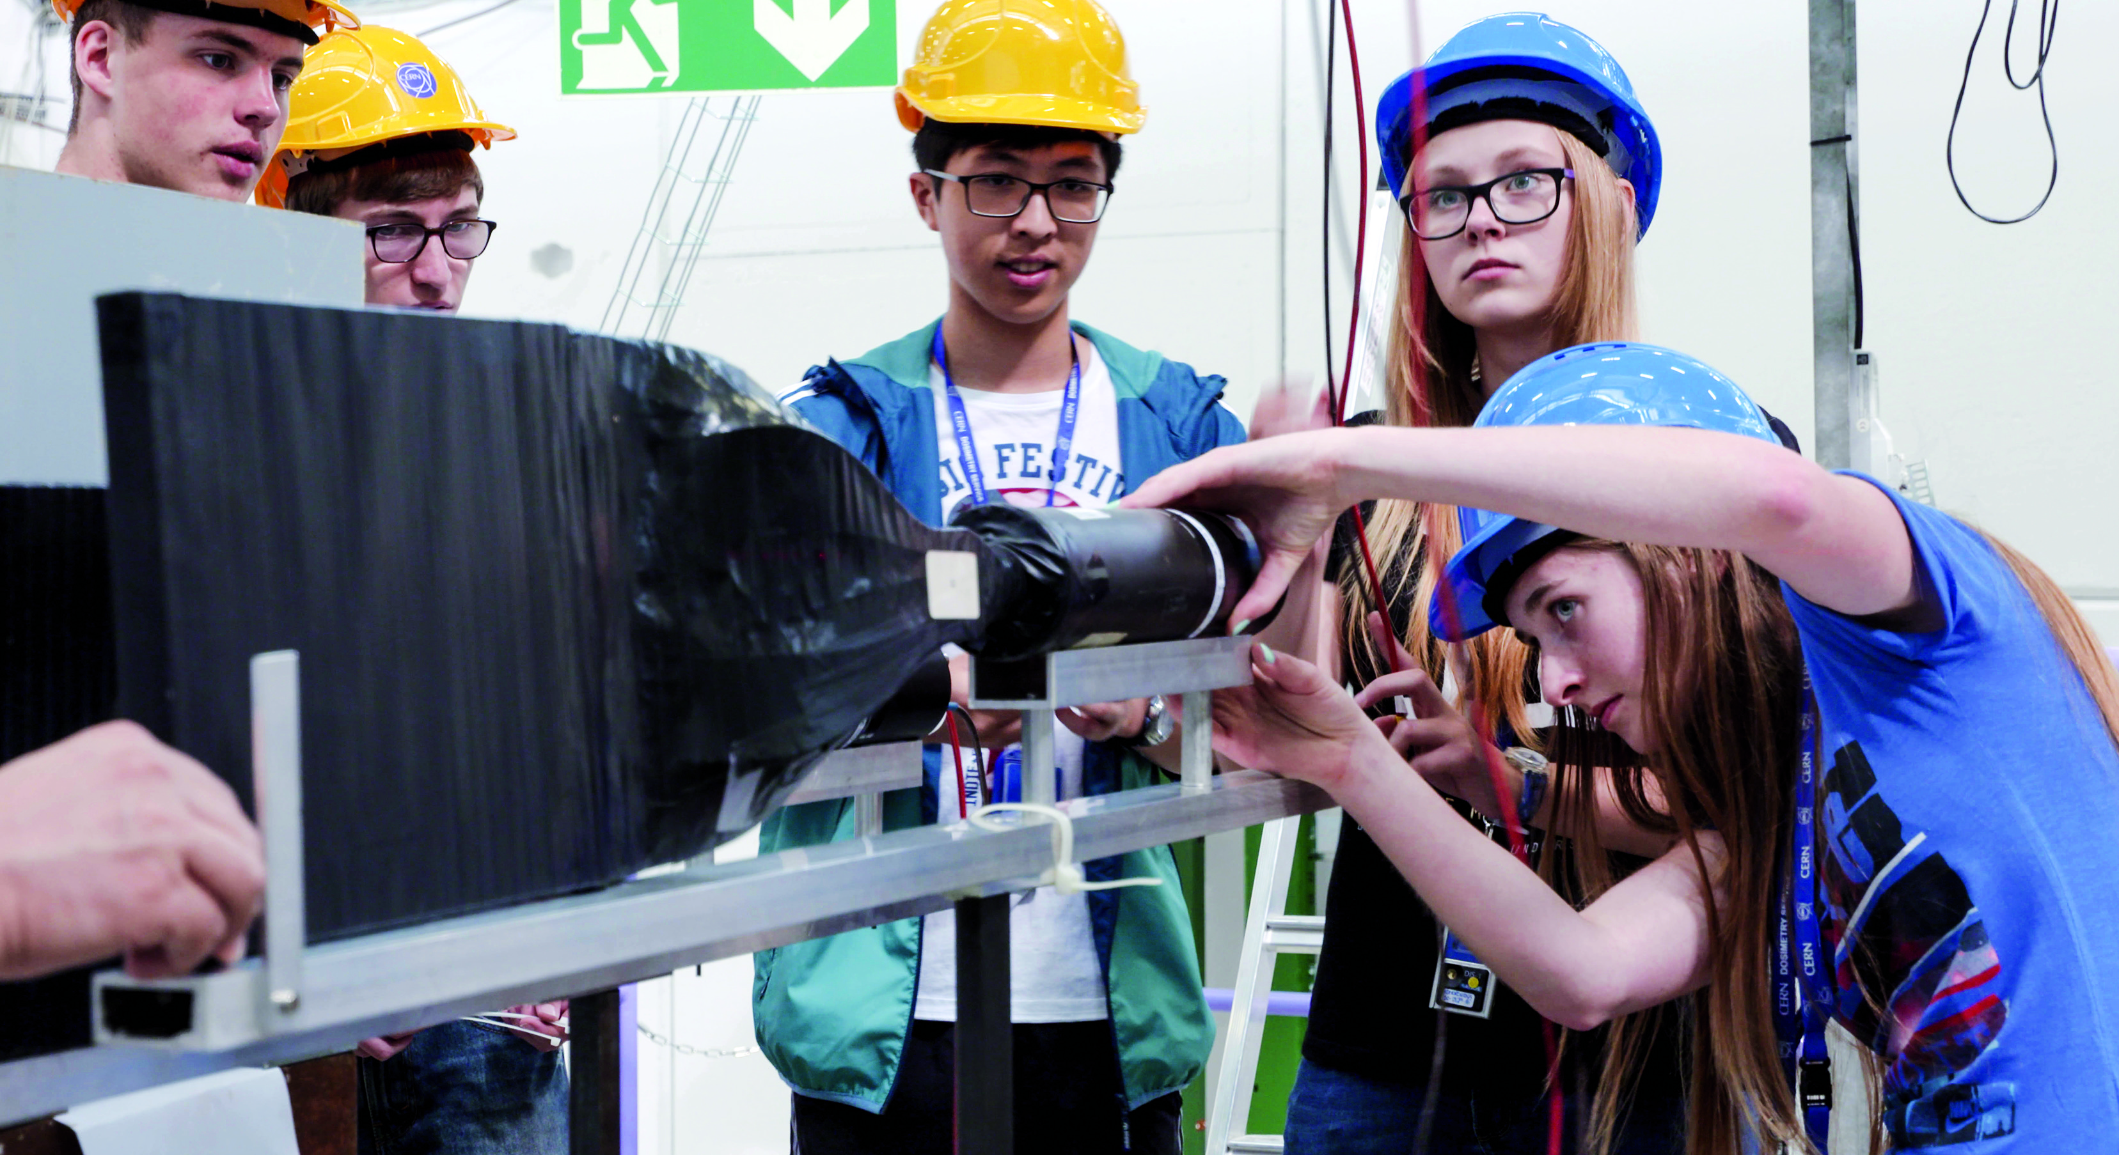
EDUCATION
& TRAINING
Notes:
This is the title slide for the section on “Education and Training”
It should be shown for just enough time for the speaker to place it in the context of the four pillars mentioned at the start of the presentation (as a form of ”signposting”)
(THIS SECTION HAS 6 SLIDES)

Slide 29
CERN opens a world of career opportunities
Number
of Persons
19%
Other fields, including
government organisations
27
45%
Industry
36%
Academia or Research
65
age
Age Distribution of Scientists working at CERN
Source: CERN Alumni survey (2014)
PhD and Technical students leaving CERN

Slide 30
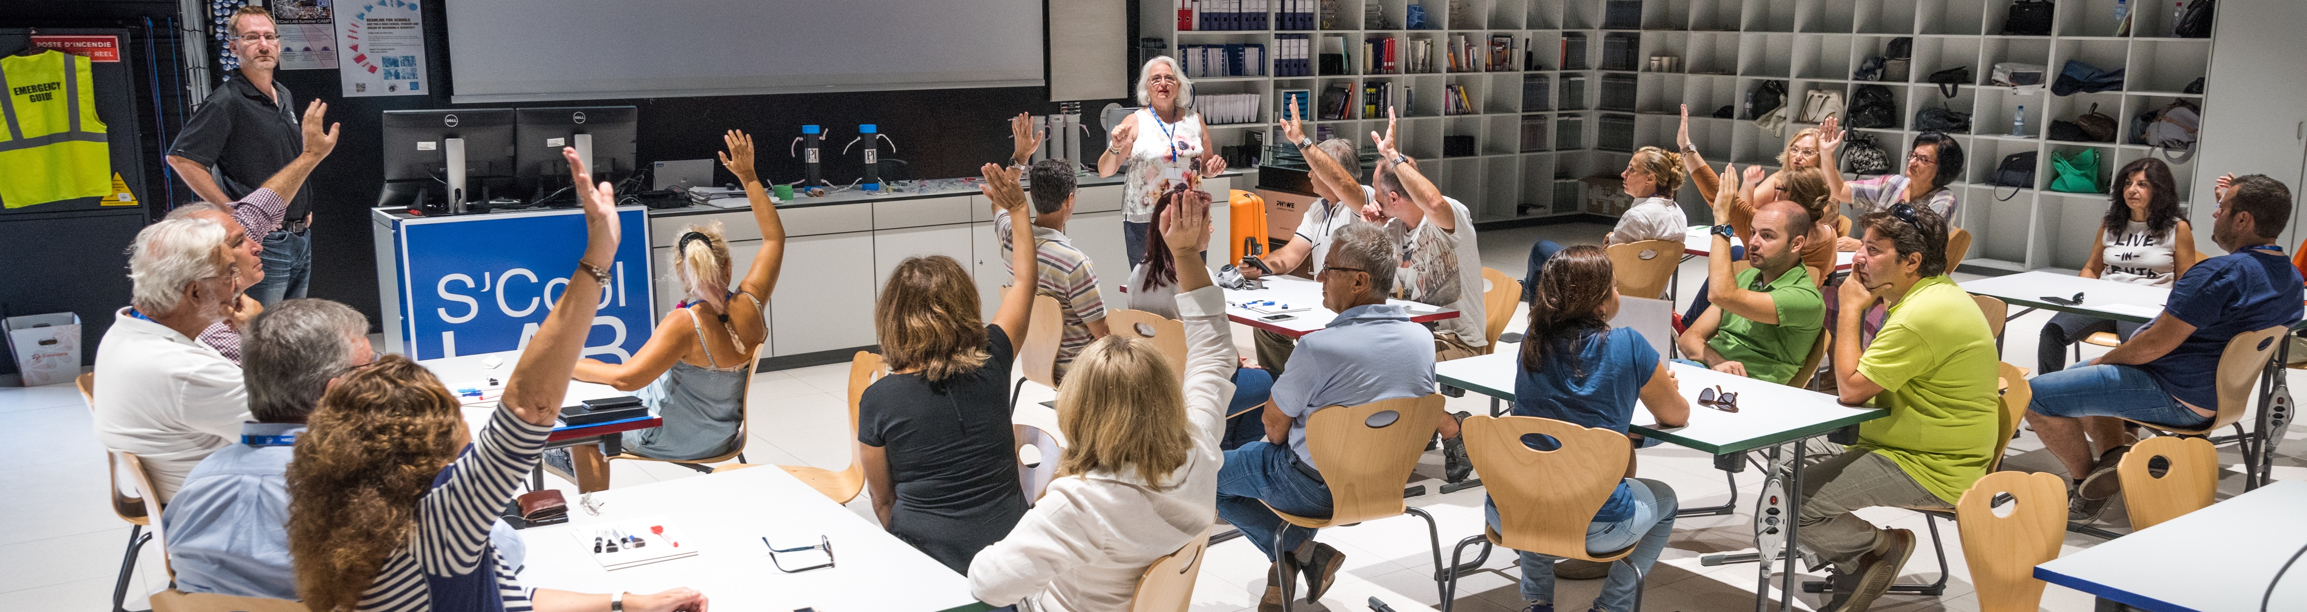
CERN’s training, education and outreach programmes
300 Undergraduate students in
Summer programmes
>3000 registered PhD students.
>1000 Fellows, Technical and Doctoral Students in research and applied physics, engineering and computing.
13 304 teachers since 1998 and 2000 participants in the webinar since 2020.
151 000 visitors on guided tours of CERN in 2019, from 95 countries.
CERN engages with citizens
across the globe:
on-site and travelling exhibitions
in 15 countries, > 1 million visitors
Science Gateway will open in 2023, expanding CERN’s outreach reach and impact, locally and globally.
Notes:
THE NUMBERS ON THIS SLIDE NEED REGULAR UPDATING
CERN schools: High Energy Physics; Computing; Accelerator

Slide 31
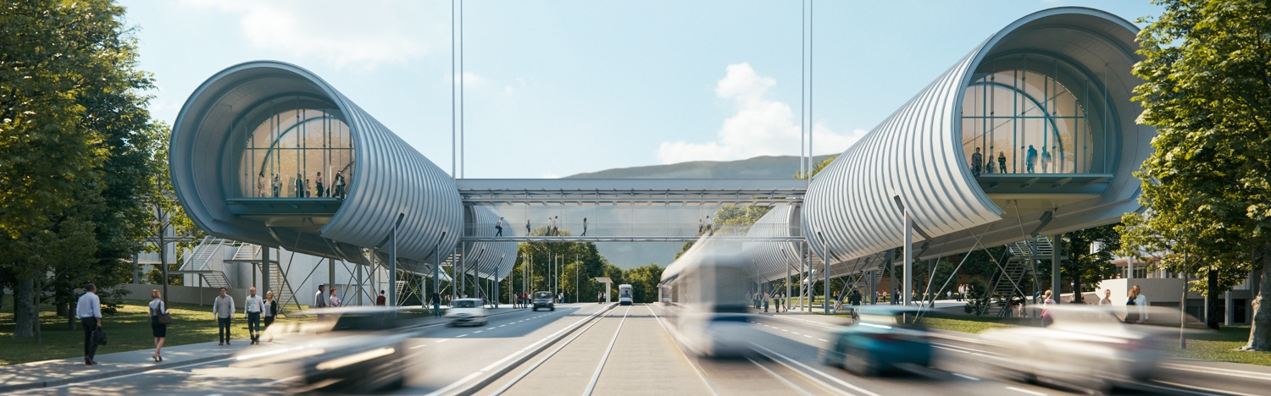
CERN Science Gateway
CERN’s new education and outreach centre for all
publics aged 5-plus.
Inaugurated October 2023.
Immersive exhibitions, education labs, events
and shows.
Notes:
Additional information:
Will engage citizens with the science, the discoveries, the technologies and the people working at CERN
Will inspire the next generation to explore a career in science and technology.
Building designed by Renzo Piano
Includes three exhibitions, two educational labs and a 900-seat auditorium, to be used for public events and scientific meetings and conferences
Fully funded by external donations
THIS IS THE LAST SLIDE IN THE “EDUCATION AND TRAINING” SECTION

Slide 32
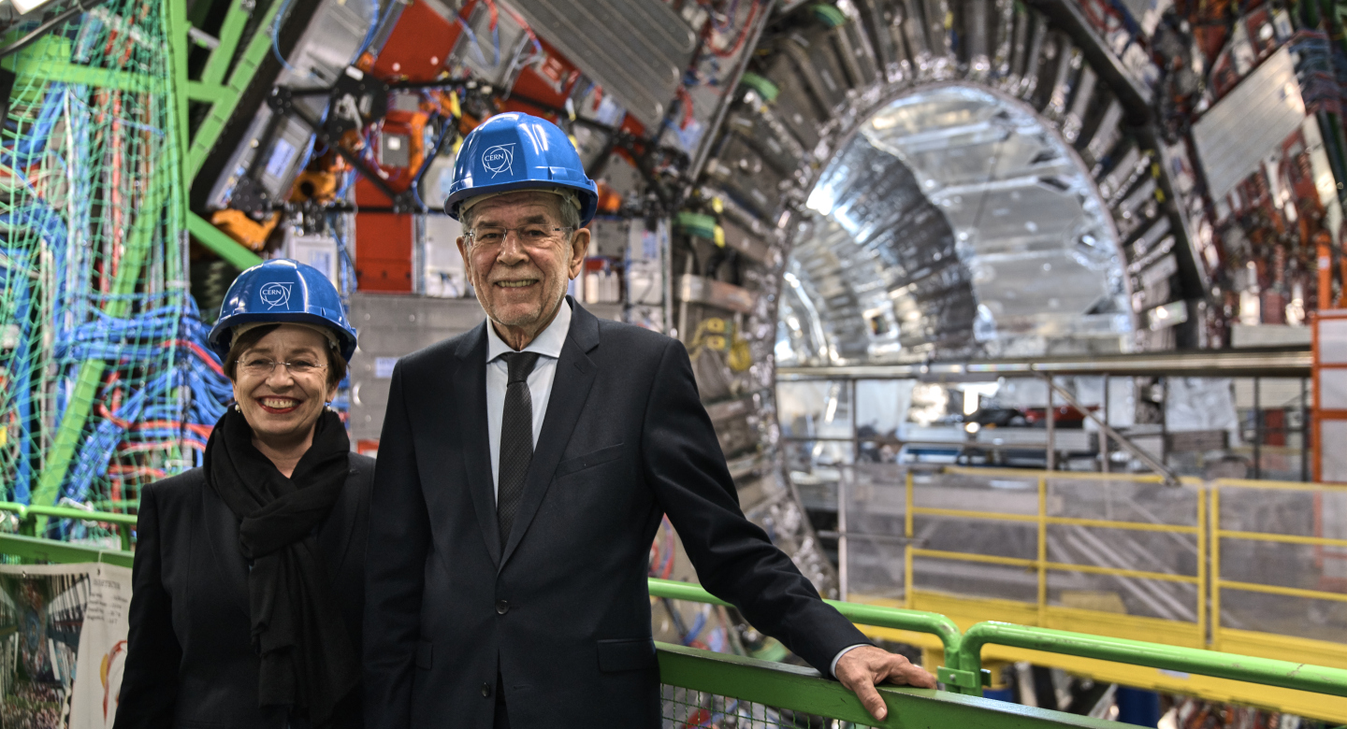
Austria has a strong tradition in Particle Physics
Became a Member State of CERN in 1959
Victor Weisskopf (Austrian-American)
  Director General (1961-1965)
Willibald Jentschke
  Director General (1971-1975)
27 February 2018 - Austrian Federal President A. Van der Bellen and Ms Schmidauer
in front of the CMS detector at LHC Point 5.
Notes:
Concerning FCC there are several Austrian contributions in a wide range of fields involved in the collaboration and I would suggest to mention this explicitly:
On the industrial side we have the company ILF as our main consultant for CE planning, scheduling and costing.
On the technical/scientific side we have several university institutes involved:
Austrian Institute of Technologies – reliability engineering
HEPHY – Physics
Montanistic University of Leoben – Tunneling technologies
Natural Historic Museum Wien – conception of exhibition on HEP and FCC
University of Applied Sciences Technikum Wien – magnet production technology
University of Innsbruck – Physics
Vienna University of Economy – socio-economic impact studies
Vienna University of Technology - Superconductor development and material research
(THIS SECTION TYPICALLY HAS 3/4 SLIDES)

Slide 33
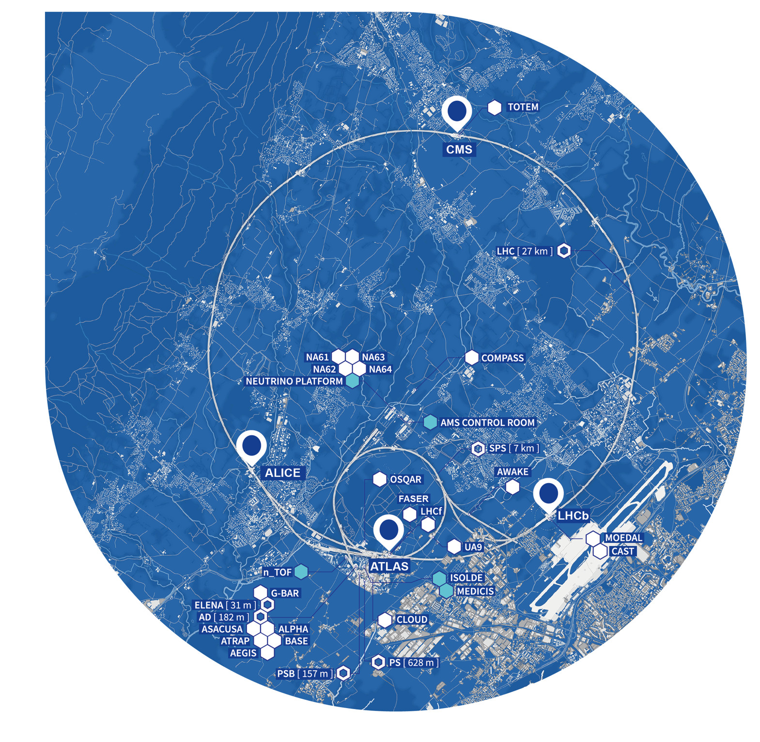
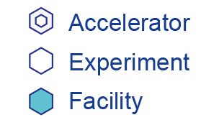
Austria has a strong involvement across the CERN experimental programme
LHC EXPERIMENTS:
ALICE 1 Institute, 11 Participants
ATLAS 2 Institutes, 13 Participants
CMS 1 Institute, 63 Participants
FIXED TARGET EXPERIMENTS
CLOUD
nToF
3 institutes, 11 Participants
ISOLDE
3 institutes, 10 Participants
ANTIPROTON EXPERIMENTS
ASACUSA
AEGIS
2 institutes, 22 Participants
LHC Grid Computing Tier-2 centre in Vienna (HEPHY/CLIP)
Significant involvement in studies for the future (FCC) with several institutes/universities strongly involved
Austrian PhD Programme at CERN
MEDAUSTRON
Notes:
r

Slide 34
There are many unanswered questions
in fundamental physics
CERN will continue to play a crucial role
in the journey of exploration
Notes:
Key messages:
- the discovery of the Higgs boson opened the door to better understanding of the Universe around us
CERN and the international particle physics community are preparing for the long-term future, in order to answer the outstanding questions in the field.
THIS IS THE LAST SLIDE OF THE PRESENTATION

