Slide 1
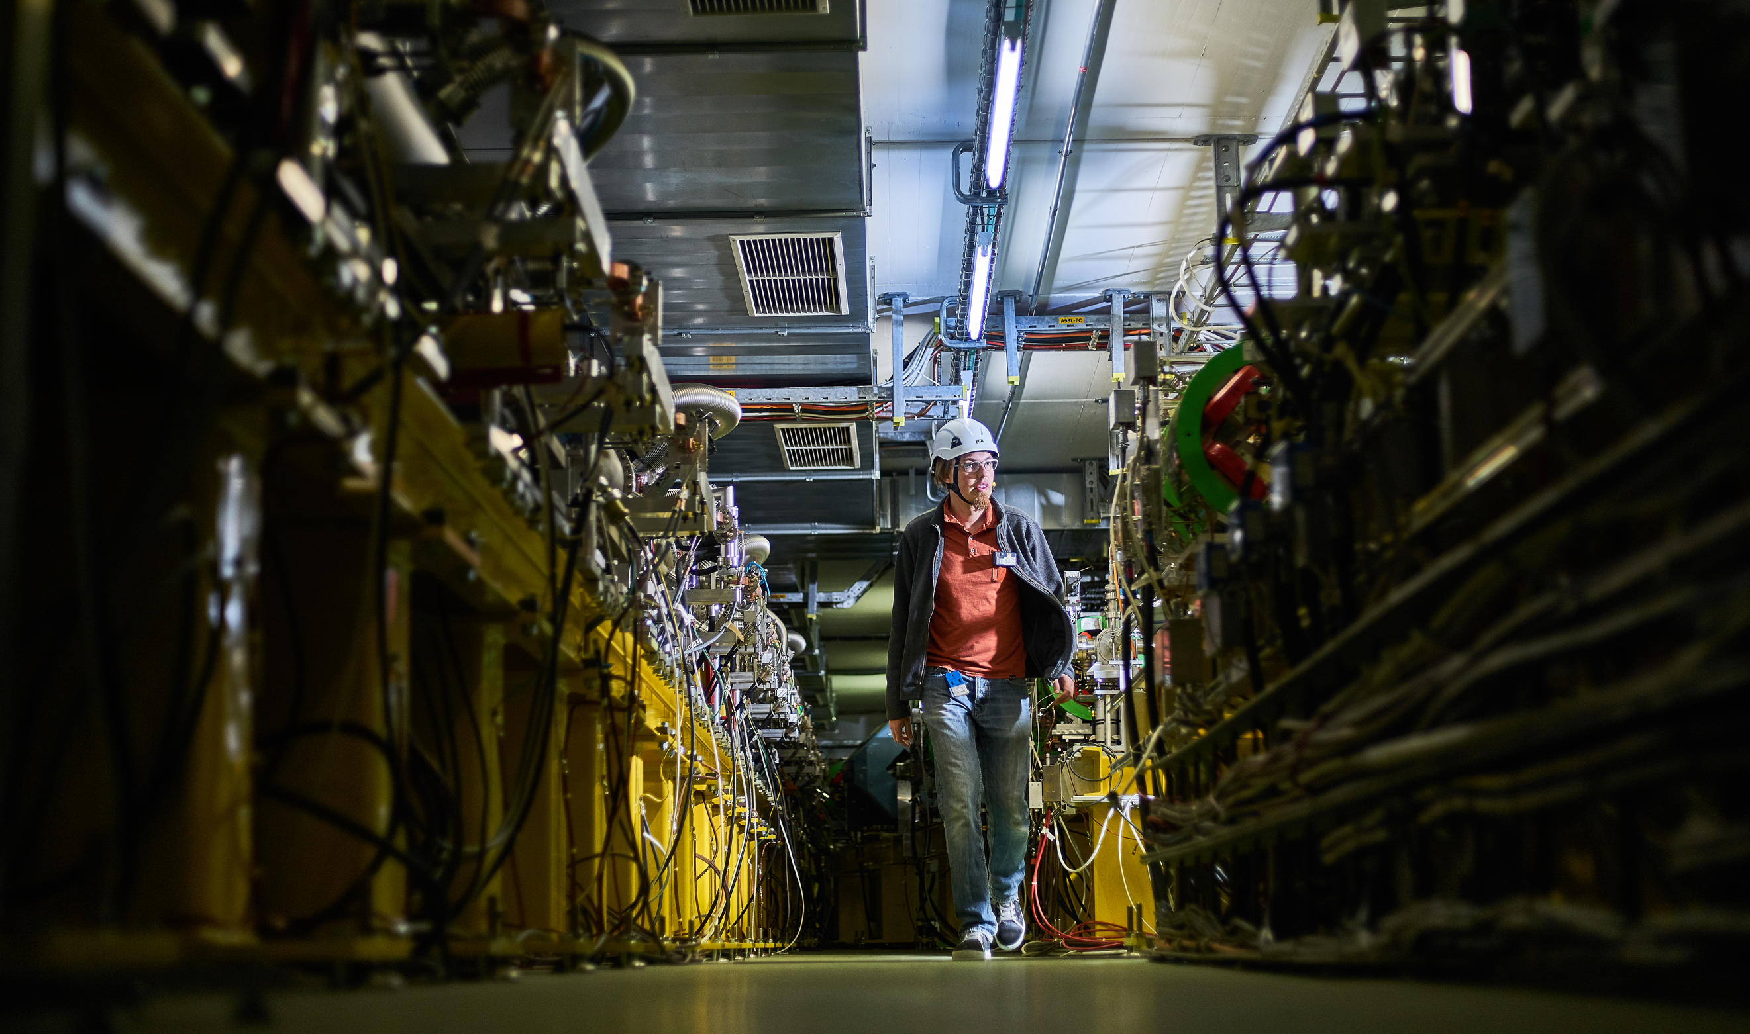
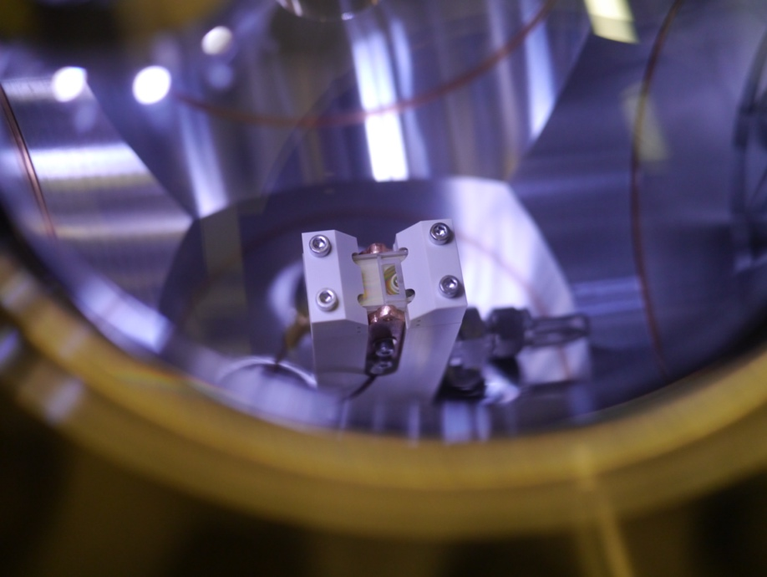
CLEAR beyond 2025 and Scenarios for e- Future Test Facilities at CERN
R. Corsini
for the CLEAR Team
CERN Linear
Electron Accelerator
for Research

Slide 2
The CERN Linear Electron Accelerator for Research (CLEAR)
Scientific and strategic goals:
Providing a test facility at CERN with high availability, easy access and high quality e- beams.
  Performing R&D on accelerator components, including beam instrumentation prototyping and high gradient RF technology
  Providing an irradiation facility with high-energy electrons, e.g. for testing electronic components in collaboration with ESA or for medical purposes(VHEE/FLASH)
  Performing R&D on novel accelerating techniques – electron driven plasma and THz acceleration.
Maintaining CERN and European expertise for electron linacs linked to future collider studies
Using CLEAR as a training infrastructure for the next generation of accelerator scientists and engineers.
CLEAR is a versatile 200 MeV electron linac + a 20 m experimental beamline, operated at CERN as a multi-purpose user facility.

Slide 3
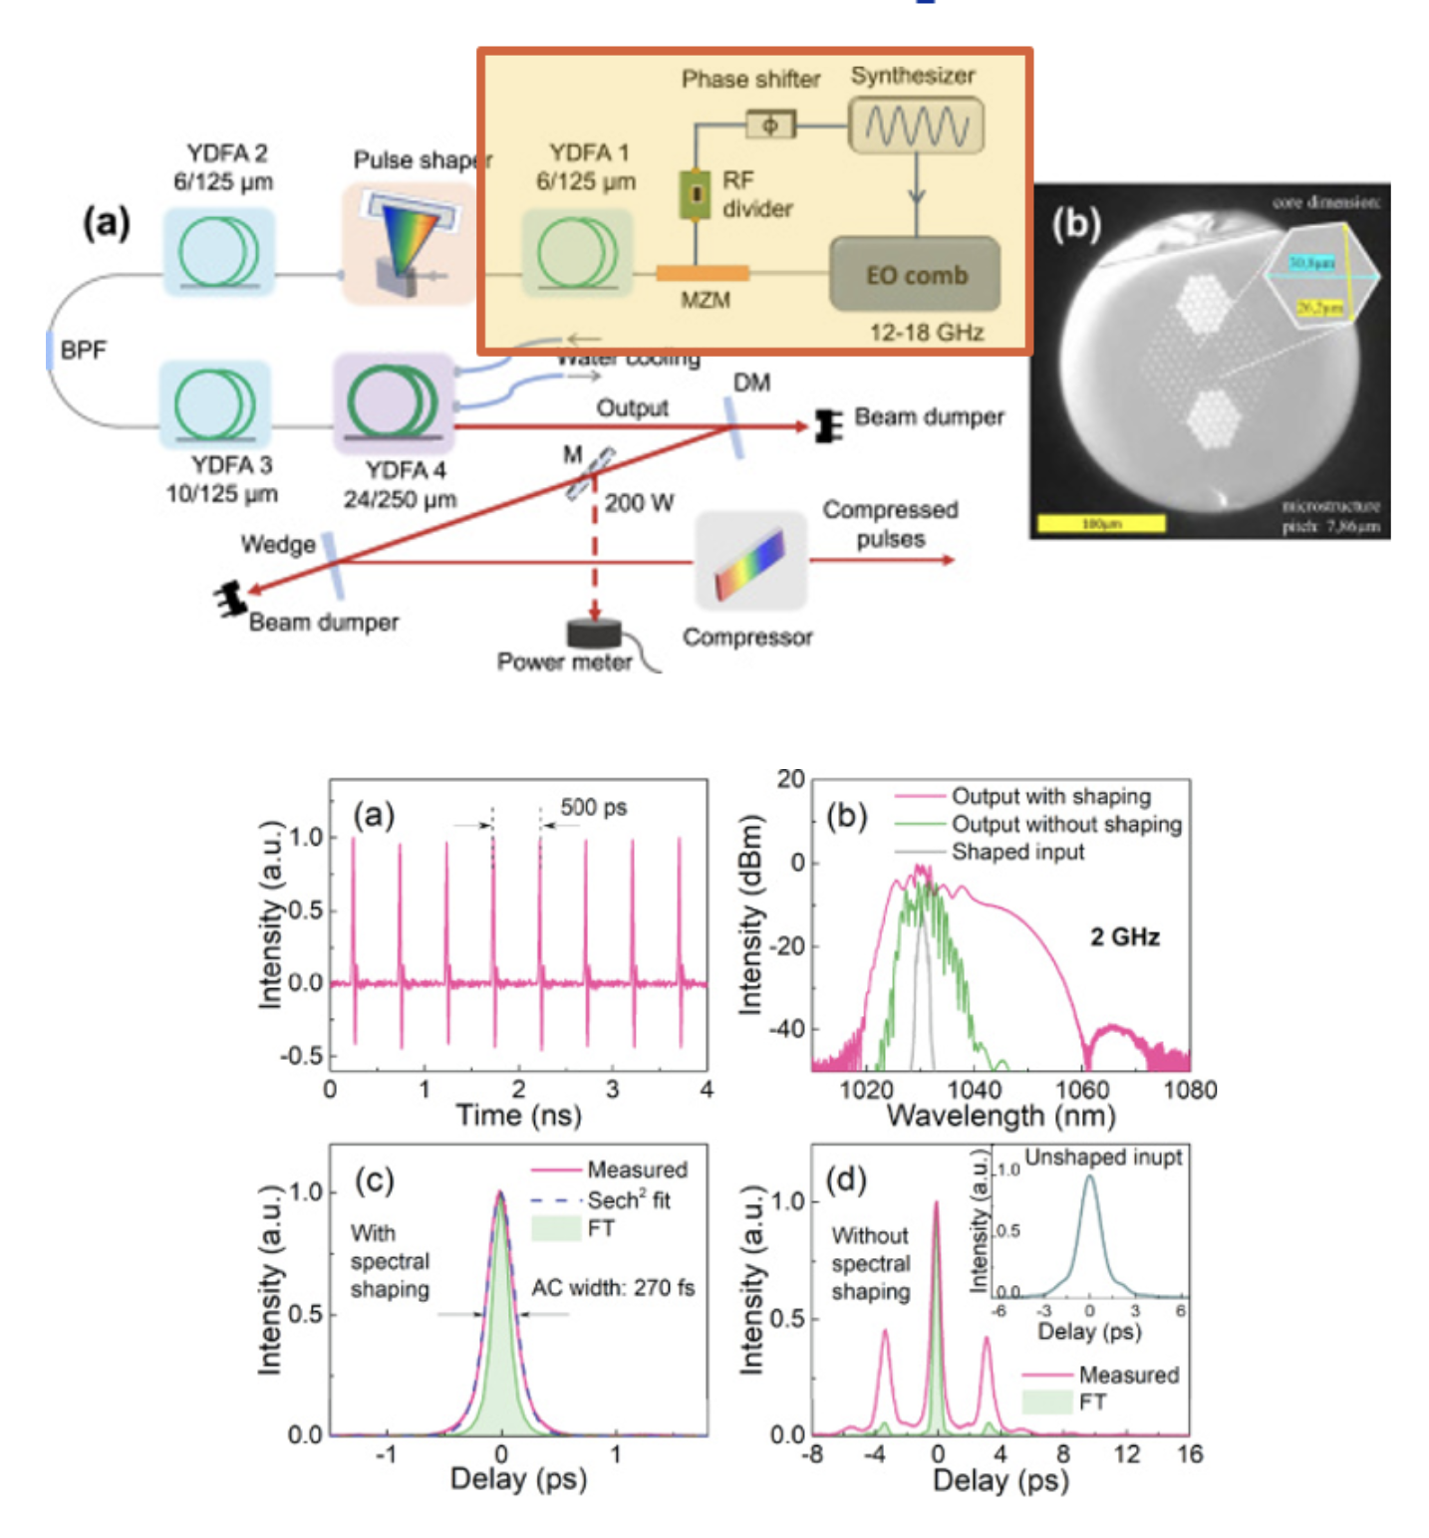
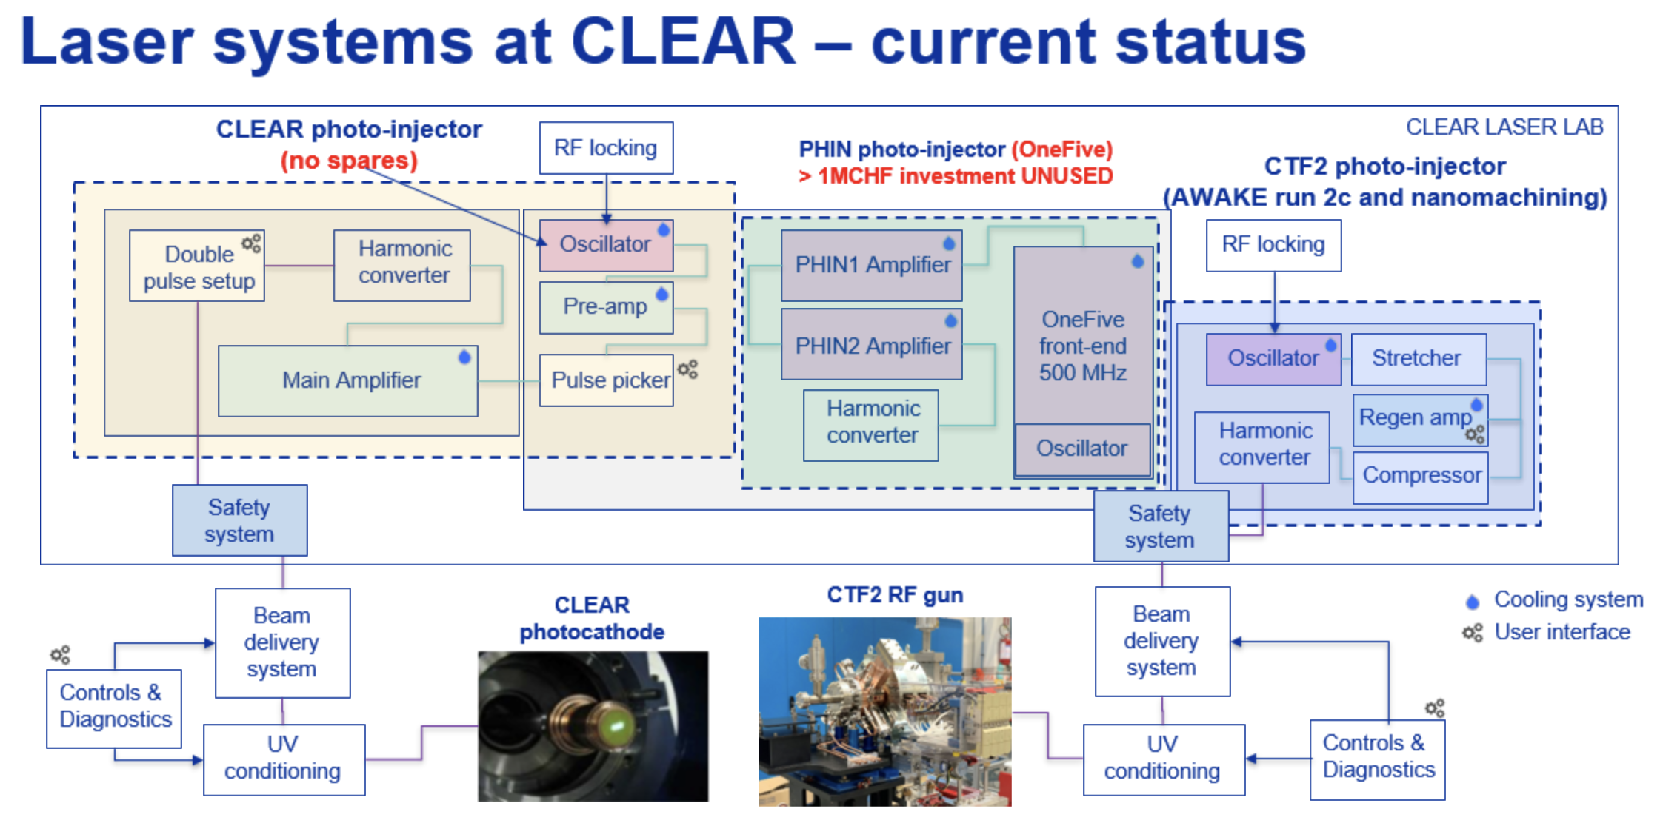
Short-term improvements - laser
E. Granados, B. Marsh
CLEAR laser points of failure:
  Ageing oscillator – could be replaced by OneFive system but operating at 500 MHz
  Laser sub-systems often fail and require replacements and spares (chillers, pulse-picker power supplies, laser diodes, laser power supplies, optical elements and motors)
New EO comb front-end
Enhance significantly CLEAR performances (stability, time structure flexibility, high rep-rate)
~ 100 kCHF program over 2 years
System may be ready at end 2024

Slide 4
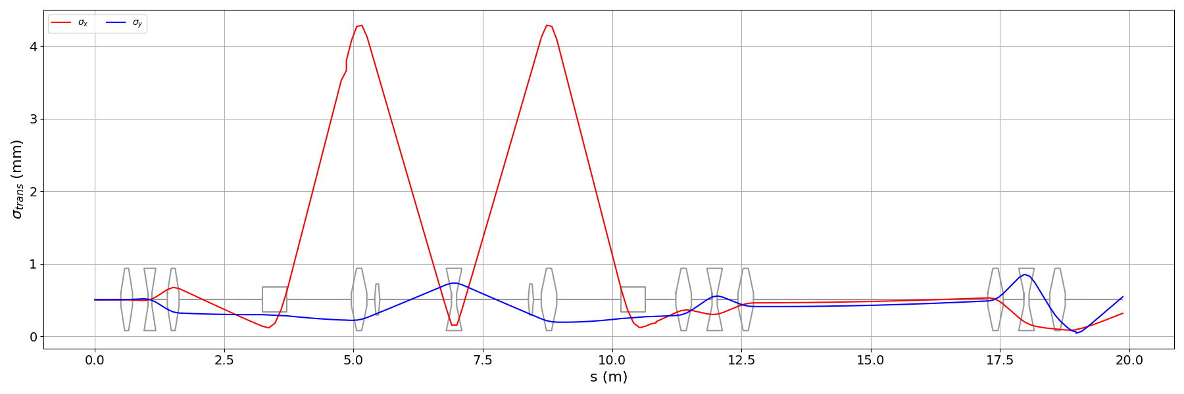
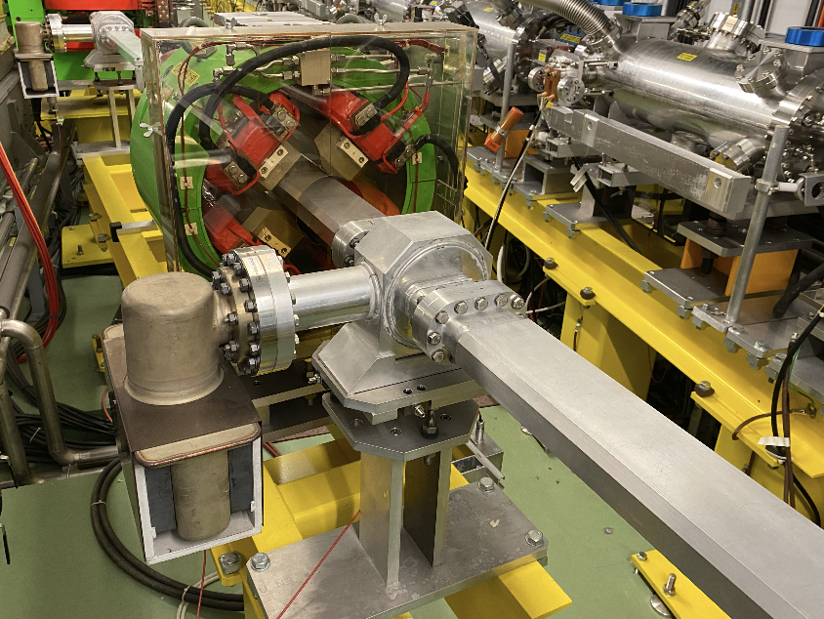
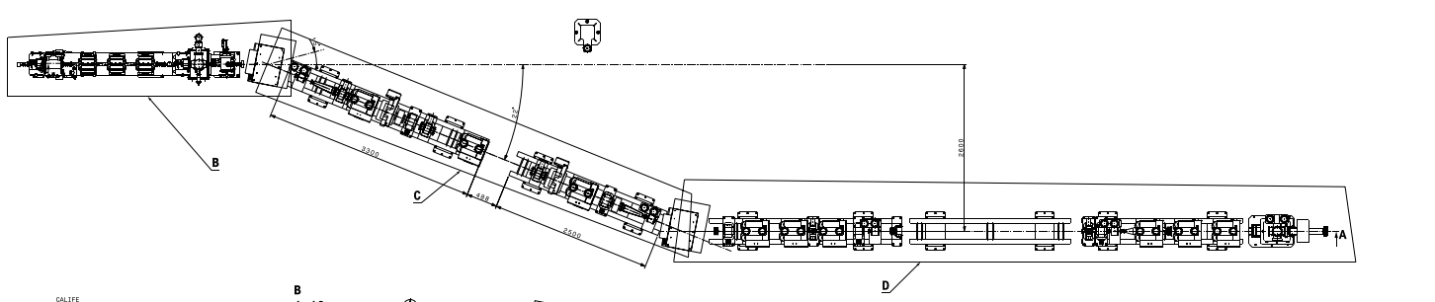
Short-term improvements – new beam line
Motivations
  Create more in-air and in-vacuum test areas for experiments – avoid repeated mounting/dismounting of experiments and diagnostics equipment, hence more beam time
  Added operational flexibility – allow for “non compatible” experiments to be performed in the same week or day, with fast turnaround time
  Expand beam parameter space, e.g., large beam sizes and strong focusing
Magnets, power supplies and most components and vacuum chambers from former drive beam chicane and TBL in CLEX, including pumping ports, bellows, pumps, vacuum valves, …
Under construction – commissioning in fall 2024 or early 2025

Slide 5
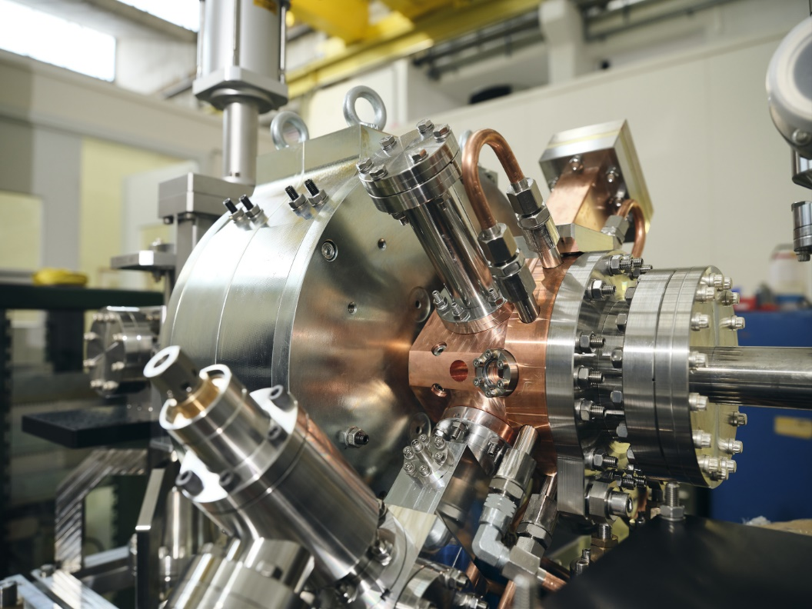
Longer-term improvement – new electron source
A new electron source (photoinjector + X-band accelerating structure) is presently being commissioned in stages in the former CTF2 area, adjacent to the CLEAR hall.
Joint effort between CLIC, AWAKE and CLEAR.
  The initial aim was to develop a front-end for AWAKE Run 2, and to use it before final installation in AWAKE as an additional source in the CLEAR hall.
  Present plans favors its use after commissioning and before installation in AWAKE as an independent beam line in the present location (CTF2), and as a part of the CLEAR user facility.
  This solution will have the advantage of being less costly and time consuming, and will better fit present user demand for more beam time and for low-energy beams, rather than two-beam experiments
This option depends on the actual timeline for AWAKE, the eventual CLEAR extended operation, and on the potential user interest. Main user operation beyond 2025, but some limited use is possible before.
It will also require some additional resources, particularly in manpower.
Common development of novel electron source
CLIC-AWAKE-CLEAR

Slide 6
Expectations and outlook on activities 2025+
So far, demand for experiments on CLEAR steadily increased (bar the pandemic period). As shown previously, we are now saturating our capacity to provide beam time to all users. We expect requests will not decrease for the next few years.
Improvements and consolidation should enable us to cope with a slightly higher load.
Beam diagnostics R&D is an important area, with about 30% of total tests, and now shared equally between CERN and external users – easy to anticipate that requests will increase/stay constant for several years beyond 2025.
Novel acceleration techniques (plasma, THz, x-band high gradient) are not growing, but there are a few rather long-term programs which will continue (including Plasma Lens, continued support to AWAKE, and potentially a full-fledged ICS experiment).
Medical activities are surely a highlight – the next 4-5 years will be critical to fully establish VHEE/FLASH (fundamental studies, including time structure dependence, and optimization of parameters) and its enabling technologies (beam delivery, dosimetry and control). If extended, CLEAR will be for several years a unique facility for VHEE/FLASH, with a key role in the field – including knowledge transfer to other labs with capability for animal testing.
Activity in other areas (irradiation, neutron production, beam test of particle detectors and detector components…) is also increasing overall, and it will provide further opportunities.
Finally, from a strategic viewpoint, CLEAR is well placed to play a role on the roadmap towards a Higgs factory at CERN > more on the next slides

Slide 7
Strategic role of CLEAR for future Higgs factories
Main relevant areas:
Beam diagnostics R&D for FCC-ee
Other FCC-ee dedicated experiments in CLEAR
Keeping at CERN hands-on experience (both on hardware and beam operation) on electron accelerators – a role partly shared with AWAKE
Training of young scientists
Both the CLEAR machine and its experimental team might be the seed for a future larger facility paving the way to FCC-ee

Slide 8
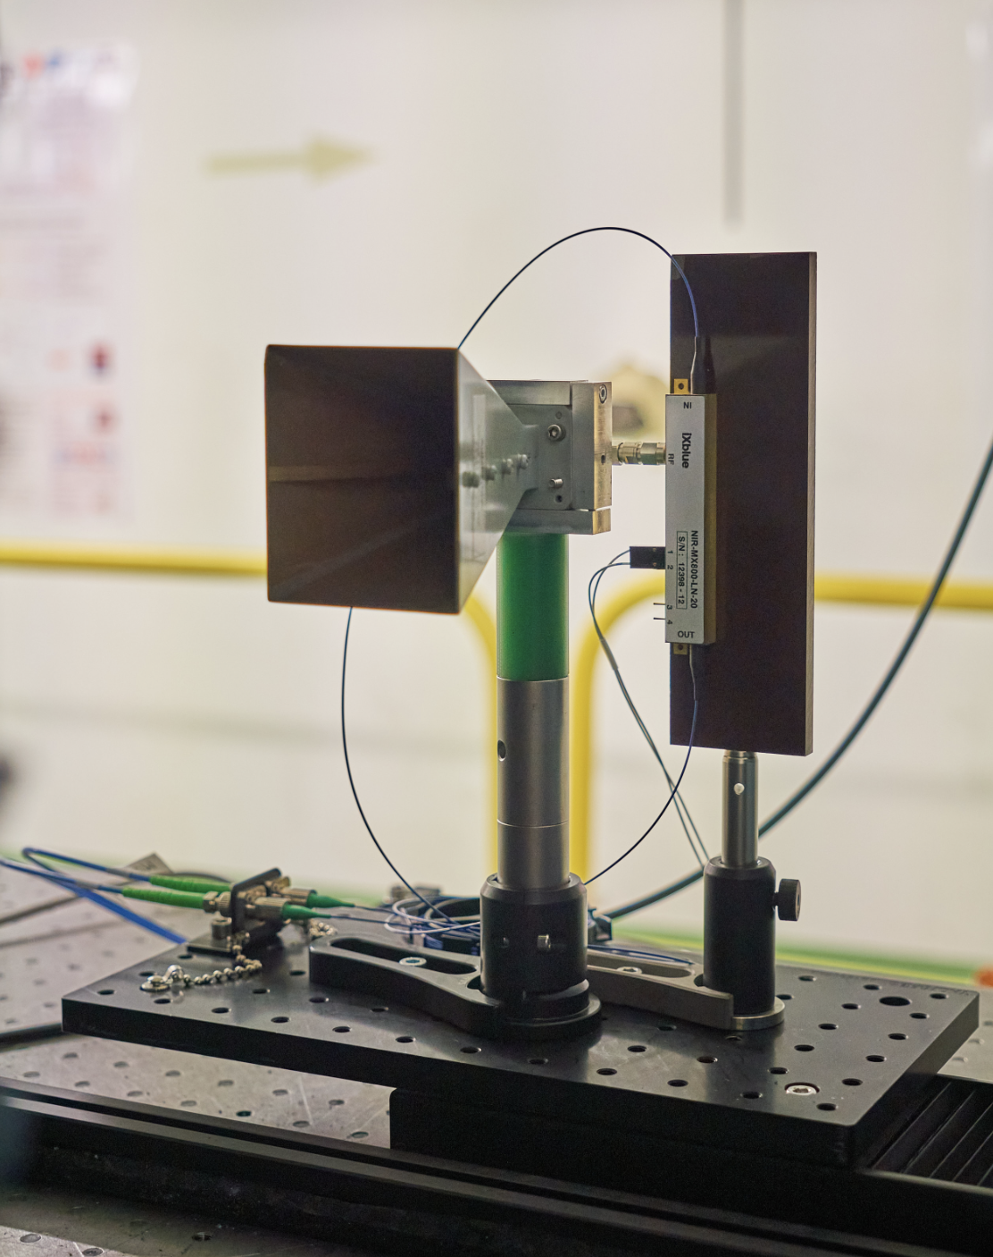
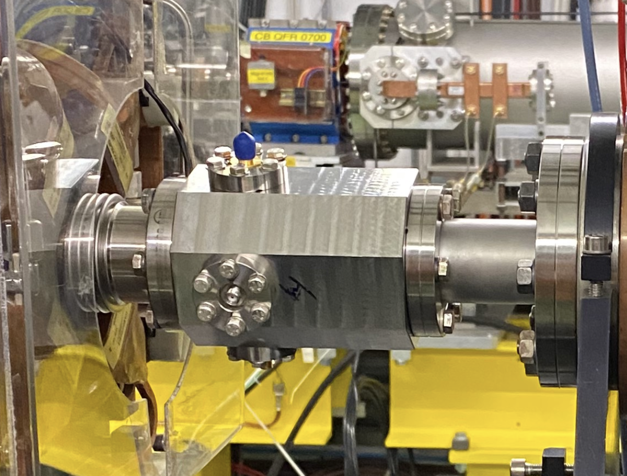
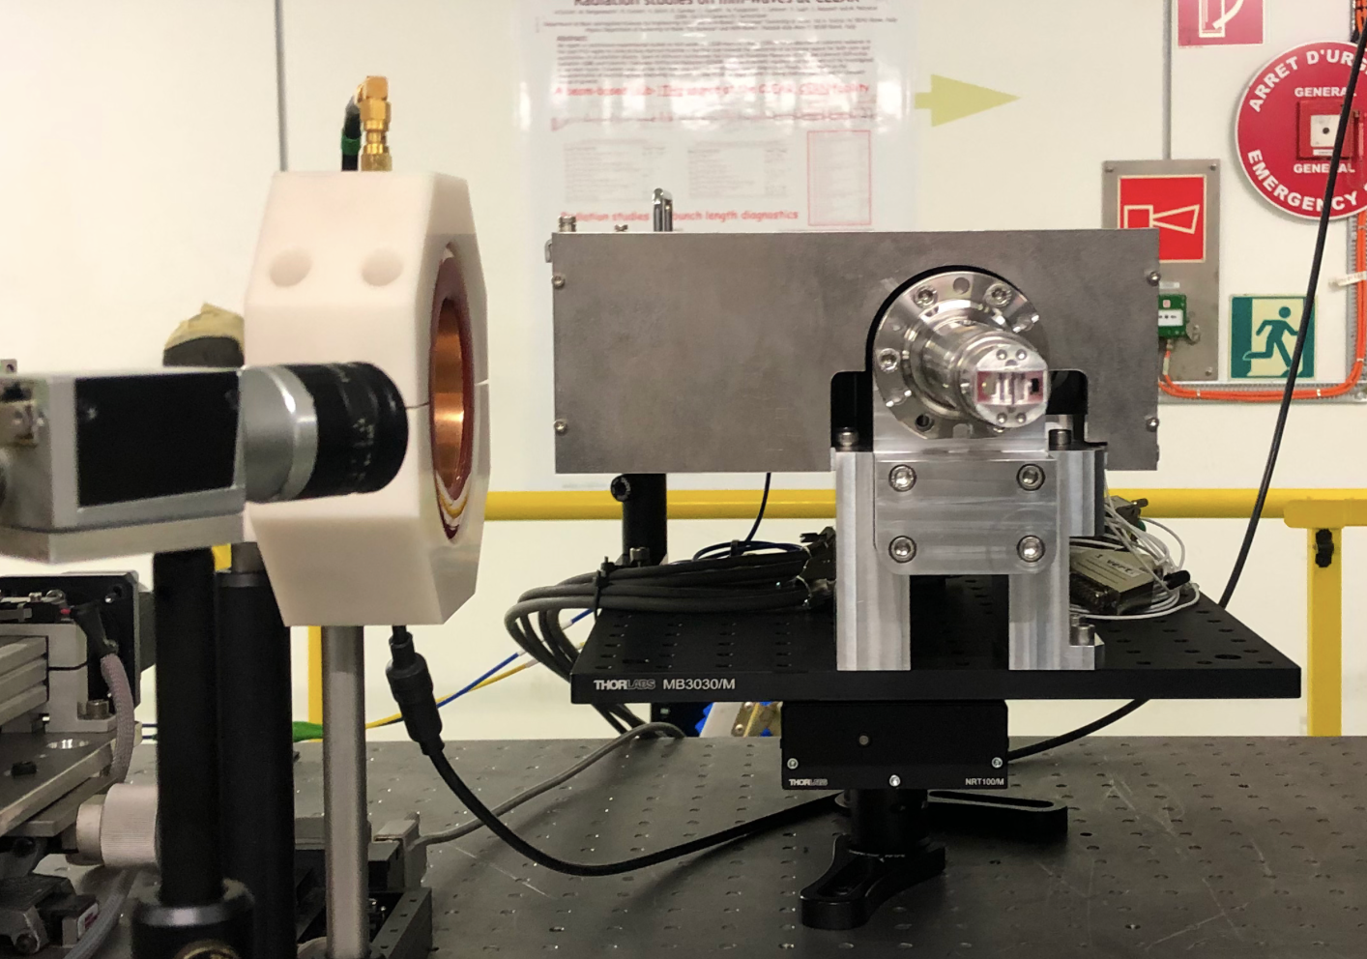
Present contributions to FCC-ee
Beam diagnostics
Experiments in 2023
CERN & external institutes,
usually in collaboration
Broadband Pick-up for the
PSI Positron Production Project
(P³ - FCC-ee collaboration)
Bunch Profile Monitor for FCC-ee (KIT - Karlsruhe)
Coherent Cherenkov diffraction radiation dielectric buttons
(FCC-ee bunch length monitors)
- Electro-Optical Longitudinal Bunch Profile Monitor for FCC-ee (KIT)
- Coherent Cherenkov diffraction radiation dielectric buttons (CERN, BI)
NEW: Damage test of positron target materials (CERN, STI – M. Calviani, A. Perillo Marcone)
➯ discussion ongoing on future program, including positron detection, etc…
Planned
Experiments in 2024

Slide 9
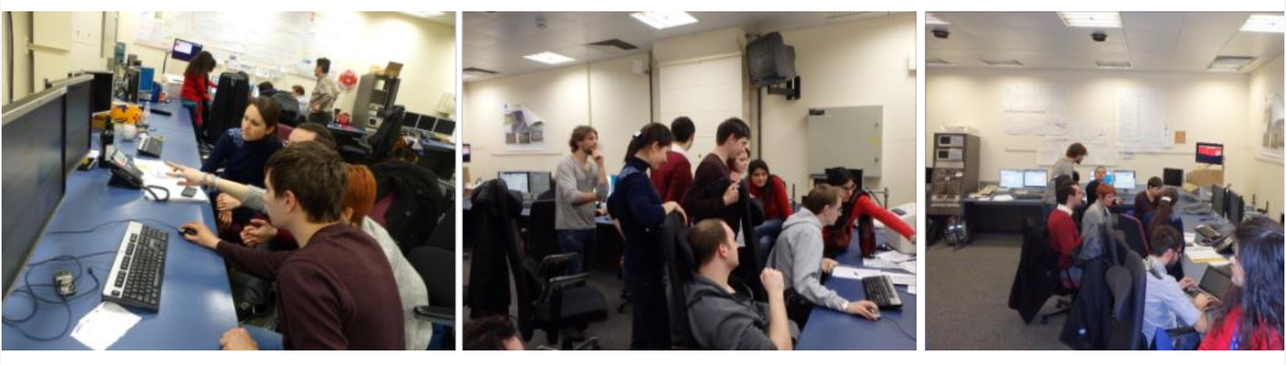
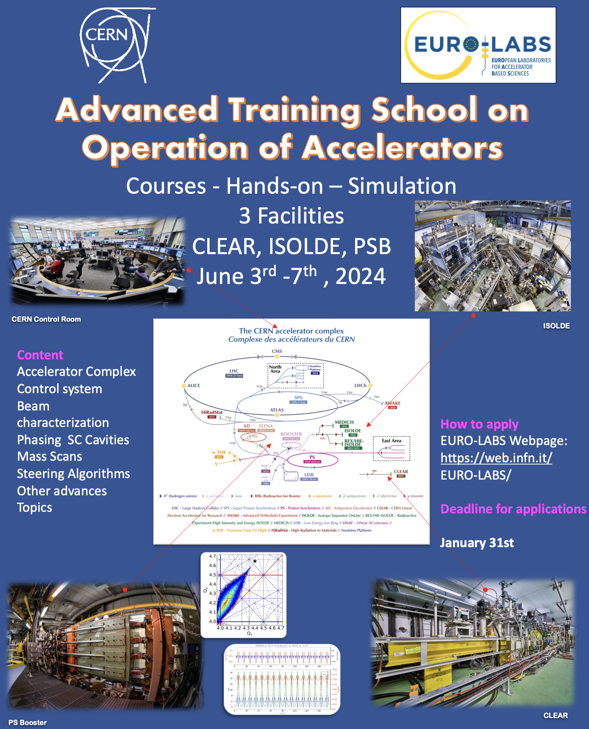

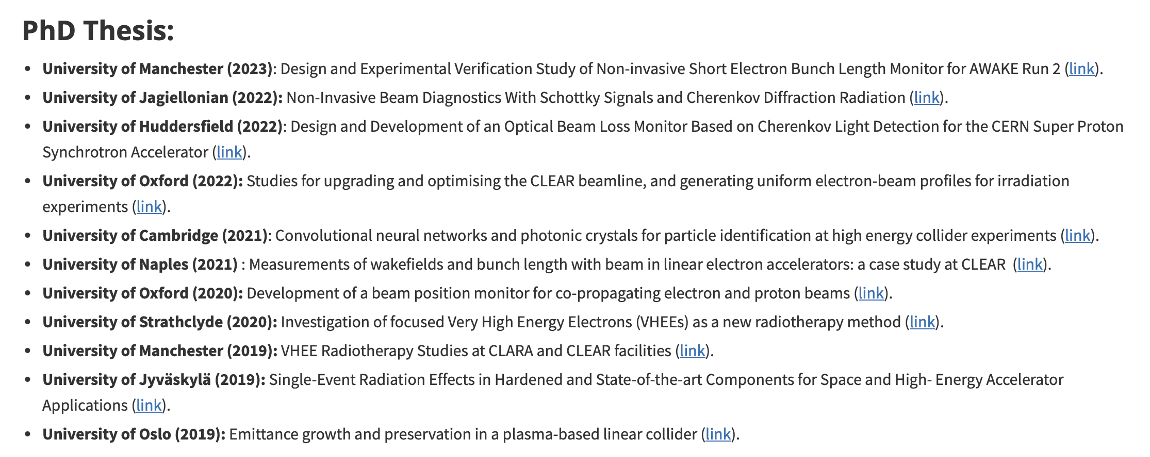
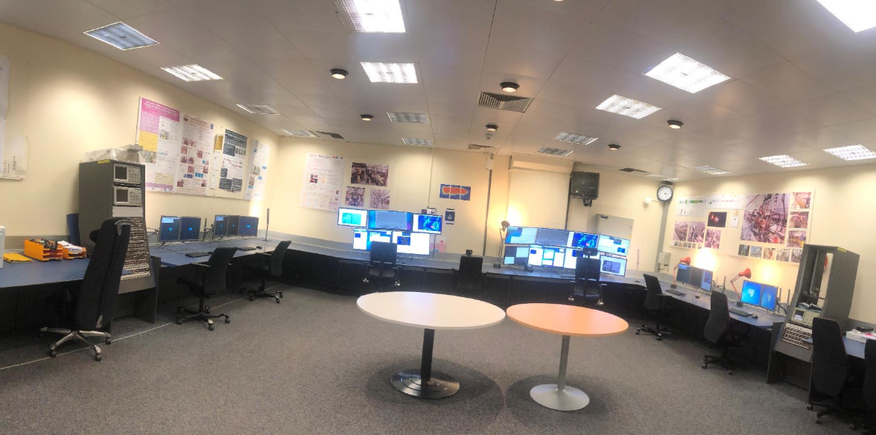
Training
Hands-on training (JUAS, EURO-LABS),
hosting Trainees, Summer/Technical and
PhD students, Fellows, Associates…

Slide 10
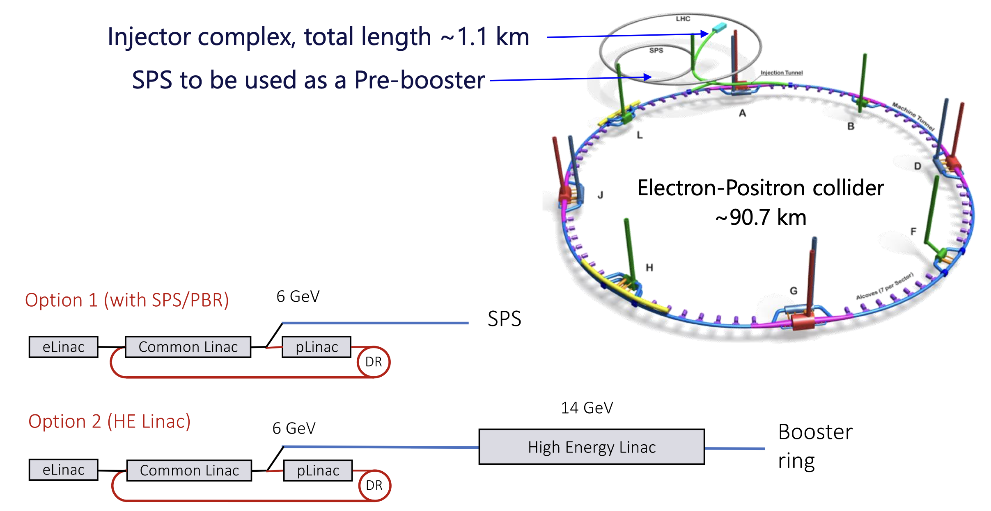
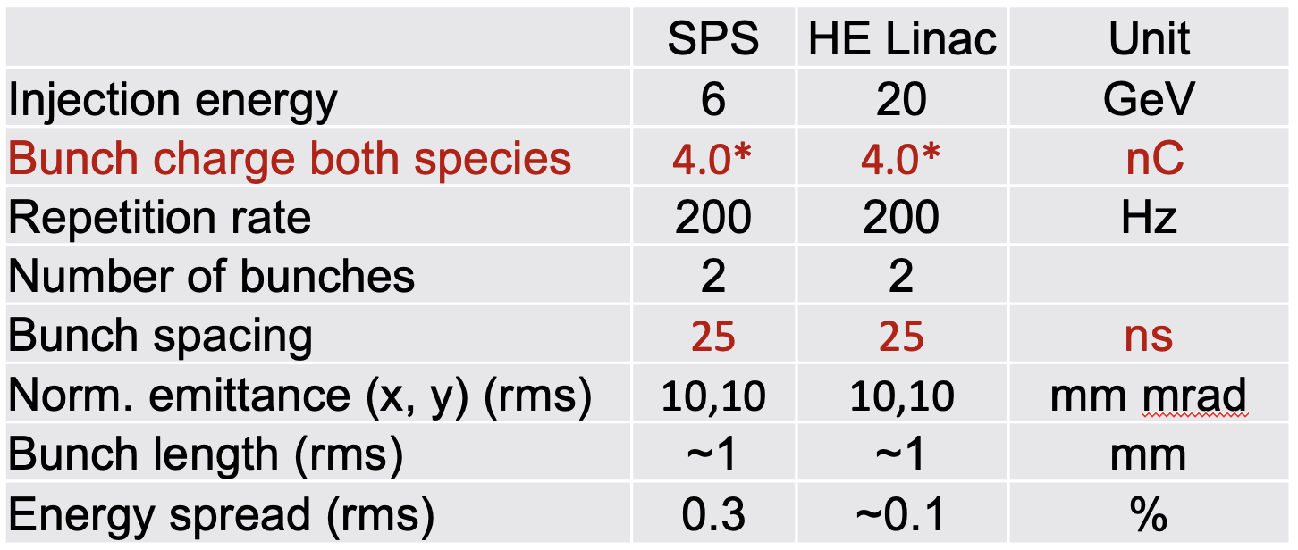
A few thoughts on future facilities I
Paolo Craievich
FCC Injector Complex
S band (2 GHz, 2.8 GHz)
C band (2 GHz, 5.6 GHz)

Slide 11
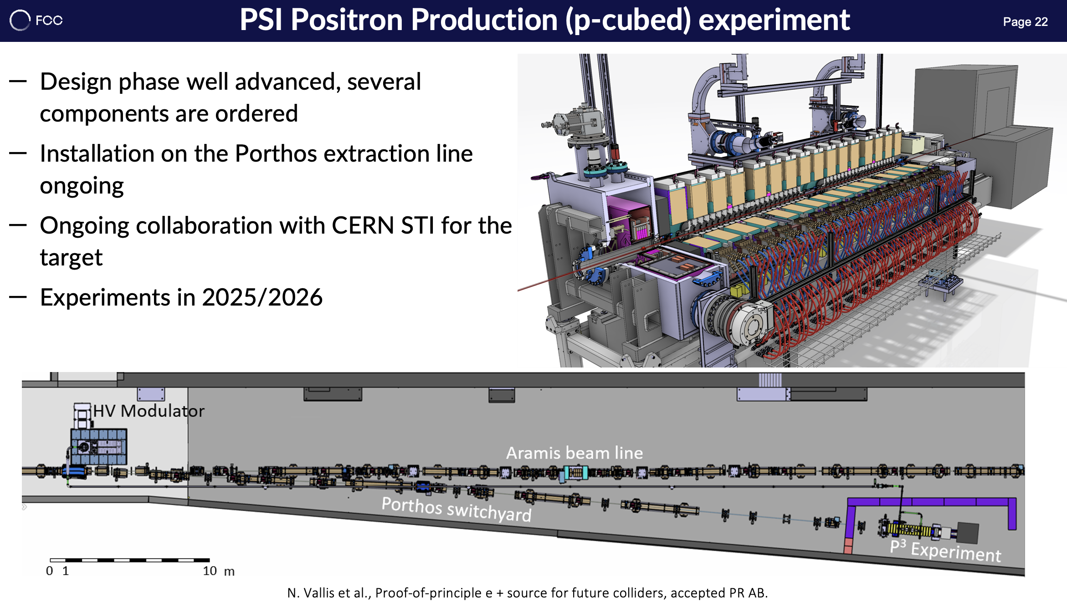
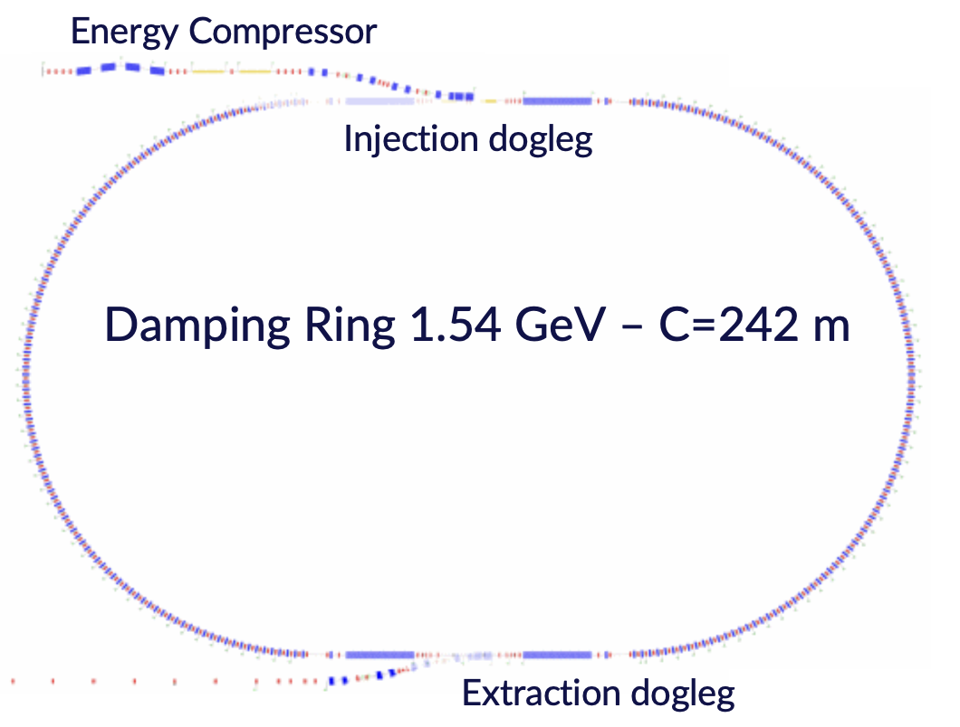
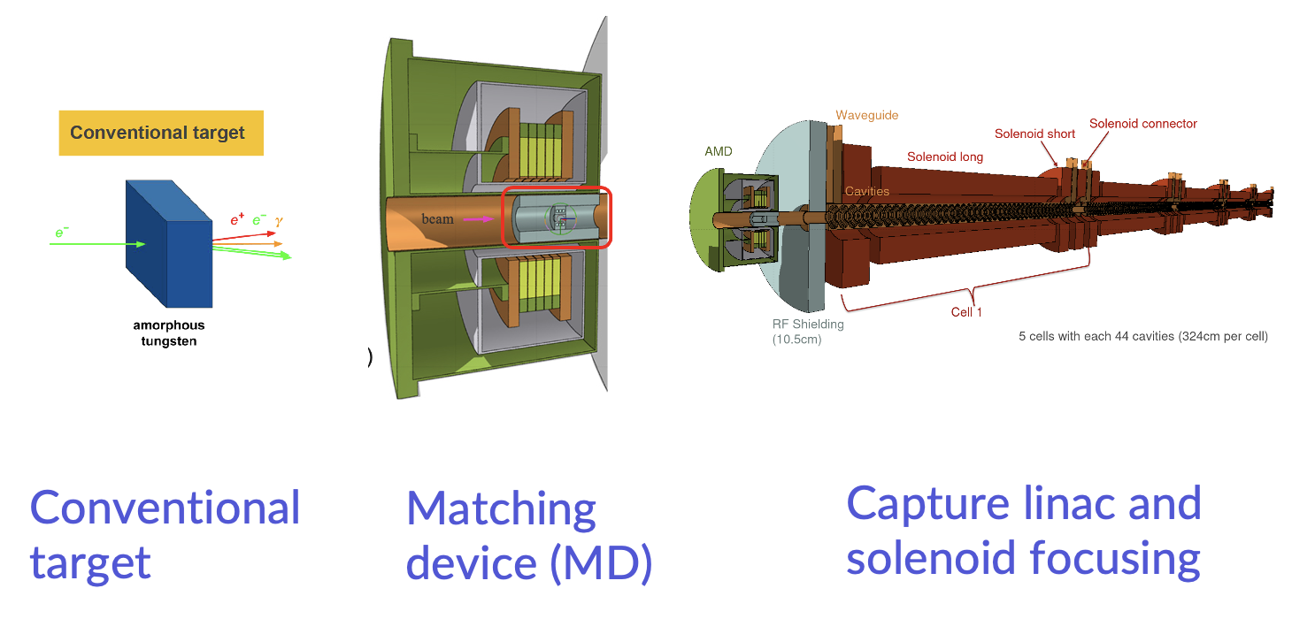
A few thoughts on future facilities II
Paolo Craievich

Slide 12
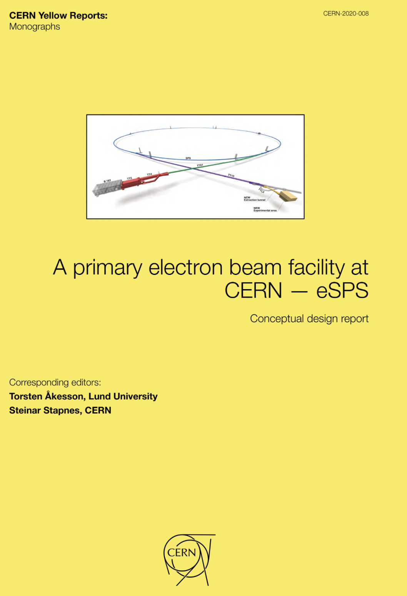
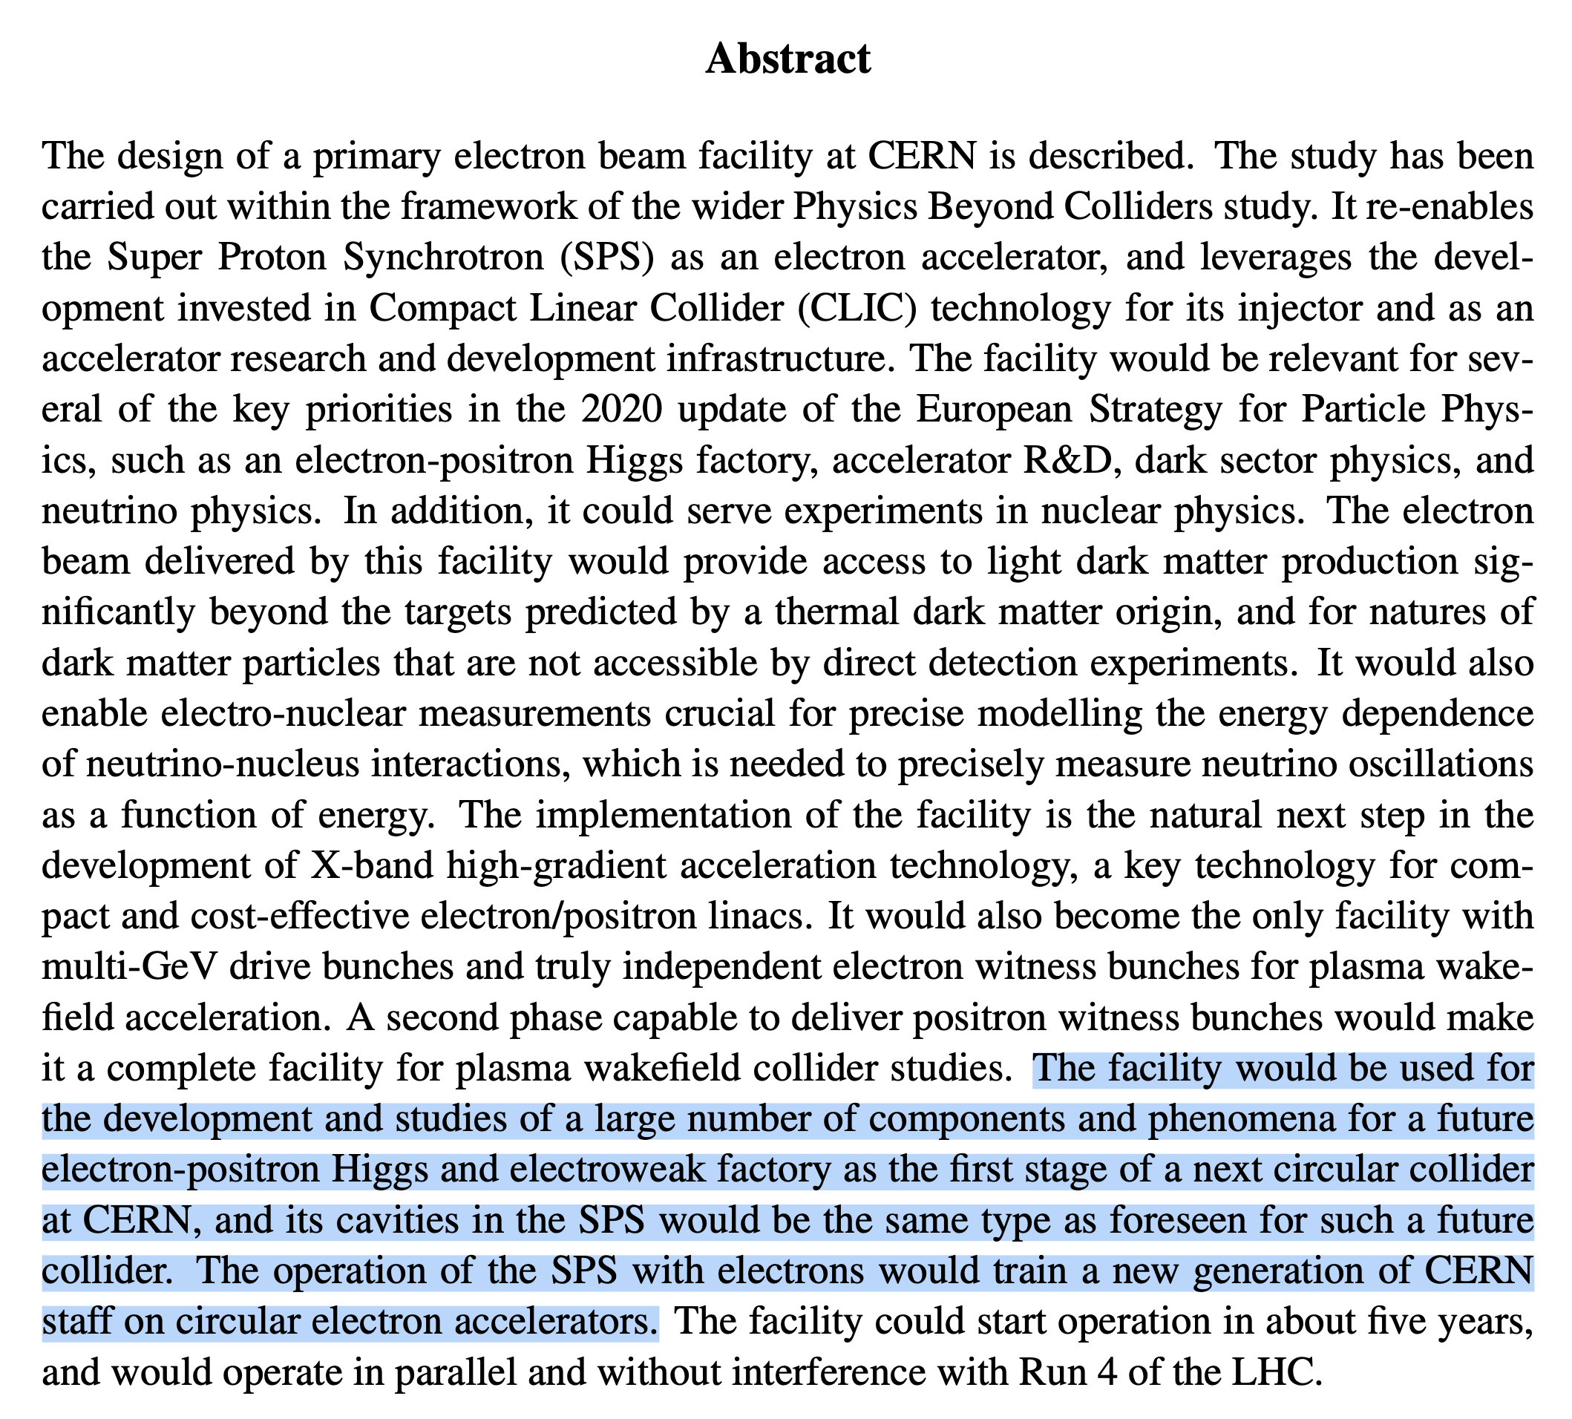
A few thoughts on future facilities III
Physics motivations: Light dark matter searches, neutrino physics

Slide 13
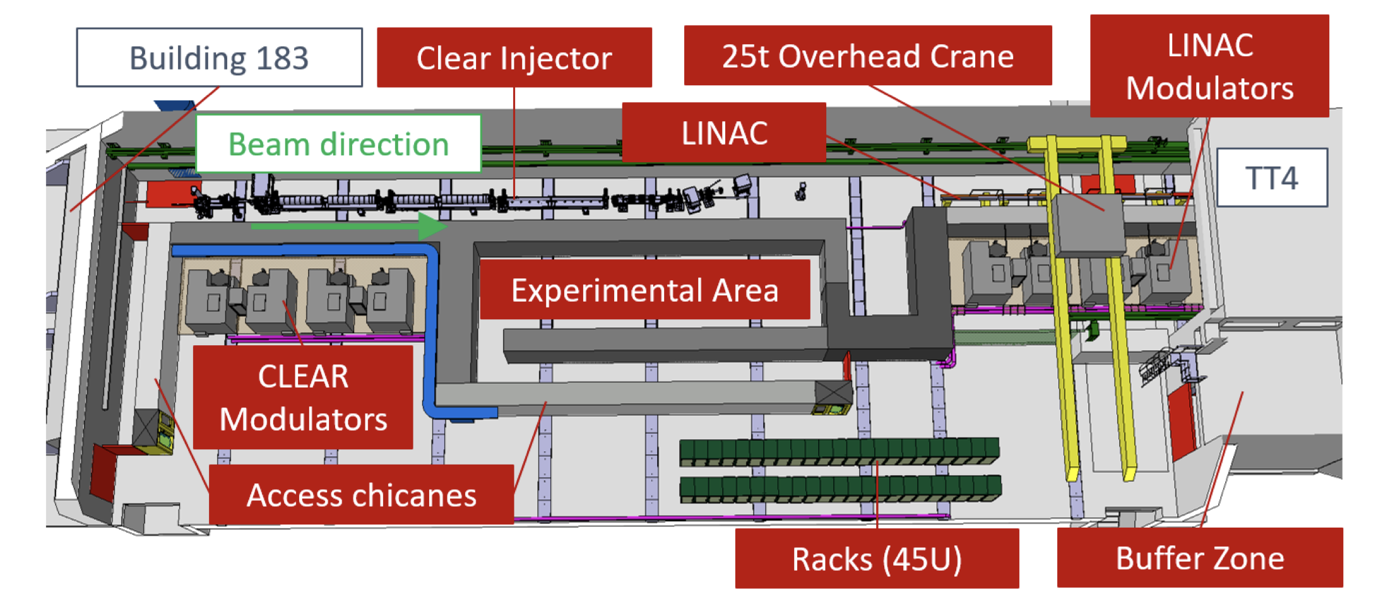
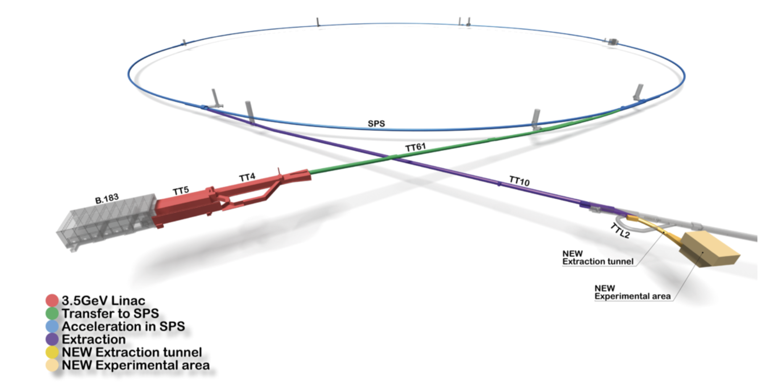
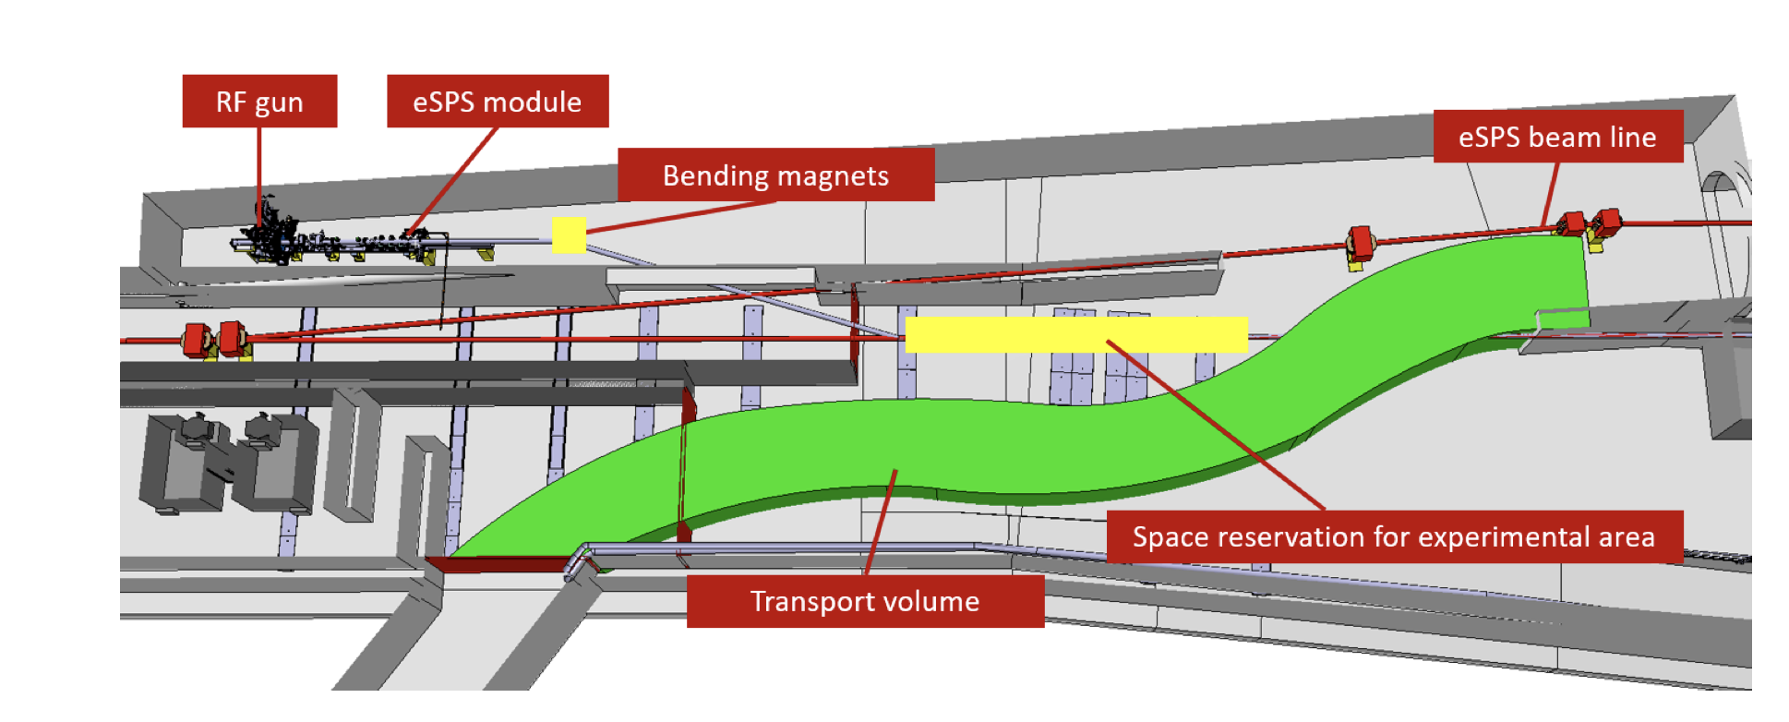
The e-SPS proposal
SPS
Low energy user facility
~ 200 MeV
3.5 GeV
16 GeV
3.5 GeV X-band linac
(CLIC technology)
High energy test stand

Slide 14
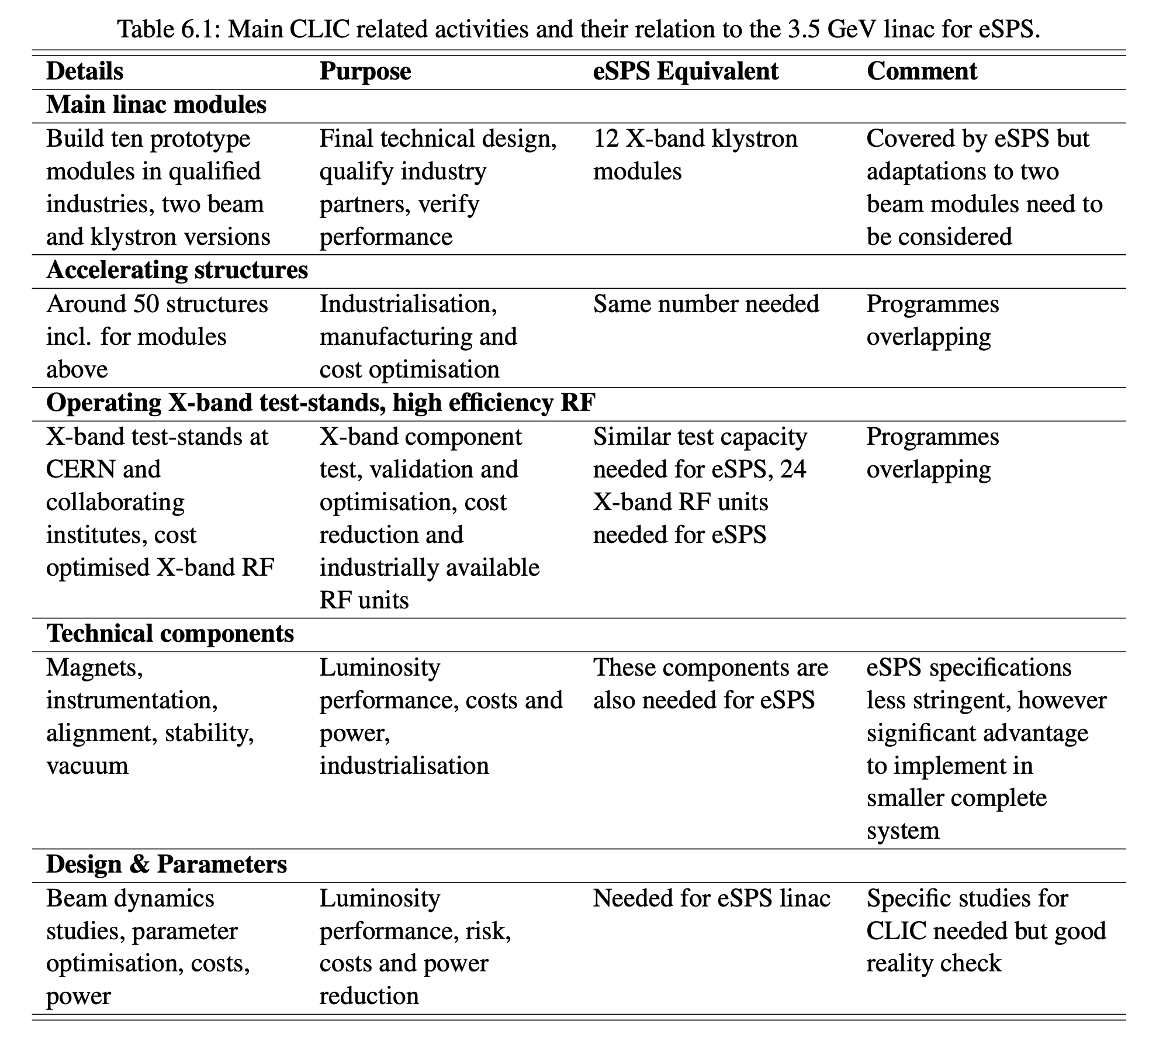
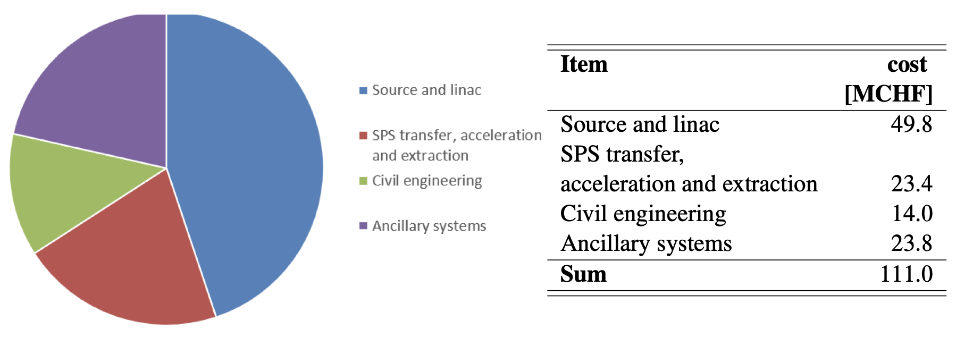
Relevance of e-SPS for CLIC, cost
May a similar project be developed based on requirements for FCC-ee ?
Is it the size/cost/time scale relevant/affordable?
Possibly, such facility should aim at being compatible with (parts of) the final FCC-ee injector complex

Slide 15

Can’t resist…

Slide 16
Some additional considerations
Presently, CLEAR (and the AWAKE e-linacs) are the only electron accelerators at CERN. If CERN is serious about a e⁺e⁻ Higgs factory as its next flagship project, experimental activities based on electron accelerators should be at least maintained.
Expertise and training achieved and maintained in CLEAR (and AWAKE) are strategically important for a future Higgs factory at CERN.
In itself, CLEAR (and the AWAKE e-linacs) are not large enough to be a sufficiently large stepping stone towards FCC-ee (or a linear collider).
A “large” facility would be needed to ramp-up expertise and industrial basis at the right level for the next flagship project. Such facility should have one or more physics goals and cover several critical aspects of the final project.
If such a “large” facility could accommodate as well multi-purpose user-dedicated areas and R&D for future activities, it will be more attractive (and justified).
An exercise on designing such a facility partly aimed at the CLIC project was done (e-SPS). This could be a good model to try and adapt.
However, e-SPS was thought more a multi-purpose facility, covering needs of a pre-approval phase of a big project. If, e.g., the facility comes after approval of FCC-ee, it should possibly target (a part of) the final injector complex.
One or more smaller facilities – or experiments, targeting specific technological or beam physics issues of the final project are also a possibility.

Slide 17
Conclusions
Short-term improvements and consolidation of CLEAR equipment are under way and should provide the facility with more effective beam time and added flexibility already in 2025.
The improvements may prove to be critical for some important experiments, mainly in the medical area, but also possibly for FCC-ee.
User requests are growing, and the facility is very close to saturate all possible beam time. Some ”real” selection will likely have to be put in place in 2024.
We expect this load will continue in the future, at least for several years. We are planning for an extension to end 2030, and we believe a full, meaningful experimental program covering this period is granted.
The CLEAR facility is fundamental for maintaining e-beam expertise at CERN, for training, and can be a potential stepping stone towards the next flagship accelerator at CERN, FCC-ee (or its potential alternatives).

Slide 18
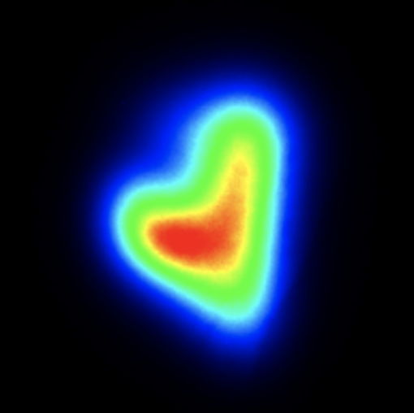
Thanks for your attention!

