Slide 1


CLEAR Plans and Experimental Program in 2024
W. Farabolini on behalf of the CLEAR team:
R. Corsini – A. Aksoy – A. Malyzhenkov – P. Korysko – V. Rieker – L. Wroe – M. Marcandella – A. Gilardi
E. Granados – M. Calderon – R. Rossel (Laser and photocathode experts)
S. Doebert - S. Curt – A. Chauchet (RF experts)
K. Sjobaek (remotely from Oslo)

Slide 2
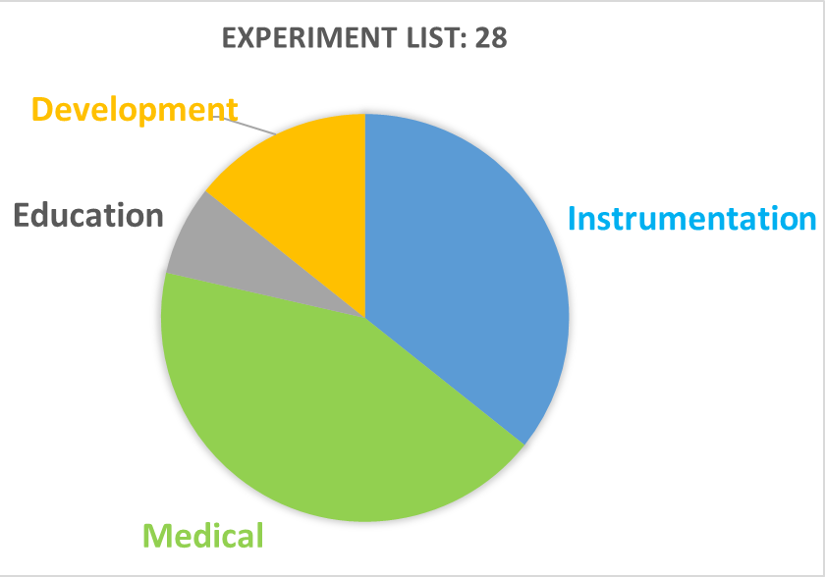
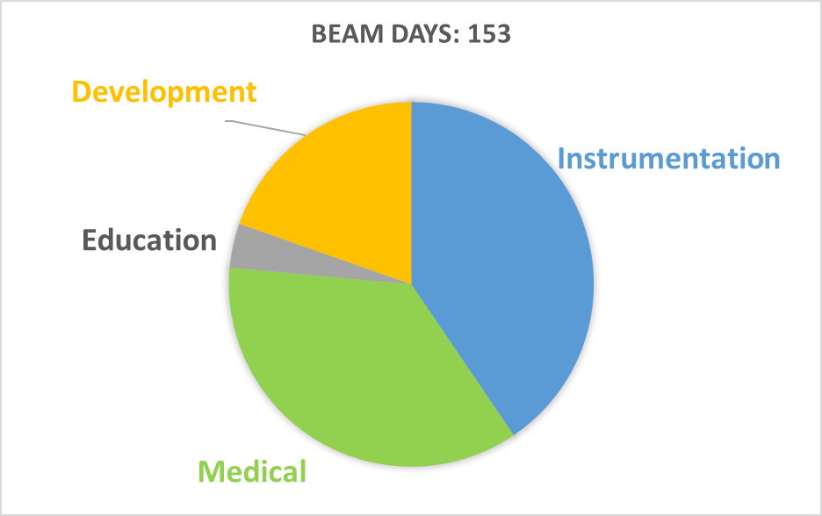
Beam time requests (so far)
28 experiments in the list: 23 beam requests officially received, 5 in preliminary discussions
14 of them are continuation of last year experiments
Already a total of 153 days of beam time requested by the users (before optimization). Last year: 185 days of beam delivered, including MD.
12 exp. related to Medical Applications (55 beam days)
10 exp. for Beam Instrumentation (62 beam days)
4 exp. for Accelerator Development and Physics (30 days)
2 cessions for Education (6 days): JUAS and Eurolabs
Growing interest in FCC-ee (instrumentation and physics)

Slide 3
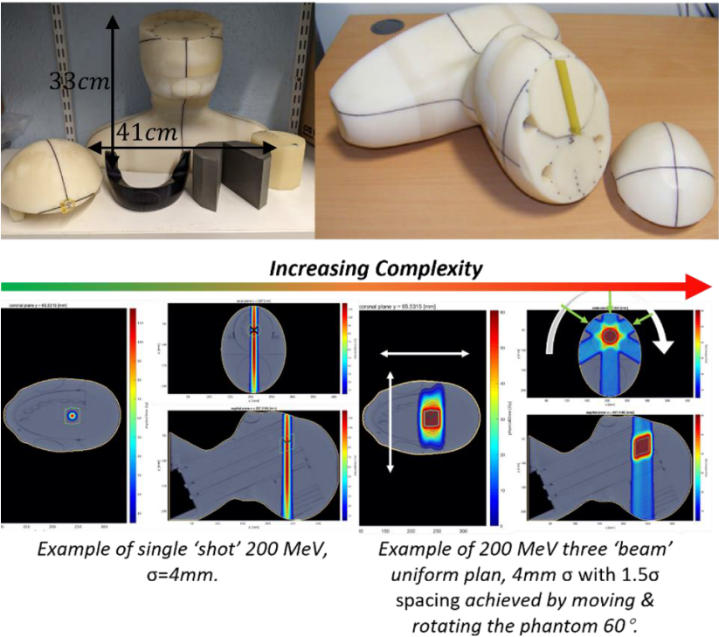
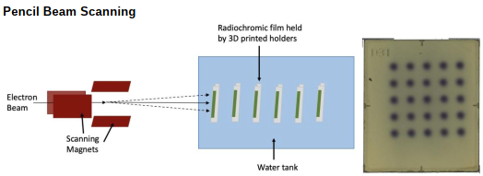
Medical related experiments
UNIGE / HUG
CHUV / IRA
Manchester Univ. / Cockcroft Inst. / Christie NHS
Victoria Univ. / EPFL / Laval Univ. / Lawrence Berkley Lab.
Gustave Roussy Inst. / ISMO
DESY
CERN
Flash therapy on various types of sample
Beam delivery on an anatomical phantom
Spatially Fractionated Radio-Therapy (SFRT)
Film and screen dosimetry
Radiosensitivity enhancement by nanoparticles
Metal implants beam interaction
Computed Tomography with e⁻
Anatomical phantom (Manchester U.)
Many more details will be given by P. Korysko, next talk
(Newcomers are in bold)
Spatially Fractionated Radio-Therapy (Victoria U.)

Slide 4
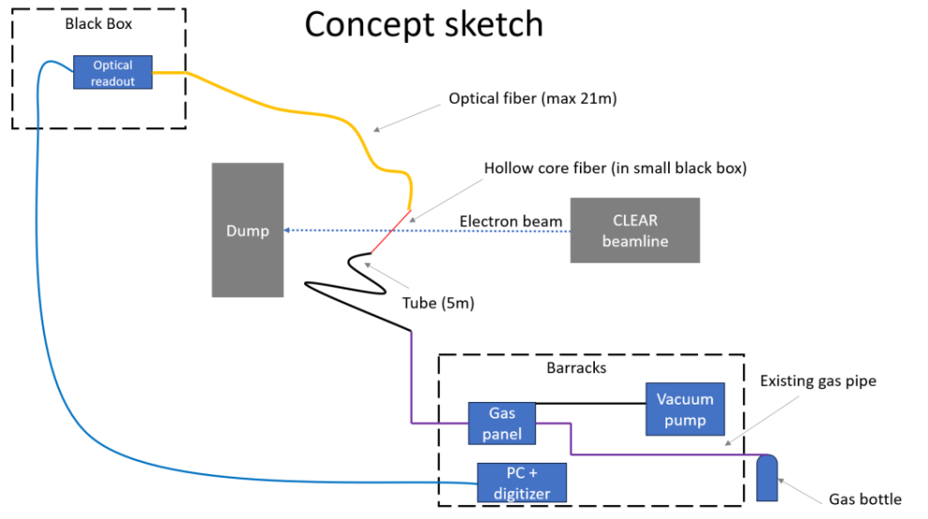
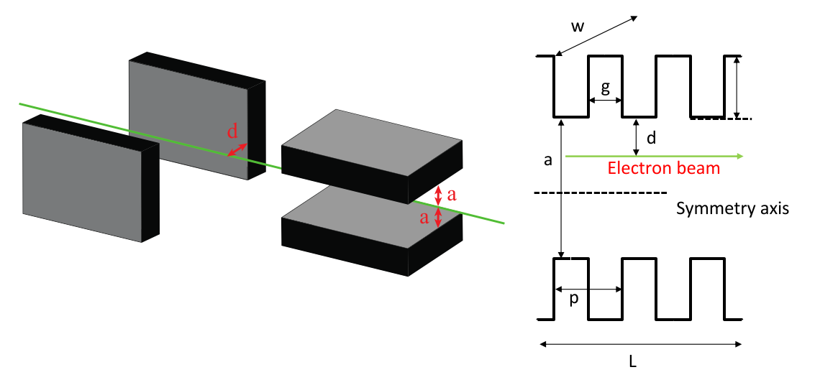
Beam diagnostics experiments
Rijksuniversiteit Gronigen / Southampton Univ. / CERN
BERGOZ
KIT / CERN BI
INFN Bologna
INFN Padova
University College of London / CERN BI
Liverpool Univ. /ASTeC / CERN BI
Manchester Univ. / RHUL / CERN BI
CERN ABP
Hollow core fibre filled with gas
High frequency Wall Current Monitor
EOS bunch length monitor for FCC-ee
Beam Profile Monitor for LUXE experiment
Screen resolution study of AWAKE spectrometer
Fibre beam loss monitor
Emittance measurement with Digital Micro-mirror Device and Micro-Lens Array
ChDR bunch length monitor using a Martin-Puplett Interferometer (for AWAKE)
Corrugated streaker for time resolved diagnostic
Hollow core fibre (RUG / CERN)
Passive beam streaking with corrugated jaws (CERN ABP)

Slide 5
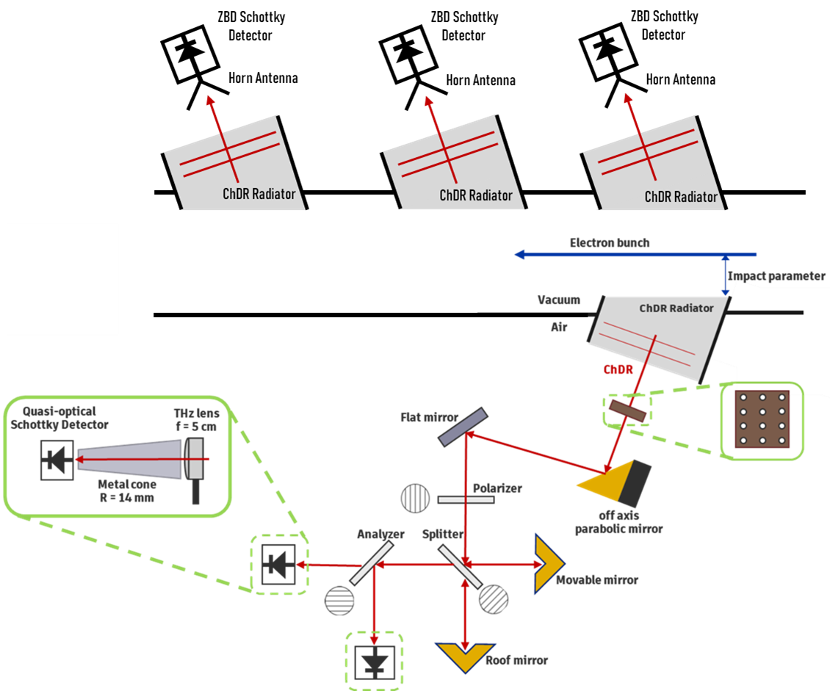
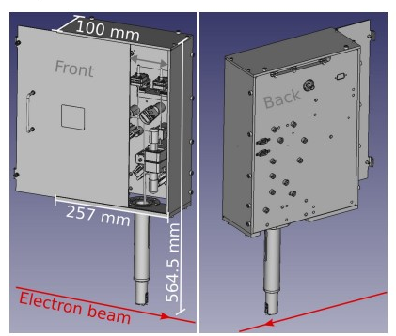
Bunch length measurement
In-air test of EOS for FCC-ee (KIT)
3 bandwidth channels (top) and Martin-Puplett Interferometer (bottom) for AWAKE (Manchester U.)

Slide 6
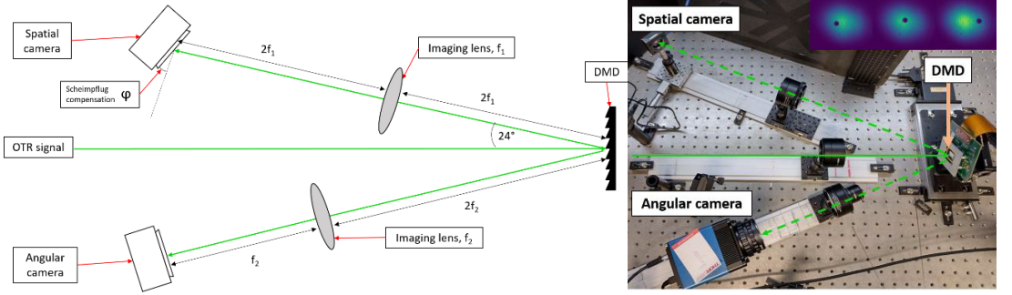
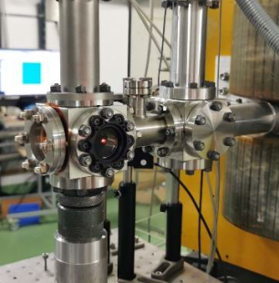
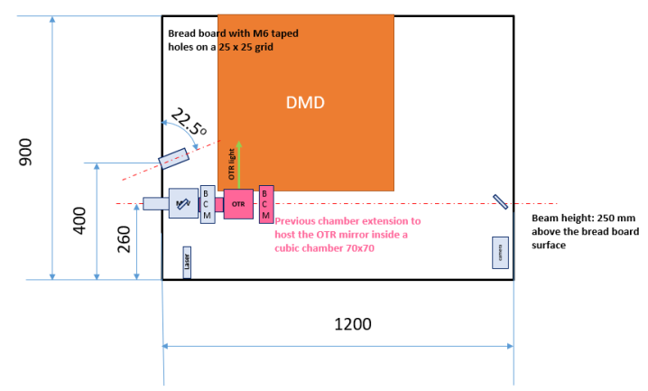
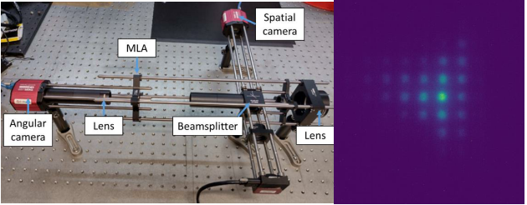
Emittance measurement with OTR light
Two images generated from OTR light by the Digital Micro-mirror Device (DMD): spatial and angular, acting like a pepper-pot or a slit on the beam (Liverpool U.)
Cube hosting the OTR screen. Later will be SR light.
Same as above but using a Micro-Lens Array (MLA) instead of a DMD
Set-up footprint on the in-air test stand

Slide 7
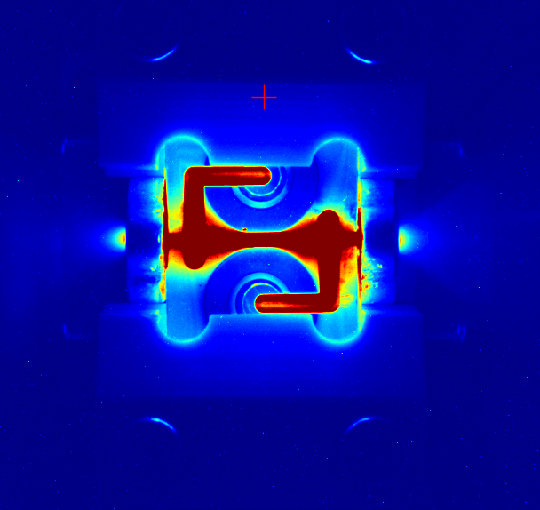
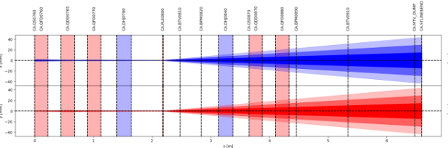
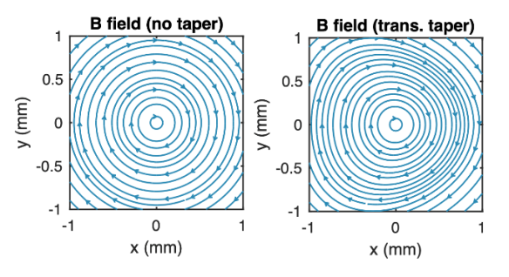
Accelerator development and Physics experiments
DAES SA
LAL / IN2P3
CERN / PSI
Oslo Univ. / Oxford Univ. / DESY / Berkley
Neutron target / cryogenic moderator
Resonance of the electron internal clock
Target for positron source (FCC-ee)
Active plasma lens defocusing device
Non-linear plasma lens generated by Hall effect
Active Plasma Lens used for beam defocusing (Oslo U.)
Usually, these experiments require larger effort for their set-up development and installation, as well as longer beam time campaign.
B field in plasma lens with and w/o external magnetic field for shaping by Hall effect (Oslo U.).

Slide 8
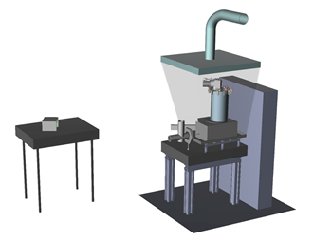
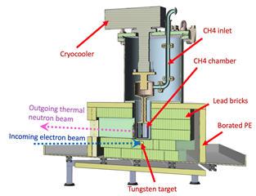
Neutron target and cryogenic moderator
Target/Moderator installation on the in-air test stand and movable neutron detector for TOF (DAES SA)
Target/Moderator elements (DAES SA)
Ultimate scope: to produce a neurography instrument (based on a X-band LINAC) aimed to be used in labs developing fuel cells. Private company supported by KT as green initiative.

Slide 9

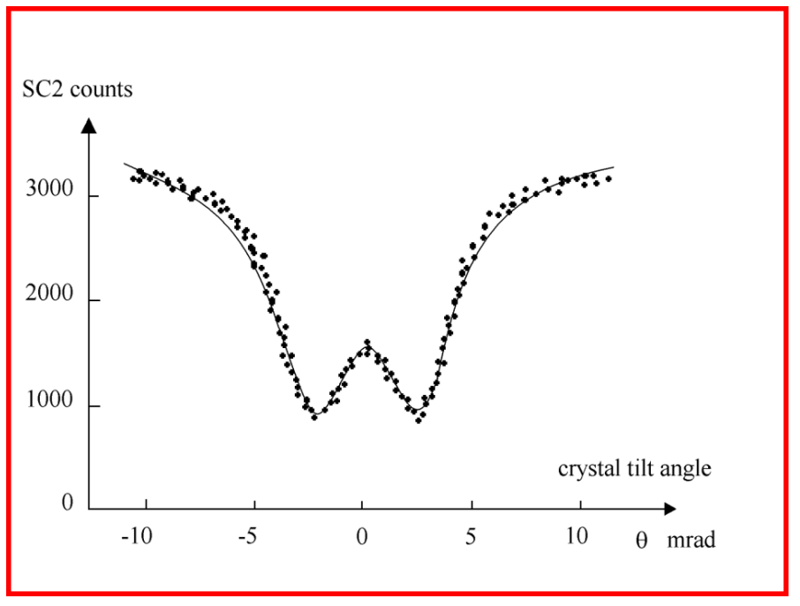
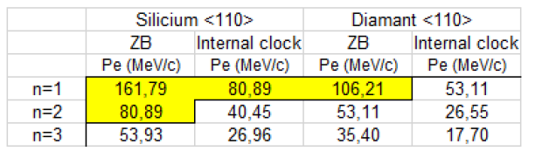
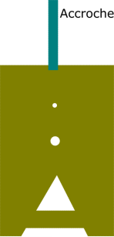
Basic research on the electron internal clock
Hypothesis from L. de Broglie 1925 : ν₀ = m_{e} c²/h = 1.2 x 10²⁰ Hz,
Alternative hypothesis from Schrodinger 1930 : Zitterbewegung frequency
Effect is reachable with the energy range available at CLEAR.
Expected anomaly in the scattering by a crystal superposed to the channelling effect (LAL)
Preliminary test with collimator to assess the ability of delivering single electron beam with very accurate energy resolution (50 keV)

Slide 10
Enhancement of Beam Time Capability
Group compatible experiments (last year: 1.9 exp/week), but difficult exercise.
Develop standard beam procedures: laser position and RF phase control, beam-based alignment, beam dynamic models, predictive dosimetry tools, flat beam generation
Optimize set-up efficiency: larger robot samples storage, larger Eppendorf, double-holder
Manage more carefully the high dose irradiations: shielding, longer decay time
Limit the number of visits: Usually authorised only on Monday during set-up installation
Allow RP access after 5pm and during week-end: training of some team members to become RP competent (2 weeks formation)
Increase manning: a new fellow: Antonio, a new part-time operator: Mathieu, a technical student: Alfred, possibly a new technician for set-up preparation (shared with the RF team), participation to a doctoral network. Conversely, there is a risk to lose some present team members due to contract ending.
Construct of a second beam line: on-going, but with no extra-shutdown period.
So far, no experiment has been refused due to lack of beam time. But MD was largely performed during WE and nights.
Increasing effort

Slide 11
Facility consolidation
All cameras are being replaced by a digital standard (1000 x 1200 px). Software adapted accordingly and unified.
Cavity BPMs electronics could be extended for simultaneous reading.
Vacuum synoptic (SCADA) has been actualised.
Laser parts received for a new system.
A modulator is being dedicated for klystron hot spare.
Beam Base Alignment program being deployed
Improved Quad scan methods
Extensive study on the best laser position on the photocathode

Slide 12
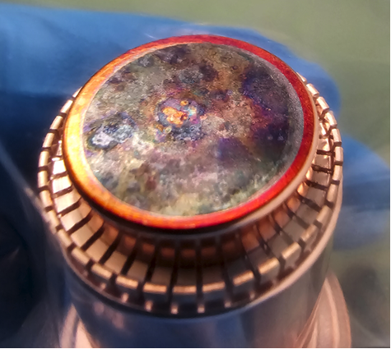
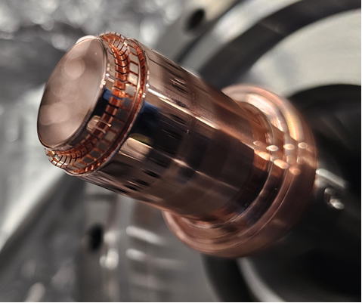
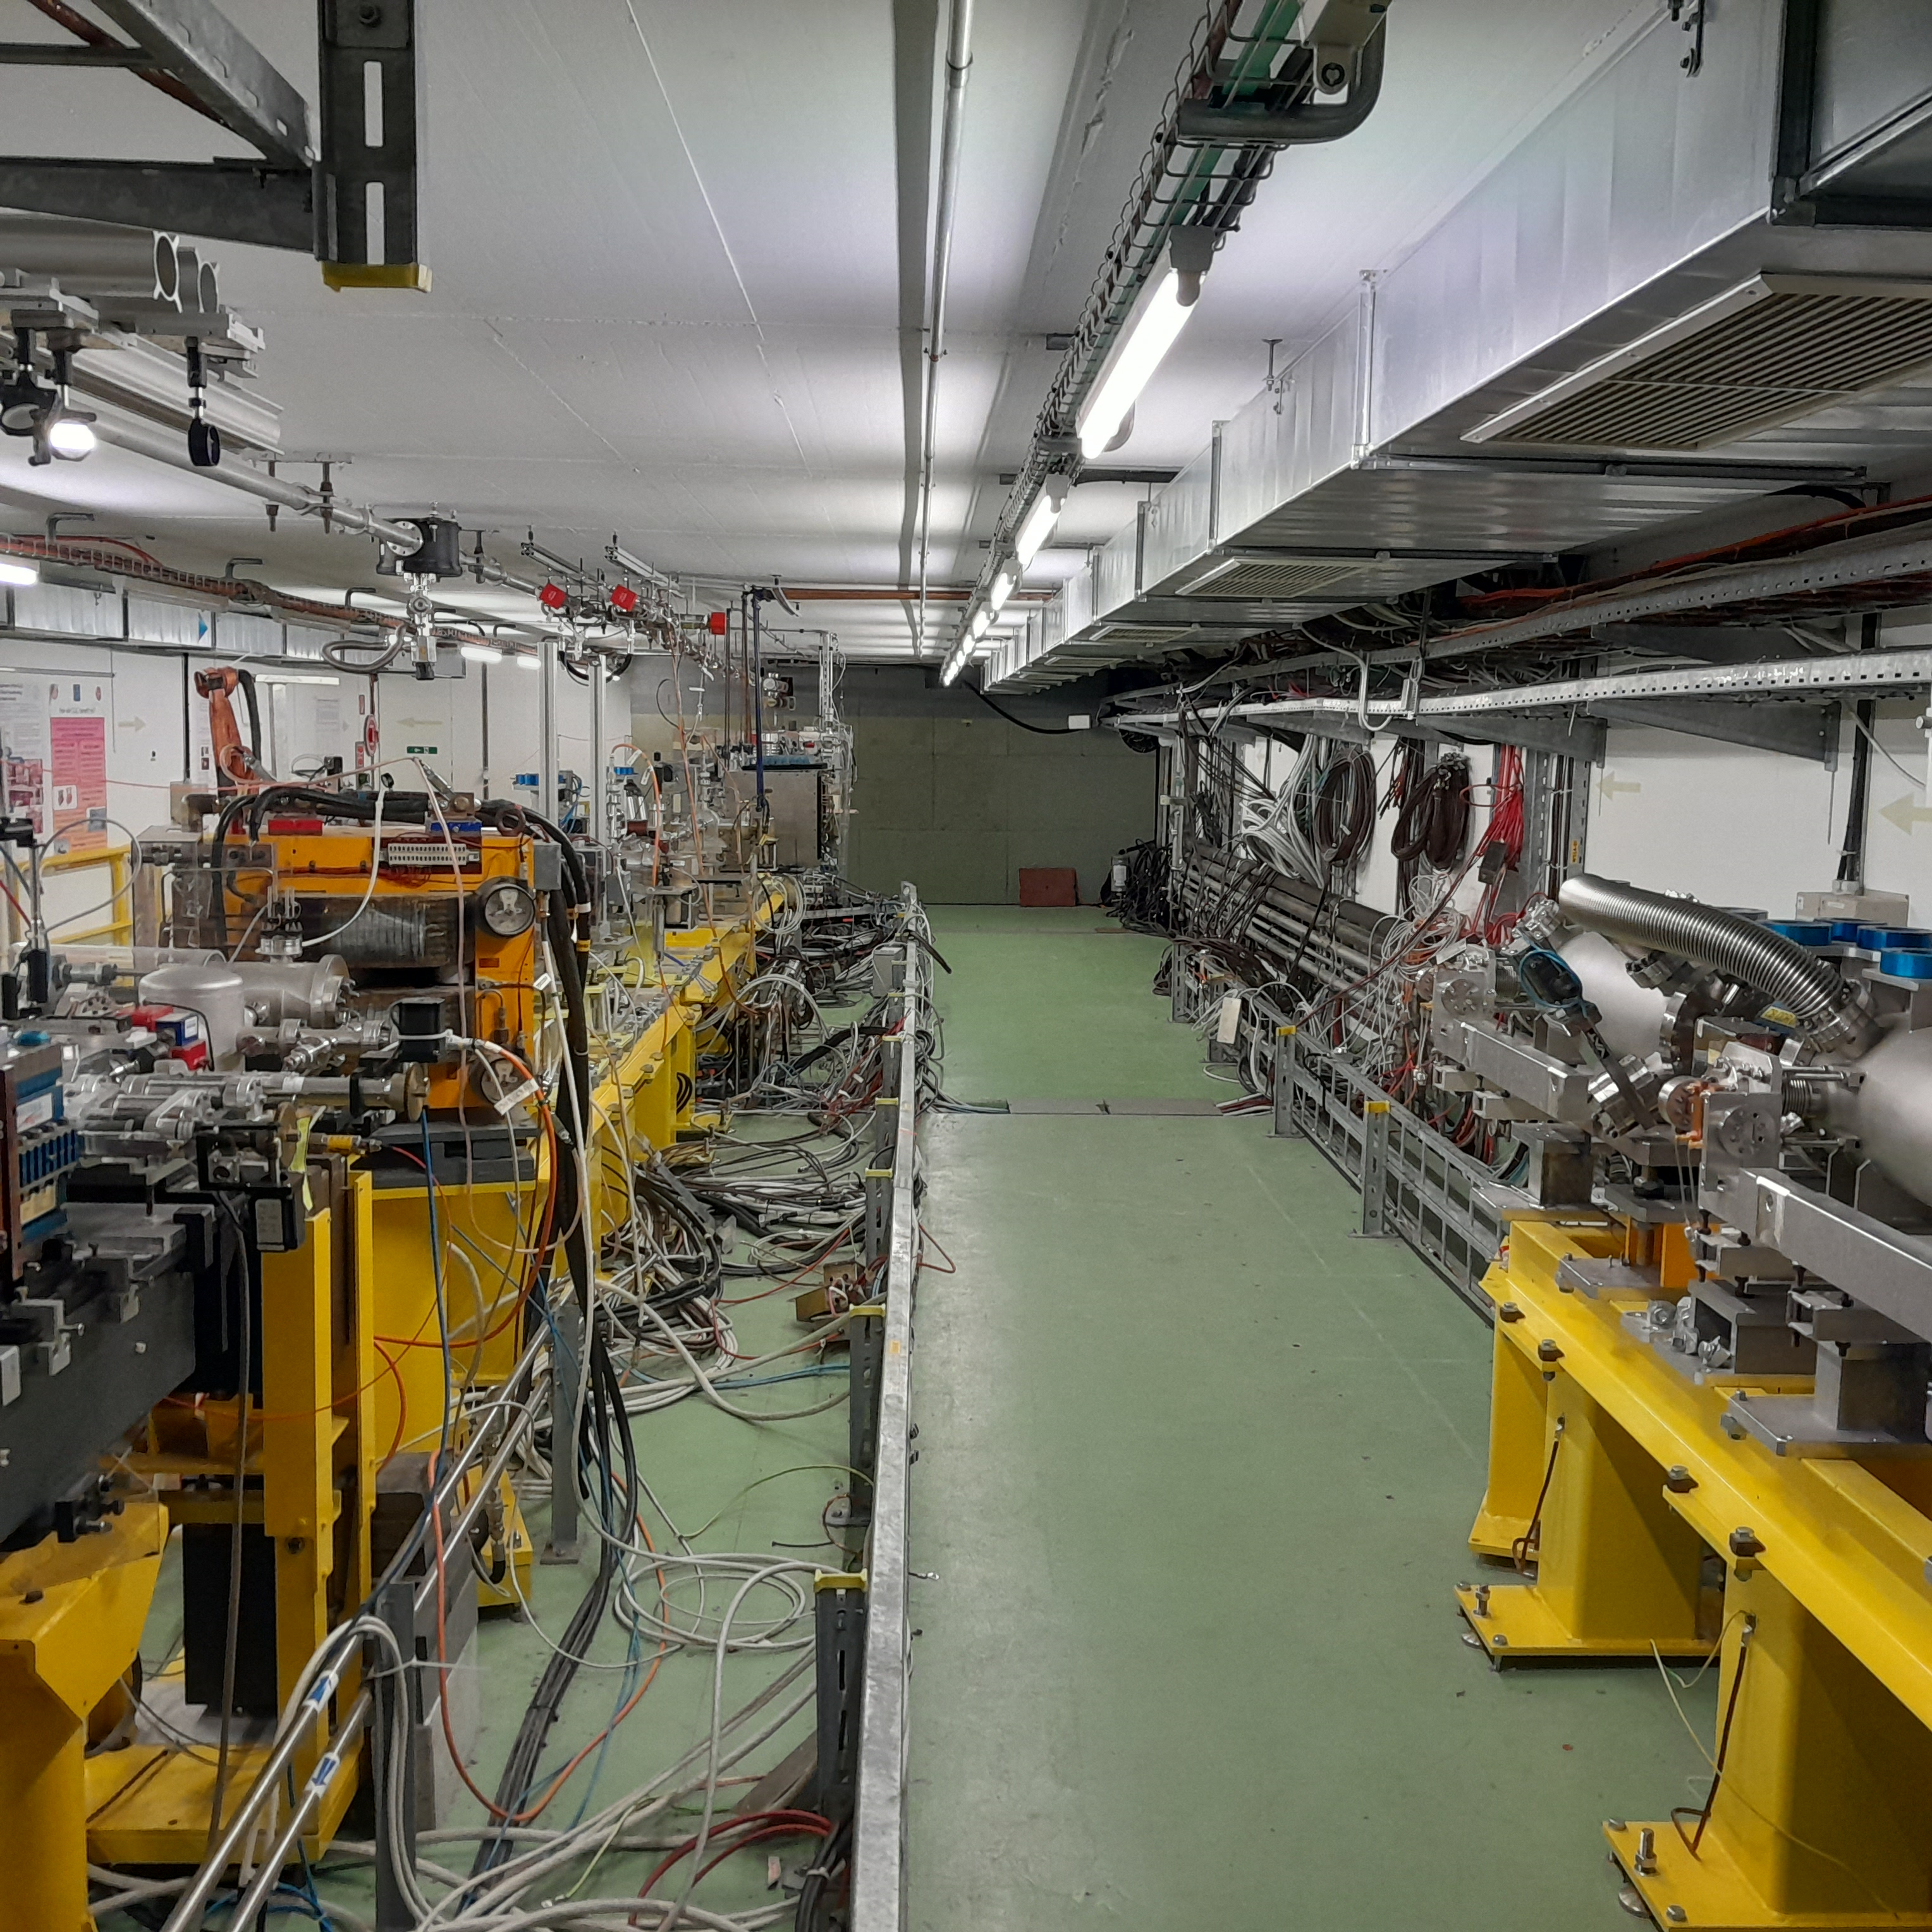
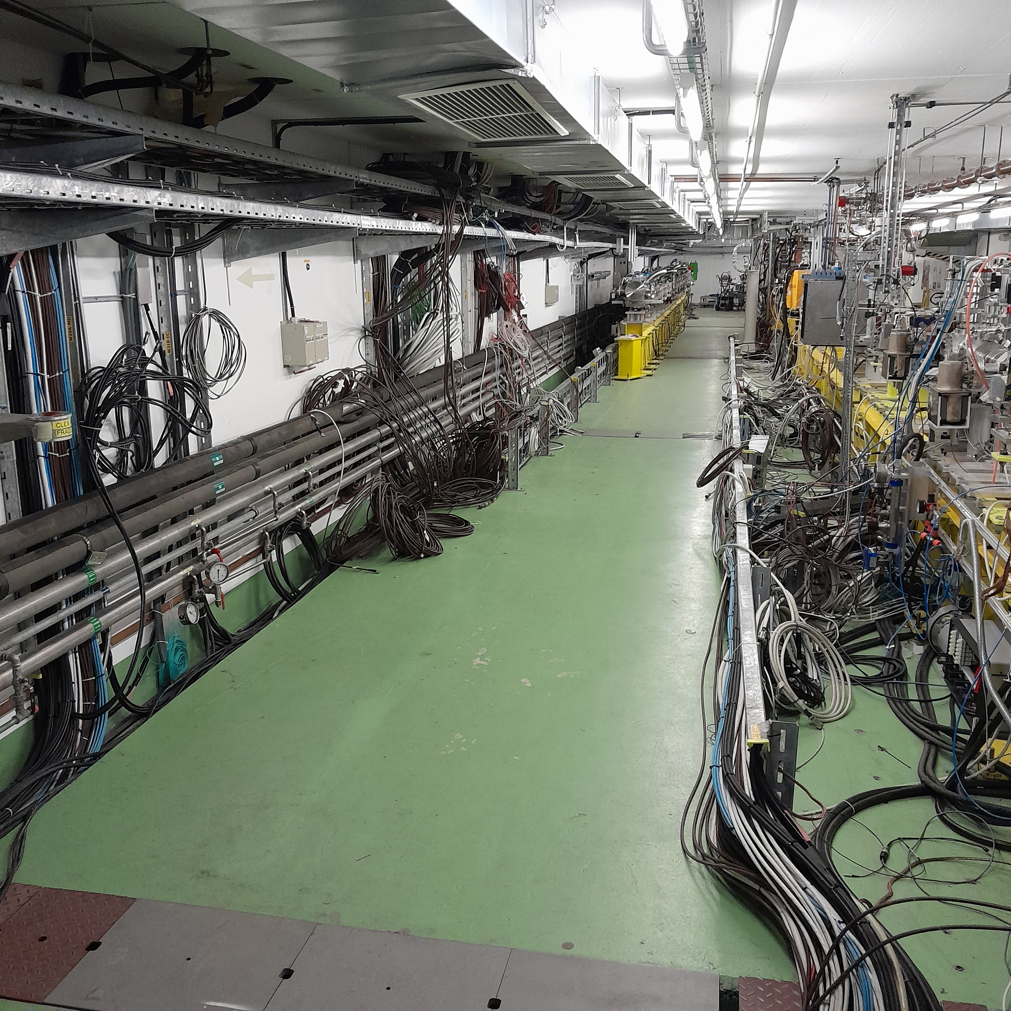
Improvements of the facility
The photocathode has been fully renewed, for an expected bunch charge >1nC.
Turbo-pump controller moved in the gallery (less exposed to radiation damage).
Construction of the second beam line (parallel experiments, adapted for large beam, in-air and in-vacuum test stands)
  Beam dynamic optimized (9 quads – 2 sextupoles)
  Drawings achieved, 2 vacuum chambers in project
  Location cleaned from the disused TBL (girder, dump, cables),
  All magnets available and renewed,
  Footprint traced, DC power cables available,
  Some equipment purchased (screens, breadboard…),
  But limited time and resources (internal + Eurolabs grant).
Old cathode
New cathode
Second beam line location cleared

Slide 13
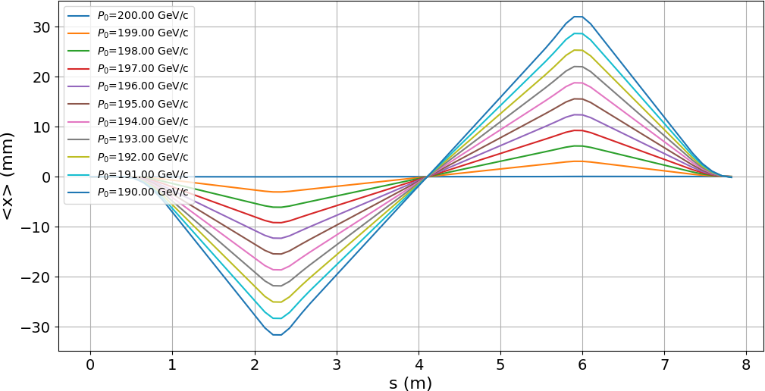
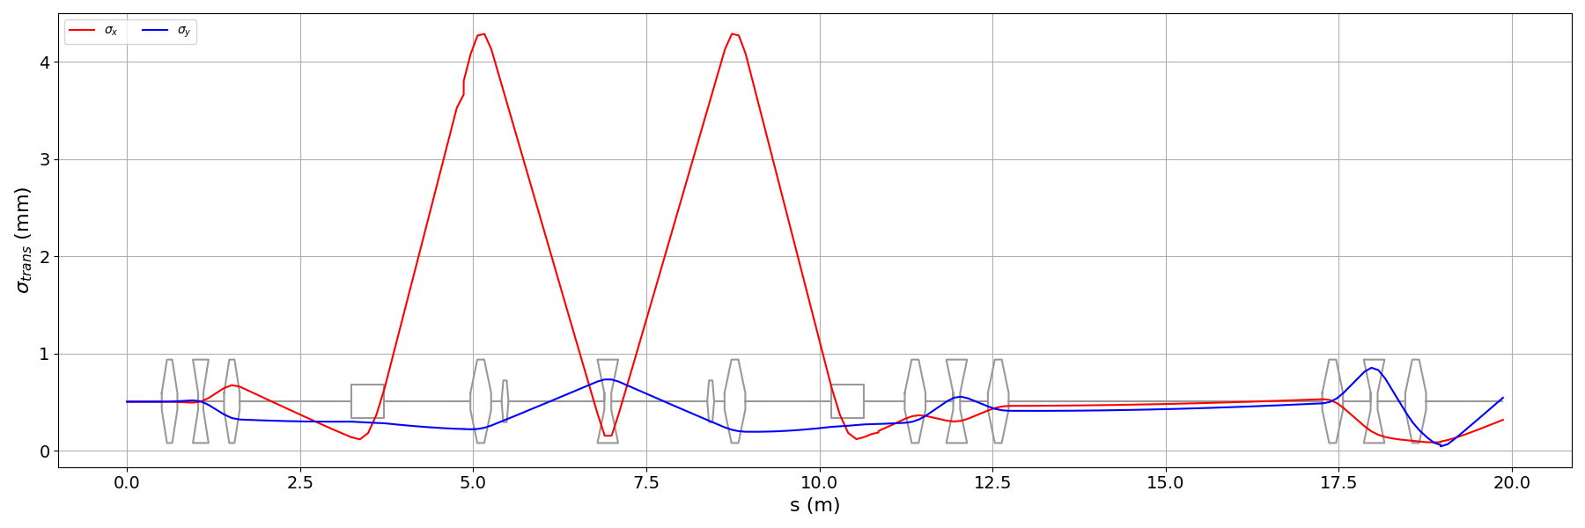
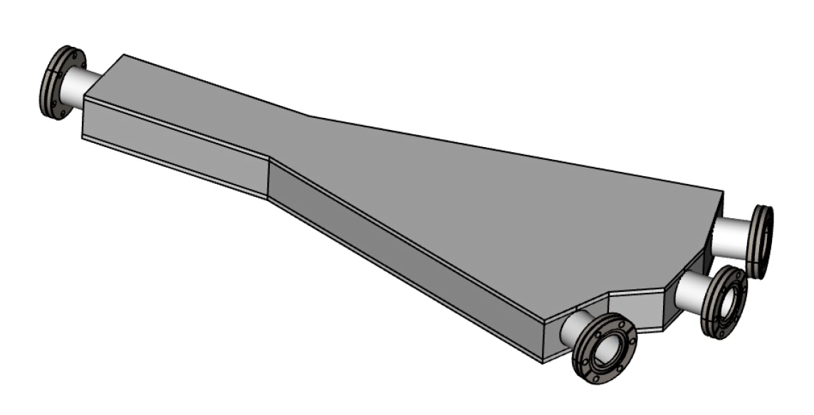
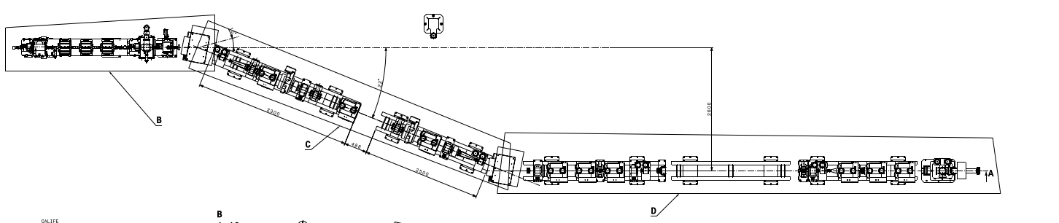
Second beam line study and plans
Bunch center for different bunch energies along beamline With sextupoles (Avni)
Beam sizes along the line (Avni)
New dipole chamber (EN-MME)
Implementation drawing (EN-MME)

Slide 14
Conclusions
The interest of the scientific community for CLEAR is ever growing.
CLEAR is instrumental in the field of medical research based on VHEE and UHDR (Flash therapy).
Being the only electron machine at CERN, it could also play a significant role in the FCC-ee development, as a test stand for diagnostics and equipment as well as an education tool for the future accelerator physicists.
Presently, the facility needs additional resources, especially human, for continuing to fulfil all the received beam requests.

