Slide 1



12/6/2024
MCnet School, CERN
Jon Butterworth, Martin Habedank, Louie Corpe, Peng Wang, Joe Egan
Contur
Constraints On New Theories Using Rivet
a tool for reinterpreting particle-level measurements.

Slide 2

The problem

Slide 3

(Part of) The Solution
The LHC measurement “library”

Slide 4
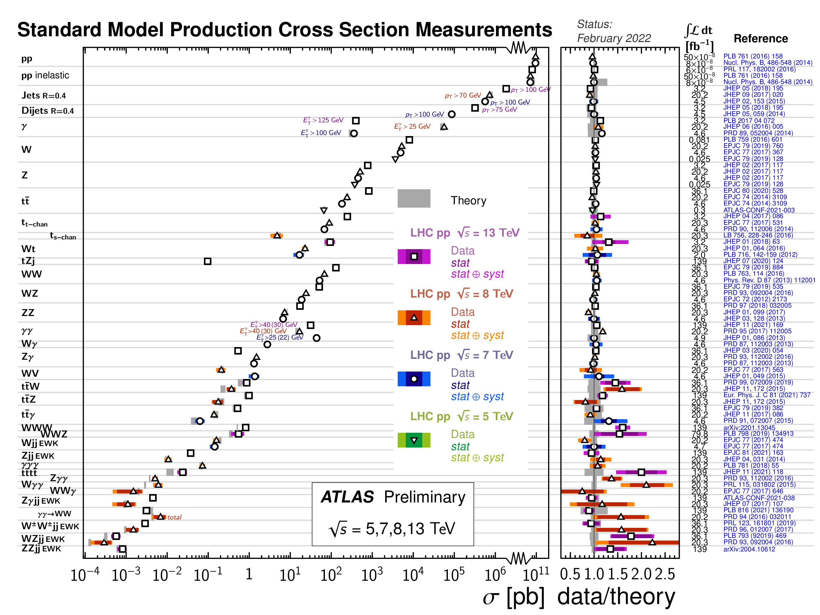

Slide 5
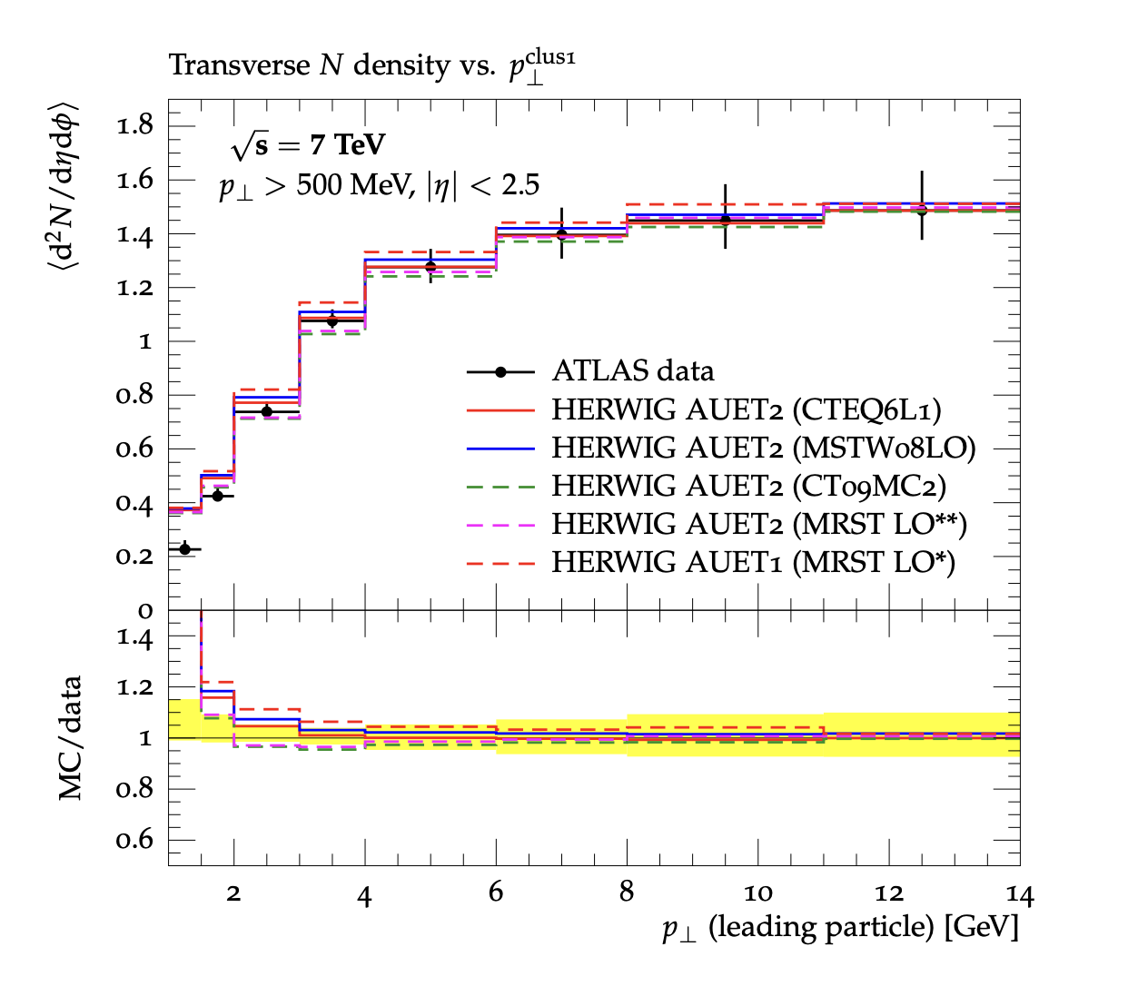
Introducing Rivet
“Robust Independent Validation of Experiment and Theory”
HERA legacy (1990s, HZTOOL)
Developed by MCnet for tuning and validation of new MC event generators
e.g. What does the underlying event look like in 7 TeV pp collisions?
Vast library of measurements of final state particles produced in collisions, and variables derived from them
Buckley et al, Bierlich et al arXiv:1003.0694 (CPC), arXiv:1912.05451 (SciPost), arXiv:2404.15984
From ATL-PHYS-PUB-2011-008

Slide 6
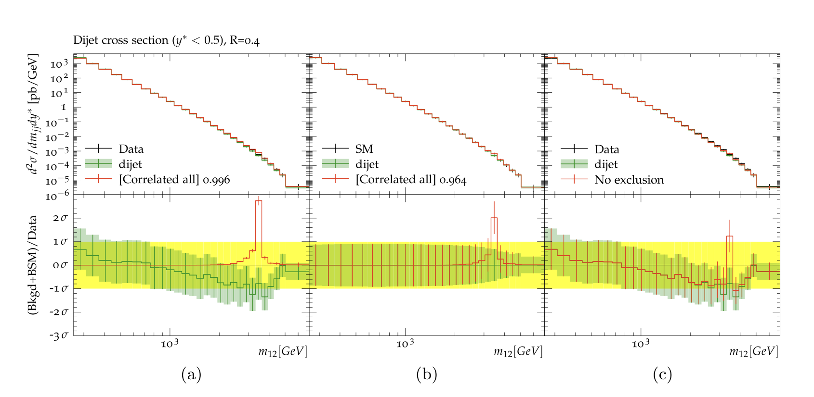
Introducing Contur
“Constraints On New Theories Using Rivet”
Extend the power of Rivet beyond the Standard Model
Signal-injection of final-state particles from BSM physics events on to measured cross sections in Rivet
From Altakach, JMB, Ježo, Klasen, Schienbein arXiv:2111.15406 (SciPost Core)
Increasingly precise measurements and SM calculations together extend the reach
JMB, Grellscheid, Krämer, Sarrazin, Yallup; Buckley et al
arXiv:1606.05296 (JHEP), arXiv:2102.04377 (SciPost)

Slide 7
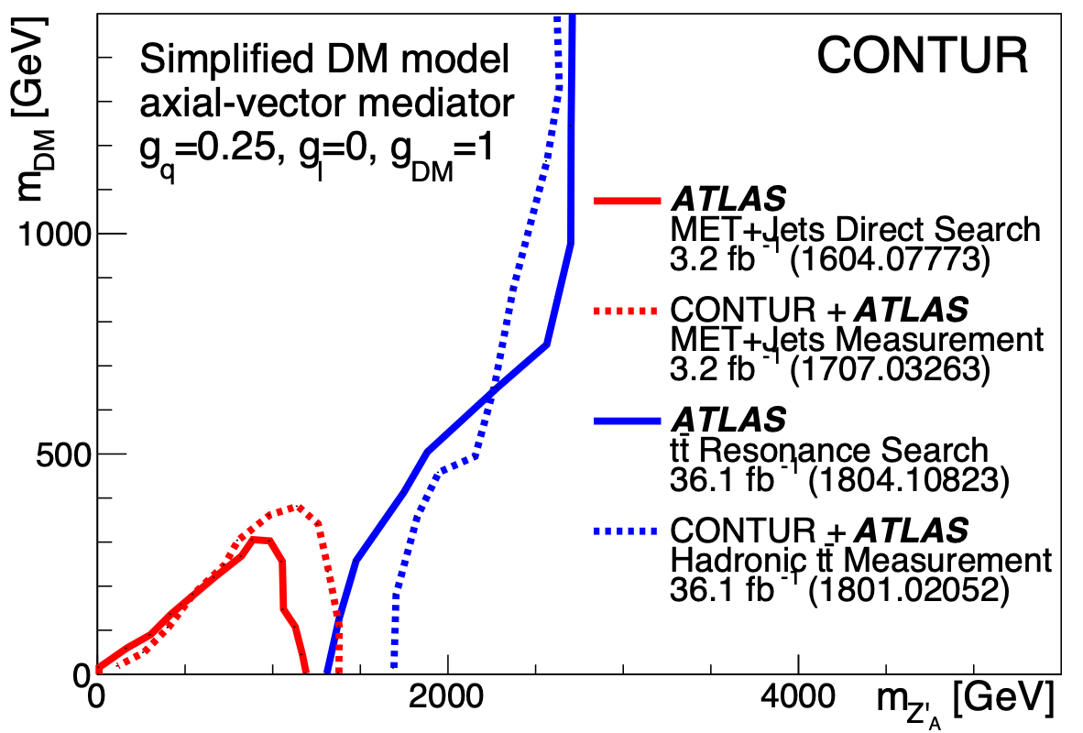
A Contur-friendly measurement
Is unfolded to particle-level
Is defined in terms of the final state, not production process
Has a fiducial phase space which is as inclusive as possible and reflects the actual selection
  No hidden vetos
  Minimal extrapolations
For example:
Louie Corpe

Slide 8
Contur Software
Written in Python: https://gitlab.com/hepcedar/contur
Heavy use of python interface to Rivet, Yoda, and of matplotlib, scipy, numpy and more (including pyslha)
Rivet, Yoda mainly C++ (all on gitlab)
Can steer event generators (currently Herwig, Madgraph, Pythia) but can also be run on any existing Rivet (Yoda) output (and Rivet can run on any HepMC events)
Can also be invoked from inside the Madgraph command-line environment (along with Rivet) or via Gambit
Nascent GUI and ML add-ons

