Slide 1

AD/ELENA FACILITY
ADTC Meeting
1st February 2024
2023-2024 YETS follow-up

Slide 2
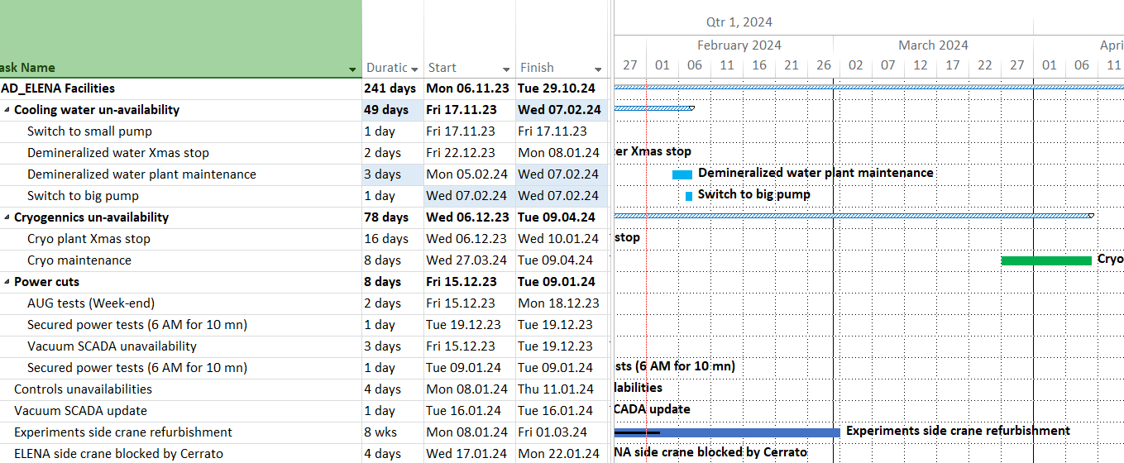
Planned services disruptions
New duration
TBC: May be
09/03 – 24/03
For info: Fire brigade training in AD ring on sat 10/02, sat 17/02
Planning available at
https://oss-coordination.web.cern.ch/gantt/latest?facilities=AD/ELENA&scale=week&worktypeproject=

Slide 3
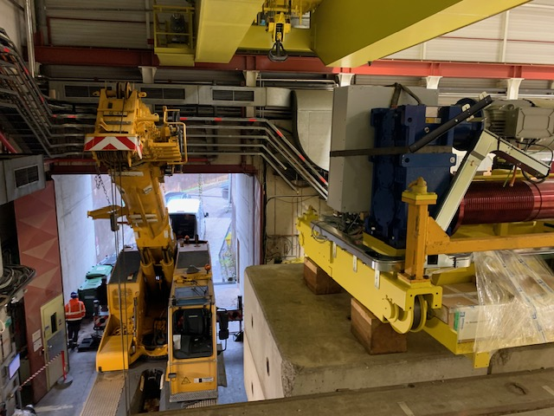
Crane refurbishment

Slide 4
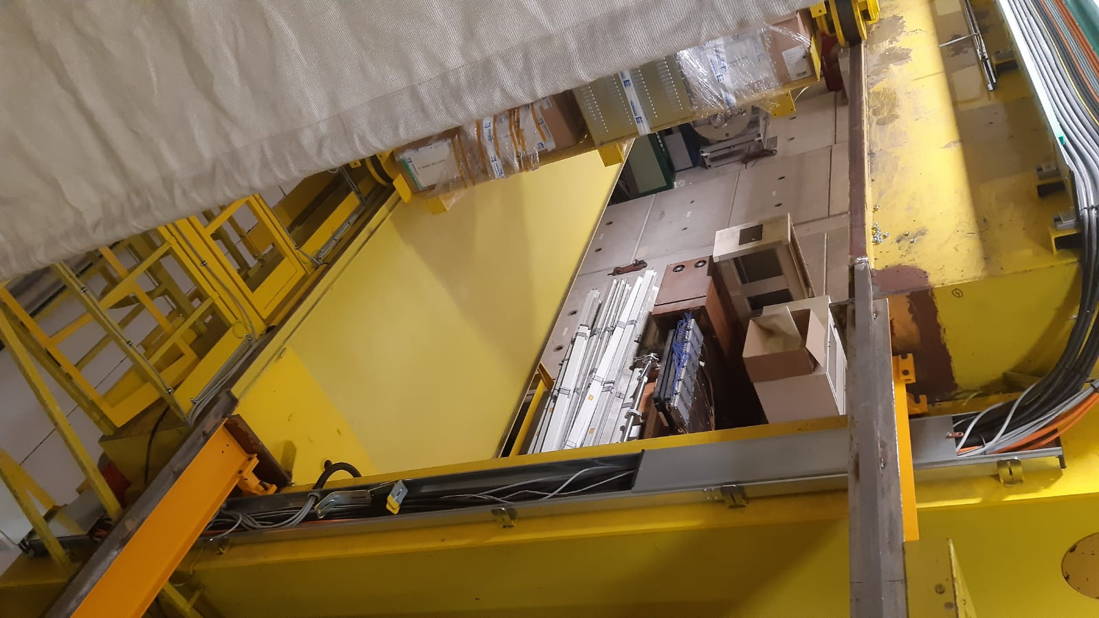
Crane refurbishment

Slide 5
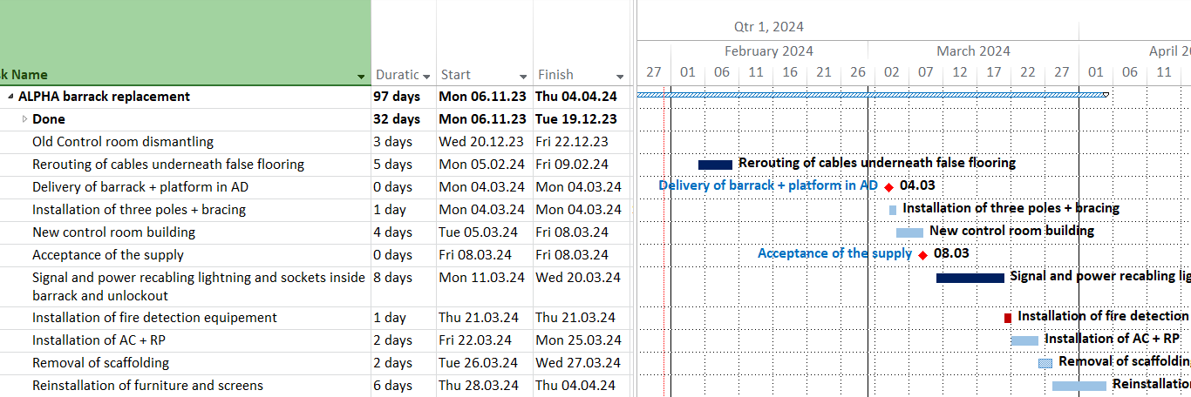
ALPHA barrack replacement

Slide 6
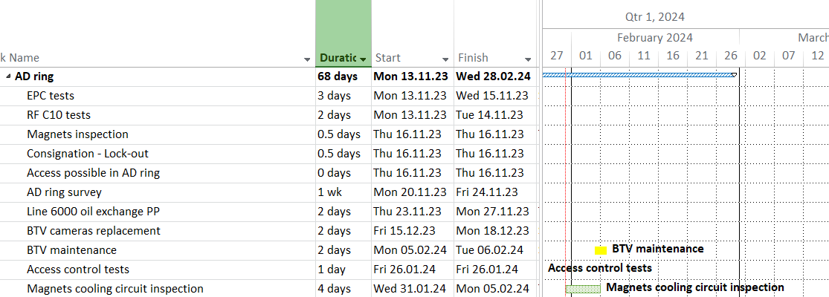
AD ring general

Slide 7
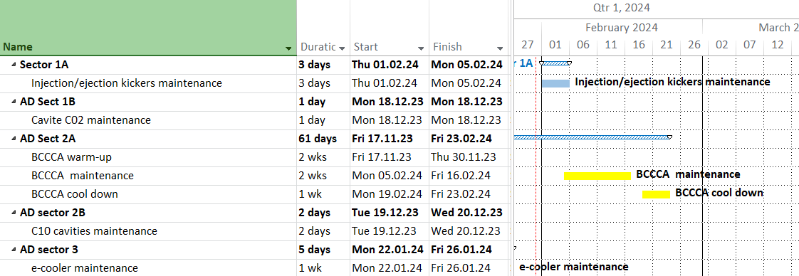
AD sectors 1A-1B-2A-2B-3

Slide 8
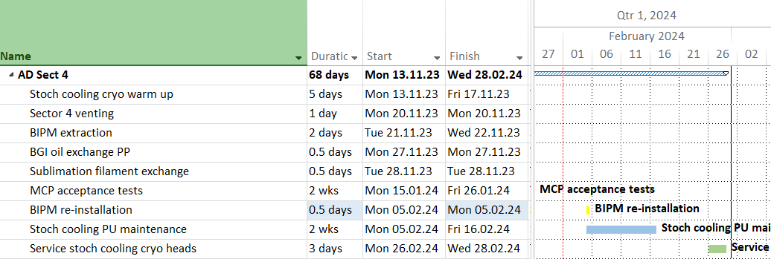
AD sector 4 - general
New date

Slide 9
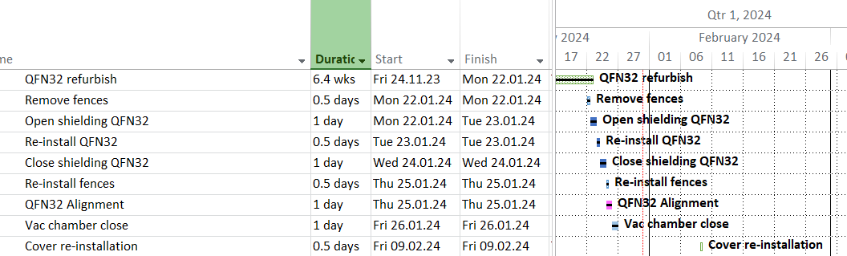

AD ring sector 4 – QFN32

Slide 10
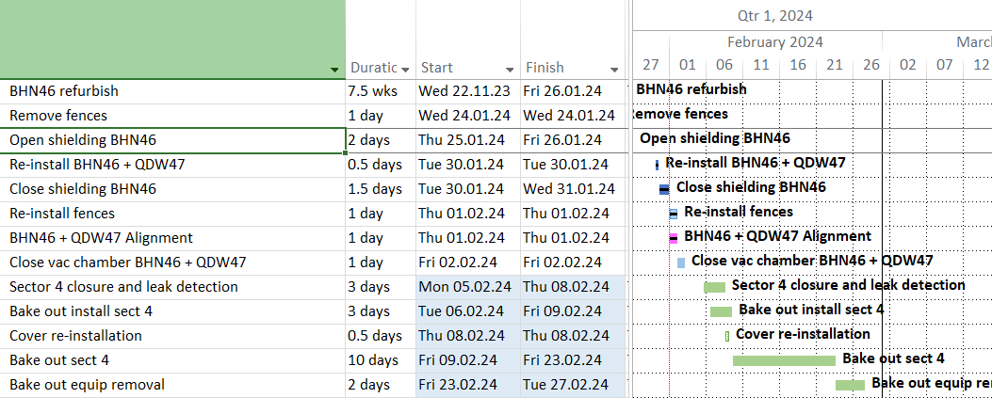
AD ring sector 4 – BHN46
New dates !

Slide 11
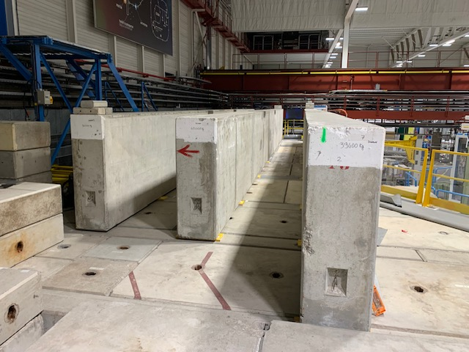
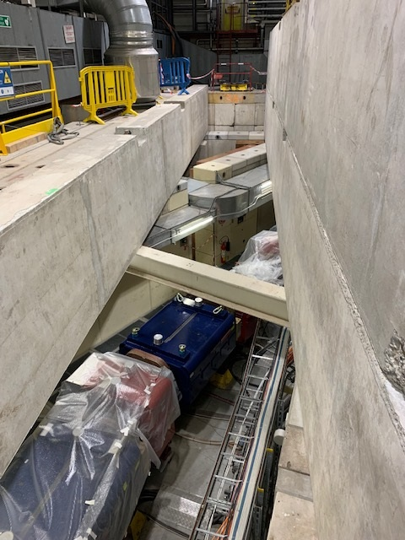
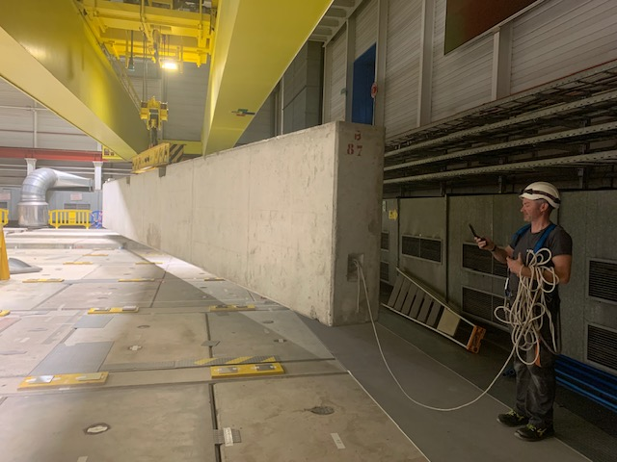
BHN46

Slide 12
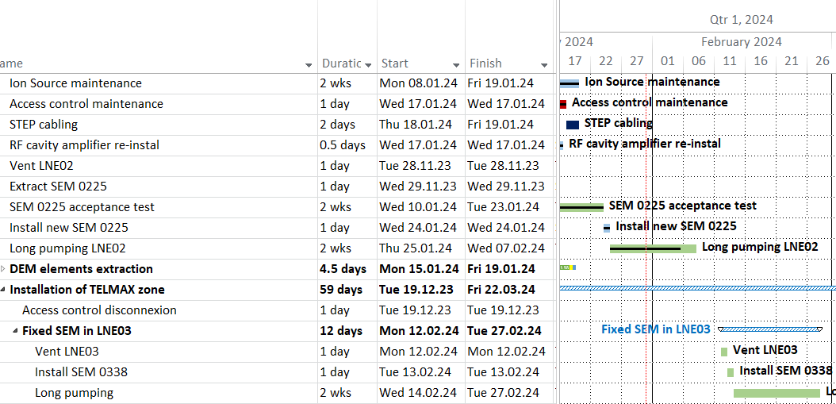
ELENA

Slide 13
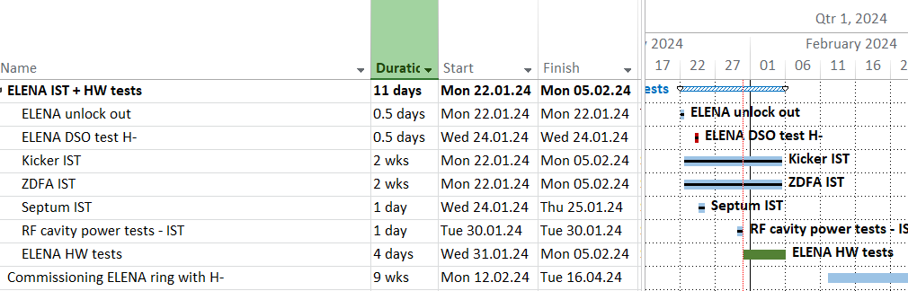
ELENA RESTART
Nota: ELENA will need to be accessed for SEM0338 installation on 12-14 Feb
AD restart: see Laurette’s presentation

