Slide 1
Mechanical engineering of accelerator components
Antti Kolehmainen EN-MME
Mikko Barinoff EP-DT
Taneli Mutanen TE-MSC
Finnish High-School Students visits program

Slide 2
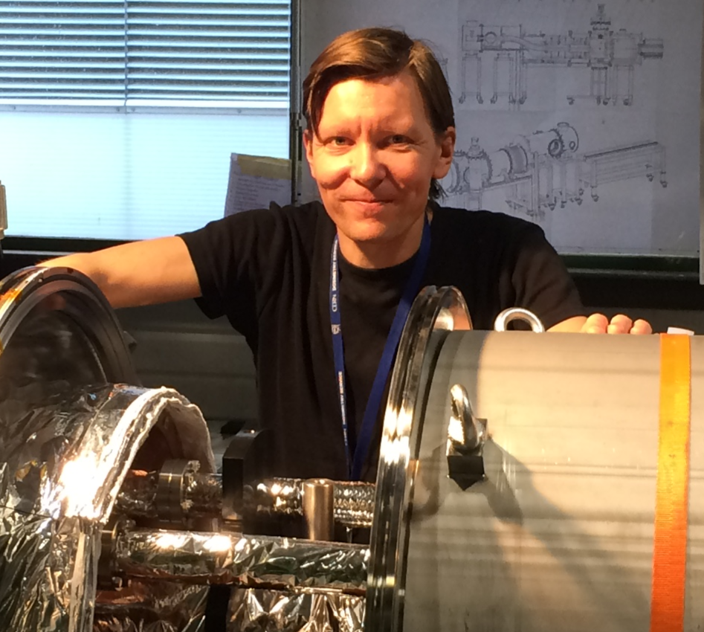

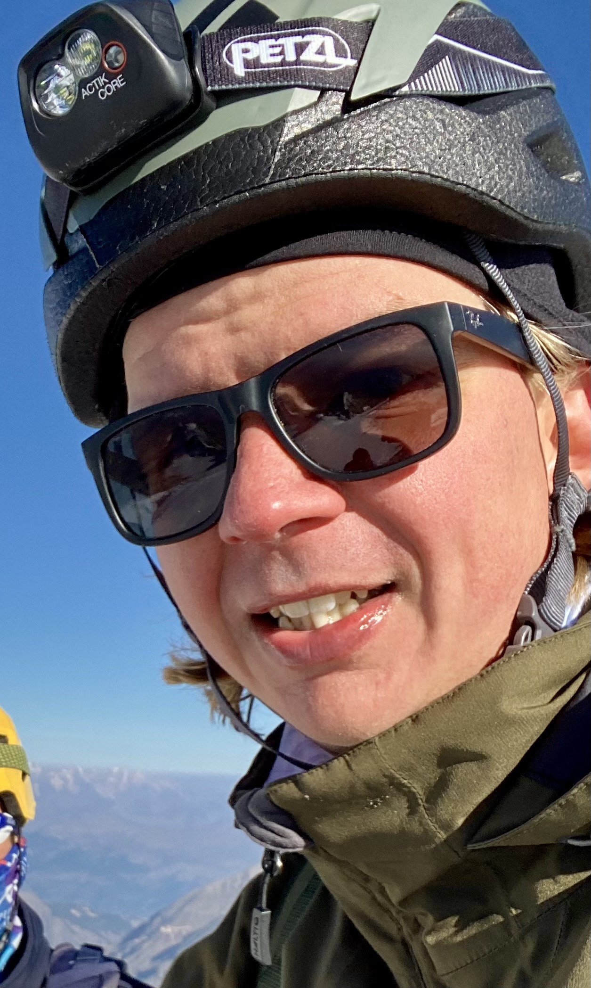

WHO WE ARE
Antti
Mikko
Taneli
Mechanical designer in Engineering Department
BSc in engineering 2004, Jyväskylä
CERN since 2012
10 years in industry prior to CERN
Mechanical engineer in the Experimental Physics department
MSc in mechanical engineering 2021, Aalto university
At CERN since 2019
Micromechanic in the Technology Department
Micromechanics 2021, Finnish School Of Watchmaking
At CERN since 2022

Slide 3
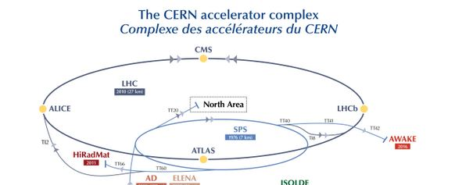
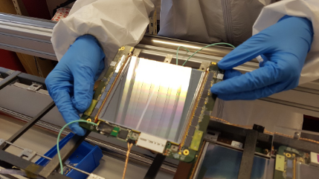
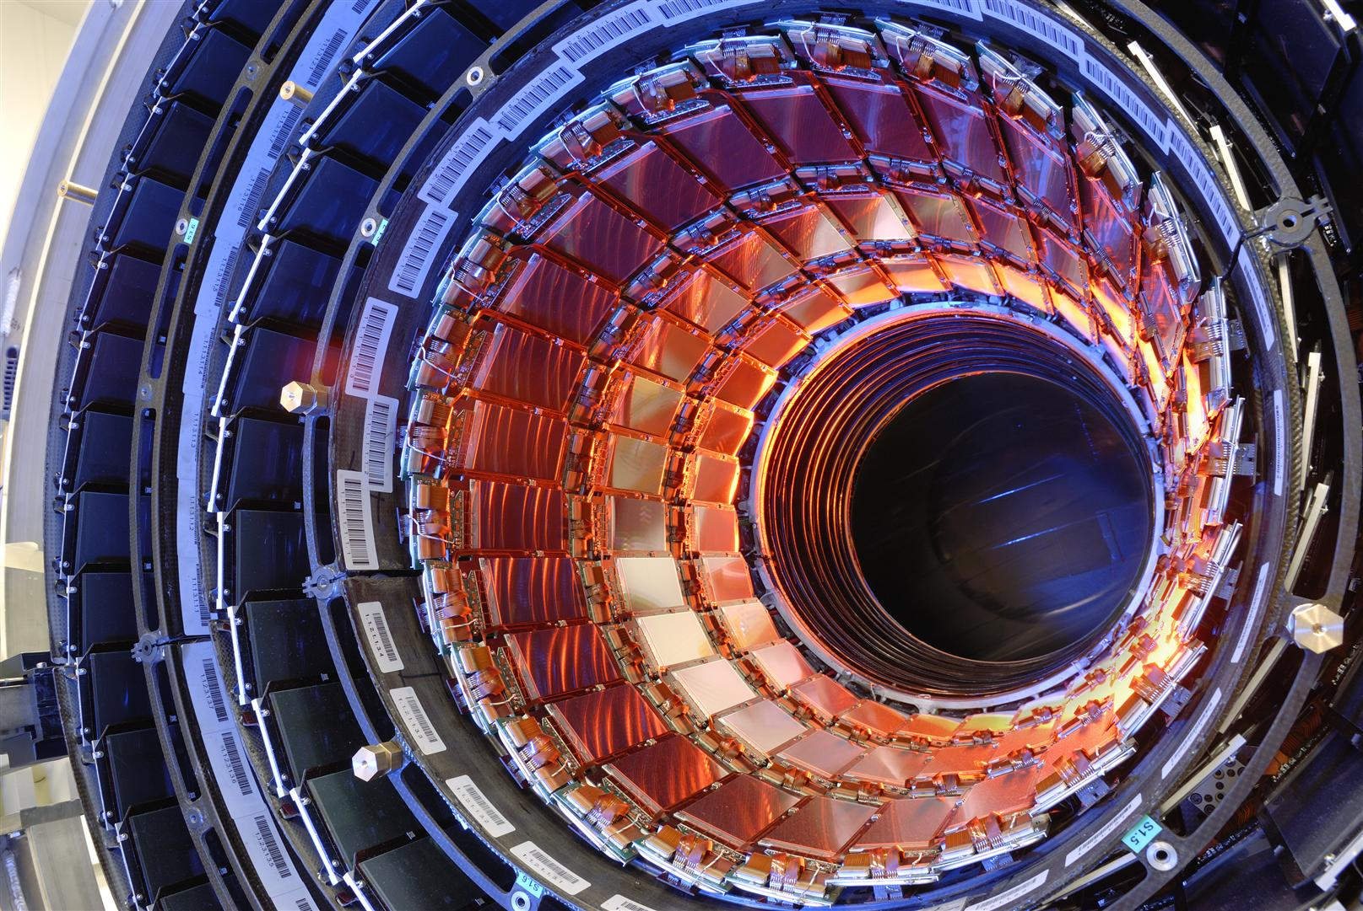
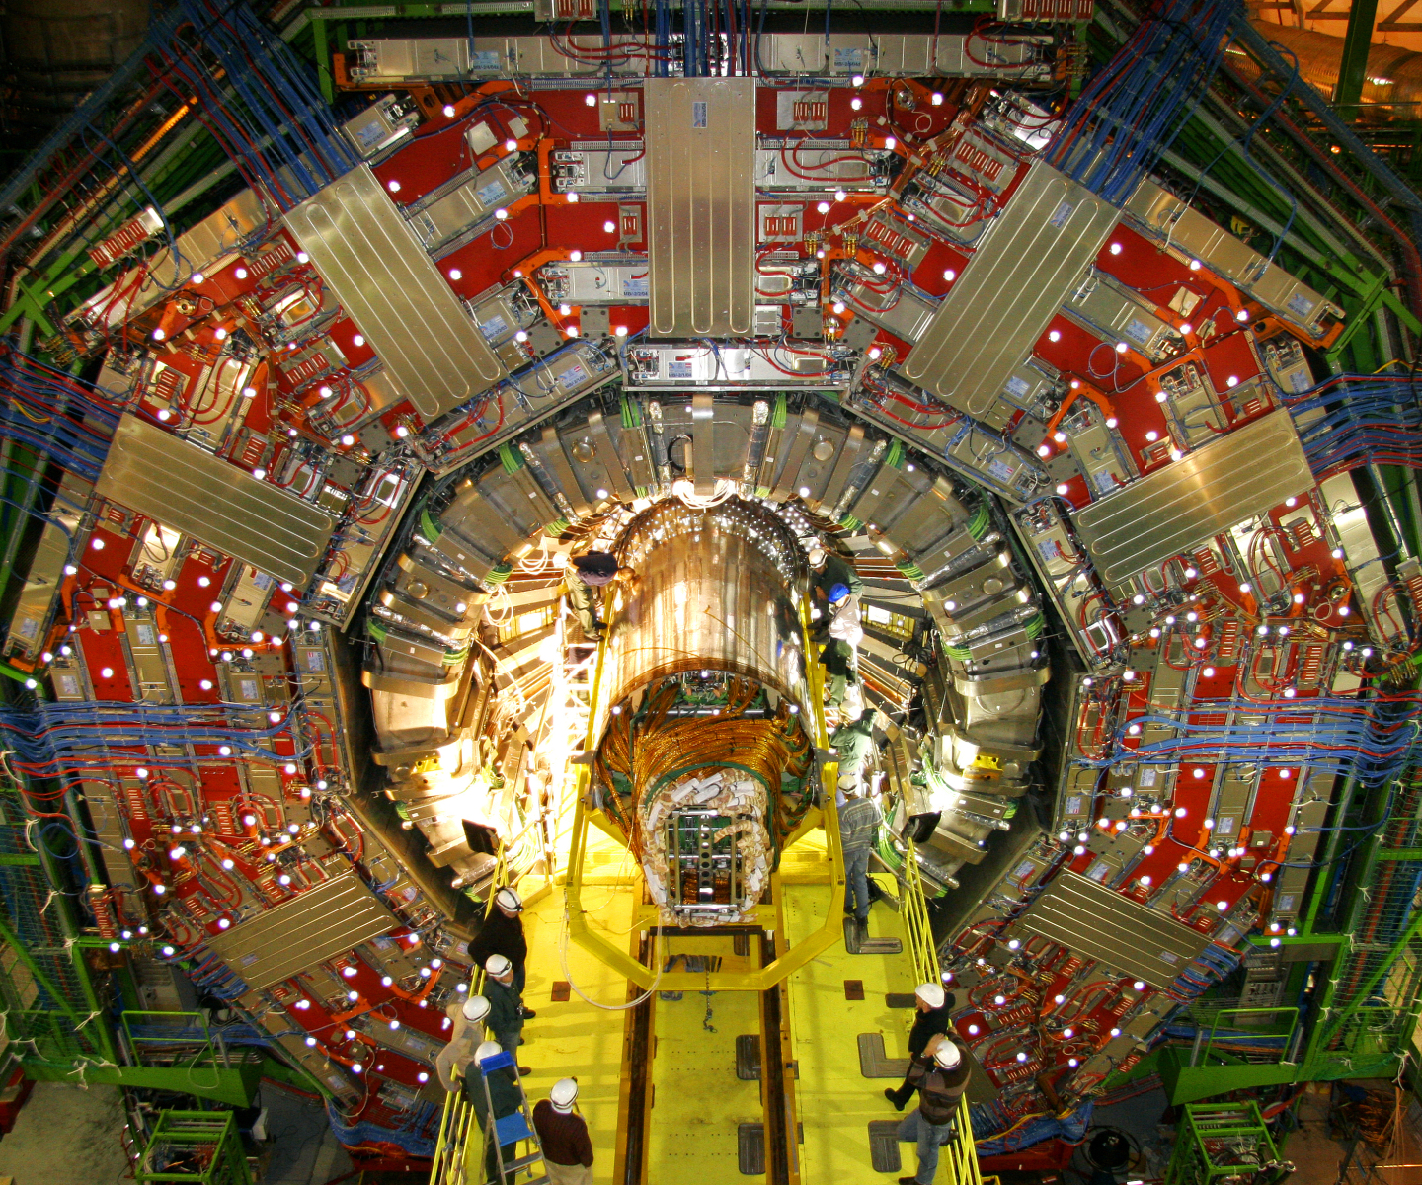
WHAT WE DO?
Mikko
Mechanical design & construction work for the Phase-2 upgrade of the CMS Tracker
Tasks vary from high precision micromechanics to heavy handling equipment

Slide 4
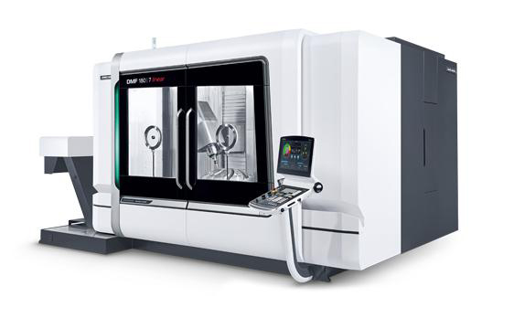
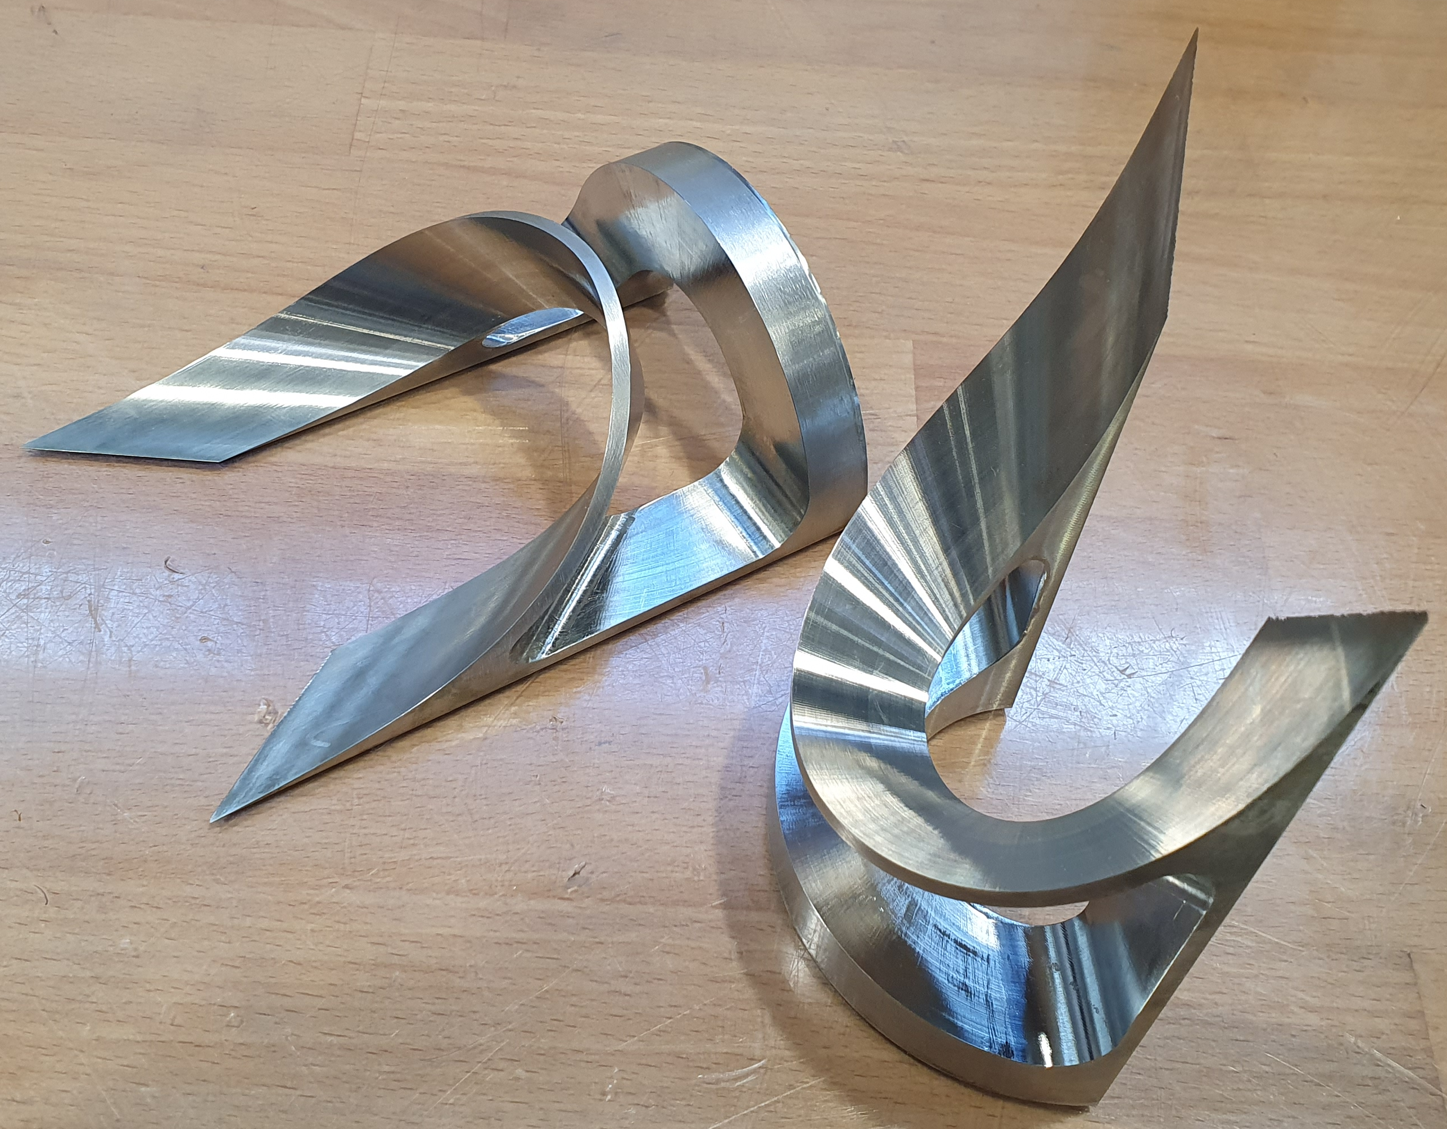
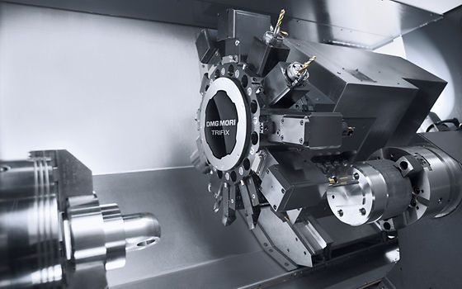
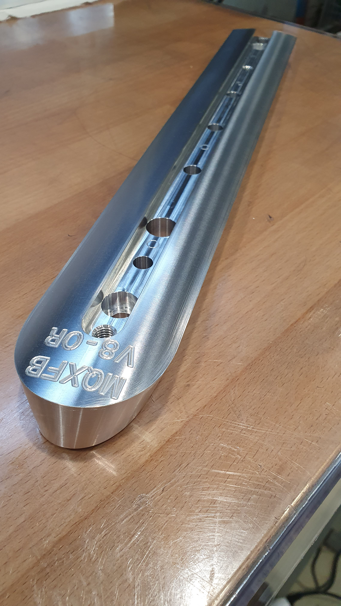
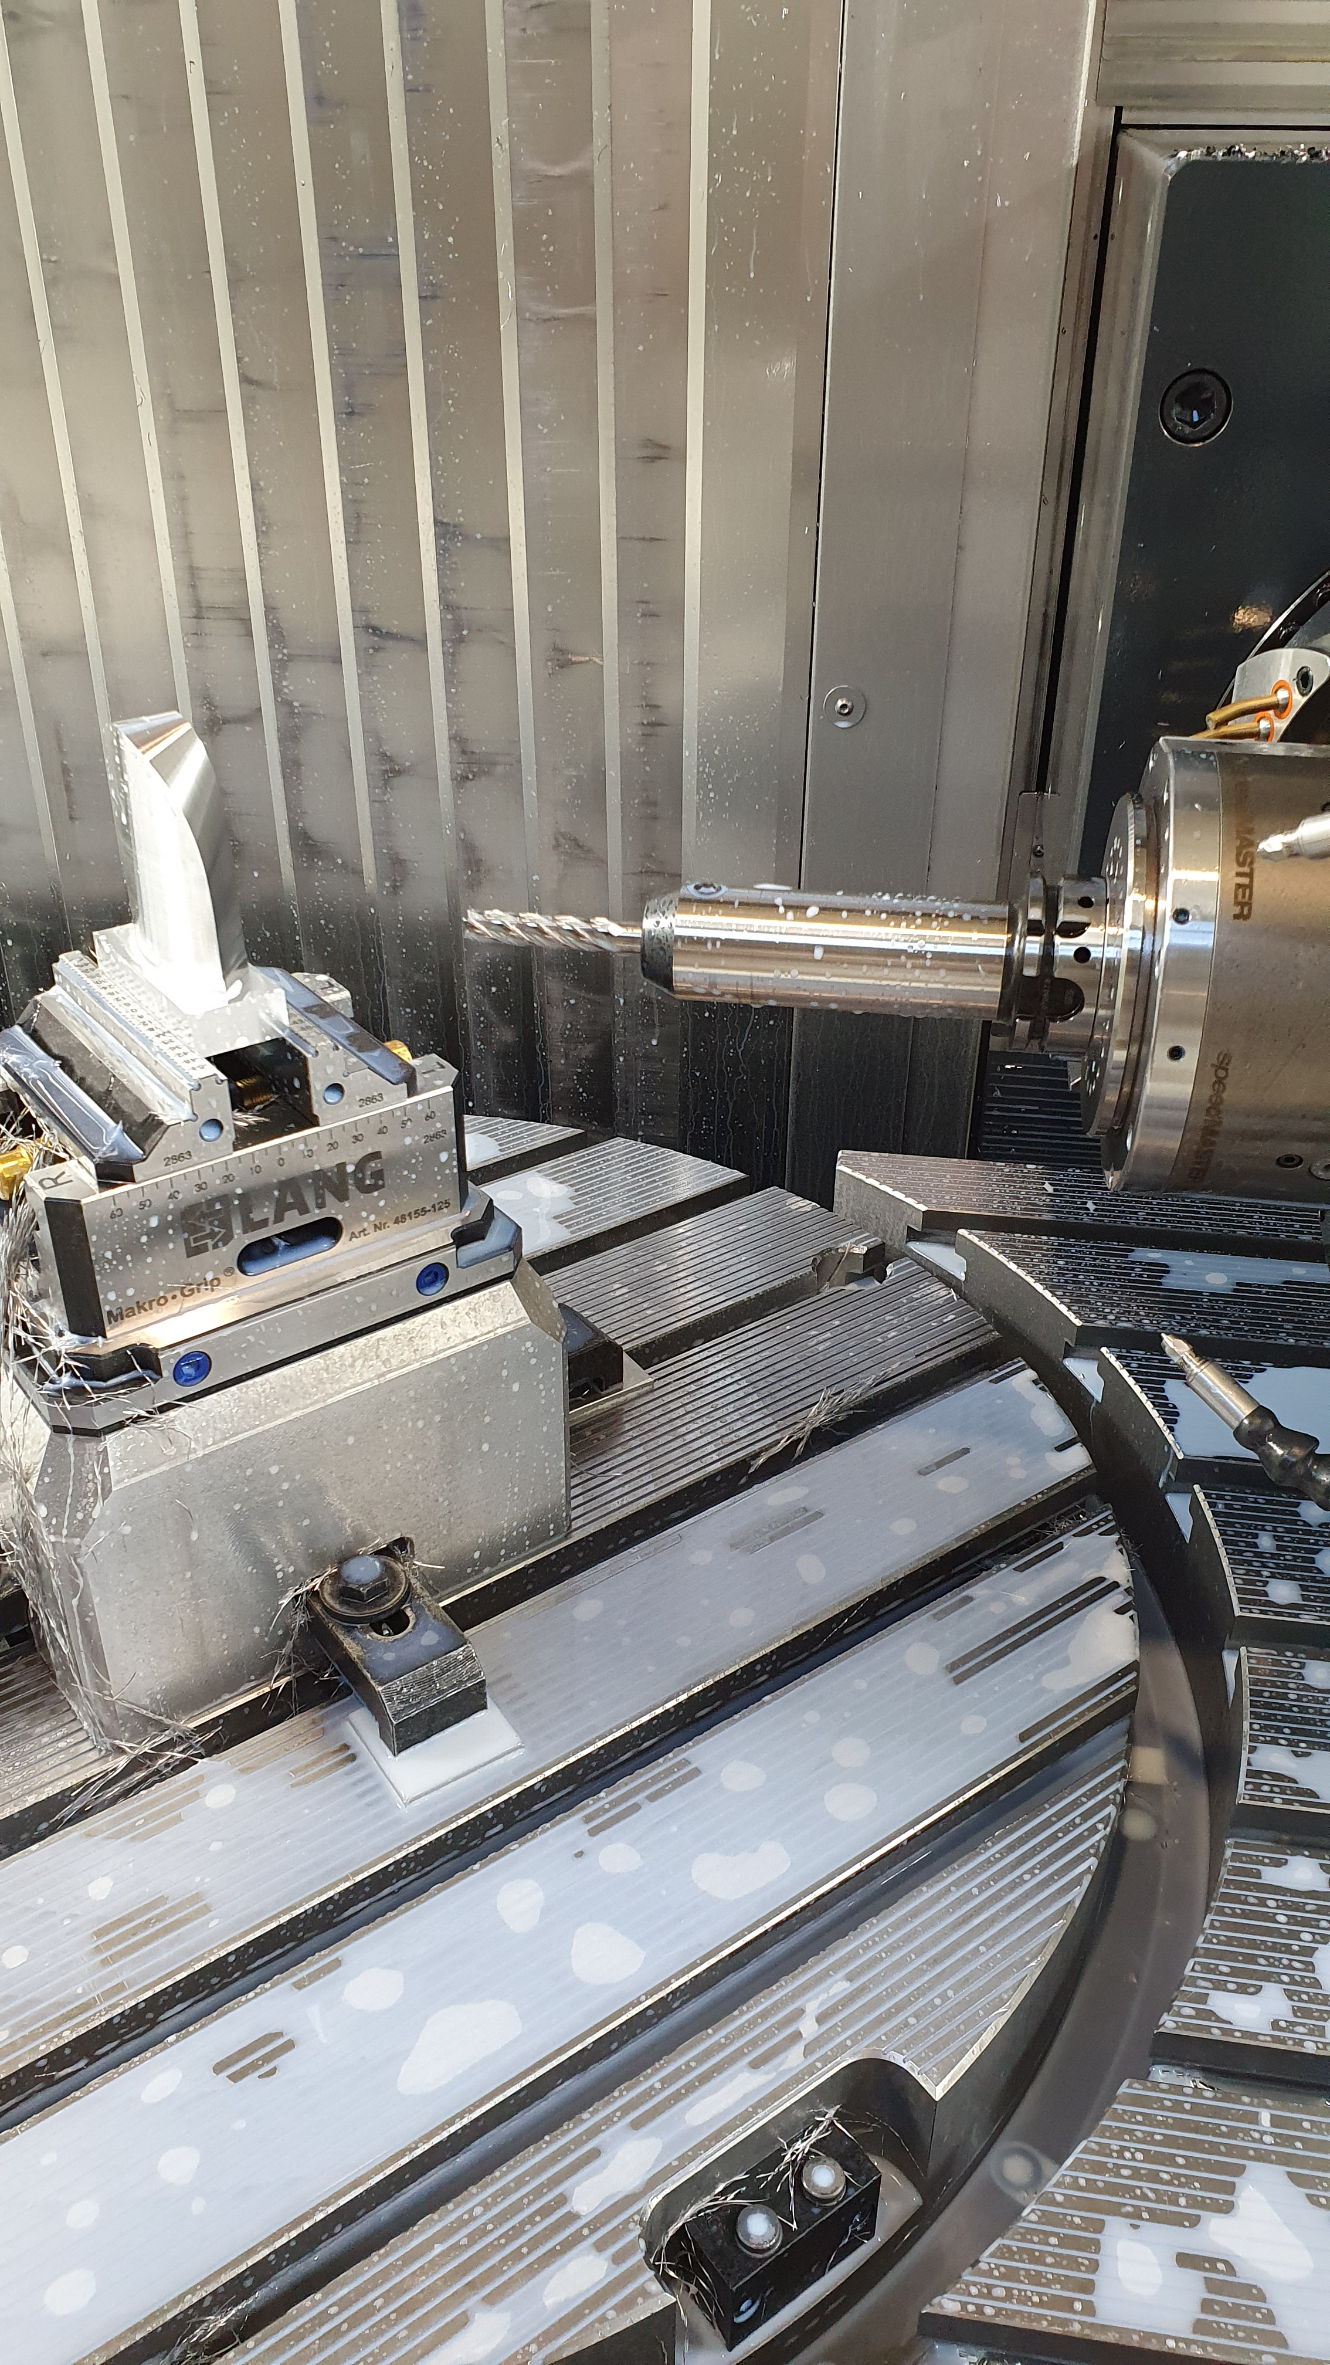
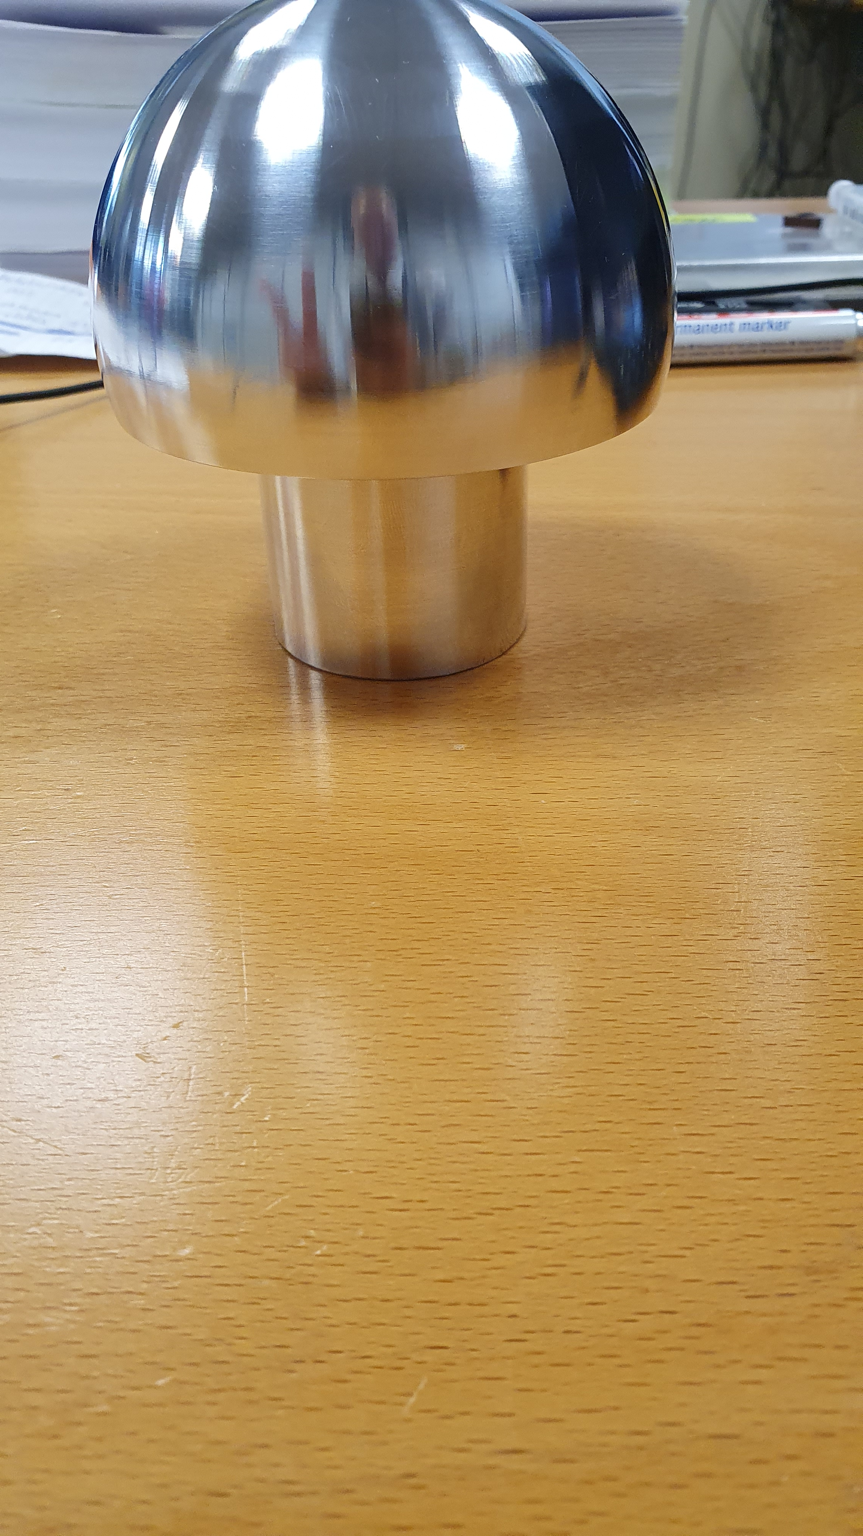
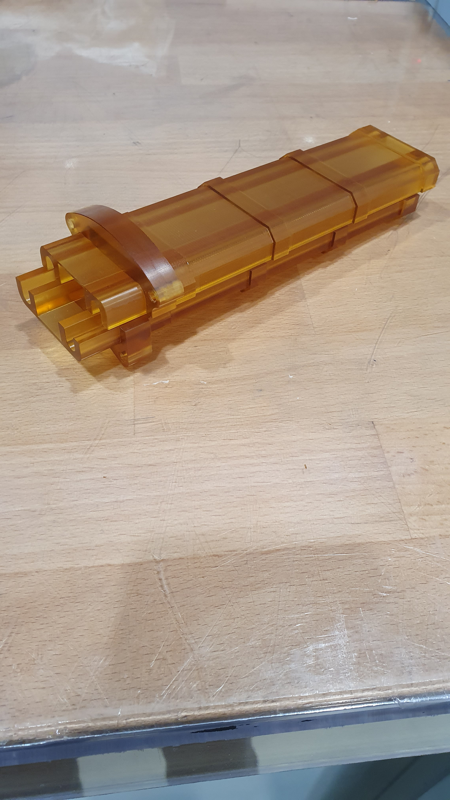
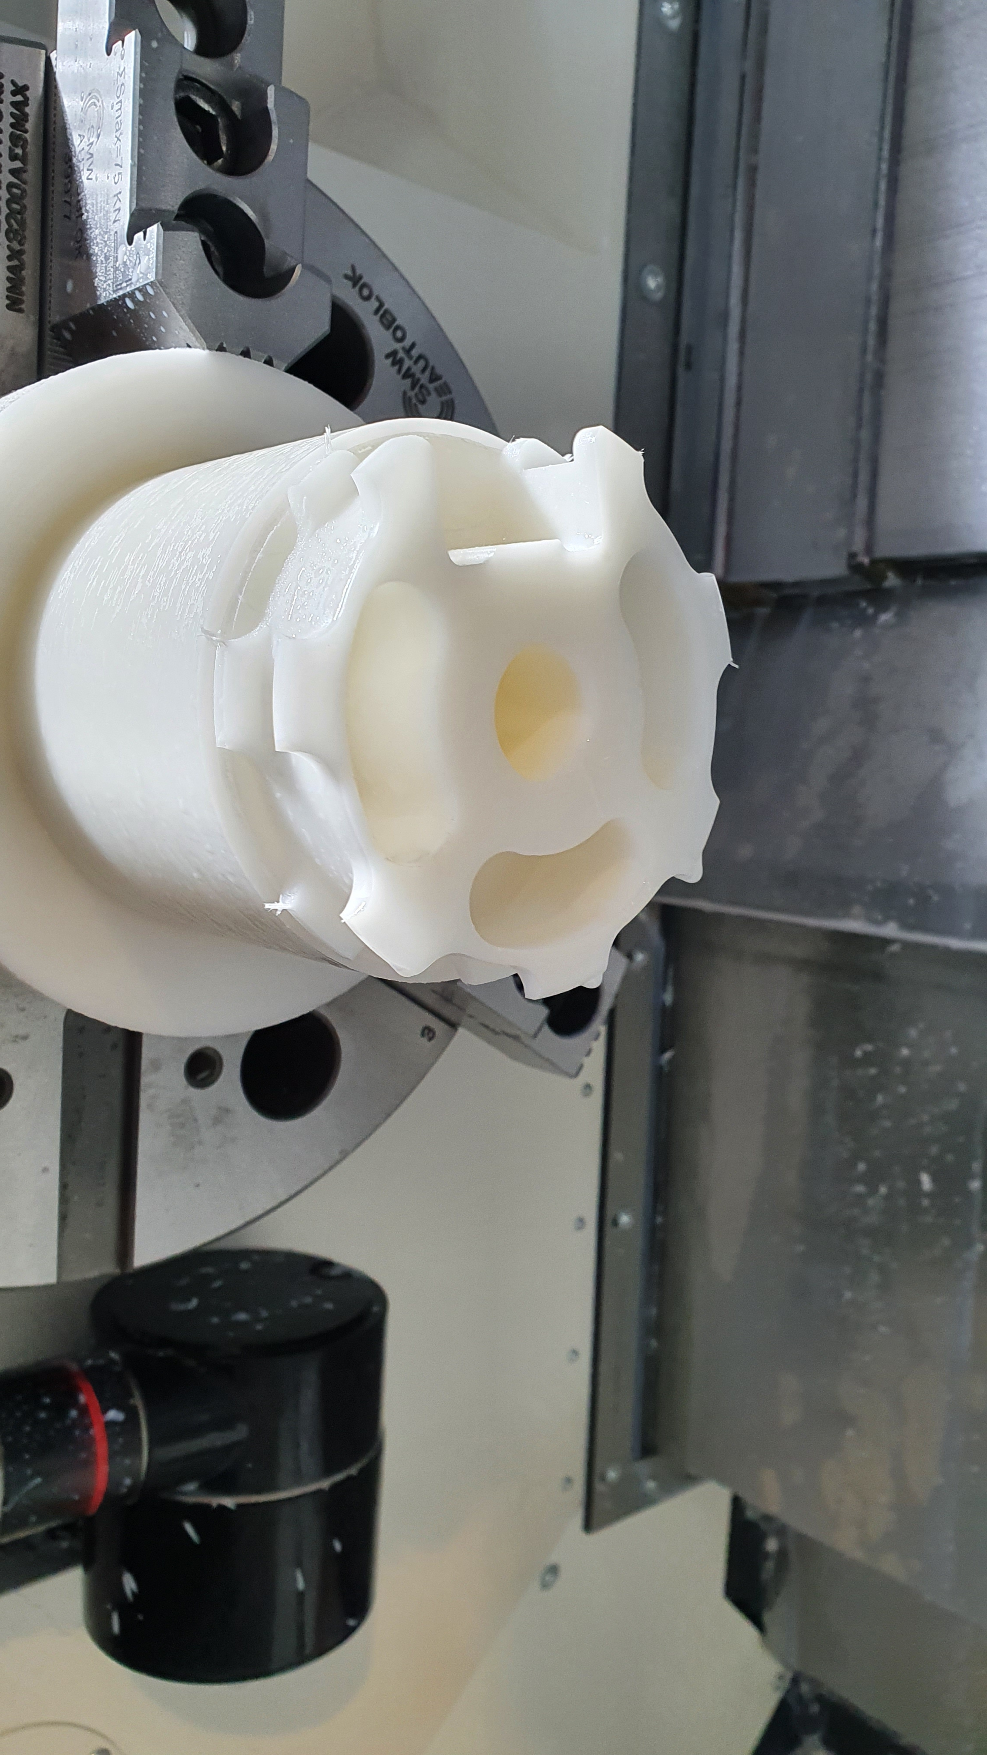
WHAT WE DO?
Taneli
Manufacturing of prototype components for superconductive accelerator magnets and other projects
TE-MSC-specialist in machining
Programming and operating computer programmable manufacturing robots
Manufacturing related consultation to help engineers and designers
2D&3D Mechanical design of components

Slide 5
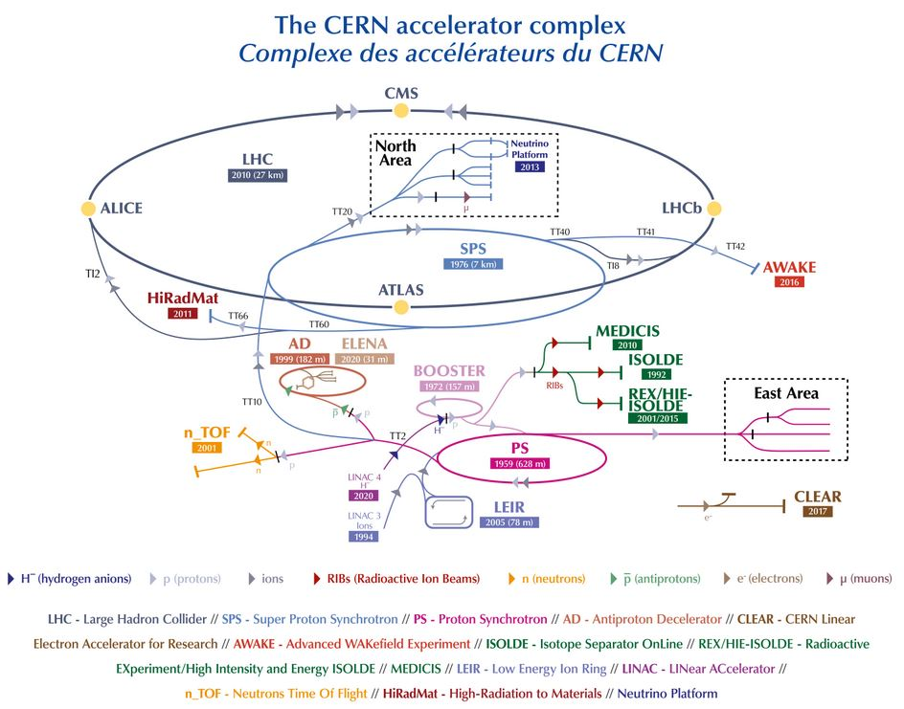
WHAT WE DO?
Antti
Mechanical design of components for the accelerator complex
EN-MME – specialist in mechanical engineering supporting other groups
Small tasks
Larger design projects
3D & 2D
Calculations
Fabrication follow-up
Installation
Pre-studies for future accelerators

Slide 6
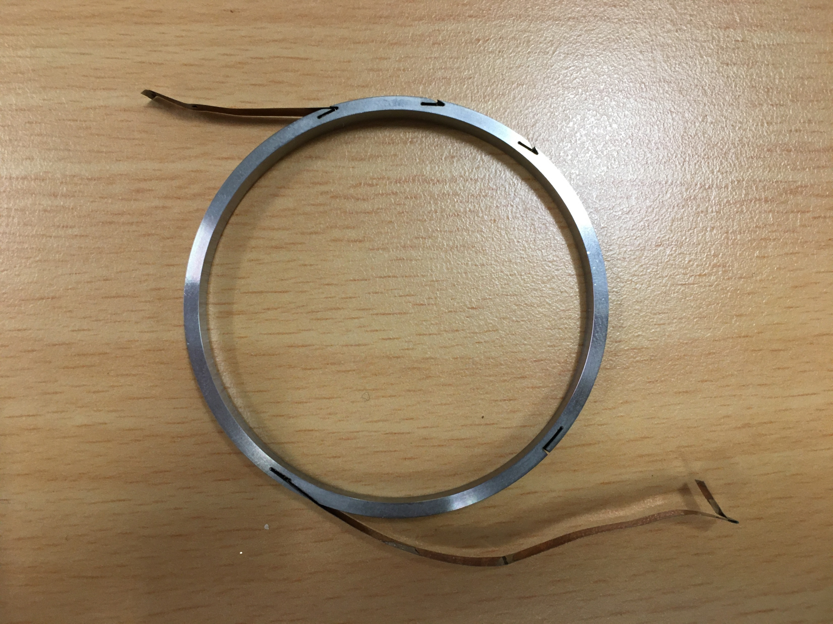
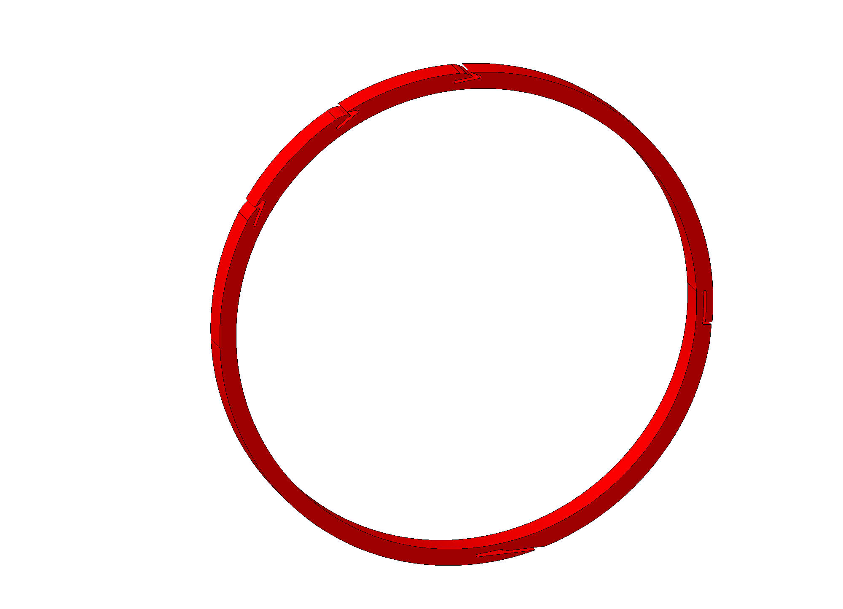
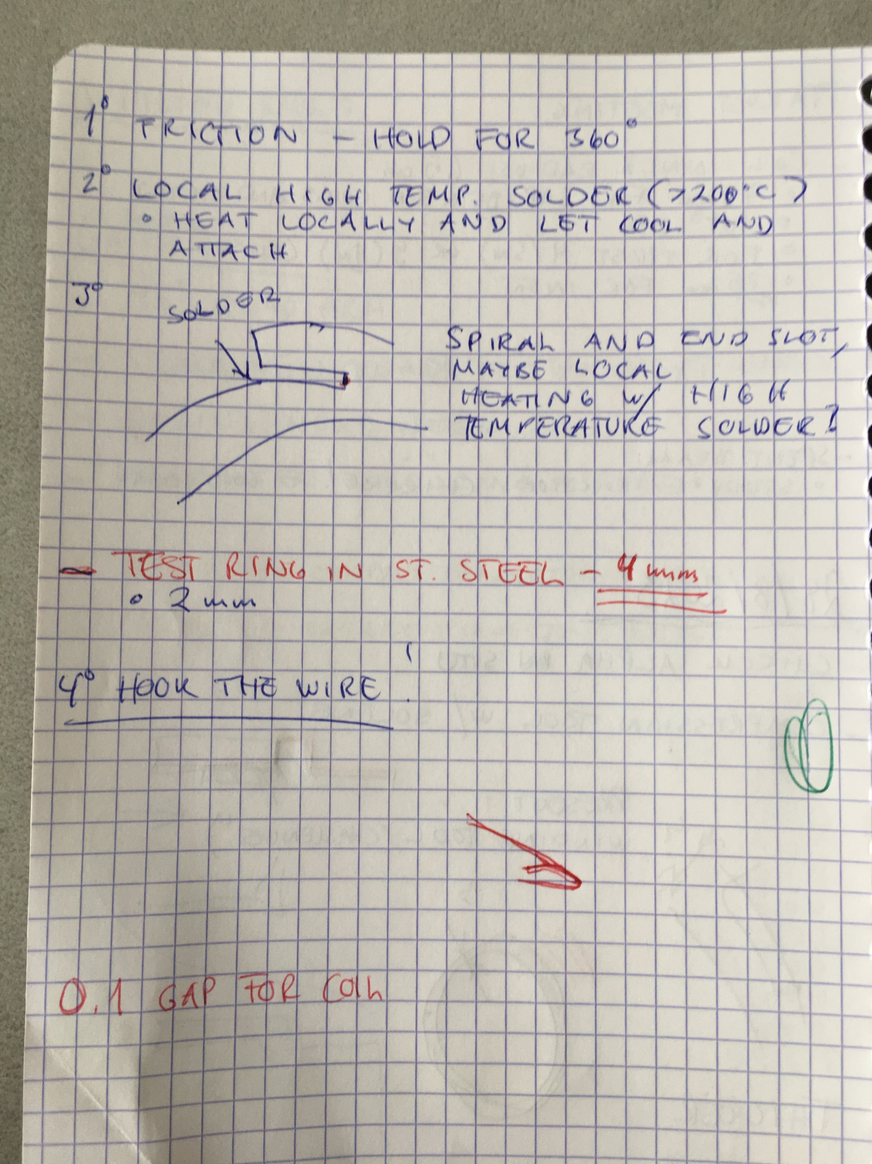
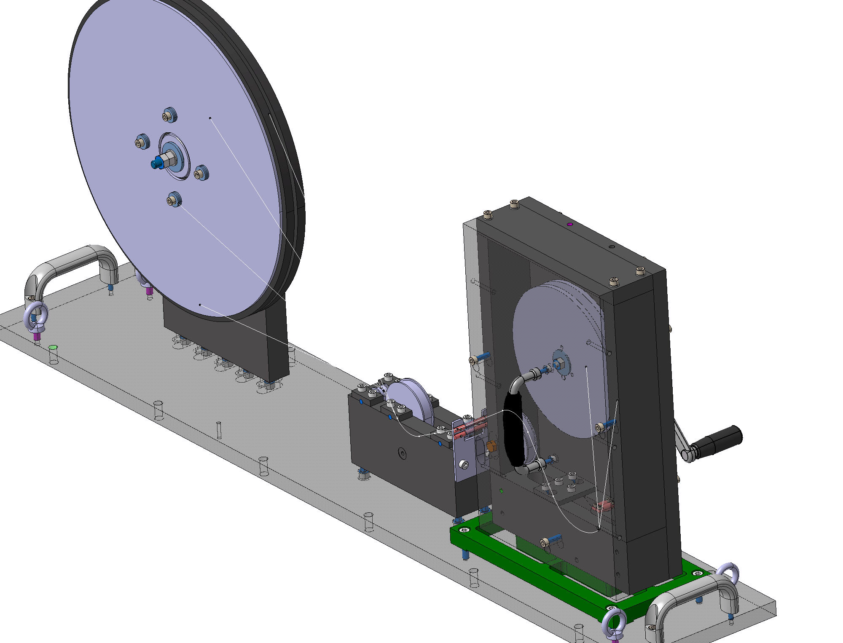
DESIGN ENGINEERING
Small tasks
Pancake coil winding tool – how to attached conductor rapidly?
Mandrel to test coil conductor attaching
Context
Discussion -> notes
Two hours to release for production

Slide 7
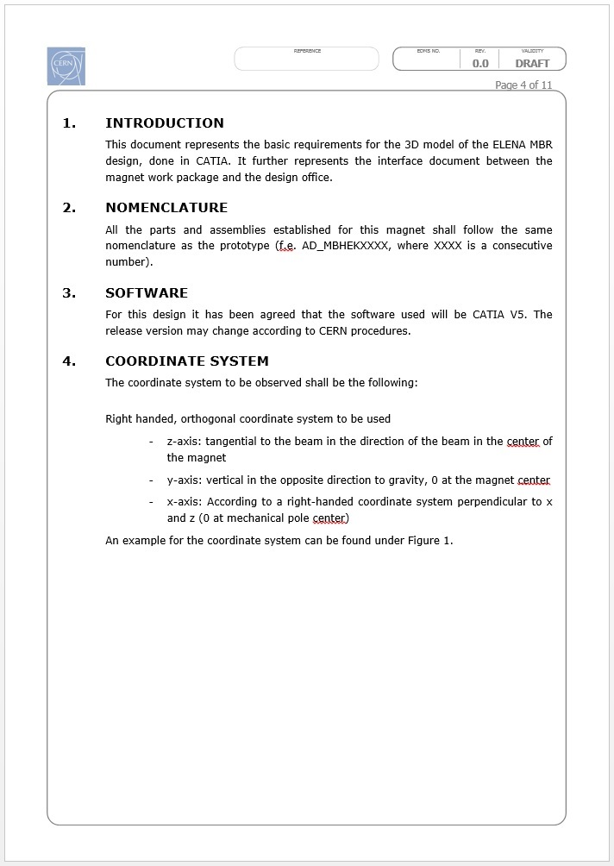
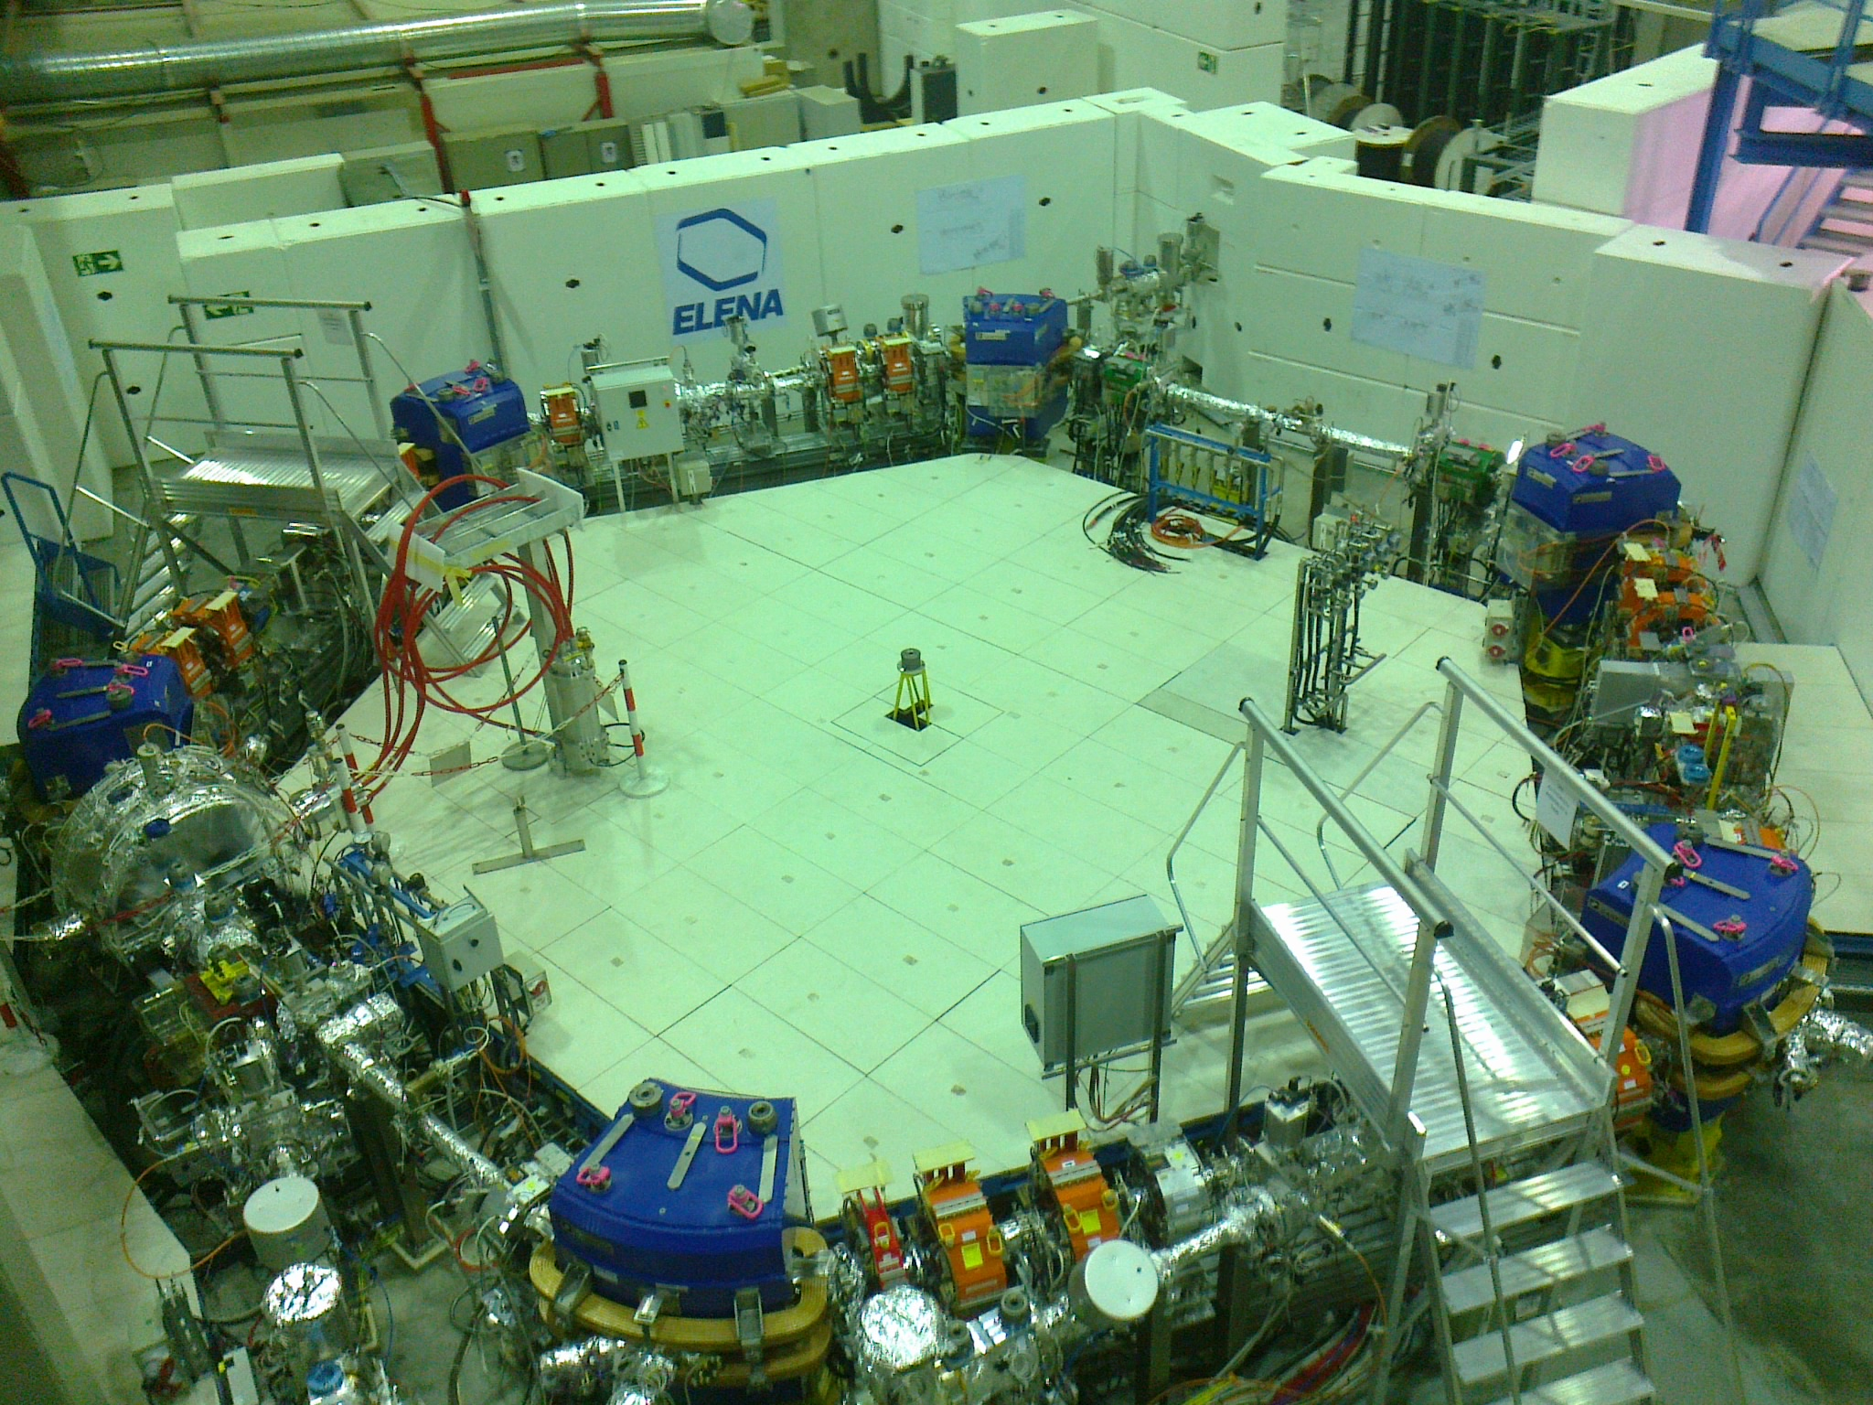
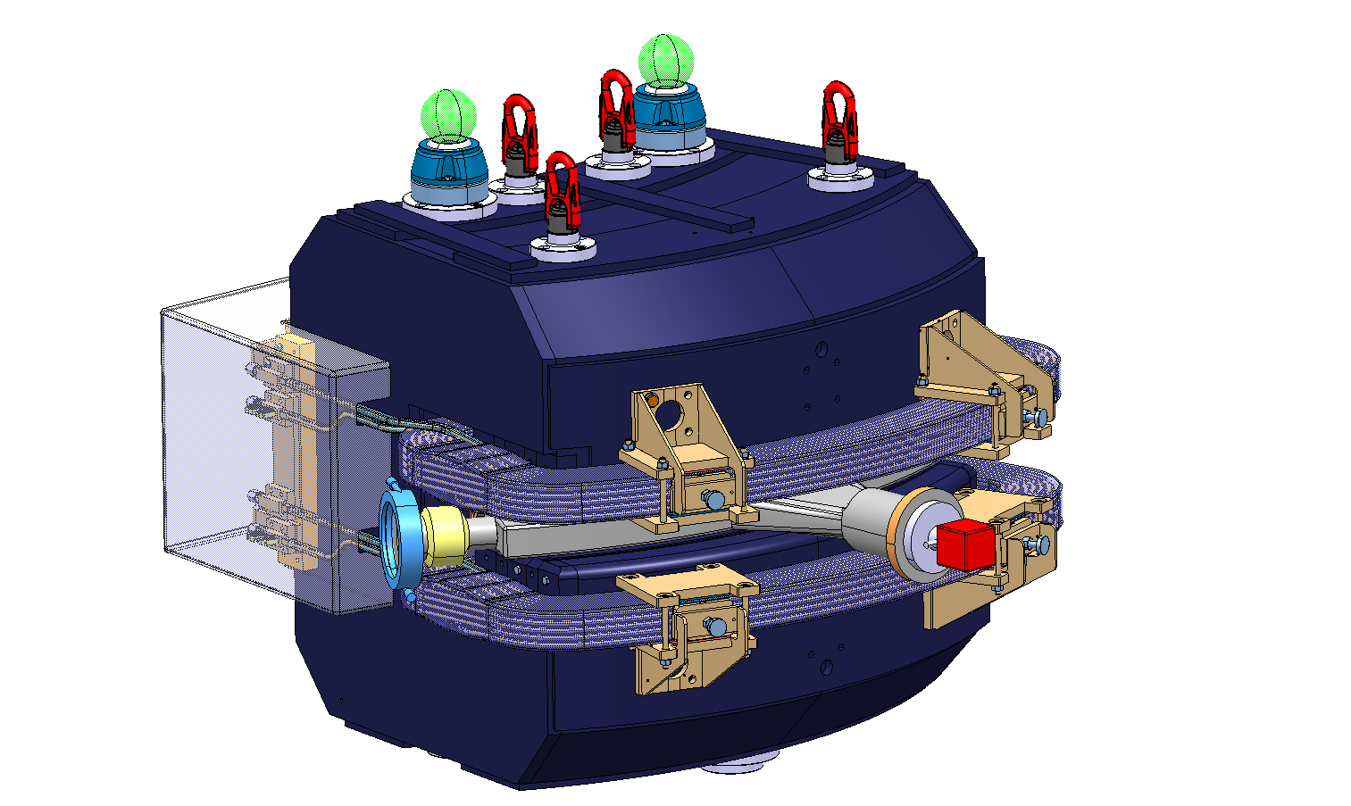
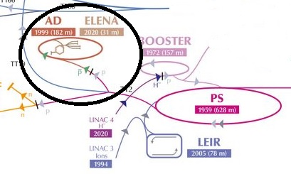
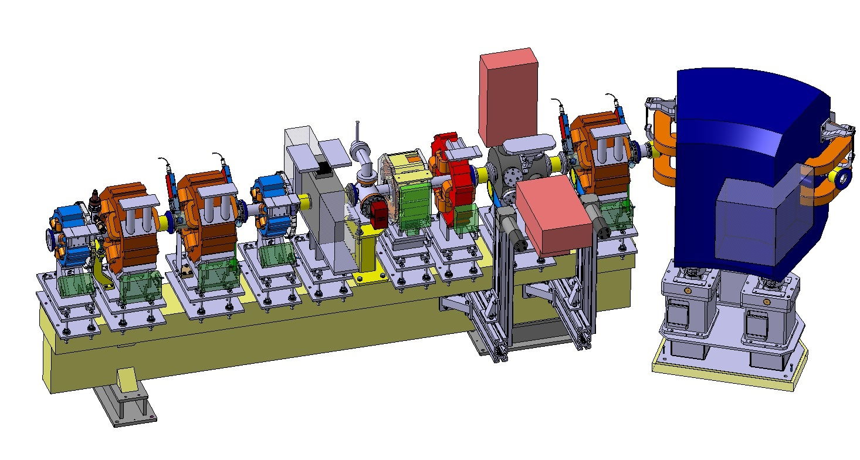
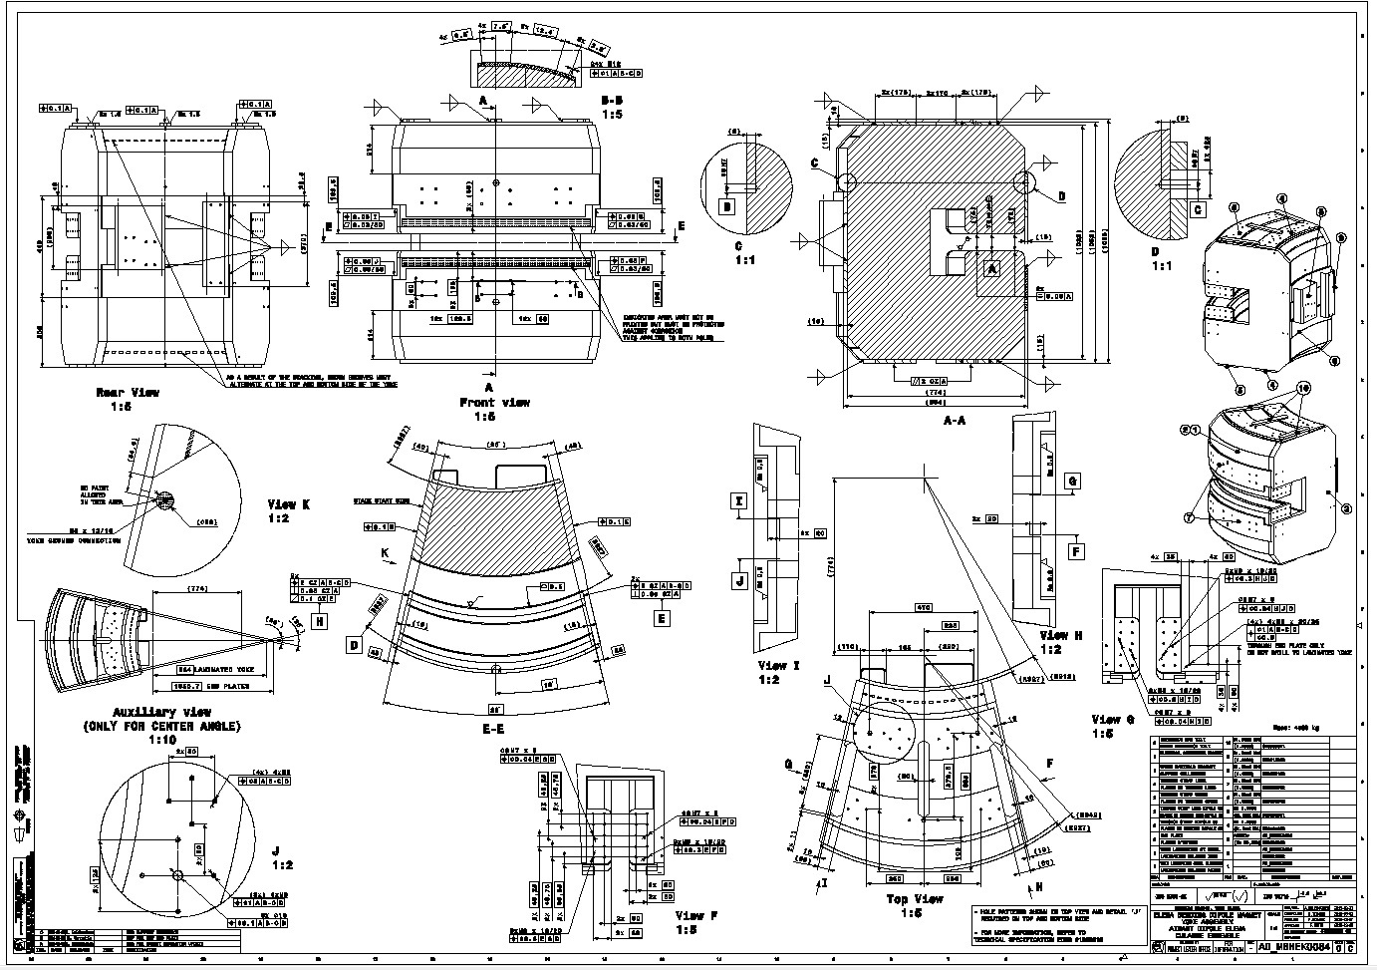
DESIGN ENGINEERING
Large projects
Improve antimatter research by better antiproton capture – new decelerator ELENA
Design of ELENA machine components
15 FT’s (years of work)
500h
Context
Specifications, simplified models, schedules
3D models, manufacturing drawings, calculations, instructions...

Slide 8
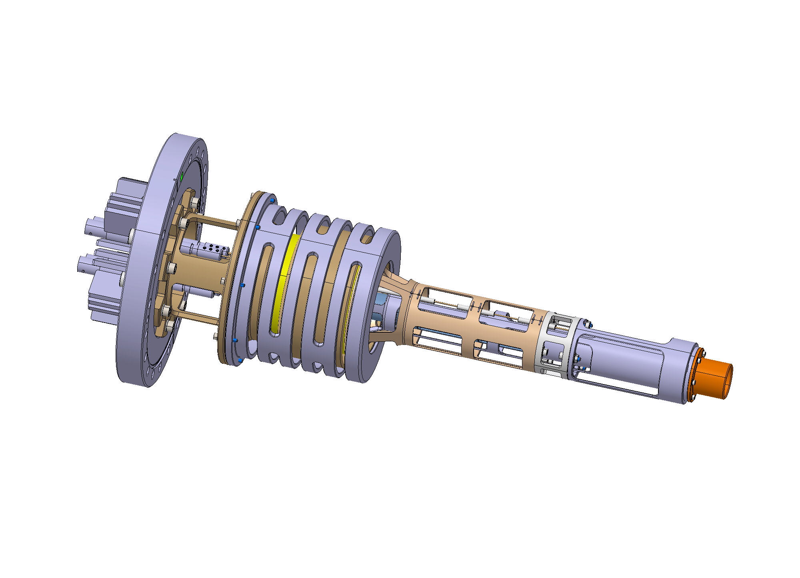
PRODUCTION
Production outside CERN
Specialist manufacturing
Capacity
Specific technologies
Specifications
Tendering
Committees
Signed contract
Production at CERN workshop
Follow-up of all steps
Technology mastered by CERN
Available capacity
Rapid delivery
Job request
Documents(drawing)
Budget

Slide 9
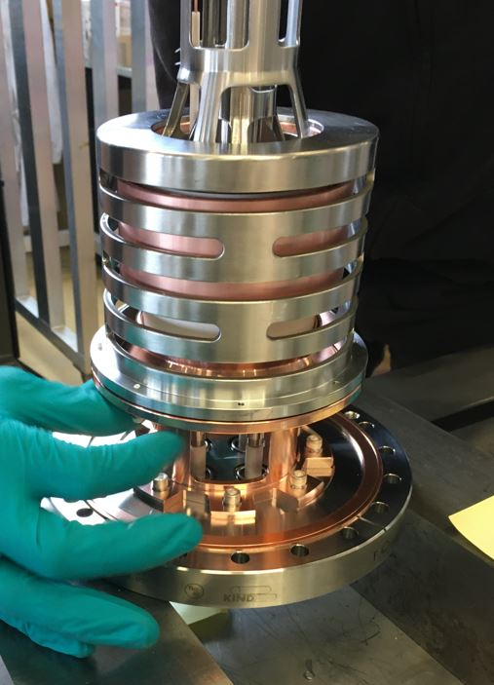
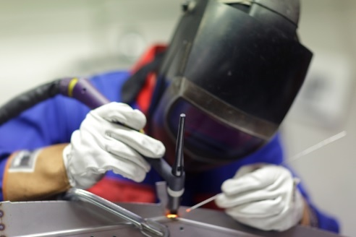
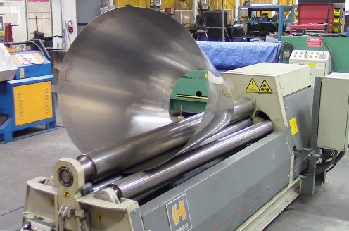
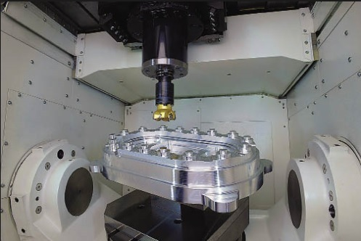
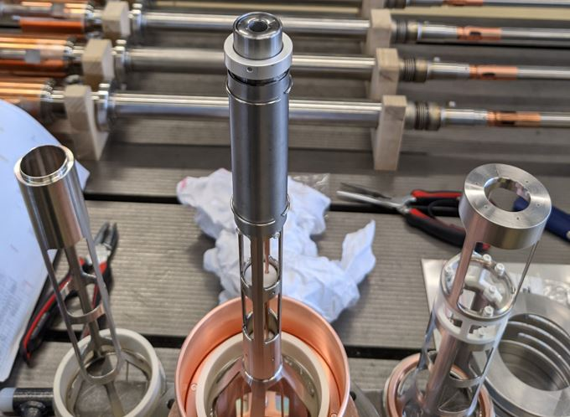
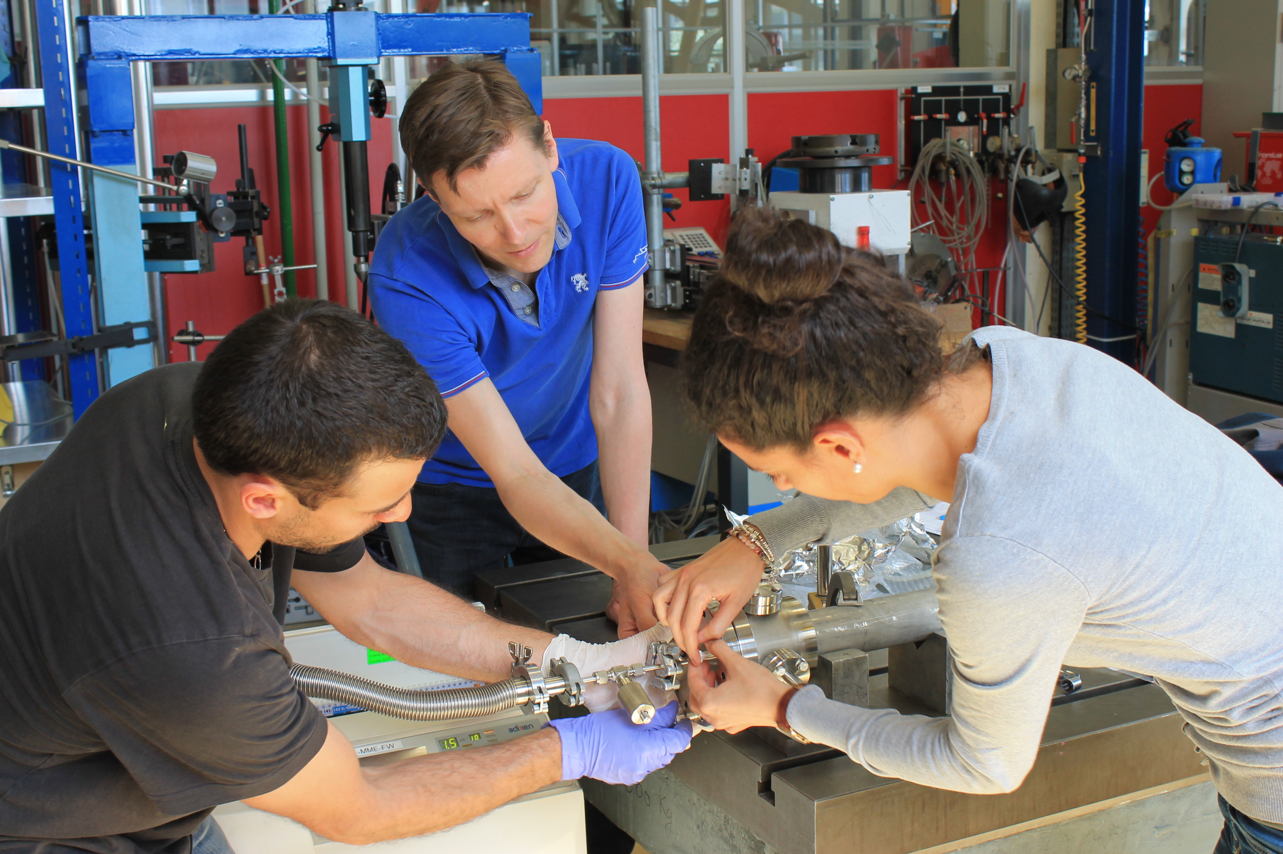
PRODUCTION
Electron gun to produce electron beam
Machining
Joining
Forming
Welding – melt pieces locally to join them
Brazing – melt material between pieces to join them
Bonding – addhesive for different materials
Remove material – the more degrees of freedom the more complex geometry
Roll, bend, stamp, draw sheets
Also subcontracting and assembly in clean room!

Slide 10
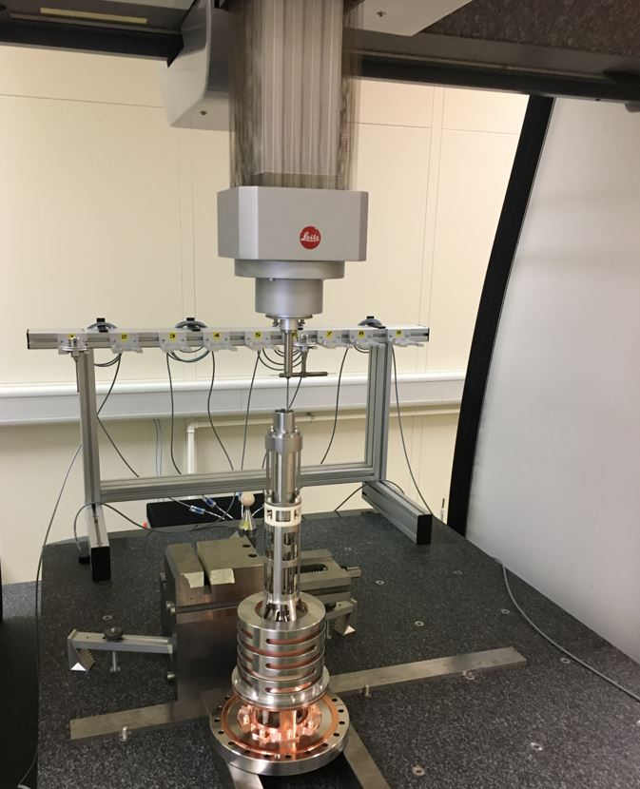
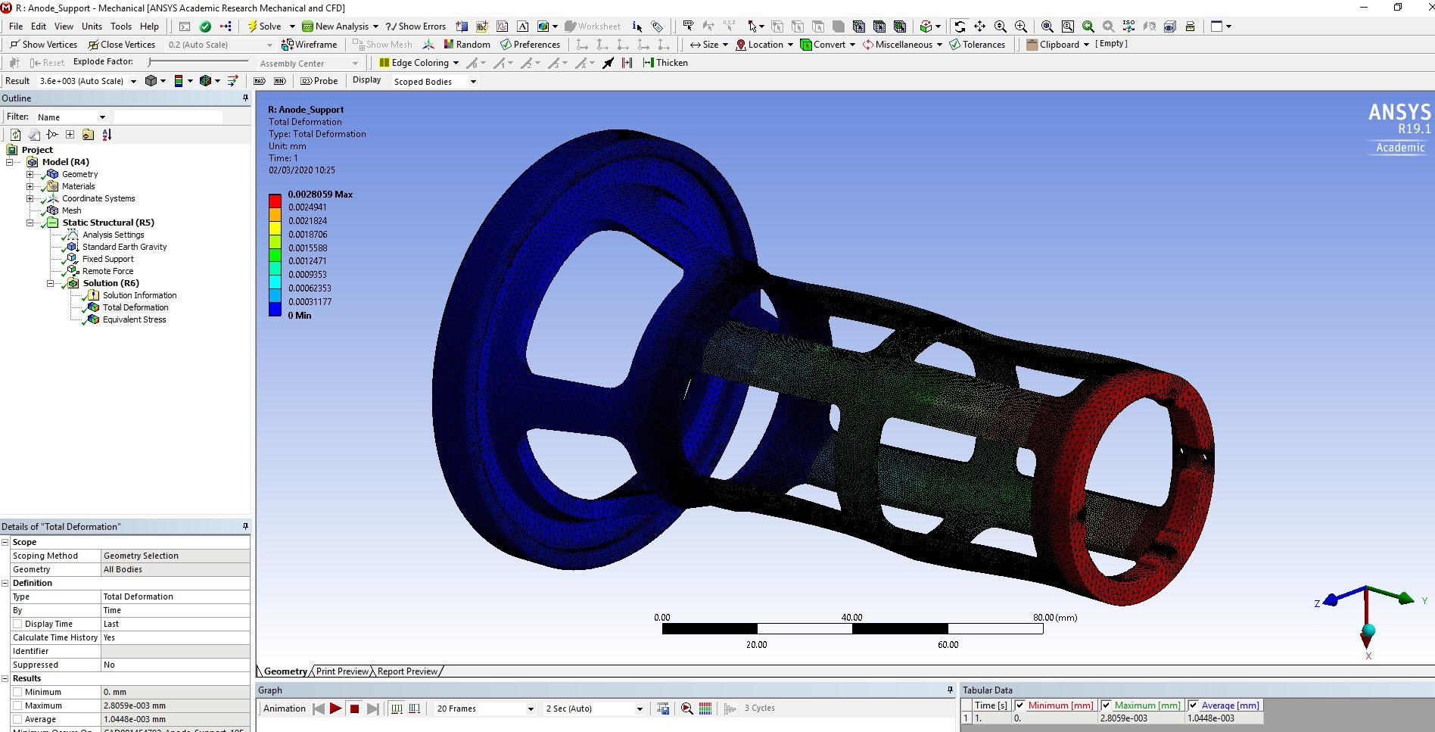
SERVICES
EN-MME Group
Calculations
Measurements
To guarantee safe operations over the component lifetime
To proof required quality
Safe (working)environment
Material loss
Calculation confirmed requirements must be followed in practice!
Geometry
Raw material
Mechanical measurements of produced components

Slide 11
EDUCATION & PR
CERN – Lapin AMK collaboration
Finnish High School Student Presentations
Engineering presentations since 2014
Until 2025 for now
2023: Timo
2019: Henrik, Jussi
2018: Katariina, Martti
2017: Jani, Eero
2016: Jani, Jari
2015: Ville, Jarkko
2014: Samuel
Experimental physics requires engineering!
An internation organisation requires people from many domains!
Finns are involved in all CERN activities!
Established

Slide 12
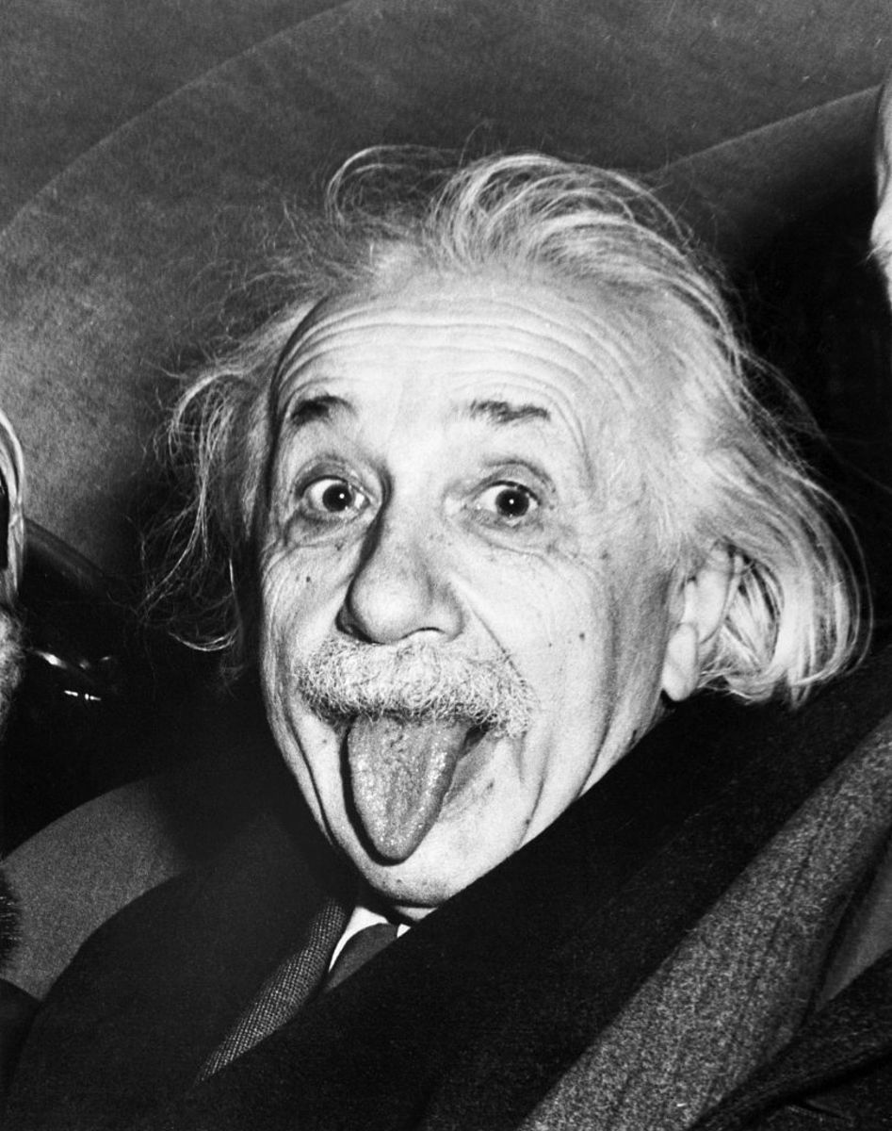


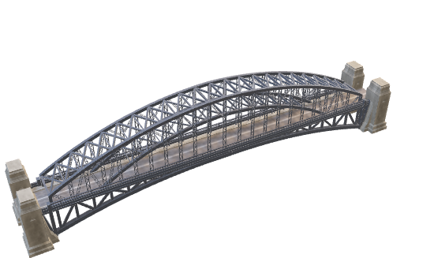
PHYSICS vs ENGINEERING
The challenge
Physics(Formula) ≠ Engineering(Real object)
→ Results in agreed compromise

Slide 13
THANK YOU FOR YOUR ATTENTION!
YOUR QUESTIONS?
!/?

