Slide 1

ECR/Documents for Information and Approval
Giulia Romagnoli and Natalya Kahn for BE-EA, 2024-02-13
EA Documents - Agile Board - CERN Central Jira

Slide 2
LIST OF DOCUMENTS for Info
FOR INFORMATION EATM
Summary | Reporter | EA Projects | EDMS number | EDMS Status
Risk Assessment for the Individual System Tests of AD Horn Power Supply During YETS | Gregor Grawer | AD | 3018473 - AD-THOR-SR-0001 | Engineering check
Consolidation of the AD Electron Cooler | Adriana Rossi | AD | 3014585 - AD-LNT-WD-0001 | Engineering check
Replacement of AD Horn Sandwich Line PXTHOR_001 and PXTHOR_002 | Edouard Grenier-Boley | AD | 3024760 - AD-THOR-PRD-0007 | Engineering check
Replacement of AD Target Sub-Assembly PXTARH_060 and PXTARAD003 | Edouard Grenier-Boley | AD | 3024759 - AD-TARAD-PRD-0002 | Engineering check
Engineering Specification of the New AD Electron Cooler Magnet System | Luke von Freeden | AD | 3014577 – AD-LNT-ES-0002 | Engineering check
NEPTUNE Converter Family for North Area and SPS Consolidation | Jerome Savary | North Area, NACONS | 3018519 - SPSX-R-ES-0004 | Engineering check
Mandate of the NA-CONS Project Safety Officer | Filipa Duque Carvalho | North Area, NACONS | 2458825 - SPSX-PM-MG-0002 | Engineering check
North Area Beam Instrumentation Consolidation Type: NA-CONS Groups: BE-BI & EN-EA | Jocelyn Tan | North Area, NACONS | 2206350 - SPSX-B-WD-0003 | Under Approval
Consolidation of the North Area Vacuum Controls NA-CONS TE-VSC | Abel Gutierrez | North Area, NACONS | 2716599 - SPSX-V-WD-0002 | Released
North Area Telecom and Network Infrastructure | Mohssen Souayah | North Area, NACONS | 2732643 - SPSX-CC-WD-0001 | Released

Slide 3
LIST OF DOCUMENTS for Info
FOR INFORMATION EATM
Summary | Reporter | EA Projects | EDMS number | EDMS Status
New Parabolic Mirror Design for the XCET Detector | Jan Buesa Orgaz | Equipment | 2851423 | Released
Electron Intensity in the H8 Beamline | Maarten Van Dijk | North Area | 3020139 - SPSX-O-RPT-0002 | Engineering check

Slide 4
LIST OF DOC for FUTURE APPROVAL
ECR INFO/FUTURE APPROVAL EATM
Summary | Reporter | EA Projects | EDMS number | EDMS Status
NA-CONS Fire Safety and Access WP 5.1.3 Fire-Resistant Partition | Adem Kaymak | North Area – NACONS | 3010259 - SPSX-SF-EC-0006 | Engineering check
Consolidated XCRHV Installation in TT82 YETS 23/24 | Jan Buesa Orgaz | North Area - NACONS | 2961759 - SPSX-TC-EC-0001 | Engineering check
Space Reservation Request - North Area Surface Fire Detection Racks | Michael Jeckel | North Area - NACONS | 3018433 - SPSX-SF-EC-0007 | Engineering check
Shielding Improvement for the High Intensity Hadron Operation of M2 | Dipanwita Banerjee | North Area | 2868386 - SPSX-J-EC-0002 | Engineering check
BA80 Fire Detection Equipment | Florian Andre Deperraz | North Area – NACONS | 2997829 - SPSX-SF-EC-0005 | Under Approval
User Requirements for XTAX Absorbers in North Area Beamlines | Miguel Lino Diogo Dos Santos | NACONS, Equipment | 2747997 - SPSX-T-ES-0003 | Under Approval
Replacement of Big Vertical Collimator XCBV on M2 Beamline in TT84 | Giulia Romagnoli | North Area - NACONS | 2976670 - SPSX-TC-EC-0002 | Under Approval
Installation of XCET Detectors in Neutrino Platform NP02 and NP04 | Giulia Romagnoli | North Area | 2811758 - SPSX-X-EC-0001 | Under Approval

Slide 5
LIST OF DOC for FUTURE APPROVAL
ECR INFO/FUTURE APPROVAL EATM
Summary | Reporter | EA Projects | EDMS number | EDMS Status
Installation of a Radiation-Hard Profile Monitor in TT81 | Inaki Ortega Ruiz | North Area | 3001893 - SPSX-B-EC-0005 | Engineering check
Installation Water Cherenkov Test Experiment in T09 beamline During YETS 23-24 | Dipanwita Banerjee | EA | 2960989 - PSZ-J-EC-0003 | Engineering check
High-Intensity Beam to IRRAD/CHARM | Federico Ravotti | EA | 3024761 - PSZ-L-EC-0002 | Engineering check

Slide 6
LIST OF MISSING ECRS for YETS 23/24
MISSING ECRS
Summary | Reporter | EA Projects | EDMS number
NP Platform Installation on H4 | Filippo Resnati | North Area | Coming soon…
Installation Tuyauterie BA81-TT81/Installation Baie SDI - Detection Incendie | Michael Dole | North Area – NACONS | Coming soon…

Slide 7
LIST OF DOCs for APPROVAL
ECR APPROVAL EATM
Summary | Reporter | EA Projects | EDMS number | EDMS Status
HiRadMat Primary Vacuum Manifold | Anthony Harrison | HiRadMat | 2958976 - HRM-V-EC-0003 | Under Approval
User Requirement for the XCRVH Micro-Collimator in H8 Line in North Area | Bastien Rae | North Area, Equipment | 2718575 - SPSX-TC-ES-0003 | Under Approval
User Requirements for XCED Detectors in North Area Beamlines | Anna Baratto Roldan | North Area, NACONS, Equipment | 2813075 - SPSX-X-ES-0004 | Under Approval
Installation of New Test Beam Experimental Area at AD/ELENA | Maud Wehrle | AD, ELENA | 2975107 - AD-LJ-EC-0026 | Under Approval

Slide 8
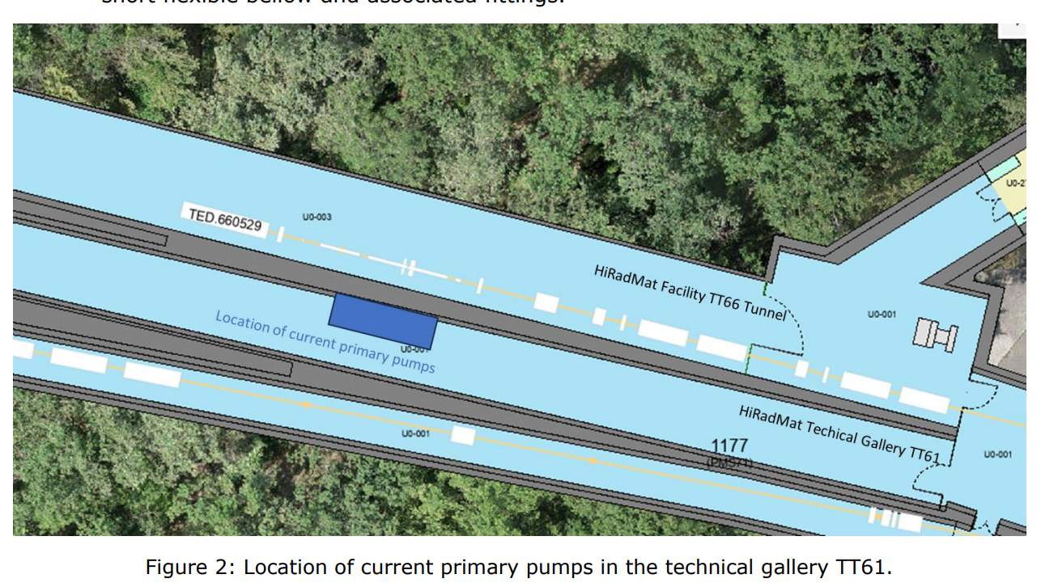
ECR for Approval
HRM-V-EC-0003
Version 0.2
HiRadMat Primary Vacuum Manifold
By Anthony Harrison
This ECR explains the modifications to the primary vacuum systems of HiRadMat, the new installation for TT66 and stand-alone beam instrumentation.
There is currently no dedicated primary pumping line installed within the HiRadMat facility experimental area. Temporary ad-hoc installations have been used.
A new primary pumping system must be installed due to the partitioning of TT66 vacuum systems. This can be expanded to include the needs of the HiRadMat experimental area, which will improve the area’s flexibility and capabilities.

Slide 9
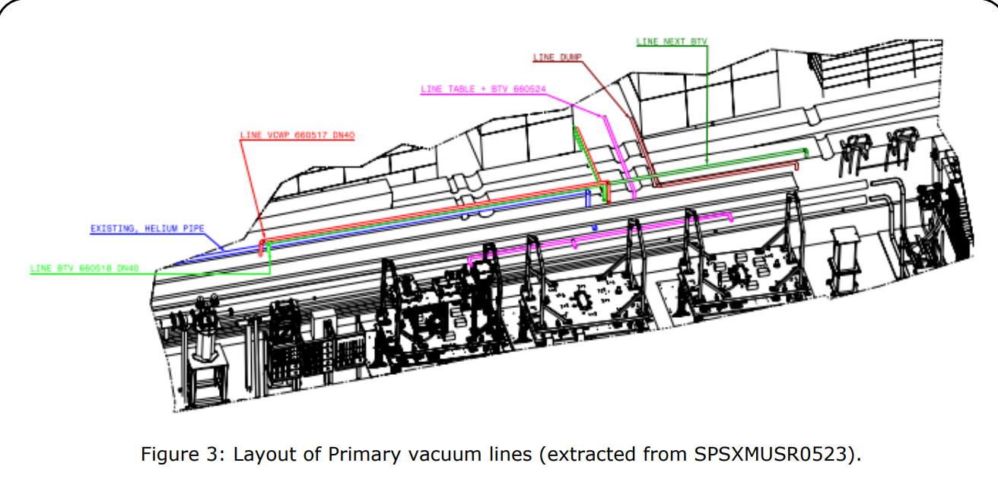
ECR for Approval
HRM-V-EC-0003
Version 0.2
HiRadMat Primary Vacuum Manifold
By Anthony Harrison
Three new primary lines will be installed on the side of the TT66 tunnel.
Line 1 (pink), monitored and controlled pumping manifold with three ports dedicated to installed experimental equipment.
Line 2 (red and green), monitored and controlled pumping manifold with three ports dedicated to beam instrumentation and a separately controlled manifold dedicated to the vacuum sector 6602.
Line 3 (brown), monitored and controlled pumping manifold with one port dedicated to the beam dump (TED.660529).
Responsibilities:
The purchasing and installation costs will be shared between TE-VSC, BE-EA and SY-STI.
BE-EA will provide integration studies and design support.
BE-CEM will develop, install and maintain the PLC-based control system to read out the pressure value from the Pirani gauges and to control the electropneumatic valves.
TE-VSC will perform the tunnel installation and commissioning.
The primary pumps will be maintained by BE-EA.
The gauges and control electropneumatic valves will be maintained by TE-VSC.

Slide 10
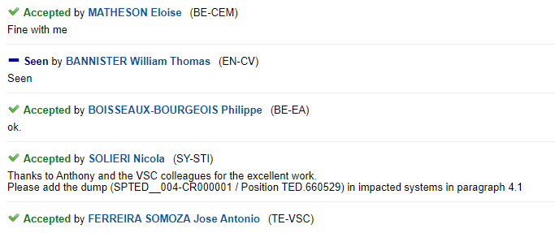
ECR for Approval
HRM-V-EC-0003
Version 0.2
HiRadMat Primary Vacuum Manifold
By Anthony Harrison
Seeking approval from EATM

Slide 11
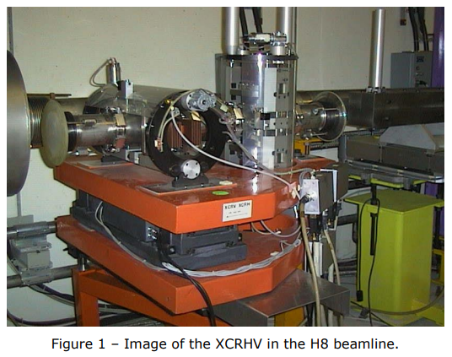
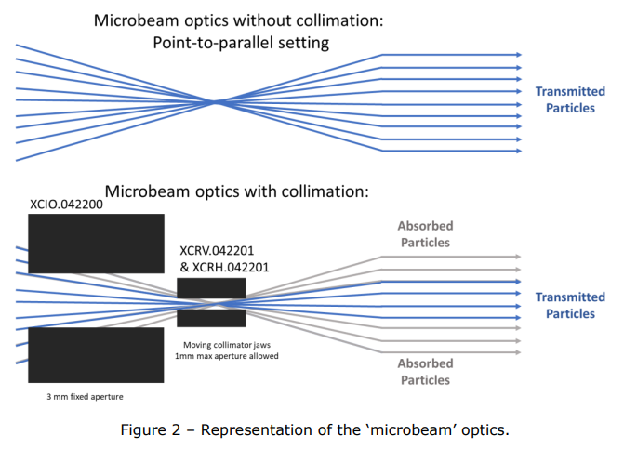
ECR for Approval
SPSX-TC-ES-0003
Version 0.5
User Requirement for the XCRVH Micro-Collimator in H8 Line in North Area
By Bastien Rae
This document summarizes the needs of the users and the physics requirements for the micro-collimator situated on the H8 beamline in the North Area.
The micro-collimator (XCRHV) was developed for use in the North Area H8 beamline. Used in ‘microbeam’ mode, the collimator attenuates a beam of particles to allow only a small number to pass.
There are currently two micro-collimators: one installed in H8 beamline and one spare.

Slide 12
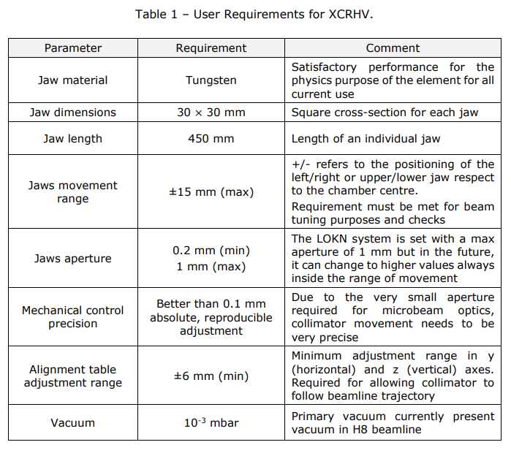
ECR for Approval
SPSX-TC-ES-0003
Version 0.5
User Requirement for the XCRVH Micro-Collimator in H8 Line in North Area
By Bastien Rae
The collimator is critical for operation of microbeams on the H8 beamline, and so consolidation is necessary. The spare XCRHV is due to be exchanged with the installed one during YETS 2023-24.
Precise alignment of the micro-collimator is essential but the current alignment mechanisms are not user-friendly, nor is there an accurate optical reference point to carry out fiducialisation. A redesign of the alignment system would be beneficial, perhaps one encompassing both the XCIO and XCRHV.

Slide 13
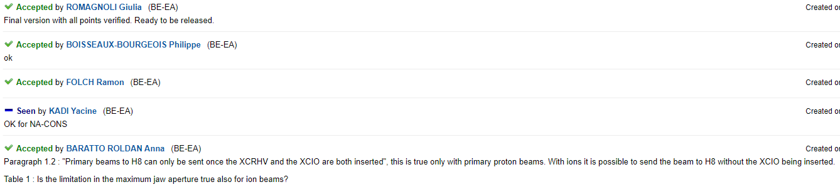
ECR for Approval
SPSX-TC-ES-0003
Version 0.5
User Requirement for the XCRVH Micro-Collimator in H8 Line in North Area
By Bastien Rae
Seeking approval from EATM

Slide 14
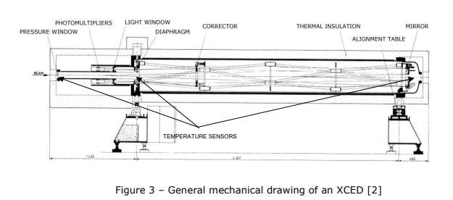
ECR for Approval
SPSX-X-ES-0004
Version 1.1
User Requirements for XCED Detectors in North Area Beamlines
By Anna Baratto Roldan
This document summarizes the user needs and the physics requirements for the CEDAR detectors (XCED) in the North Area.
Several XCEDs are currently in use in the North Area. The following types exist:
XCED N1 , filled with helium and comprising adapted optics;
XCED W2 , filled with nitrogen;
XCED H, filled with hydrogen.
The normal Threshold Cherenkov Counters (XCETs) are limited at high intensities, therefore, the XCEDs are more desirable for fixed-target experiments and for test beam users who would like to tag or veto individual particle species.
The consolidation of the XCED detectors aims to standardise all North Area XCED detectors.
Thermal insulation and pressure control systems must be improved to meet user requirements and to achieve the required precision in particle identification.
Procurement of new XCEDs is necessary to ensure there are sufficient spares, given that the interest in XCEDs detectors is increasing.

Slide 15
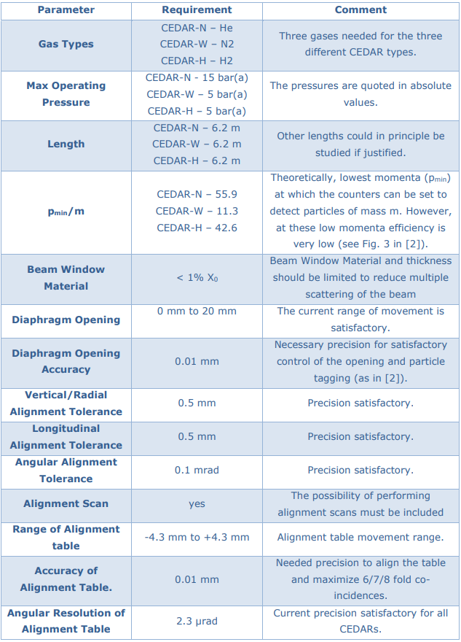
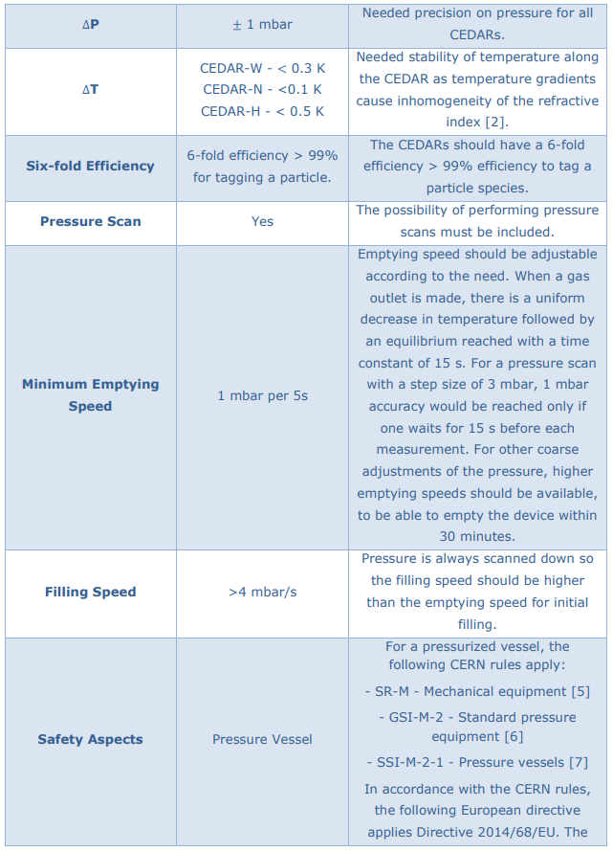
ECR for Approval
SPSX-X-ES-0004
Version 1.1
User Requirements for XCED Detectors in North Area Beamlines
By Anna Baratto Roldan

Slide 16
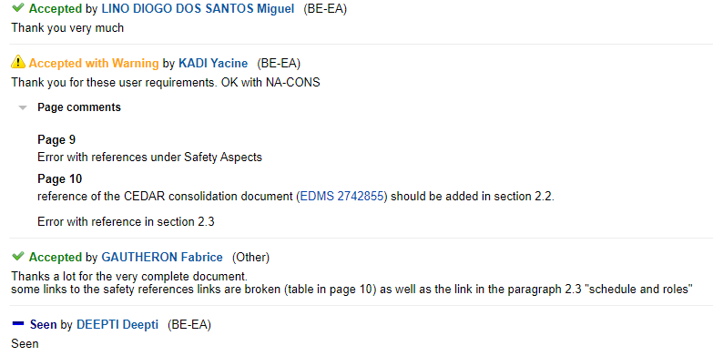
ECR for Approval
SPSX-X-ES-0004
Version 1.1
User Requirements for XCED Detectors in North Area Beamlines
By Anna Baratto Roldan
Seeking approval from EATM

Slide 17
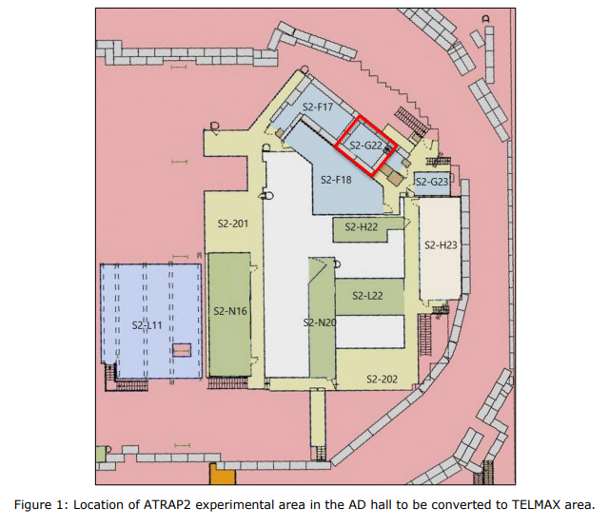
ECR for Approval
AD-LJ-EC-0026
Version 0.4
Installation of New Test Beam Experimental Area at AD/ELENA
By Maud Wehrle
This ECR describes the request for the remodelling of the former ATRAP2 experimental area in the AD hall to make it available for a new test beam area.
The existing ATRAP2 experimental area in the AD hall (Building 193) is unused. We propose the creation of a test beamline experimental area to be used both for machine equipment tests and by experiments for new equipment.
If a new experiment expresses interest in this zone at a later stage, it would be very easy to adapt the beamline equipment to meet its needs.
The existing layout of the space needs to be cleaned up and reorganised. Current platforms, stairs and handrails do not meet safety standards and need to be upgraded.

Slide 18
ECR for Approval
AD-LJ-EC-0026
Version 0.4
Installation of New Test Beam Experimental Area at AD/ELENA
By Maud Wehrle
This ECR describes the request for the remodelling of the former ATRAP2 experimental area in the AD hall to make it available for a new test beam area.
The proposal involves :
Removing the old ATRAP solenoid magnet;
Removing the platform surrounding the magnet;
Changing the LNE03 line layout (e.g. adding a SEM);
Modifying the shielding layout;
Replacing the personnel access device with an EIS-access door;
Equipping the zone with electricity, demineralised water, compressed air, fibre connectivity;
Adding a new access route to the 193-S3-G22 storage platform with appropriate stairs and handrails.
The document describes:
Remodelling the space to become more efficient and up to modern standards. This will involve changes to the access route;
A new optics design in case of horizontal use (should this be needed, a separate ECR will be produced);
A possible redesign for the vacuum layout;
New shielding;
Electrical and cooling water distribution.

Slide 19
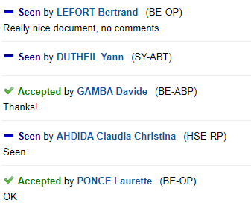
ECR for Approval
AD-LJ-EC-0026
Version 0.4
Installation of New Test Beam Experimental Area at AD/ELENA
By Maud Wehrle
Seeking approval from EATM

Slide 20
Thank you!

