Slide 1
TSU CONS Reliability Meeting - 3
Reliability Block Diagrams of the main functions

Slide 2
Meeting details
List of contents
Meeting objectives
Excerpt of the top-level FMECA
Reliability Block Diagram
Synchronous Beam Dump
Asynchronous Beam Dump
Additional top-level failure mode
Establishing Reliability Block Diagrams for most critical functions as input for simulation model
Clarifying the interfaces with other systems

Slide 3
Recap – Top-level FMECA table (excerpt)
Most critical failures (acceptable once in 1,000 years)
Situation | Failure | Effect | Criticality
3. Dump request | 3.1 Fail to issue a synchronous dump request | 3.1.1. Asynchronous beam dump | 3.1.1.1. No damage, investigation: Acceptable once in 10 years
 | 3.2. Fail to issue synchronous and asynchronous beam dump requests | 3.2.1. TSU missing a beam dump. | 3.2.1.1. With CIBDS: investigation, access on-site required, dry runs Acceptable once in 100 years 3.2.1.2. No CIBDS: massive damage Acceptable once in 1,000 years
4. Injection | 4.2. Allowing injections when conditions NOT OK (2 TSU per beam, each sends a separate permit and there is also a user permit for the Ring BIS) | 4.2.1. Risk of damages caused not being able to dump. | 4.2.1.1. With CIBDS: investigation, etc. Acceptable once in 100 years 4.2.1.2. No CIBDS: massive damage Acceptable once in 1,000 years
5. Arming | 5.2. Arming when conditions NOT OK (2 TSU per beam, each arms separately) | 5.2.1 Risk of missing a beam dump. | 5.2.1.1. With CIBDS: investigation, etc. Acceptable once in 100 years 5.2.1.2. No CIBDS: massive damage Acceptable once in 1,000 years

Slide 4
Recap – Top-level FMECA table (excerpt)
Most critical failures (acceptable once in 1,000 years)
Situation | Failure | Effect | Criticality
3. Dump request | 3.2. Fail to issue synchronous and asynchronous beam dump requests | 3.2.1. TSU missing a beam dump. | 3.2.1.1. With CIBDS: investigation, access on-site required, dry runs Acceptable once in 100 years 3.2.1.2. No CIBDS: massive damage Acceptable once in 1,000 years
4. Injection | 4.2. Allowing injections when conditions NOT OK (2 TSU per beam, each sends a separate permit and there is also a user permit for the Ring BIS) | 4.2.1 Risk of damages caused not being able to dump. | 4.2.1.1. With CIBDS: investigation, etc. Acceptable once in 100 years 4.2.1.2. No CIBDS: massive damage Acceptable once in 1,000 years
5. Arming | 5.2. Arming when conditions NOT OK (2 TSU per beam, each arms separately) | 5.2.1 Risk of missing a beam dump. | 5.2.1.1. With CIBDS: investigation, etc. Acceptable once in 100 years 5.2.1.2. No CIBDS: massive damage Acceptable once in 1,000 years

Slide 5
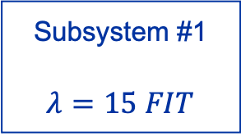
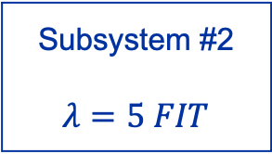
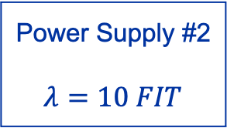
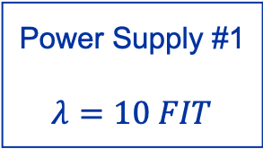
Reliability Block Diagrams
Concept
Subsystem #1
$$λ=15 FIT$$
Method in the reliability domain to visualize failure propagation pathways
  Focus on functional dependencies between components (also known as Dependency Diagram).
  Components are represented by connected blocks.
  Elements can be connected in parallel (signifying redundancy) or in series (any failure leads to a failure of the path).
Used to calculate the overall reliability.
  Critical points of failure can be visualized.
  They can be transformed into a success tree (for instance to use in AvailSim4) or a fault tree.
Power Supply #1
$$λ=10 FIT$$
Power Supply #2
$$λ=10 FIT$$
Subsystem #2
$$λ=5 FIT$$
Example RDB of a system with redundant power supply

Slide 6
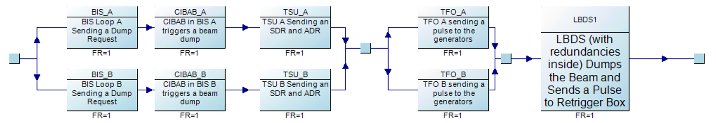
Synchronous Beam Dump (triggered by BIS)
Reliability Block Diagram
Note:
BRF (Beam Revolution Frequency) not included as input because TSU will regenerate rBRF (regenerated Beam Revolution Frequency) upon loss of BRF signal in normal circumstances.
Spurious asynchronous beam dump could be added as another box at the end of the chain for completeness.
Question: Of BETS, BLM, SCSS, ETRIG, Which of these also trigger the BIS? Also: LBDS Kickers, LHC Fast Timing.
  For those triggering the BIS, they add redundancy.
  Those not triggering the BIS have to be considered separately.

Slide 7
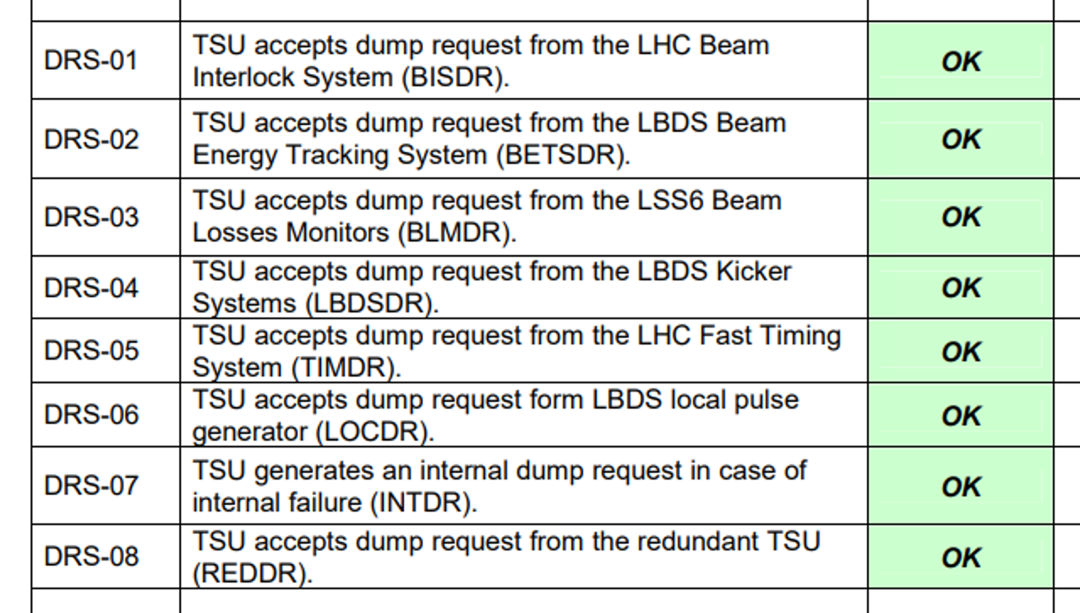

Slide 8
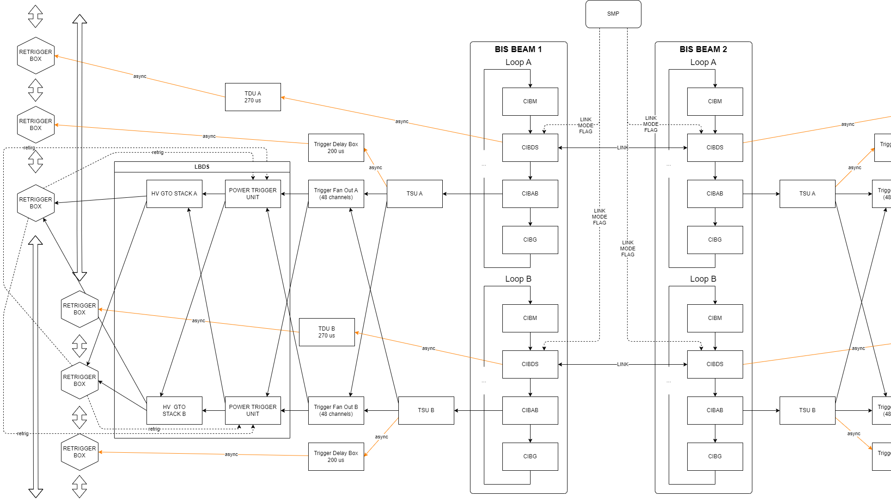

Slide 9
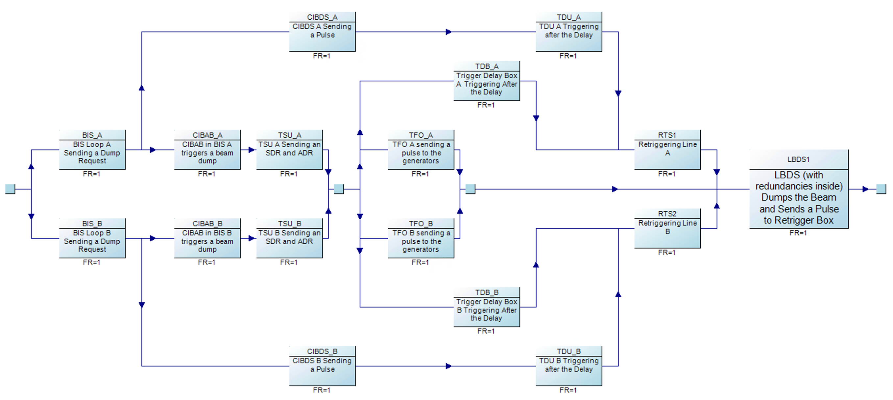
Beam Dump via CIBDS and TSU (triggered by BIS)
Reliability Block Diagram
Part resposible for a synchronous beam dump

Slide 10
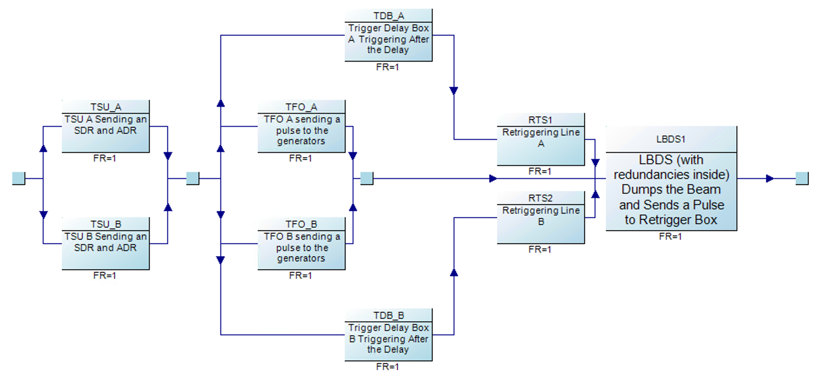
Beam Dump via TSU (not triggered by BIS)
Question: Of BETS, BLM, SCSS, ETRIG, Which of these also trigger the BIS? Also: LBDS Kickers, LHC Fast Timing.
  For those triggering the BIS, they add redundancy.
  Those not triggering the BIS must be considered separately.

Slide 11
Additional top-level failure mode
Discrepancy between frequencies in TSUs
Situation | Failure | Effect | Criticality
7. Dump when discrepancy between TSUs is detected | 7.1. Failure to detect the discrepancy within acceptable time 7.2. Fail to dump the beam within 5 revolutions OR send an asynchronous dump request only | 7.1.1. Exposing the machine to the risk of an asynchronous dump. ///OR/// Asynchronous dump (if proceeds anyways) | 7.1.1.1. Investigation required Acceptable once in 10 years
 |  | 7.2.1. – same effects and criticality as 7.1.1
Question: Discrepancy of which parameters would trigger a dump? (RBRF, DRBRF, AGK Status signals (CRC, PS surveillance))

Slide 12
Next steps
Parameters for beam dump request simulation:
  Failure modes and rates -> bottom-up FMECA for TSU (assumptions for now), existing studies for other elements.
  Inspections (XPOC/IPOC/Post Mortem scope, yearly tests, …)
    Detectability of component failures
    Any blind failures not detected in XPOC/IPOC/Post Mortem
  Operational phases
  Demand rate (to be extracted from Post Mortem database)
Defining blind failure requirements from sensitivity analysis and spurious failure requirements from availability targets
Starting bottom-up FMECA once design files available and compare with the requirements
Development of a reliability model of LBDS Power distribution?
Notes:
XPOC – if it can be considered
Phases which change the stress of the system

Slide 13
TSU not sending SDR, ADR
OR
Hardware failure
Software/Firmware failure
Procedural failure
Component FMECA

