Slide 1
TSU CONS Reliaiblity Study – Meeting 4
Simulation scenarios parameters and inputs

Slide 2
List of contents
Simulations for requirements.
  Assumptions.
  Reliability Block Diagram (RBD) of the model.
  General results.
  Results for various mission lengths.
  Conclusions.
  Synchronous Beam Dump simulations.
Remaing questions.
Next steps.

Slide 3
Simulations
Assumptions
Hybrid Monte-Carlo analytical model
  Each iteration draws the mission length of from a probability distribution with mean set to 12 hours.
Assumptions:
  Each mission ends with a check (IPOC/XPOC, Post Mortem, active surveillance) which removes blinds failiures and brings the system back to “as good as new” state. Assuming full coverage (see simulations for various mission lengths).
  Each year has 250 operational days.
  Not considering software or other common cause errors.
Failure rates:
  TFO assigned 548 FITS (TO1 “TO unit failed open”, RF’s thesis, Table A.6)
  TDU/TDB assigned 130 FITS (V. Vatensever thesis, Equation 5.9)
  RTS assigned 78 FITS (L “Re-triggering line failed”, RF’s thesis, Table A.7)
  LBDS assigned ("< 14 MKD available”, RF’s thesis, 0.084 FITS, Table 7.2)

Slide 4
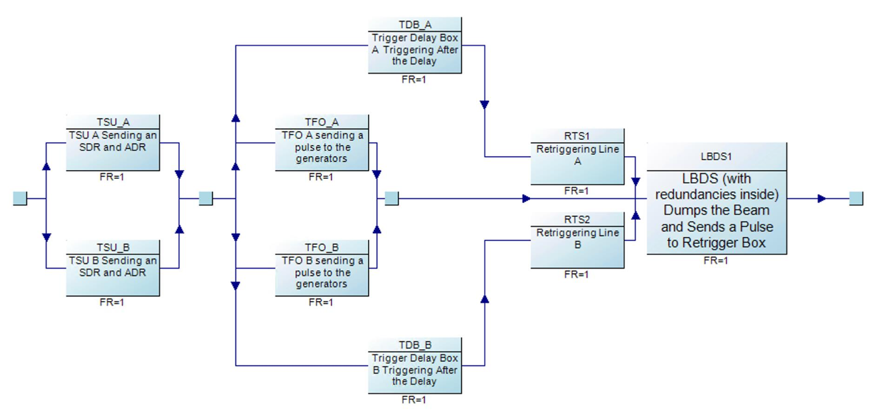
Simulated model
Async Beam Dump via TSU (not triggered by BIS)
Critical functionality with fewer layers of redundancy (no trigger via BIS – CIBDS in parallel)

Slide 5
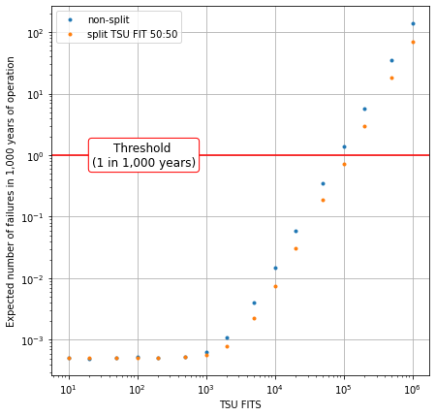
Simulation results
Sensitivity analysis of the TSU FITS
Accceptable failure probability threshold
  1 failure every 1,000 years.
  Fulfilled as long as FITS of TSU’s blind failures << 10^5 (equivalent to 0.6 failures per 250 days)
  Result should have at least an order of magnitude margin to account for other critical scenrios.
Mission length sampled from the exponential distribution with mean of 12 hours.
Two model variants considered:
  Blue dots: model without the inter-TSU dump request communication.
  Orange dots: model assuming that each TSU exchanges information with the other one (parts responsible for receiving and transmitting have the failure rate divided equally).

Slide 6
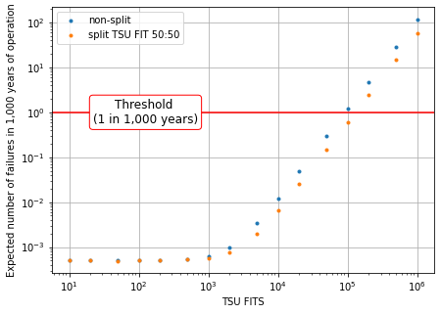
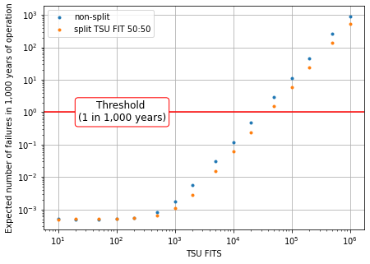
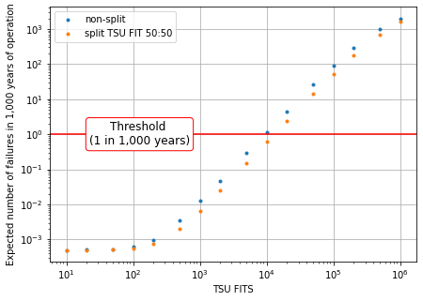
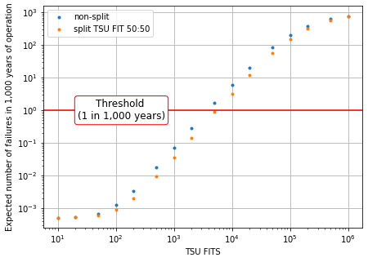




Impact of fill length
(→ time until system is as good as new)
Mission length = 10h , threshold at ${10}^{5}$
Mission length = 100h , threshold at ${3×10}^{4}$
Extreme case
checks do not work; failures detected and removed only the end of the year
Mission length = 1000h, threshold at ${10}^{4}$
Mission length = 6000h , threshold at ${5×10}^{3}$

Slide 7
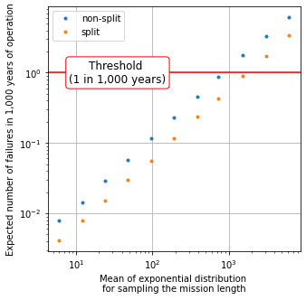
Simulation results
Varying mission length
TSU failure rate set to 10,000 FIT.
Increasing the time between missions increases the probability of a critical failure.
  Longer missions mean longer periods without checks, removing the possibility for the system to be repaired.
  In effect, lack of checks leads to accumulation of the failures in redundant paths.

Slide 8
Simulation
First takeaways
C0. With current assumptions, estimated TSU blind failure rate requirement not very stringent.
C1. Inter-TSU dump request doesn't make much difference.
  It provides additional advantage but does not seem to be changing the results significantly.
C2. More important: ensuring that checks cover all failures.

Slide 9
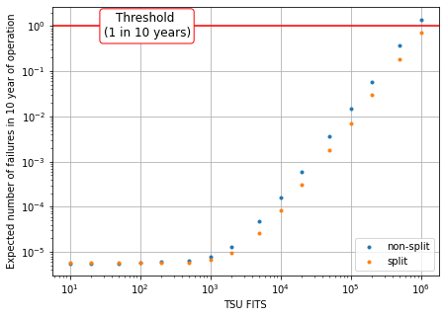
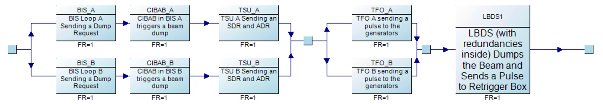
Synchronous Beam Dump (triggered by BIS)
Model of triggering an asynchronous beam dump in effect of a failure in the standard triggering
  Failure more likely (less protection layers), but given the relaxed threshold (1 asynchronous beam dump per year), FITS are not a problem
Simulation
  Completed for a mission length sampled from the exponential distribution with mean of 12 hours
  Increasing or decreasing that value leads to same observations as before: more time between checks increases the risk of a critical failure
    For comparison, the threshold is reached for a TSU with 10,000 FIT when mission length is ~1,000 hours.

Slide 10
Other critical failures in R. Filippini’s thesis
When does the BETS trigger a dump? (Unable to trigger a dump request is classified as a critical failure in R. Filippini’s thesis)
  The thesis explains the failure mode as the system being blind to powering failures (unable to detect an energy tracking error).
  Or can it only cause an erratic energy measurement?

Slide 11
Next steps
Extension of simulation model & sensitivity analysis
  Increased failure rate of other systems
  Beam dump via TSU and CIBDS (triggered by BIS) model
Depending on status of the detailed TSU design could start bottom-up analysis
Top-level analysis of LBDS Power Distribution

