Slide 1
TSU CONS Reliability
Progress Meeting - #5

Slide 2
Study workflow
Steps followed in the reliability analyses in BISv2
Failure Rate prediction
217Plus standard
Completed with automated tools & Isograph.
Failure Modes apportionment
Sources:
End-effects assignment
Provided by system expert.
FMD-91 (after MIL-HDBK-338B [1])
FMD-2016 [2]
Expert knowledge
Final table in [3]
Discussed with reliability expert
Outcomes:
Estimation of failure likelihoods for individual components, system and sub-systems.
Outcomes:
Failure modes (e.g., capacitor open, short) with assigned probabilities.
Outcomes:
Establishing probability for each failure end-effect (that are then comparable with risk matrices).

Slide 3
Failure rate prediction
Failure Rate prediction
217Plus standard
Completed with automated tools & Isograph.
TSU Board
TSU RTM Board
The first step of the analysis

Slide 4
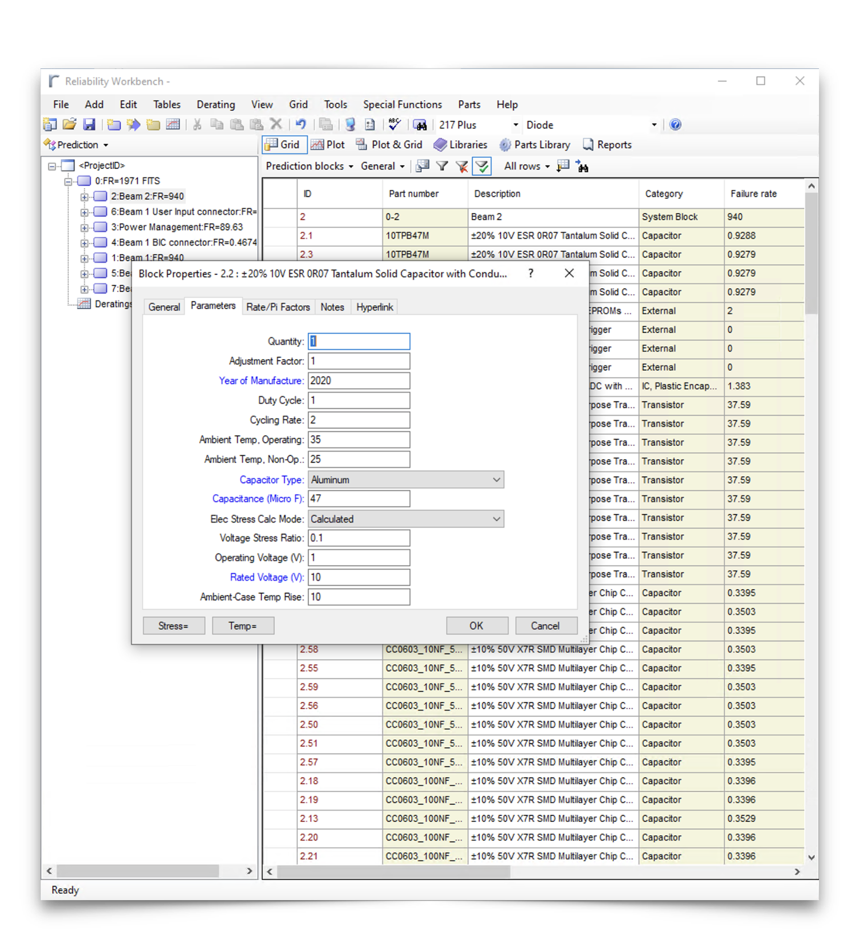
Failure rate prediction
217Plus standard & Isograph
Objective: establishing probabilities of failure for individual components.
217Plus: 2015 & Isograph: completed by using 217Plus models [4] in Isograph [5], aided by automated scripts processing design files [6].
Failure models: combine empirical data with physics-of-failure models, being adjustable for specific environmental and operational conditions.
  Factors like temperature, voltage, environment adjustable for components depending on the category
  Certain parameters can be set globally to apply to all components (see next slide).
Screenshot of Isograph Reliability Workbench [2] (tool used for FMECA analysis)

Slide 5
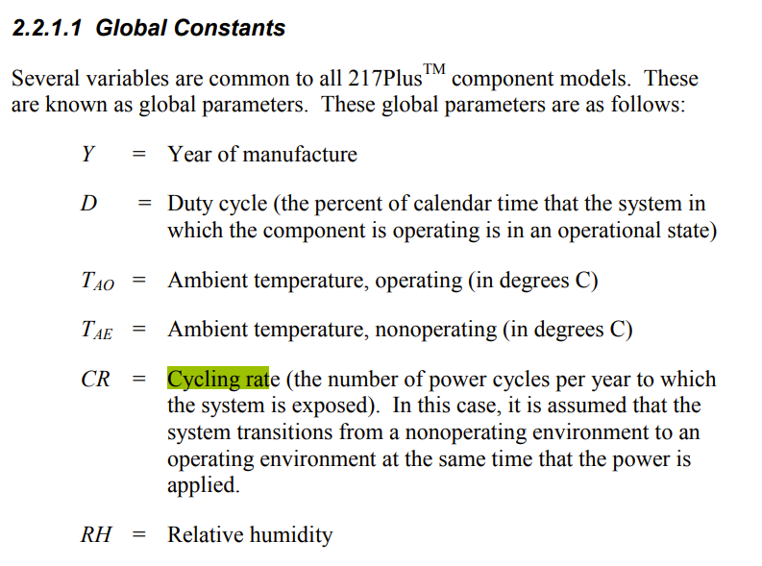
Assumptions
Global parameters and mission profile
Year of manufacture: 2020
Duty cycle: 1 (i.e., always on)
Cycling rate: 2 (i.e., two power cycles in a year)
Ambient temperature, operating: 35
Ambient temperature, non-operating: 25
Relative humidity: 0.5
Parts assumed to be used within their ratings, no modifications made to quality and process factors (217Plus standard assumed).
Excerpt from the 217Plus document [7]

Slide 6
Trigger Synchronization Unit Board
Failure Rate prediction
217Plus standard
Completed with automated tools & Isograph.
TSU Board
TSU RTM Board
Statistics of the project and preliminary failure rate estimation

Slide 7
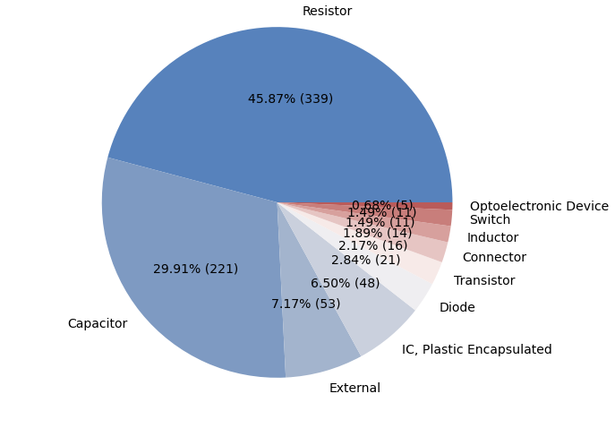
Number of components in categories
Total number of components: 739

Slide 8
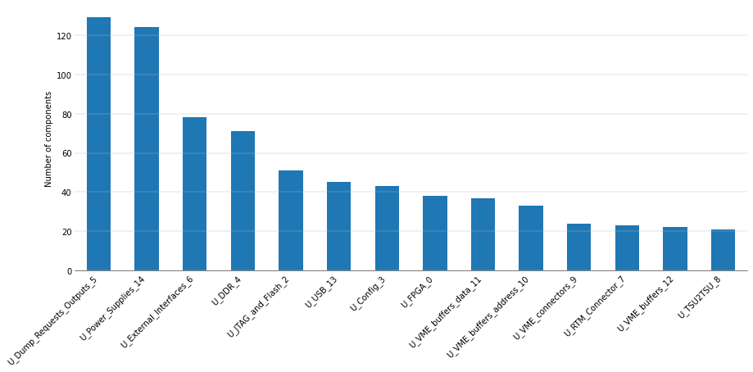
Distribution of components across pages
Total number of components: 739

Slide 9
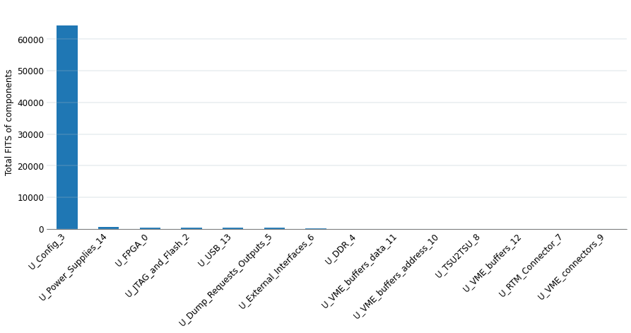
Total FITS of design pages
Total FITS of components in a given page (66,997)
Results dominated by the rotary switches in the Config.
The 217Plus standard sets their failure rates to 8,041 FITS – and there is 8 of them, resulting in 64,328 FIT.
(See the next slide for results without them)

Slide 10
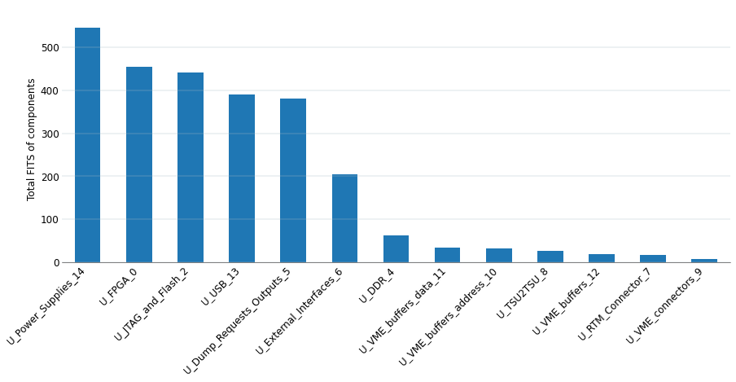
Total FITS of design pages (w/o U_Config)
Total FITS of components in a given page (2,618)

Slide 11
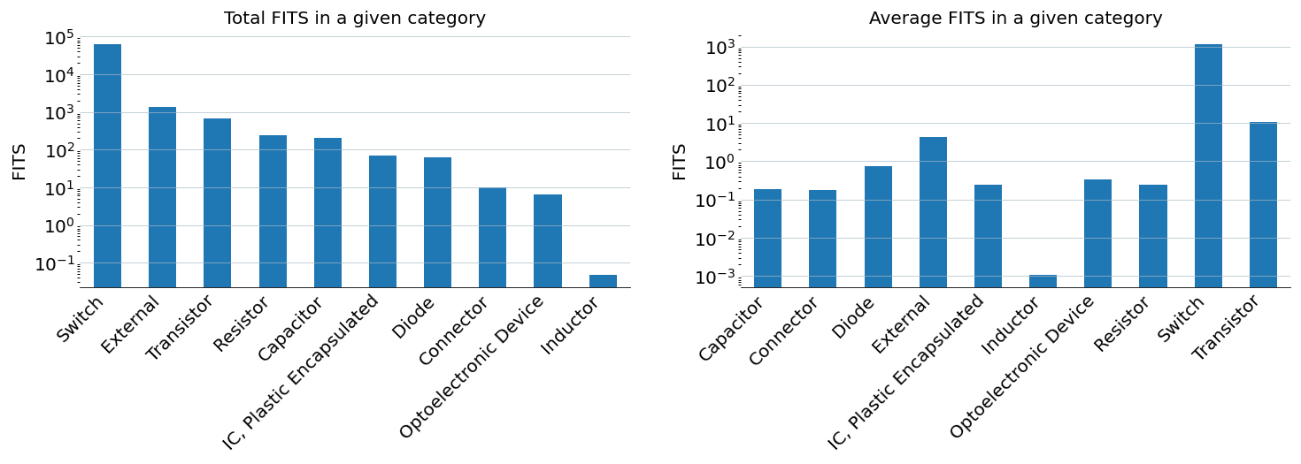
FITS of component categories
Distribution of number of predicted failures in 10⁹ hours across categories

Slide 12
TSU Rear Transition Module Board
Failure Rate prediction
217Plus standard
Completed with automated tools & Isograph.
TSU Board
TSU RTM Board
Statistics of the project and preliminary failure rate estimation

Slide 13
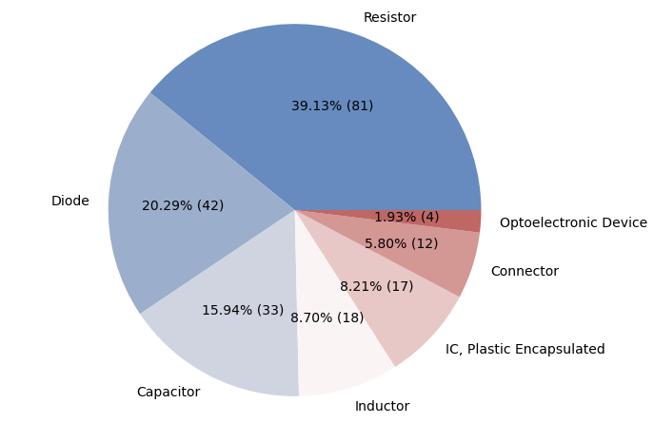
Number of components in categories
Total number of components: 207

Slide 14
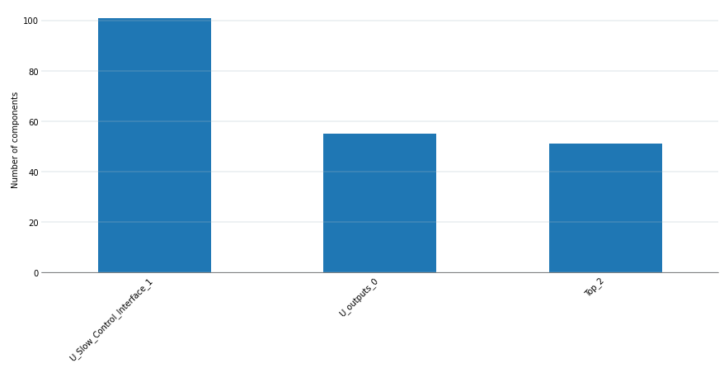
Distribution of components across pages
Total number of components: 207

Slide 15
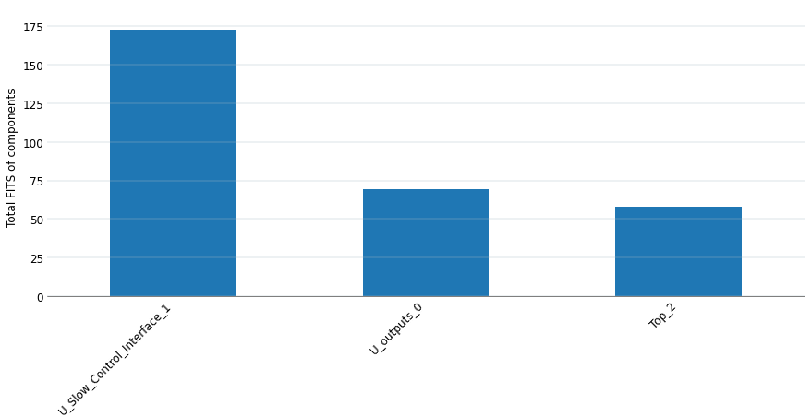
Total FITS of design pages
Total FITS of components in a given page (299)

Slide 16
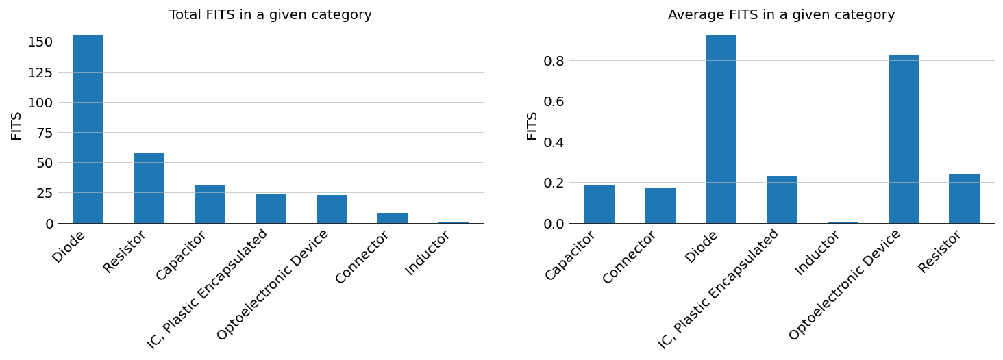
FITS of component categories
Distribution of number of predicted failures in 10⁹ hours across categories

Slide 17
Failure rate prediction summary
Conclusions of the first step
The total failure rates are the following:
TSU Board: 2,618 FIT (w/o rotary switches).
TSU RTM Board: 299 FIT.
Results comparable to boards of similar size in BISv2 project.
Continuing the analysis to establish single points of failure as individual failure modes leading to critical failures could further the confidence in the reliaiblity by decreasing (potentially) the estimations by orders of magnitude.

Slide 18
Next steps
Failure Modes apportionment
Sources:
End-effects assignment
Exclusively relaying on expert knowledge of the system.
FMD-93 (from MIL-HDBK-338B [1])
FMD-2016 [2]
Expert knowledge
Final table in [3]
Failure mode apportionment and end-effects

Slide 19
Failure mode apportionment
Based on FMDs and past experience
Objective:
Identify failure rates for different end-effects (defined in top-level FMECA)
Exclude possibility of common mode blind failures (across paths A & B)
Weigh the trade-offs between end effects (e.g. false async vs. blind single path)
Emprical data: Completed by using models apporting overall failure rate to individiual modes based on field data, such as FMD-91 and FMD-2016.
Example
Capacitor C1, failure rate 2.49 FIT:
  Short (30%) – 0.7 FIT.
  Parameter change (61%) – 1.5 FIT.
  Open (6%) – 0.1 FIT.
End Effects from Top-Level FMECA
sync beam dump
async beam dump
missed beam dump
no timestamp for Post Mortem, IPOC, etc.
downtime

Slide 20

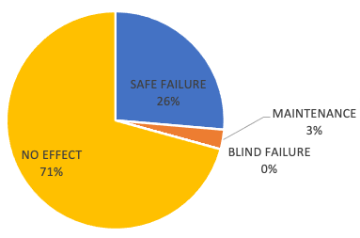
End-effects assignment
 | Component | Failure mode | Mode failure rate FIT | Expert-assigned end-effect
C1 | Capacitor | Drift | 19.98 | NO EFFECT
C1 | Capacitor | Shorted | 10 | BEAM DUMP
…
D1 | Diode | Shorted | 4.57 | NO EFFECT
…
Experts & designers
Designers assigning end-effect for the entire system to each failure mode (could be limited to critical parts of the design)
Followed by a common review with designers, experts, reliability team
Work-intense element of the study, requiring deep knowledge of the system
  ”What is the impact of a component failing one way on the entire board?”
  As much support as possible provided.

Slide 21
End Effects
Example from another project
Blind failure (single path).
Blind sync | Not generating asynchronous dump request.
Blind async | Not generating a synchronous dump request.
Blind | Not generating asynchronous nor synchronous dump requests.
Blind failure (both paths)
Blind both paths sync | Not generating asynchronous dump request on both paths.
Blind both paths async | Not generating a synchronous dump request on both paths.
Blind both paths | Not generating asynchronous nor synchronous dump requests on both paths.
False dumps
False dump async | Spuriously generate ONLY asynchronous dump request.
False dump sync | Spuriously generate ONLY synchronous dump request.
False dump | Spuriously generate asynchronous and synchronous dump requests.
Maintenance | Failure will cause maintenance action after the mission (LHC fill) is finished.

Slide 22
Conclusions
Rotary switches – very high failure rate in 217Plus standard
  Establishing non-criticallity of their failures could let us focus on the remaining faults.
Next steps:
  Failure mode apportionment and end-effects assignment.
  FMECA Tables are ready for both boards projects.

Slide 23
References
[1] MIL-HDBK-338B, US Department of Defence, 1 October 1998, https://www.navsea.navy.mil/Portals/103/Documents/NSWC_Crane/SD-18/Test%20Methods/MILHDBK338B.pdf
[2] Failure Mode/Mechanism Distributions – 2016, Reliability Databook Series, Quanterion Solutions Inc., https://www.quanterion.com/product/tools/failure-mode-mechanism-distributions-fmd-2016/
[3] Table FMD-CB.csv, https://gitlab.cern.ch/mblaszki/fmeca-assist-tool/-/blob/cd5826e15fc053132d3b6e6cfb34f6e50755b08b/resources/FMD-CB.csv
[4] HDBK-217Plus:2015 Notice 1, Quanterion Inc., 15 January 2017, https://www.quanterion.com/products-services/tools/217plus/
[5] Isograph Reliability Workbench, Isograph Ltd., https://www.isograph.com/software/reliability-workbench
[6] Automatizing Component-FMECA Analyses for Electronics Assemblies, Joint RAWG & Electronics Forum Meeting, 11 April 2024, https://indico.cern.ch/event/1398920/
[7] HDBK-217Plus:2015, Quanterion Solutions Inc., 15 December 2014, https://www.quanterion.com/product/publications/hdbk-217plus-2015/

