Slide 1
FMECA End-effects
TSU CONS Reliability Study Progress Meetings #7

Slide 2
List of contents
End-effects in this FMECA.
Failure rates & details of TSU end-effects categories.
Failure rates of TSU RTM end-effects categories.
TSU Hybrid MC model.
Questions and next steps.

Slide 3
End-effects in TSU FMECA
Categories of failure modes’ effects in the table
All options assigned to failure modes:
Unpredictable
Asynchronous Beam Dump
Synchronous Beam Dump
Downtime
Loss of injection permit
No diagnositcs (RTM only)
No effects
Requirements:
1 failure in 1,000 years (≅ 114 FITS)
1 failure in 10 years (≅ 11,400 FITS)
1 failure in 1 year (≅ 114,000 FITS)
Less critical
no requirement
no requirement
FIT – number of failures in 10⁹ hours (≅ 115,000 years)

Slide 4
Combining end-effects between TSUs
TSU1 and TSU2
End-effect TSU 1 | End-effect TSU 2 | Result
No effect | No effect | No Effect
Async beam dump | Sync beam dump | Sync beam dump
Downtime | No effect | Downtime
Async beam dump | No effect | Async beam dump
… | … | …
TSU 1 column indicates what happens with the affected board.
TSU 2 shows reaction of the other TSU.
To simplify the analysis, the two columns are merged together using
rules like shown above.

Slide 5
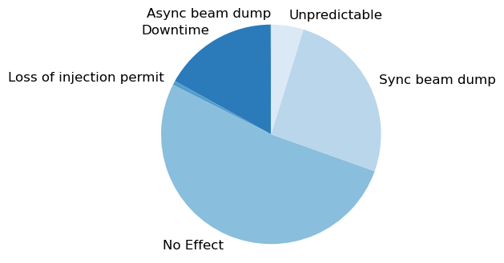
End-effects identified in TSU FMECA
Breakdown of total FITS
Unpredictable – 109 FIT
Asynchronous Beam Dump – 1 FIT
Synchronous Beam Dump – 594 FIT
Downtime – 390 FIT
Loss of injection permit – 14 FIT
Total (with effects) – 1,106 FIT
No effect – 1,202 FIT*
* Without 8 rotary switches (each 8041 FIT according to 217Plus, total – 64,328 FIT)
0.06%
16.9%
4.8%
0.6%
25.7%
52%
FIT – number of failures in 10⁹ hours (≅ 115,000 years)

Slide 6
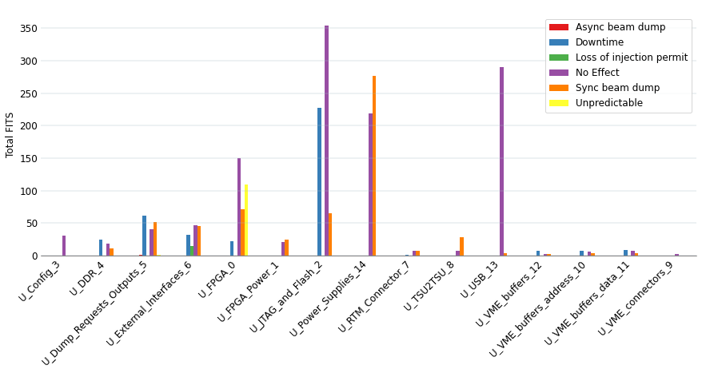
FITS in TSU design pages
FIT – number of failures in 10⁹ hours
109 FIT
unpredictable
1.4 FIT
async beam dump

Slide 7
TSU End-effect: Unpredictable
Failure rate: 109 FITS.
Causes:
Parameter change of a switching diode, D2, in Dump Requests Output: 2.9 FITS.
Parameter change of an AND gate, IC18, in Dump Requests Output: 1.4 FITS.
Open, param. change, stuck high/low of Artix 7 FPGA, IC1: 27 FITS x 4.
  Exact effect depending on the pin.
Parameter change of the RS-485 Transceiver, IC41, in External Interfaces: 1.4 FITS.

Slide 8
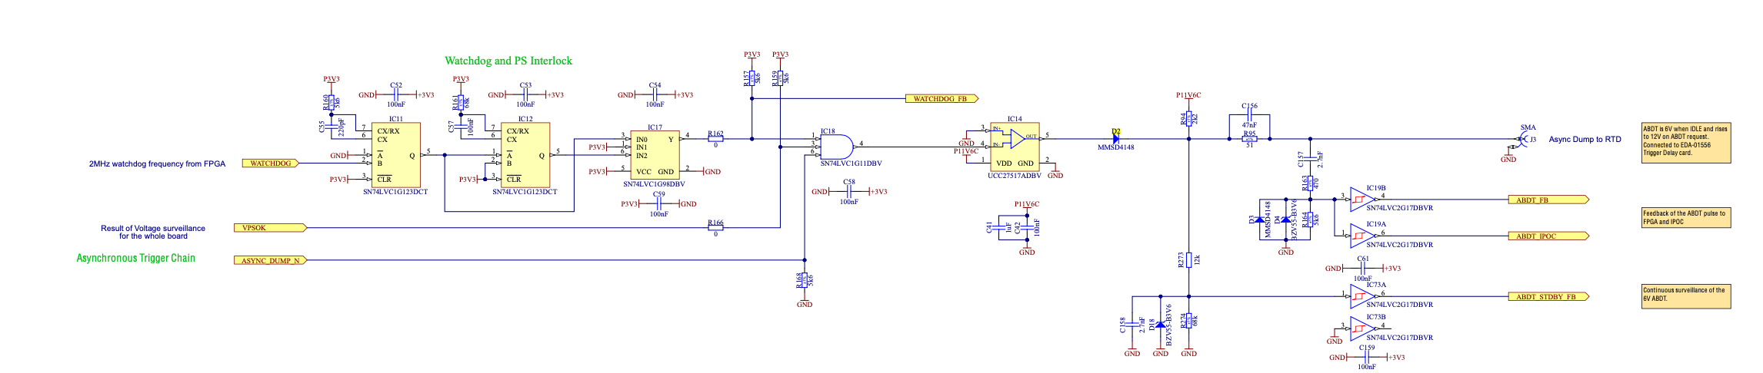
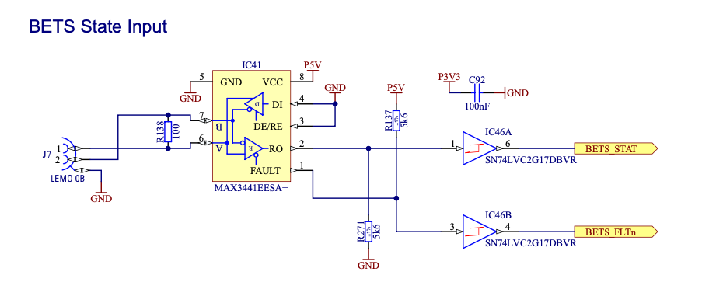
TSU End-effect: Unpredictable
Locations
Dump Request Outputs
IC18
D2
External Interfaces
IC41

Slide 9
TSU End-effect: Asynchronous Beam Dump
Failure rate: 1.4 FIT.
Causes:
Stuck high or parameter change in gate drivers, IC14, IC32, IC40, in Dump Requests Outputs: 0.2 or 0.5 FIT.
Open, poor contact/intermittent, short in PCB Jack, J3, in Dump Requests Outputs:
0.2 FIT.

Slide 10
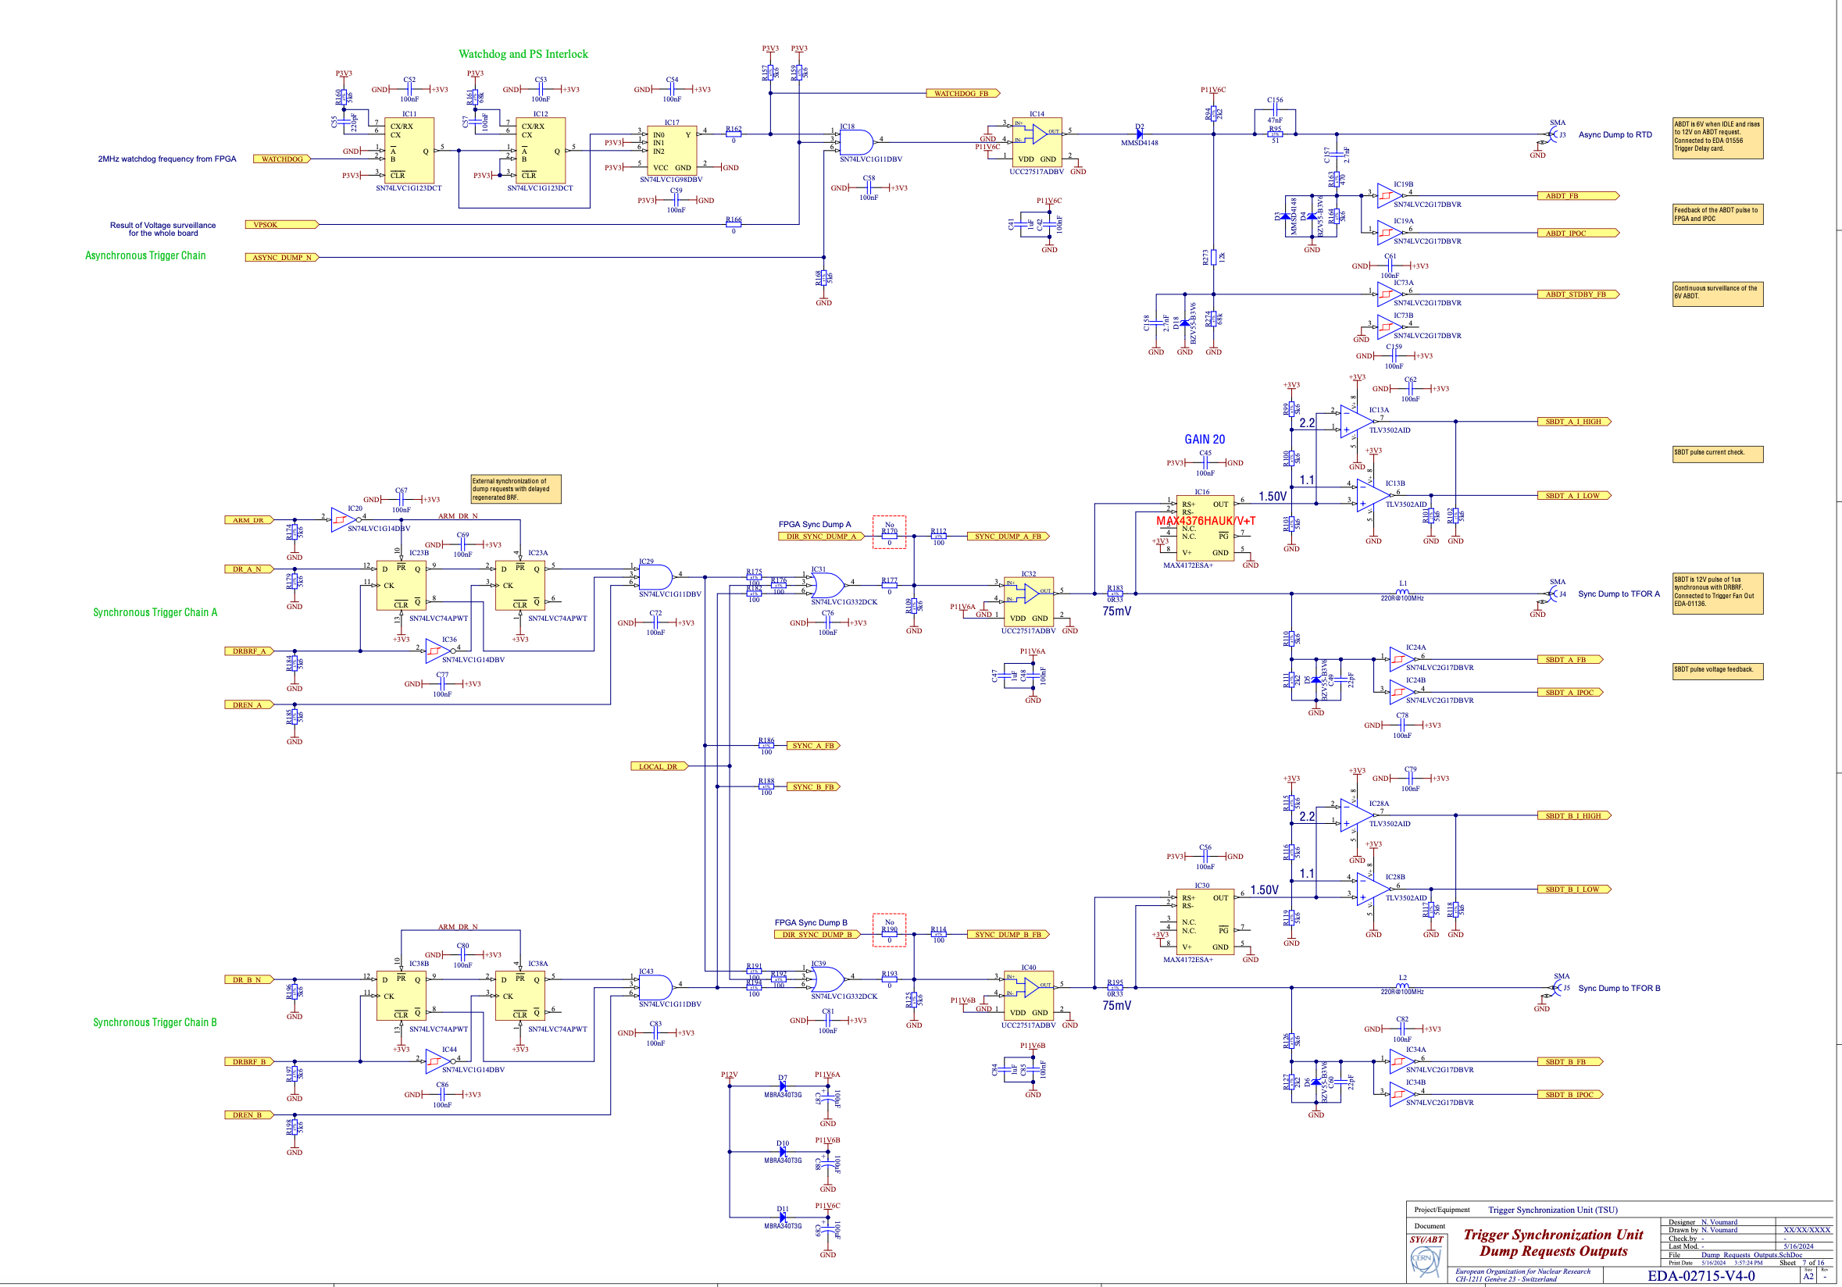
TSU End-effect: Synchronous Beam Dump
Locations
IC14
J3
IC32
IC40

Slide 11
TSU End-effect: Synchronous Beam Dump
Total: 594 FITS.
Top contributors:
Short in temperature monitors, IC6: 56 FITS.
Short in Artix-7 FPGA, IC1: 27 FITS.
Failures in transistors T11, T12: 22 FITS.
Failures of fuses F1, F2, F3: 20 FITS.
Remaining components’ failure rates are below 20 FITS.

Slide 12
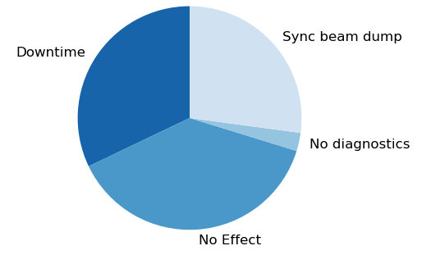
End-effects identified in TSU RTM FMECA
Breakdown of total FITS
Synchronous Beam Dump – 83 FIT
Downtime – 99 FIT
No diagnostics – 8 FIT
Total (with effects) – 190 FIT
No effect – 118 FIT
32%
27%
3%
38%
FIT – number of failures in 10⁹ hours (≅ 115,000 years)

Slide 13
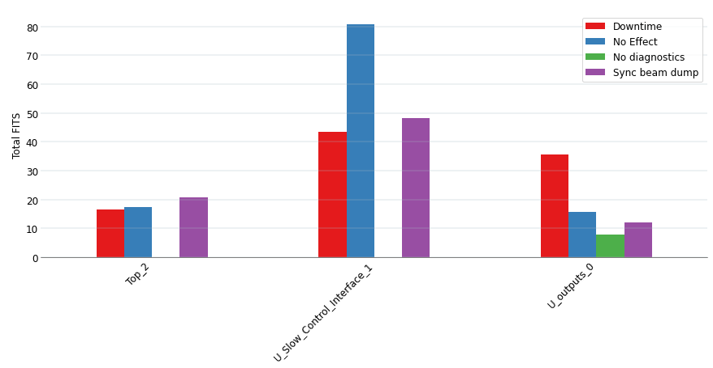
FITS in TSU RTM design pages
FIT – number of failures in 10⁹ hours

Slide 14
TSU Hybrid MC Model
FMECA inputs for the model

Slide 15
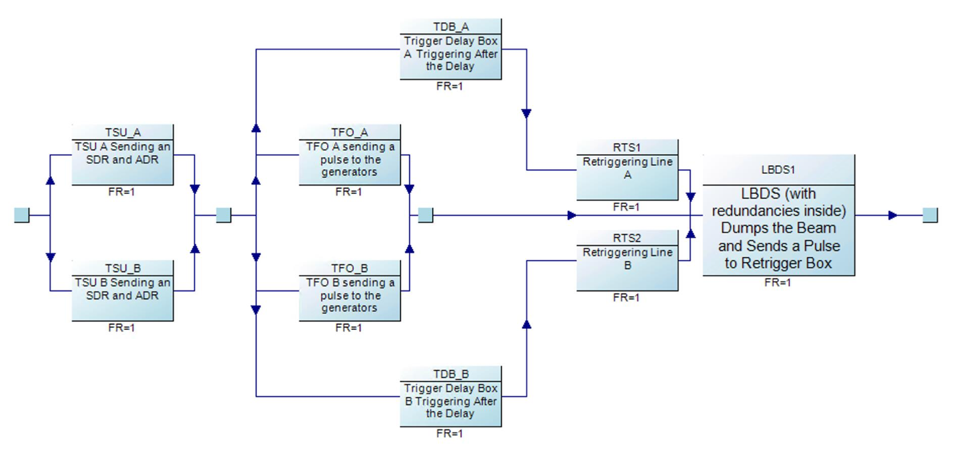
TSU Hybrid MC Model
Asynchronous beam dump not triggered by BIS

Slide 16
Failure rates to be used in the model
Can “no effect” lead to an effect?
Certain failure modes are assigned “no effect” and “no effect” but lead to loss of redundancy.
Example:
Fuses F4 and [F5], param. change or short: assigned “no effect”, “no effect”, with comment: “loss of SBDT1[2] path”.
Switching diode D2, open: “no effect”, with comment: “Loss of ABDT path”.
On the other hand, there is ”loss of SBDT1 path” with async dump of a gate driver stuck high – but that one triggers an synchronous beam dump, therefore – it is safe as
Can failure modes like this ”linger” in the system unnoticed?

Slide 17
Questions and next steps
Can all of the faults in the “unpredictable” end-effects category lead to missed dumps?
Rotary switches (high failure rate estimation and past experience):
  Are their faults at the start of operation also not impacting the functionalities of TSU?
  Will their faults require follow-ups and card replacements?
Understanding of repair and inspection strategies.
Hybrid MC model for missing a beam dump (1 in 1,000 years) when not triggered by the BIS.

