Slide 1
Reliability Model of Critical TSU Failure – Missing the Triggering
TSU CONS Reliability Study Progress Meeting #9

Slide 2
List of contents
TSU Simplified Analytical Model
Failure rates
  Input Signals
  Synchronous Paths
  Asynchronous Paths
Simulation Results
Remaining questions

Slide 3
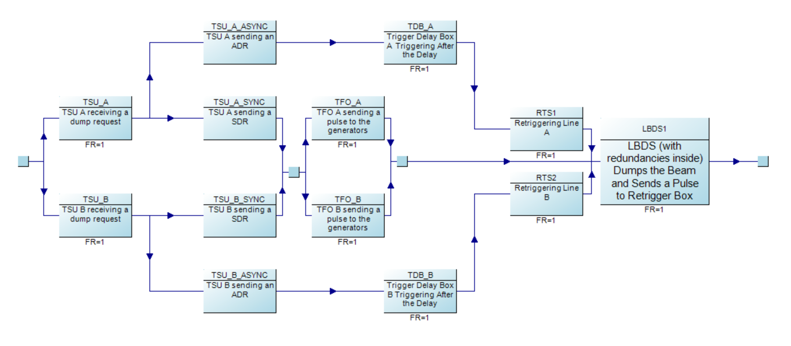
TSU Missing Triggering Model
Discussed in the previous meetings
TSU
Missing a triggering
Failing to receive the trigger from the external sources.
Issue during “processing” of the trigger inside the TSU.
Failing to trigger any of the 2 synchronous paths.
Failing to trigger any of the 2 asynchronous paths.
LBDS critical malfunction.

Slide 4
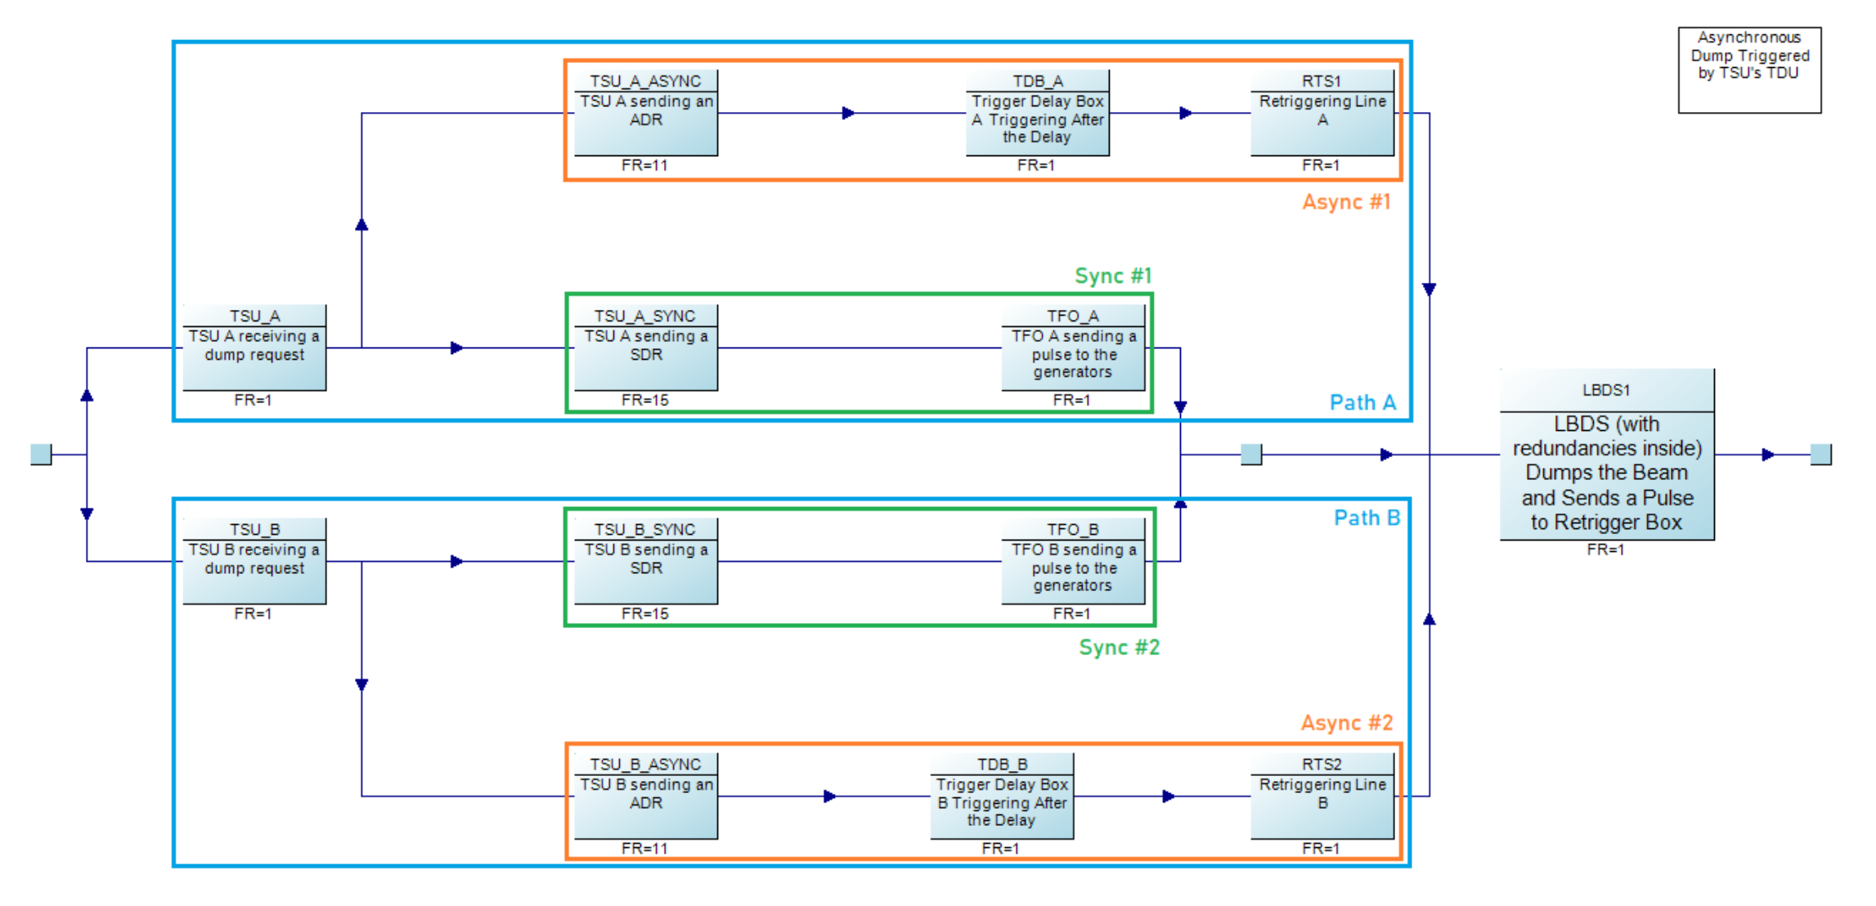
TSU Simplified Analytical Model
Simplifying calculations through pessimistic assumptions
130 FITS
78 FITS
TSU
548 FITS
0.048 FITS
548 FITS
Legend
Asynchronous
Synchronous
130 FITS
78 FITS
Redundant path
FITS – number of failures in 10⁹ hours

Slide 5
Failure rates
Input Signals
Applicable failure modes:
BLM always TRUE – 2.89 FITS
BETS always TRUE – 0.67 FITS
BIS always TRUE – 0.67 FITS
T1/T2 always TRUE – 0.5 FITS
  Only problematic when another failure occurs.
Total: 4.3 FITS.

Slide 6
Failure rates
Synchronous Paths
Applicable failure modes:
Loss of SBDT A – 30.3 FITS
  Fuse F3 – 20 FITS
Loss of SBDT B – 28.7 FITS
  Fuses F4 – 20 FITS
Loss of SBDT A&B – 1.0 FITS
  In the simplified model there is just one path (to only one TFO) anyways.
Total: 31.3 FITS (SBDT A + SBDT A&B)

Slide 7
Failure rates
Asynchronous Path
Applicable failure modes:
“Loss of ABDT path” – 4.9 FITS.
Additional potentially relevant failure modes
  Comment “Loss of ABDT path”
  However, causing immediate synchronous or asynchronous dump
  Total of 49.8 FITS.

Slide 8
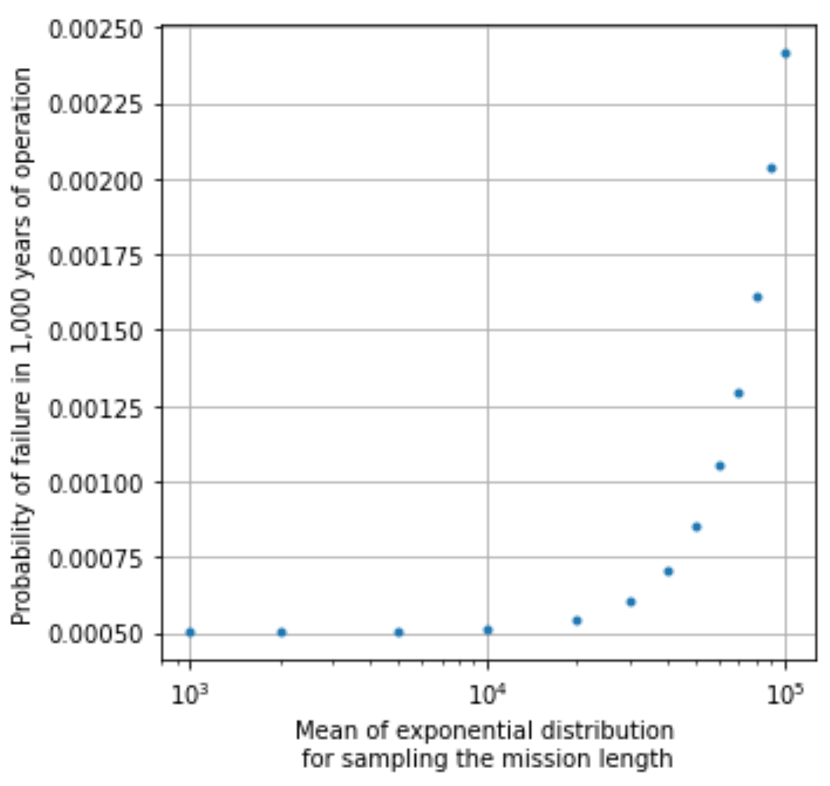
Simulation Results
Of the Hybrid MC Model
Reliability requirement:
No more than 10% probability of a failure after 1,000 years.
Assumptions:
Simulations of lifetimes lasting 1,000 years
  A single year is assumed to have 6,000 operational hours.
  Within that time, there are multiple “missions” ended by triggers.
    Mission lenghts are sampled according to the value on the x axis.
Each component is repaired after a trigger (i.e., mission).

Slide 9
Conclusions
The hybrid MC model shows that the system meets the reliability requirement.
  With significant margins.
No single points of failure identified in the analysis.
There is reasonable confidence in the reliability of the system even with 1 year long missions.
  Critical since the number of triggering does not impact the failure rates in the models, but decreases the testing frequency.
  Shown by results of both, hybrid MC model and exact model.
  Frequent testing/IPOC monitoring remain important though to avoid failure buildups, 2nd order failures, etc. (as was only partially in the scope of the FMECA and simulations).
Next step: hybrid MC model of the asynchronous dumps.

Slide 10
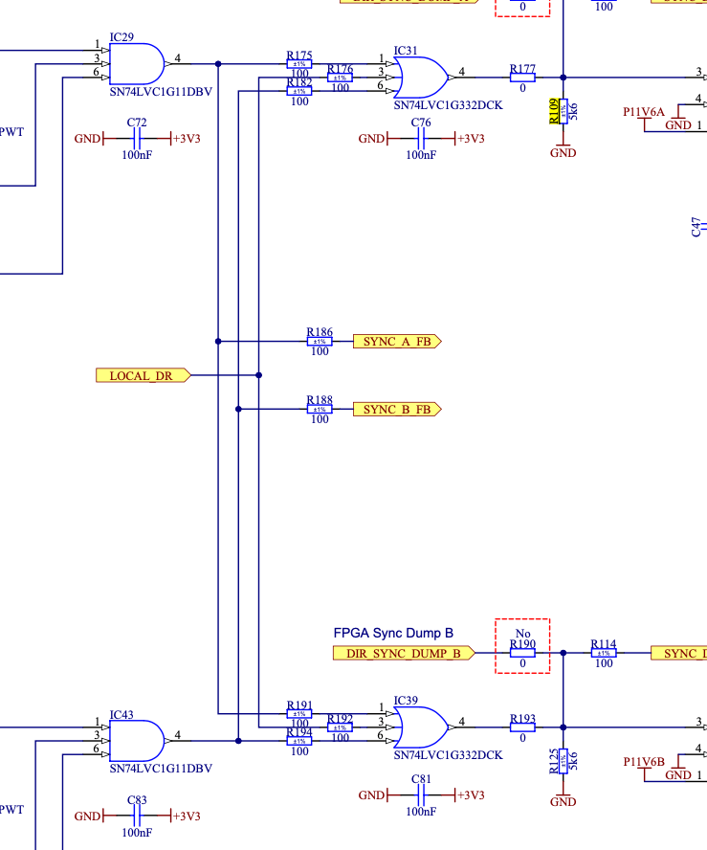
Remaining questions
R175 Open – Loss of SBDT A path
R109 Param. Change – Loss of SBDT A path
Failure modes causing ”Loss of ABDT path” but triggering asynchronous or synchronous dumps – can they be danegrous?
Can a “VPSOK always TRUE” failure mode result in missing a trigger?
Where is the discrepancy between failure rates assigned to “Loss of SBDT A” (10.3 FITS) and “Loss of SBDT B” (8.7 FITS) coming from?
  R175 Open causing loss of SBDT A path, while corresponding R194 is #N/A
  R109 param. change causing loss of SBDT A path, while corresponding R125 no effect

