Slide 1
Double Higgs Boson Production in Association of Jets in the Triplet Higgs Model at the LHC
Dr. Terrance Figy
Associate Professor
Department of Mathematics, Statistics, and Physics
Wichita State University
Extended Scalars form All Angles
CERN, Oct. 22, 2024

Slide 2
Single and Double Higgs Boson Production in Association of Jets using Herwig 7 in the SM and in BSM
Dr. Terrance Figy
Associate Professor
Department of Mathematics, Statistics, and Physics
Wichita State University
Extended Scalars form All Angles
CERN, Oct. 23, 2024

Slide 3
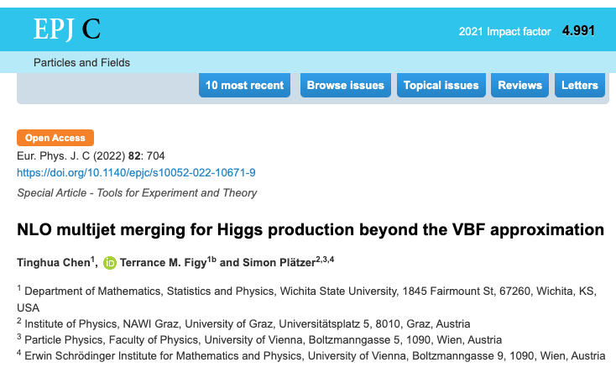
References and Thanks to Collaborators…
Collaborators: Simon Platzer, Peter Schichtel, Michael Rauch, Malin Sjodahl, Francisco Campanario, Tinghua Chen, and Bathiya Samarakoon.
https://arxiv.org/abs/2109.03730
https://arxiv.org/abs/1802.09955
https://arxiv.org/abs/1610.07922
https://arxiv.org/abs/1308.2932
https://arxiv.org/abs/0710.5621
In a full talk I would discuss the history of calculations.
Notes:
Yes, I like to talk about the same thing over and over.

Slide 4
More References and Collaborators
Anomalous Higgs boson couplings in vector boson fusion (Ph.D. Thesis 2023, Tinghua Chen). Related paper in progress.
Azimuthal angle correlations for Higgs boson plus multi-jet events (J. Andersen, K. Arnold, D. Zeppenfeld)
In Progress: Double Higgs via VBF in BSM scenarios.
Collaborators: Tinghua Chen and Bathiya Samarakoon

Slide 5
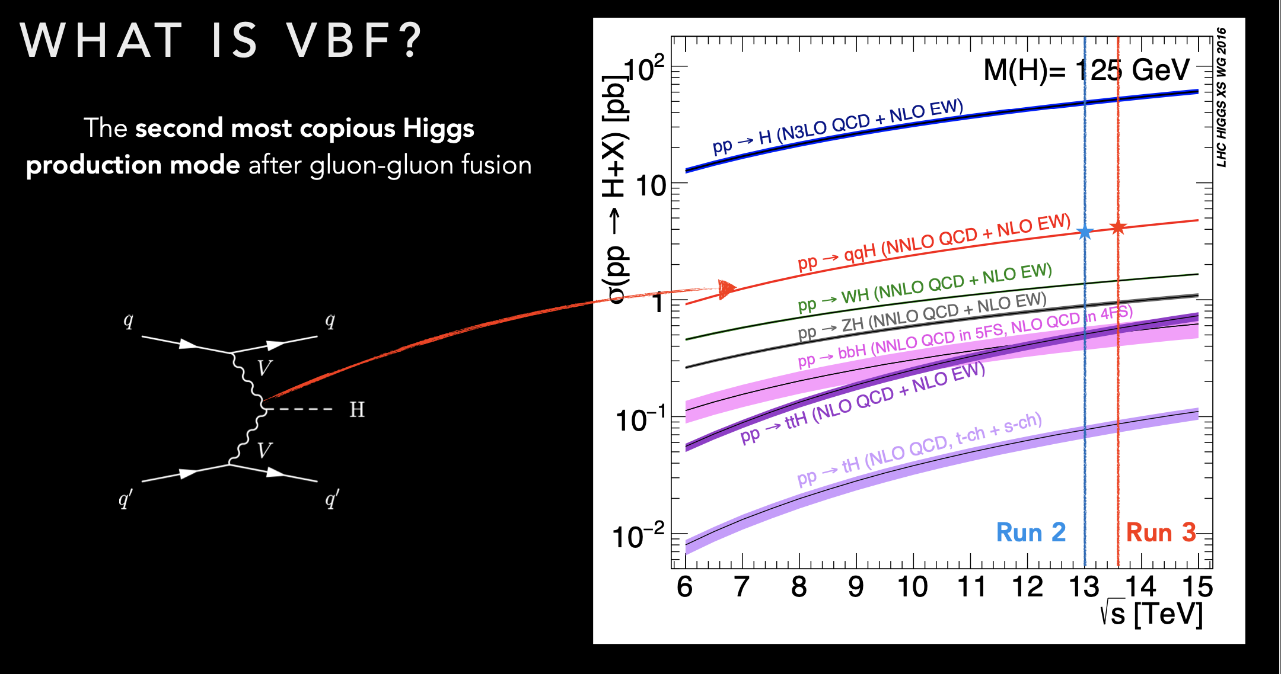

Slide 6
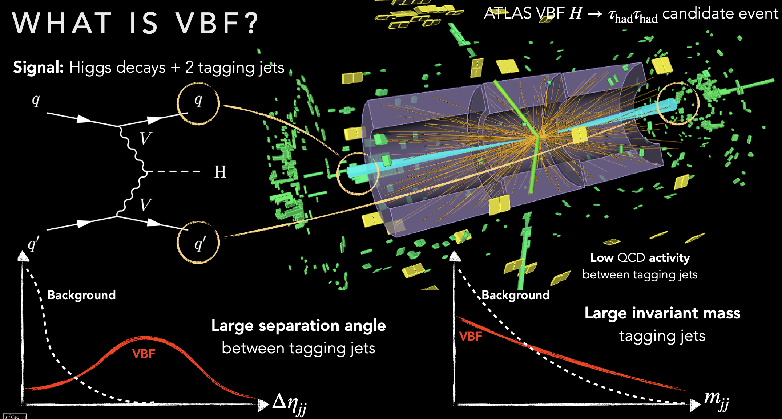

Slide 7
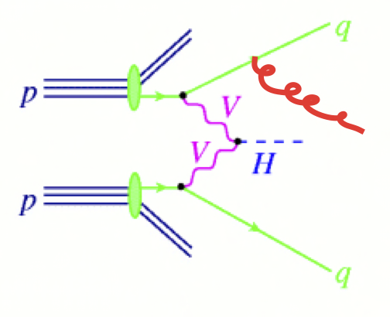
Vector Boson Fusion (+Jet)

Slide 8
Simulation Tools and Matrix Elements
Herwig 7 Event Generator (https://herwig.hepforge.org)
  General purpose event generator,
  parton showers, hadronization, MPI modeling
HJETS++ (https://hjets.hepforge.org)
  Add-on module to Herwig 7
VBFNLO (https://www.itp.kit.edu/vbfnlo)
  Interfaced to Herwig 7 via the Binoth One-Loop Accord

Slide 9
HJETS
F. Campario, T. M. Figy, S. Platzer, and M. Sjodahl, PRL 111, 211802
Matchbox [S. Platzer and S. Gieseke, arXiv:1109.6256]
  Catani-Seymour Dipole subtraction [hep-ph/9605323]
  Subtractive and POWHEG style matching to parton shower
  ColorFull [M. Sjodahl, arXiv:1211.2099, http://colorfull.hepforge.org]
Tensorial Reduction [F. Capanario, arXiv:1105.0920]
Scalar Loop Integrals: OneLOop [A. van Hameren arXiv:1007.4716 ]

Slide 10
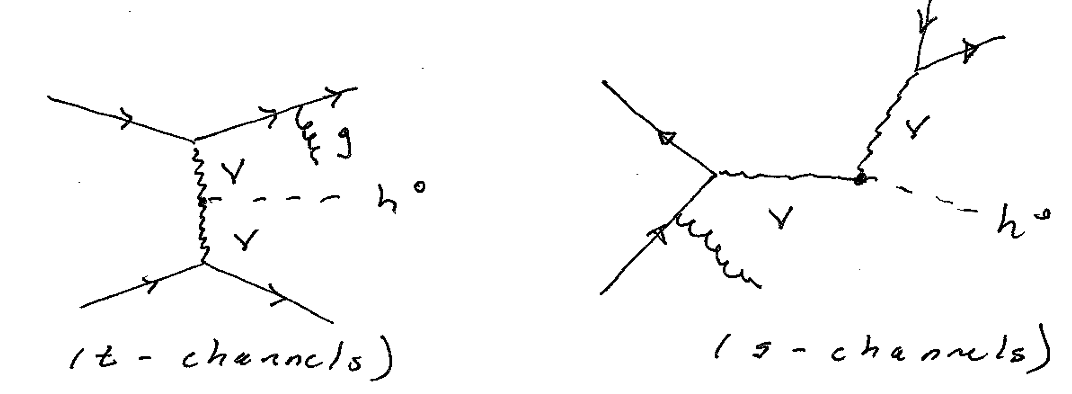
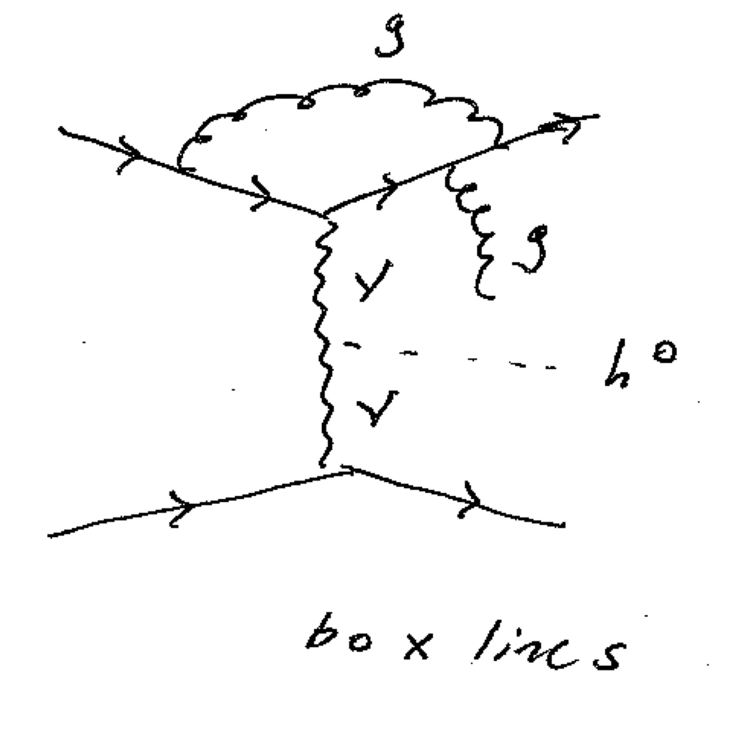
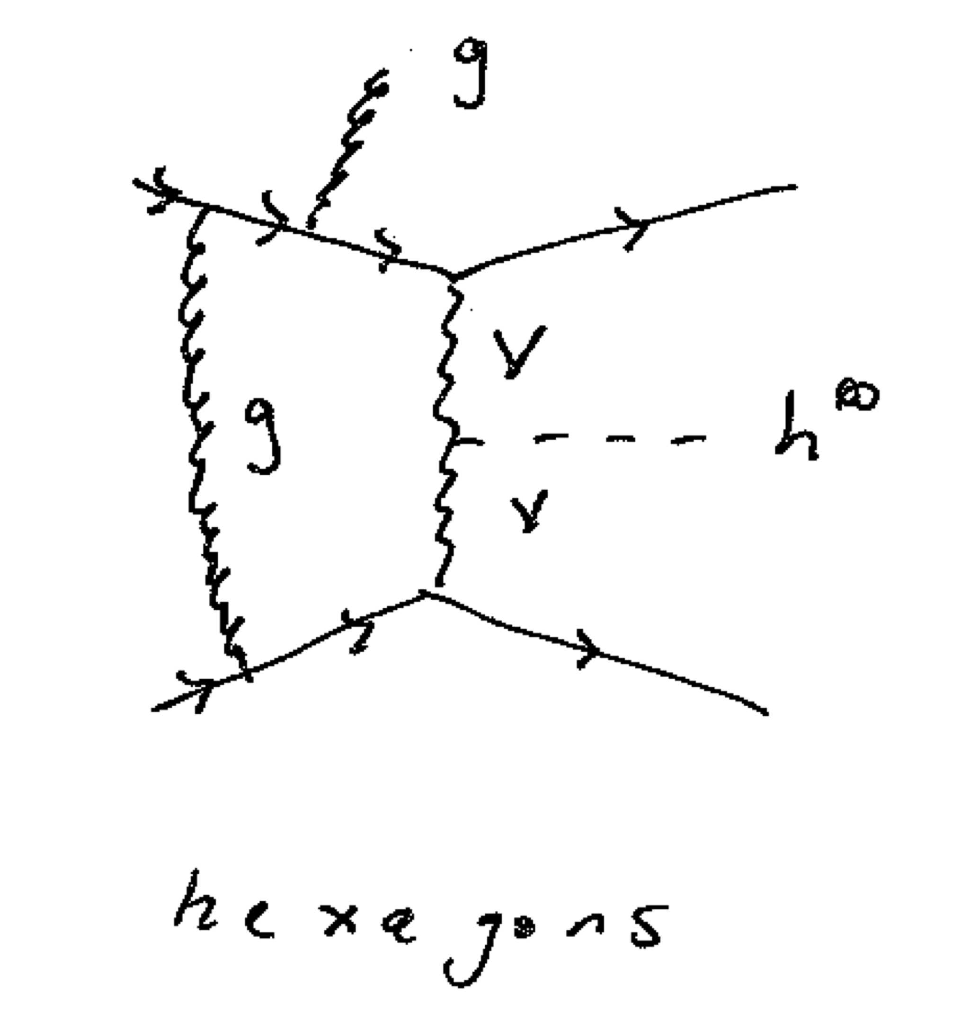
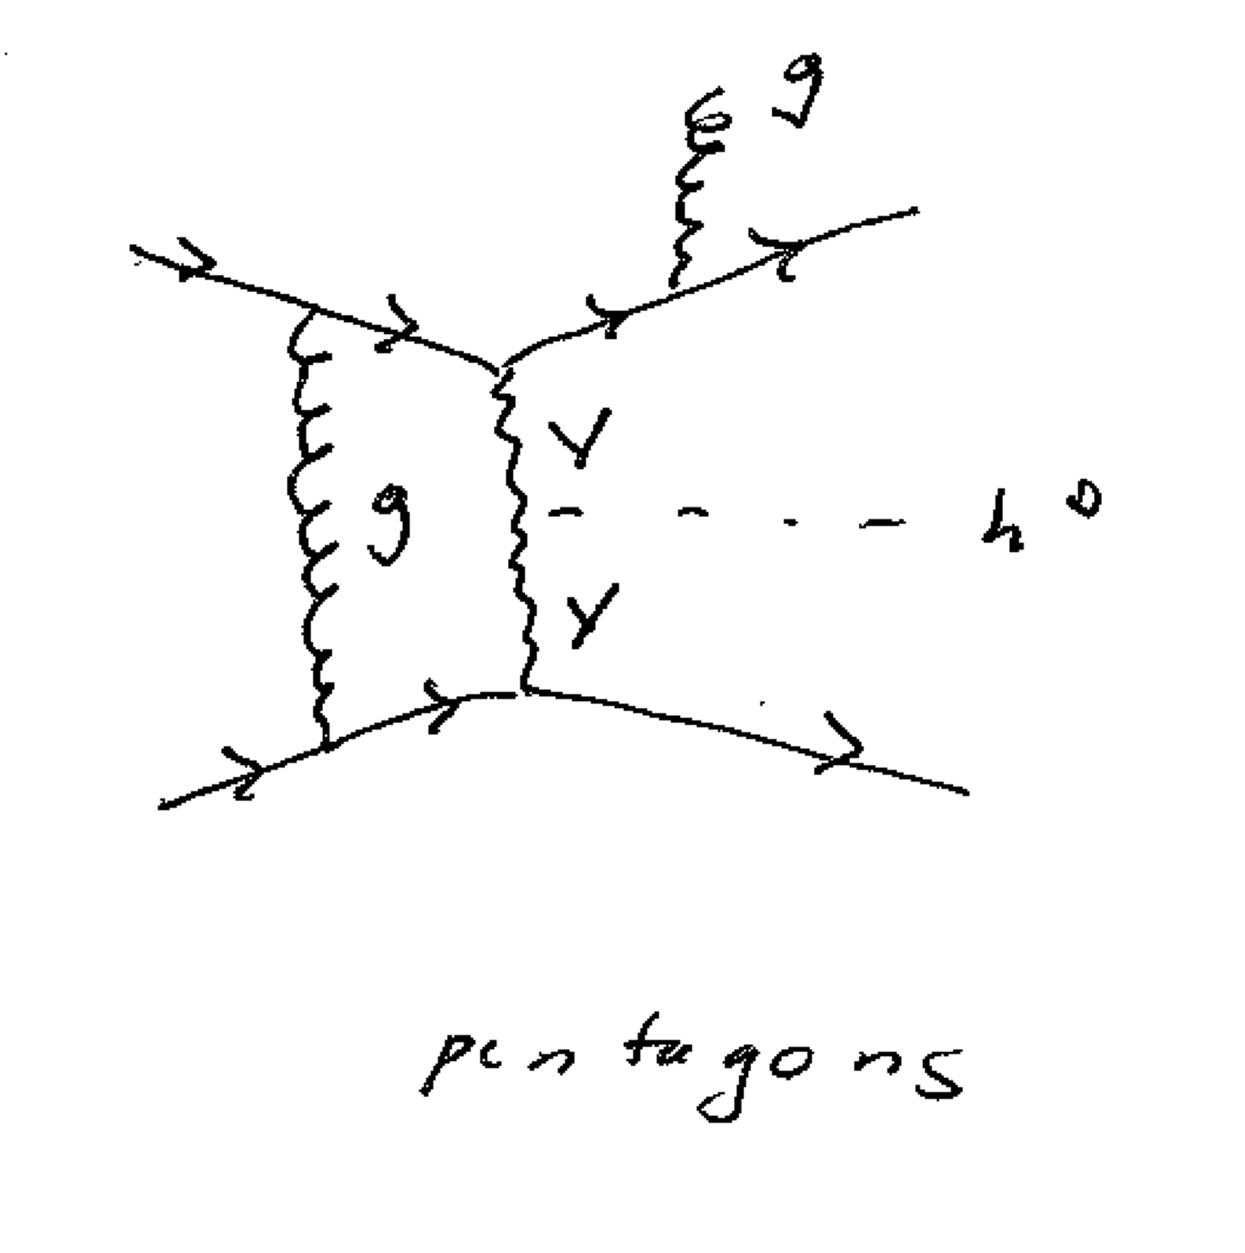
HJETS

Slide 11
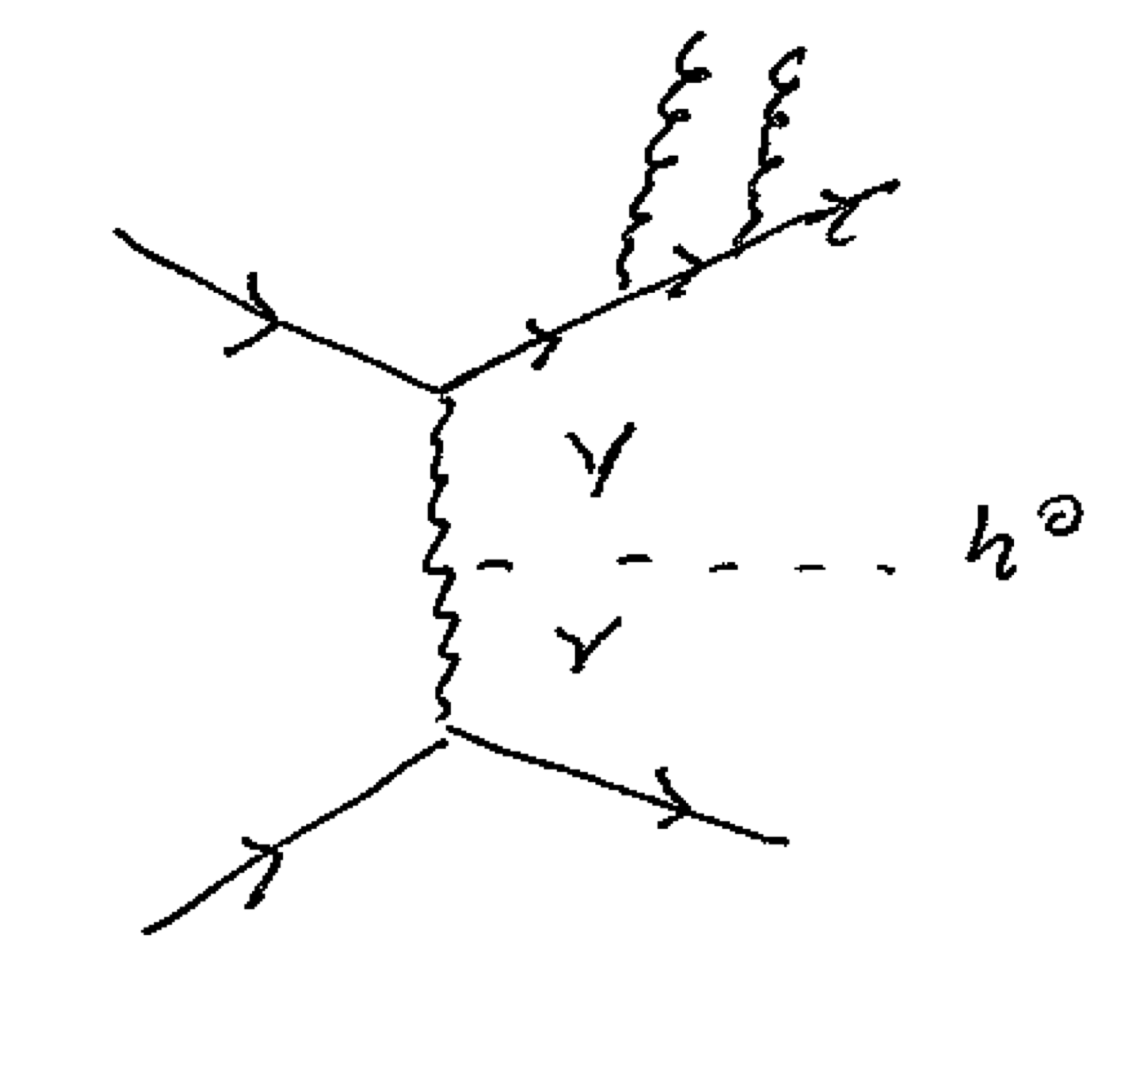
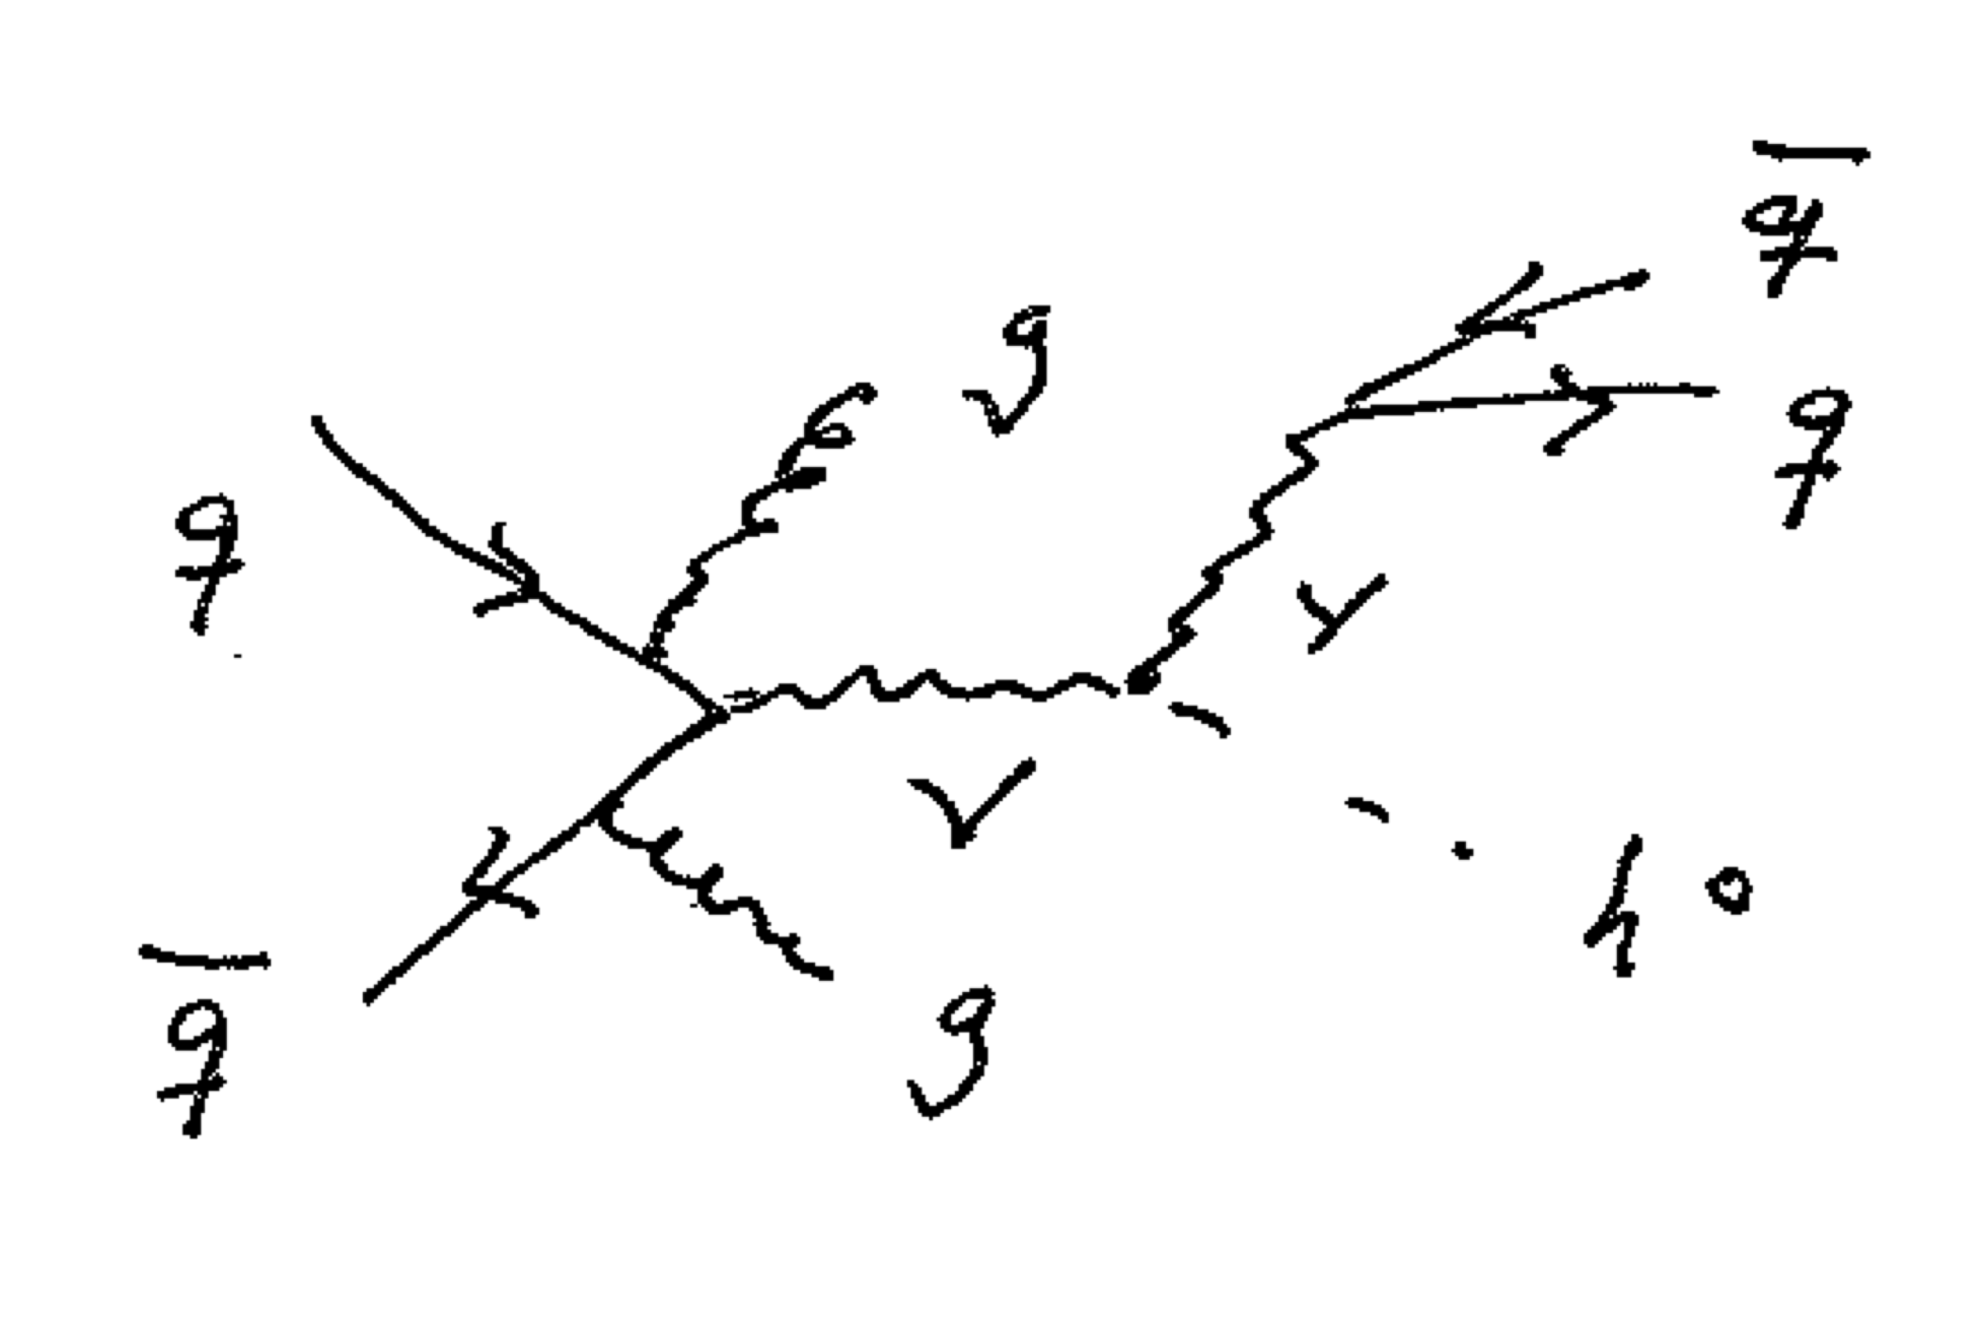
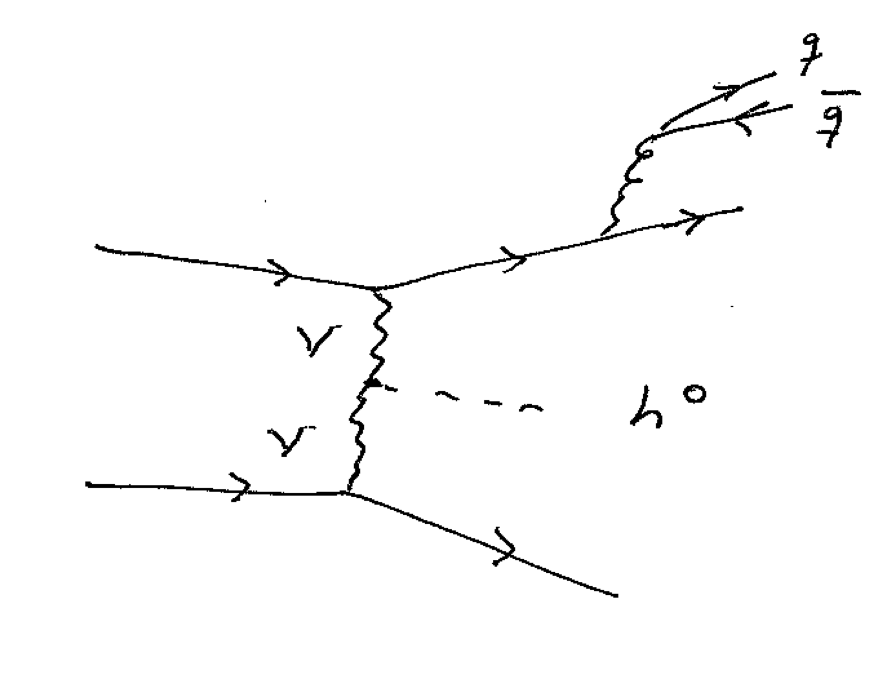
HJETS
Real Corrections

Slide 12
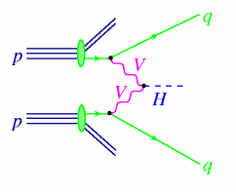
VBFNLO
Project Description
VBFNLO is a fully flexible parton level Monte Carlo program for the simulation of vector boson fusion, double and triple vector boson production in hadronic collisions at next to leading order in the strong coupling constant. VBFNLO includes Higgs and vector boson decays with full spin correlations and all off-shell effects. In addition, VBFNLO implements CP-even and CP-odd Higgs boson via gluon fusion, associated with two jets, at the leading order one loop level with the full top-quark and bottom-quark mass dependence in a generic two Higgs doublet model.
A variety of effects arising from beyond the Standard Model physics are implemented for selected processes. This includes anomalous couplings of Higgs and vector bosons and a Warped Higgsless extra dimension model. The program offers the possibility to generate Les Houches Accord event files for all processes available at leading order.
All implemented processes can be found here.
The list of people involved in VBFNLO is here.

Slide 13
Herwig 7

Slide 14
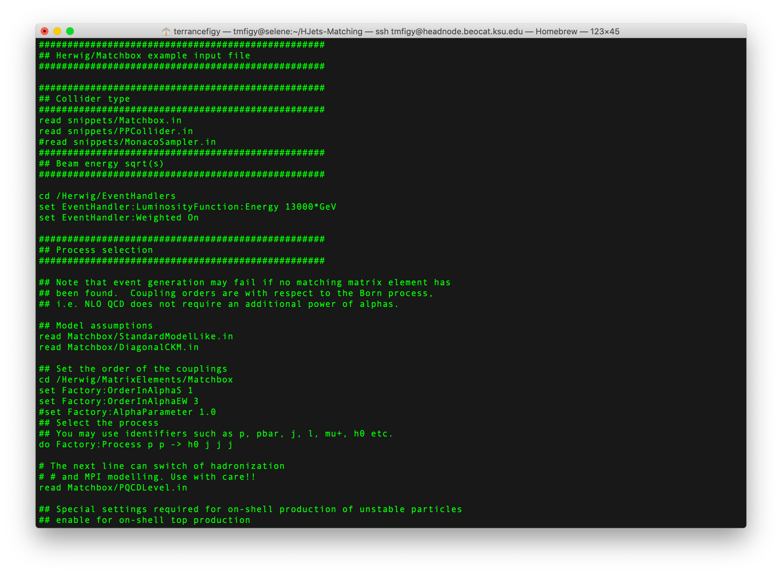
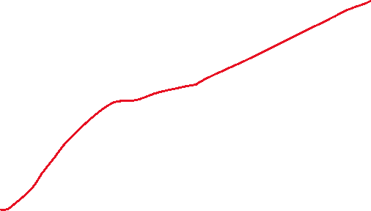

Slide 15
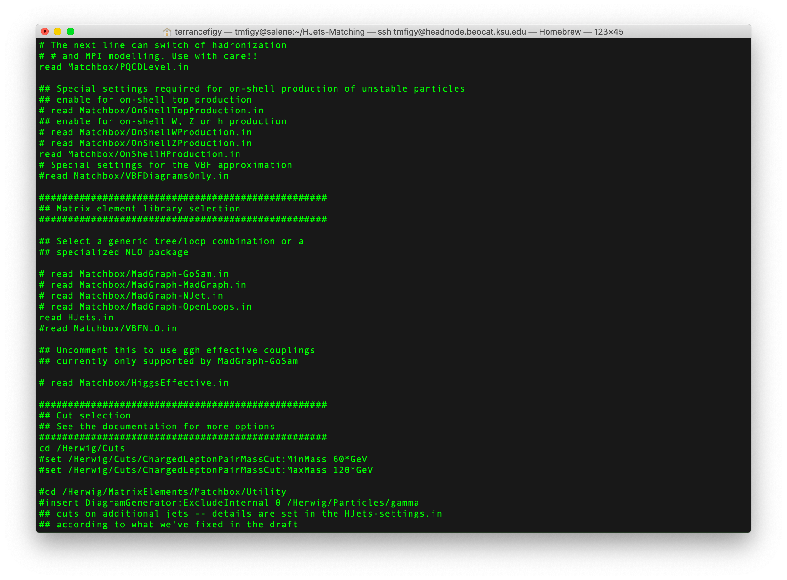

HJets
VBFNLO

Slide 16
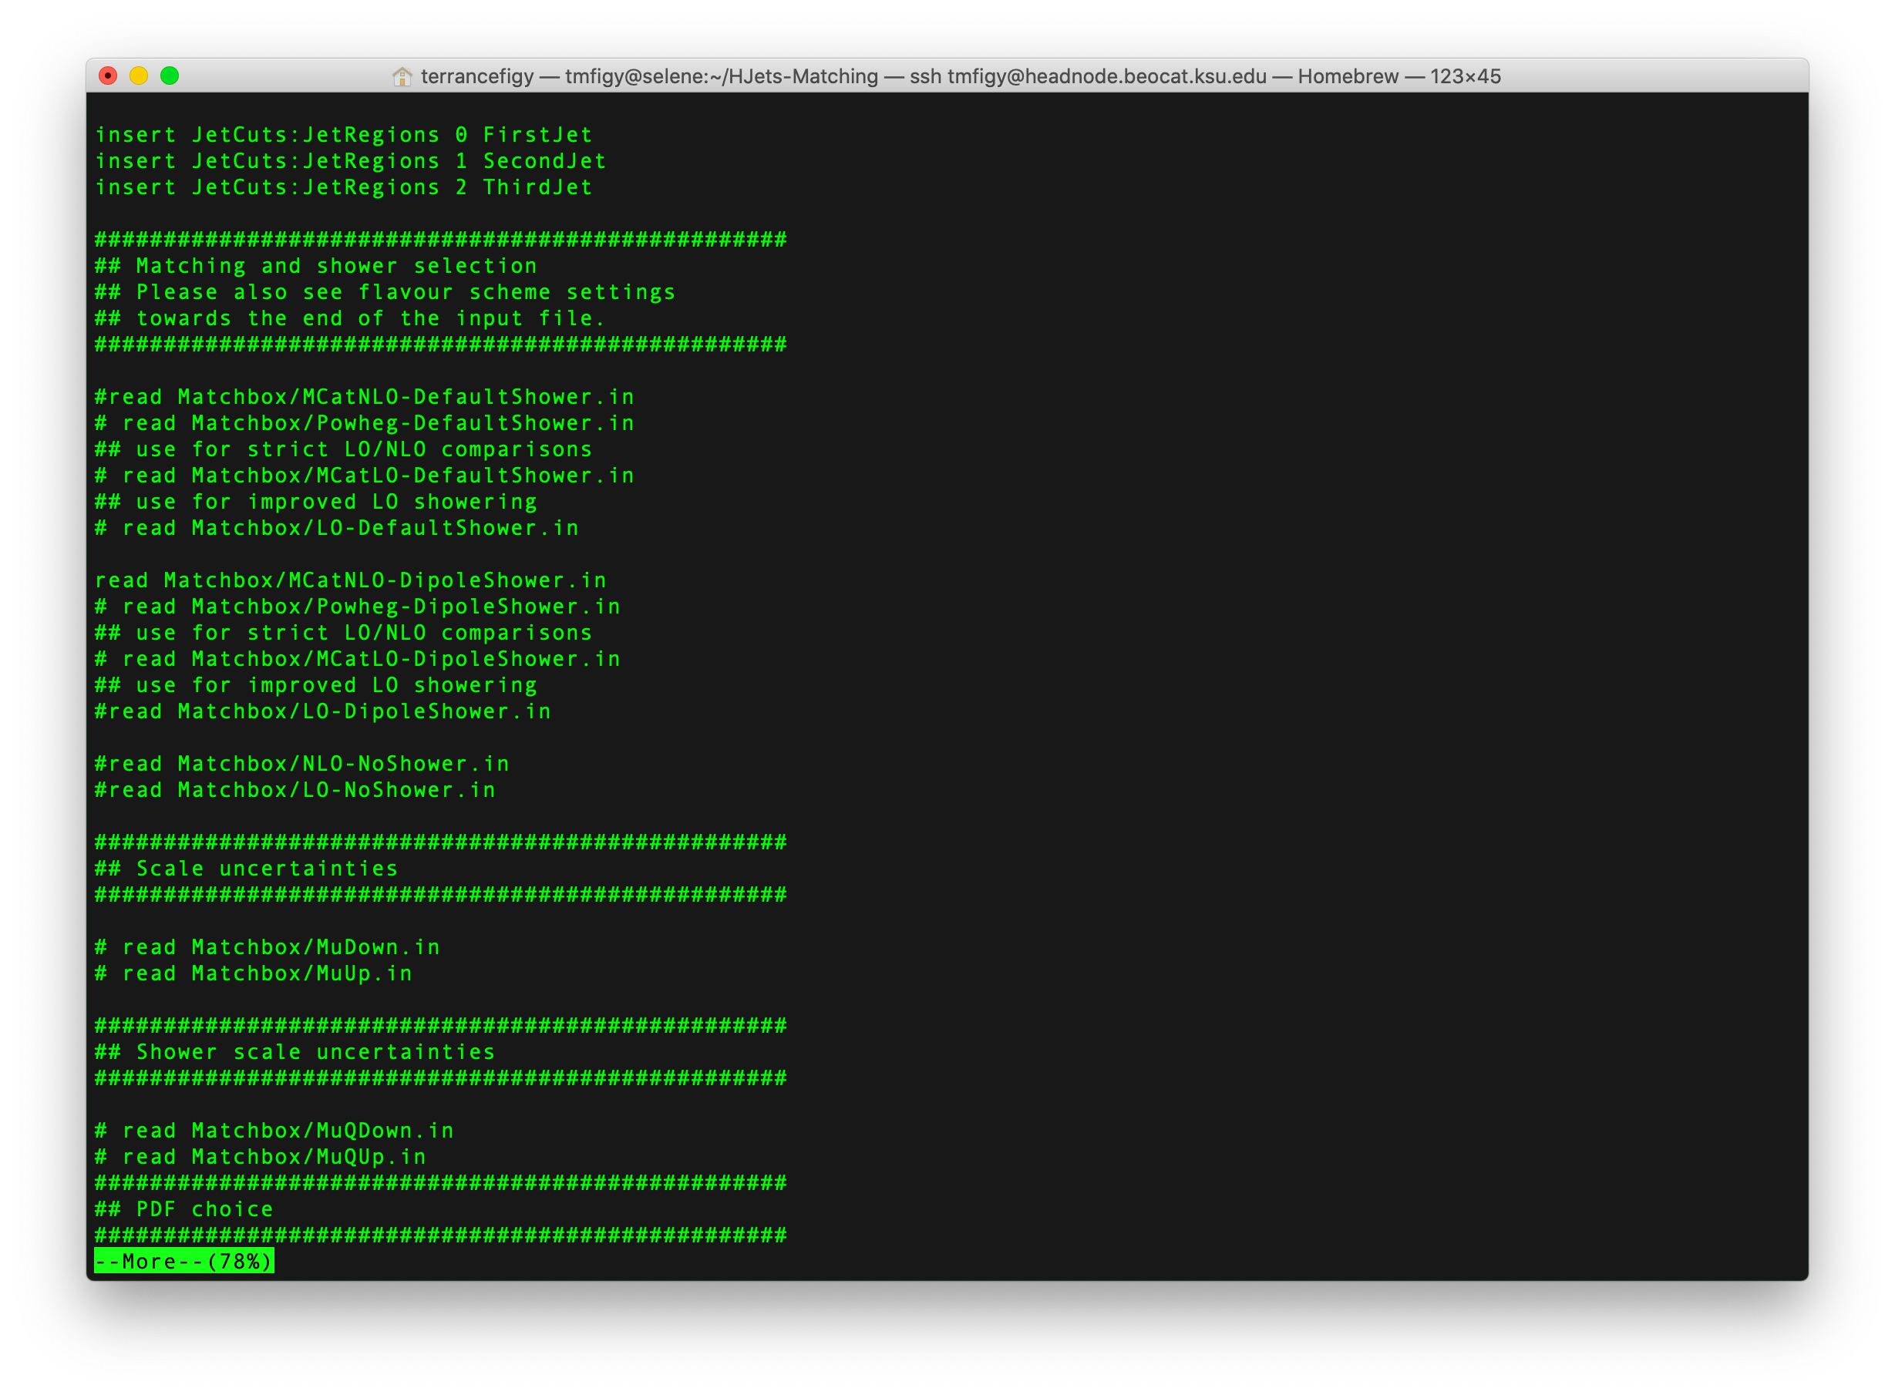


Various setup:
Fixed Order
NLO/LO matching
  Subtractive
  Powheg

Slide 17
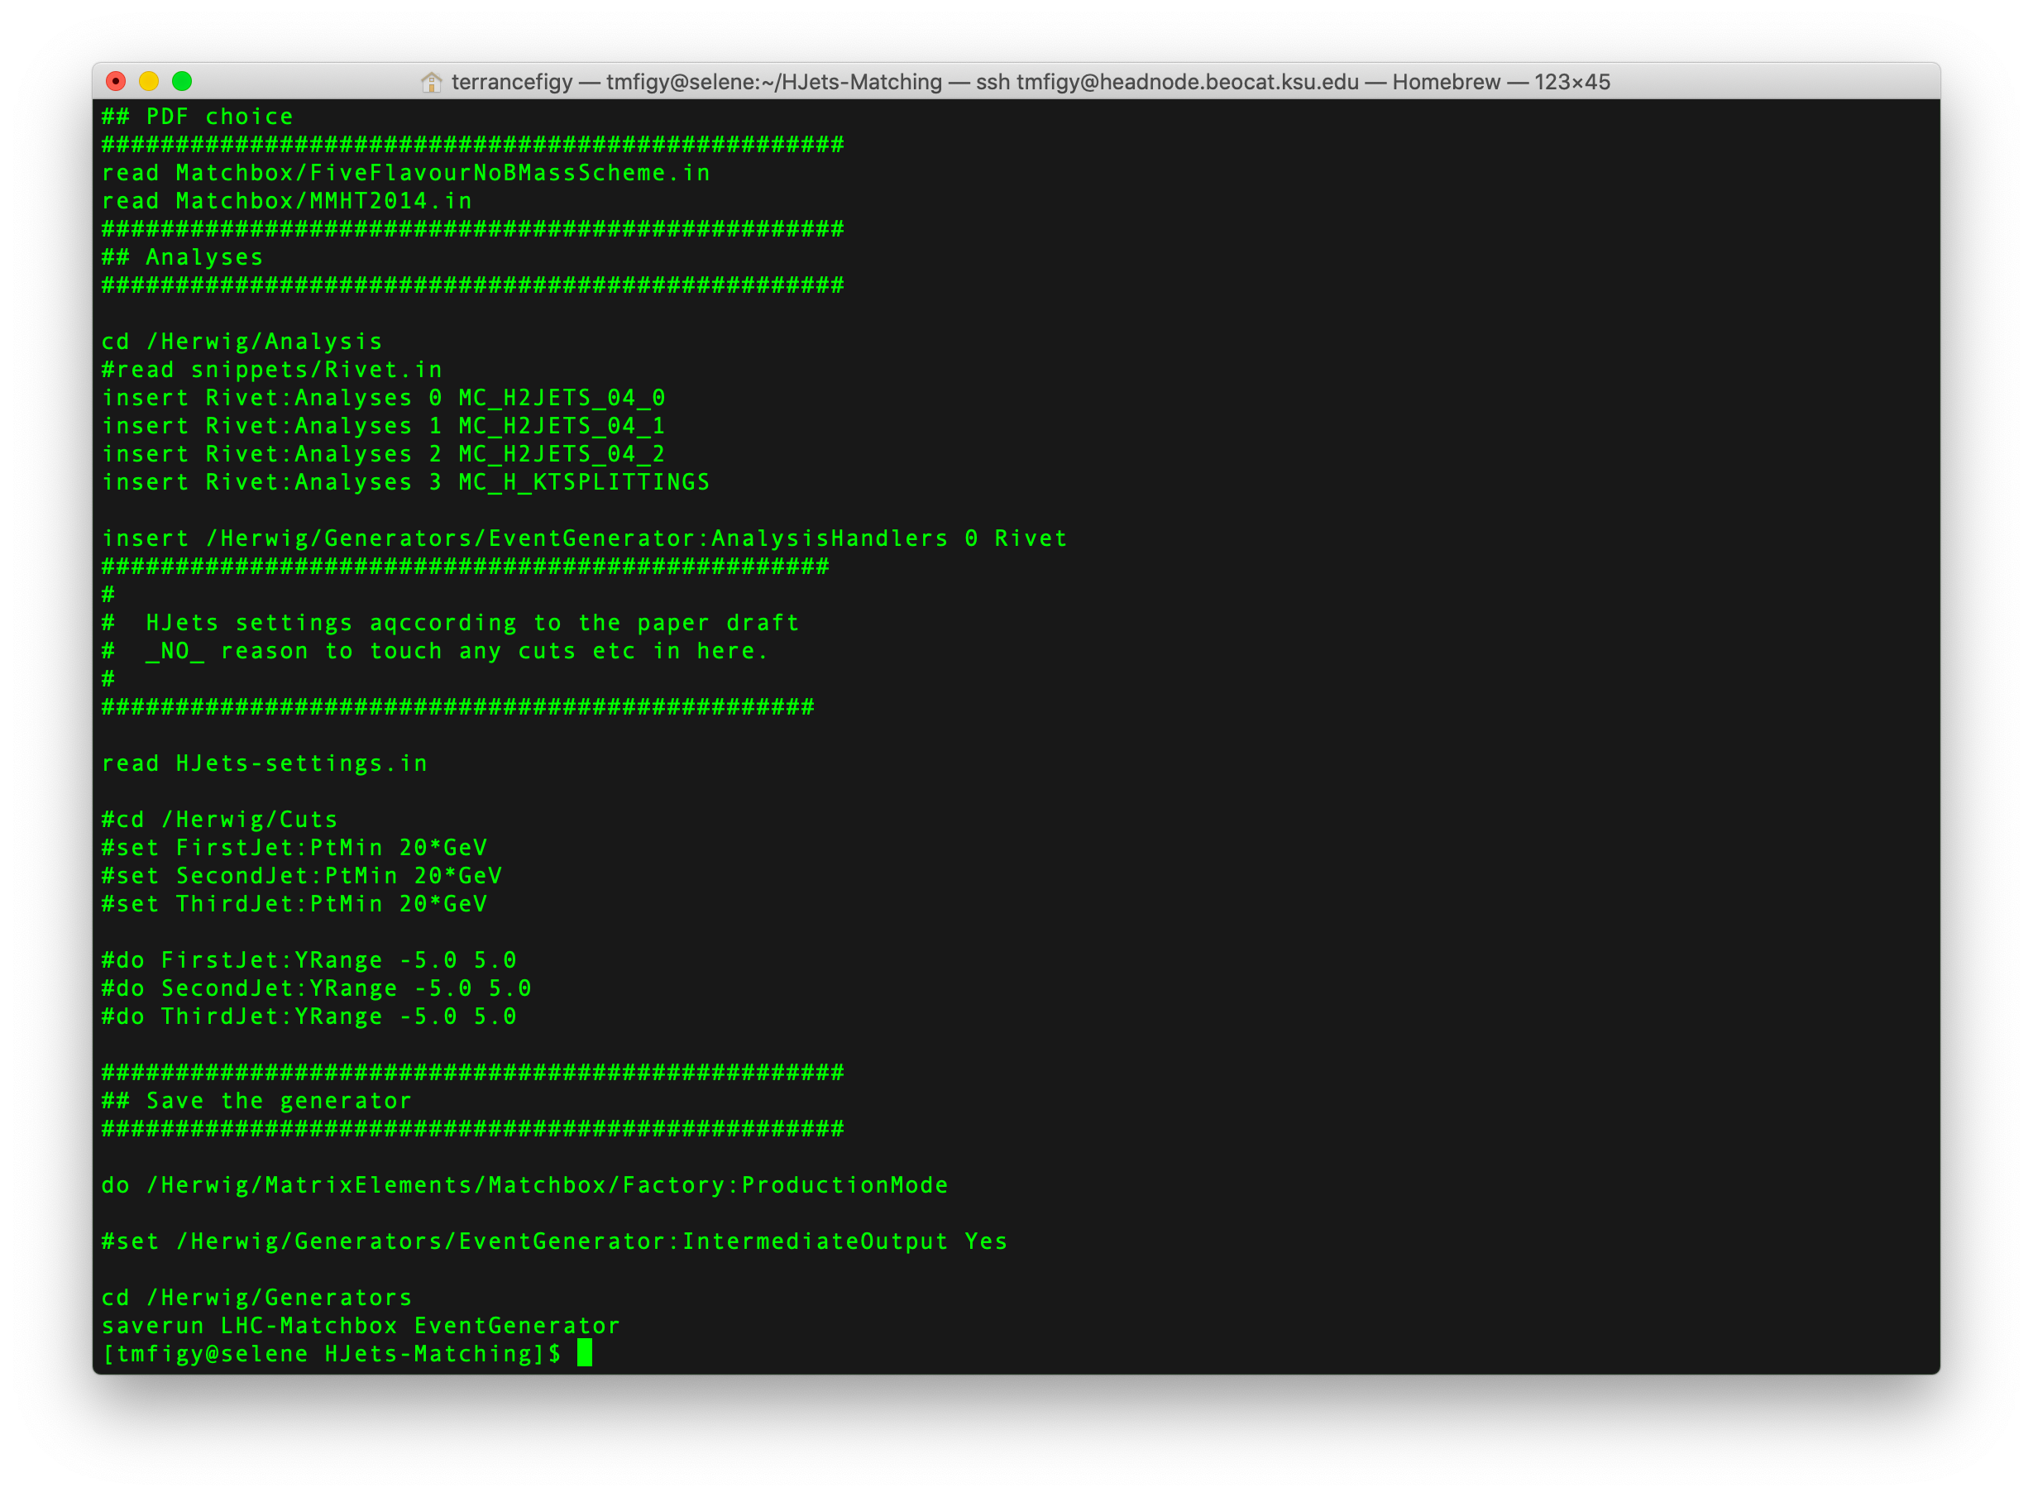

Rivet analysis for implementing
selection cuts and histogram.
Custom run setting can be read in.

Slide 18
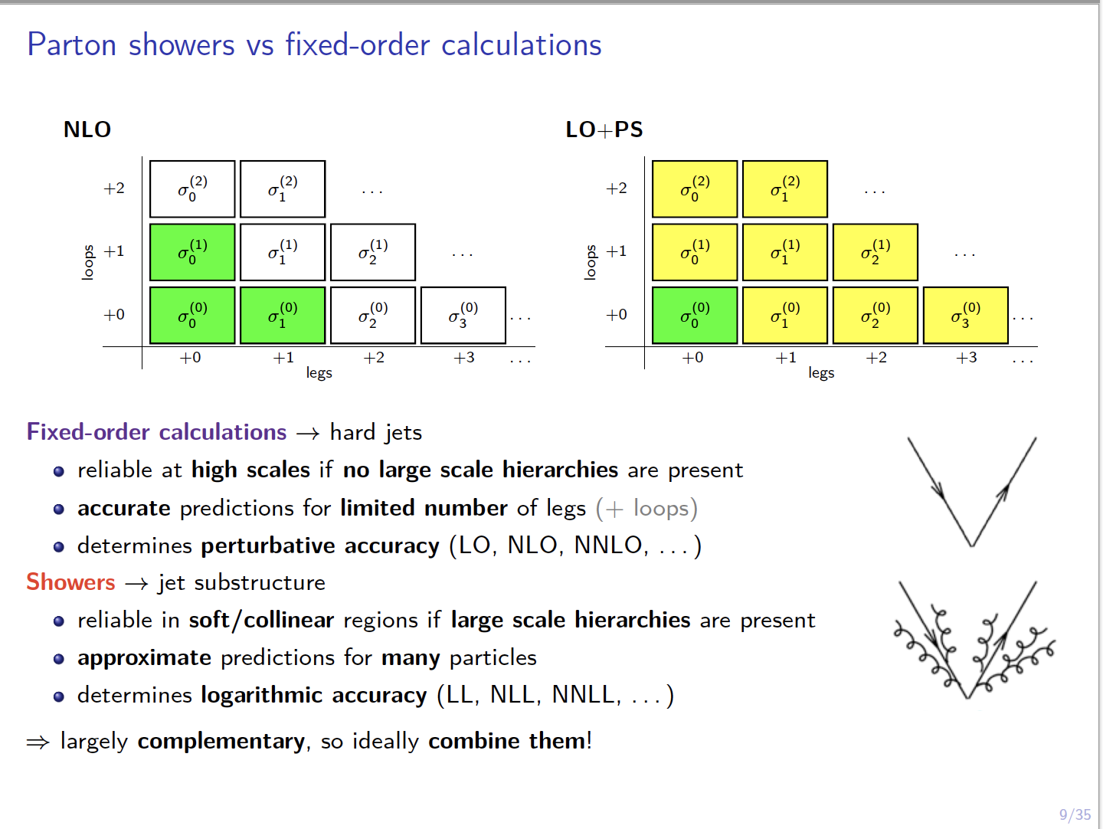
NLO Matching in Herwig 7
See https://arxiv.org/pdf/1605.07851.pdf
https://arxiv.org/pdf/1912.06509.pdf
https://arxiv.org/pdf/1109.6256.pdf

Slide 19
NLO Merging in Herwig 7
See https://arxiv.org/pdf/1705.06700.pdf
Dijet Production at the LHC

Slide 20
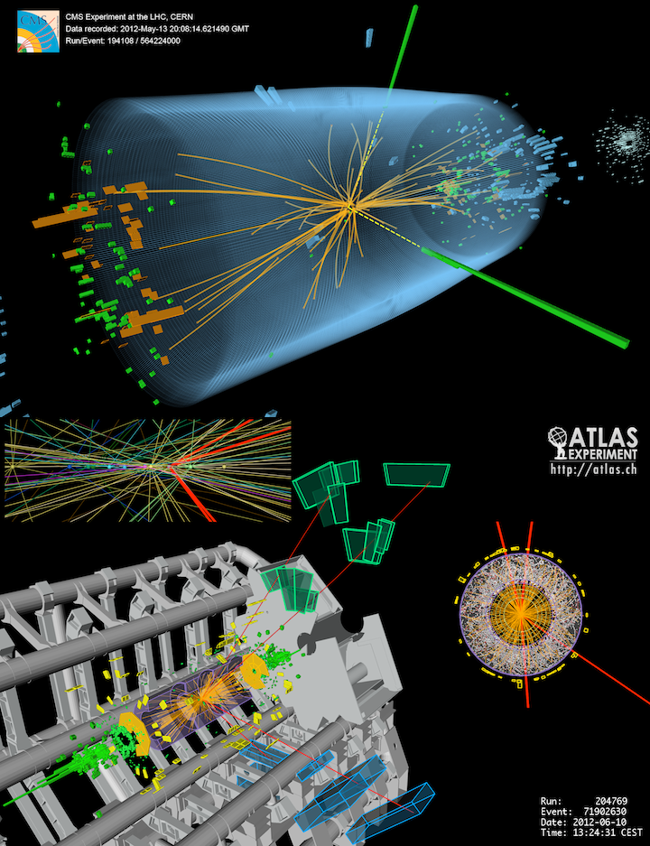
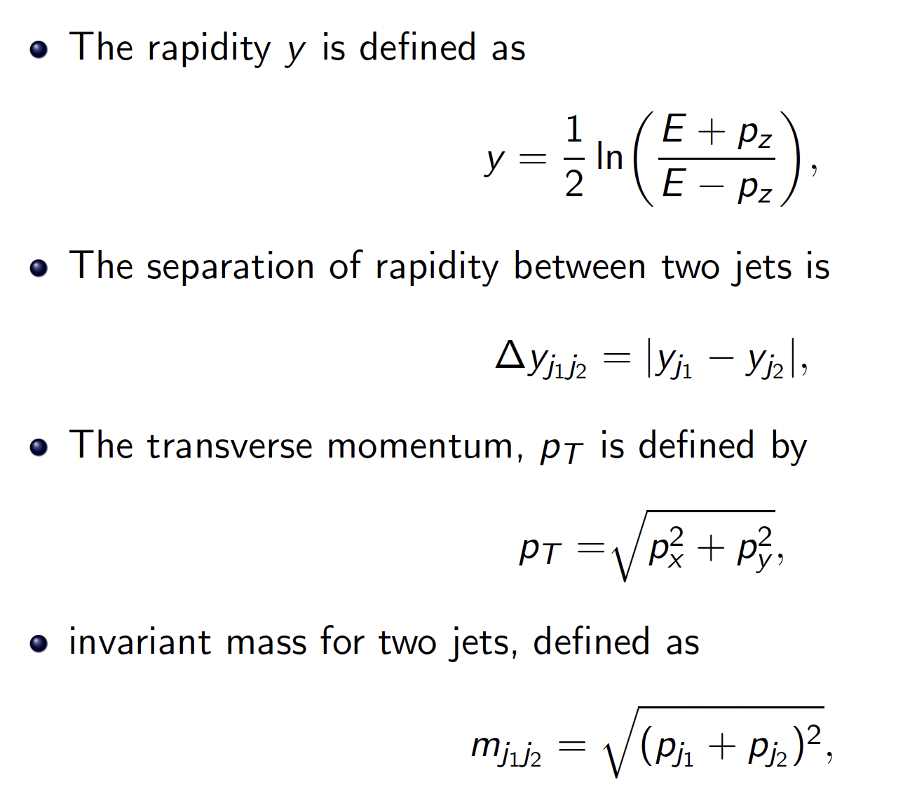
Definitions

Slide 21
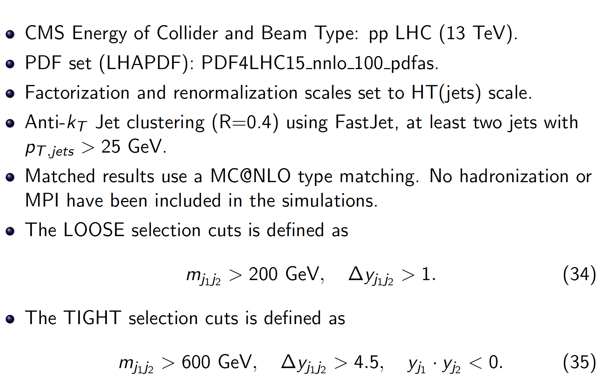
Input Parameters and Event Selection

Slide 22
Rapidity Gap and Invariant Mass
NLO+PS does a good job overall for 2 jet observables.

Slide 23
Inclusive Jet and Gap Jet Cross Section
Using HT(jets) for the scale.
Gap jets reside between yj1 and yj2.
Beyond 2 jets you need NLO 3 jet.

Slide 24
Gap Jet Activity
Gap Jets are quite soft.
Again, you need NLO for more than 2 jets

Slide 25
Transverse Momentum Spectrum (fixed scale: mh)

Slide 26
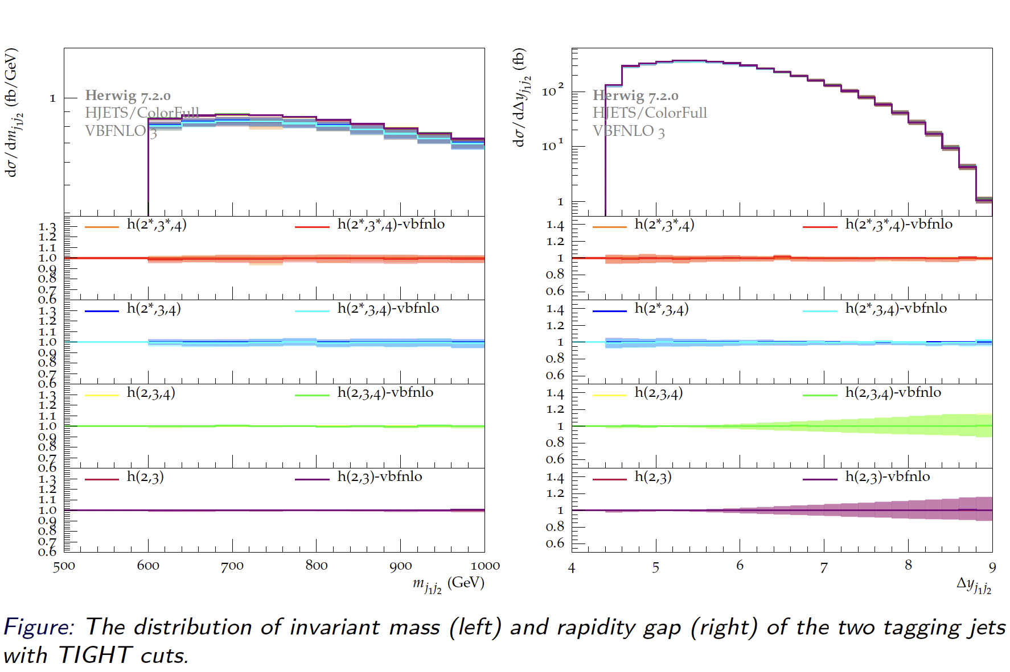
VBFNLO vs HJETS – Tight Selection Cuts

Slide 27
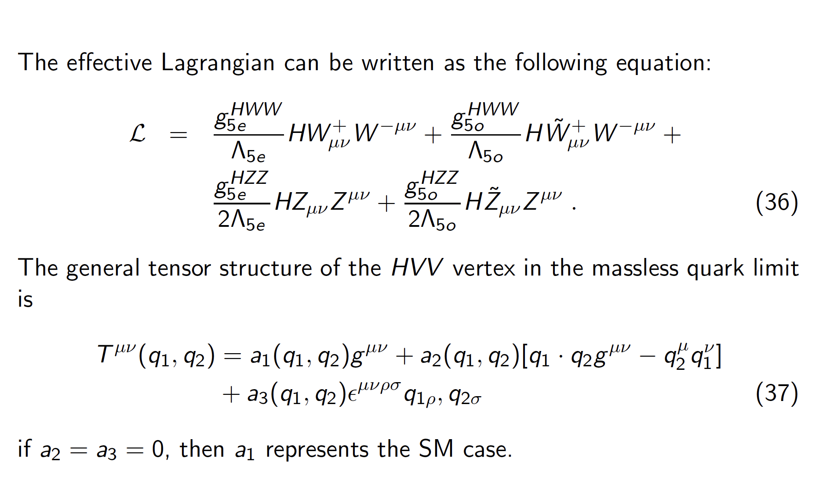
Anomalous Higgs Couplings

Slide 28
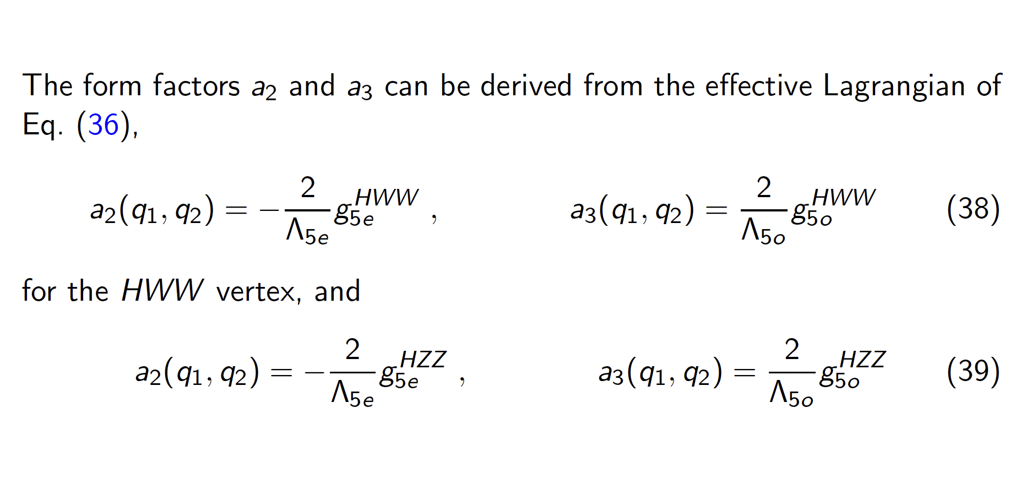
Anomalous Higgs Couplings

Slide 29
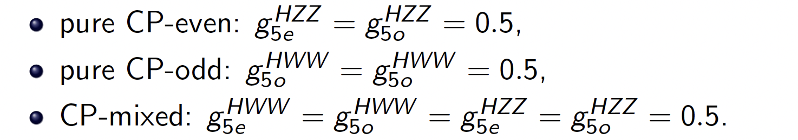
Anomalous Higgs Couplings

Slide 30
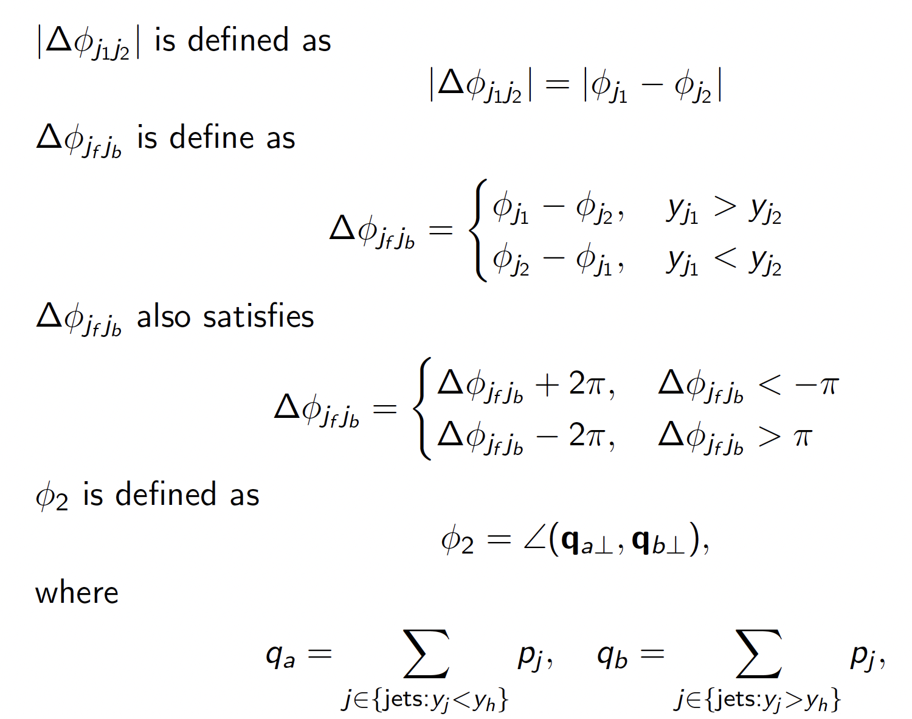
CP Sensitive Observables

Slide 31
Anomalous Higgs in VBFNLO
Anomalous Higgs Couplings were implemented into VBFNLO since 2004 for Higgs + 2 jets via VBF.
In 2012 there was an interest in using the PowHEG implementation of Higgs + 2 jets via VBF and a reweighting technique to generate predictions include parton shower and hadronization effects.
Today you can use VBFNLO with Herwig 7 to simulate Higgs Production with Anom Couplings (See Release Note—VBFNLO 3.0 for details, https://arxiv.org/abs/2405.06990 )

Slide 32
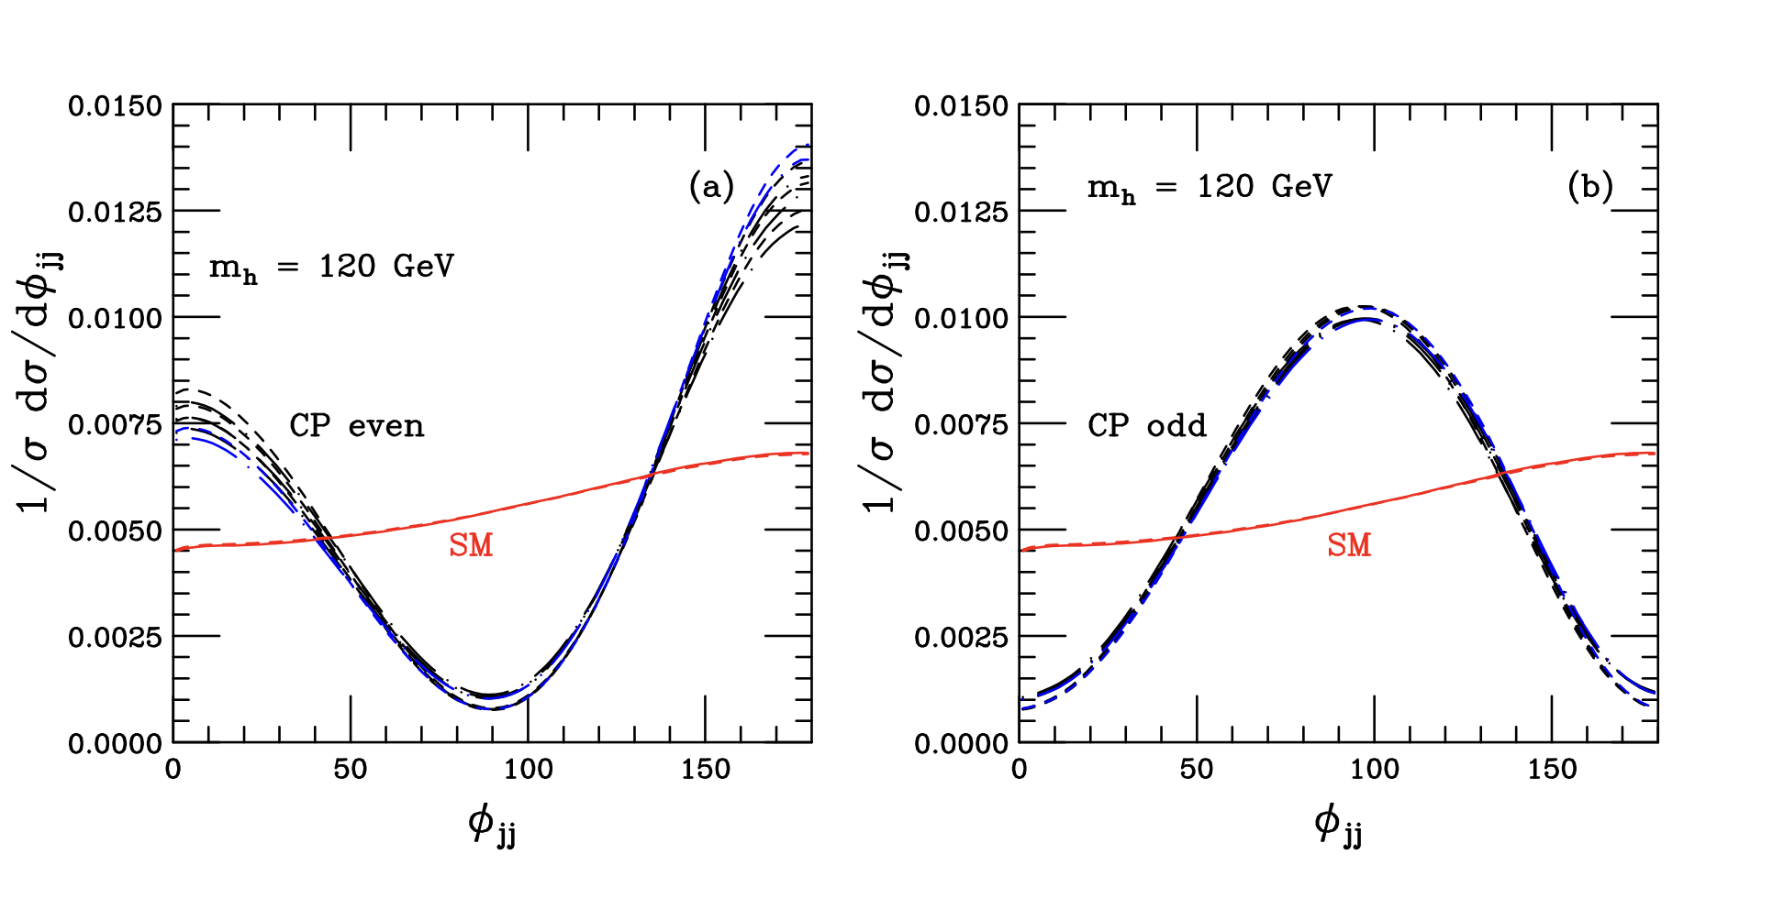
H+2 jets at Fixed Order (2004, arXiv: 0403297v1 )

Slide 33
Results using VBFNLO interfaced to Herwig 7
H+3 jets now allows anom couplings
You can now merge H+2 and H+3 NLO calculations using Herwig 7.
Also, H+2 and H+3 jet NLO matched calcuations can be performed using Herwig 7

Slide 34
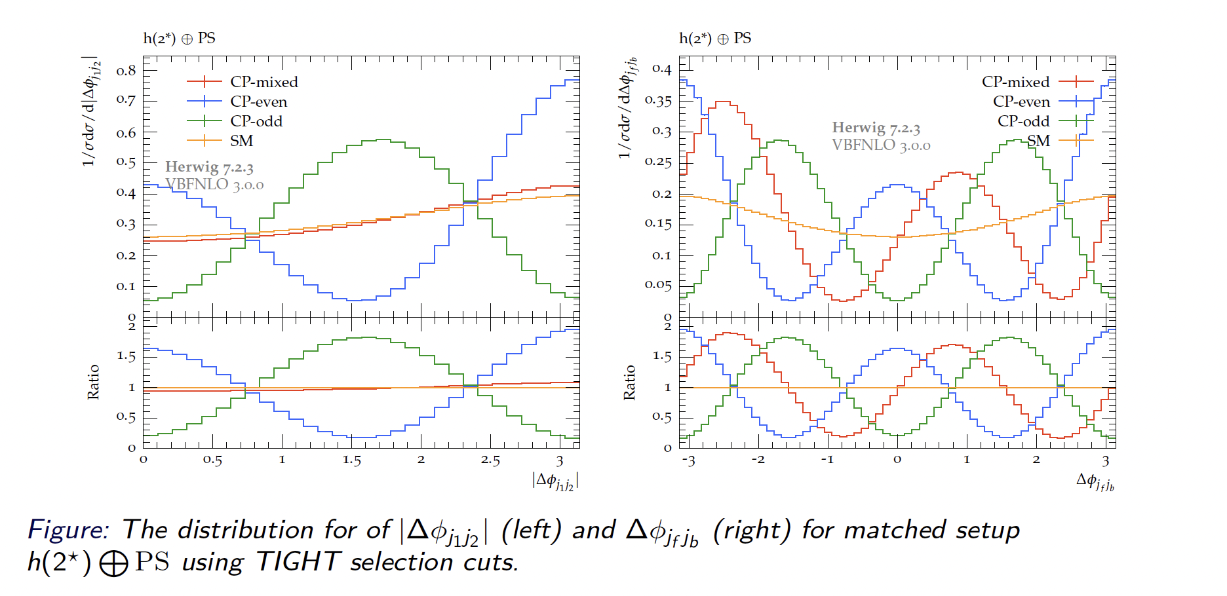
Azimuthal Angle Correlations

Slide 35
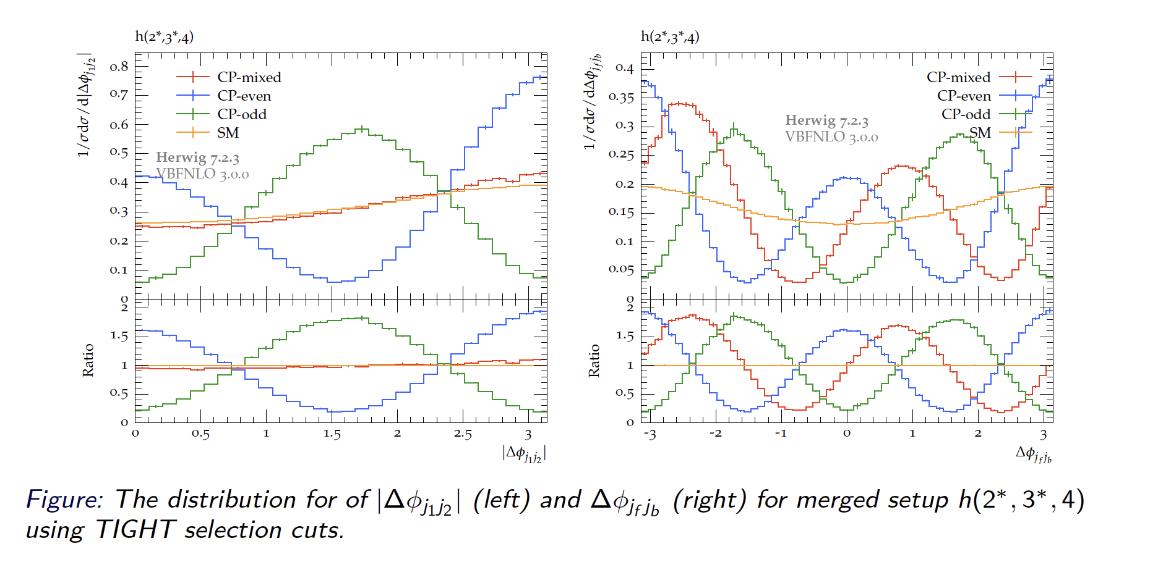
Azimuthal Angle Correlations

Slide 36
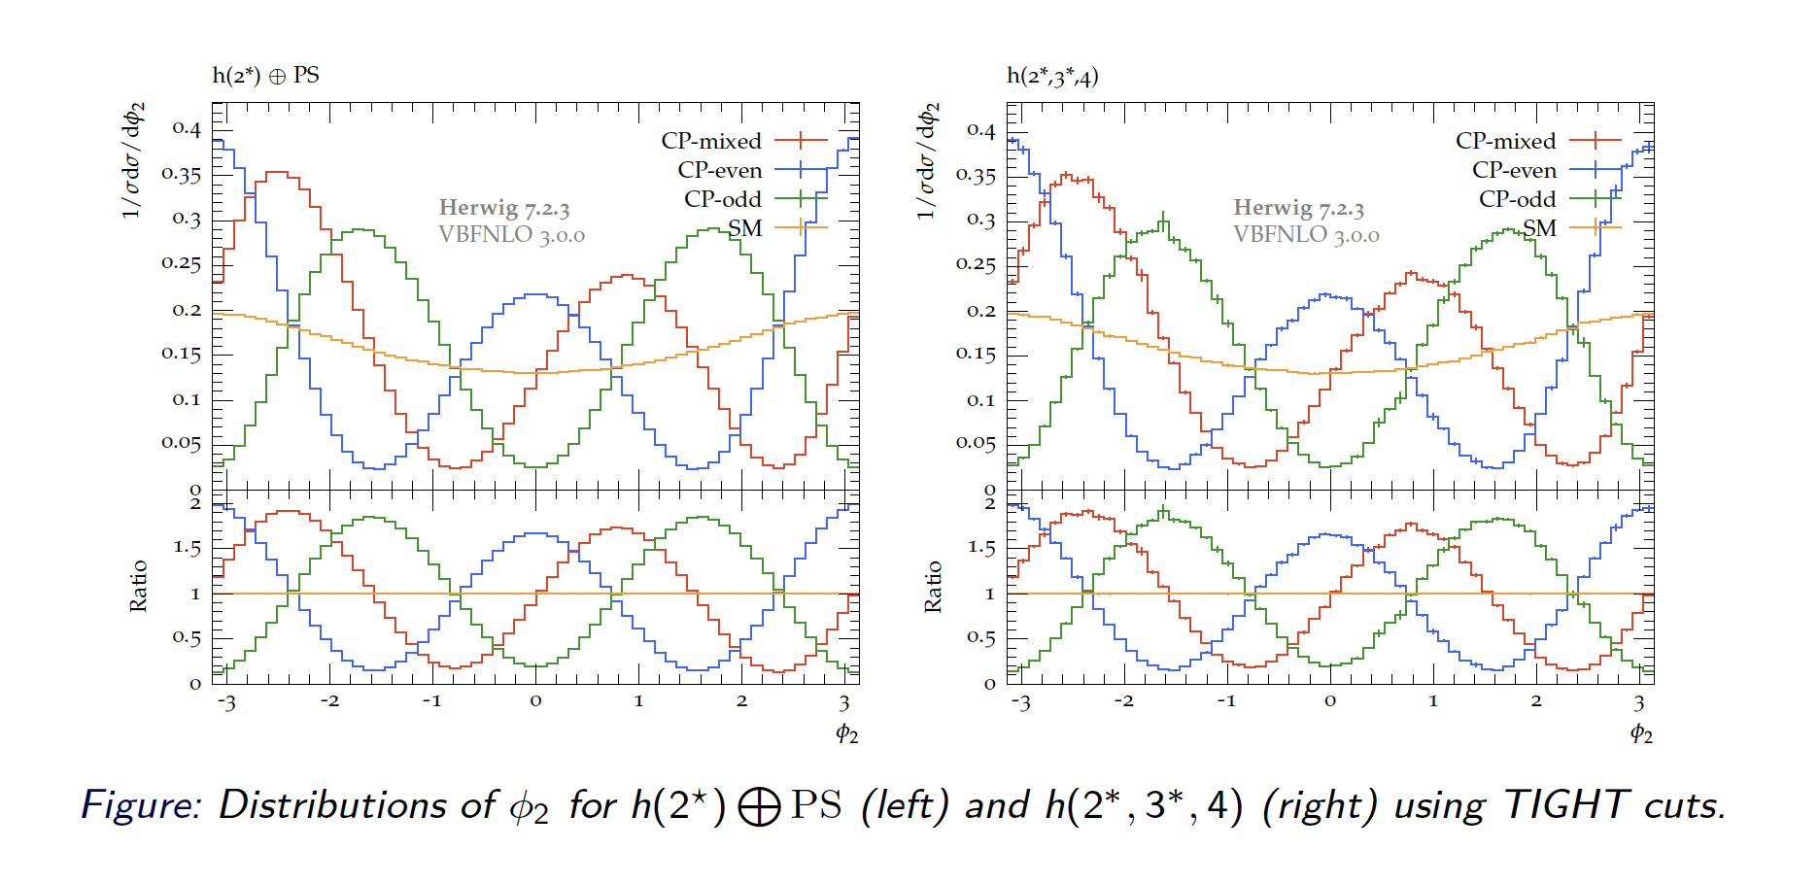
Azimuthal Angle Correlations

Slide 37
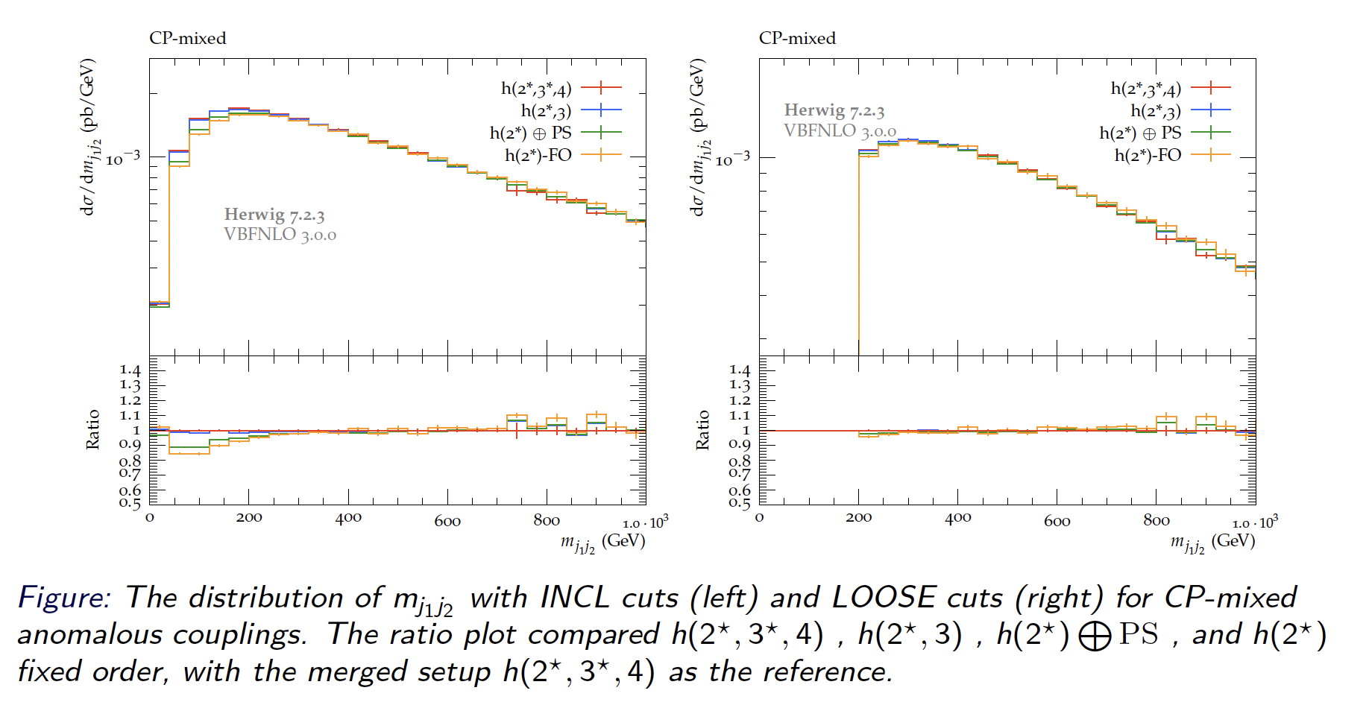
Invariant Mass of Di-Tag System

Slide 38
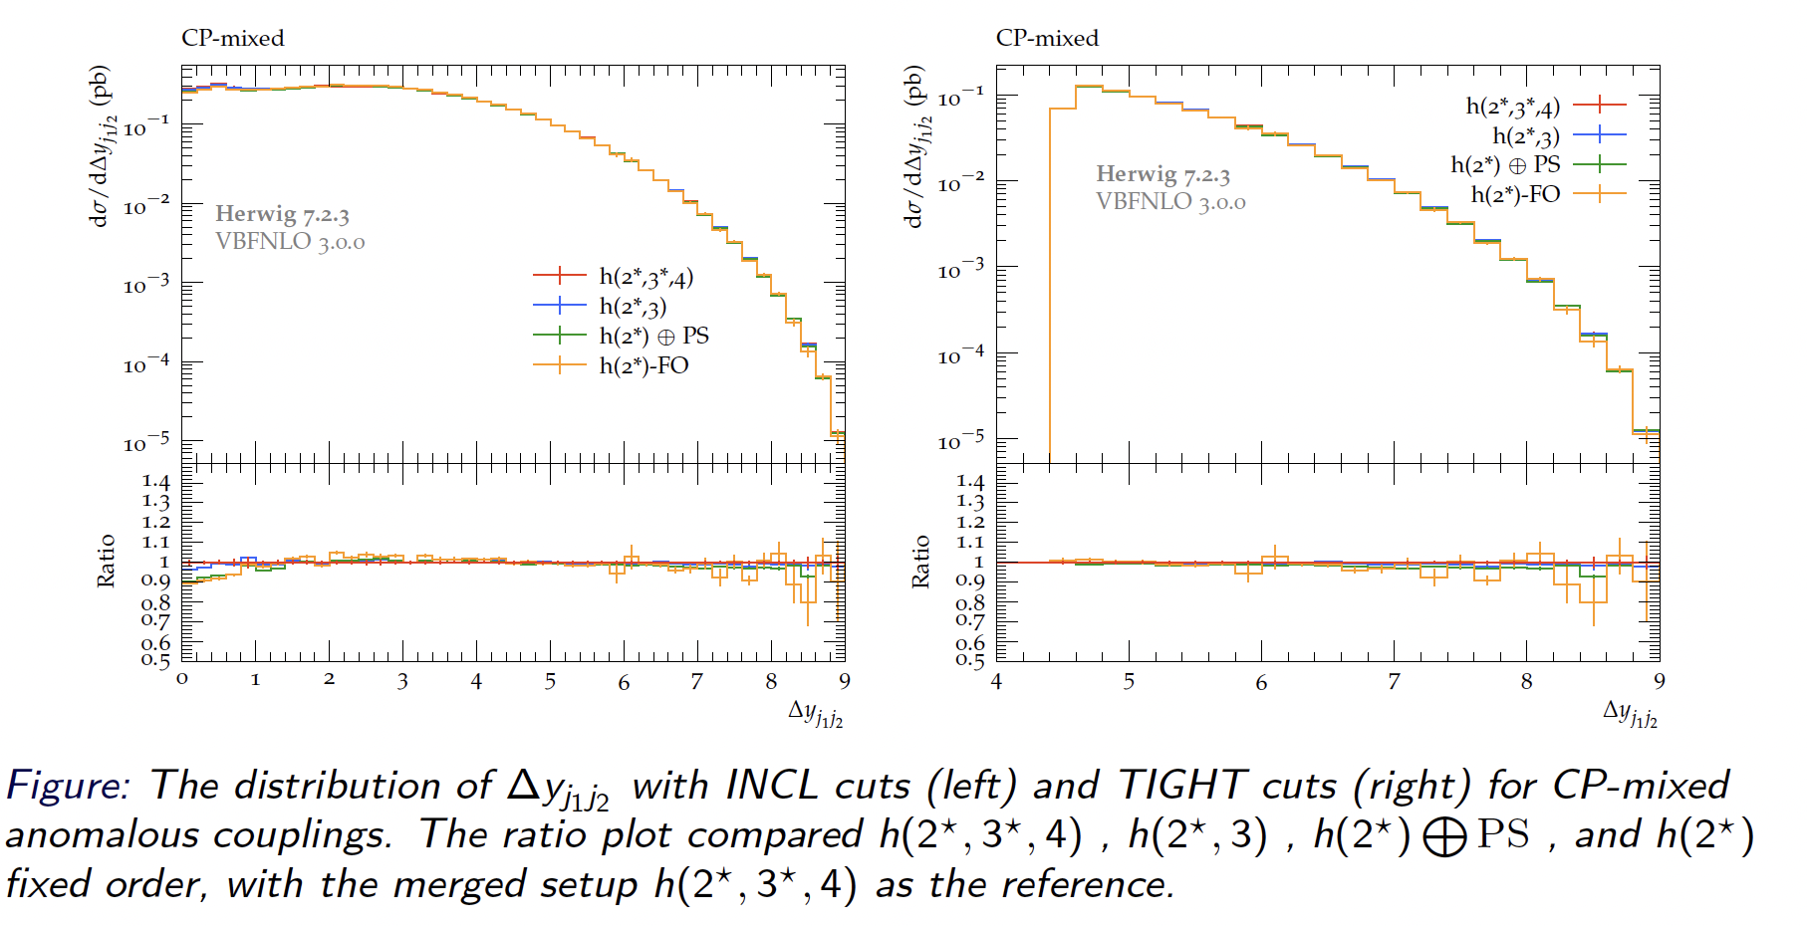
Rapidity Gap

Slide 39
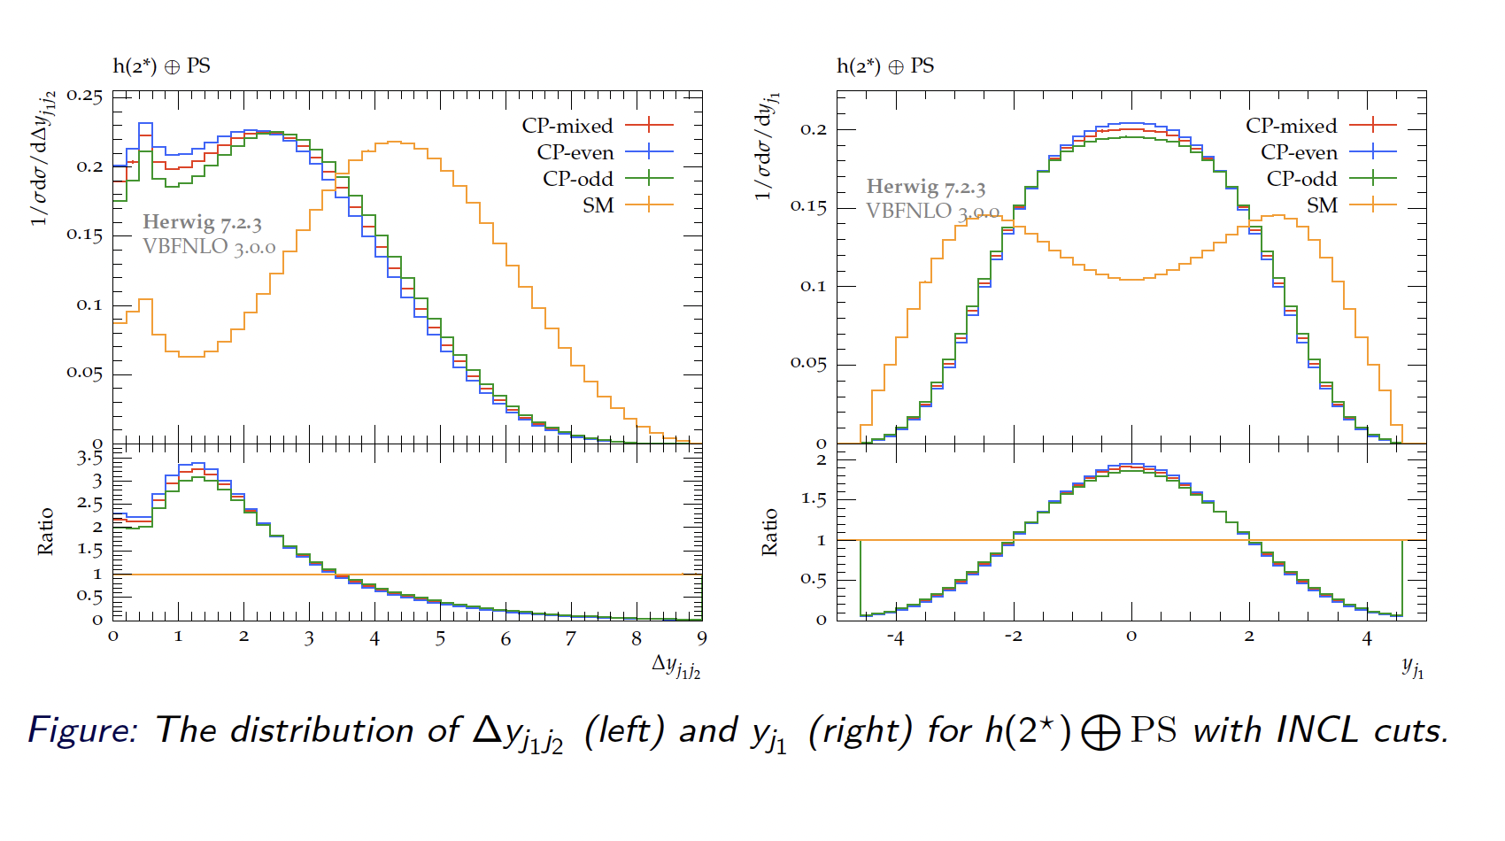
Rapidity Gap and Rapidity

Slide 40
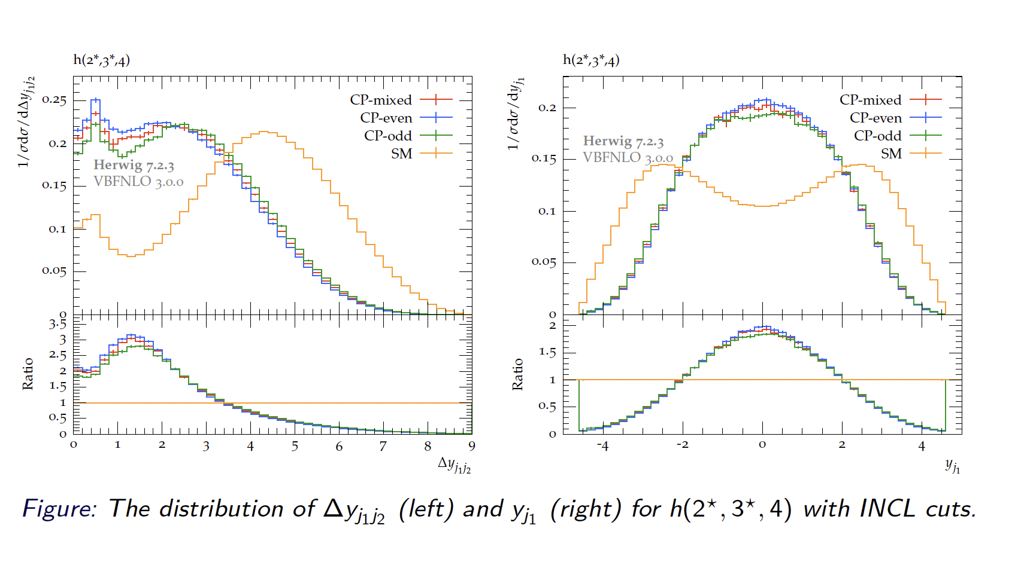
Rapidity Gap and Rapidity

Slide 41
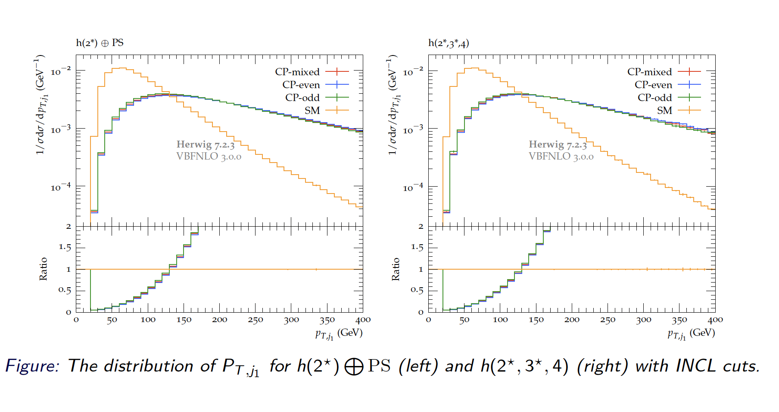
Transverse Momentum

Slide 42
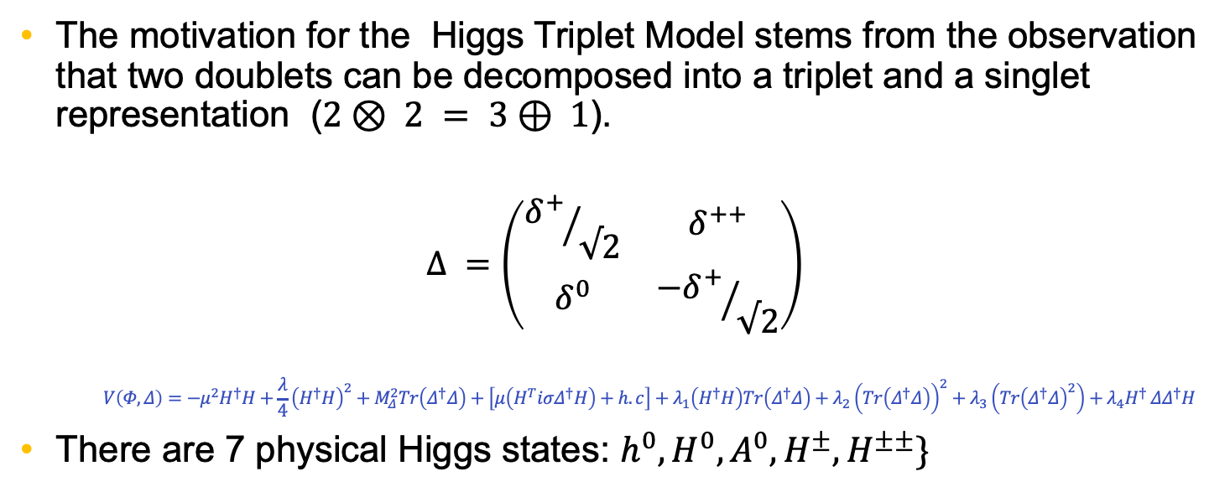
Higgs Triplet Model (Type II Seesaw Model)
arXiv:1105.1925
The motivation for the Higgs Triplet Model stems from the observation that two doublets can be decomposed into a triplet and a singlet representation ($2⊗ 2 = 3⊕ 1$).
$$Δ =\left(\begin{matrix}{δ^{+}}/{√2} & δ^{++} \\ δ^{0} & {−δ^{+}}/{√2}\end{matrix}\right)$$
    $$V\left(Φ,Δ\right)=−μ^{2}H^{†}H+\frac{λ}{4}{\left(H^{†}H\right)}^{2}+M_{Δ}^{2}Tr\left(Δ^{†}Δ\right)+\left[μ\left(H^{T}iσΔ^{†}H\right)+h.c\right]+λ_{1}\left(H^{†}H\right)Tr\left(Δ^{†}Δ\right)+λ_{2}{\left(Tr\left(Δ^{†}Δ\right)\right)}^{2}+λ_{3}\left(Tr{\left(Δ^{†}Δ\right)}^{2}\right)+λ_{4}H^{† }ΔΔ^{†}H$$
There are 7 physical Higgs states: $h^{0},H^{0}, A^{0}, H^{±},H^{±±}\}$

Slide 43
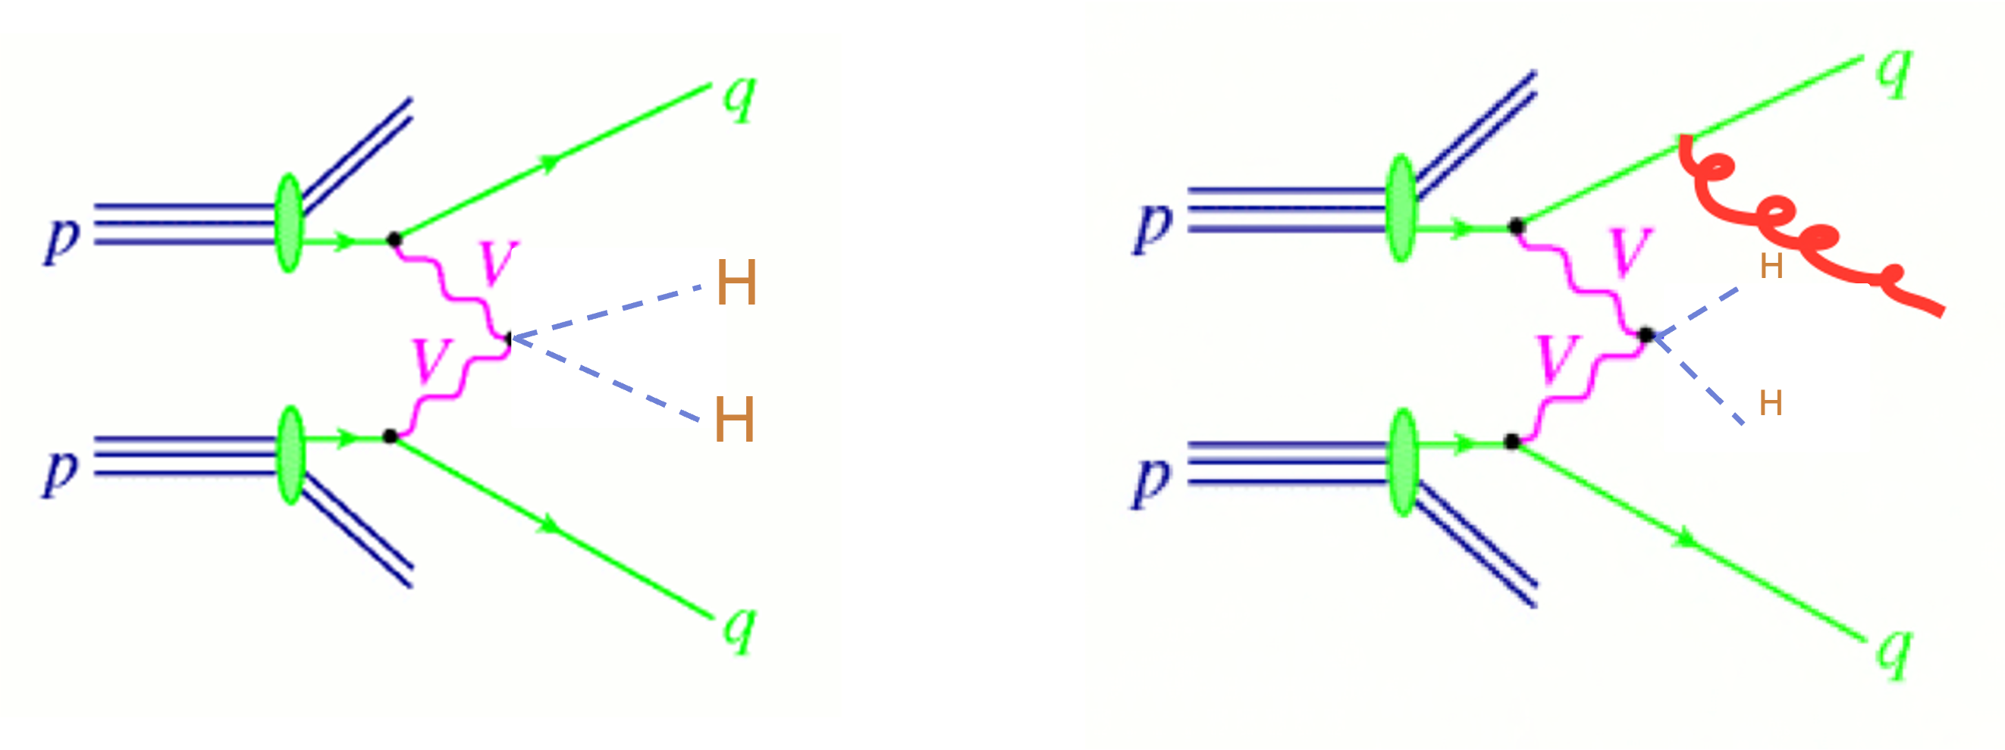
Double Higgs Production via VBF

Slide 44
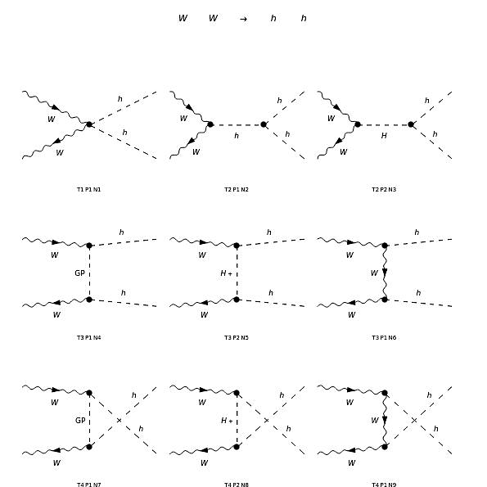
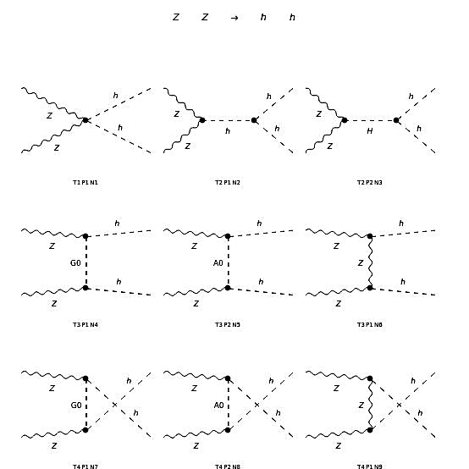
Double Higgs Production via VBF

Slide 45
Double Higgs via VBF Matched to Parton Showers (Type II Seesaw Model)
arXiv:0806.2200

Slide 46
Questions

Slide 47
Auxiliary Slides

Slide 48
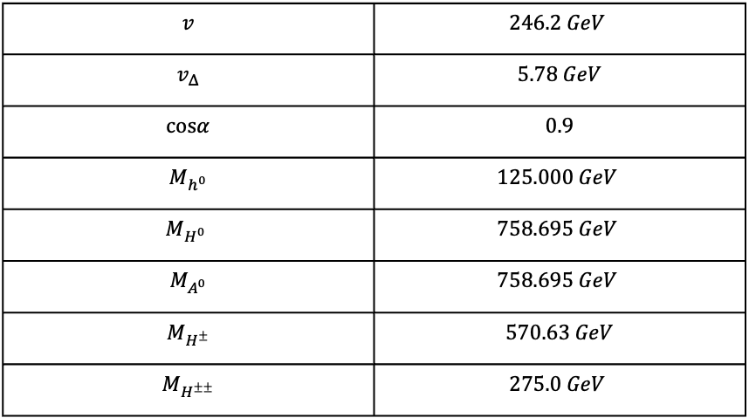

Parameter Space
We can establish a parameter space as follows:
$$P= \{M_{h^{0}}=125 GeV, M_{H^{0}}, M_{A^{0}}, M_{H^{±}},M_{H^{±±}}v_{Δ}, v, cos\left(α\right)\}$$
$$v$$ | $$246.2 GeV$$
$$v_{Δ}$$ | $$5.78 GeV$$
$$cosα$$ | $$0.9$$
$$M_{h^{0}}$$ | $$125.000 GeV$$
$$M_{H^{0}}$$ | $$758.695 GeV$$
$$M_{A^{0}}$$ | $$758.695 GeV$$
$$M_{H^{±}}$$ | $$570.63 GeV$$
$$M_{H^{±±}}$$ | $$275.0 GeV$$

Slide 49
Work on Muon Colliders
Double Higgs boson production via photon fusion at muon colliders within the triplet Higgs model
Bathiya Samarakoon(Wichita State U.)
Terrance M. Figy(Wichita State U.)
Published in: Phys.Rev.D 109 (2024) 7, 075015
e-Print: 2312.12594 [hep-ph]
DOI: 10.1103/PhysRevD.109.075015 (publication)

