Slide 1
Dry Cooling Strategies for Accelerator Components
(Cryocooler based cooling stations)
T. Koettig, M. Chioteli, P. Borges de Sousa, A. Onufrena, B. Naydenov, J. Bremer (CERN TE/CRG)
16th April 2024, IFAST Paris

Slide 2
Contents
Introduction, from liquid bath cooling towards conduction cooled devices
Cryocooler based systems – additional cooling loops
Counter-flow HEXs
Application examples
Summary

Slide 3
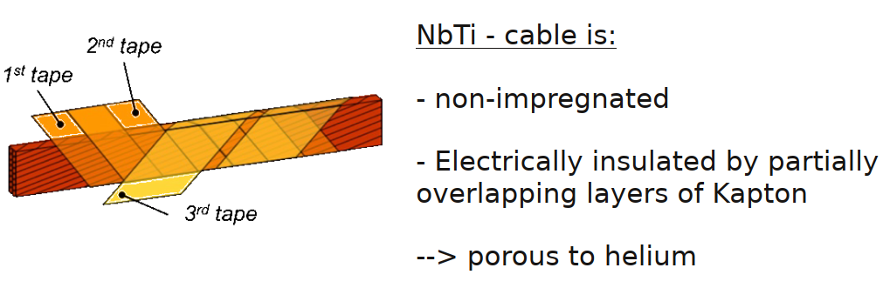
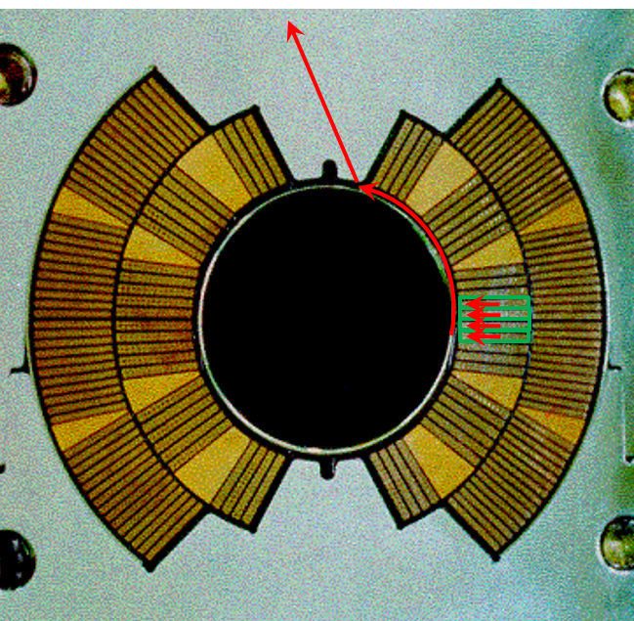
NbTi superconducting magnets in the LHC at CERN
Bath cooled magnets, heat extraction by He II @ 1.9 K pressurised
130 ton minimum He inventory for the LHC incl. detectors, e.g. LHC dipole magnet V_{He}=28 l/m
Safety in underground installations, complex inventory management, He cost and availability …
Cold-source
In fully immersed magnets the heat generated in the coil-pack must find its way out to the cold-source via helium path-ways kept clear in the cold-mass construct
In the example left, of the LHC main dipole, heat flows from the coil pack into the annular space between beam-pipe and coil-pack and out via space between the collar laminations

Slide 4
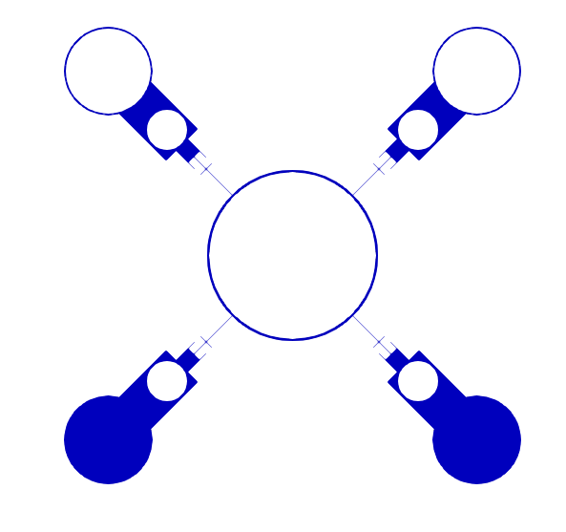
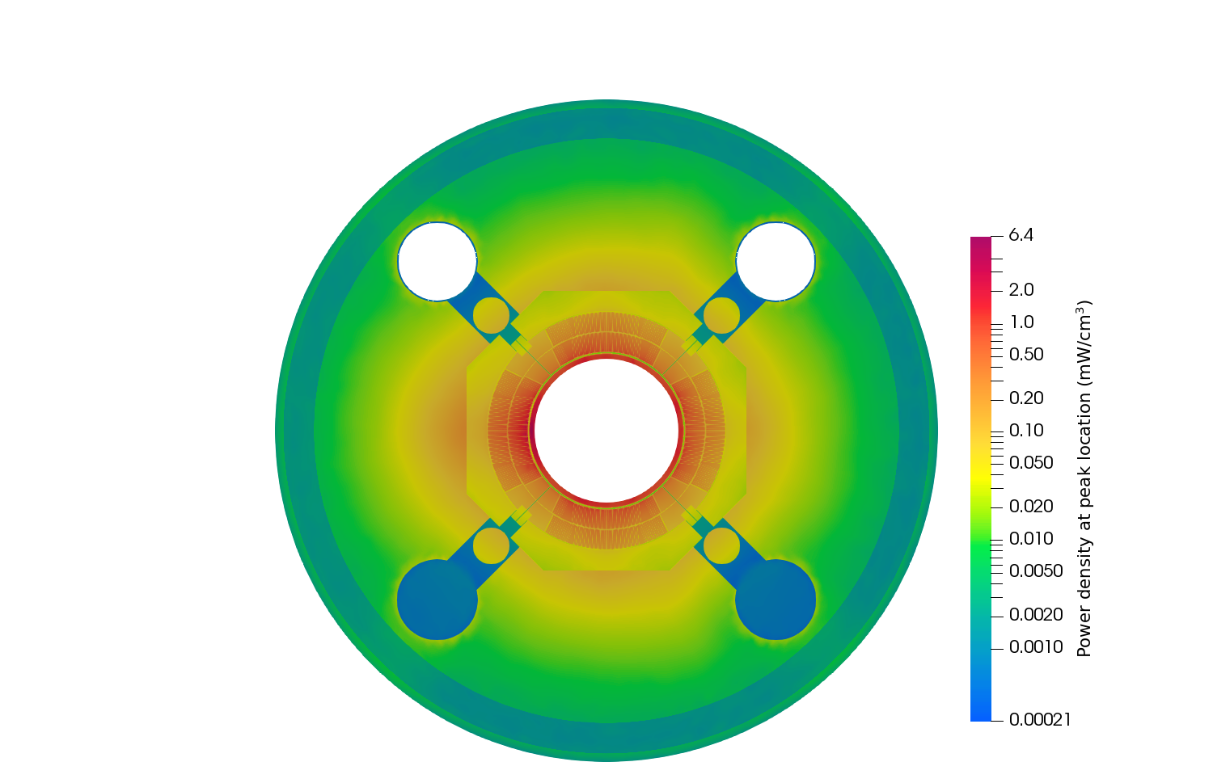
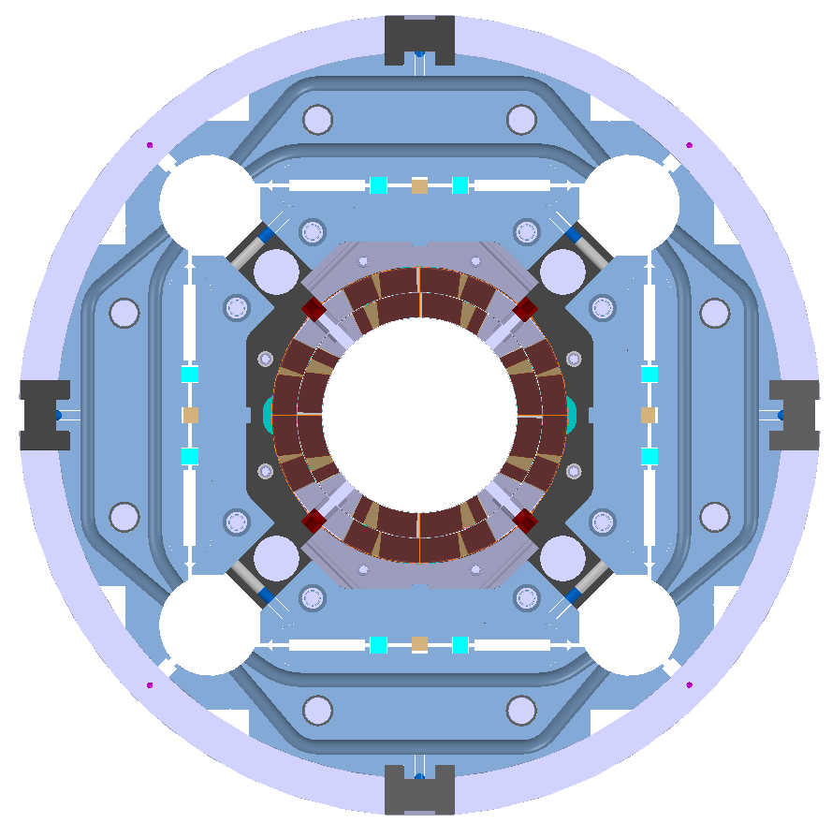
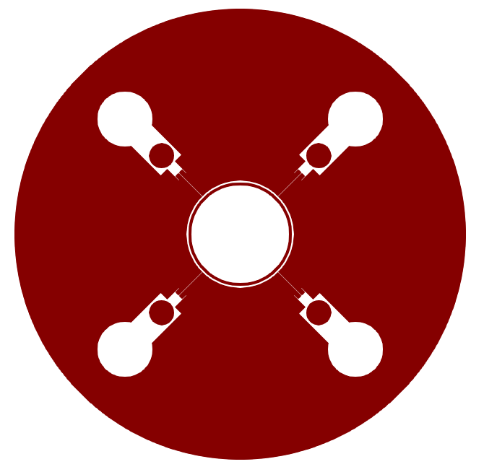
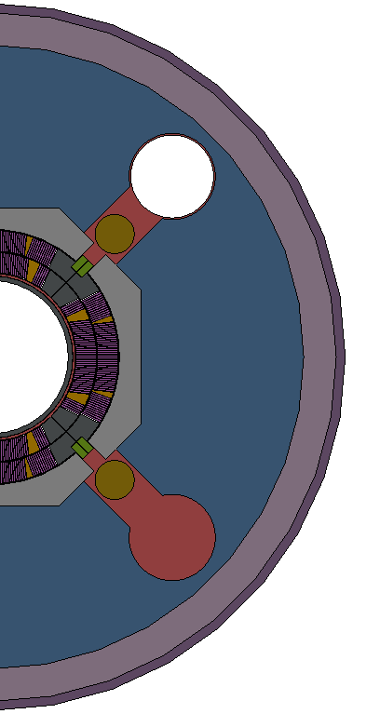
Nb₃Sn fully impregnated magnet coils for HL-LHC at CERN
New electrical and thermal insulation scheme for fully epoxy impregnated coil packages
He II cooling via the annular gap between beam tube and coil package, HL-LHC MQXF magnet V_{He}=30 l/m
Numerical simulation of heat transfer, He II cooling performance, temperature distribution and Temp. margin
Numerical assessment
MQXF v7 + cold mass
(ST0703448)
Q2B IR1-HC – power dep. @ peak loc.
He II region (connected passages via poles)
Solid region (17 parts)

Slide 5
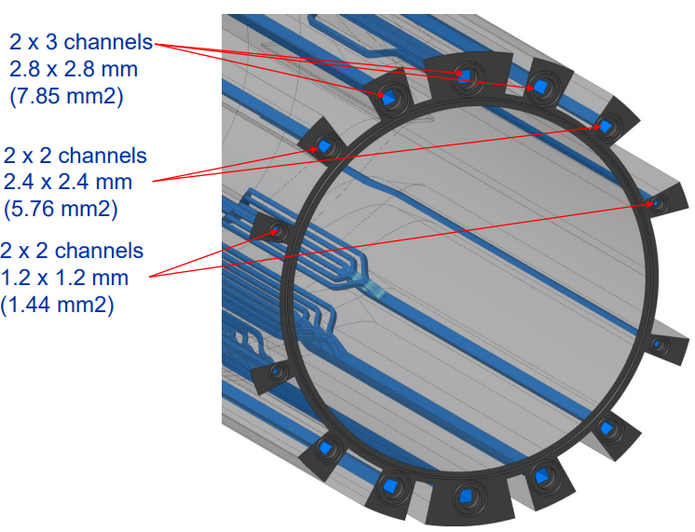
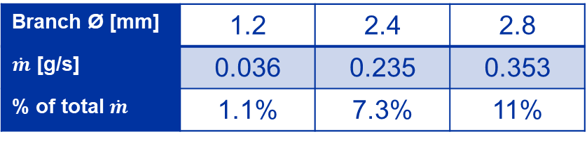
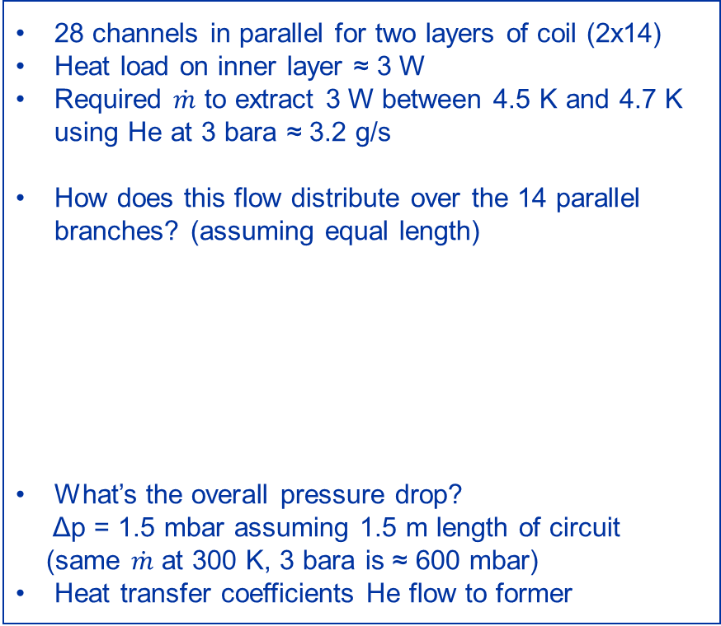
Dry cooled prototype of a gantry magnet, design
Stainless steel former, 3D printed incl. cooling channels => Cooling channel size and distribution – inner layer,
28 channels in parallel for two layers of coil (2x14)
Heat load on inner layer ≈ 3 W
Required $\dot{m}$ to extract 3 W between 4.5 K and 4.7 K using He at 3 bara ≈ 3.2 g/s
How does this flow distribute over the 14 parallel branches? (assuming equal length)
What’s the overall pressure drop?
Δp = 1.5 mbar assuming 1.5 m length of circuit
(same $\dot{m}$ at 300 K, 3 bara is ≈ 600 mbar)
Heat transfer coefficients He flow to former
Ø 2.8 mm
A_{ch} = 6.2 mm²
Ø 2.4 mm
A_{ch} = 4.5 mm²
Ø 1.2 mm
A_{ch} = 1.1 mm²
Branch Ø [mm] | 1.2 | 2.4 | 2.8
$\dot{m}$ [g/s] | 0.036 | 0.235 | 0.353
% of total $\dot{m}$ | 1.1% | 7.3% | 11%
Adapted from G. Ceruti, Weekly Meeting 13 (26 January 2024) · Indico (cern.ch)

Slide 6
Cryocooler as cooling source
Keeping in mind large scale applications with their distribution system

Slide 7
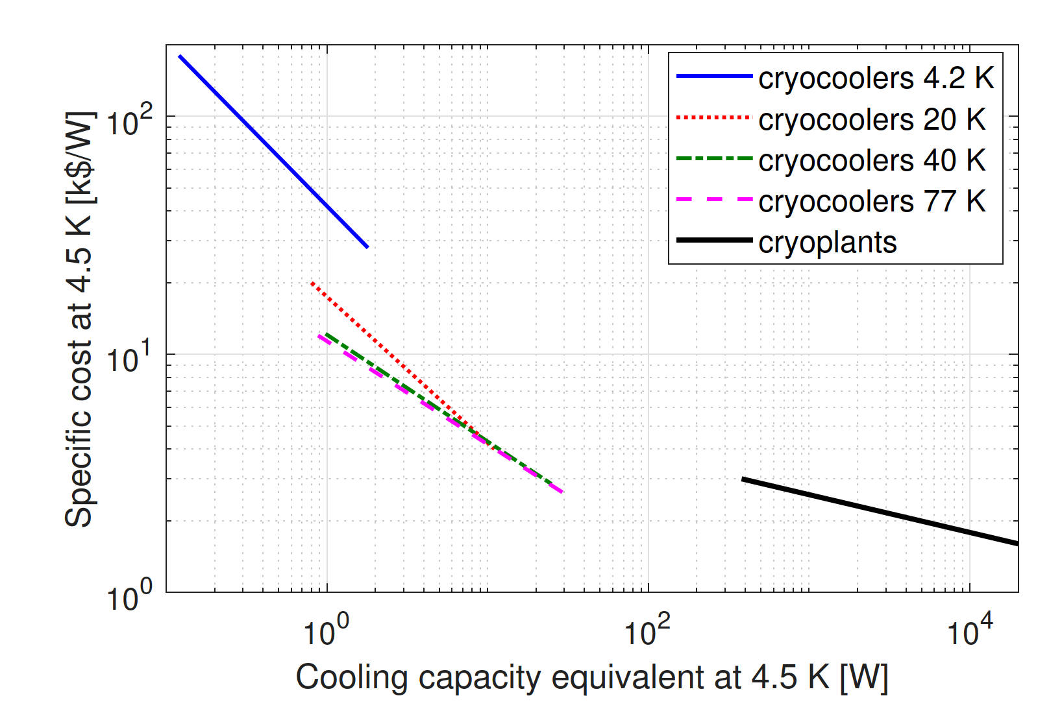


Background: remote cooling
Several applications require a cooling capacity of several Watts at 4.5 K → cooling capacity between cryocoolers and cryoplants
Remote cooling principle = Cooling source + convection loop
2-stage
cryocooler
Fluid circulation loop (e.g. with JT restriction)
$≈$ 40 K
Cooling technology gap
2.5 W – 350 W at 4.5 K
$≈$ 4.5 K
Increased cooling capacity + dry, vibration-free, distributed, remote cooling for a number of applications
Map adapted from: L. Decker, “Overview on cryogenic refrigeration cycles for large scale HTS applications”, 2016.

Slide 8
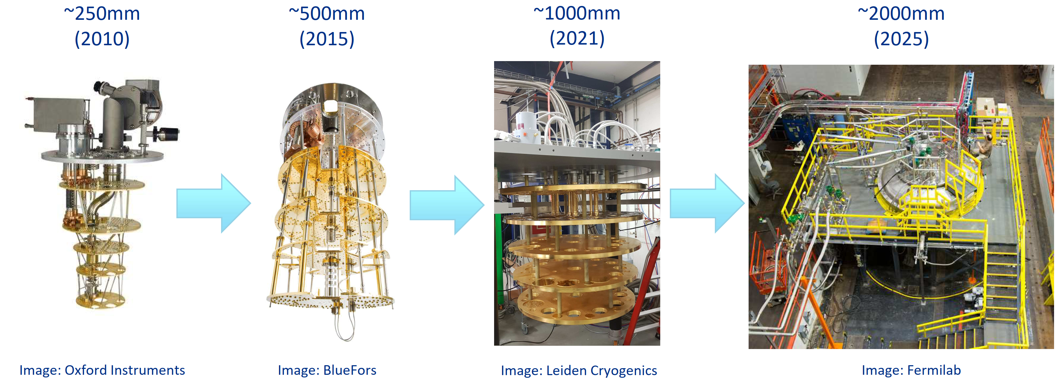
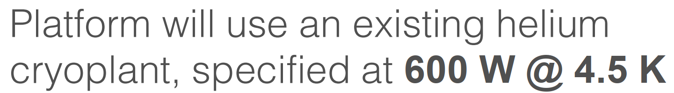
High-tech applications for remote cooling circuits
Cryogenic cooling of IR cameras / spectrometers in space (e.g. NICMOS on Hubble Space Telescope)
Pre-cooling of dilution refrigerators for quantum sensing/computing
→ from 2 integrated PTR to remote PTR box to cryoplant connection

Slide 9
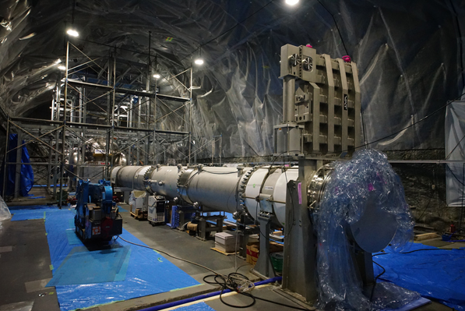
High-tech applications for remote cooling circuits
Cryogenic cooling of IR cameras / spectrometers in space (e.g. NICMOS on Hubble Space Telescope)
Pre-cooling of dilution refrigerators for quantum sensing/computing
→ from 2 integrated PTR to remote PTR box to cryoplant connection
Next generation of gravitational wave detectors => mirror cooling @ 4 K – 20 K
Cryogenic mirrors of gravitational wave detectors (e.g. KAGRA)

Slide 10
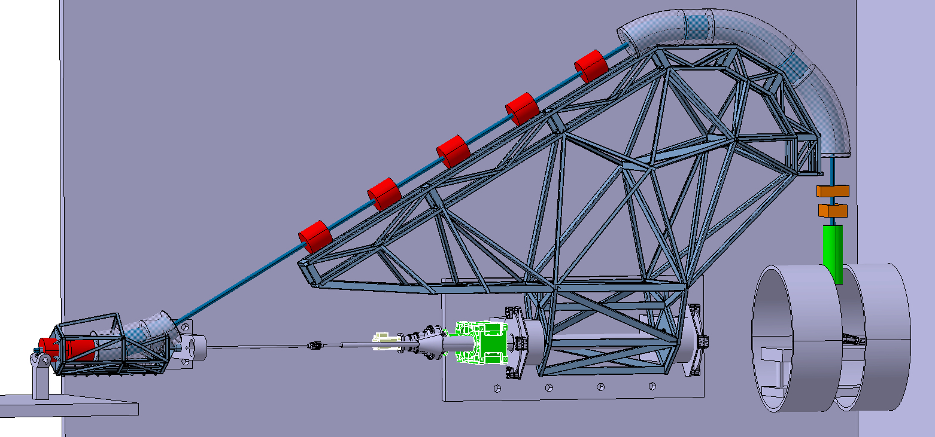
High-tech applications for remote cooling circuits
Cryogenic cooling of IR cameras / spectrometers in space (e.g. NICMOS on Hubble Space Telescope)
Pre-cooling of dilution refrigerators for quantum sensing/computing
→ from 2 integrated PTR to remote PTR box to cryoplant connection
Next generation of gravitational wave detectors => mirror cooling @ 4 K – 20 K
SC gantries for proton/heavy-ion therapy
Courtesy: L. Gentini

Slide 11
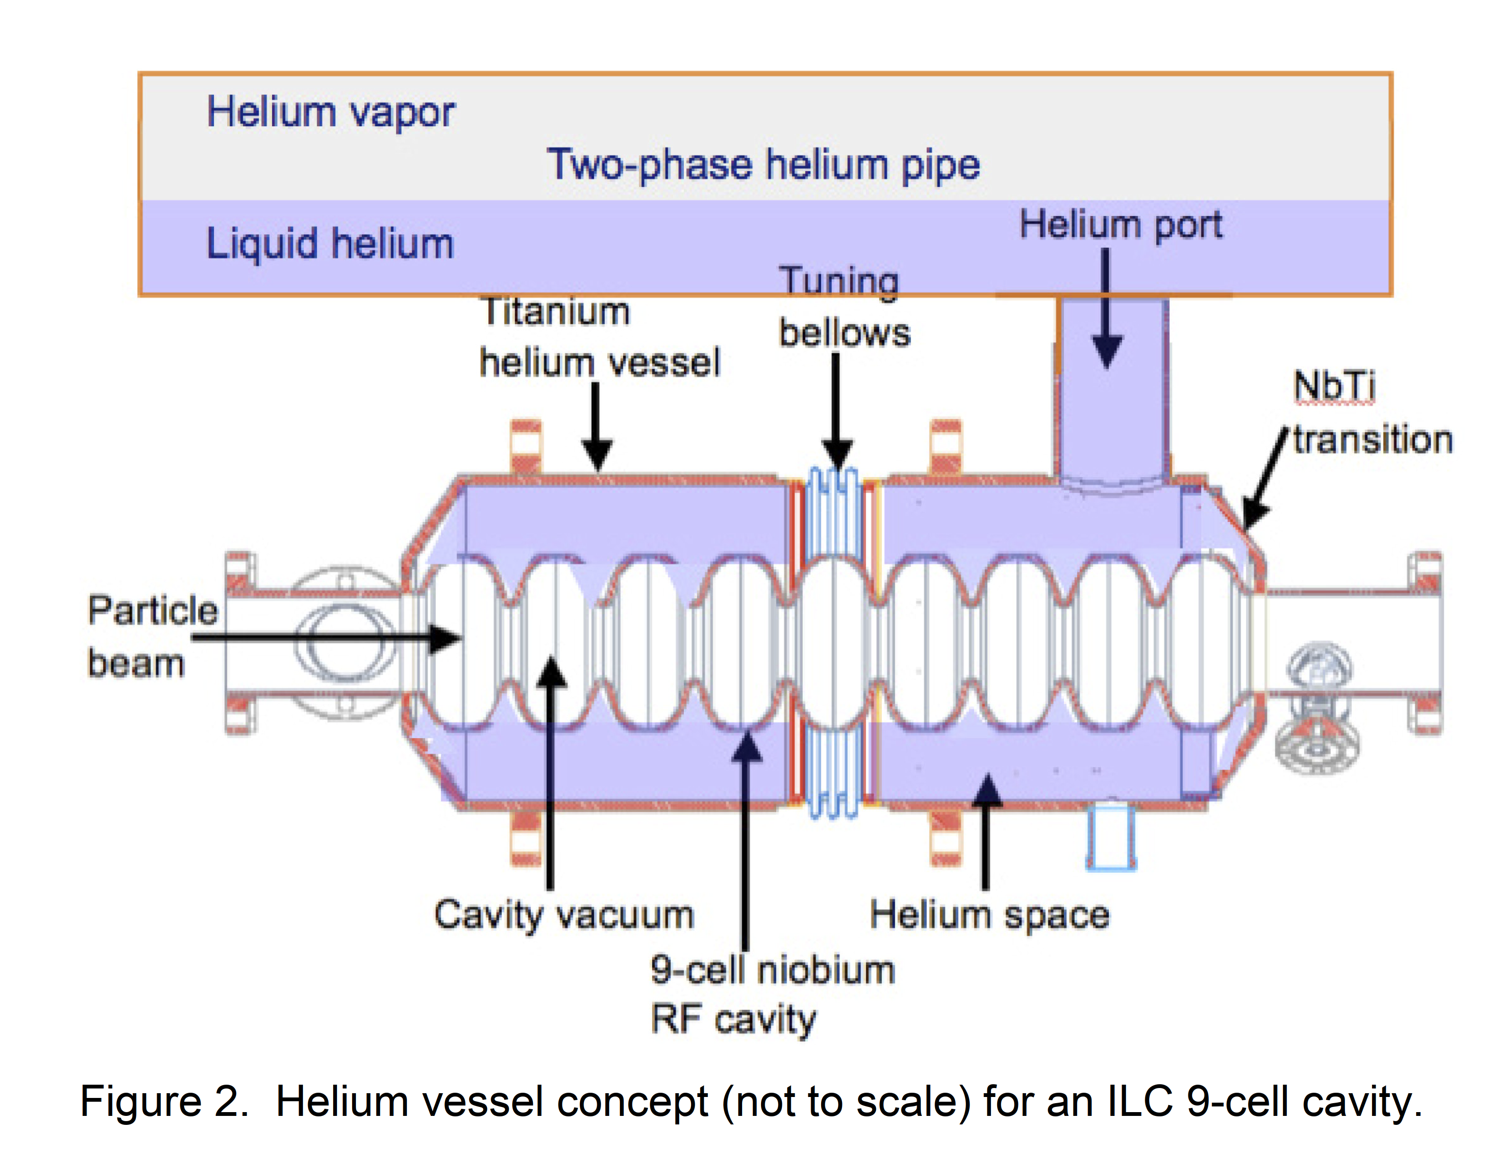
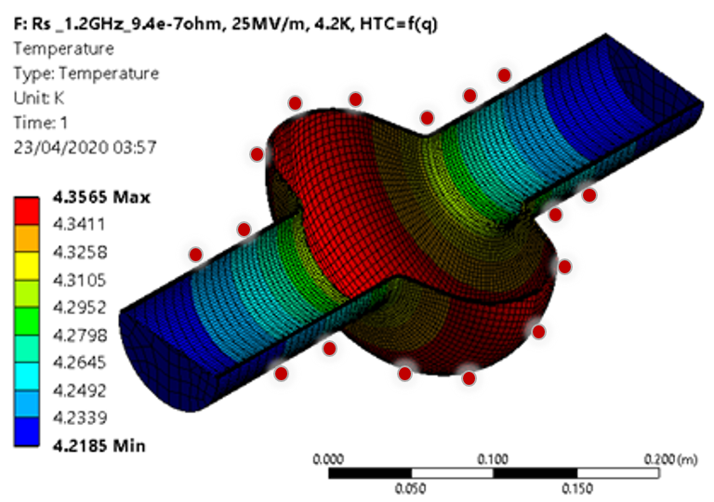
High-tech applications for remote cooling circuits
Cryogenic cooling of IR cameras / spectrometers in space (e.g. NICMOS on Hubble Space Telescope)
Pre-cooling of dilution refrigerators for quantum sensing/computing
→ from 2 integrated PTR to remote PTR box to cryoplant connection
Next generation of gravitational wave detectors => mirror cooling @ 4 K – 20 K
SC gantries for proton/heavy-ion therapy
SC RF cavities in particle accelerators

Slide 12
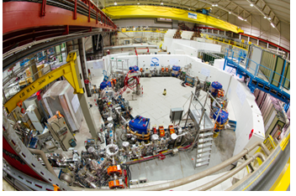
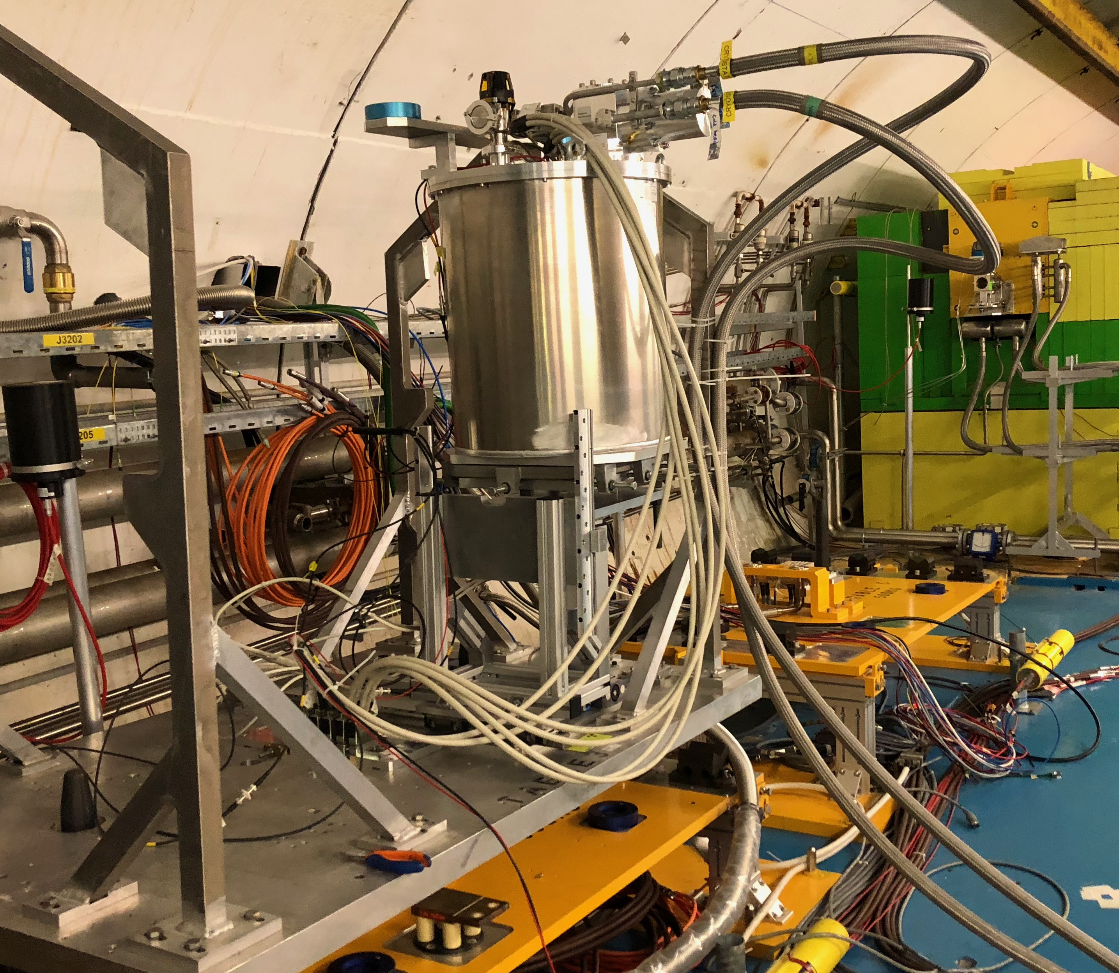
High-tech applications for remote cooling circuits
Cryogenic cooling of IR cameras / spectrometers in space (e.g. NICMOS on Hubble Space Telescope)
Pre-cooling of dilution refrigerators for quantum sensing/computing
→ from 2 integrated PTR to remote PTR box to cryoplant connection
Next generation of gravitational wave detectors => mirror cooling @ 4 K – 20 K
SC gantries for proton/heavy-ion therapy
SC RF cavities in particle accelerators
Cryostats in confined/radioactive environments etc. that require separation of cooling source from CIF
SQUID sensors in anti-proton decelerator at CERN
Equipment in high-radiation CHARM facility at CERN

Slide 13
Remote cooling loops
High effectiveness counter-flow heat exchangers (CFHEX)

Slide 14
Remote cooling arrangements
Option for SQUID sensor cooling in CERN Antiproton Decelerator
Pump
Compressor
Pump
Compressor
Pump
Compressor
1 bar
(LP)
4-5 bar
(HP)
1 bar
(LP)
4-5 bar
(HP)
1 bar
(LP)
4-5 bar
(HP)
Alternative cooling of superconducting RF cavities for particle accelerators
Wound capillary cooling interface
Very effective heat exchangers !!!
Cryogenic mirrors of gravitational wave detectors (e.g. KAGRA)
~1 bar
~1 bar
~4-5 bar
Cooling interface
Cooling interface
Cooling interface

Slide 15
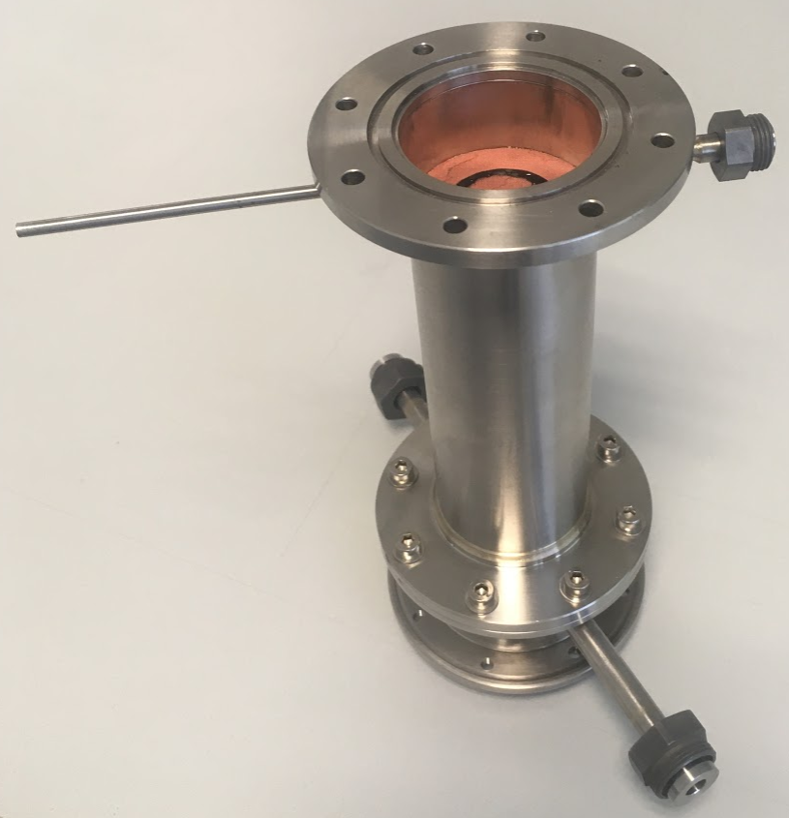
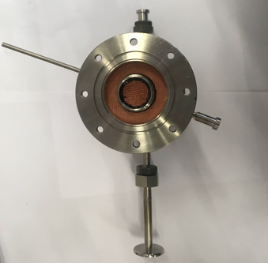
Transparent-wall concept
Pump
Compressor
1 bar
(LP)
Careful sizing for operation in the 10 K - 50 K and 4.5 K – 10 K ranges using the numerical model [1]
4-5 bar
(HP)
CFHEX 1
2-stage
GM cryocooler
Transparent-wall CFHEX during assembly
Top view
Stage 1
Epoxy wall
CFHEX 2
Stage 2
CFHEX 3
Joule-Thomson expansion
~1 bar
Cooling interface

Slide 16
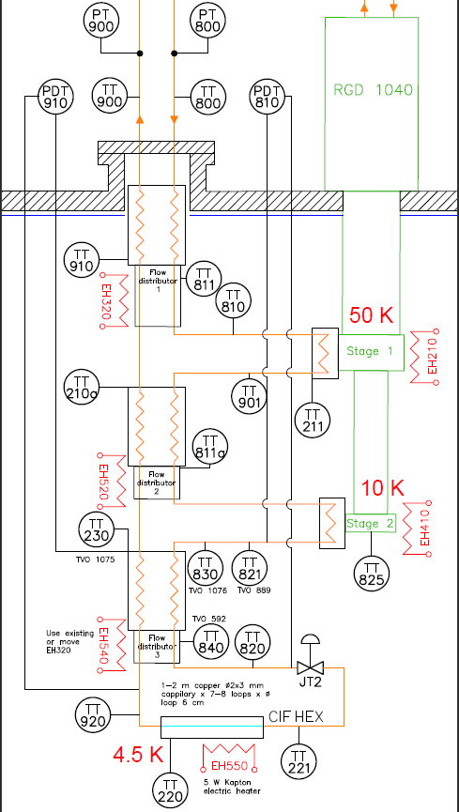
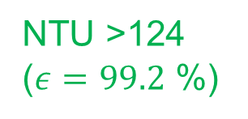
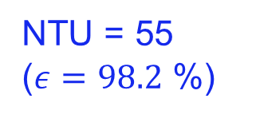
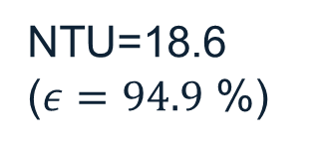
Performance: CFHEX effectiveness
Transparent-wall designs were implemented for the two coldest CFHEXs
Very high experimental performance achieved with the novel transparent-wall design
NTU=18.6 ($ε=94.9$ %)
NTU = 55 ($ε=98.2$ %)
NTU >124 ($ε=99.2$ %)

Slide 17
Application examples

Slide 18
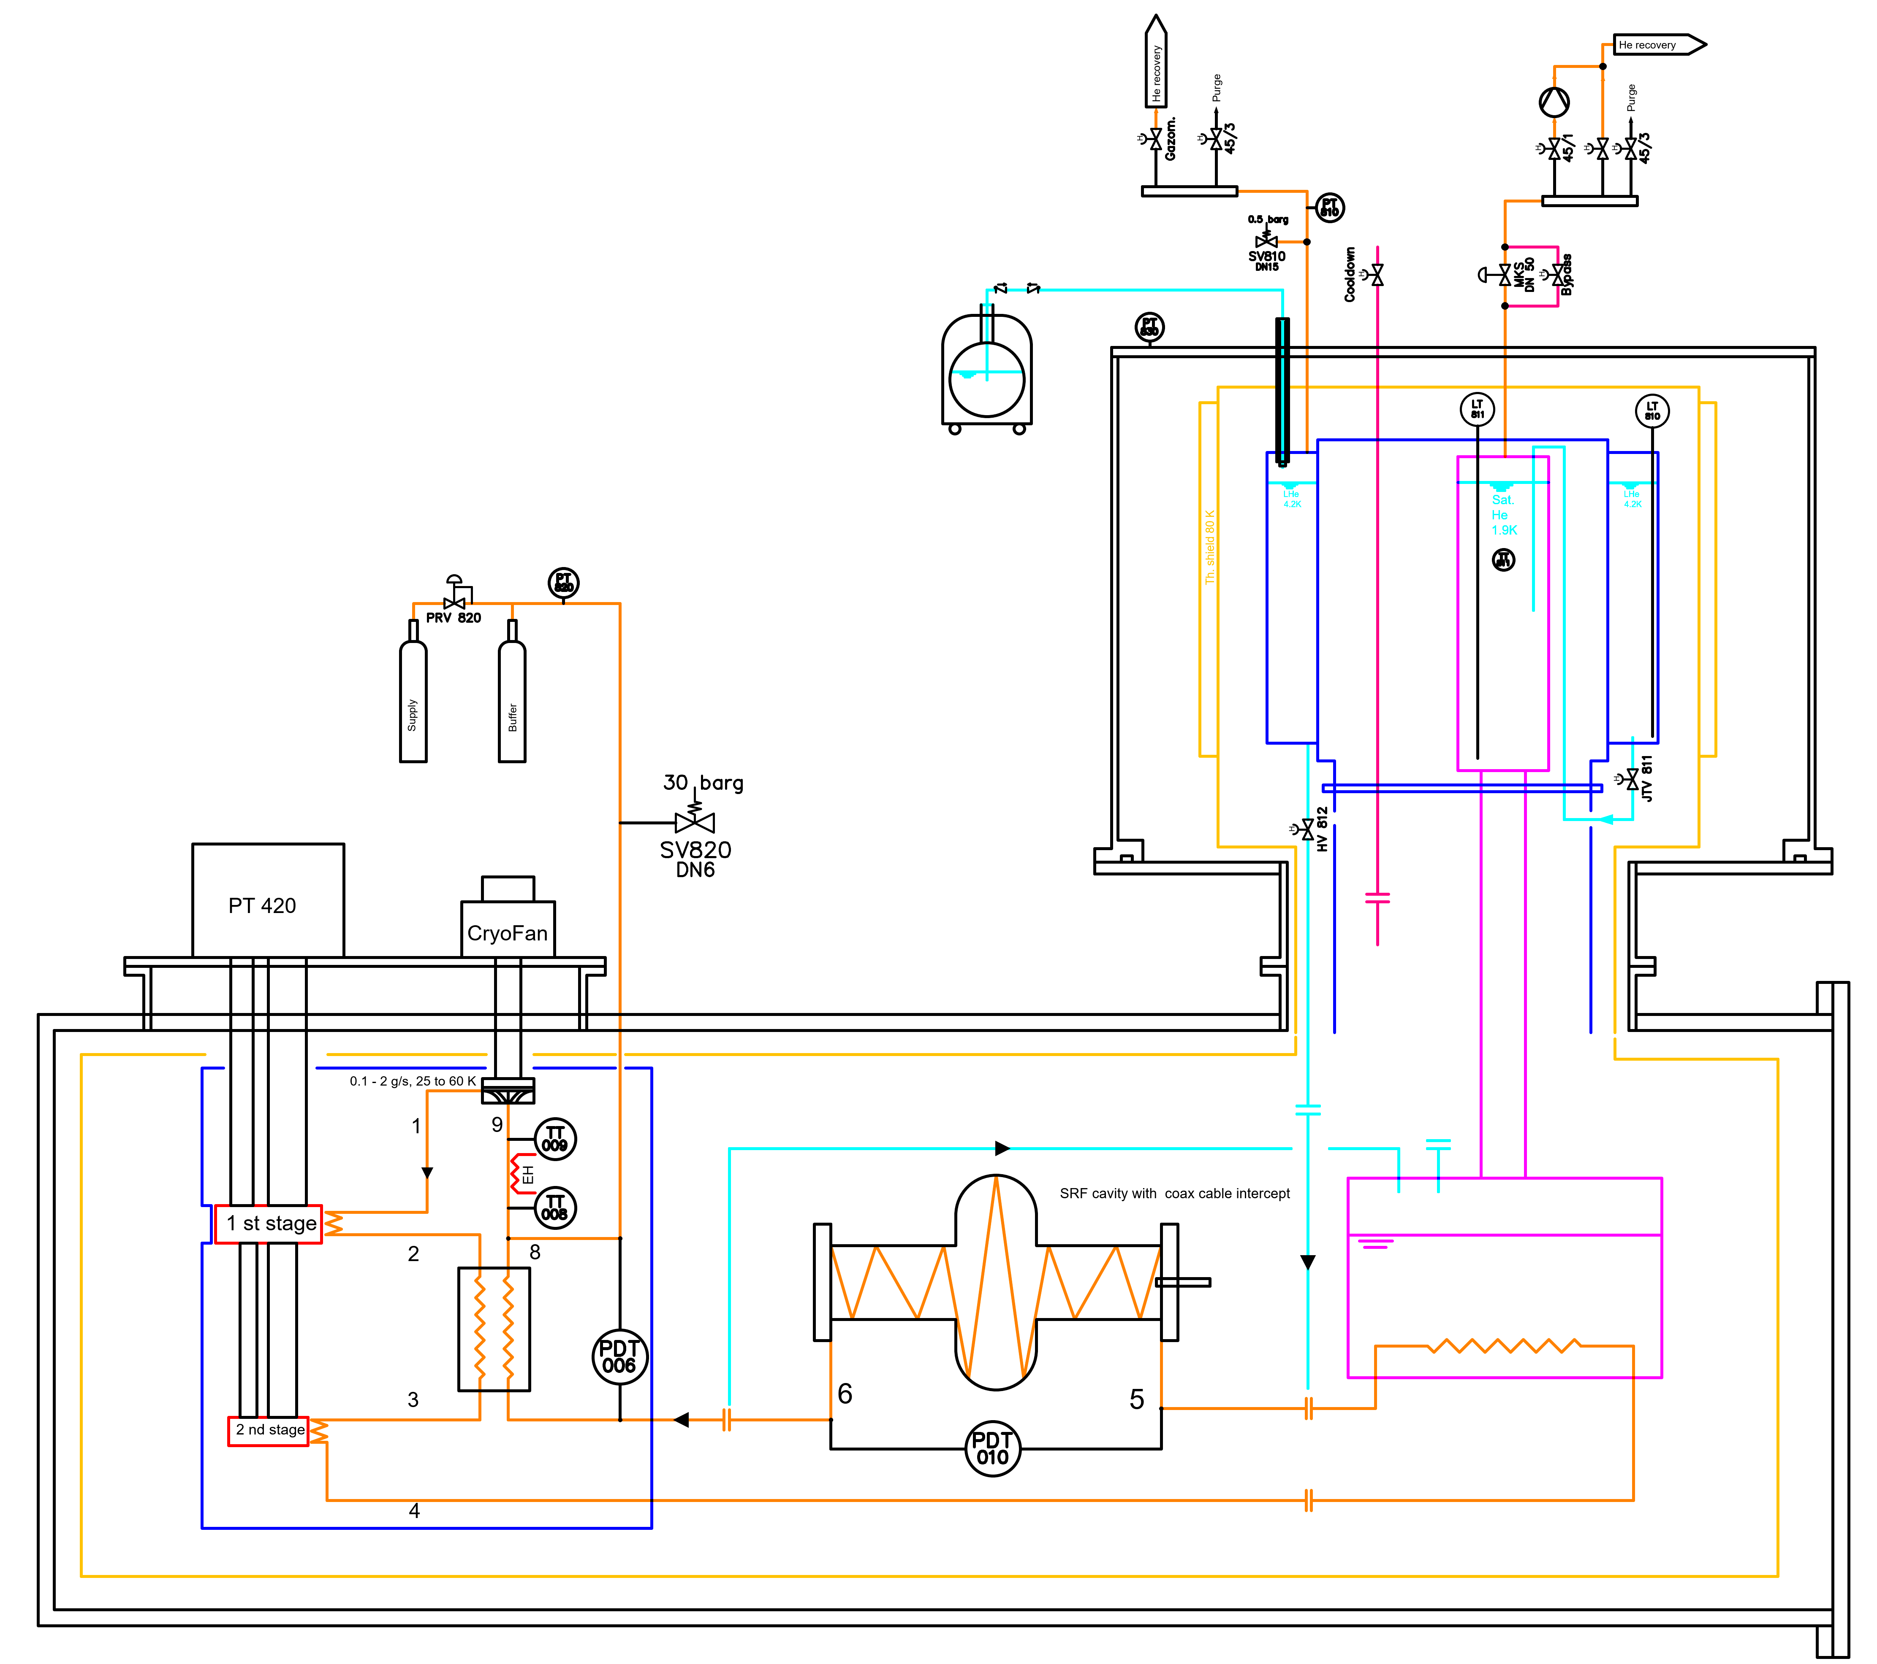
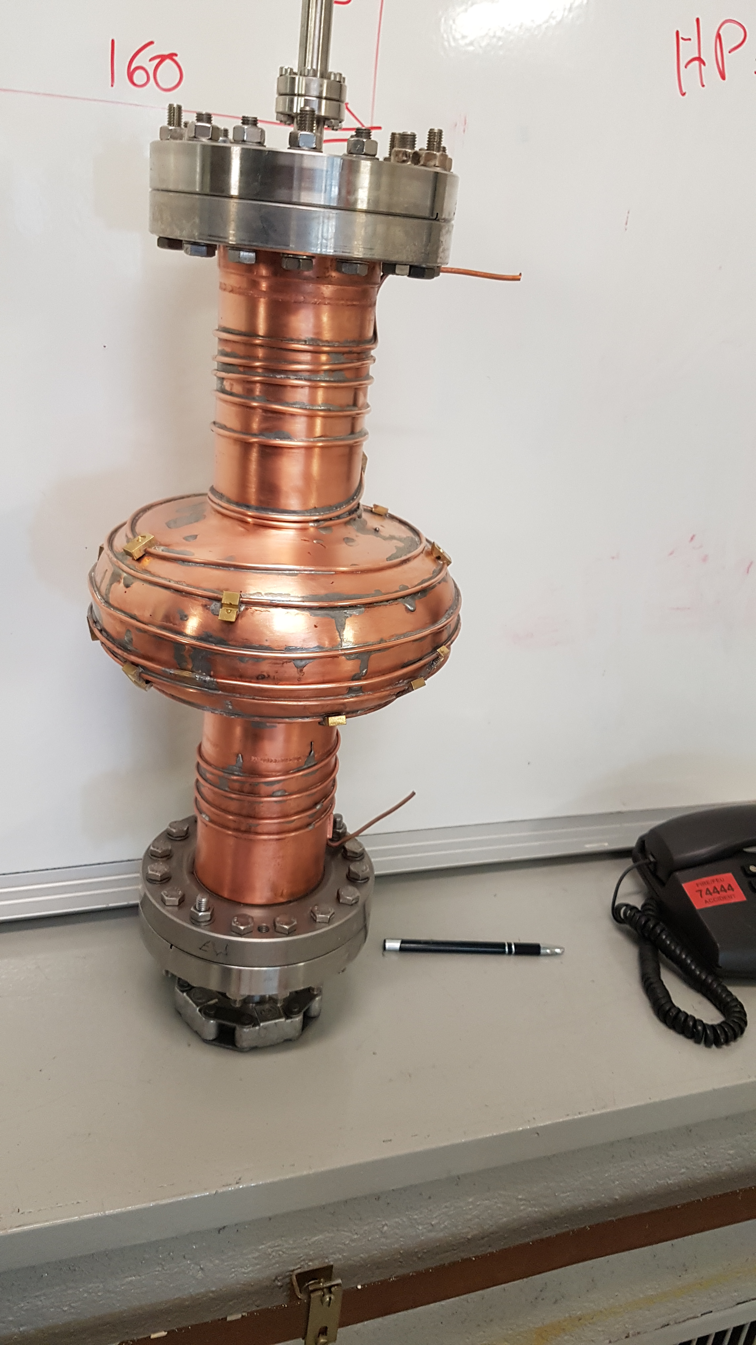
Applications: dry SRF cavity cooling
Dry cooling principle
Test setup to study dry colling (system performance, flow in the capillary)

Slide 19
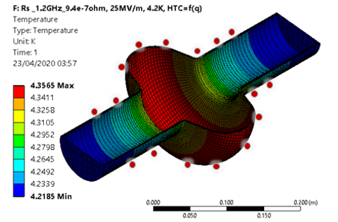
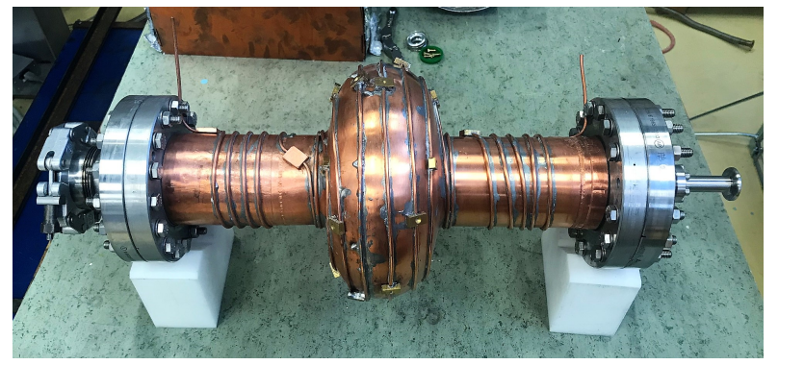
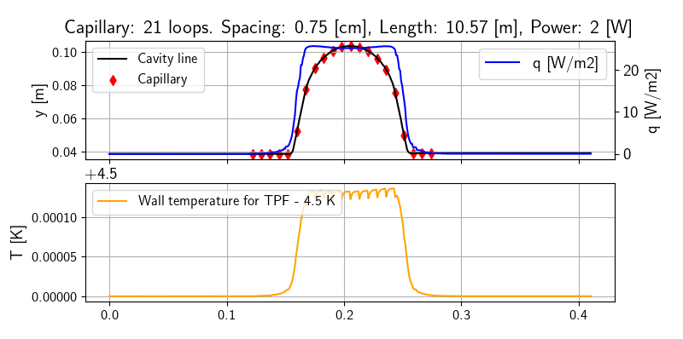
Cavity wall temperature distribution
Numerical simulation!
to be validated by the experiments
He two-phase flow (TPF)
Capillary: 21 loops, spacing 0.75 cm, length 10.57 m, power 2 W
x-position [m]

Slide 20
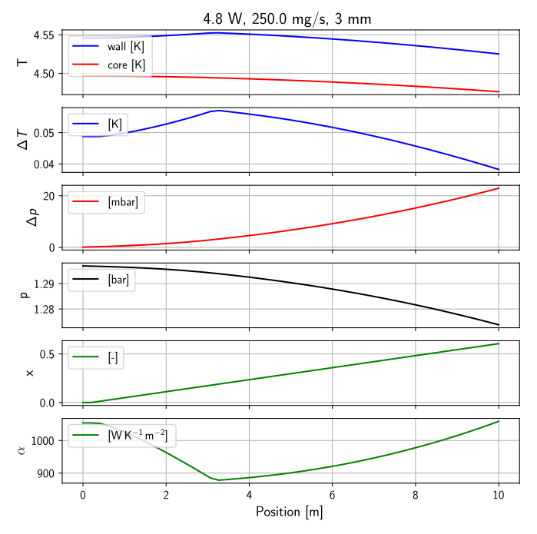
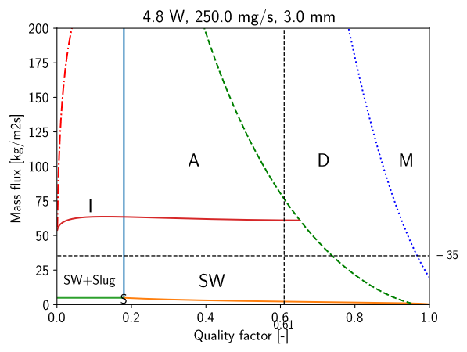
Two-phase flow – flow pattern map calculations
Heat loads and mass flow

Slide 21
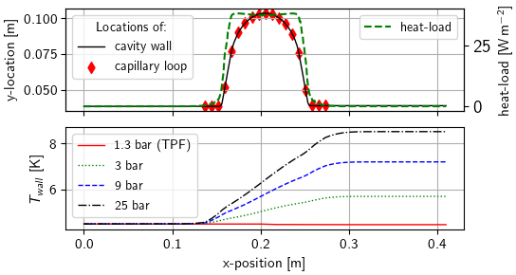
Cavity wall temperature distribution
Numerical simulation!
to be validated by the experiments
He two-phase flow (TPF)
Flow options – a comparison
Capillary: 21 loops, spacing 0.75 cm, length 10.57 m, power 2 W
Capillary: 21 loops, spacing 0.75 cm, length 10.57 m, power 3 W
Courtesy: A. Onufrena et al. CEC 2021, IOP Conf. Series: Materials Science and Engineering
x-position [m]

Slide 22
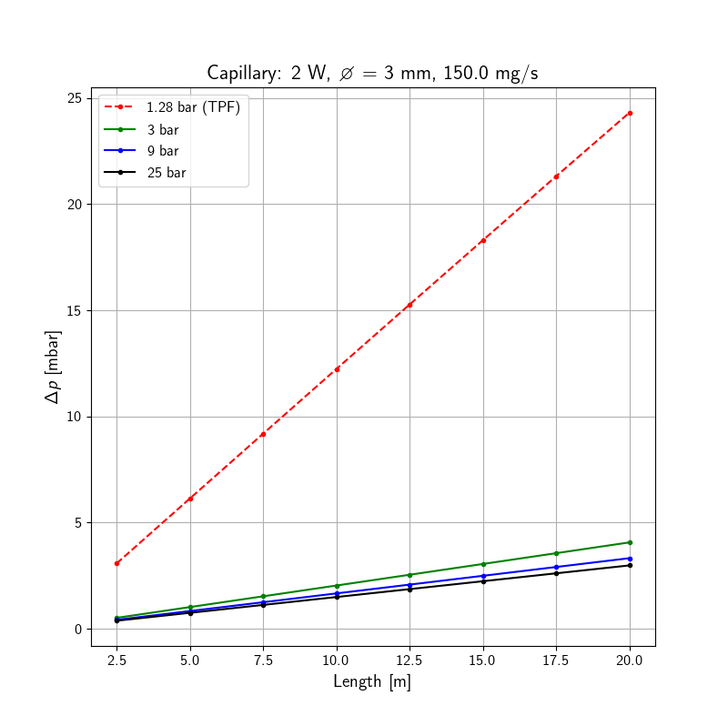
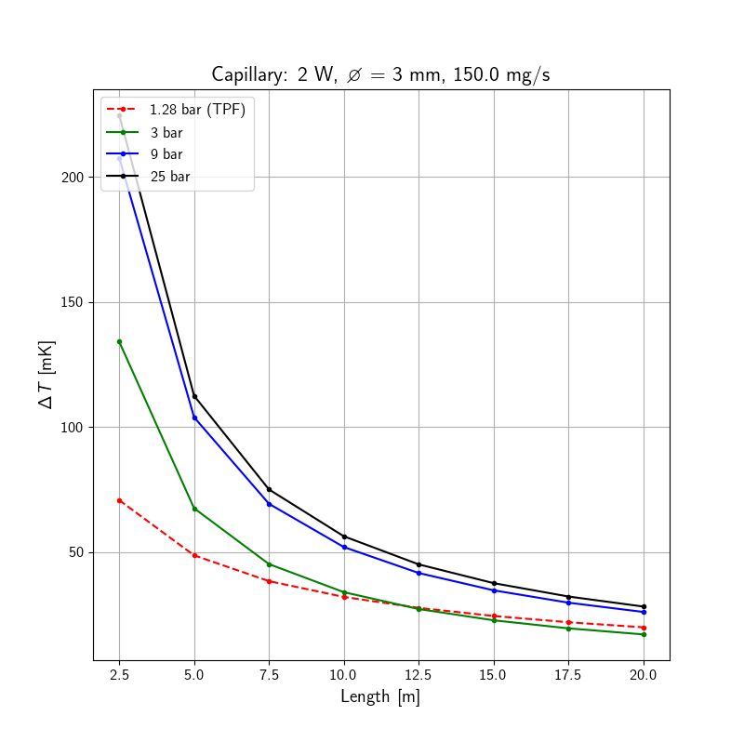
Optimum cooling tube diameter/length/fluid pressure
Numerical simulation of friction and heat transfer, a comparison of flow conditions
Pressure drop comparison
Temperature difference tube wall to fluid core
Quite higher pressure drop of TPF
Similar heat transfer of TPF and Sup. crit. 3 bar

Slide 23
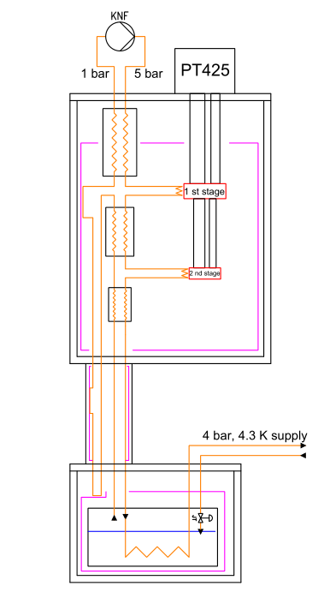
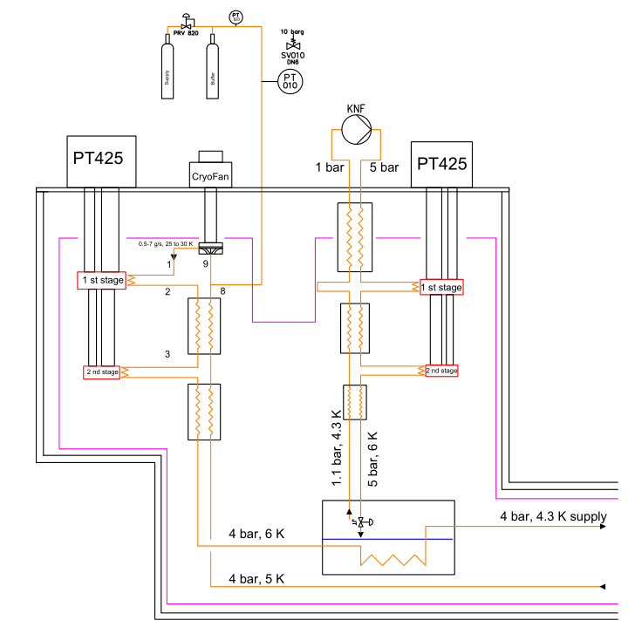
Remote cooling loops with boosted performance
Subcooled 4 bar cooling loop
Subcooled 4 bar cooling loop – high Q
Remarks:
Single phase flow above crit. pressure
Good heat transfer
CryoFan works better at higher pressure (density)
JT cryocooler systems exit in industry e.g. 9 W @ 4.2 K
PTC
PTC
3-4 x

Slide 24
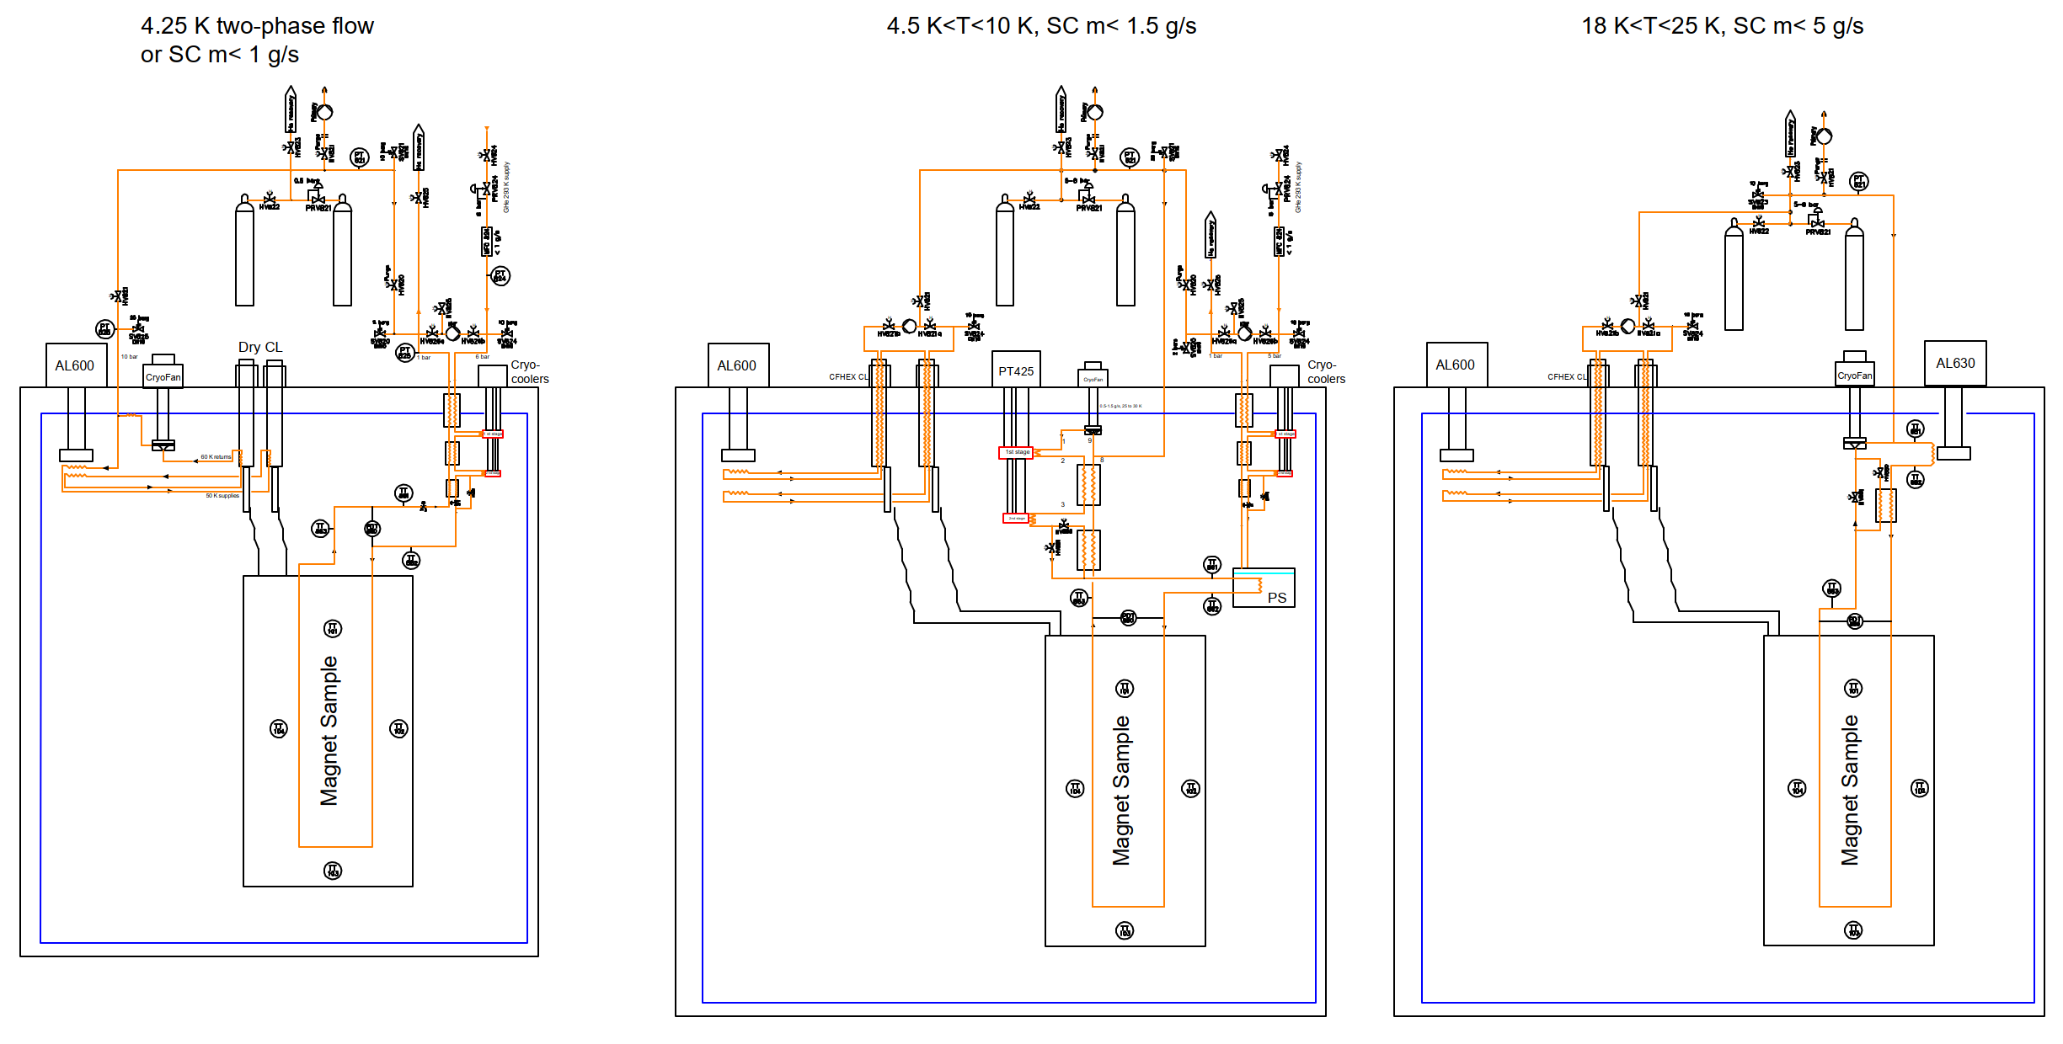
Envisaged dry cooling test stations at the Cryolab at CERN
GM
GM
PTC
GM
GM

Slide 25
Summary
Dry cooling
    Enables effective cooling of novel magnet, cavity and detector concepts
    Enables stand alone systems with a physical separation between the cooling source and the object
    Small test stations with an emphasis on large scale conditions
    Future developments towards higher Tc materials Nb₃Sn on Cu for cavities or HTS magnets => 20 K
Numerical assessment of fluid flow heat transfer and conduction pathway is required:
    Benefits from reliable, experimentally obtained material properties and interface data
    Enables the parametric study of heat transfer mechanisms in large-scale complex structures
    Can be used early on to aid in magnet design w.r.t. heat extraction and safe operating temperatures

Slide 26
Thank you for your attention!

