Slide 1
MUonE experiment
Carlo Ferrari
on behalf of the MUonE collaboration
INFN-Pisa & CNR-INO & CERN
c.ferrari@cern.ch
10th PBCacc - 16 Feb 2024

Slide 2
Outlook for 2024
The main activity in the first six months of the year is to write the TDR and submit it for approval to SPSC.
Requested 2 weeks on the M2 beamline for technical tests of the tracker (efficiency of the sensors at high rate) and the ECAL (synchronization with the tracker).
Services same as the 2023 run, but the tent.
16/02/2024
Carlo Ferrari - PBCacc

Slide 3
Outlook for 2025
We would like to perform the first physics run, aiming at the first measurement of the hadronic corrections to the running of alpha, with limited statistic.
The number of stations will be limited by the availability of 2S modules (the tracking sensors). At least three full stations + ECAL + PID.
The plan is to also have a BMS, with DAQ integrated with the experiment.
The beam time we will ask for is in the order of 2 months.
For 2025 we have no further requests in terms of infrastructure and services, compared to run 2023.
We would like to set up the tent again, so we would like to exploit the connection to the CEDAR air conditioning circuit again.
16/02/2024
Carlo Ferrari - PBCacc

Slide 4
Beyond LS3: Long term goals
The real experiment, to be carried out after LS3, consists of a setup with 40 stations + ECAL (dimensions to be defined) + BMS + PID.
A space of at least 45 m is required.
AC of the CEDAR for T control.
The required beam time will be in the order of three years.
The beam intensity should possibly be higher than the current one, ideally by a factor of 3.
16/02/2024
Carlo Ferrari - PBCacc

Slide 5
SPARE
16/02/2024
Carlo Ferrari - PBCacc

Slide 6
Introduction
MUonE is a high precision experiment.
It requires:
light tightness
humidity below a threshold (20%)
Stability of the tracking sensors along the beam δz < 10 μm
Mechanical support is made of Invar (CTE = 1.2 ppm/K)
07/11/2023
Carlo Ferrari - EATM

Slide 7
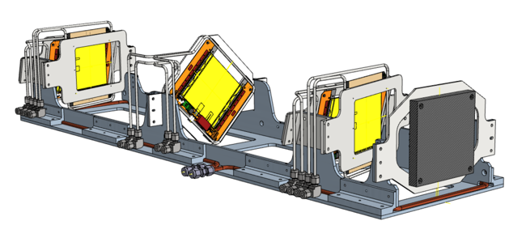
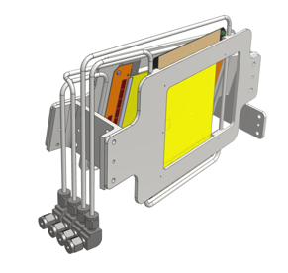
Tracker station mechanical design
1m long tracking stations; 3 layers of XY sensors
Beryllium (graphite) target
(u,v) layer
Requirement: very stable structure (< 10 μm)
Cooling circuit
Based on Pt2S modules from CMS
“tilt angle” to improve the hit resolution, (more complex fitting stage)
Second module rotated to resolve ambiguities
Module stability along the beam is δz < 10 μm
Structure with low thermal expansion coefficient (Invar, cte = 1.2 x 10⁻⁶ K⁻¹)
Cooling circuit to control temperature and extract heat produced by the Pt2S modules (5W)
XY tilted modules
07/11/2023
Carlo Ferrari - EATM

Slide 8
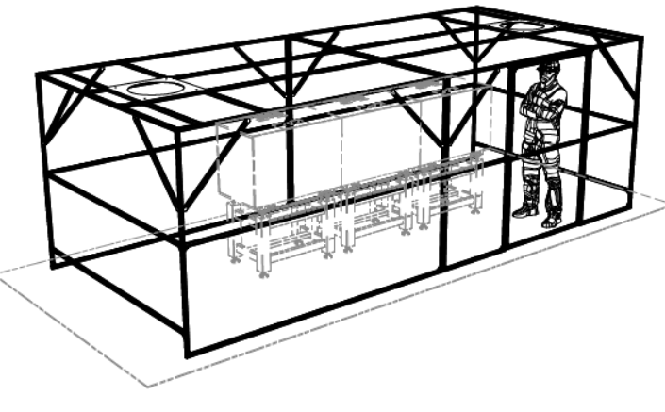
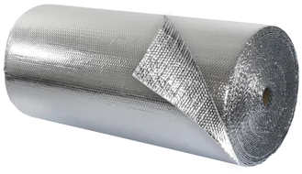
The «tent»
M. Massa, A. Moggi – INFN Pisa
Inflow
Outflow
Beam
2 m
6 m
2.5 m
Insulating material: Double Bubble Insulation
07/11/2023
Carlo Ferrari - EATM

Slide 9
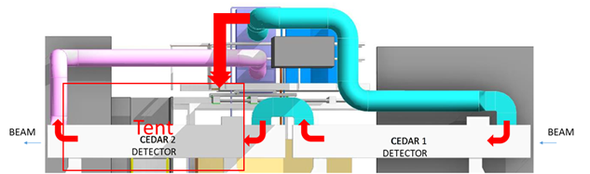
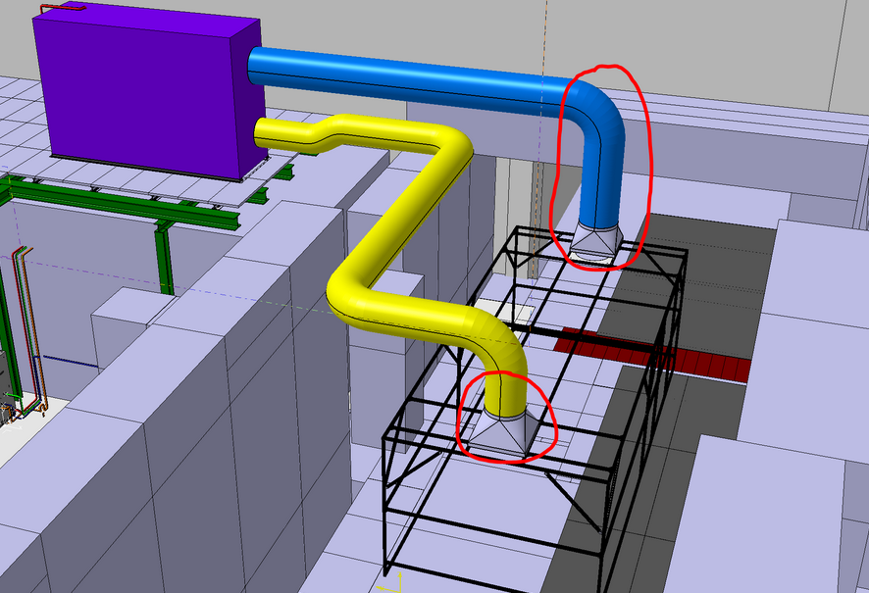
The «tent»: The integration model
F. Dragoni – CERN
Air T = 18 °C
Mixing ventilation
Duct modification
C&V will take care of it
07/11/2023
Carlo Ferrari - EATM

Slide 10
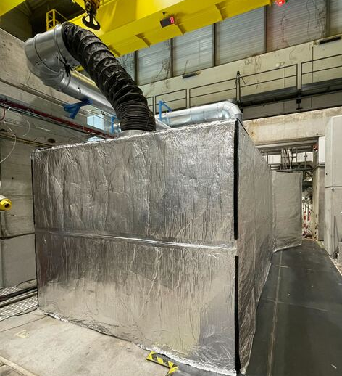
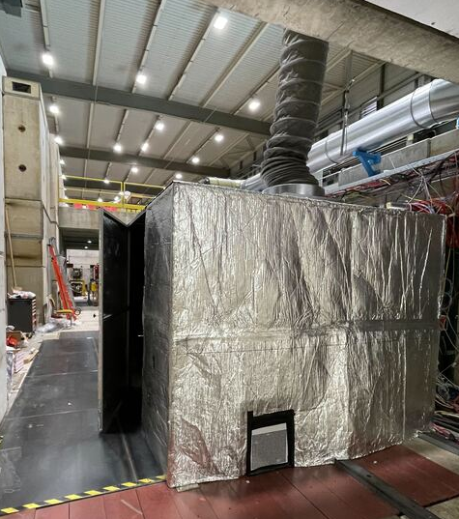
MUonE installation
07/11/2023
Carlo Ferrari - EATM

Slide 11
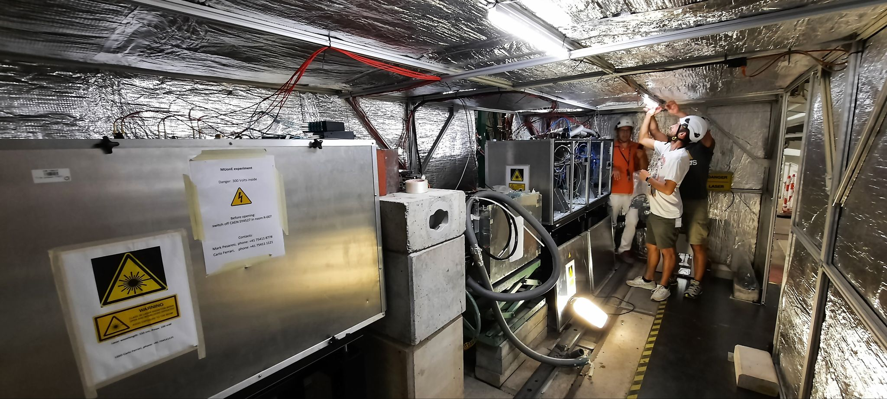
MUonE installation
Tent
Tracker
beam direction
Tracker
Calorimeter
07/11/2023
Carlo Ferrari - EATM

Slide 12
Temperature
Starting point: Wednesday 31st Aug. Cooling started at 6pm (20 h)
Sunday 3th Sept (90.5 h): improved heat exchange on the dry air circuit
Monday 4th Sept: increased flow of cooling air (108h), access (110h), increased flow of dry air (112h)
Wednesday 6th Sept: Laser survey, flow to the calorimeter (155h)
Wednesday 13th Sept: Power supply Pt-2S OFF (250h), third station connected (270h)
07/11/2023
Carlo Ferrari - EATM

Slide 13
Comments on temperature
The temperature of the structure is the result of a balance between various factors:
The AC at 18°C
the chiller at 18°C
modules releasing 5 W each
the dry air arriving at room T
the heat flux through the station walls which depends on the ambient/station temperature difference
Unfortunately, the AC is not dry air: the dry air is at room T
To mitigate this, dry air at ambient T go through a long pipe inside the tent before inserting it into the station, in order to thermalize it at 18°C.
Conclusions:
Temperature of the frames are higher that that of the structure (as it should)
The night/day fluctuation are visible in the plot
Fluctuations in stable conditions are about 0.4 °C
Temperatures are affected by the flows (both AC and dry air)
AC flow and dry air flow can change the temperature by about 0.5 °C each
07/11/2023
Carlo Ferrari - EATM

Slide 14
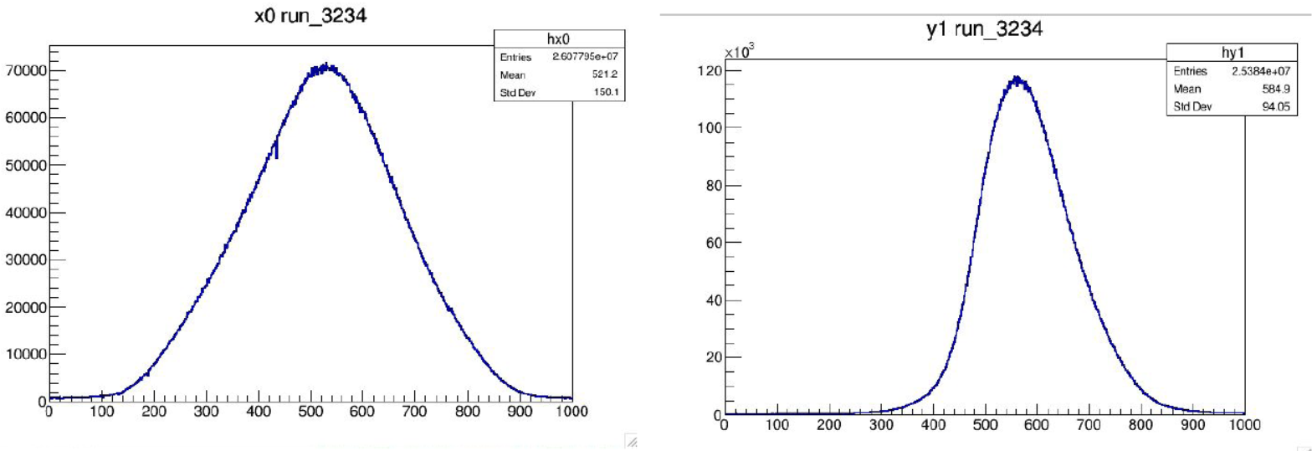
Beam profile
We requested high intensity, focalized beam
The beam is entirely in the detector acceptance
07/11/2023
Carlo Ferrari - EATM

Slide 15
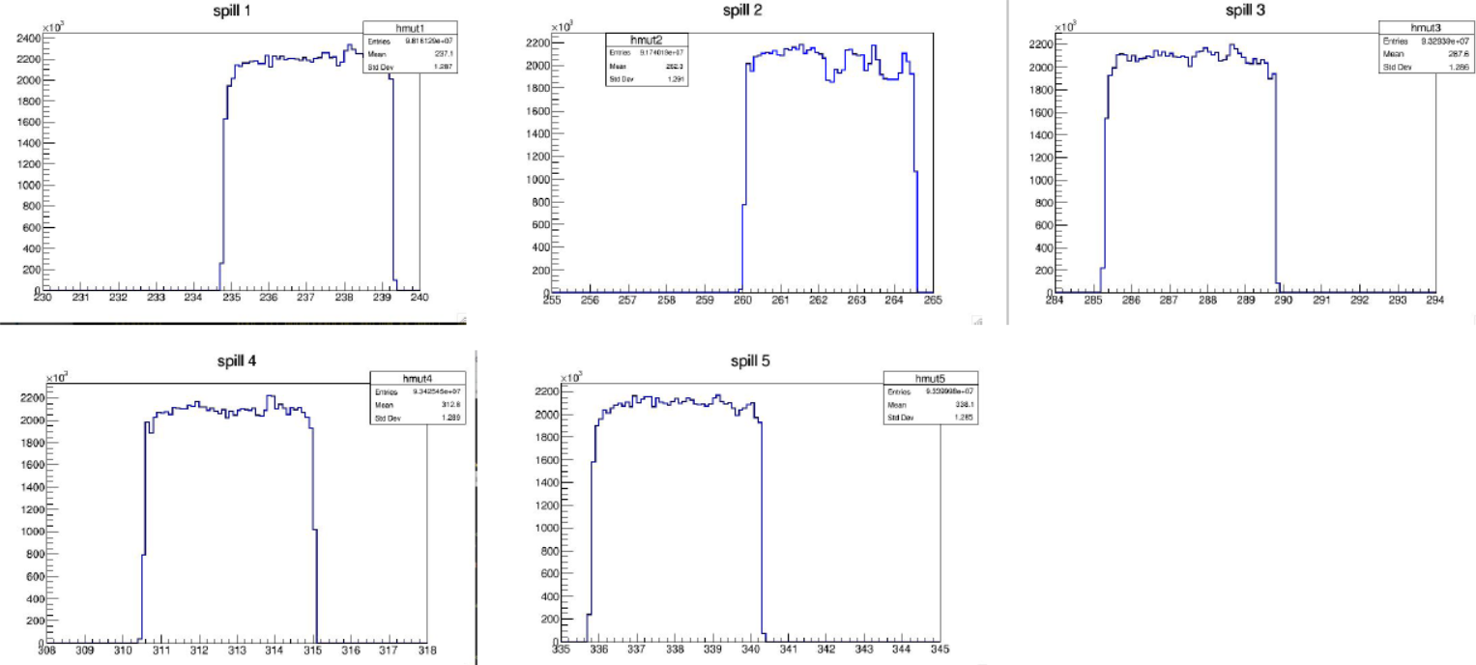
Beam: event time distribution (spills)
Flat distribution: this is good
07/11/2023
Carlo Ferrari - EATM

Slide 16
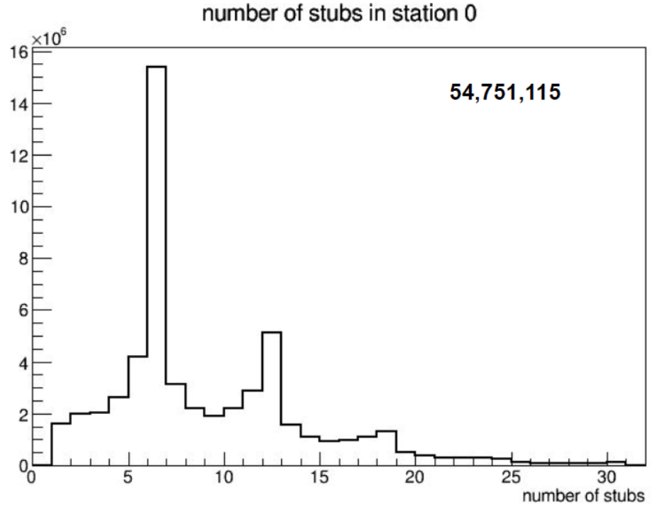
Beam pileup: number of stubs in station 1
Sample rate 40 MHz (25 ns)
PRELIMINARY
1, 2 or 3 Muons
07/11/2023
Carlo Ferrari - EATM

Slide 17
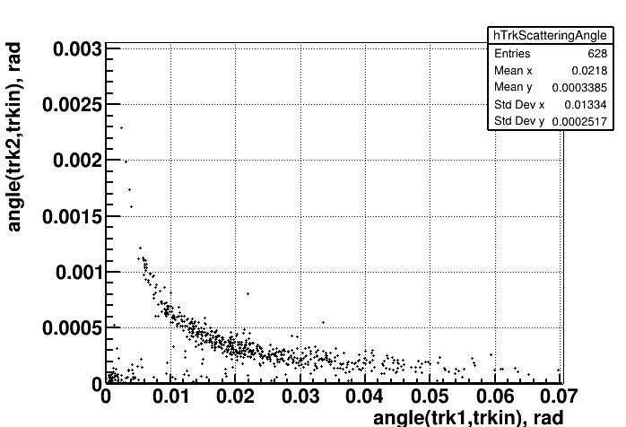
The test beam (25/8 – 10/9)
PRELIMINARY
Plot of the elastic scattering processes we have obtained running the detector at 40 MHz
07/11/2023
Carlo Ferrari - EATM

Slide 18
Comment on the beam
Next time we will probably request a wider beam: trade off between the loss of particles due to acceptance and the capability to record “simultaneous” Muons
An higher intensity beam for the whole experiment (after the LS3) is foreseen
Our detector has the minimum number of sensors to reconstruct two tracks. We are considering whether and how to modify the detector to be able to reconstruct the tracks of multiple simultaneous muons
07/11/2023
Carlo Ferrari - EATM

Slide 19
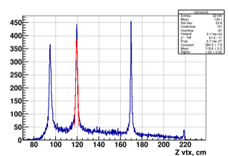
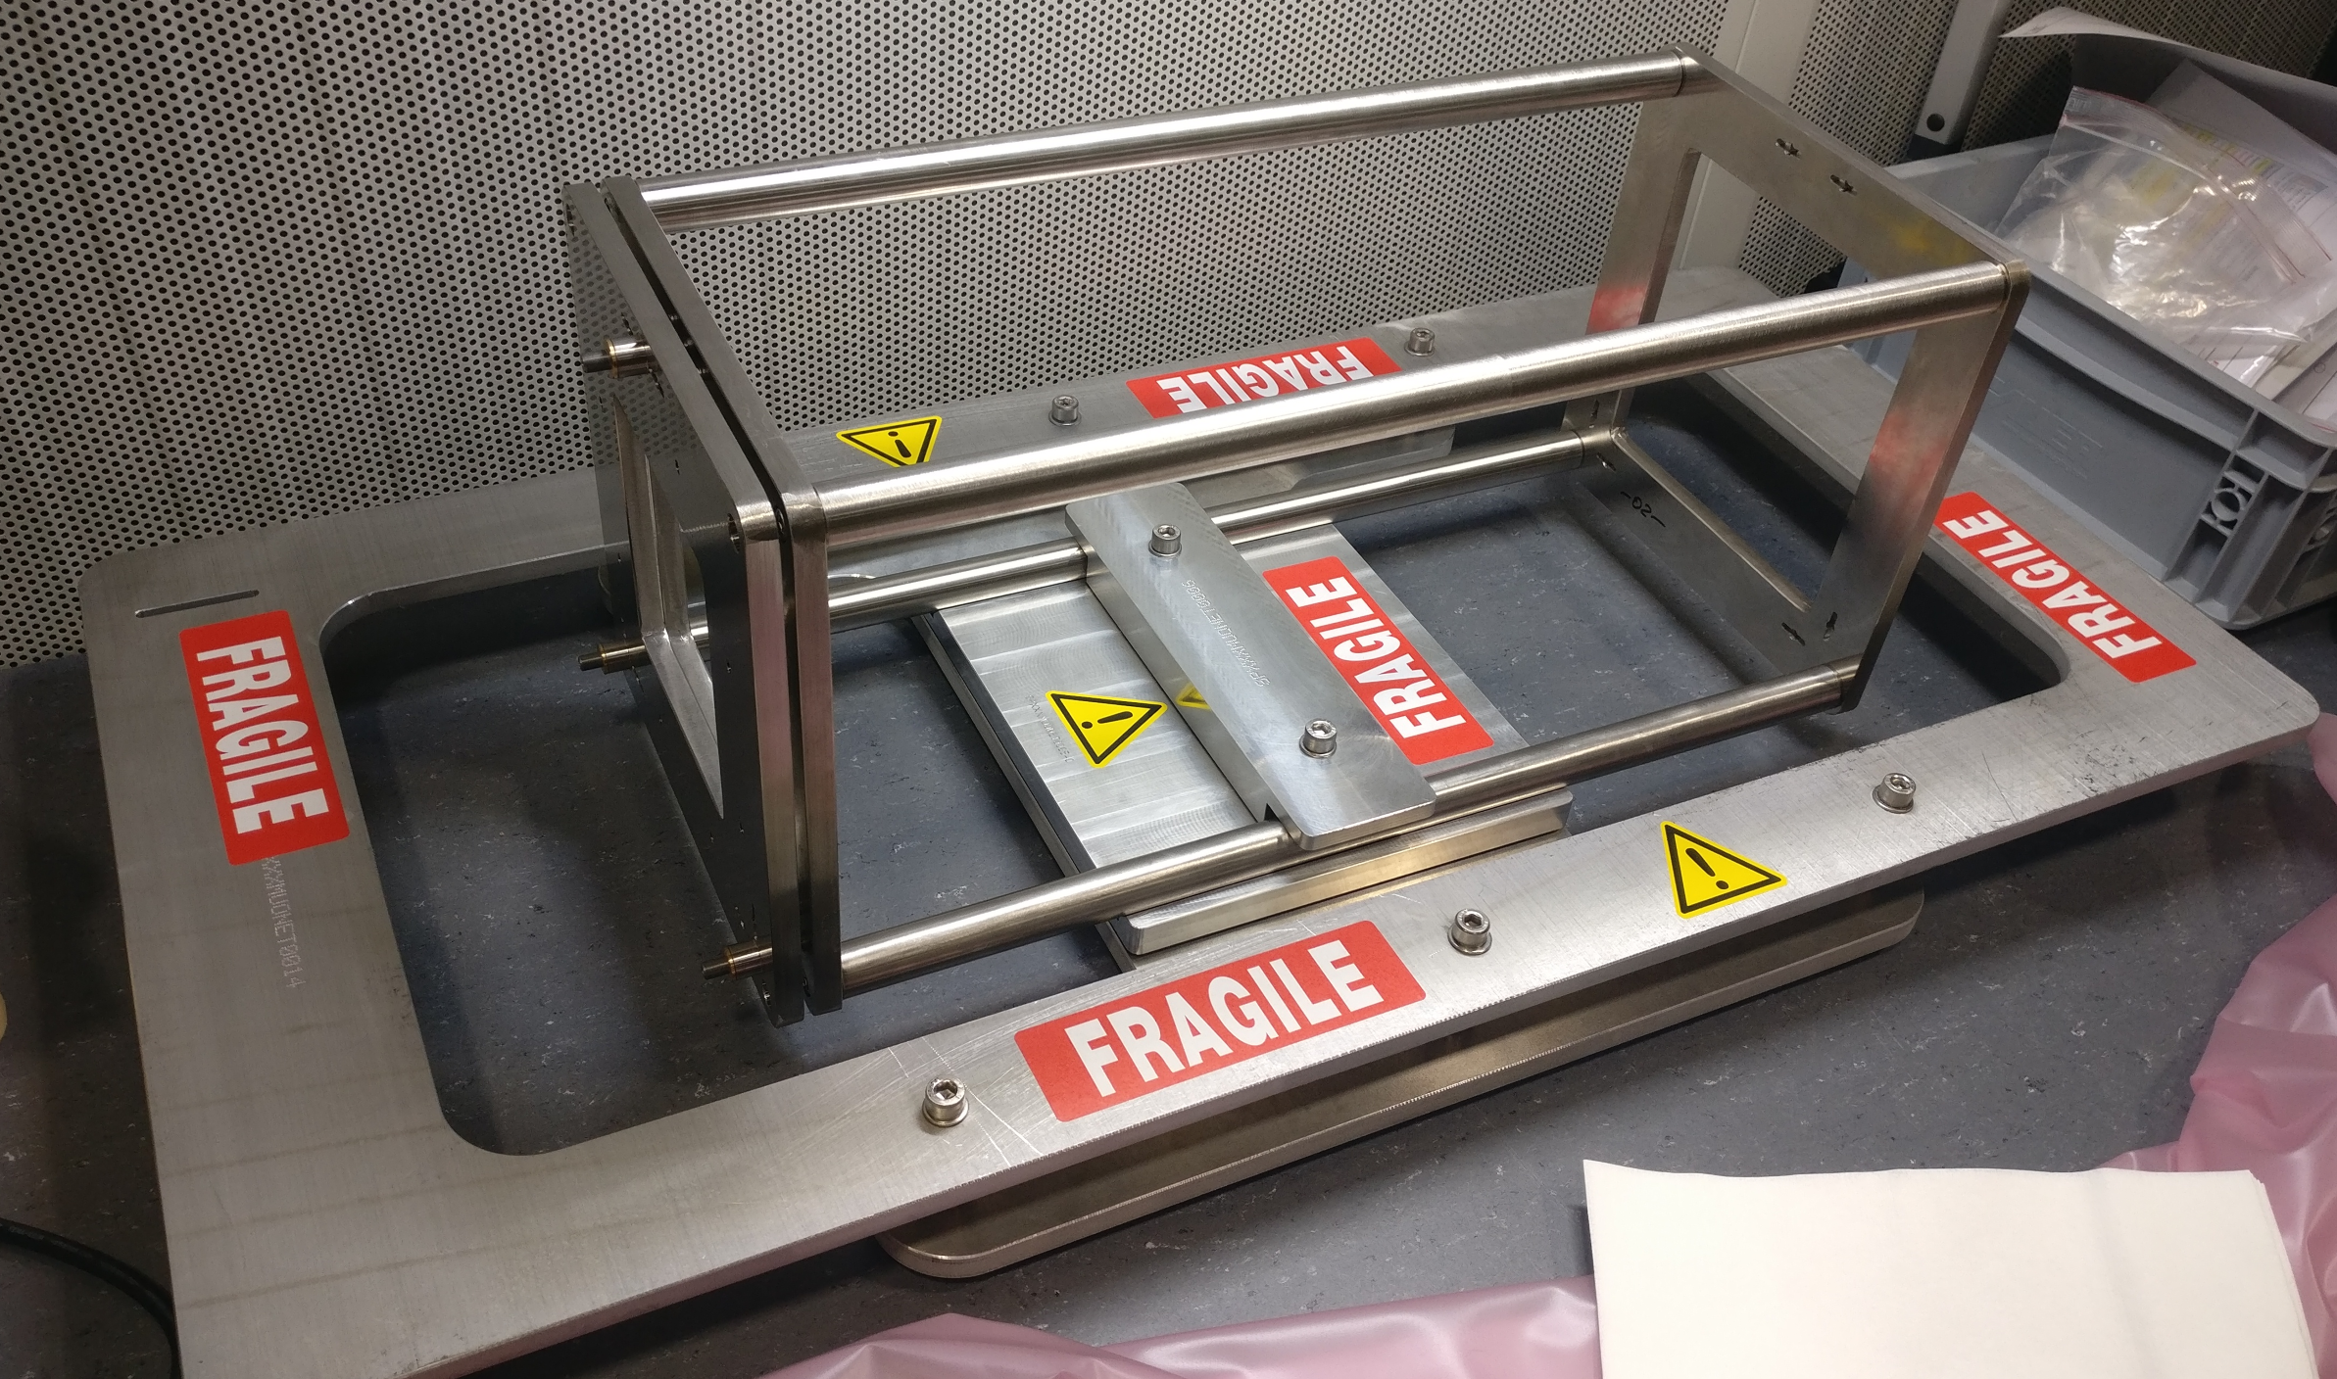
The Etalon device
In the MUonE project, a crucial requirement is to control the systematic error on the
incoming muon energy with a precision of few MeV in a beam of 160 GeV. This translates into
being able to control the position along the beam direction 𝑧 of the Si sensors with a precision at
the level of O(few 𝜇m).
It is proposed to use hadron interactions produced in two thin planes (of few micrometer)
separated by a distance that can be measured to the required micron accuracy.
Etalon is developed by the CERN SY-STI-TCD group
PRELIMINARY
07/11/2023
Carlo Ferrari - EATM

Slide 20
The end
Tank you for your attention!
07/11/2023
Carlo Ferrari - EATM

