Slide 1

International Organizing Committee:
C.Z. Antoine (CEA, France), Chair
A. Gurevich (Old Dominion University Univ, USA)
C. Pira (INFN LNL)
T. Saeki (KEK, Japan)
A.- M. Valente-Feliciano (Jefferson Lab, USA)
R. Valizadeh (STFC, UK)
W. Venturini (CERN, Switzerland)
Local Organizing committee:
C.Z. Antoine (CEA)
Y. Kalboussy (CEA)
D. Longuevergne (IJCLAB)
A. Miyazaki (IJCLAB)
T. Proslier (CEA)

Slide 2

SRF Thin film Series since 2005…
  Has been alternatively every 2 years by IJCLAB and INFN Legnaro (except 2020)
  This 2024 edition is special
    For the first time it is organized somewhere else (work should be shared among the community)
    We propose to work on a comon road map, at the European level... Or more.
    It is sponsored by the European Project IFAST (no fee this years!)

Slide 3
Bringing a community together…
  The primary aim of the workshop is to provide a collaborative environment as open, inclusive and diverse as possible, to foster discussion and new ideas.
  Initially the workshop has never been limited to thin films, but since our community and new ideas have been flourishing over the past years… and our time is limited… we had to make choices, mostly centered around thin films.
  List of topics:
    SRF limits + focus on deposition modeling
    Nb Thin film technology
    Beyond Nb
    Advanced substrates
    Characterization
    Functional layers
    Synergies with other domains
    Perspective + Roadmap
  Speakers
Please upload your slides the day BEFORE your talk, we need to download them in order to verify them and show on ZOOM if needed

Slide 4
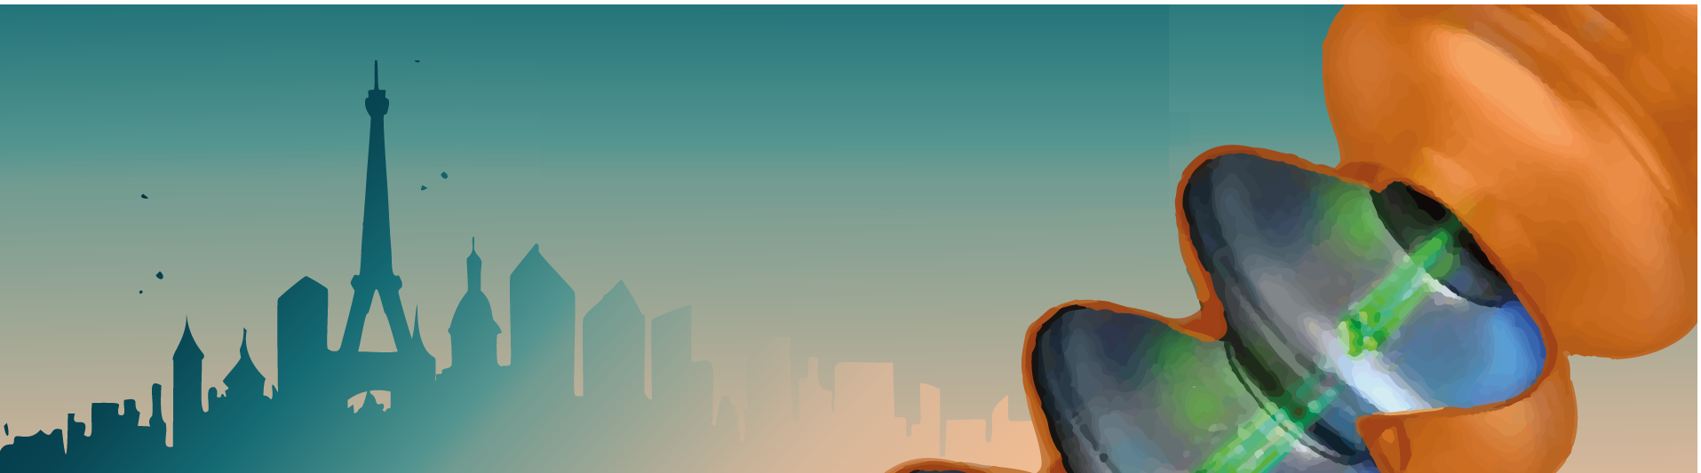
Practical information

Slide 5
Lunches
  No food allowed in the Auditorium!
  Several options are available at walking distance :
    The university restaurant CESFO is accessible by foot (~ 12 min). For about 16.5€, you can have a complete meal (self-service). Service closes at 1.30pm !! CASH ONLY !!
    Several restaurants or bakeries (food to go) are accessible by foot (~ 15 min) in Orsay city center (uphill!). Orsay is a small city with many students, you might want to reserve for some restaurants!
    A supermarket Franprix is accessible (food to go) in Orsay city center.

Slide 6
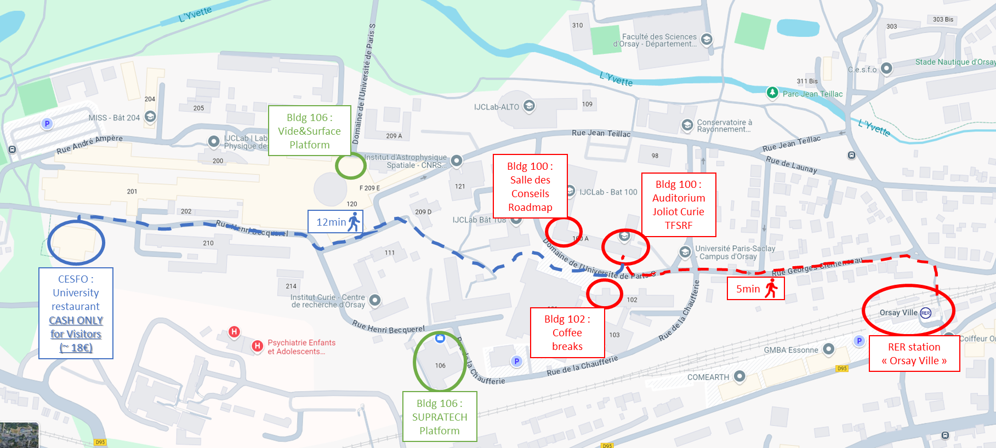
Lunches
Google map
    Bldg 100: https://maps.app.goo.gl/g6v8Sdy8SNm3USCE6
    CESFO restaurant (CASH ONLY) https://maps.app.goo.gl/HbiP61LnGUS6yPWJ7

Slide 7
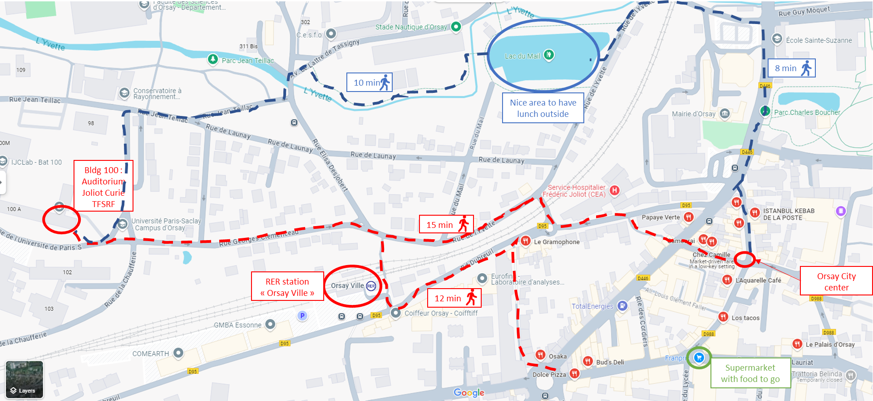
Lunches
Google map
    Restaurants in Orsay: https://maps.app.goo.gl/6dV3HULGEhiunjKBA
    Bakeries (food to go) https://maps.app.goo.gl/SV5XLapGjgXfDPgL7

Slide 8
Lunches
Pizza :
  Trattoria Belinda : https://maps.app.goo.gl/vrKyqwcYi8Vo6MDJ8
  Le 63 : https://maps.app.goo.gl/Y2EkqKoEkgR9JAtM6
French :
  Gramophone : https://maps.app.goo.gl/HSgRGzD4UdfNZVgH9
  Chez Camille : https://maps.app.goo.gl/FKCNPfgJKcSURcp88
  Aquarelle Cafe : https://maps.app.goo.gl/kKtiUoyCfeLue9BNA
  Bud’s deli (burger) : https://maps.app.goo.gl/f8oeCBgq9MbQ8m2Y8
Asian :
  Papaye verte (thai) : https://maps.app.goo.gl/9F2vUxcMi6rZVVod9
  Palais d’Orsay (chinese) : https://maps.app.goo.gl/DkYsqSPaffotAERt5
  Orsay Sushi : https://maps.app.goo.gl/zmqFYBZ3N3pFG3WXA
  Samourai : https://maps.app.goo.gl/rNj7APHb1bdWgv2p6
  Thali Bar (indian) : https://maps.app.goo.gl/3kiJ8e9wszMpru3z6
  Tan Do (not in city center!) : https://maps.app.goo.gl/jviAqoEa2nzscPnu8

Slide 9
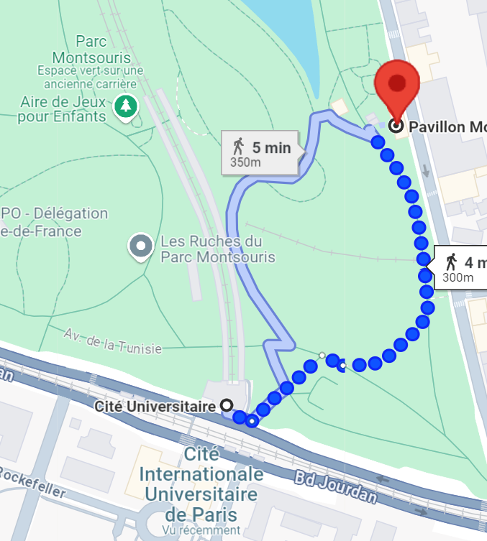
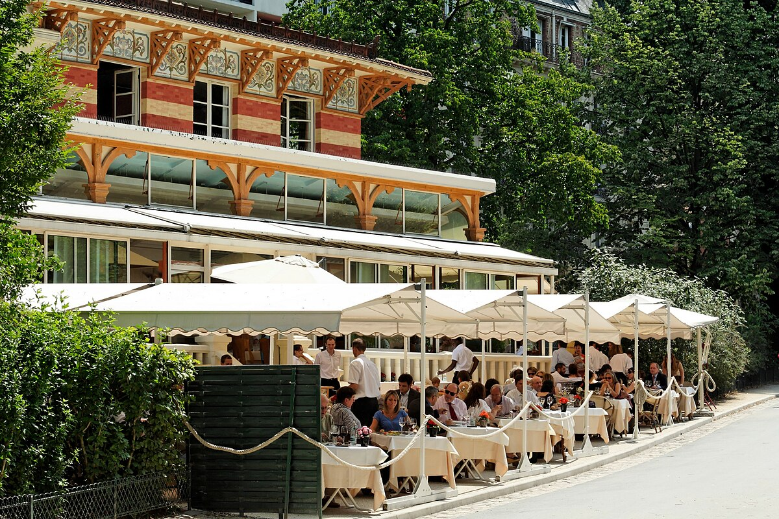
Social Events
  Welcome Reception: Monday 16th at 7 pm
    IJCLab cafeteria bldg. 102 (same as for coffee breaks) -
  Workshop Dinner: Wednesday 18th at 7:30 pm
    Pavillon Montsouris
    20 Rue Gazan, 75014 Paris
    Take RER B at Orsay (ticket!)
    Exit at Cité Universitaire station (~26 min)
    Cross the « Parc Montsouris »

